Slide 1
Recommender systems
Hung-Hsuan Chen
Many are taken from Robert Bell and S.-D. Lin

Slide 2
Why Netflix highly interested in “recommendation” (esp. in early days)?
Their early business model is DVD delivery
Deliver through “real” mails
Huge warehouses for DVDs
Difficult warehouse management
Extremely high demand for hot DVDs
What is the next hot DVD?
Some DVDs were never rented
How about recommending less popular DVDs?

Slide 3
Cinematch – Netflix’s early recommender system
Guide customers to “avoid” hot movies (DVDs); select less popular movies (DVDs) that the customers may still be interested
If Netflix can predict users’ tastes, Netflix can better manage inventory
Core tech of Cinematch
A 5-star rating system
Group users based on their previous ratings
Recommend movies receiving high scores in a group to users (of the same group) who haven’t seen the movie
Check inventory every hour; pick the available movies (DVDs)

Slide 4
Netflix prize

Slide 5
Netflix prize
On 2006/10/2, Netflix initiate a competition
Challenge: drop the RMSE by 10%
Prize:
$1M for the first team that completes the challenge
$0.5M for best result each year

Slide 6
Data summary
Training data
~1M ratings
480,000 users
17,770 items
Rating scale: [1, 2, 3, 4, 5]
Test data
Last few ratings of each user

Slide 7
Training vs probe data
Probe data (later ratings) indeed differ systematically from the training data

Slide 8
Mean score vs. time
2004
Something happened in 2004, although we don’t know what it is

Slide 9
Some stats of the movies
Count | Avg rating | Most Loved Movies
137812 | 4.593 | The Shawshank Redemption
133597 | 4.545 | Lord of the Rings: The Return of the King
180883 | 4.306 | The Green Mile
150676 | 4.460 | Lord of the Rings: The Two Towers
139050 | 4.415 | Finding Nemo
117456 | 4.504 | Raiders of the Lost Ark
Most Rated Movies
Miss Congeniality
Independence Day
The Patriot
The Day After Tomorrow
Pretty Woman
Pirates of the Caribbean
Highest Variance
The Royal Tenenbaums
Lost In Translation
Pearl Harbor
Miss Congeniality
Napolean Dynamite
Fahrenheit 9/11

Slide 10
Most active users
User ID | # Ratings | Mean Rating
305344 | 17,651 | 1.90
387418 | 17,432 | 1.81
2439493 | 16,560 | 1.22
1664010 | 15,811 | 4.26
2118461 | 14,829 | 4.08
1461435 | 9,820 | 1.37
1639792 | 9,764 | 1.33
1314869 | 9,739 | 2.95
Rate 5000+ movies everyday

Slide 11
Progress over the years
The winner’s approach is a blending of over 800 models
It is too complex that Netflix had never used it

Slide 12
Lessons learned from Netflix
Factorization-based approaches
Identify useful features for rating prediction
Implicit feedback
Temporal effect
Neighborhood effect
Regularization is important
We will cover some of the these topics in the following

Slide 13
Recommender system techniques

Slide 14
Types of recommender systems
Content-based
Recommendation based on contents
Collaborative filtering
Recommendation based on users’ collective behavior

Slide 15
Content-based
Users’ information
E.g., users’ profile, interest, gender, etc.
Items’ information
E.g., movie title, genre, actors, actresses, director, content description, etc.
Compare the similarity between user profiles and items
Compare the similarity between users’ unseen items with the items they liked
Disadvantage: user and item information is not always clean or available

Slide 16
Collaborative filtering (CF)
A very successful type of method
Amazon, Netflix, etc.
Cross domain
No content information is required
Types
Memory based
User-based CF
Item-based CF
Model based
Matrix factorization (a.k.a., SVD, latent factor model)

Slide 17
Math form of CF
 | I1 | I2 | I3 | I4
U1 | 3 | ? | 1 | ?
U2 | ? | 4 | ? | 3
U3 | 1 | ? | ? | ?
U4 | ? | ? | 5 | 2
Given: some ratings
Predict: unknown ratings
Netflix prize!
This may look different from what we’ve learned in class
Target variables are explicit, but where are the features?
It turns out that popular techniques to solve the problem are very similar to what we’ve learned

Slide 18
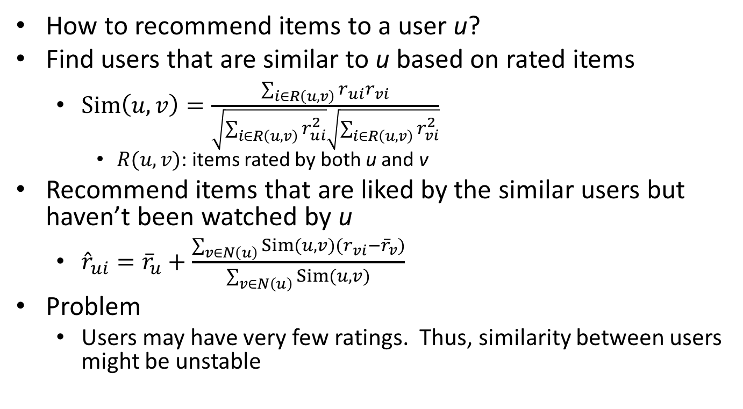
User-based CF
How to recommend items to a user u?
Find users that are similar to u based on rated items
$Sim\left(u,v\right)=\frac{\sum_{i∈R\left(u,v\right)}{r_{ui}r_{vi}}}{\sqrt{\sum_{i∈R\left(u,v\right)}{r_{ui}^{2}}}\sqrt{\sum_{i∈R\left(u,v\right)}{r_{vi}^{2}}}}$
$R(u,v)$: items rated by both u and v
Recommend items that are liked by the similar users but haven’t been watched by u
${\hat{r}}_{ui}={\overline{r}}_{u}+\frac{\sum_{v∈N\left(u\right)}{Sim\left(u,v\right)\left(r_{vi}−{\overline{r}}_{v}\right)}}{\sum_{v∈N\left(u\right)}{Sim\left(u,v\right)}}$
Problem
Users may have very few ratings. Thus, similarity between users might be unstable

Slide 19
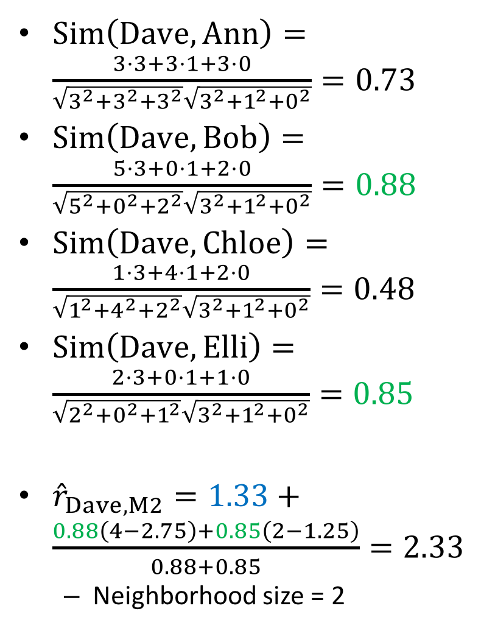
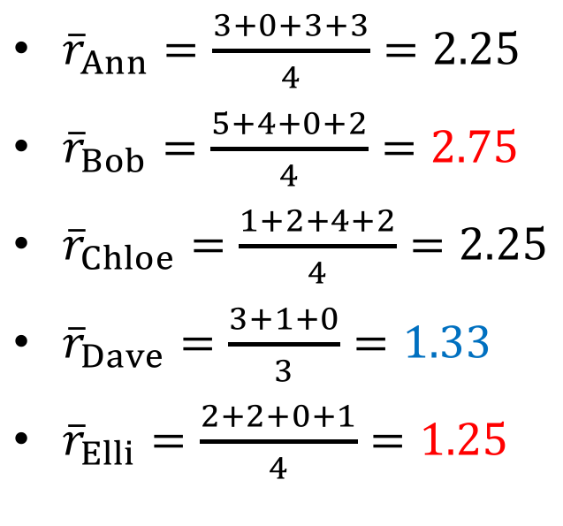
 | M1 | M2 | M3 | M4
Ann | 3 | 0 | 3 | 3
Bob | 5 | 4 | 0 | 2
Chloe | 1 | 2 | 4 | 2
Dave | 3 | ? | 1 | 0
Elli | 2 | 2 | 0 | 1
$Sim\left(Dave, Ann\right)=\frac{3⋅3+3⋅1+3⋅0}{\sqrt{3^{2}+3^{2}+3^{2}}\sqrt{3^{2}+1^{2}+0^{2}}}=0.73$
$Sim\left(Dave, Bob\right)=\frac{5⋅3+0⋅1+2⋅0}{\sqrt{5^{2}+0^{2}+2^{2}}\sqrt{3^{2}+1^{2}+0^{2}}}=0.88$
$Sim\left(Dave, Chloe\right)=\frac{1⋅3+4⋅1+2⋅0}{\sqrt{1^{2}+4^{2}+2^{2}}\sqrt{3^{2}+1^{2}+0^{2}}}=0.48$
$Sim\left(Dave, Elli\right)=\frac{2⋅3+0⋅1+1⋅0}{\sqrt{2^{2}+0^{2}+1^{2}}\sqrt{3^{2}+1^{2}+0^{2}}}=0.85$
${\hat{r}}_{Dave,M2}=1.33+\frac{0.88\left(4−2.75\right)+0.85\left(2−1.25\right)}{0.88+0.85}=2.33$
Neighborhood size = 2
${\overline{r}}_{Ann}=\frac{3+0+3+3}{4}=2.25$
${\overline{r}}_{Bob}=\frac{5+4+0+2}{4}=2.75$
${\overline{r}}_{Chloe}=\frac{1+2+4+2}{4}=2.25$
${\overline{r}}_{Dave}=\frac{3+1+0}{3}=1.33$
${\overline{r}}_{Elli}=\frac{2+2+0+1}{4}=1.25$

Slide 20
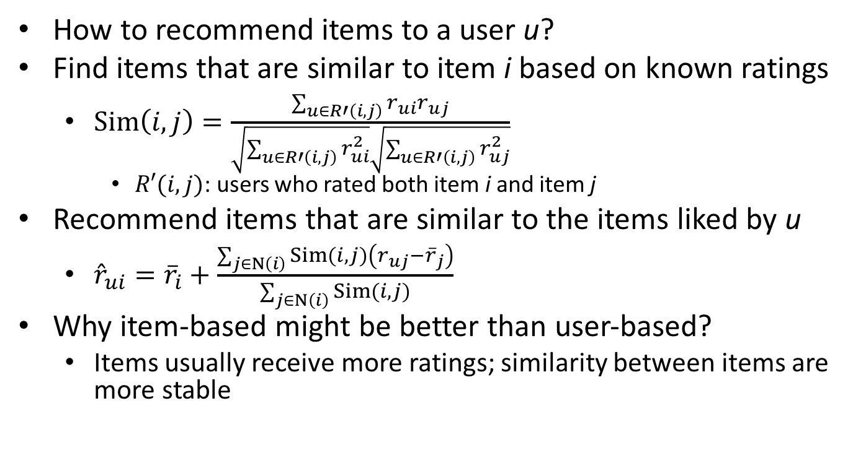
Item-based CF
How to recommend items to a user u?
Find items that are similar to item i based on known ratings
$Sim\left(i,j\right)=\frac{\sum_{u∈R′\left(i,j\right)}{r_{ui}r_{uj}}}{\sqrt{\sum_{u∈R′\left(i,j\right)}{r_{ui}^{2}}}\sqrt{\sum_{u∈R′\left(i,j\right)}{r_{uj}^{2}}}}$
$R′(i,j)$: users who rated both item i and item j
Recommend items that are similar to the items liked by u
${\hat{r}}_{ui}={\overline{r}}_{i}+\frac{\sum_{j∈N\left(i\right)}{Sim\left(i,j\right)\left(r_{uj}−{\overline{r}}_{j}\right)}}{\sum_{j∈N\left(i\right)}{Sim\left(i,j\right)}}$
Why item-based might be better than user-based?
Items usually receive more ratings; similarity between items are more stable

Slide 21
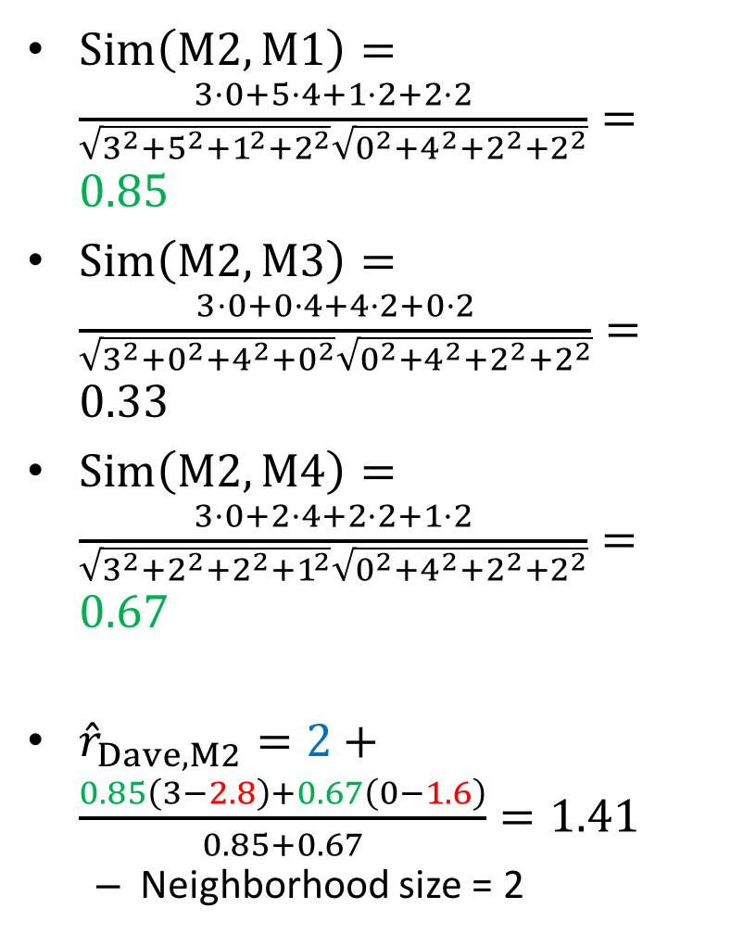
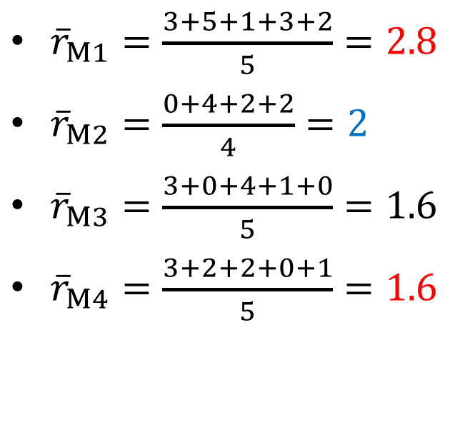
 | M1 | M2 | M3 | M4
Ann | 3 | 0 | 3 | 3
Bob | 5 | 4 | 0 | 2
Chloe | 1 | 2 | 4 | 2
Dave | 3 | ? | 1 | 0
Elli | 2 | 2 | 0 | 1
$Sim\left(M2, M1\right)=\frac{3⋅0+5⋅4+1⋅2+2⋅2}{\sqrt{3^{2}+5^{2}+1^{2}+2^{2}}\sqrt{0^{2}+4^{2}+2^{2}+2^{2}}}=0.85$
$Sim\left(M2, M3\right)=\frac{3⋅0+0⋅4+4⋅2+0⋅2}{\sqrt{3^{2}+0^{2}+4^{2}+0^{2}}\sqrt{0^{2}+4^{2}+2^{2}+2^{2}}}=0.33$
$Sim\left(M2, M4\right)=\frac{3⋅0+2⋅4+2⋅2+1⋅2}{\sqrt{3^{2}+2^{2}+2^{2}+1^{2}}\sqrt{0^{2}+4^{2}+2^{2}+2^{2}}}=0.67$
${\hat{r}}_{Dave,M2}=2+\frac{0.85\left(3−2.8\right)+0.67\left(0−1.6\right)}{0.85+0.67}=1.41$
Neighborhood size = 2
${\overline{r}}_{M1}=\frac{3+5+1+3+2}{5}=2.8$
${\overline{r}}_{M2}=\frac{0+4+2+2}{4}=2$
${\overline{r}}_{M3}=\frac{3+0+4+1+0}{5}=1.6$
${\overline{r}}_{M4}=\frac{3+2+2+0+1}{5}=1.6$

Slide 22
Quiz
Do you feel familiar with the User-based CF and the item-based CF?

Slide 23
Model-based CF

Slide 24
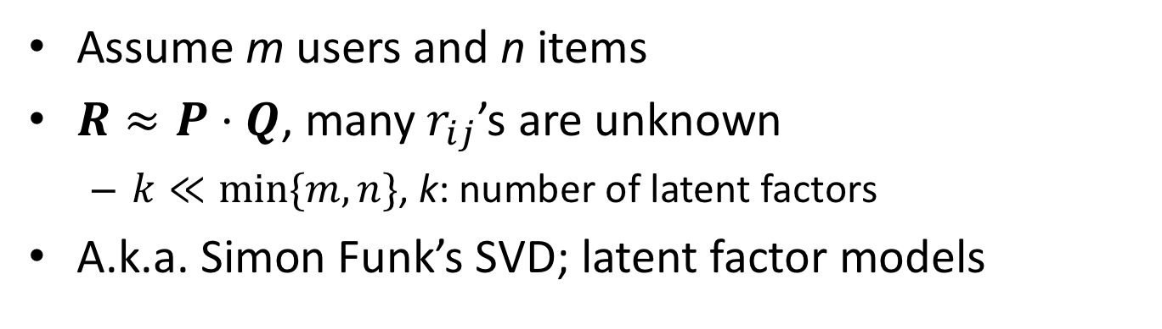
Matrix factorization
Assume m users and n items
$R≈P⋅Q$, many $r_{ij}$’s are unknown
$k≪min⁡\{m, n\}$, k: number of latent factors
A.k.a. Simon Funk’s SVD; latent factor models
R
P
m
≈
m
·
Q
k
n
n
k

Slide 25
What are latent factors?
Each latent factor represents certain property of the users and the items
However, we don’t really know the meaning of each latent factor
 | M1 | M2 | M3 | M4
Ann | 3 | 0 | 3 | 3
Bob | 5 | 4 | 0 | 2
Chloe | 1 | 2 | 4 | 2
Dave | 3 | ? | 1 | 0
Elli | 2 | 2 | 0 | 1
 | f1 | f2
Ann | p₁₁ | p₁₂
Bob | p₂₁ | p₂₂
Chloe | p₃₁ | p₃₂
Dave | p₄₁ | p₄₂
Elli | p₅₁ | p₅₂
 | M1 | M2 | M3 | M4
f1 | q₁₁ | q₁₂ | q₁₃ | q₁₄
f2 | q₂₁ | q₂₂ | q₂₃ | q₂₄
≈
∙

Slide 26
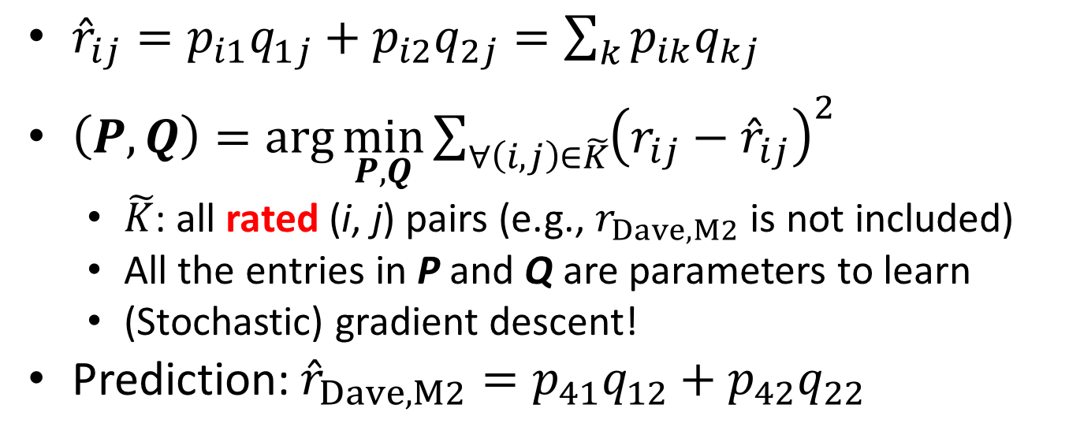
 | M1 | M2 | M3 | M4
Ann | 3 | 0 | 3 | 3
Bob | 5 | 4 | 0 | 2
Chloe | 1 | 2 | 4 | 2
Dave | 3 | ? | 1 | 0
Elli | 2 | 2 | 0 | 1
 | f1 | f2
Ann | p₁₁ | p₁₂
Bob | p₂₁ | p₂₂
Chloe | p₃₁ | p₃₂
Dave | p₄₁ | p₄₂
Elli | p₅₁ | p₅₂
 | M1 | M2 | M3 | M4
f1 | q₁₁ | q₁₂ | q₁₃ | q₁₄
f2 | q₂₁ | q₂₂ | q₂₃ | q₂₄
≈
∙
${\hat{r}}_{ij}=p_{i1}q_{1j}+p_{i2}q_{2j}=\sum_{k}{p_{ik}q_{kj}}$
$\left(P, Q\right)=\arg{\min_{P,Q}{\sum_{∀\left(i,j\right)∈\tilde{K}}{{\left(r_{ij}−{\hat{r}}_{ij}\right)}^{2}}}}$
$\tilde{K}$: all rated (i, j) pairs (e.g., $r_{Dave,M2}$ is not included)
All the entries in P and Q are parameters to learn
(Stochastic) gradient descent!
Prediction: ${\hat{r}}_{Dave, M2}=p_{41}q_{12}+p_{42}q_{22}$

Slide 27
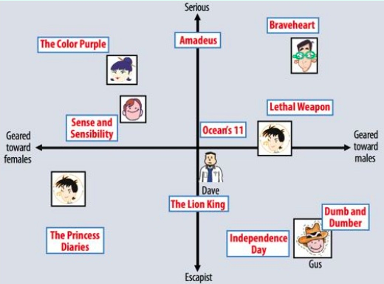
Example
Factor 2
Factor 1
In practice, the meaning of each factor is unknown

Slide 28
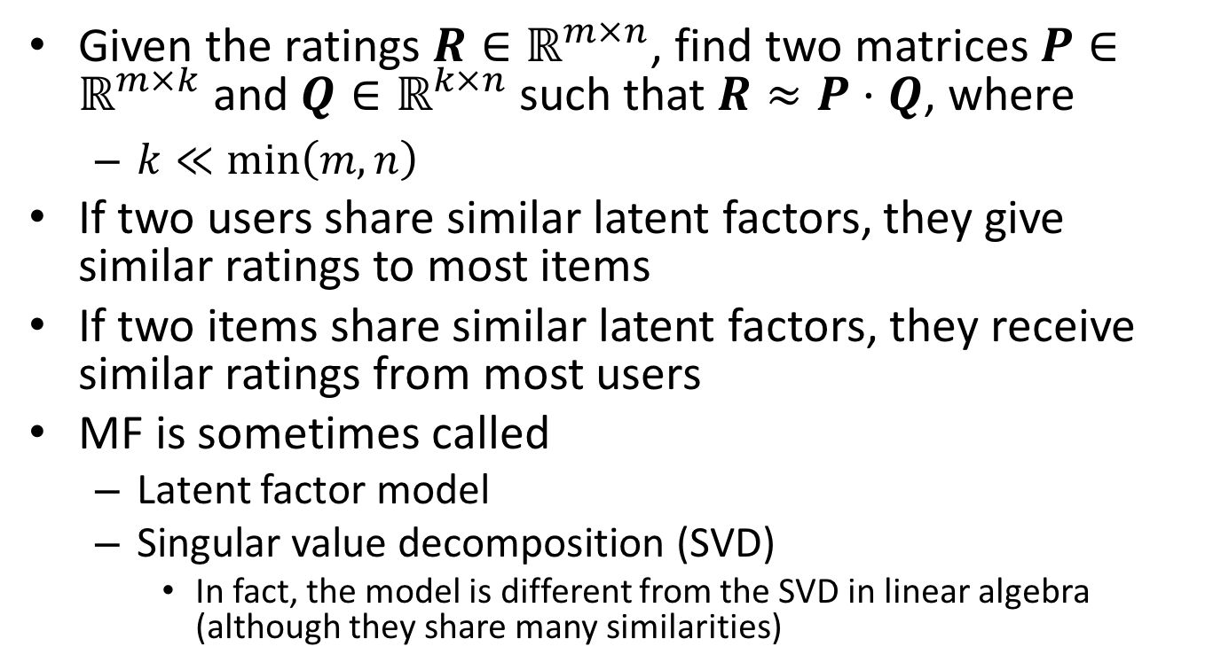
Summary of MF
Given the ratings $R∈ℝ^{m×n}$, find two matrices $P∈ℝ^{m×k}$ and $Q∈ℝ^{k×n}$ such that $R≈P⋅Q$, where
$k≪\min\left(m, n\right)$
If two users share similar latent factors, they give similar ratings to most items
If two items share similar latent factors, they receive similar ratings from most users
MF is sometimes called
Latent factor model
Singular value decomposition (SVD)
In fact, the model is different from the SVD in linear algebra (although they share many similarities)

Slide 29
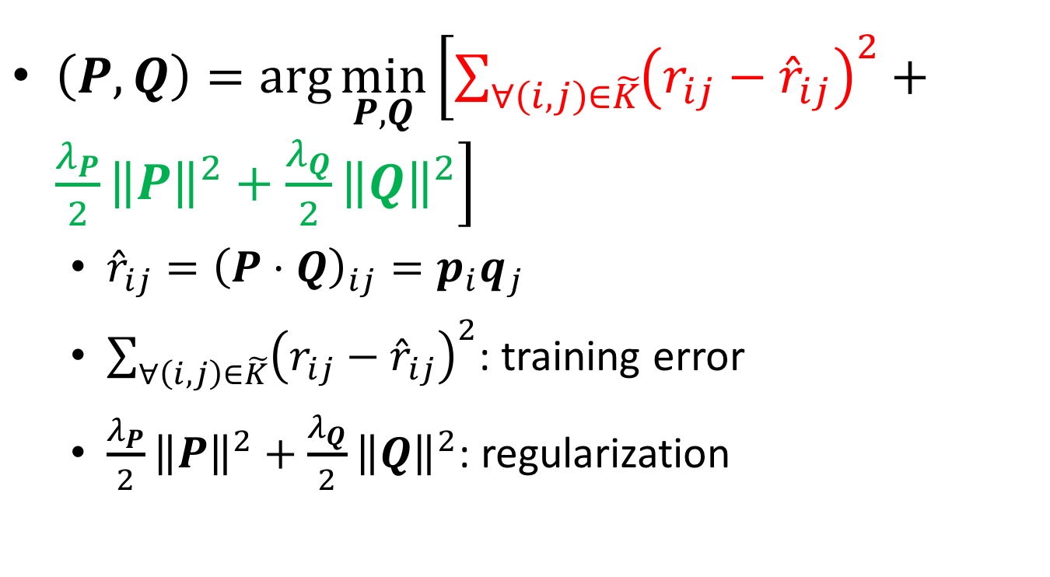
MF – including the regularization terms
$\left(P, Q\right)=\arg{\min_{P,Q}\left[\sum_{∀\left(i,j\right)∈\tilde{K}}{{\left(r_{ij}−{\hat{r}}_{ij}\right)}^{2}}+\frac{λ_{P}}{2}{\left\|P\right\|}^{2}+\frac{λ_{Q}}{2}{\left\|Q\right\|}^{2}\right]}$
${\hat{r}}_{ij}={\left(P⋅Q\right)}_{ij}=p_{i}q_{j}$
$\sum_{∀\left(i,j\right)∈\tilde{K}}{{\left(r_{ij}−{\hat{r}}_{ij}\right)}^{2}}$: training error
$\frac{λ_{P}}{2}{\left\|P\right\|}^{2}+\frac{λ_{Q}}{2}{\left\|Q\right\|}^{2}$: regularization

Slide 30
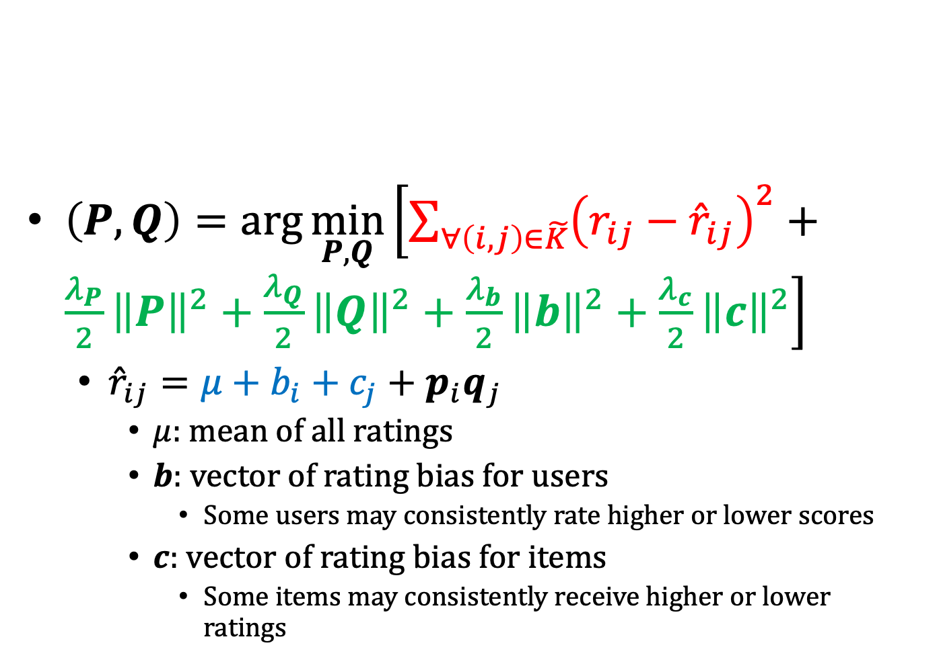
SVD
This is different from the SVD in linear algebra
$\left(P, Q\right)=\arg{\min_{P,Q}\left[\sum_{∀\left(i,j\right)∈\tilde{K}}{{\left(r_{ij}−{\hat{r}}_{ij}\right)}^{2}}+\frac{λ_{P}}{2}{\left\|P\right\|}^{2}+\frac{λ_{Q}}{2}{\left\|Q\right\|}^{2}+\frac{λ_{b}}{2}{\left\|b\right\|}^{2}+\frac{λ_{c}}{2}{\left\|c\right\|}^{2}\right]}$
${\hat{r}}_{ij}=μ+b_{i}+c_{j}+p_{i}q_{j}$
$μ$: mean of all ratings
$b$: vector of rating bias for users
Some users may consistently rate higher or lower scores
$c$: vector of rating bias for items
Some items may consistently receive higher or lower ratings

Slide 31
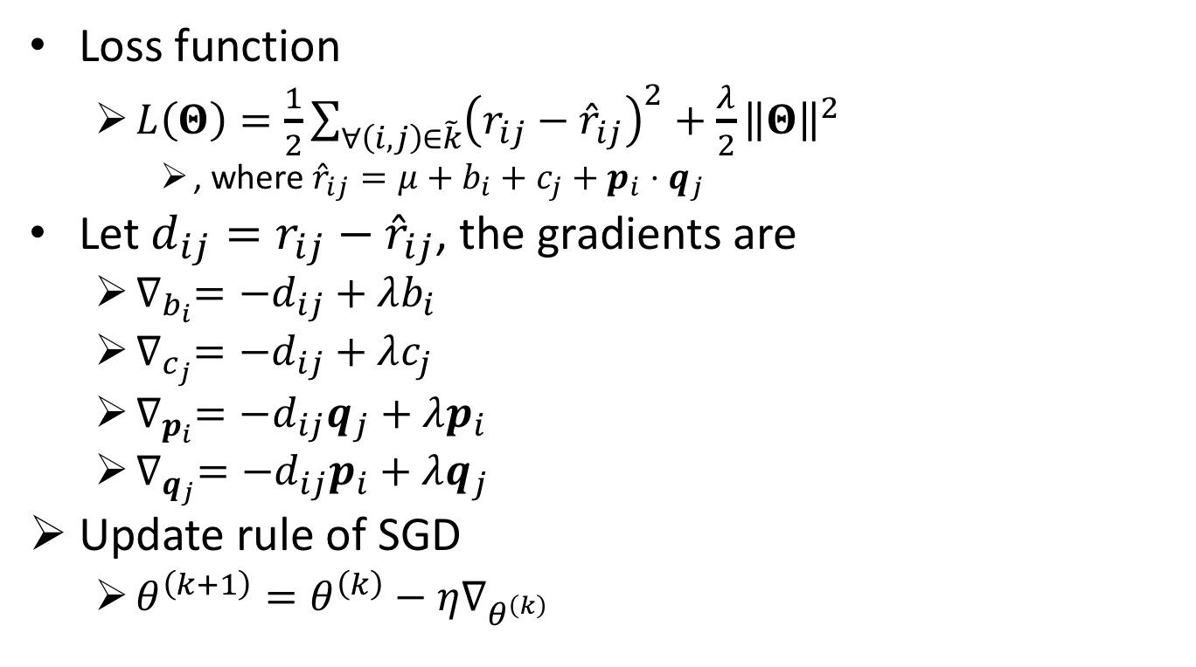
SVD training procedure
Loss function
$L\left(Θ\right)=\frac{1}{2}\sum_{∀\left(i,j\right)∈\tilde{k}}{{\left(r_{ij}−{\hat{r}}_{ij}\right)}^{2}}+\frac{λ}{2}{\left\|Θ\right\|}^{2}$
, where ${\hat{r}}_{ij}=μ+b_{i}+c_{j}+p_{i}⋅q_{j}$
Let $d_{ij}=r_{ij}−{\hat{r}}_{ij}$, the gradients are
$∇_{b_{i}}=−d_{ij}+λb_{i}$
$∇_{c_{j}}=−d_{ij}+λc_{j}$
$∇_{p_{i}}=−d_{ij}q_{j}+λp_{i}$
$∇_{q_{j}}=−d_{ij}p_{i}+λq_{j}$
Update rule of SGD
$θ^{\left(k+1\right)}=θ^{\left(k\right)}−η∇_{θ^{\left(k\right)}}$

Slide 32
Summary (1/2)
A large branch of studies on recommender systems aims at predicting users’ ratings on items based on the known ratings
Although the problem looks different from most supervised learning problems (no features), it can be solved by some techniques we learned in class
kNN
(Stochastic) gradient descent
If you can model your task as a optimization problem, there’s a good chance that gradient descent might be able to help you

Slide 33
Summary (2/2)
Adv of MF
No need to label to item and user features
Support online learning
Disadv of MF
Cold start
Difficult to integrate item features and user features, even if they are given

Slide 34
Matrix Factorization vs Factorization Machine

Slide 35
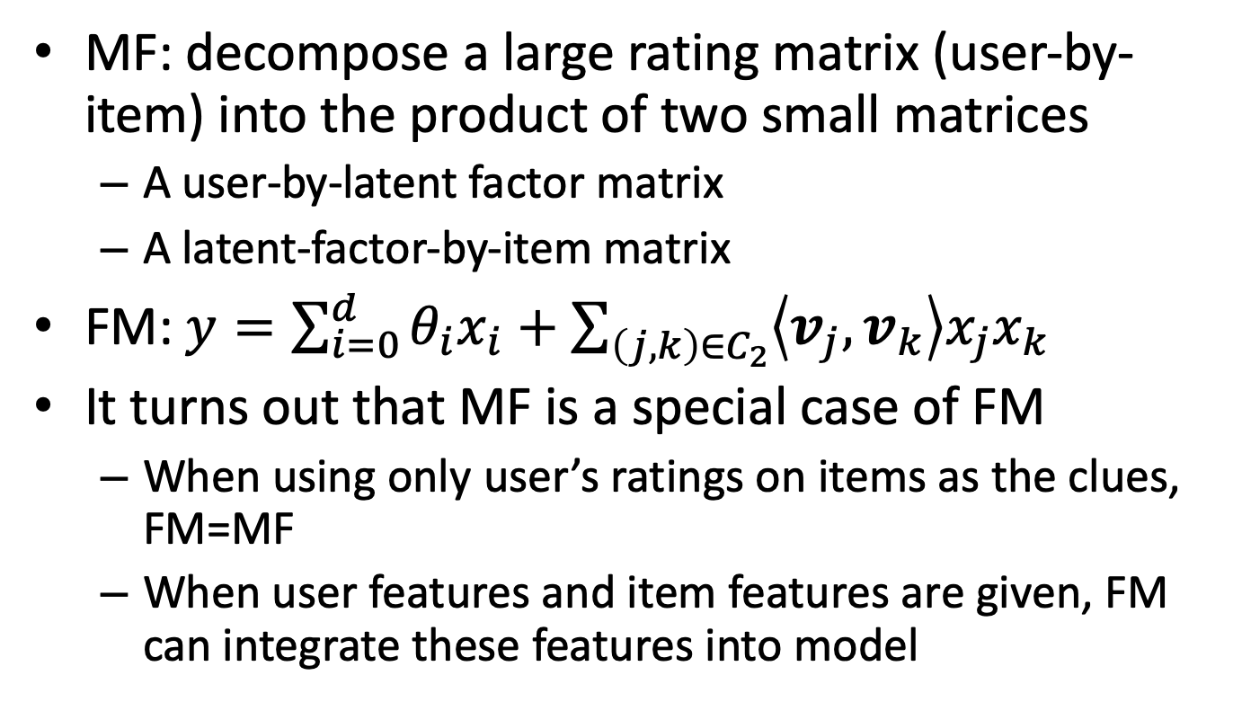
Matrix Factorization (MF) vs Factorization Machine (FM)
MF: decompose a large rating matrix (user-by-item) into the product of two small matrices
A user-by-latent factor matrix
A latent-factor-by-item matrix
FM: $y=\sum_{i=0}^{d}{θ_{i}x_{i}}+\sum_{\left(j,k\right)∈C_{2}}{\left\langle v_{j},v_{k}\right\rangle x_{j}x_{k}}$
It turns out that MF is a special case of FM
When using only user’s ratings on items as the clues, FM=MF
When user features and item features are given, FM can integrate these features into model

Slide 36
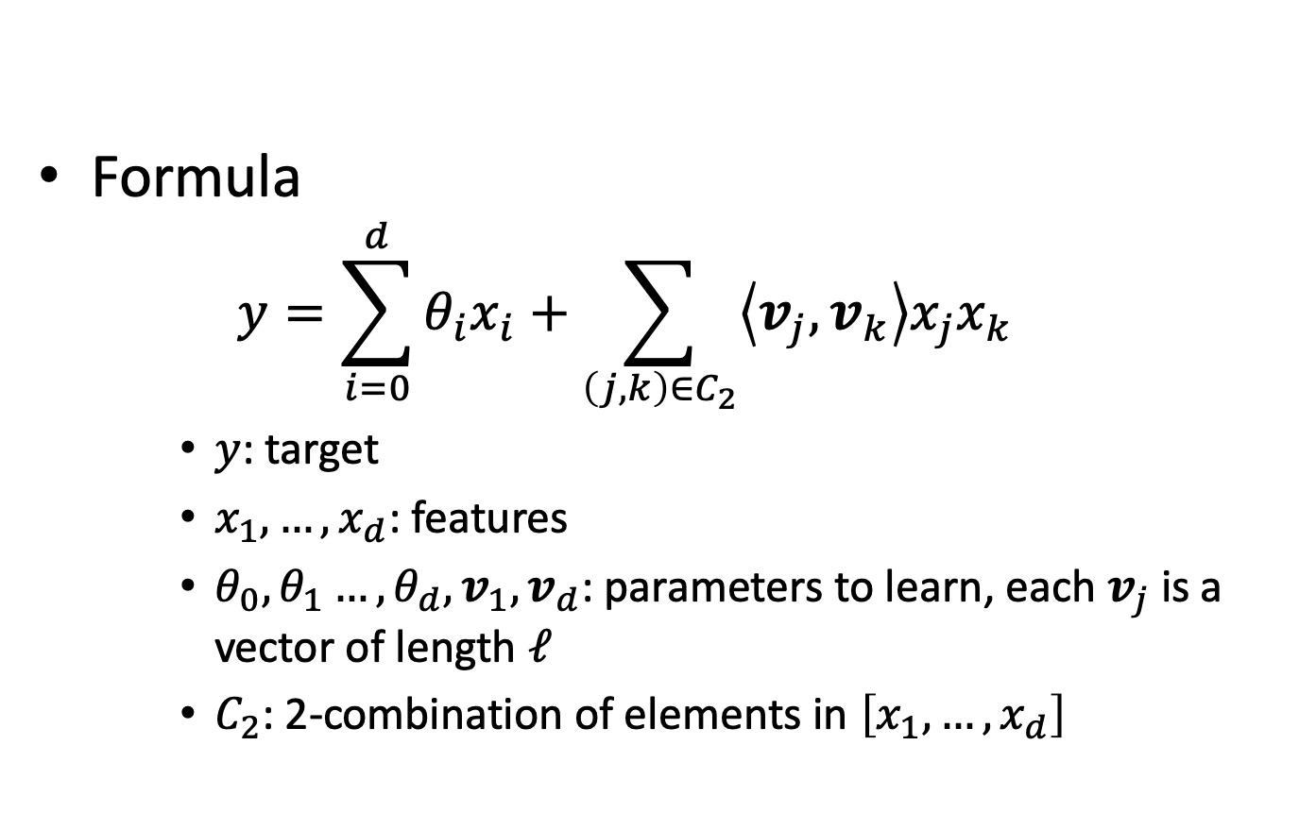
Factorization machines (FM)
Formula
$$y=\sum_{i=0}^{d}{θ_{i}x_{i}}+\sum_{\left(j,k\right)∈C_{2}}{\left\langle v_{j},v_{k}\right\rangle x_{j}x_{k}}$$
$y$: target
$x_{1},…,x_{d}$: features
$θ_{0}, θ_{1}…, θ_{d},v_{1}, v_{d}$: parameters to learn, each $v_{j}$ is a vector of length $ℓ$
$C_{2}$: 2-combination of elements in $\left[x_{1},…,x_{d}\right]$

Slide 37
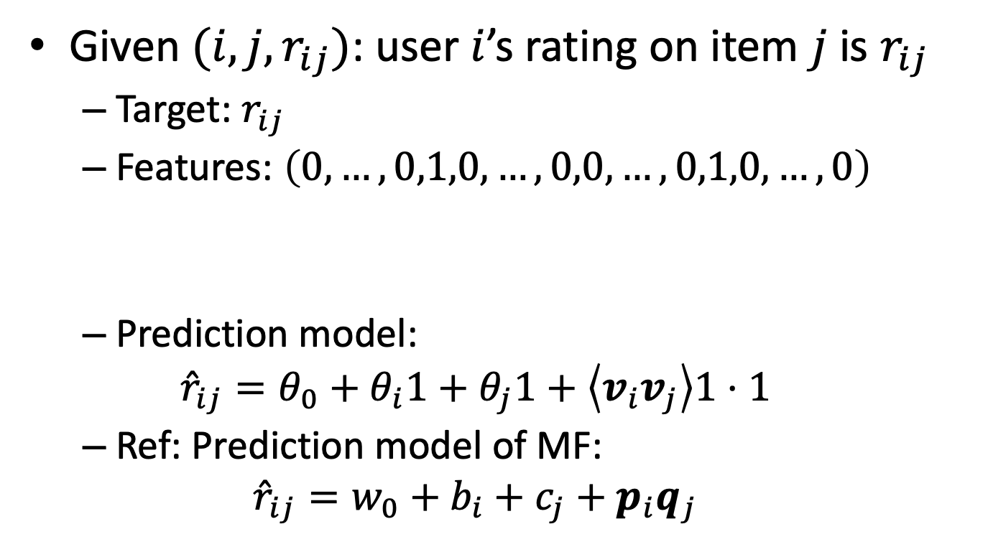
FM vs MF
Given $(i,j,r_{ij})$: user $i$’s rating on item $j$ is $r_{ij}$
Target: $r_{ij}$
Features: $\left(0,…,0,1,0,…,0,0,…,0,1,0,…,0\right)$
Prediction model:
$${\hat{r}}_{ij}=θ_{0}+θ_{i}1+θ_{j}1+\left\langle v_{i}v_{j}\right\rangle 1⋅1$$
Ref: Prediction model of MF:
$${\hat{r}}_{ij}=w_{0}+b_{i}+c_{j}+p_{i}q_{j}$$
$$|U|$$
$$|I|$$

Slide 38

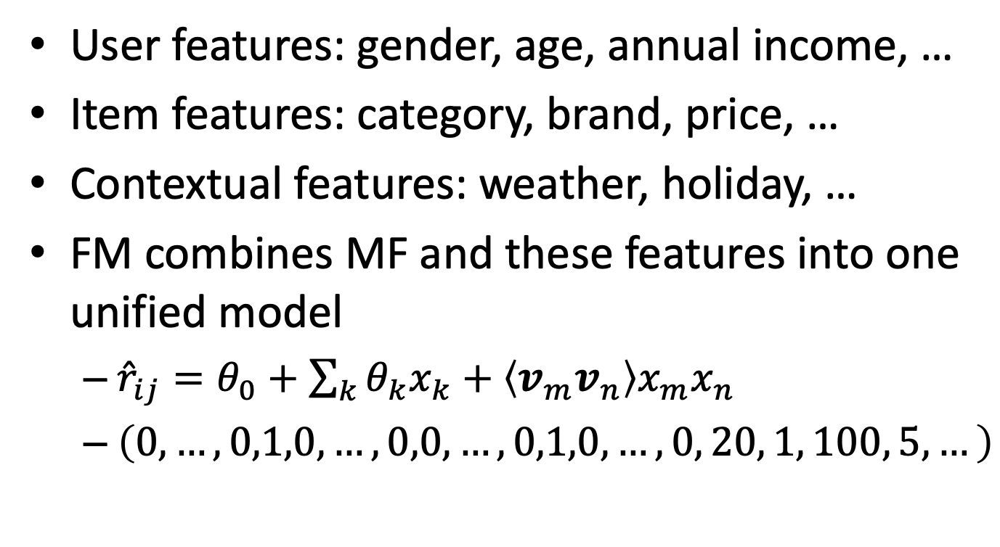

FM can integrate other features
User features: gender, age, annual income, …
Item features: category, brand, price, …
Contextual features: weather, holiday, …
FM combines MF and these features into one unified model
${\hat{r}}_{ij}=θ_{0}+\sum_{k}{θ_{k}x_{k}}+\left\langle v_{m}v_{n}\right\rangle x_{m}x_{n}$
$\left(0,…,0,1,0,…,0,0,…,0,1,0,…,0, 20, 1, 100, 5, …\right)$
$$|U|$$
$$|I|$$
Other features (e.g., age, gender, price, …)

Slide 39
Summary
We derived FM from the perspective of improving the poly-2 model
We derived MF from the perspective of decomposing a matrix
It turns out that MF is a special case of FM

Slide 40
Quiz
Matrix factorization describes user-item relationship in high-dimensional space (true or false)
In matrix factorization, what would happen if we set the number of latent factors to be larger than m and n?

