Slide 1
Lagrange multiplier and KKT condition
Hung-Hsuan Chen

Slide 2
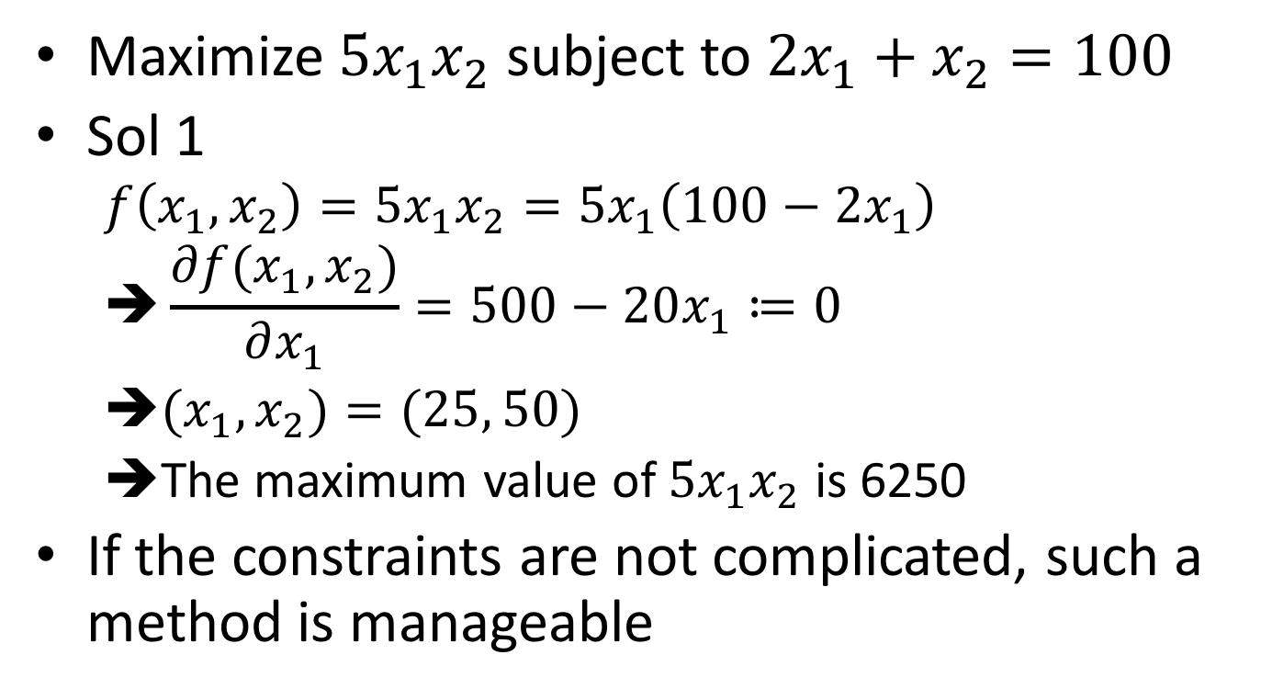
Toy example
Maximize $5x_{1}x_{2}$ subject to $2x_{1}+x_{2}=100$
Sol 1
$$f\left(x_{1},x_{2}\right)=5x_{1}x_{2}=5x_{1}\left(100−2x_{1}\right)$$
$$➔\frac{∂f(x_{1},x_{2})}{∂x_{1}}=500−20x_{1}≔0$$
${(x}_{1},x_{2})=(25, 50)$
The maximum value of $5x_{1}x_{2}$ is 6250
If the constraints are not complicated, such a method is manageable

Slide 3
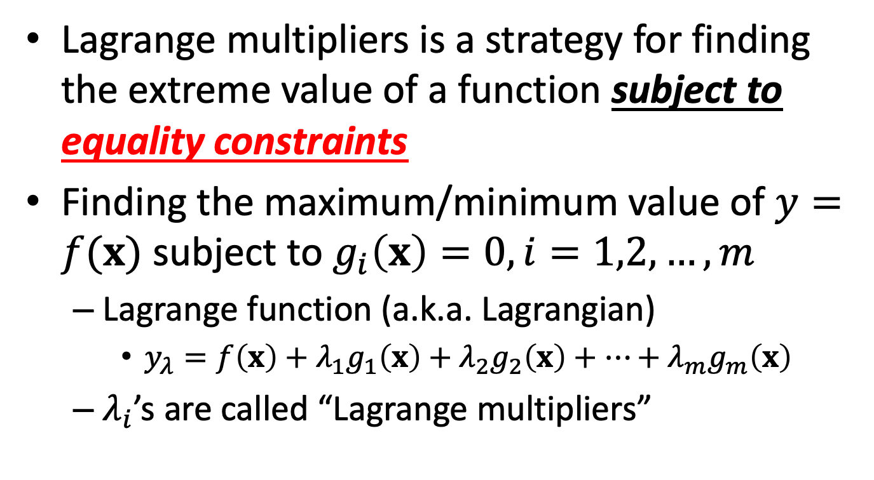
Lagrange multiplier
Lagrange multipliers is a strategy for finding the extreme value of a function subject to equality constraints
Finding the maximum/minimum value of $y=f(x)$ subject to $g_{i}\left(x\right)=0, i=1,2,…,m$
Lagrange function (a.k.a. Lagrangian)
$y_{λ}=f\left(x\right)+λ_{1}g_{1}\left(x\right)+λ_{2}g_{2}\left(x\right)+…+λ_{m}g_{m}\left(x\right)$
$λ_{i}$’s are called “Lagrange multipliers”

Slide 4
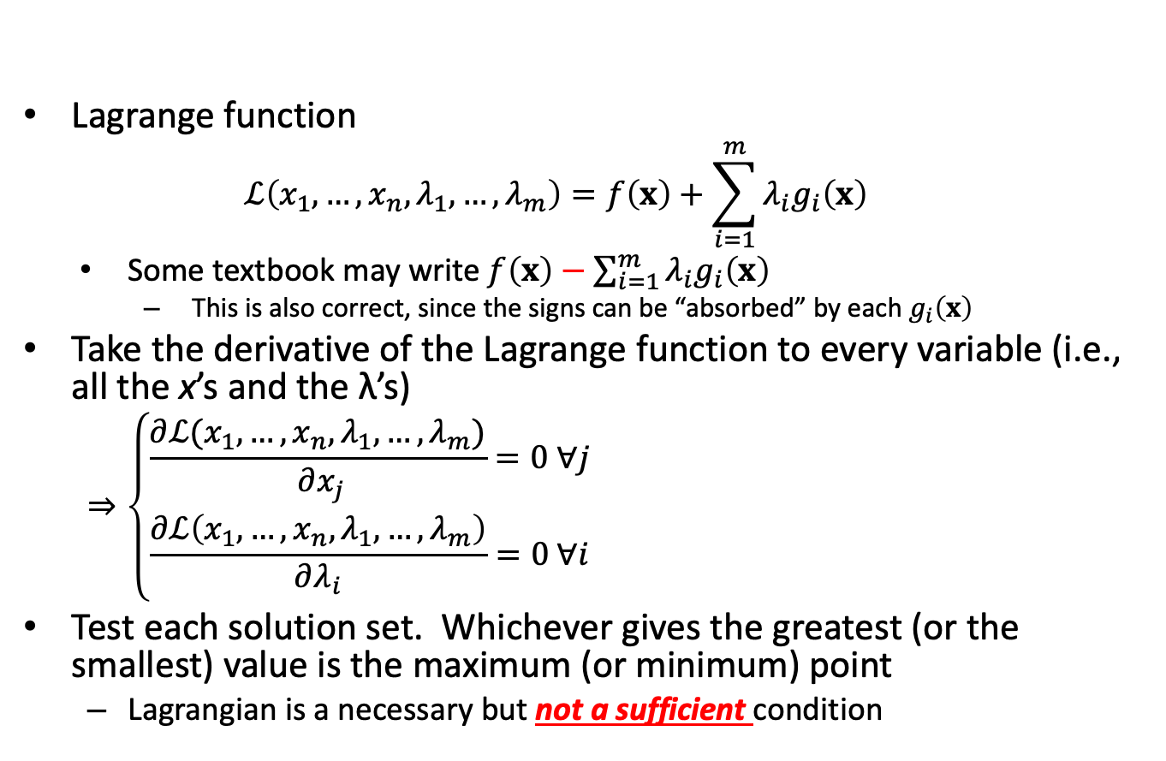
Solving the problem
Lagrange function
$$ℒ\left(x_{1},…,x_{n},λ_{1},…,λ_{m}\right)=f\left(x\right)+\sum_{i=1}^{m}{λ_{i}g_{i}\left(x\right)}$$
Some textbook may write $f\left(x\right)−\sum_{i=1}^{m}{λ_{i}g_{i}\left(x\right)}$
This is also correct, since the signs can be “absorbed” by each $g_{i}\left(x\right)$
Take the derivative of the Lagrange function to every variable (i.e., all the x’s and the λ’s)
$$⇒\left\{\begin{aligned}\frac{∂ℒ(x_{1},…,x_{n},λ_{1},…,λ_{m})}{ ∂x_{j}}=0 ∀j \\ \frac{∂ℒ\left(x_{1},…,x_{n},λ_{1},…,λ_{m}\right)}{∂λ_{i}}=0 ∀i\end{aligned}\right.$$
Test each solution set. Whichever gives the greatest (or the smallest) value is the maximum (or minimum) point
Lagrangian is a necessary but not a sufficient condition

Slide 5
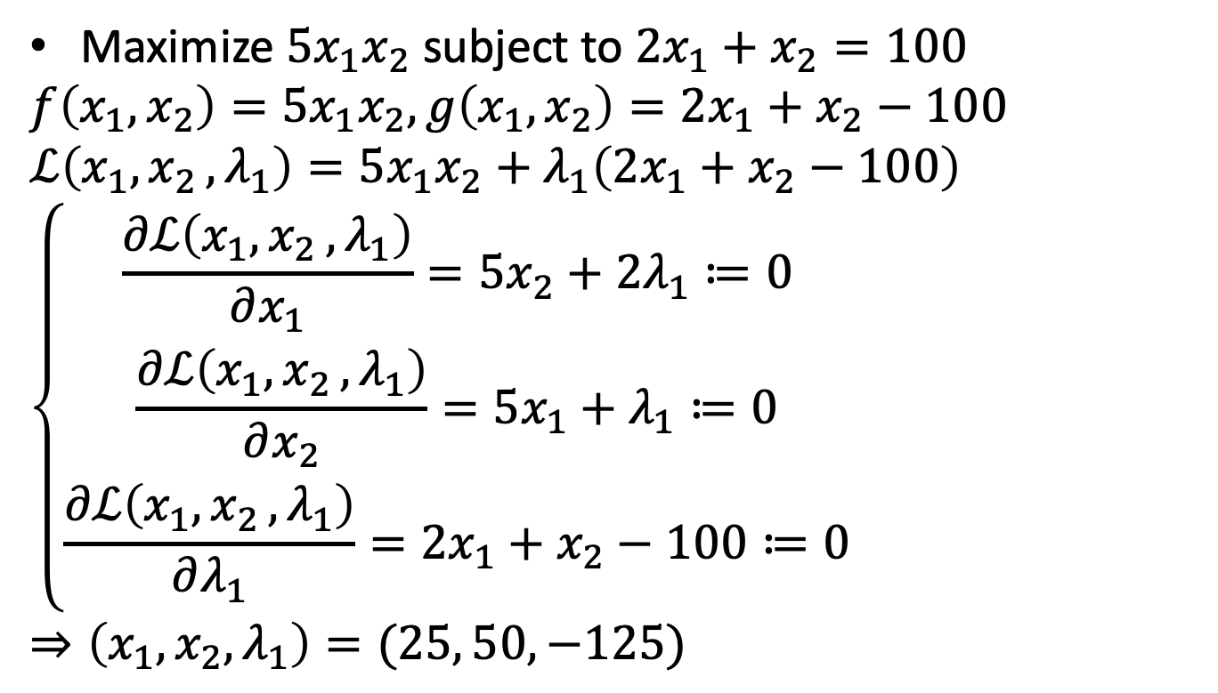
Solving the toy example by Lagrange multiplier
Maximize $5x_{1}x_{2}$ subject to $2x_{1}+x_{2}=100$
$$f\left(x_{1},x_{2}\right)=5x_{1}x_{2}, g\left(x_{1},x_{2}\right)=2x_{1}+x_{2}−100$$
$$ℒ\left(x_{1}{,x}_{2},λ_{1}\right)=5x_{1}x_{2}+λ_{1}\left(2x_{1}+x_{2}−100\right)$$
$$\left\{\begin{aligned}\frac{∂ℒ\left(x_{1}{,x}_{2},λ_{1}\right)}{∂x_{1}}=5x_{2}+2λ_{1}≔0 \\ \frac{∂ℒ\left(x_{1}{,x}_{2},λ_{1}\right)}{∂x_{2}}=5x_{1}+λ_{1}≔0 \\ \frac{∂ℒ\left(x_{1}{,x}_{2},λ_{1}\right)}{∂λ_{1}}=2x_{1}+x_{2}−100≔0\end{aligned}\right.$$
$$⇒\left(x_{1},x_{2},λ_{1}\right)=(25, 50, −125)$$

Slide 6
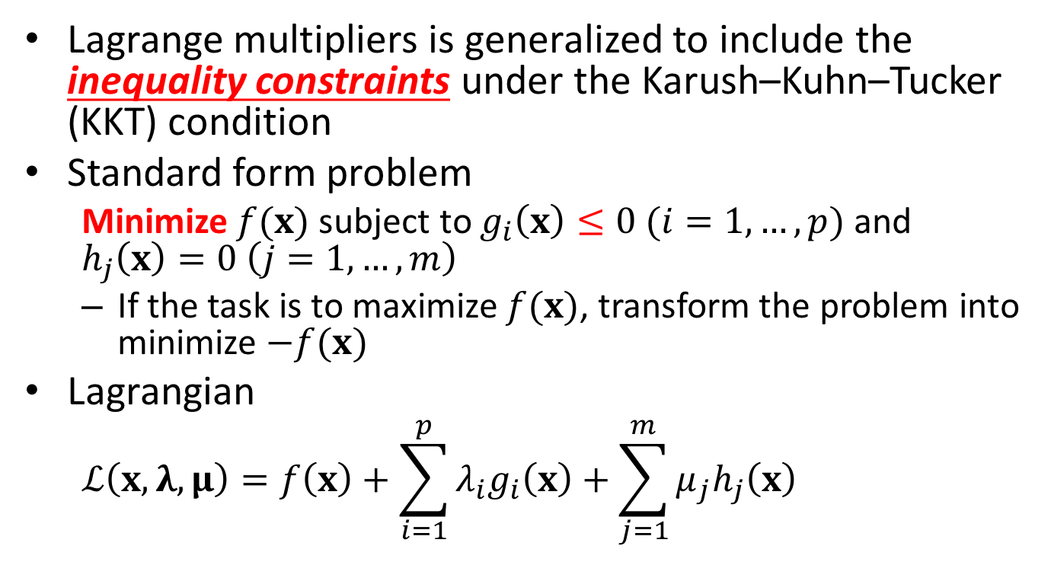
Generalized Lagrange multiplier
Lagrange multipliers is generalized to include the inequality constraints under the Karush–Kuhn–Tucker (KKT) condition
Standard form problem
Minimize $f(x)$ subject to $g_{i}\left(x\right)≤0 (i=1,…,p)$ and $h_{j}\left(x\right)=0 \left(j=1,…,m\right)$
If the task is to maximize $f(x)$, transform the problem into minimize $−f(x)$
Lagrangian
$$ℒ\left(x,λ,μ\right)=f\left(x\right)+\sum_{i=1}^{p}{λ_{i}g_{i}\left(x\right)}+\sum_{j=1}^{m}{μ_{j}h_{j}\left(x\right)}$$

Slide 7
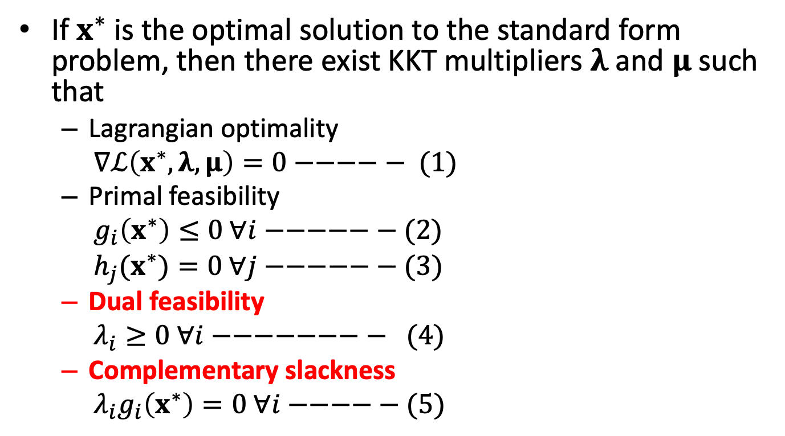
Necessary (not sufficient!) optimal condition (KKT condition)
If $x^{∗}$ is the optimal solution to the standard form problem, then there exist KKT multipliers $λ$ and $μ$ such that
Lagrangian optimality
$∇ℒ\left(x^{∗},λ,μ\right)=0−−−−− (1)$
Primal feasibility
$g_{i}\left(x^{∗}\right)≤0 ∀i−−−−−− (2)$
${h_{j}(x}^{∗})=0 ∀j−−−−−− (3)$
Dual feasibility
$λ_{i}≥0 ∀i−−−−−−−− (4)$
Complementary slackness
$λ_{i}g_{i}\left(x^{∗}\right)=0 ∀i−−−−− (5)$

Slide 8
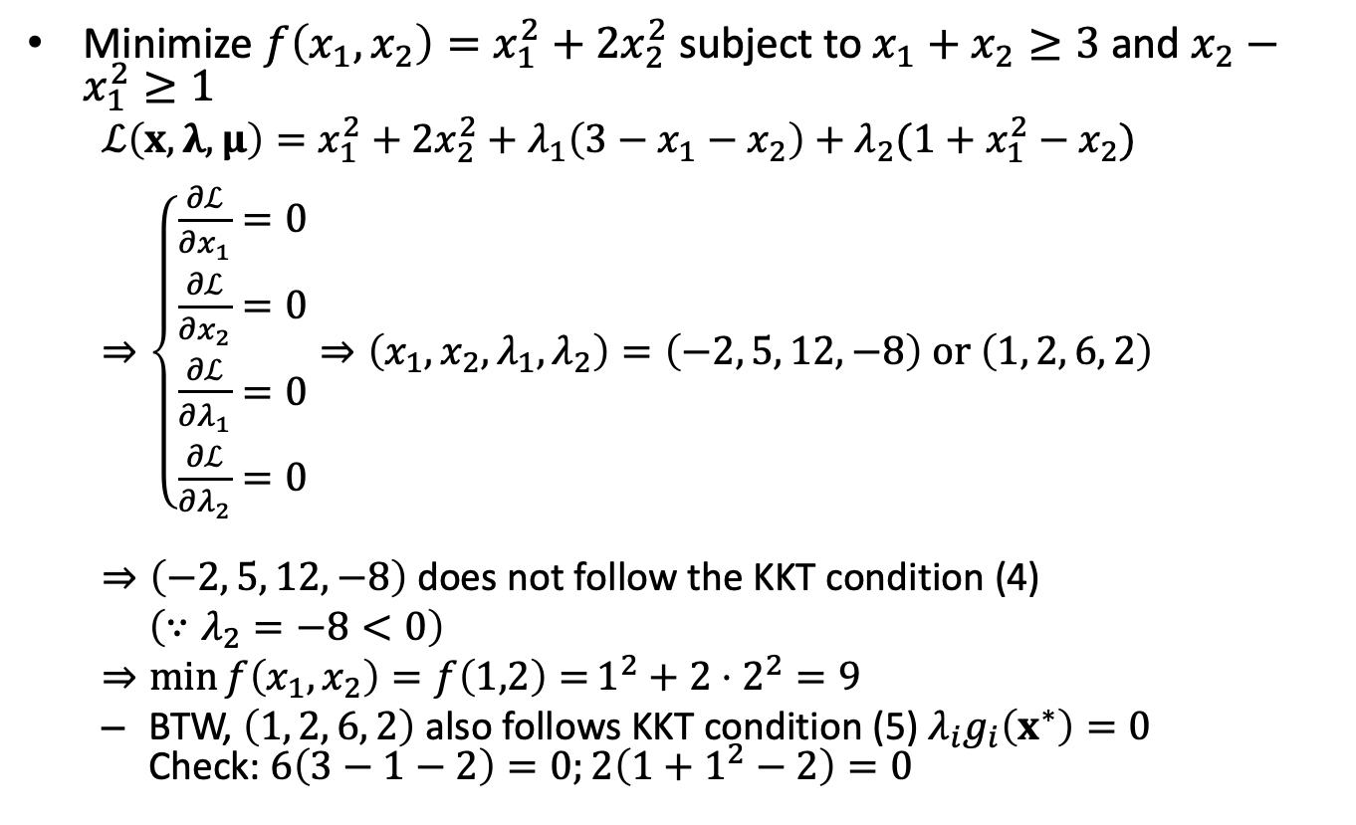
Example
Minimize $f\left(x_{1},x_{2}\right)=x_{1}^{2}+2x_{2}^{2}$ subject to $x_{1}+x_{2}≥3$ and $x_{2}−x_{1}^{2}≥1$
$$ℒ\left(x,λ,μ\right)=x_{1}^{2}+2x_{2}^{2}+λ_{1}\left(3−x_{1}−x_{2}\right)+λ_{2}(1+x_{1}^{2}−x_{2})$$
$⇒\left\{\begin{aligned}\frac{∂ℒ}{∂x_{1}}=0 \\ \frac{∂ℒ}{∂x_{2}}=0 \\ \frac{∂ℒ}{∂λ_{1}}=0 \\ \frac{∂ℒ}{∂λ_{2}}=0\end{aligned}⇒\left(x_{1},x_{2},λ_{1},λ_{2}\right)=\left(−2, 5, 12,−8\right) or \left(1, 2, 6, 2\right)\right.$
$⇒\left(−2, 5, 12, −8\right)$ does not follow the KKT condition (4)
$\left(∵λ_{2}=−8<0\right)$
$$⇒\min{f\left(x_{1},x_{2}\right)=f\left(1,2\right)=}1^{2}+2⋅2^{2}=9$$
BTW, $\left(1, 2, 6, 2\right)$ also follows KKT condition (5) $λ_{i}g_{i}\left(x^{∗}\right)=0$ Check: $6\left(3−1−2\right)=0;2\left(1+1^{2}−2\right)=0$

Slide 9
Summary
Lagrangian as a tool to find extreme values of a function with equality constraints
Genralized Lagrangian and KKT condition together as a tool set to find extreme values of a function with equality and inequality constraints
We will use KKT conditions to analyze the properties of SVM solutions

Slide 10
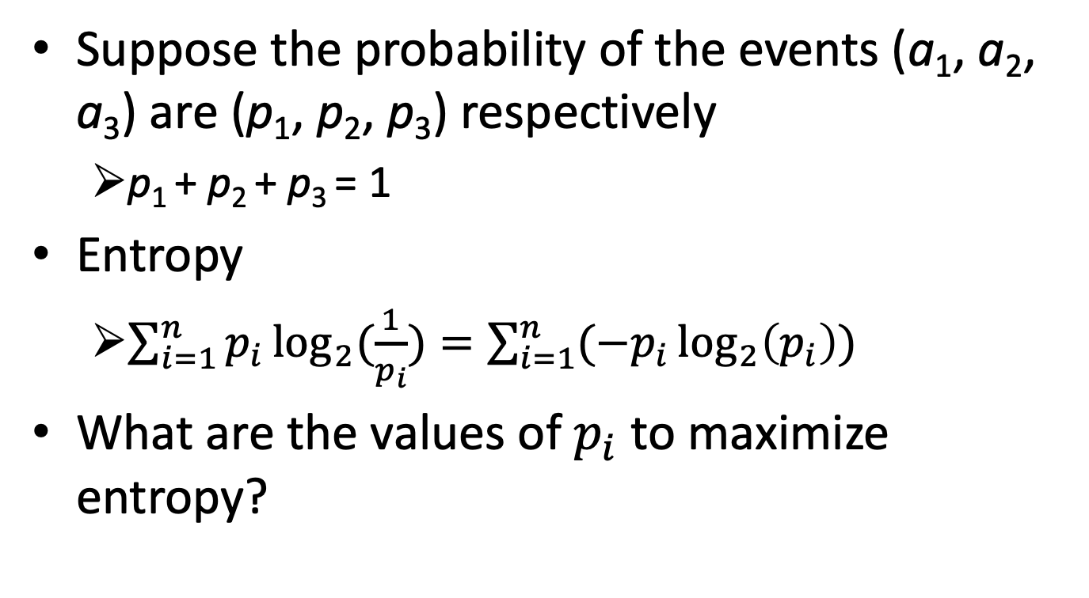

Quiz: find $p_{i}$s to maximize entropy
Suppose the probability of the events (a₁, a₂, a₃) are (p₁, p₂, p₃) respectively
p₁ + p₂ + p₃ = 1
Entropy
$\sum_{i=1}^{n}{p_{i}\log_{2}{(\frac{1}{p_{i}})}}=\sum_{i=1}^{n}{({−p}_{i}\log_{2}\left(p_{i}\right))}$
What are the values of $p_{i}$ to maximize entropy?

Slide 11
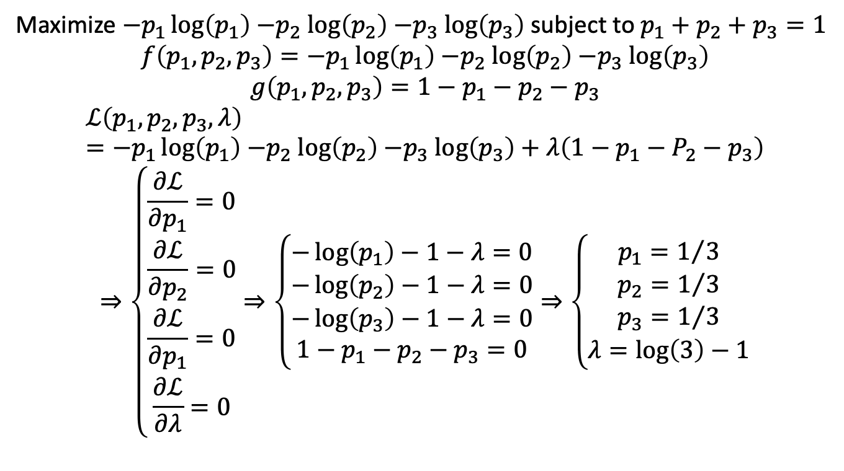
Quiz: find $p_{i}$s to maximize entropy
Maximize ${−p}_{1}\log\left(p_{1}\right){−p}_{2}\log\left(p_{2}\right){−p}_{3}\log\left(p_{3}\right)$ subject to $p_{1}+p_{2}+p_{3}=1$
$$f\left(p_{1},p_{2},p_{3}\right)={−p}_{1}\log\left(p_{1}\right){−p}_{2}\log\left(p_{2}\right){−p}_{3}\log\left(p_{3}\right)$$
$$g\left(p_{1},p_{2},p_{3}\right)=1−p_{1}−p_{2}−p_{3}$$
$$ℒ\left(p_{1},p_{2},p_{3},λ\right)={−p}_{1}\log\left(p_{1}\right){−p}_{2}\log\left(p_{2}\right){−p}_{3}\log\left(p_{3}\right)+λ\left(1−p_{1}−P_{2}−p_{3}\right)$$
$$⇒\left\{\begin{aligned}\frac{∂ℒ}{∂p_{1}}=0 \\ \frac{∂ℒ}{∂p_{2}}=0 \\ \frac{∂ℒ}{∂p_{1}}=0 \\ \frac{∂ℒ}{∂λ}=0\end{aligned}\right.⇒\left\{\begin{aligned}−\log\left(p_{1}\right)−1−λ=0 \\ −\log\left(p_{2}\right)−1−λ=0 \\ −\log\left(p_{3}\right)−1−λ=0 \\ 1−p_{1}−p_{2}−p_{3}=0\end{aligned}\right.⇒\left\{\begin{aligned}p_{1}=1/3 \\ p_{2}=1/3 \\ p_{3}=1/3 \\ λ=\log\left(3\right)−1\end{aligned}\right.$$

