Slide 1
Exercise 1:
Categories
CategoryID | CategoryDescription
Publishers
BookCategories
PublisherID | PublisherName
ISBNNumber | CategoryID
BookTitles
ISBNNumber | Title | PublisherID | PublishedDate | BookFormat | Pages | Price
BookAuthors
ISBNNumber | AuthorID
BookFomats
Authors
BookFormat | FormatDescription
AuthorID | AuthorFirstName | AuthorLastName

Slide 2
Exercise 1a:
DepartmentName
Budget
DepartmentNumber
Departments
Manage
Work in
EmployeeSsn
Employees
Salary
Phone
Has
ChildrenName
ChildrenOfEmployees
Age
ParentSsn

Slide 3
Exercise 1a:
DepartmentName
Budget
DepartmentNumber
Companies
Manage
Work in
EmployeeSsn
Employees
Salary
Phone
Has
ChildrenName
ChildrenOfEmployees
Age
ParentSsn

Slide 4
Exercise 1b:
Departments
DepartmentNumber | DepartmentName | Budget | EmployeeManagerSsn
Employees
EmployeeSsn | Salary | Phone | DepartmentNumber
ChildrenOfEmployees
ChildrenName | EmployeeParentSsn | Age

Slide 5
Exercise 1
Companies
CompanyNumber
DoctorNumber
CompanyName
Doctors
Has
DrugNumber
StartDate
DoctorName
Drugs
DrugName
Contract
Date
Prescrition
Sell
EndDate
PatientNumber
PharmacyNumber
Patients
Pharmacies
PatientName

Slide 6
Exercise 2:
Students
StudentSsn | StudentName | Major | DateOfBirth
Enrolls
StudentSsn | CourseNumber | Quarter | Grade
Courses
CourseNumber | CourseName | Dept
BookAdoption
CourseNumber | BookIsbn | Quarter
Books
BookIsbn | BookTitle | Publisher | Author

Slide 7
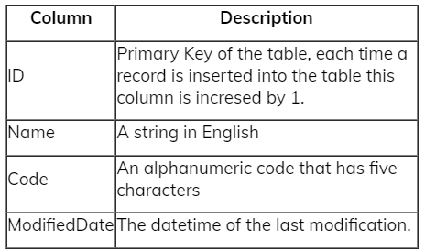
Exercise 3
Data type
SMALLINT
VARCHAR(80)
VARCHAR(5)
SMALLDATETIME

Slide 8
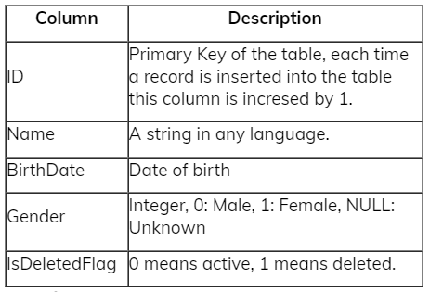
Exercise 4
Data type
SMALLINT
NVARCHAR(80)
DATE
BIT NULL
BIT NOT NULL

Slide 9
Exercise 1a:
TypeName
EmployeeID
TypeKepperName
Space
AnimalTypes
Has
TypeKeepers
CageId
Height
Ssn
Cages
PhoneNumber
Address
Of Type
Has
AnimalId
Has
Animals
Age
BeginningTime
Gender
Handle
CageKepperName
Has
Duration
CageKeepers
EmployeeID
Diseases
PhoneNumber
Ssn
Address
DiseaseName

Slide 10
Exercise 1b:
AnimalTypes
TypeKeepers
TypeName
TypeName | EmployeeID | TypeKeeperName | Ssn | Address | PhoneNumber
Cages
Animals
CageID | Space | Height
CageID | TypeName | AnimalID | Age | Gender
AnimalDiseases
DiseaseName | AnimalID | BeginningTime | Duration
CageKeeperCages
CageID | EmployeeID
Diseases
DiseaseName
TypeKeeperDiseases
DiseaseName | EmployeeID
CageKeepers
EmployeeID | CageKeeperName | Ssn | Address | PhoneNumber

Slide 11
Exercise 2:
Customers
CustomerID | CustomerName | CustomerAddress | CustomerSuburd | CustomerPostCode
Invoices
InvoiceNumber | InvoiceDate | CustomerID
InvoiceItems
LineNumber | Quantity | InvoiceNumber | ItemNumber
Items
ItemNumber | ItemDesciption | ItemPrice

