Slide 1





Core Java
Strings
LEVEL – PRACTITIONER

Slide 2

Objectives
After completing this chapter you will be able to:
Create String,StringBuffer and StringBuilder Objects
Work with String, StringBuffer and StringBuilder API's.
Work with String Tokenizer API's.

Slide 3
String Class
Strings, which are widely used in Java programming, they are a sequence of characters.
Java provides String class to create and process strings.
Strings are objects.
How to create a String?
Option 1: String greeting = "Hello world!"; // Create a string literal and assign it to a String reference. (OR)
Option 2: String greeting = new String("Hello world!“); // Using the String constructor.

Slide 4
About String Class
String is available in java.lang package.
What does String class contain?
String class contains the API’s used for creating and processing strings.
Example:
Comparing Strings
Searching strings.
Extracting substrings.
Also constructors for creating Strings in different ways.

Slide 5

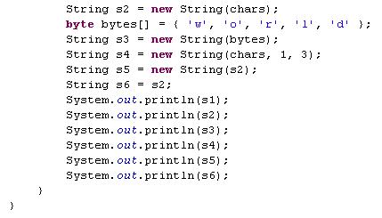
Lend a hand-String Constructors
Lets develop a program to explore the various String constructors to build a String.
Creating string objects from a character array.
From byte array.
From other char objects.
From other string objects.

Slide 6
String Class API’s
Some commonly used API’s inside String Class.
Result | Method | Description
char | charAt(int index) | Returns the character at the specified index.
int | compareTo(String anotherString) | Compares two strings lexicographically.
boolean | equalsIgnoreCase(String anotherString) | Compares this String to another String, ignoring case considerations.
int | indexOf(int ch) | Returns the index within this string of the first occurrence of the specified character.
int | length() | Returns the length of this string.

Slide 7

String Class API’s
Result | Method | Description
String | concat(String str) | Concatenates the specified string to the end of this string.
String | replace(char oldChar, char newChar) | Returns a new string resulting from replacing all occurrences of oldChar in this string with newChar.
String | substring(int beginIndex, int endIndex) | Returns a new string that is a substring of this string.
String | trim() | Returns a copy of the string, with leading and trailing whitespace omitted.
For more information refer http://docs.oracle.com/javase/1.4.2/docs/api/java/lang/String.html

Slide 8
Key points on String Class
Key points on Strings:
Strings are immutable i.e. once it is created a String object cannot be changed.
If you assign a String reference to a new String, the old String will be lost.
Example:
String str1="Hello"; str1="World";
Now, str1 contains "World".
All string operations (concatenate, trim, replace, substring) construct and return new strings.
String class is final.

Slide 9

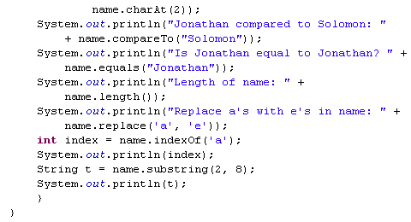
Lend a hand - String API’s
Lets develop a program to explore the few API’s of String class, namely,
print a specific character of a string, compare, print length of string, replace a string etc.
Prints the character at second index
This compares t oStrings.
This equates two string and returns true/false.
Prints the String length.
This returns “Jonethen”.
This the returns the index of the character ‘a’ in the String.
This returns substring between index 2 & 8.

Slide 10
What is StringBuffer?
StringBuffer objects unlike Strings are mutable i.e. string value can be changed.
So string buffer is like a String, that can be modified.
Using the API’s in the StringBuffer the content and the length of the string can be changed without creating a new object.
The API's of StringBuffer are synchronized.
This class is preferred when modification of character strings are needed since it is efficient in memory utilization.
Examples:
Appending String
Inserting characters in string.
Deleting characters from a string

Slide 11
StringBuffer Class
StringBuffer is a final class.
StringBuffer objects can be created empty,
StringBuffer strBuf = new StringBuffer();
•StringBuffer can be created from a String.
StringBuffer strBuf = new StringBuffer(“Bob”);
•StringBuffer can be created with a capacity.
StringBuffer strBuf = new StringBuffer(100);
For more information refer http://docs.oracle.com/javase/1.4.2/docs/api/java/lang/StringBuffer.html

Slide 12
StringBuffer Class
String buffers are used by developers to concatenate String rather than using concatenation operator "+" on string objects. StringBuffer is efficient than "+" concatenation.
Example:
String str="Stanford"; str = str+ "University"; Can be developed as
Step 2: Appends the string representation of each operand to the string buffer in turn.
str = new StringBuffer().append("Standford").append("University").toString();
Step 1: Compiler creates a new string buffer initially empty.
Step 3: Converts the contents of the string buffer to a string as ‘str’ is a string object.

Slide 13
StringBuffer API’s
Result | Method | Description
void | setCharAt(int index, char ch) | The character at the specified index of this string buffer is set to the character ch.
StringBuffer | insert(int offset, String str) | Inserts the string argument into this string buffer.
StringBuffer | delete(int start, int end) | Removes the characters in a substring of this StringBuffer.
StringBuffer | replace(int start, int end, String str) | Replaces the characters in a substring of this StringBuffer with characters in the specified String.

Slide 14
StringBuffer API’s
Result | Method | Description
StringBuffer | reverse() | The character sequence contained in this string buffer is replaced by the reverse of the sequence.
StringBuffer | append(String str) | Appends the string to this string buffer.
void | setLength(int newLength) | Sets the length of this String buffer.
String | substring(int start, int end) | Returns a new String that contains a subsequence of characters currently contained in this StringBuffer.

Slide 15
Lend a Hand – StringBuffer API
Lets develop a program to explore the few API’s of String Buffer class.
We will solve the following problem,
1. Append two Strings “Hello” & “World” . Output: “Hello World”
Lets develop a program to explore the few API’s of String Buffer class.
We will solve the following problem,
Append two Strings “Hello” & “World” . Output: “Hello World”
Insert a string “_Java” in the String after “Hello”. Output: “Hello_Java World”
Replace _ with space. Output: “Hello Java World”.
Print the character at the 6’th position . Output: J
Delete the character in the third position. Output: “Helo World”
Print the capacity of the buffer.
Reverse the string and print the string. Output: “dlroW avaJ oleH”
Insert a string “_Java” in the String after “Hello”. Output: “Hello_Java World”
Replace _ with space. Output: “Hello Java World”.
Print the character at the 6’th position . Output: J
Delete the character in the third position. Output: “Helo World”
Print the capacity of the buffer.
Reverse the string and print the string. Output: “dlroW avaJ oleH”

Slide 16
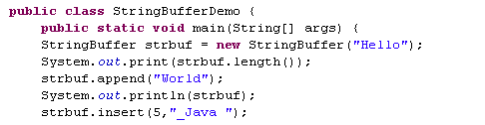
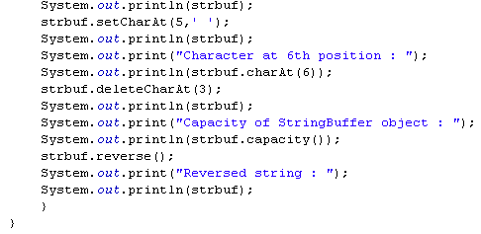
Lend a hand Solution -StringBuffer API’s
This returns 5.
This returns “HelloWorld” .
This returns “Hello_Java World”.
This returns “Hello Java World”.
This returns ‘J ‘ .
This returns “Helo Java World”.
This returns ‘21 ‘. This returns “dlroW avaJ oleH“ .

Slide 17
What is StringBuilder?
StringBuilder class, which is a drop-in replacement for StringBuffer .
StringBuilder is not synchronized which means it is not thread-safe.
Use StringBuilder class where thread safety is not an issue.
It offers faster performance than StringBuffer.
All the methods available on StringBuffer are also available on StringBuilder, so it really is a drop-in replacement.

Slide 18
Lend a Hand – StringBuilder API
Lets develop a program to explore the few API’s of String Builder class.
We will solve the following problem,
1. Append two Strings “Hello” & “World” . Output: “HelloWorld”
Lets develop a program to explore the few API’s of String Builder class.
We will solve the following problem,
Append two Strings “Hello” & “World” . Output: “HelloWorld”
Insert a string “_Java” in the String after “Hello”. Output: “Hello_Java World”
Replace _ with space. Output: “Hello Java World”.
Insert a string “_Java” in the String after “Hello”. Output: “Hello_Java World”
Replace _ with space. Output: “Hello Java World”.

Slide 19

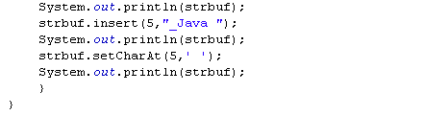
Lend a hand-StringBuilder Methods
This returns 5.
This returns “HelloWorld”.
This returns “Hello_Java World”. This returns “Hello Java World” .

Slide 20
StringTokenizer Class
The StringTokenizer class is used to break a string into tokens base don some delimiters.
Example: India, USA, UK, Russia – This string can be split based on the delimiter “,”
It is available in java.util package.
StringTokenizer implements the Enumeration interface.
The given string can be enumerated, you can enumerate the individual tokens contained in it using StringTokenizer.
Tokens from the String:
Token 1- India Token 2- USA Token 3- UK Token 4- Russia

Slide 21
StringTokenizer API’s
Result | Method | Description
boolean | hasMoreTokens() | Tests if there are more tokens available from this tokenizer's string.
String | nextToken() | Returns the next token in this string tokenizer's string.
The default delimiters are whitespace characters. space, tab, newline, and carriage return.

Slide 22
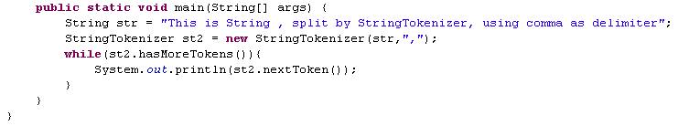
Lend a hand-StringTokenizer
Lets develop a program to explore the StringTokenizer.
Run the program and check the output.
Now Execute the same program without using delimiter and see the output.
StringTokenizer st = new StringTokenizer(str);

Slide 23
equals() and hashCode() method
java.lang.Object has methods called hashCode() and equals().
These methods can be overridden and implemented with the object specific logic,
What is a Hash code?
Hash code is an unique id number allocated to an object by JVM. This number is maintain throught the lifecycle of the Object.
hashCode():
This method by default returns the hash code value of the object on which this method is invoked.
This method returns the hash code value as an integer.
You can develop your own logic of generating hash code.

Slide 24
equals() and hashCode() method
What is a Equals method used for?
This particular method is used for comparing two objects for equality.
equals():
equals() refers to equivalence relation i.e. you say that two objects are equivalent they satisfy the “equals()” condition.
Override the equals() with a logic which needs to be used for comparing for equivalence.
Example: Assume we have a object Employee with the following instance variables, EmployeeId, EmployeeName.
The developer can override the equals method and compare the employee Id for checking equivalence.

Slide 25
Lend a Hand – Equals and Hash Code
Lets develop a program to explore how equals and hash code works.
Create a Employee object with instance variable age and name. Override the hash code and equals method as mentioned below,
Equals – The method overridden to compare the age of the
Lets develop a program to explore how equals and hash code works.
Create a Employee object with instance variable age and name. Override the hash code and equals method as mentioned below,
Equals – The method overridden to compare the age of the employees if same they should return a true else return false.
hashCode – Should return the age as hash code.
employees if same they should return a true else return false.
hashCode – Should return the age as hash code.

Slide 26
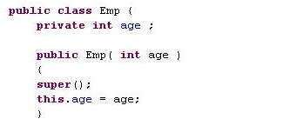
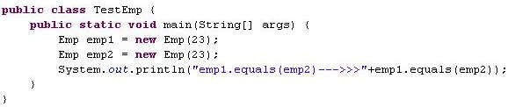
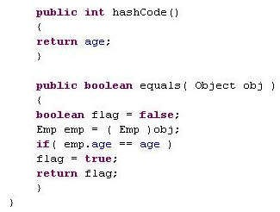
Lend a hand Solution
This returns true.
Overriding hashcode ().
Overriding equals().

Slide 27
Key points on equals method.
Reflexive: x.equals(x) is true.
Symmetric: if x.equals(y) is true, then y.equals(x) must be true.
Transitive: if x.equals(y) is true, and y.equals(z) is true, then z.equals(x) is true.
Consistent: Multiple calls to x.equals(y) will return the same result.
Null: If x.equals(y) is true, then x.hashCode() == y.hashCode() is true.

Slide 28
Key points on hash code method
Consistent: Multiple calls to x.hashCode() return the same integer.
If x.equals(y) is true, x.hashCode() == y.hashCode() is true.
But, a.hashCode() == b.hashCode() does not have to mean a.equals(b).
Transient variables are not appropriate for equals() and hashCode().

Slide 29

Time To Reflect
Associates to reflect the following before proceeding.
What is String?
What is the use of StringBufferClass?
What is the use of StringBuilderClass?
What is the use of StringTokenizerClass?
What is the significance of hashcode() and equals() mehods?

Slide 30
You have successfully completed –
Java String

