Slide 1




Core Java
Java Threads Part - 1
LEVEL – PRACTITIONER

Slide 2
Objectives
After completing this chapter you will be able to understand:
What is Multithreading and it's advantages?
What is Thread life cycle?
What is meant by thread priority?
What are the ways of implementing threads?
How to use Thread class to create threads?

Slide 3

Process Vs Thread
Before we learn about Threads lets first understand the difference between a thread and a process.
Process are executables which run in separate memory space.
Threads are small process which run in shared memory space within a process.
So in a nutshell Process is a container for Threads, all thread runs inside the process.
Before we learn about Threads lets first understand the difference between a thread and a process.
Process are executables which run in separate memory space.
Threads are small process which run in shared memory space within a process.
So in a nutshell Process is a container for Threads, all thread runs inside the process.
Still confused lets look at a example to understand it
better.

Slide 4
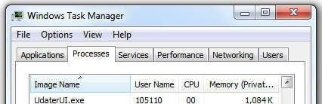
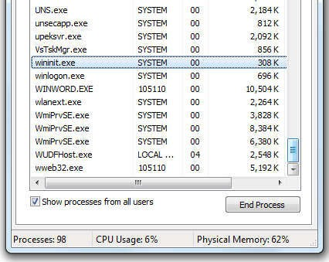
Process Example
Lets consider Microsoft word application to understand it better, what happens when you start an word application.
A process for word application will be started.
Now lets see what happens when the user starts using word application.

Slide 5
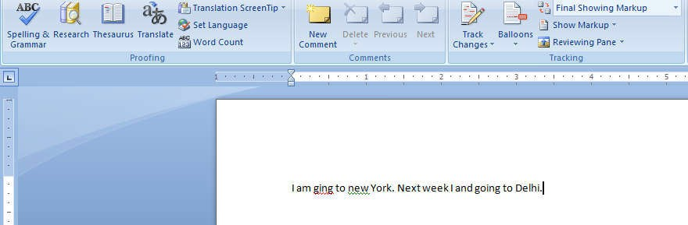
Thread Example
The spell check has been implemented as a thread within the worde.exe process which runs continuously and verifies what you type.
Word.exe is the process and spell check is a thread running inside the process.
Now as you type you will see the spelling and grammar being verified by the word process.
7

Slide 6
A Problem Statement
Tim was developing an application where he has a requirement where user can register his profile in the application , assume registration has three steps
Validate user details – Takes 3 seconds for execution for each user.
Validate user Citizenship - Takes 4 seconds for execution for each user. Now customer wants to complete the registration process is less than 5 seconds.
Guess how Tim would have achieved it?
He used Multi Threading.
Lets see what it is and how it can be implemented in this session.
₈8

Slide 7
What is Multitasking and Multithreading ?
What is Multitasking?
Refers to a computer's ability to perform multiple jobs concurrently
More than one program are running concurrently,
Example: In windows you can run Word, power point , media player at the same time. Yu will working on word and in parallel media player might play some music.
What is Multithreading?
A thread is a single sequence of execution within a program/process.
This refers to multiple threads of control within a single program.
Each program can run multiple threads of control within it.
Example: Microsoft word process having multiple threads like spell check, auto save etc.

Slide 8
Multitasking & Multithreading Illustration
CPU
Process1
Process 2
Thread 1
Word Process
Auto Save
Thread 2
Spell Check
Thread 3
The CPU is running three processes. Process 2 in turn has three threads running inside it.
10

Slide 9
Benefits of Multithreading
To reduce response (execution) time of a process.
Support Parallel Operation of Functions.
Increase System Efficiency.
Requires less overheads compared to Multitasking.

Slide 10

How Tim solved the problem?
Tim implemented two threads for processing the Validate user details and Validate user Citizenship.
Single Threaded
4
Seconds
The thread takes 7 seconds for completing the registration process.
Validate User Citizenship
Let look how Tim implemented it.
3
Seconds
Validate User Details

Slide 11

How Tim solved the problem?
Tim implemented two threads one thread for each method Validate user details
and Validate user Citizenship.
Multi Threaded
Validate User Citizenship
Validate User Details
4
Seconds
3
Seconds
The process will be completed in 4 seconds.
Since both the threads works in parallel.

Slide 12
What is an Application Thread?
When we execute an application,
The JVM creates a thread (T1) object which invokes the main() method and starts the application.
The thread executes the statements of the program one by one (or) starts other threads.
After executing all the statements, the method returns and the thread dies.
The thread T1 which is responsible for starting the application by invoking the main method is called “Application Thread”.

Slide 13

How Multiple threads run in an application?
Each thread has its private run-time stack for storing variables and data.
If two threads execute the same method, each will have its own copy of the stack to store the method local variables.
The objects instance variables are (Class variables) shared across all the threads, they are not thread safe.
Stacks

Slide 14
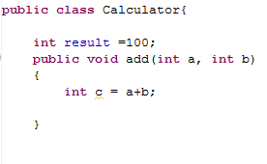
How Multiple threads run in an application?
result = 2000
The result instance variable will be shared by both the threads. NOTE: For thread T2 the result will be displayed as 2000.
C = 5
C = 6
Assume two threads are executing the above methods.
Thread T1 : a=3 & b=2 Thread T2 : a=1 & b=5
b= 2
b= 5
a=3
a=1
T1 Stack T2 Stack
Each thread will have its own stack to store the method local variables.
Assume thread T1 sets the class variable result to 2000.

Slide 15
Ways of Implementing Threads
Method 1 : Extend Thread Class
Method 2 : Implement Runnable Interface
In this session we will learn about Method 1.

Slide 16
Thread Class Methods
Method | Description
void run() | The thread logic should be implemented in this method. This method should be overridden in all the Thread class.
void start() | Creates a new thread and invokes run method of the thread.
getName() | Returns the thread's name.
int getPriority() | Returns the thread's priority
boolean isAlive() | Tests if the thread is alive.

Slide 17
Thread Class Methods
Method | Description
boolean isDaemon() | Tests if the thread is a daemon thread.
setName(String name) | Sets a name for the thread to be equal to the argument name.
setPriority (int newPriority) | Changes the priority of the thread
static void sleep(long millis) | Causes the currently executing thread to sleep (temporarily cease execution) for the specified number of milliseconds.
void yield() | Causes the currently executing thread object to temporarily pause and allow other threads of same priority to execute

Slide 18
Method 1 : Steps to develop thread using Thread
Step 1 : Develop a Thread class by extending the java.lang.Thread class
class ThreadDemo extends Thread
Step 2 : Override the run() function for making the code run as a separate thread
class ThreadDemo extends Thread { void run() {
// do Something
}
}
Step 3 : Create an entry point for the Thread (main method) which can start the thread.

Slide 19
Method 1 : Steps to develop thread using Thread
Step 4 : Create an instance of the Thread class.
Step 5 : Invoke the start () method on the Thread object which in turn invokes the
run() method in the Thread class.
class ThreadProgram {
public static void main(String args[])
{
ThreadDemo thread=new ThreadDemo(); thread.start() ;
}
}

Slide 20

Time To Reflect
Associates to quickly summarize the following before proceeding the session
What is the difference between Thread and process?
What is the difference between multitasking and multiprocessing
What are the two methods of implementing multithreading in java?
What is the method used to set the priority of a thread?
How to start a new Thread ?

Slide 21

Thread Life Cycle
Programmer
Thread States
When start method is invoked the Thread moves into the runnable state. The scheduler based on the time slot executes the thread.
Scheduler
Create a Thread Class
Runnable
Create a Thread object
When scheduler executes the thread.
Running
When sleep or yield method is invoked.
Calls the start method on the newly created
Thread object
When sleep or yield time is over.
Thread finishes execution
.
Dead
Blocked

Slide 22
Scheduling Threads
Execution of multiple threads on a single CPU, in some order, is called
scheduling.
The Java runtime supports a very simple, deterministic scheduling preemptive
priority scheduling algorithm.
This algorithm schedules threads based on their priority.
At any given time, when multiple threads are ready to be executed, the runtime system chooses the runnable thread with the highest priority for execution.
Low priority thread gets a chance only when threads with high priority move to a non runnable state.

Slide 23
Scheduling Threads(Cont)
If two threads of the same priority are waiting for the CPU, the scheduler chooses one of them to run in a round-robin fashion. The chosen thread will run until one of the following conditions is true:
A higher priority thread becomes "Runnable"
It yields, or its run() method exits
Then the second thread is given a chance to run, and so on, until the interpreter exits.
The Java runtime system's thread scheduling algorithm is also preemptive.
If at any time a thread with a higher priority than all other "Runnable" threads becomes "Runnable", the runtime system chooses the new higher priority thread for execution. The new higher priority thread is said to preempt the other threads.

Slide 24
Thread Priority
Priorities determine, which thread receives CPU control and gets to be executed first.
When a thread is created, it inherits the priority of the thread that created it.
The priority values range from 1 to 10, in increasing priority.
The priority can be adjusted subsequently using the setPriority() method.
The priority of a thread may be obtained using getPriority().
Priority constants are defined in Thread Class.
MIN_PRIORITY=1
MAX_PRIORITY=10
NORM_PRIORITY=5
The main thread is created with priority NORM_PRIORITY

Slide 25
Important Note
As per the specification, at any given time, the highest priority thread is always running.
However, this is not guaranteed.
This depends on the Thread scheduler as it can run a lower priority thread to avoid starvation without getting a chance to execute.
So don’t rely on thread priority for algorithm correctness.

Slide 26
What are Daemon Threads?
Daemon threads are “background” threads, that provide services to other threads.
Example: The garbage collection thread.
The Java VM cannot exit if non-Daemon threads are executing.
The Java VM can exit Daemon threads are executing.
Daemon threads die when the Java VM exits.

Slide 27
Thread Group
A thread group represents a set of threads.
Thread groups are typically used if a collection of similar threads needs to be collectively managed. These threads will be added to a thread group.
A thread group can also include other thread groups.
The thread groups form a tree in which every thread group except the initial thread group has a parent.

Slide 28
Time To Reflect
Associates to quickly summarize the following before ending the session
What is the thread state when a new thread is created?
What is the state of the thread when a sleep or yield method is invoked?.
Can a Thread in the dead state move back to the runnable state?
A thread with priority 6 creates a new Thread T1. What will be the priority of thread T1?

Slide 29
Lend a Hand – How to develop a thread?
In this demo we will learn how to
Create a Thread by extending the Thread class
Override the run method
Create a thread object and start the thread using the start method
How the following methods operates
getName()
setName()
setPriority()
getPriority()
sleep()
Components to be developed,
ThreadEX – The Thread class should loop and print values 0…4.
ThreadExMain – The main class to execute the Threads

Slide 30
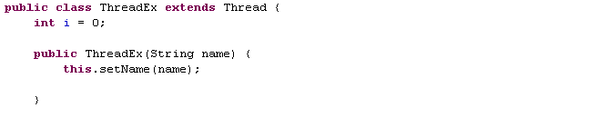
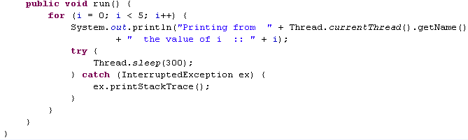
Lend a Hand Solution - How to develop a Thread?
Class ThreadEx extends Thread class and becomes a Thread class
Sets the name of the Thread using setName method()
Overrides the run()
method
Prints the name of the current Thread using the getName() method
Makes the Thread sleep for 300 milliseconds. Invoking the sleep may cause an InterruptedException to be thrown which should be handlers.

Slide 31
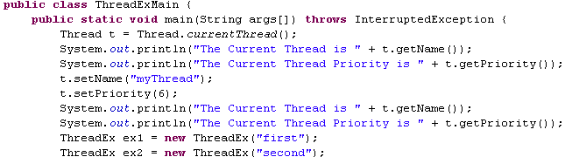
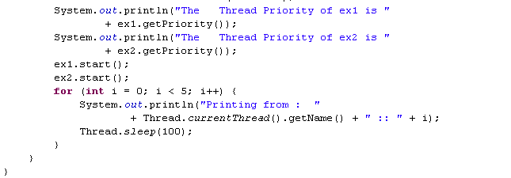
Lend a Hand Solution– How to develop a Thread?
Gets the priority and name of the main thread
Sets the priority and name of the main thread
Creates two new Thread objects with name “first “and “second”
Starts the Thread by invoking the start () which will invoke the run() method of the Thread class

Slide 32


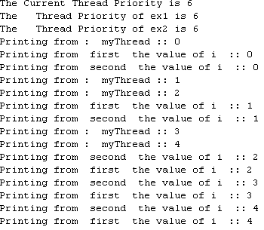
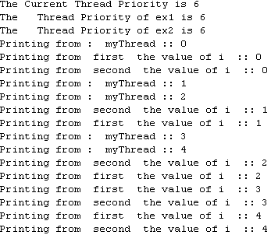
Lend a Hand Output - How to develop a Thread?
Execute the main class – ThreadExMain
The output will be something as shown below – Output may vary for each execution since Thread execution is based on the underlying operating system.
Different output displayed during different run

Slide 33

Core Java
You have successfully completed – Threads Part 1

