Slide 1




Core Java
Threads Part - 3
LEVEL – PRACTITIONER

Slide 2
Objectives
After completing this chapter you will be able to understand:
What is synchronization?
Various thread method wait, notify and notifyAll.

Slide 3

What is Race Condition?
Scenario: Consider a scenario in which you want to keep green blocks sequentially at the bottom and red blocks be placed on top of the green blocks. You have developed a program in such a way that two threads one for placing the green blocks and other for red blocks. Lets see how the program places the blocks.
Thread 1-Put green pieces
Thread 2 - Put red pieces
You couldn’t get your expected output. The red blocks and greens

Slide 4
When does Race Condition occur ?
A race condition occurs when two or more threads are able to access shared data and they try to change it at the same time.
Both of them try to modify the data at the same time that is both are racing to get access/change the data
Since the thread scheduling is system dependent we cannot predict a reliable behavior of the application.
So what can be done to make only one Thread access a shared resource at a time ?
The solution is synchronization.

Slide 5
What is Synchronization?
Synchronizing threads means access to shared data (or) method execution logic in a multithreaded application is controlled in such a way that only one thread can access the method/shared data at a time. The other threads will wait till the thread releases the control. The shared data is considered to be Thread Safe.
Java uses the concept of monitors to implement synchronization.

Slide 6


Block problem solved using Synchronization ?
Lets see how synchronization can solve our problem in placing the colored blocks
Here the red thread waits till the green thread completes the job.
This is achieved using Synchronization.

Slide 7
What is a Thread Monitor?
A monitor is like a room of a building that can be occupied by only one thread at a time.
The room contains a data or logic.
From the time a thread enters this room to the time it leaves, it has exclusive access to any data/logic in the room.
This is done by gaining control on the monitor which is nothing but the
room.
Entering the special room inside the building is called "acquiring the monitor”.
Occupying the room is called "owning the monitor“ or exclusive access to the data.
Leaving the room is called "releasing the monitor" .

Slide 8
Synchronization methods
Synchronization is achieved by using one of the two methods,
Method 1: Synchronized blocks
Method 2: Synchronized methods

Slide 9
Method 1: Synchronized method
Synchronized methods can be created by using the keyword synchronized
for defining the method.
The code which should be thread safe is written inside this method.
During the execution of a synchronized method, the thread holds the monitor of that method's object (or) if the method is static it holds the monitor of that method's class.
If another thread is executing the synchronized method, your thread is blocked until that thread releases the monitor.

Slide 10
Example for Synchronized method
public class SyncMethods{
public synchronized void methodA() {
//critical code
}
}
Assume synch is an object of the SyncMethods class . A thread that needs to execute sync.methodA() needs to acquire the lock on object sync before it can enter the monitor entry.
If another Thread holds the lock for sync object the new thread must wait till the other Thread releases the lock.

Slide 11

Time To Reflect
Associates to quickly summarize the following before ending the session
What is the need of synchronization in multi threaded programming?
What is a race condition?
How can Synchronization be implemented?

Slide 12
Lend a Hand- Synchronize method
Demonstration : In this demo we will see how to implement synchronization and how it works?. We will create a small application which prints a text message on the console.
This demo will also help you to understand the behavior of synchronized and unsynchronized methods.

Slide 13

Lend a Hand – Program Details
We will develop a program to spawn three threads, each thread should accept two string arguments and print the String message.
The following two messages should be printed by each thread,
Thread 1 – “Hello..” and “There” Thread 2 – “How” and “are you”
Thread 3 – “Thank you,” and “very much” Classes
Output Expected
PrinterThread : Thread class used for printing the String.
StringPrinter : This class is used by the Thread class to print the Strings, contains a method which prints the strings.
SyncExMain : Main method to initiate the threads.

Slide 14
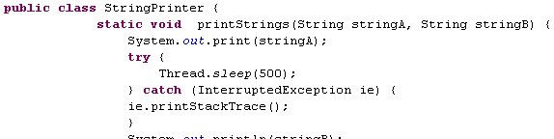

Lend a Hand – Develop String Printer
Methods to print the strings. NOTE:
The strings are printed one after the other with a pause. This has been
implemented using the sleep method.
The first message should be printed without a new line.
•Second message should be printed with a new line.

Slide 15
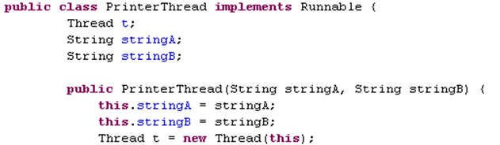
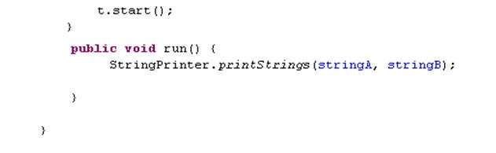
Lend a Hand – Develop the Thread class
Creates a thread object on “this” Runnable object and starts the thread.

Slide 16
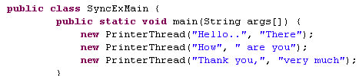
Lend a Hand-Develop the main class
Create three threads and pass the appropriate String messages.
18

Slide 17

Lend a Hand - Output
Execute the class, the output could be displayed as below.
This is the output we get, not the expected one. Note the order in which the messages are printed could be different depending upon the OS scheduler.
Inference:
Each thread overruns the other thread resulting in the message being jumbled.

Slide 18
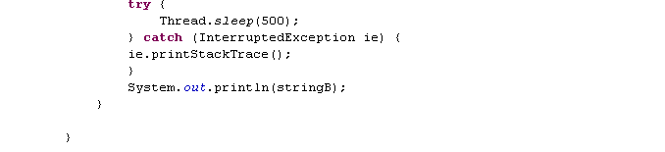
Lend a Hand – Add Synchronization
Now lets control the threads by using synchronized key word.
Make the printStrings() method of the StringPrinter class synchronized.
Add the synchronized keyword in method declaration.

Slide 19

Lend a Hand- Output With Synchronization
Execute the class, the output could be displayed as below.
The output is as expected.
Inference:
The synchronized keyword has ensured that the thread executes in order. Only after a thread completes printing both the messages the other thread starts the printing.

Slide 20
Method 2:Synchronized statements
Where is Synchronized statement used?
If only a small portion of code in a method needs to be Thread safe we can mark that portion only as synchronized rather than marking the entire method as synchronized.
Syntax:
public class SyncMethods{ public void methodA() { synchronized(this){
//This block contains a set of
//statements which needs to be synchronized
}
}
The syntax is synchronized(this) where this denotes the current object meaning the thread should acquire a lock on the current object to execute the statements.

Slide 21
Inter Thread Communication
In many instance we end up in a situation where we need one thread to communicate with other threads in a process. This is referred to as “Inter Thread Communication”
Inter Thread communication is achieved using one or more of the below methods,
Occasionally used
1. wait()
in application development.
notify()
notifyAll()

Slide 22
wait() method
wait() method causes a thread to release the lock it is holding on an object allowing another thread to run.
wait() can only be invoked within a synchronized code.
It should always be wrapped in a try block and handle IOException.
wait() can only be invoked by the thread that owns the lock on the object using synchronized(this).

Slide 23
How wait() method works?
When wait() is invoked, the thread becomes dormant until one of the below four things occur,
Another thread invokes the notify() method for this object and the scheduler arbitrarily chooses to run the thread.
Another thread invokes the notifyAll() method for this object.
Another thread interrupts this thread.
The specified wait() time elapses.
When one of the above occurs, the thread becomes re-available to the Thread scheduler and competes for a lock on the object.
Once it regains the lock on the object, everything resumes as if no suspension had occurred.

Slide 24
notify() method
notify() method wakes up a single thread that is waiting on the monitor of this object
If many threads are waiting on this object, then one of them is chosen to be awakened.
The choice is arbitrary and occurs at the discretion of the JVM implementation.
notify() method can only be used within synchronized code.
The awakened thread will not be able to proceed until the current thread relinquishes the lock on this object.

Slide 25
notifyAll() method
Similar to notify method notifyAll() is also used to wake up threads that wait on an object
The difference is notify() awakens only one thread whereas notifyAll() awakens all the threads

Slide 26

Deadlocks
Deadlock describes a situation where two or more threads are blocked forever, waiting for each other.
Example to understand dead locks:
Tim & Ron are two good friends they belong to a country where they have a weird culture, whenever they meet each other one has to bow and wish the other “Good Day” he has to remain bowed till the other person bows back and greets back “Thank you”
Lets see what happened?

Slide 27

Tim & Ron Bowing
They are into a “Dead
Hi, I am Ron
^{Ti}L^{m}et^{n}s^{e}e^{e}e^{ds}wh^{to}at^{re}h^{m}apªp^{in}ens
Hi, I am Tim
Lock” situation.
bow_{if}e_{b}d_{o}t_{t}i_{h}ll _{b}R_{o}o_{w}n_{s}b_{a}o_{t}w_{th}s_{e}
Neither of them can
back an_{s}d_{am}gr_{e}ee_{ti}t_{m}s _{e}h.im.
raise now.
Tim Bows Tim Raises
Ron Bows Back and greets Ron Raises
Both have bowed greeting “Good Day” at the same time . Now only when the other person greets back “Thank You” they are supposed to raise.

Slide 28
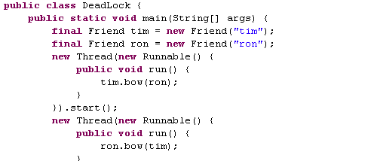
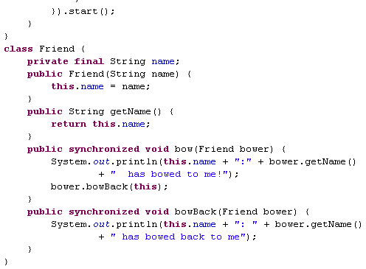
Program code for Tim and Ron Bowing
In this the bow method is marked as synchronized and at one point of time either Tim or Ron can execute it. Thus preventing the dead lock situation of both bowing.
NOTE: The bow method accepts Bower as a input. Say if Bow method is triggered on Tim object the Bower will be Ron whose bowBack method will be fired.

Slide 29
Time To Reflect
Associates to quickly summarize the following before ending the session
How can we make a thread wait on an object it holds the lock?
What is the difference between notify and notify all?
What is a dead lock?

Slide 30

Core Java
You have successfully completed – Threads Part 3

