Slide 1
APPID – MACHINE LEARNING

Slide 2
Application Identification
Identifying application using Decision trees.
Core Concept
Identify statistical info of current application.
Classify it using decision tree.
If decision tree has found the match , application is identified.
If decision tree fails to classify the data, train the decision tree using it.

Slide 3
Decision Trees
Available Open source Decision Trees :
C4.5 : An algorithm used to generate a decision tree developed by Ross Quinlan
VFDT : Very Fast Decision Tree. A wrapper of c4.5 to work with high speed data streams.
VFDT is preferred over c4.5 as instead of giving input to decision tree in terms of file, directly working with data streams is easy with respect to snort.

Slide 4
Identifying sessions
Session identification is required to collect enough packets of same application when creating dataset for training the decision tree.
Sessions are stored in a hash table structure with keys being socket address pairs. Efficient searching is ensured through murmur hash.
AVL tree is used for managing unique session Ids.
After there are enough packets in a session, its cumulative information is saved in a file which is used to train a decision tree afterwards.
Structure chart for session identification is as below:

Slide 6
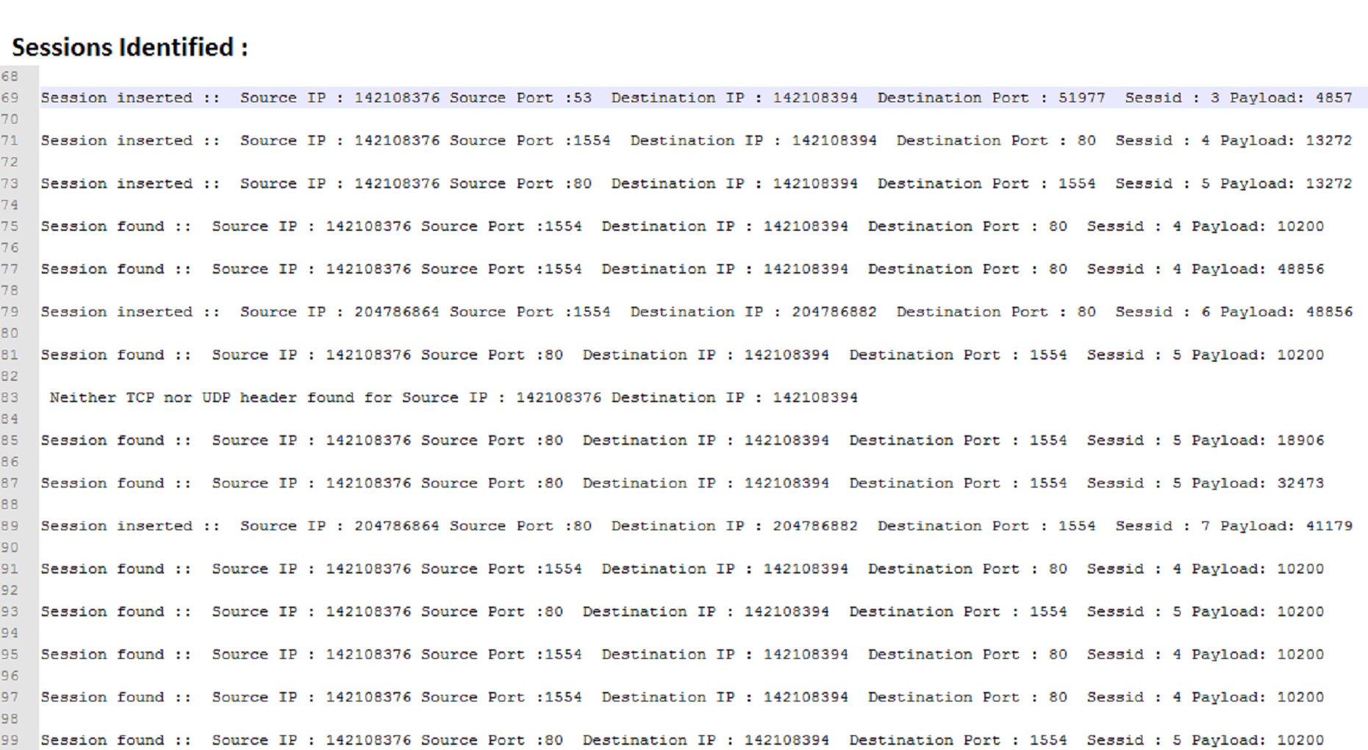

Slide 7
Identifying Statistical Info
Statistical Information is used to train the decision tree and later classify it using trained decision tree.
Statistical information contains :
Application name
Average packet size of first 10 requests of session
Average packet size of first 10 replies of session
Average packet payload size of first 10 requests of session

Slide 8
Identifying Statistical Info
Statistical information contains :
Average packet payload size of first 10 replies in session
Tcp options in request [1..10 requests]
Tcp options in reply [1..10 replies]
More parameters can be added later on to ensure the efficient decision tree is made.
Following dataset is created from the sessions identified before.

Slide 9
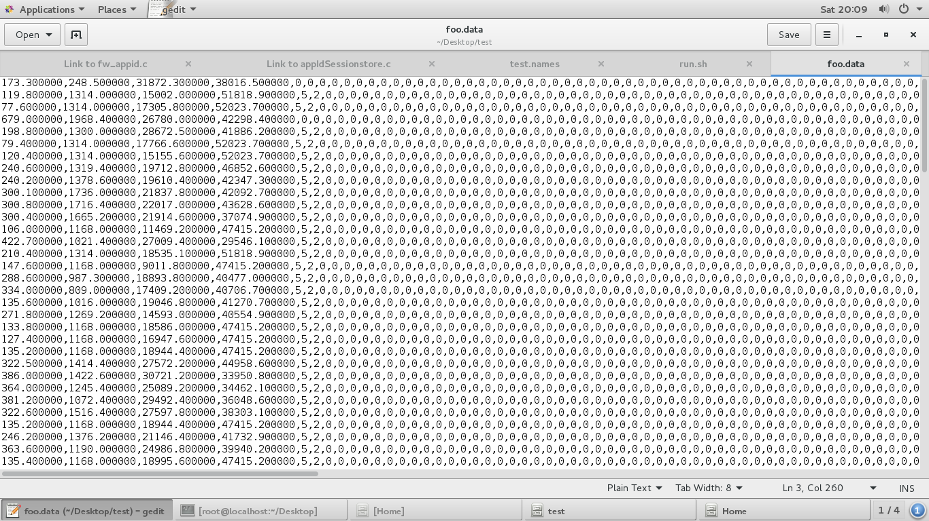
Dataset for training decision tree

Slide 10
Classify Statistical Info using decision tree
VFDT (Very Fast Decision Tree ) is used to classify statistical information gained from application packets.
VFDT needs to be trained first before using it to classify other data.
Decision tree is trained before it is used in snort to classify the data with various application information.
Training decision tree before snort instance is running, is necessary to avoid initial false identification.
Trained decision tree is stored in file, which later is used to classify the data.

Slide 11
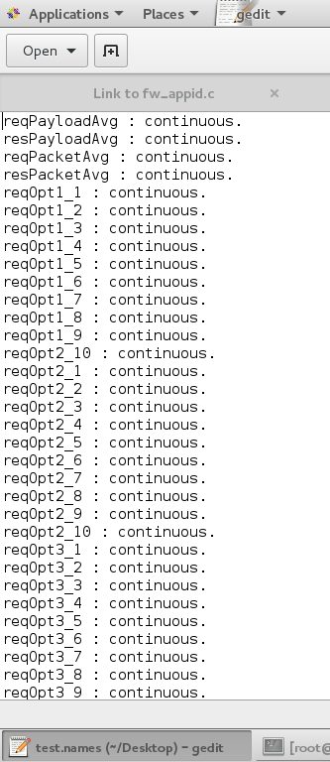
Attributes

Slide 12
Classify Statistical Info using decision tree
Possible problem with decision tree can be , it always classifies given data to nearest match.
Which creates confusion of taking the decision of whether to train the decision tree using the gained statistical info , or the classify it using decision tree?
One solution can be calculating confidence factor of the decision tree i.e. calculating probability of correct decision
If confidence factor is above 70%(used initially) the decision is correct else it is of a new application and decision tree should be trained with the data.

Slide 13
Application Identification
After classifying the data by decision tree , if new application is found, it’ll be named as “new unknown” which can be changed manually later on.
If application match is found in decision tree, appropriate message is shown.
Current application Identification is done based on packet headers which can be extended using deep packet inspection.

