Slide 1
Bank Credit Scoring using SPSS
Nisanth T S

Slide 2
Problem Statement
ROBEASY bank would like to tighten its loan disbursal process since the earlier process resulted in numerous defaults. Findings by the bank experts was that customers who overdrew their checking account and customers who used the loan for electronics were the most likely to default.
REVA analytics team has been given the responsibility of coming up with a predictive model to ensure loan is given to the right candidates and thus reduce defaults.

Slide 3
Data Understanding
GermanCredit.sav file has 33 variables and 1000 observations.
Credit is the target variable and the remaining are independent variables. We have omitted the CUST variable since they are just customer id’s.
Among independent variables, there are 25 categorical variables and 8 are scale variables.
Since we are trying to predict a binary outcome (GOOD credit or BAD credit), logistic regression or CHAID looks like good modelling techniques to use.

Slide 4
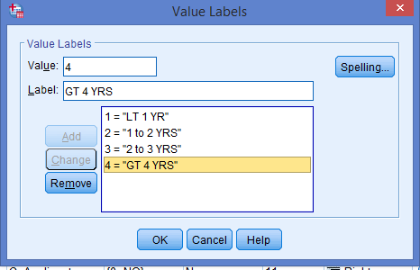
Data Preparation
There were no missing values in the dataset.
The levels of the variable PRESENT_RESIDENT had erroneous levels coded in the variable information. Actuals were 1,2,3,4 but levels were coded as 0,1,2,3 in variable information. This was recoded.

Slide 5
Modelling
First we would like to test the findings of bank experts – whether there is any association between Credit and Checking account status, Credit and Credit use.
We will use Chi Square test to do this analysis.

Slide 6
Credit vs Checking Account Status
Chi-Square Tests
Value df Asymptotic Significance (2-sided)
Pearson Chi-Square 123.721ª 3 .000
Likelihood Ratio 131.336 3 .000
Linear-by-Linear Association 122.971 1 .000
N of Valid Cases 1000
a. 0 cells (0.0%) have expected count less than 5. The minimum expected count is 18.90.

Slide 7
Credit vs Checking Use
Chi-Square Tests
Value df Asymptotic Significance (2-sided)
Pearson Chi-Square 30.757ª 6 .000
Likelihood Ratio 31.662 6 .000
Linear-by-Linear Association .763 1 .382
N of Valid Cases 1000
a. 0 cells (0.0%) have expected count less than 5. The minimum expected count is 15.00.

Slide 8
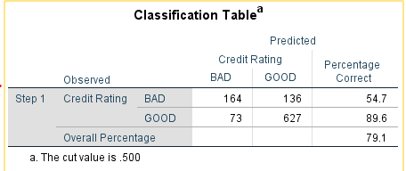
Modelling – Logistic Regression

Slide 9
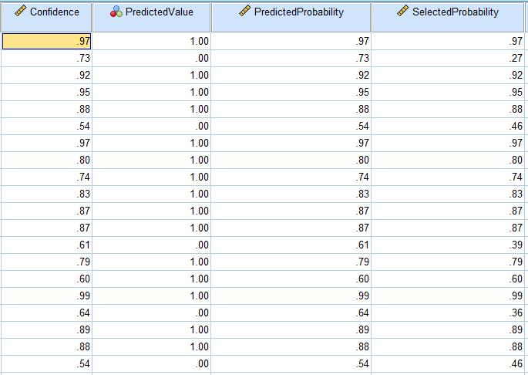
Modelling – Logistic Regression

Slide 10
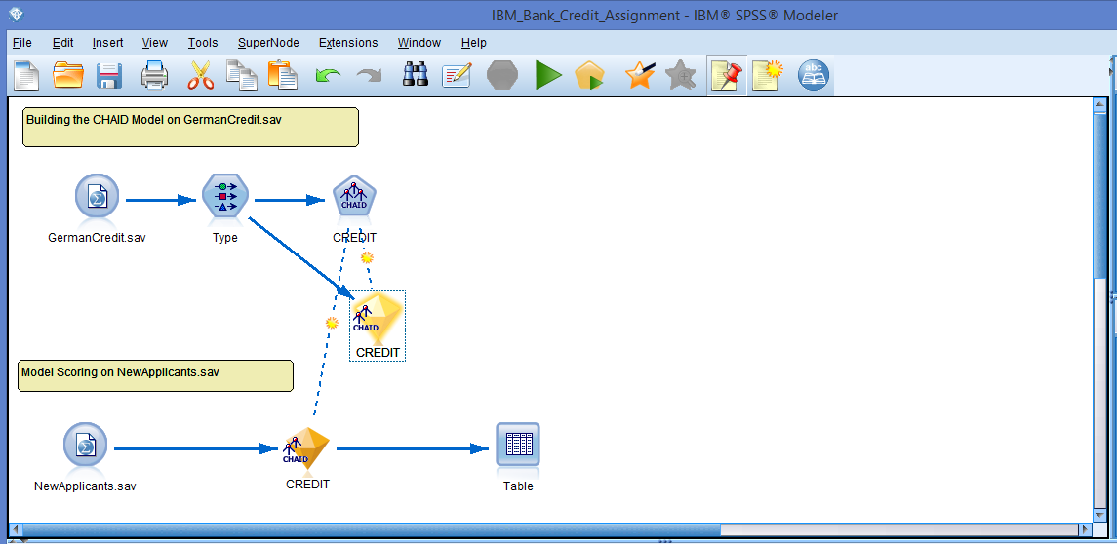
Modelling - CHAID
Used IBM SPSS Modeler to build a decision tree and predict the Credit for NewApplicants.sav (Test) dataset.

Slide 11
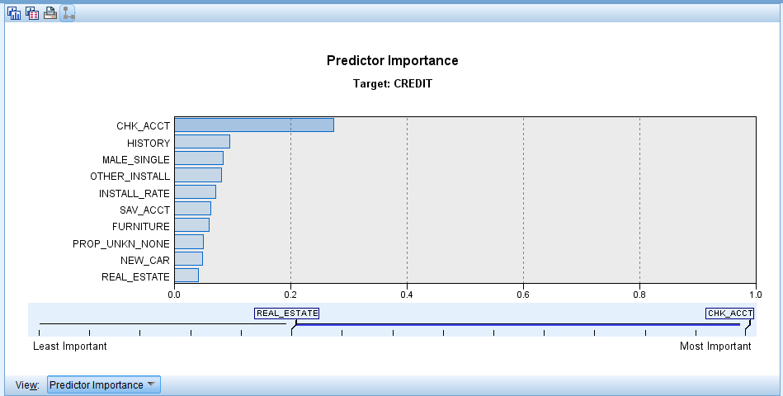
CHAID – Predictor Importance - Train

Slide 12
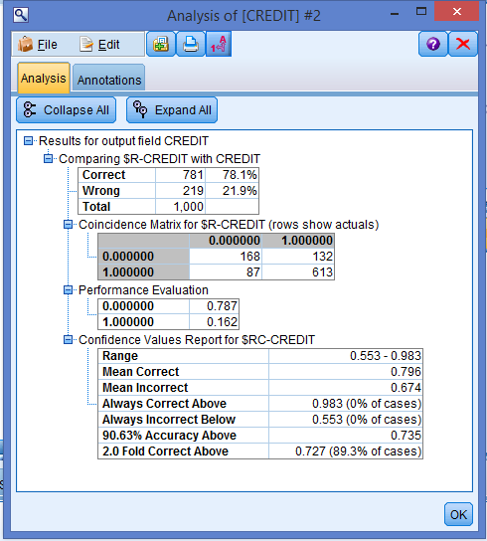
CHAID - Analysis

Slide 13
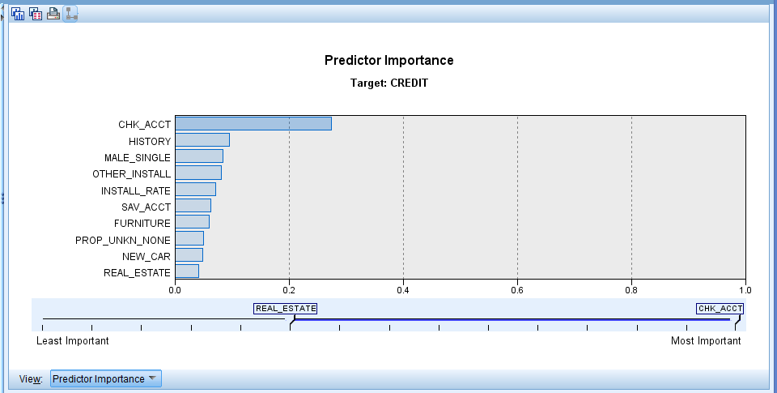
CHAID – Predictor Importance - Test

Slide 14
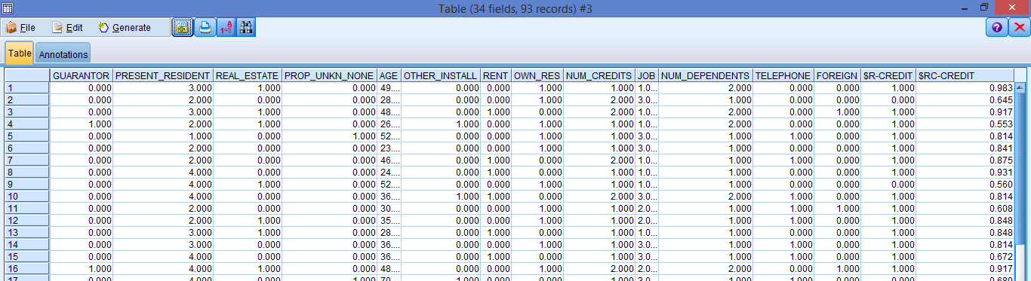
CHAID – Predicted Values

Slide 15
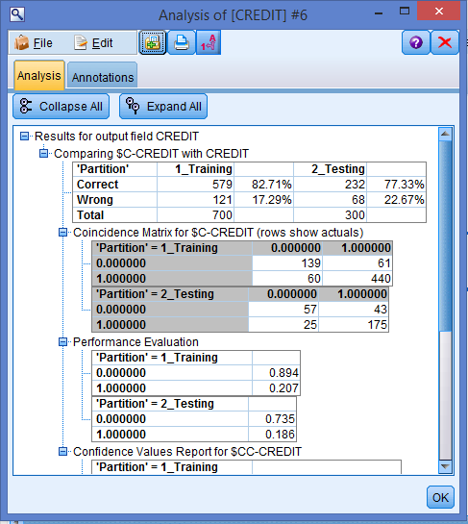
C5.0 Test and Train Analysis

Slide 16
Business Decisions
Checking account turned out to be the predictor of maximum importance.
CHAID provided a decision tree with rule sets which can be followed for approving loans.
C5.0 was better in predicting the defaulters compared to CHAID.

Slide 17
THANK YOU

