Slide 1
Visualization of Sensor Network Coverage with Sensor Location Uncertainty
Tim Sodergren and Jessica Lohse
May 1, 2017
CS 6170 – Computational Topology

Slide 2
outline
Motivation – Wireless Sensor Networks
Location Uncertainty
Problem Statement and Objective
Technical details – Computing Simplicial Complexes
Visualization overview and demonstration
Conclusions

Slide 3
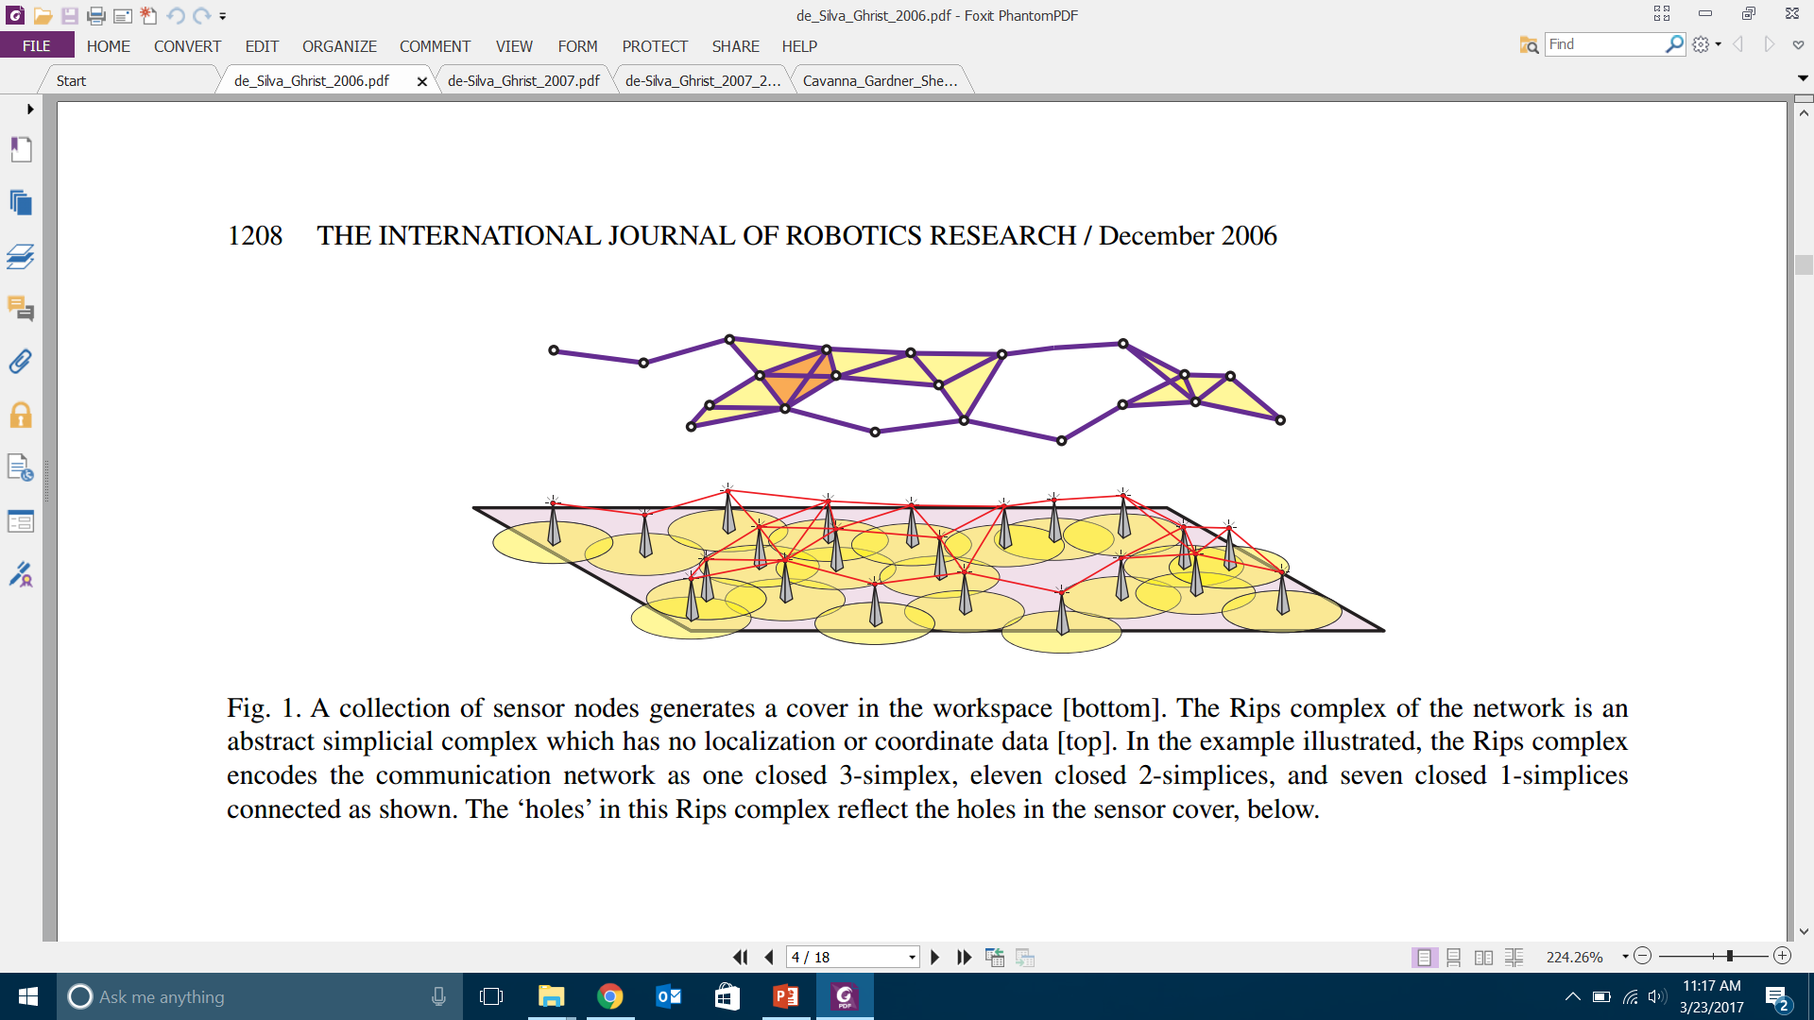
Motivation - background
Wireless Sensor Networks – spatially distributed, autonomous sensors to monitor physical or environmental conditions.
Applications: Robotics, cellular phone networks, robotics, security and surveillance.

Slide 4
Uncertain Data
Often desirable to have low-cost hardware which leads to network nodes with limited localization capability, leading to uncertain node location data. Each nodes location may only be described by a probability distribution.

Slide 5
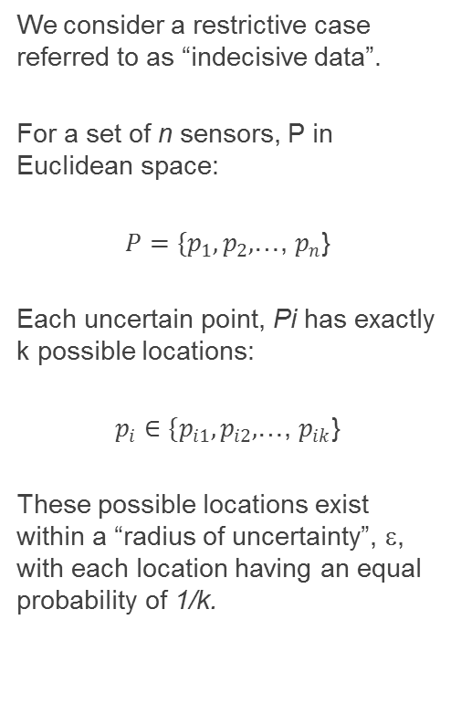
Problem Setup
We consider a restrictive case referred to as “indecisive data”.
For a set of n sensors, P in Euclidean space:
$P=\{p_{1},p_{2},$…, $p_{n}$}
Each uncertain point, Pi has exactly k possible locations:
$p_{i}∈\{p_{i1},p_{i2},$…, $p_{ik}$}
These possible locations exist within a “radius of uncertainty”, ε, with each location having an equal probability of 1/k.

Slide 6
Objective:
To compute and visualize the simplicial complexes of uncertain sensor network coverage, determining the probability of each simplex.

Slide 7
Related Work
V. De Silva and R. Ghrist. Homological sensor networks. Notices Amer. Math. Soc, pages 10-17, 2007.
C. Schulz, A. Nocaj, J. Goertler, O. Deussen, U. Brandes, and D. Weiskopf. Probabilistic graph layout for uncertain network visualization. IEEE Transactions on Visualization and Computer Graphics, 23(1):531-540, Jan 2017.
Jorgensen, Allan, Maarten Löffler, and Jeff M. Phillips. "Geometric computations on indecisive and uncertain points." arXiv preprint arXiv:1205.0273 (2012).
Sodergren, Tim,Visualization class project, Fall 2016

Slide 8
Calculating probability of each simplex
We define an “instance” as one possible realization of sensor locations.
There are k^{n} possible instances.
Each sensor has a sensing radius, rc.
An edge has a probability of existing between 2 sensors if their coverage radii overlap.
In the Cech complex a face or triangle exists between three points if their coverage radii share a common intersection.
The Vietoris-Rips complex requires only that all three vertices are pairwise connected.

Slide 9
Computing probability – Minimum Enclosing Disk

Slide 10
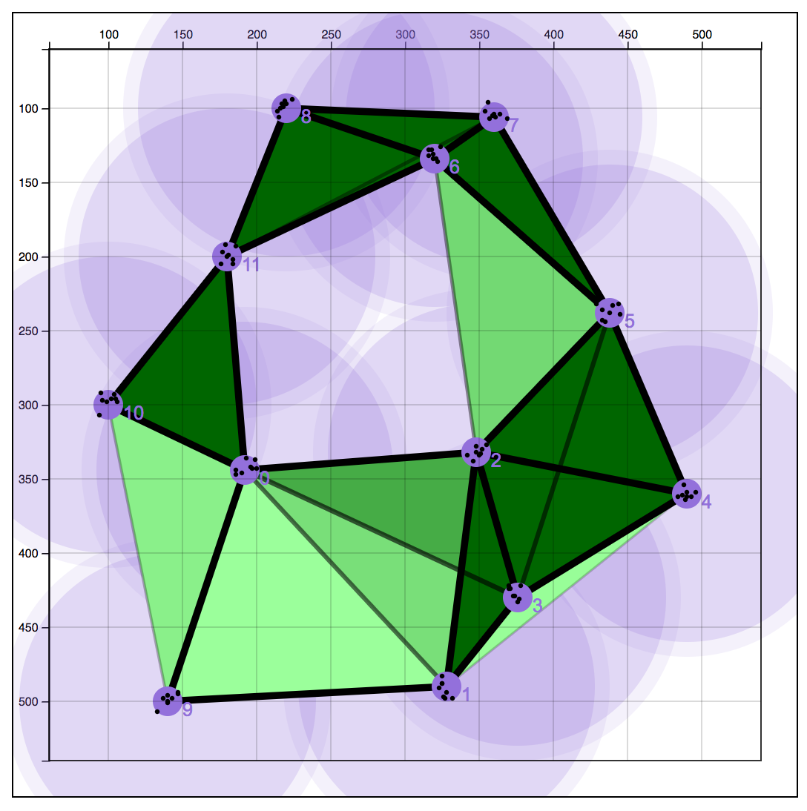
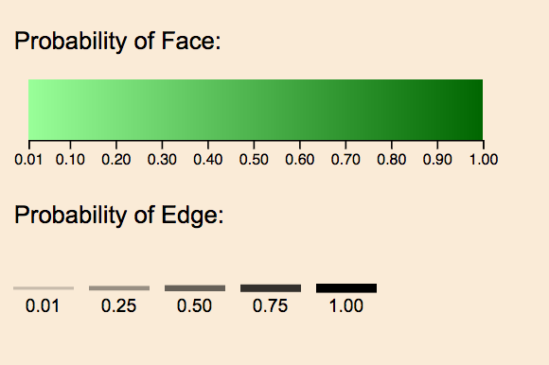
Visualization Details
Notes:
Layering of opacities
Double encoding of edges
Color scale of faces

Slide 11
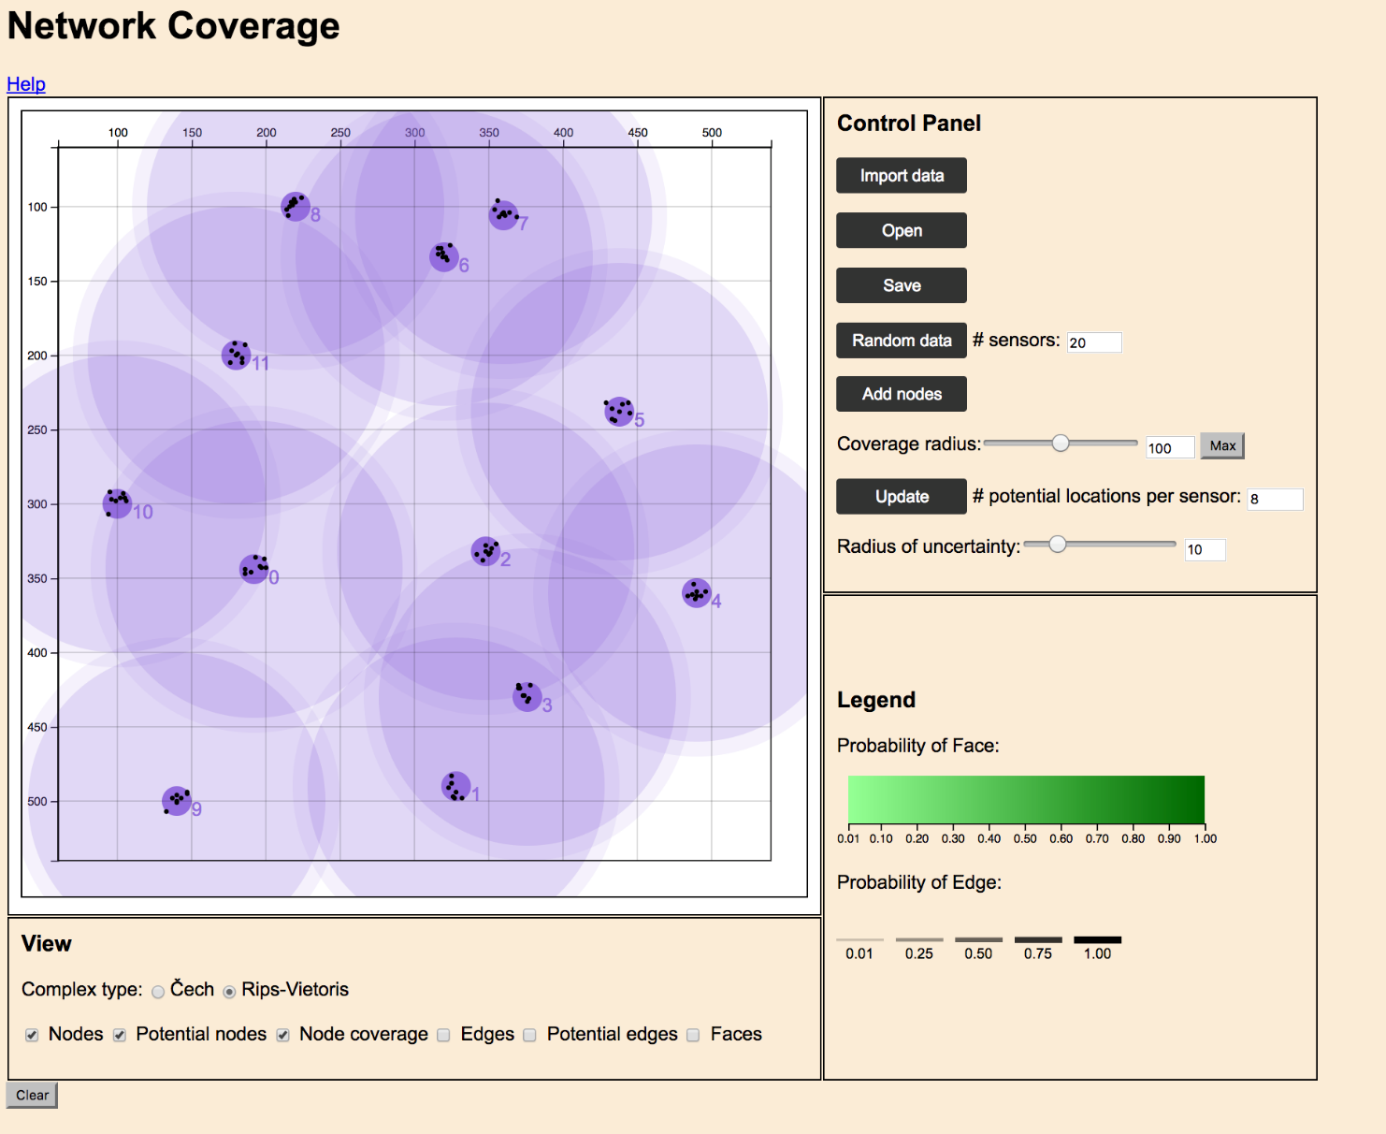
Results

Slide 12
Conclusions
Wireless Sensor Networks are an increasingly significant component of the modern computing environment.
Determing coverage when sensor locations are uncertain poses additional challenges.
We can address this via TDA by computing probabilistic simplicial complexes for input into coverage models (i.e. persistent homology).
We have developed means of also visualizing these types of networks.

Slide 13
Future work
Taking output to external TDA package for determination of coverage via persistent homology.
Generalizing solution to allow for probability distributions of sensor locations.
Improved rendering for scalability.

Slide 14
Contributions
Implemented a simple algorithim for determining the “Probabilistic Simplicial Complex” of an uncertain WSN.
Developed a in interactive visualization tool that allows for the setup and manipulation of an uncertain WSN and computation and output of probabilistic simplicial complexes.
Individual contributions:
TS – algorithm development – computation of simplicial complexes
JL – visualization design, rendering of probabilistic complexes

Slide 15
Questions

