Slide 1
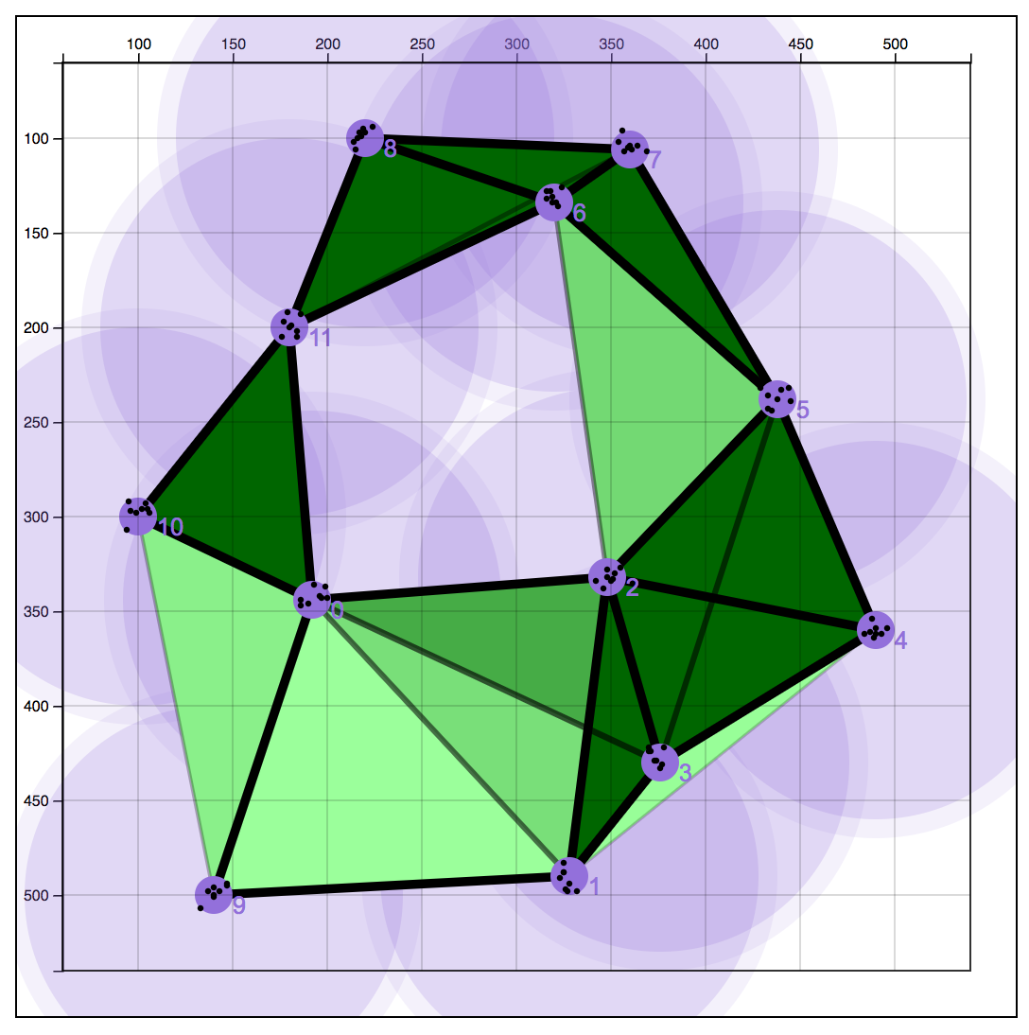
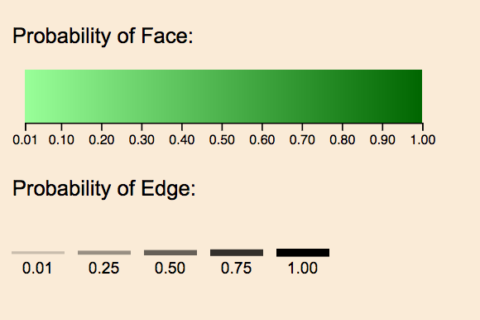
Visualization Details
Notes:
Layering of opacities
Double encoding of edges
Color scale of faces

Slide 2
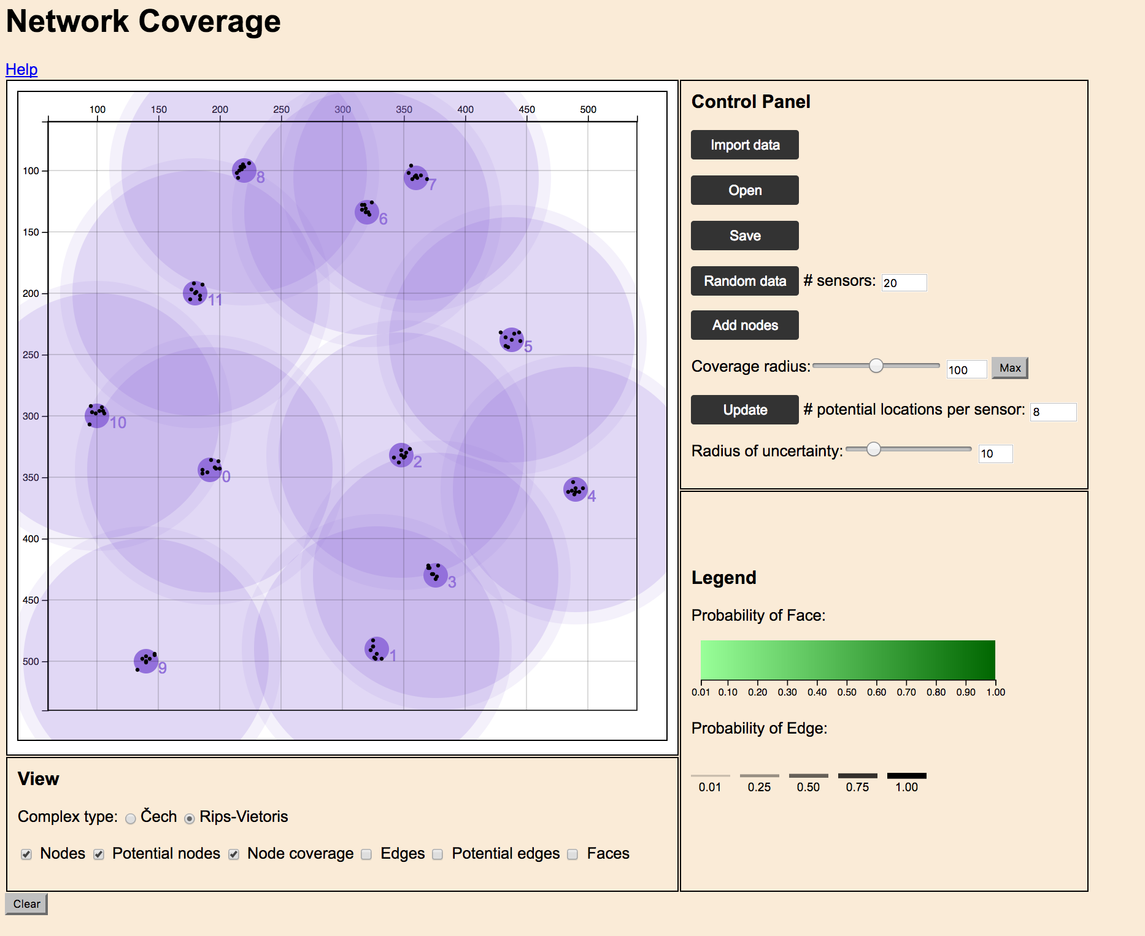
Results

Slide 3
Contributions
Probabilities of Complexes
Visualization Tool
Give Others Better Understanding

Slide 4
Conclusions
Simple Rips, Cech complex
Ability to See Probabilities
Easily See Changes of Complexes

Slide 5
Future work
Rendering
Move to Better Platform
Increase Efficiency

Slide 6
Questions

