Slide 1




Subcortical brain structure segmentation using FCNNs
Stavros Tsogkas¹, Mahsa Shakeri^{2,3}, Enzo Ferrante¹, Sarah Lippe^{3,4}, Samuel Kadoury^{2,3}, Nikos Paragios¹, Iasonas Kokkinos¹
1
3
2
4
Notes:
Hello everybody, my name is Stavros Tsogkas and I will present work done with my collaborators, on segmenting subcortical brain structures using fully convolutional neural networks
Slides 1-6 : 3 minutes
Slides 7-10: 3-4 minutes
Slides 11-16: 4 minutes
Slides 17-18: 2 minutes

Slide 2
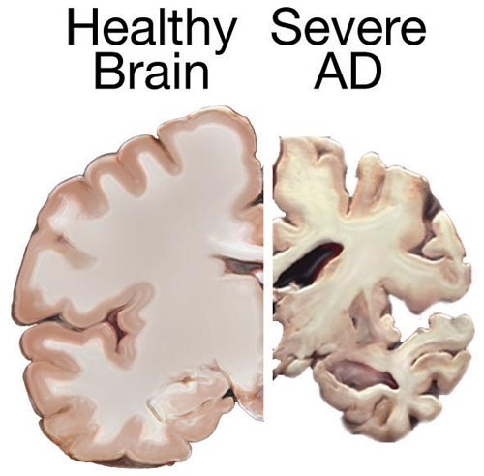
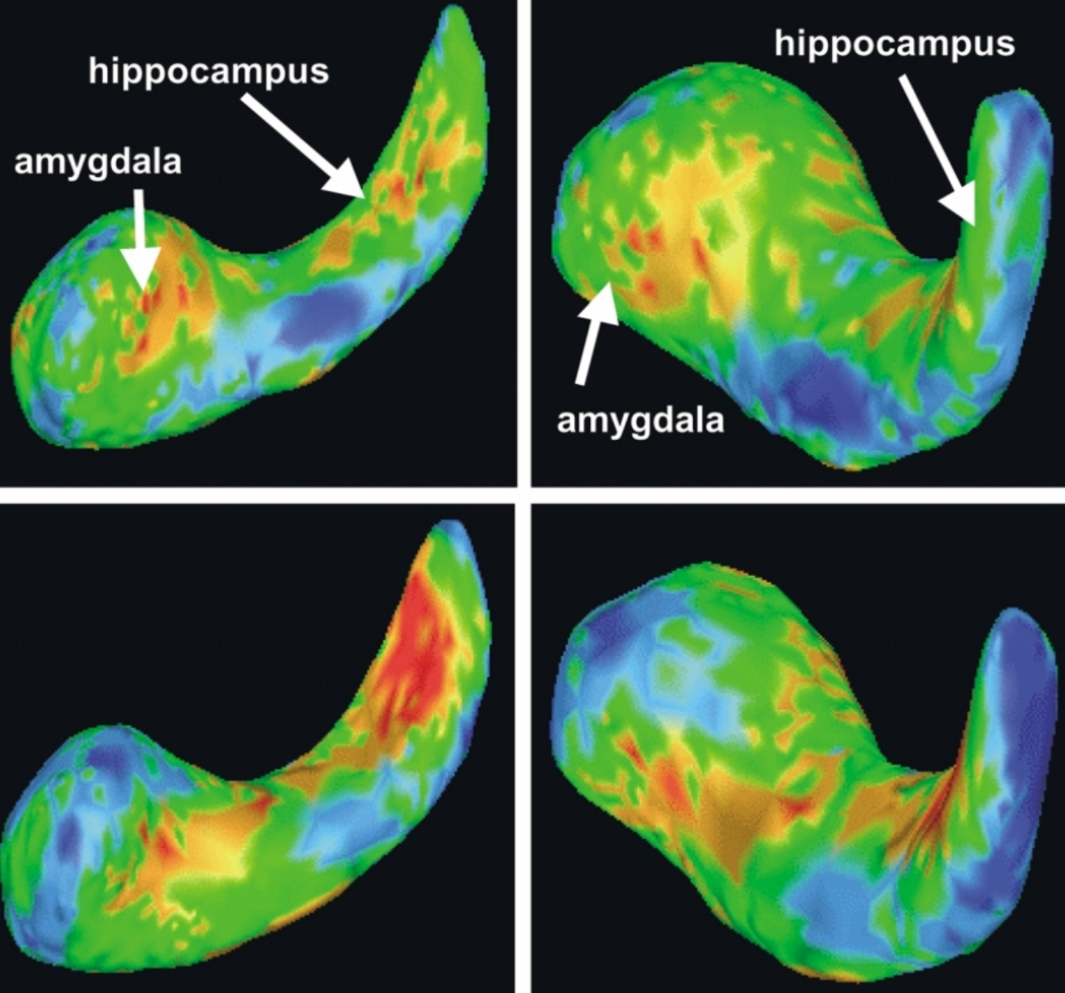
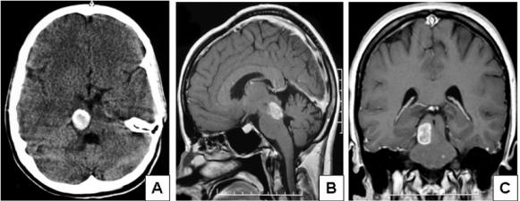
Diseases and their relation to subcortical structures
Alzheimer's:
structure degeneration
Schizophrenia: volume abnormalities
[Shenton M.E. et al., Psychiatry Res. 2002]
Tumors: avoid radiation on sensitive regions
[Hoehn D. et al., Journal of Medical Cases, 2012]
Notes:
Studies have shown the involvement of the frontostriatal brain structures in various neurodegenerative and neuropsychiatric disorders.
For example, Alzheimer's disease leads to severe degeneration of the caudate, putamen and thalamus areas, while schizophrenia is associated with volume abnormalities in amygdala and hippocampus, with respect to healthy subjects.
There are also cases where we want to localize these structures with high precision: for instance, during brain cancer treatment using radiotherapy, we want to avoid exposure of these sensitive areas to radiation.

Slide 3
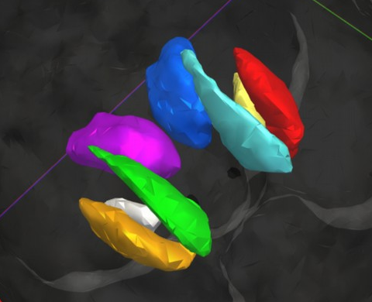
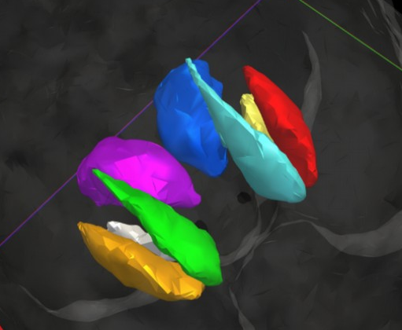
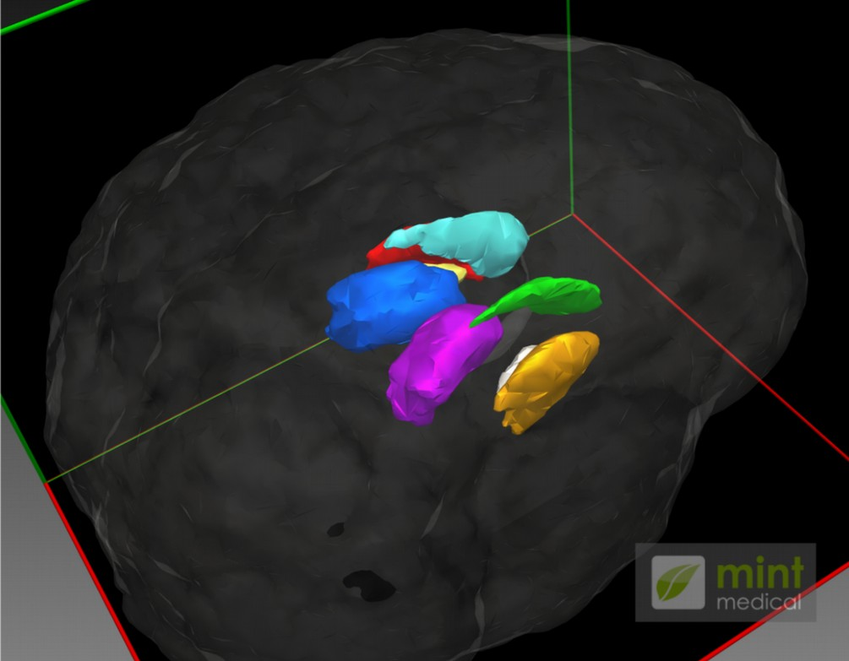
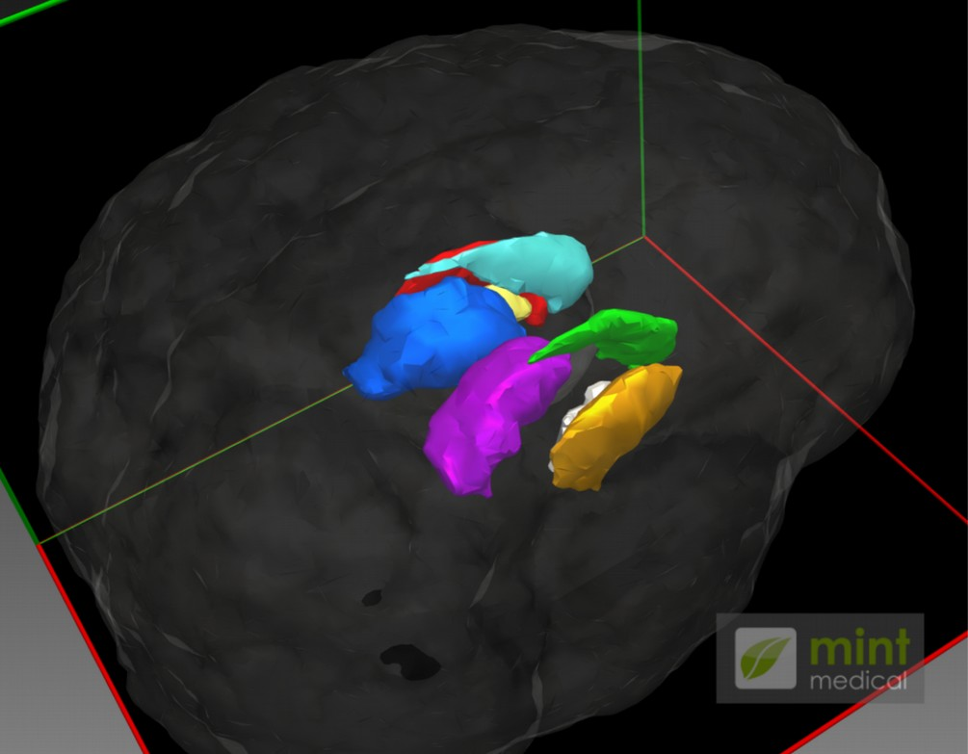
3D Segmentation
Our results
Groundtruth
Notes:
In this work we are interested in segmenting these parts of the brain, to obtain useful volumetric and morphological indicators.
Here, I am showing example results of our method alongside segmentations obtained by expert annotators.
Automating this segmentation procedure has several advantages:

Slide 4
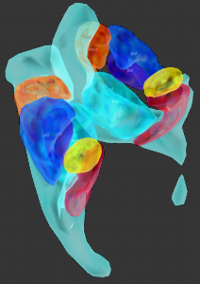


Why automatic segmentation?
Putamen
Caudate
No need for manual annotation
(time consuming, need experts,
limited reproducibility)
Amygdala
Ventricle
Hippocampus
Visualization and inspection
Non-invasive diagnosis and treatment
Notes:
First, it allows us to easily visualize and inspect brain areas that may be associated with a pathological condition.
Second, It relieves us from the need of employing experts to manually annotate these areas, which is a time consuming and costly task
And, third, it aids towards non-invasive diagnosis and treatment.

Slide 5
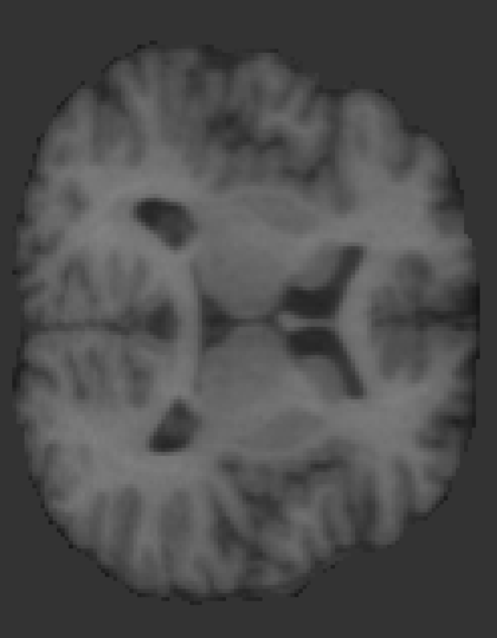



Segmentation using MRI
Intensity is not enough
Spatial arrangement patterns
white matter?
thalamus?
Notes:
Segmentation methods often use Magnetic Resonance Images. However:
Image intensity is not always enough to differentiate between different structures and __CLICK__
Usually additional spatial information is necessary, since neuroanatomical structures occur in characteristic patterns relative to one another.

Slide 6
Goal
Classify every pixel as one of L possible structures.
Exploit context.
Enforce volumetric homogeneity.
Fully convolutional neural networks (FCNNs)
+ Graphical models (MRFs)
Notes:
Our goal is to design a system that can:
Classify every pixel as one of L possible subcortical structures, exploiting context to distinguish between areas with similar appearance.
And also, enforce consistency of the assigned labels across the full MRI volume.
__CLICK__
In this work we propose a system that combines FCNNs and MRFs and show that it meets these requirements.

Slide 7

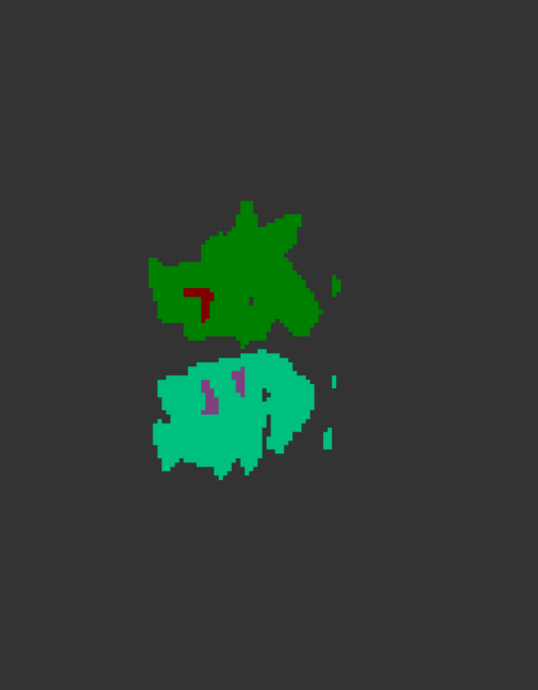

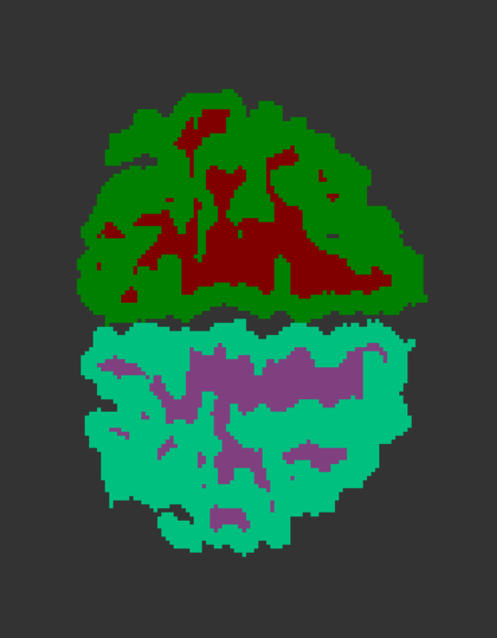
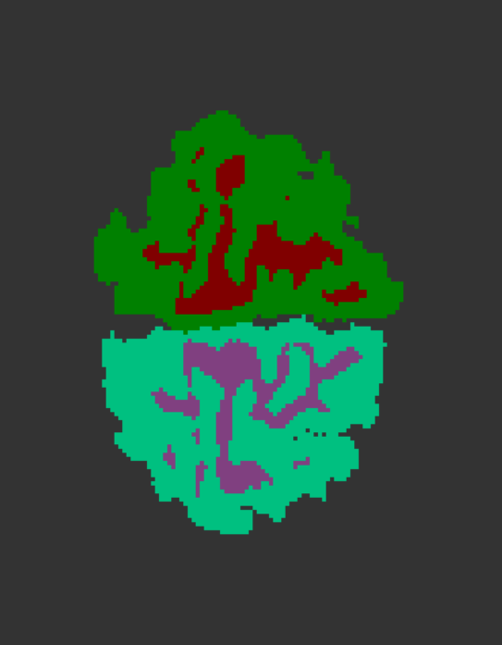
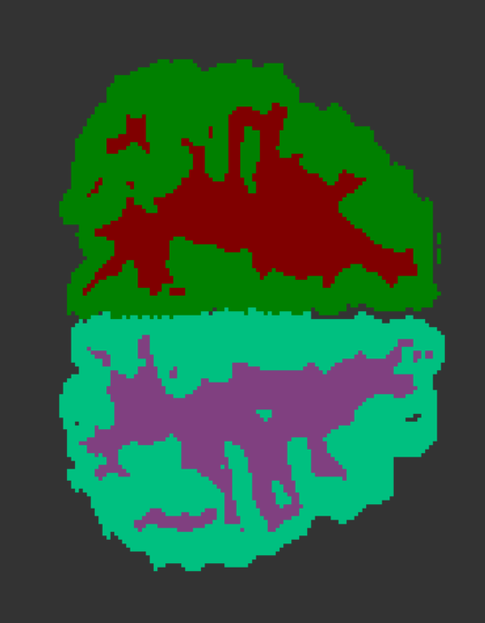
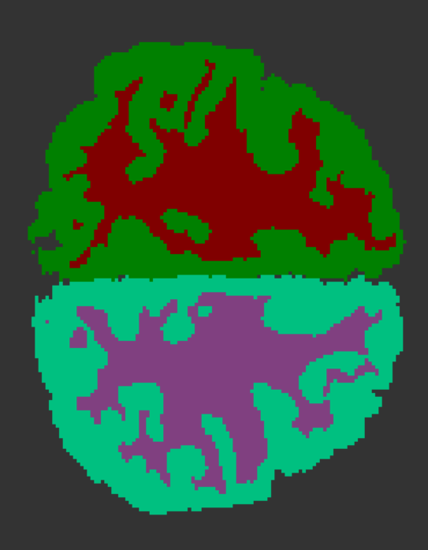
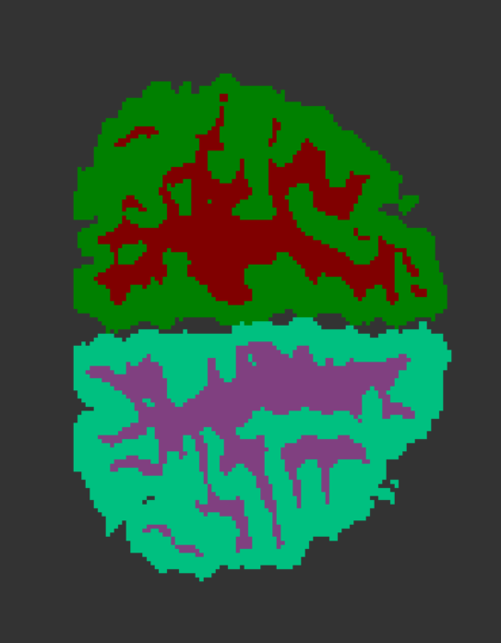
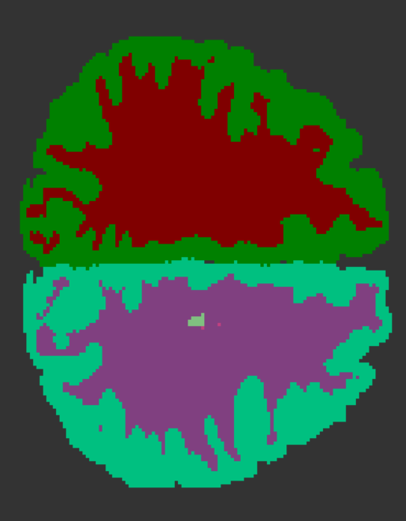
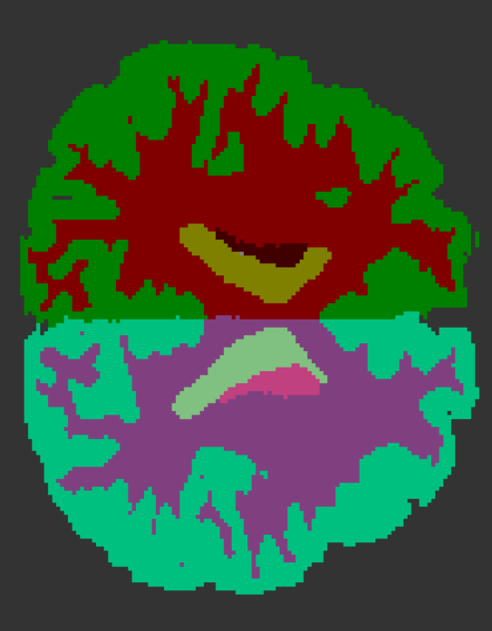
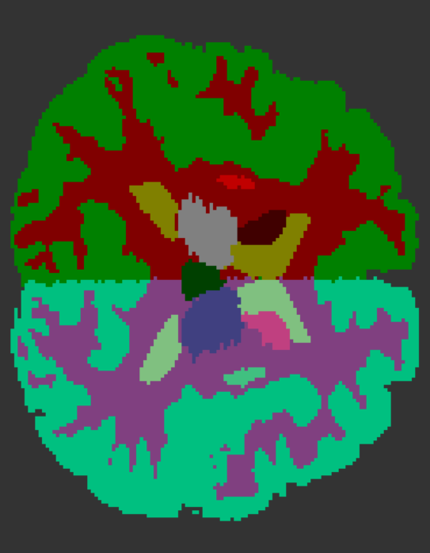
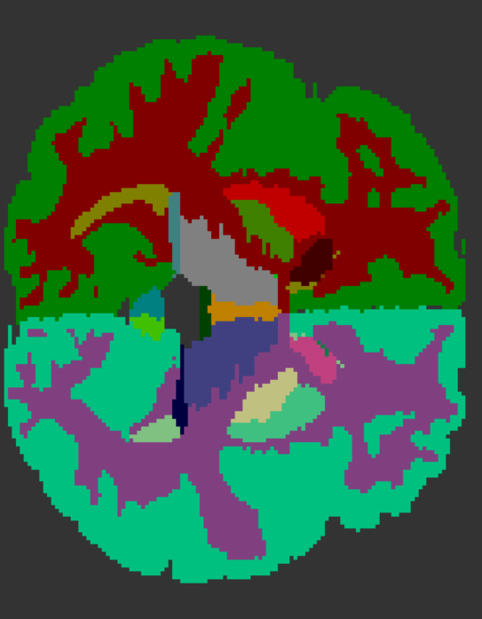
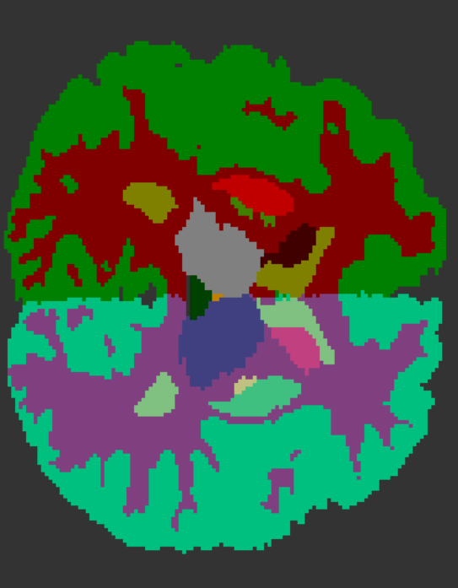
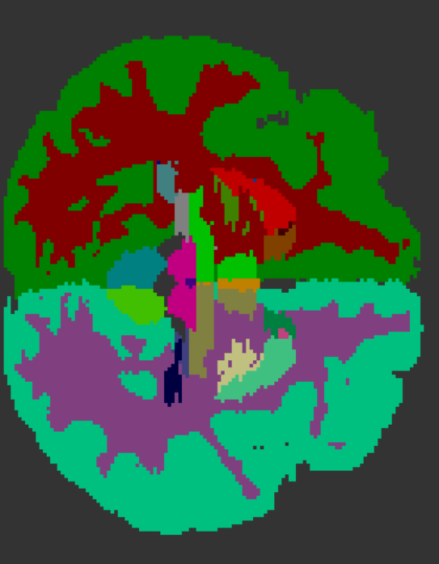
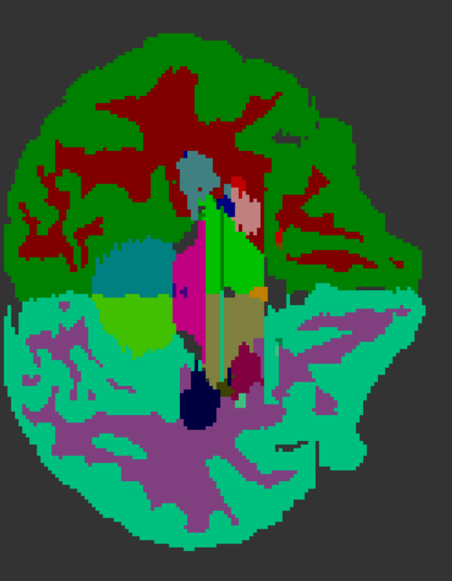
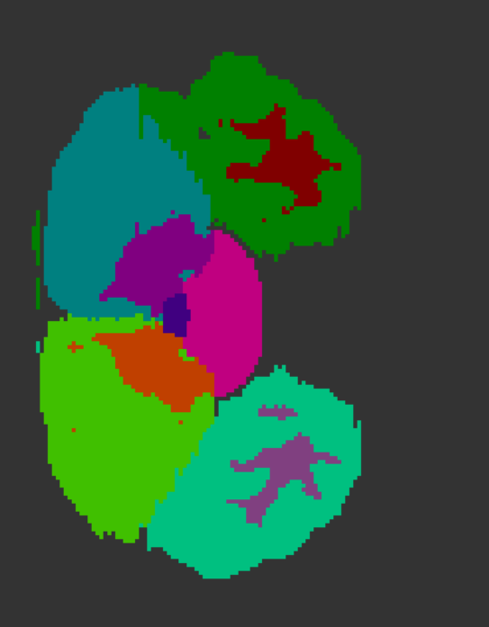
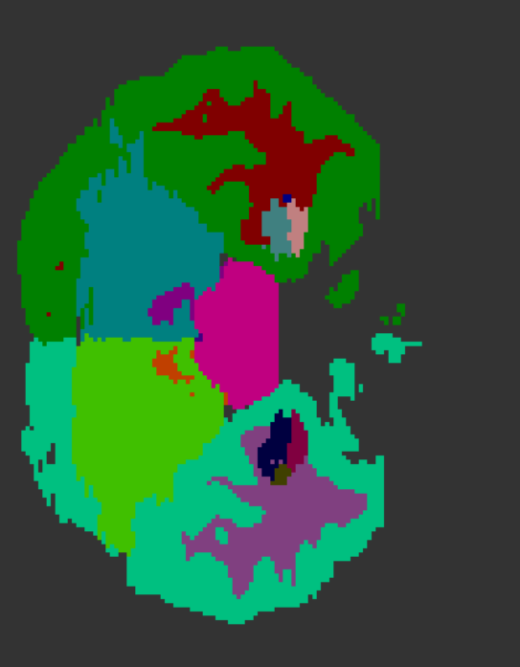
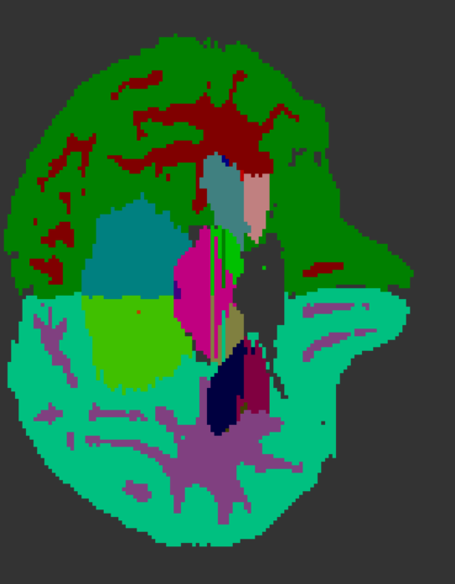
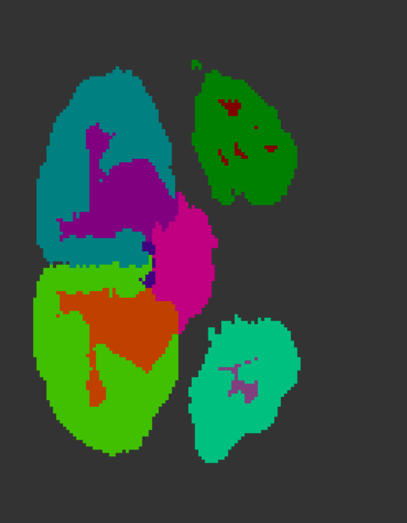
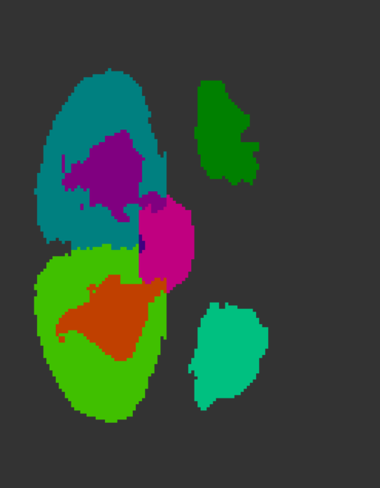

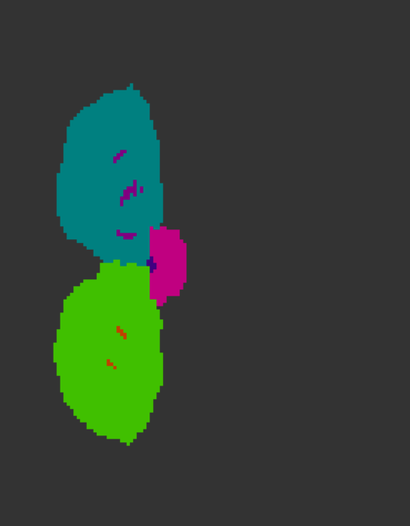
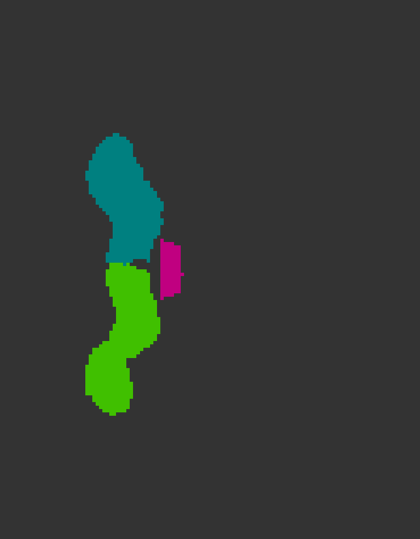
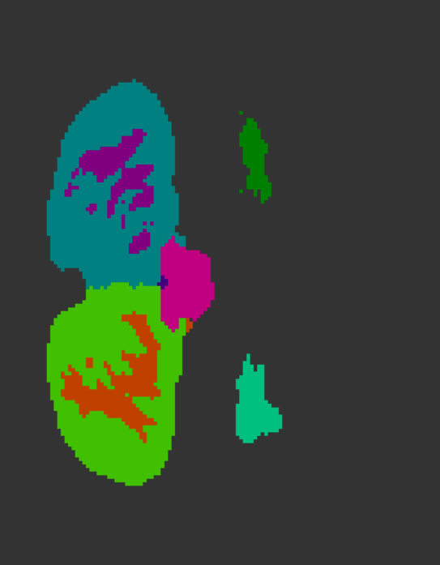
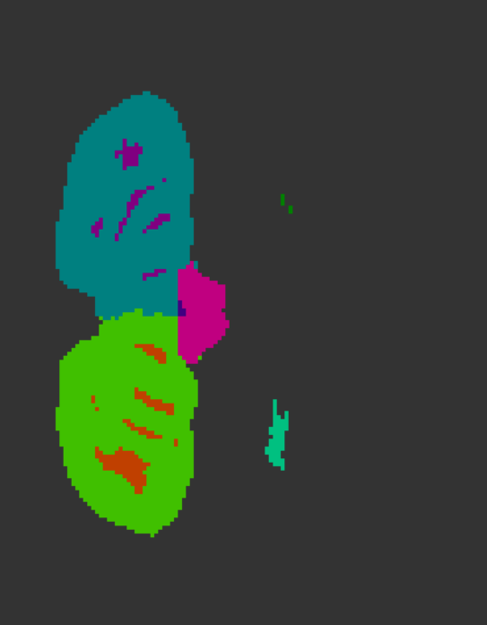

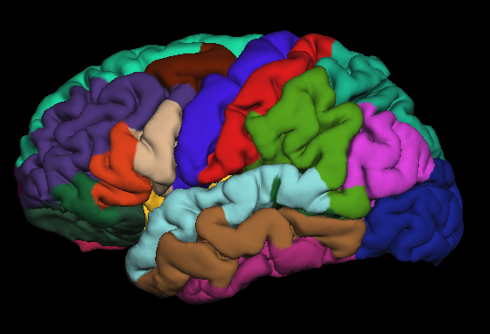

Outline
Label probabilities
FCNN
MRF
Groundtruth
Annotations
Notes:
Our pipeline is the following:
We use MRI volumes and their corresponding ground truth annotations to discriminately train a CNN classifier for subcortical structures.
At test time, the CNN processes each slice individually and produces arrays of class probability scores. These scores are subsequently refined with a markov random field, to enforce spatial label consistency and improve volume segmentations.

Slide 8


Semantic segmentation of MRI slices
P(thalamus)
Segmentation
2D slice
Softmax
:
P(putamen)
:
P(caudate)
:
FCNN^{[1]}
thalamus
white matter
P(white matter)
[1] Long et al., CVPR 2015
Notes:
Now I will talk about the first component of our pipeline.
FCNNs were first proposed by Long et al as a method for semantic segmentation of objects in color images. Here we employ them to segment subcortical structures in MRI data.
The input image is processed by a multi-layer network, whose last layer is a softmax function.
The softmax layer produces a dense probability map for each one of the possible classes and the probability maps are combined to generate a pixel-wise labelling of the input image.

Slide 9
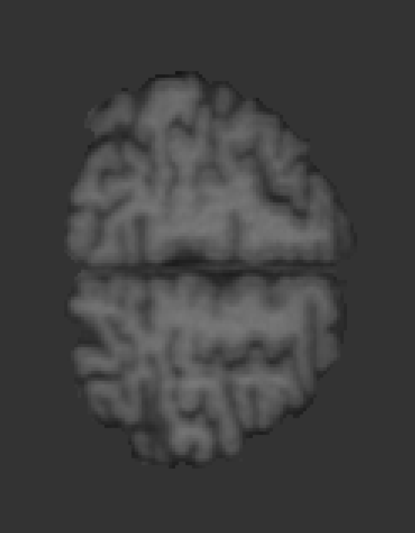
Our CNN architecture
conv
conv
conv
conv
conv
conv
conv
64
5x5
7x7
128
256
512
512
1024
3x3
3x3
3x3
3x3
1x1
L
16 layers including max-pooling and dropout.
Compact architecture (~4GB GPU RAM).
Notes:
Our CNN architecture draws inspiration from previous works with some modifications.
First, We deliberately opt for a more “shallow” architecture to keep a low training and testing computational cost, and avoid overfitting.
Second, we train the network from a random initialization, rather than finetuning a model that was pre-trained on RGB data.
The motivation for this choice was the difference architecture wrt to pre-trained models and the very different image statistics of MRI data and natural color images (for example MRI images have a single channel instead of 3).
Our network consists of 16 layers in total and is compact enough to fit in a 4GB RAM GPU.

Slide 10
MRF for volume homogeneity
Slice k-1
Slice k
Slice k+1
i
j
f(P_{i}^{CNN}(l_{i}))
Notes:
Now I will talk about the second component of our pipeline.
The Markov Random Field we use is represented as a graph whose nodes correspond to voxels. The voxels take labels l_i that are associated with the different structures in the brain.
Unary terms V_i assign low energy to high probability labels, while pairwise terms V_ij encourage neighboring variables to assume the same label.
Note that we consider a 3-D grid over consecutive slices, which helps us enforce volumetric homogeneity.
The energy of the model is minimized using a-expansion and the parameter \lambda is selected through cross-validation.

Slide 11
Experiments
Two datasets:
  Internet Brain Segmentation Repository (IBSR).
  Roland Epilepsy (RE).
Train CNN on 2D slices from axial view.
Data augmentation: ~100K training images.
Notes:
We performed experiments on two different datasets: the publicly available IBSR, and RE, a clinical dataset of patients suffering from epilepsy.
Our CNN was trained using 2D slices from the axial view.
We split the data into training, validation and test sets and performed data augmentation on the training set to obtain approximately 100K training images in each case.

Slide 12
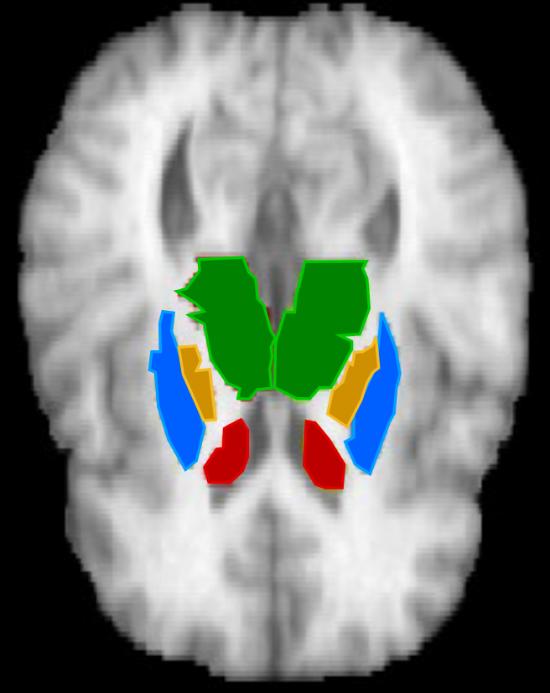
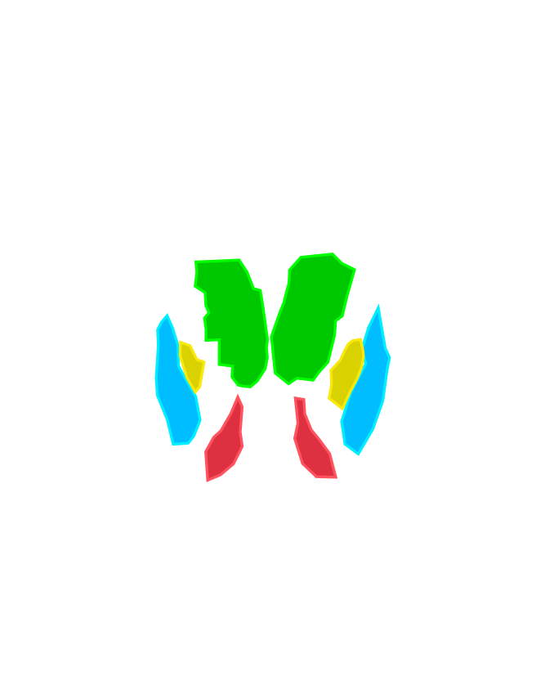
Results (Dice coefficient)
Dice: 1 = perfect overlap with ground truth.
Average Dice (IBSR)
Thalamus: 0.87
Putamen: 0.83
Caudate: 0.78
Pallidum: 0.75
Notes:
We evaluate the performance of our method, using the Dice coefficient, which quantifies how well the predicted masks overlap with ground truth annotations.
Here I am showing an example of a qualitative result as well as the average DIce results for the four structures we considered in our experiments on the ISBI dataset.

Slide 13
Comparison with other methods
Dice coefficient
 | Freesurfer¹ | FSL² | Ours
IBSR - Thalamus | 0.86 | 0.85 | 0.87
IBSR - Caudate | 0.82 | 0.68 | 0.78
IBSR - Putamen | 0.81 | 0.81 | 0.83
IBSR - Pallidum | 0.71 | 0.73 | 0.75
RE - Putamen | 0.74 | 0.88 | 0.89
Running time (1 vol.) | ~hours | ~minutes | ~1 minute
[1] Fischl et al., Neuron 2002.
[2] Patenaude et al., NeuroImage 2011.
Notes:
We also compared our results with two standard automated brain segmentation techniques.
For the RE dataset, only putamen annotations are available, so we report performance only on that class.
Our method outperforms previous methods almost in all cases, except for Caudate. We believe that this result is attributed to the CNN's inherent translational invariance which makes it difficult to capture the very thin tail areas of the caudate structure.
Note, that our approach is also much faster than competing techniques. Our unoptimized implementation segments a full MRI volume in one minute, whereas FSL requires several minutes and Freesurfer hours.

Slide 14
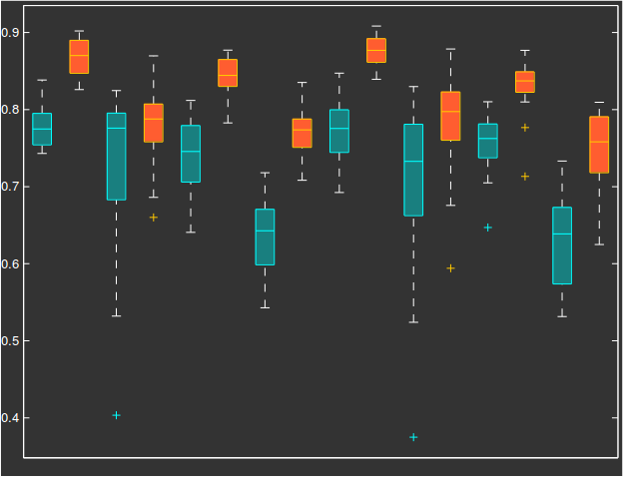
The type of unaries matters
Dice coefficient (IBSR dataset)
Thalamus left
Caudate left
Putamen left
Pallidum left
Thalamus right
Caudate right
Putamen right
Pallidum right
Random forest unaries
CNN unaries
Notes:
One could ask whether CNNs are necessary or if we can use any type of classifier.
In our experiments we show that good unary terms do matter in terms of the final result. We evaluated compared performance of our pipeline using likelihoods obtained from a random forest classifier and verified that CNN unaries result in much better performance for 8 structures in the IBSR dataset. (For this experiment we considered different labels for structures of the same type in left and right brain hemispheres).
It is clear that performance heavily depends on the choice of unary potentials, which motivates the use of better classifiers.

Slide 15
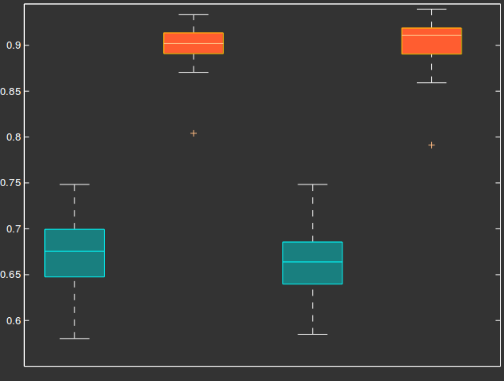
The type of unaries matters
Dice coefficient (RE dataset)
Random forest unaries
CNN unaries
Notes:
The same trend is observed for the RE dataset.
In our experiments we also considered two more metrics: hausdorff distance and contour mean distance, obtaining similar results

Slide 16
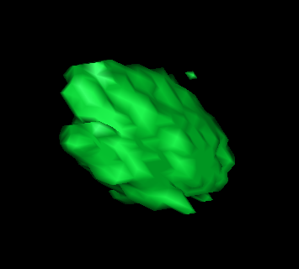
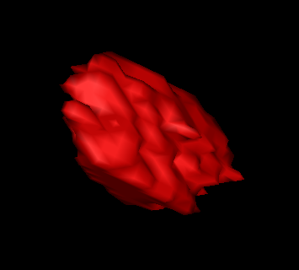
MRF removes spurious responses
CNN
CNN+MRF
Notes:
In this figure we show the beneficial effect of the MRF refinement on the CNN output for the pallidum structure. Note how a disconnected, erroneous response gets eliminated after applying the MRF on top of the CNN result.

Slide 17
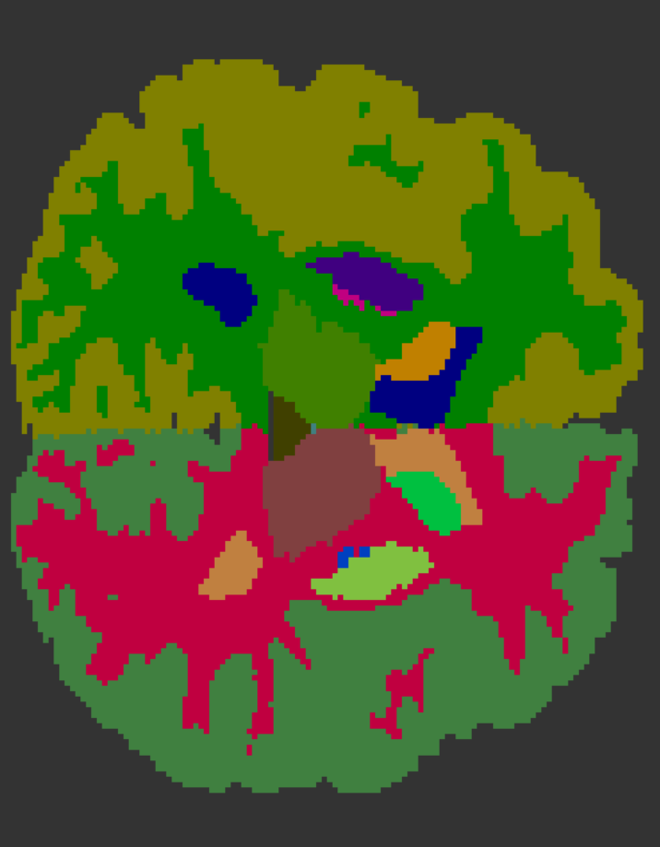
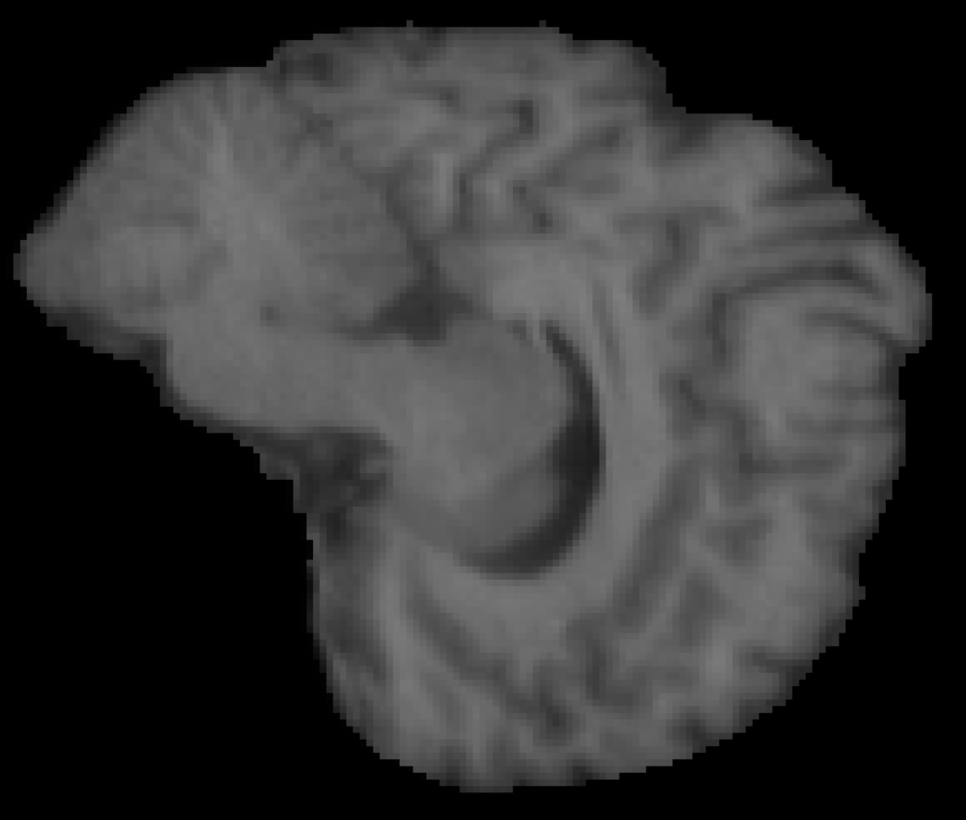
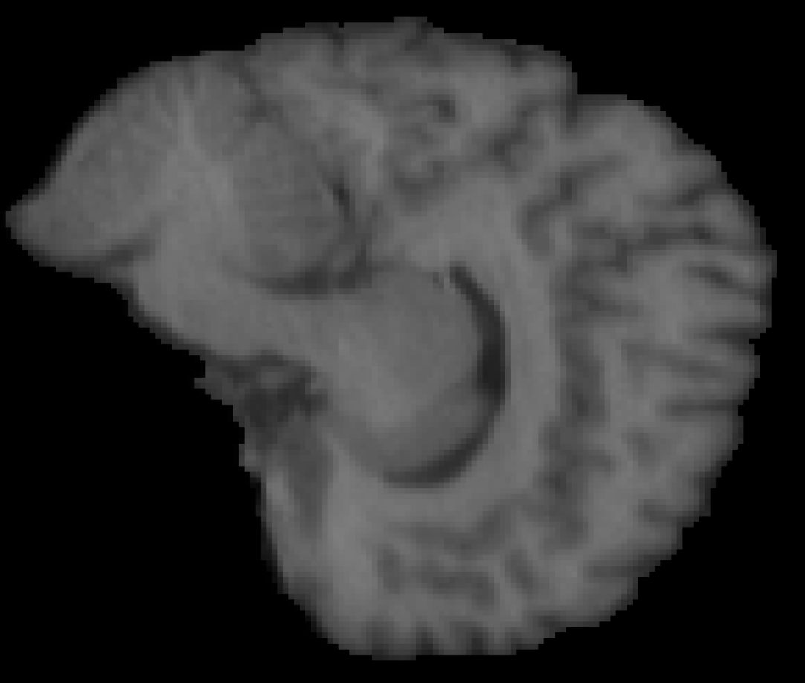
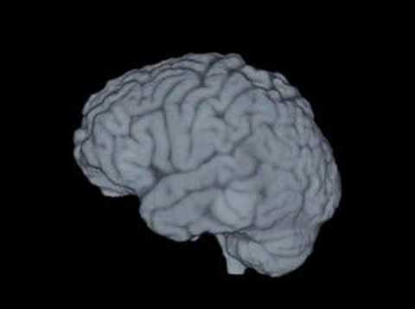
Limitations and future directions
Small structures are challenging
1-2 pixels wide
Left hemisphere
Right hemisphere
Does not work for sagittal view because of symmetry
3D CNNs
Notes:
Now I will discuss some limitations of our approach:
First, small, thin structures prove challenging to segment accurately - this could probably be addressed using a multi-scale variant of our method.
Another limitation of our approach is that it does not work equally well for images from any view. The symmetry of subcortical structures with respect to the sagittal plane, makes it impossible to distinguish between “left” and “right” versions of the same structure, relying only on 2D information. A straightforward way to resolve these ambiguities would be to use 3D CNNs that directly operate on subvolumes, taking into account the 3D arrangement of brain structures.

Slide 18


Summary
FCNNs + MRFs:
  accurate, dense labelling using 2D image data.
  volumetric homogeneity
Efficient segmentation of 3D volumes: (~1 min)
No need for expensive GPUs (~4GB GPU RAM)
Code, CNN probability maps:https://github.com/tsogkas/brainseg
FCNNs: dense labelling using 2D image data.
MRFs: volumetric homogeneity.
FCNNs + MRFs: 3D segmentations of subcortical brain structures, efficiently.
No need for expensive GPUs (~4GB GPU RAM).
Notes:
To conclude:
We showed that a combination of Fully convolutional neural networks and Markov random fields can produce accurate and spatially consistent segmentations of subcortical structures in MRI data.
Our system outperforms standard methods for automated segmentation, while being much faster, even with unoptimized code, segmenting a 3D volume in approximately 1 minute.
Finally our CNN architecture is compact, and our models can be trained on inexpensive GPUs with 4GB of RAM.
You can find code and extracted probability maps on my github and now I would be happy to answer any questions.
Possible questions:
Why not use densecrf instead of MRF
Look at review remarks

Slide 20
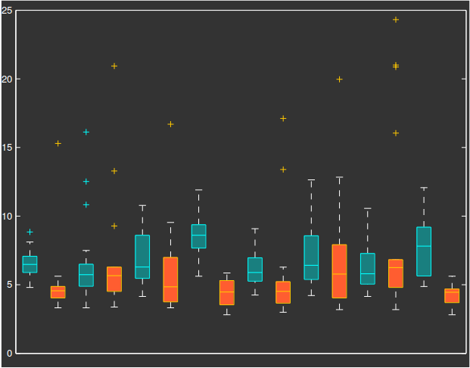
IBSR dataset: Hausdorff distance
Thalamus left
Caudate left
Putamen left
Pallidum left
Thalamus right
Caudate right
Putamen right
Pallidum right
Random forest unaries
CNN unaries

Slide 21
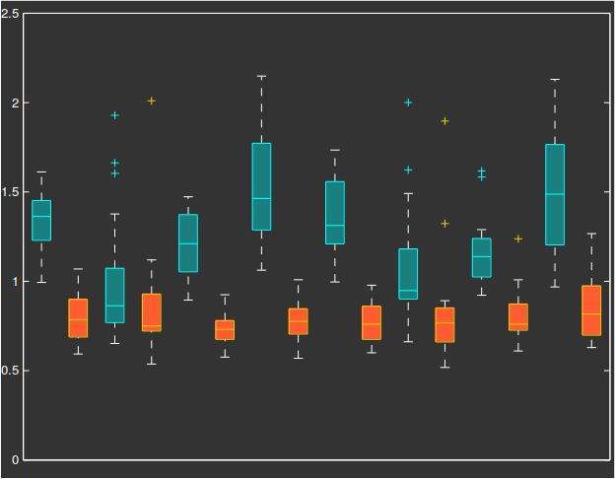
IBSR dataset: contour mean distance
Thalamus left
Caudate left
Putamen left
Pallidum left
Thalamus right
Caudate right
Putamen right
Pallidum right
Random forest unaries
CNN unaries

Slide 22
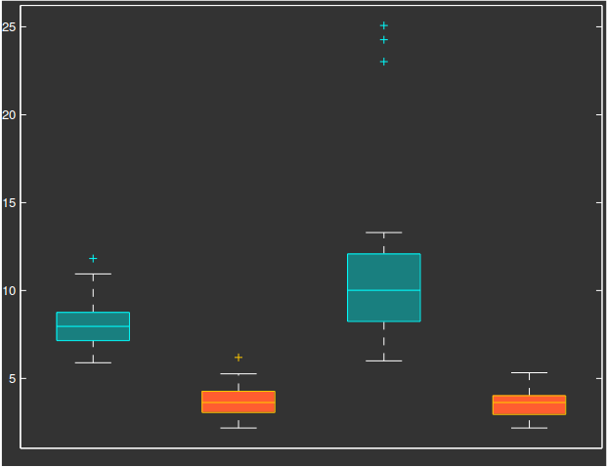
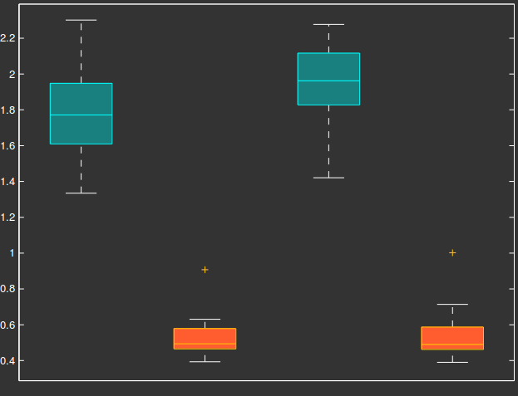
RE dataset: HD and CMD
Hausdorff distance
Contour mean distance
Random forest unaries
CNN unaries

