Slide 1





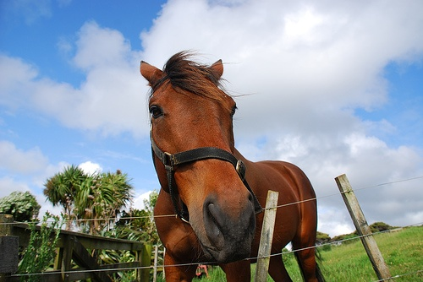
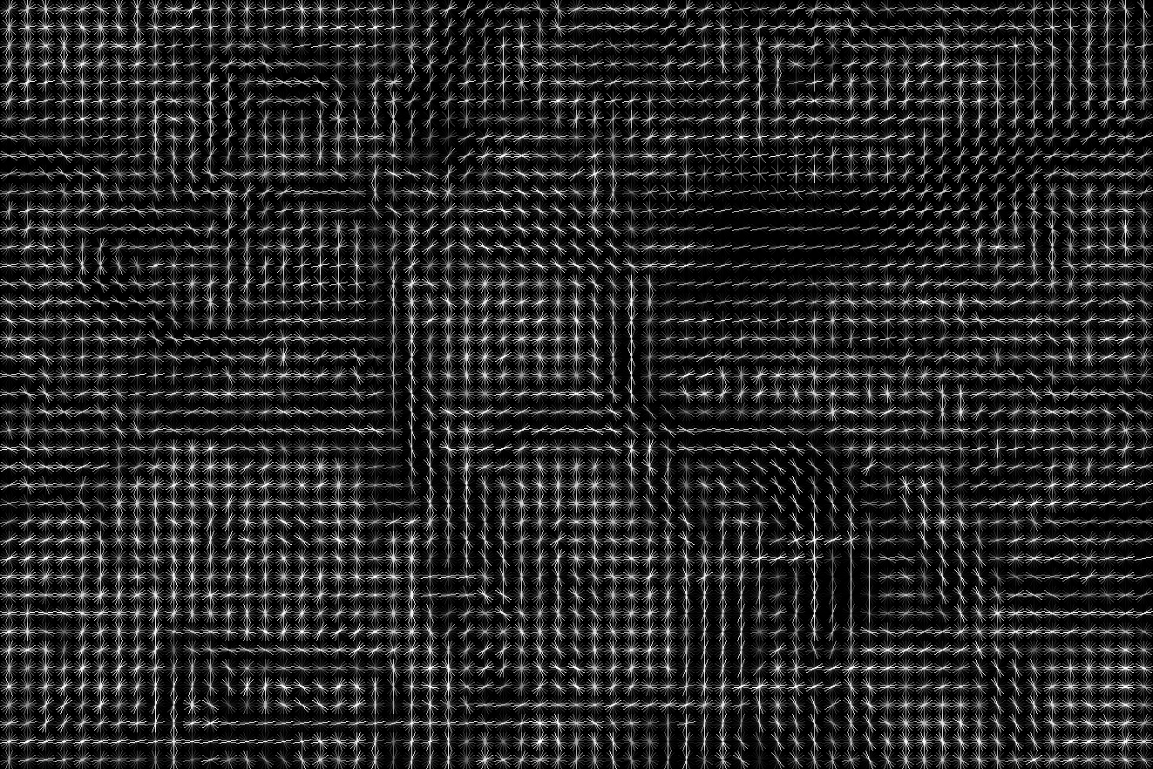
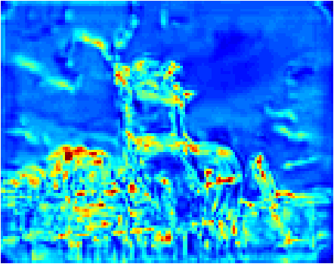
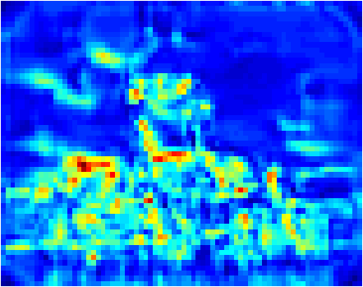
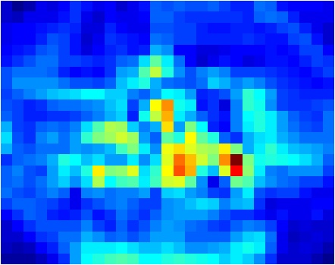
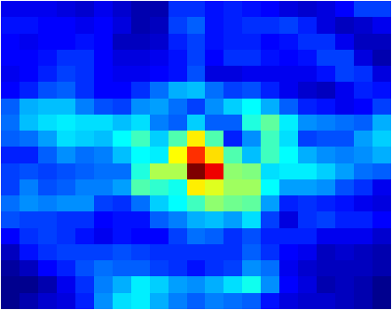
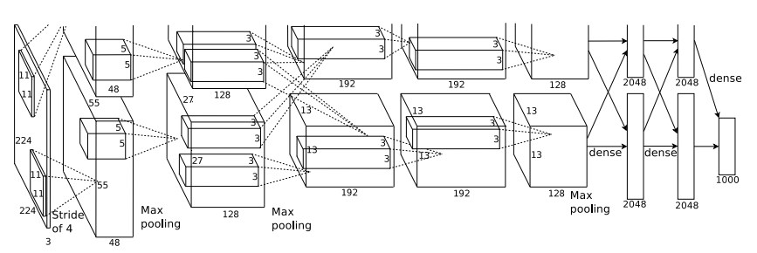
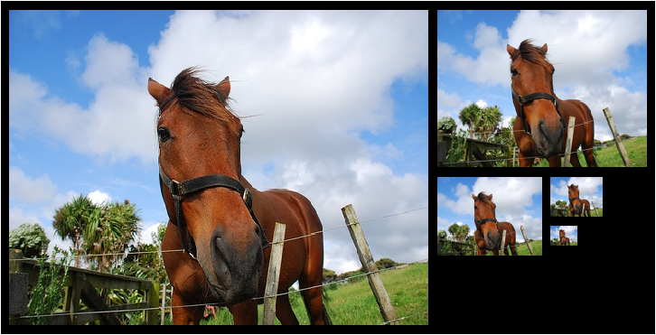
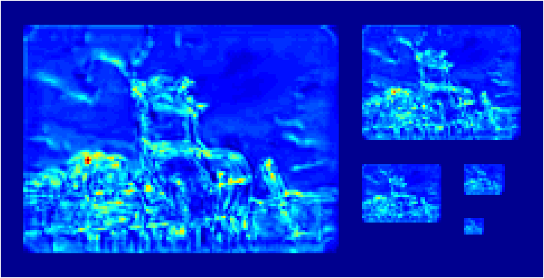
Deformable Part Models with CNN Features
Pierre-André Savalle, Stavros Tsogkas, George Papandreou, Iasonas Kokkinos
From HOG to CNN features
CNN-DPM
HOG: gradient filters
Fast multi-scale sliding window with patchworks
[Dubout and Fleuret, 2012; Iandola et al., 2014]
gradient filters + pooling
8
8
S(x,y,s)
H x W x 32-D
pyramid
DPM
Convolutional Neural Networks: learned filters
learned filters + pooling
stitch
unstitch
convolutional
layers
4096-D
convolutional layers
fully connected
We can feed an arbitrary-size image to
convolutional layers: CNN feature map
[Sermanet et al., 2014; Iandola et al., 2014]
Compare to RCNN detector [Girshick et al., 2014]
convolutional +
fully connected
S(i)
warp
SVM
H x W x 256-D
region(i)
4096-D
Efficiency concerns
Detection performance of C-DPM
Problem: 8x larger features
Learning:
LDA on whitened representation [Girshick and Malik, 2013]
Learning + Testing:
Common Network: RCNN’s finetuned network
Method | aero | bike | bird | boat | botl | bus | car | cat | chair | cow | dtbl | dog | hors | mbk | pers | plant | sheep | sofa | train | tv | mAP
C-DPM | 39.7 | 59.5 | 35.8 | 24.8 | 35.5 | 53.7 | 48.6 | 46.0 | 29.2 | 36.8 | 45.5 | 42.0 | 57.7 | 56.0 | 37.4 | 30.1 | 31.1 | 50.4 | 56.1 | 51.6 | 43.4
C-DPM-BB | 50.9 | 64.4 | 43.4 | 29.8 | 40.3 | 56.9 | 58.6 | 46.3 | 33.3 | 40.5 | 47.3 | 43.4 | 65.2 | 60.5 | 42.2 | 31.4 | 35.2 | 54.5 | 61.6 | 58.6 | 48.2
DPMv5 | 33.2 | 60.3 | 10.2 | 16.1 | 27.3 | 54.3 | 58.2 | 23.0 | 20.0 | 24.1 | 26.7 | 12.7 | 58.1 | 48.2 | 43.2 | 12.0 | 21.1 | 36.1 | 46.0 | 43.5 | 33.7
C-DPM-BB vs DPMv5 | +17.7 | +4.1 | +33.2 | +13.7 | +13.0 | +2.6 | +0.4 | +23.3 | +13.3 | +16.4 | +20.6 | +30.7 | +7.1 | +12.3 | -1.0 | +19.4 | +14.1 | +18.4 | +15.6 | +15.1 | +14.5
RCNN7-BB | 68.1 | 72.8 | 56.8 | 43.0 | 36.8 | 66.3 | 74.2 | 67.6 | 34.4 | 63.5 | 54.5 | 61.2 | 69.1 | 68.6 | 58.7 | 33.4 | 62.9 | 51.1 | 62.5 | 64.8 | 58.5
RCNN7 | 64.2 | 69.7 | 50.0 | 41.9 | 32.0 | 62.6 | 71.0 | 60.7 | 32.7 | 58.5 | 46.5 | 56.1 | 60.6 | 66.8 | 54.2 | 31.5 | 52.8 | 48.9 | 57.9 | 64.7 | 54.2
RCNN5 | 58.2 | 63.3 | 37.9 | 27.6 | 26.1 | 54.1 | 66.9 | 51.4 | 26.7 | 55.5 | 43.4 | 43.1 | 57.7 | 59.0 | 45.8 | 28.1 | 50.8 | 40.6 | 53.1 | 56.4 | 47.3
C-DPM vs RCNN5 | -18.5 | -3.8 | -2.1 | -2.8 | +9.4 | -0.4 | -18.3 | -5.4 | +2.5 | -18.7 | +2.1 | -1.1 | 0.0 | -3.0 | -8.4 | +2.0 | -19.7 | +9.8 | +3.0 | -4.8 | -3.9
FFT-based convolution [Dubout and Fleuret, 2012]
HOG-DPM<< C-DPM
Observations:
✔
C-DPM<<RCNN-7
?!?!
✔
C-DPM<=RCNN-5
Image
CNN fts.
Image
CNN fts.
Conjecture: C-DPM<RCNN-5 is due to aspect ratio clustering
Image
CNN fts.
Image
CNN fts.
Image
CNN fts.
FT Image
Image
CNN fts.
Way ahead: higher-level CNN features, integrate into pose estimation, deal with aspect ratio
256
FFT
256
x
Image
CNN fts.
+
FT Det.
scores
Detection
scores
References
Image
CNN fts.
Image
CNN fts.
256
FFT⁻¹
Dubout, C., Fleuret, F.: Exact acceleration of linear object detectors (ECCV 2012)
Girshick, R., Donahue, J., Darrell, T., Malik, J.: Rich feature hierarchies for accurate object detection and semantic segmentation (CVPR 2014)
Girshick, R., Malik, J.:Training Deformable Part Models with Decorrelated features (ICCV 2013)
Sermanet, P., Eigen, D., Zhang, X., Mathieu, M., Fergus, R., LeCun, Y.: Overfeat: Integrated recognition, localization and detection using convolutional networks (ICLR 2014)
Iandola, F., Moskewicz, M., Karayev, S., Girshick, R., Darrell, T., Keutzer, K.: Densenet: Implementing efficient convnet descriptor pyramids. (arXiv:1404.1869 2014)
Image
CNN fts.
Image
CNN fts.
Filter
CNN fts.
256
FFT
FT Filter
256

