Slide 1
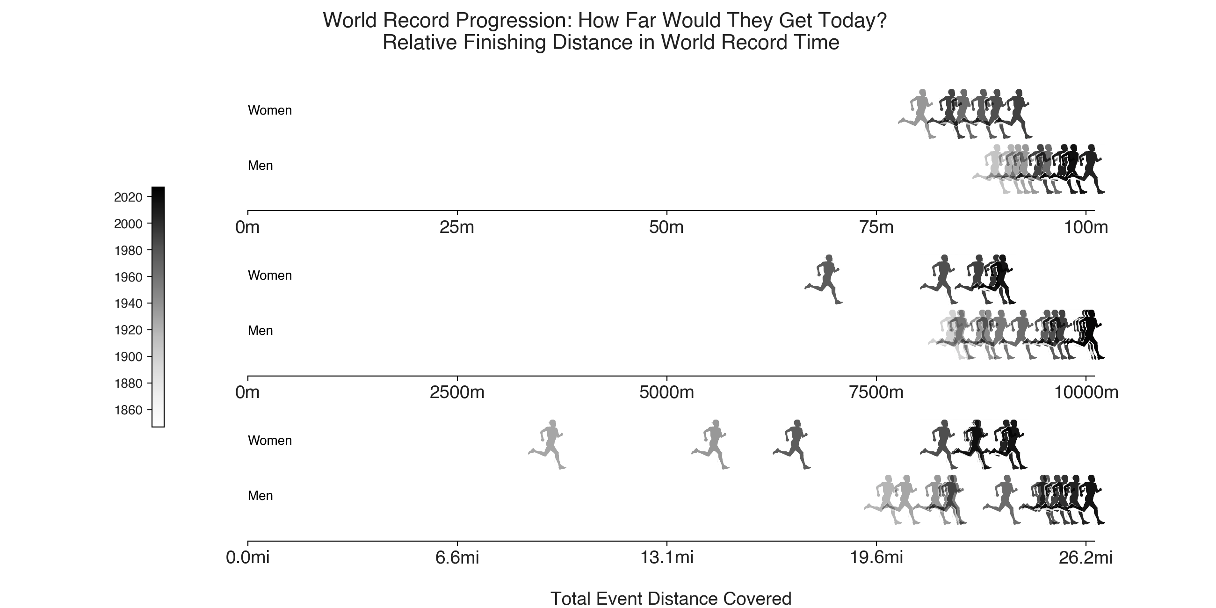
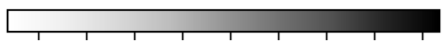
World Record Progression: Women are Closing the Gap!
Relative Finishing Distance in World Record Time
Griffith-Joyner (USA) – Women
10.49 — 1988
100 m
Bolt (JAM) – Men
9.58 — 2009
Ayana (ETH) – Women
29:17.45 — 2016
10,000 m
Cheptegei (UGA) – Men
26:11.00 — 2020
Kosgei (KEN) – Women
2:14:04 — 2019
Marathon
Kipchoge (KEN) – Men
2:01:39 — 2018
1860
1880
1900
1920
1940
1960
1980
2000
2020

Slide 2
World Record Progression: Women are Closing the Gap!
Relative Finishing Distance in World Record Time
Griffith-Joyner (1988) beats Mejzlíková II (1922) by 22m!
Griffith-Joyner (USA) – Women
10.49 — 1988
100 m
Bolt (JAM) – Men
9.58 — 2009
Ayana (ETH) – Women
29:17.45 — 2016
10,000 m
Cheptegei (UGA) – Men
26:11.00 — 2020
Kosgei (KEN) – Women
2:14:04 — 2019
Marathon
Kosgei (2019) beats
Ledru (1918) by 10 miles!
Kipchoge (KEN) – Men
2:01:39 — 2018
1860
1880
1900
1920
1940
1960
1980
2000
2020

Slide 3
World Record Progression: Women are Closing the Gap!
Relative Finishing Distance in World Record Time
Griffith-Joyner (1988) beats Mejzlíková II (1922) by 22m!
10.49 — 1988
Griffith-Joyner (USA) – Women
100 m
9.58 — 2009
Bolt (JAM) – Men
29:17.45 — 2016
Ayana (ETH) – Women
10,000 m
26:11.00 — 2020
Cheptegei (UGA) – Men
2:14:04 — 2019
Kosgei (KEN) – Women
Marathon
Kosgei (2019) beats
Ledru (1918) by 10 miles!
2:01:39 — 2018
Kipchoge (KEN) – Men
1860
1880
1900
1920
1940
1960
1980
2000
2020

Slide 4
Griffith-Joyner (1988) beats Mejzlíková II (1922) by 22m!
10.49 — 1988
Griffith-Joyner (USA) – Women
100 m
9.58 — 2009
Bolt (JAM) – Men
29:17.45 — 2016
Ayana (ETH) – Women
10,000 m
26:11.00 — 2020
Cheptegei (UGA) – Men
2:14:04 — 2019
Kosgei (KEN) – Women
Marathon
Kosgei (2019) beats
Ledru (1918) by 10 miles!
2:01:39 — 2018
Kipchoge (KEN) – Men
1860
1880
1900
1920
1940
1960
1980
2000
2020

Slide 5
Griffith-Joyner (USA) – W
10.49 — 1988
100m dash
Griffith-Joyner (1988) beats Mejzlíková II (1922) by 22m!
Bolt (JAM) – M
9.58 — 2009
Ayana (ETH) – W
29:17.45 — 2016
10,000m
Cheptegei (UGA) – M
26:11.00 — 2020
Kosgei (KEN) – W
2:14:04 — 2019
Marathon
Kipchoge (KEN) – M
2:01:39 — 2018
1860
1880
1900
1920
1940
1960
1980
2000
2020

Slide 6
2020
Griffith-Joyner (USA)
10.49 — 1988
Women
2000
Bolt (JAM)
9.58 — 2009
Men
1980
1960
Ayana (ETH)
29:17.45 — 2016
Women
1940
Men
Cheptegei (UGA)
26:11.00 — 2020
1920
1900
Kosgei (KEN)
2:14:04 — 2019
Women
1880
Kipchoge (KEN)
2:01:39 — 2018
Men
1860

