Slide 1








What a big word!
And how misunderstood!

Slide 2
When a person asks for an integration, this is normally the image they have in their mind.

Slide 3

When a person asks for an integration, this is normally the image they have in their mind.

Slide 4

When a person asks for an integration, this is normally the image they have in their mind.

Slide 5

When a person asks for an integration, this is normally the image they have in their mind.

Slide 6


PARADISE!

Slide 7
What they really see is this...

Slide 8
What they really see is this...

Slide 9

What they really see is this...

Slide 10
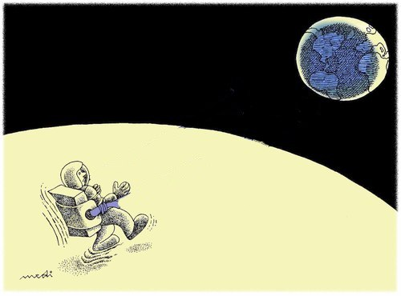
Something like this far away...

Slide 11
Ahh! It's …
That's how big it is !

Slide 12
Real life examples

Slide 13

Real life examples
  Sharing Documents

Slide 14
Real life examples
  Sharing Documents
  Emails

Slide 15
Real life examples
  Sharing Documents
  Emails
  Sending Quotes

Slide 16
Real life examples
  Sharing Documents
  Emails
  Sending Quotes
  Communication Problems

Slide 17
F LES
DMS
Dropbox
OpenKM
AlFresco
Webdav
GDrive
Samba

Slide 18
OPE DOCUMENT
OpenOffice
MSWord
OOMerge
Gendoc
CWC

Slide 19
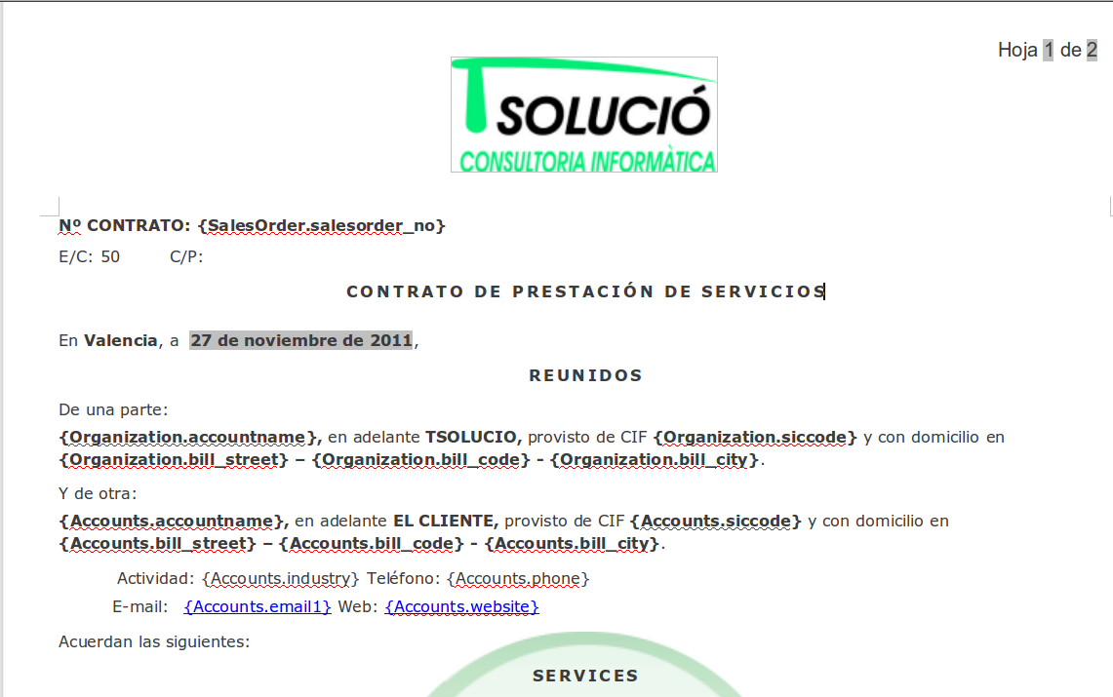
GENDOC

Slide 20
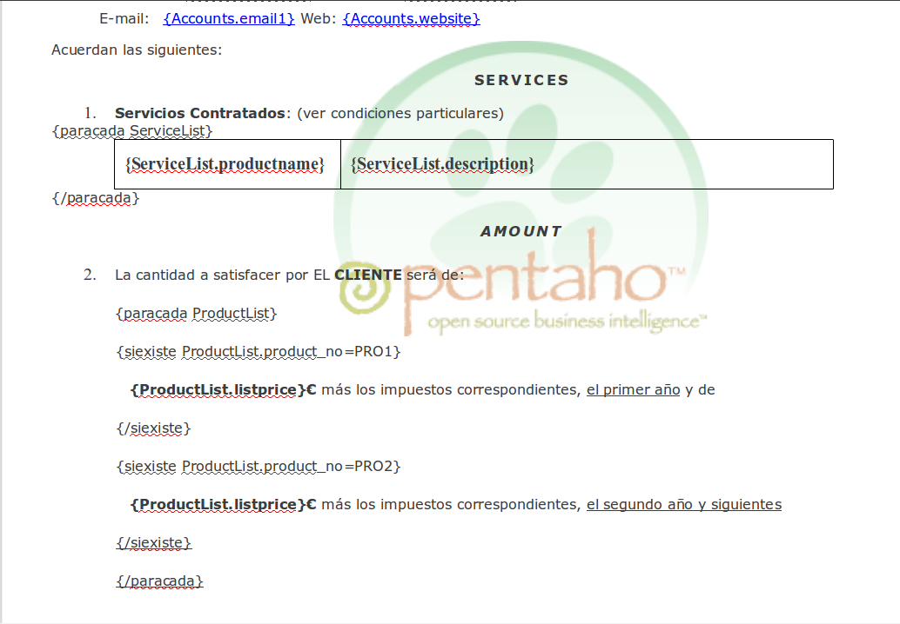
GENDOC

Slide 21
BUSINESS
IN ELIGENCE
Pentaho
JasperSoft
Vanilla

Slide 22
W BSITES
Typo 3
WordPress
Webforms
Drupal
Prestashop
eCommerce
Joomla

Slide 23


OOGLE
Google’s mission is to organize the world‘s information
and make it universally accessible and useful.
Maps
Contacts
GCalendar

Slide 24
E P
WEBERP
SUCCESS!
SAP
AS400
Custom Sensors
BACKEND
Many others ...

Slide 25
CUSTOMER
PORT L

Slide 26
REPOR ING
BIRT
Reportico
Excel
Access

Slide 27
EMA L
ThunderBird
Outlook
Mailchmp
Exchange
RoundCube
Send grid
PhpList

Slide 28
fficial
PayPal
EBilling
XML
BlueHost
Bank/SEPA

Slide 29
E DLESS
SMS, Accounting ...

Slide 30
E DLESS
SMS, Accounting ...
Where do you want to take it?

Slide 31
E DLESS
SMS, Accounting ...
Where do you want to take it?
Thank you!

