Slide 1


Slide 2
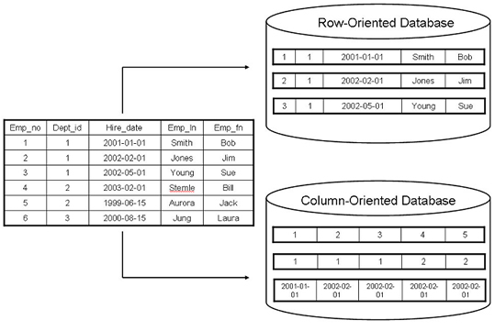
What is InfiniDB?
InfiniDB is a column oriented database designed for data warehousing, business intelligence and big data.
When you execute a query, only the necessary columns in a query are accessed rather than entire rows as MySQL, also query response times can be reduced.

Slide 3
Test performances (1)
The following tests were done with a notebook with the following characteristics:
Operating system: Fedora 16;
RAM: DDR3 4 GB;
CPU: quadcore 2.40 GHz i5;

Slide 4
Test performances (2)
Number of records | Number of columns | Columns selected | Response time of MySQL | Response time of InfiniDB
10.000 | 50 | 50 | 0,05 sec | 1,31 sec
10.000 | 50 | 1 | 0,02 sec | 0,04 sec
2.000.000 | 8 | 1 | 2,15 sec | 0,27 sec
18.000.000 | 8 | 2 | 42,45 sec | 3,77 sec
InfiniDB is convenient if you select
a few columns and many rows.

Slide 5
Vtiger+Flexviews+InfiniDB (1)
If you have a huge amount of data in Vtiger,
you can not use directly InfiniDB,
because InfiniDB is incompatible with Vitger.
You could create a materialized view on
InfiniDB with Flexviews that take data
from MySQL.
Flexviews is incompatible with InfiniDB but...

Slide 6



Vtiger+Flexviews+InfiniDB (2)
You can create a materialized view with
Flexviews in MySQL with all the data that
are necessary, and than you can load data
in InfiniDB with a InfiniDB loader, that is
very fast.
I'm loader
View
View
Copy
InfiniDB
MySQL

Slide 7
Thanks for listening!
Matteo Bonardi
Studio Synthesis
References:
http://www.calpont.com/

