Slide 1
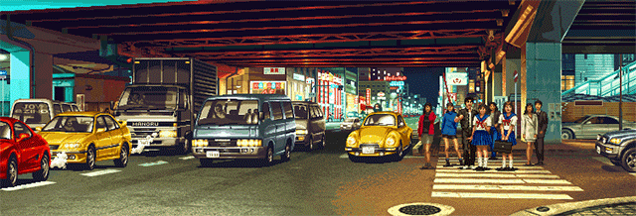
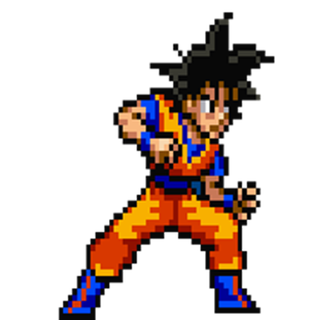
Fighter Z
Press any SPACE to start

Slide 2
Choose Your Character
GOKU
Kirby

Slide 3


Goku
Kirby

