Slide 1

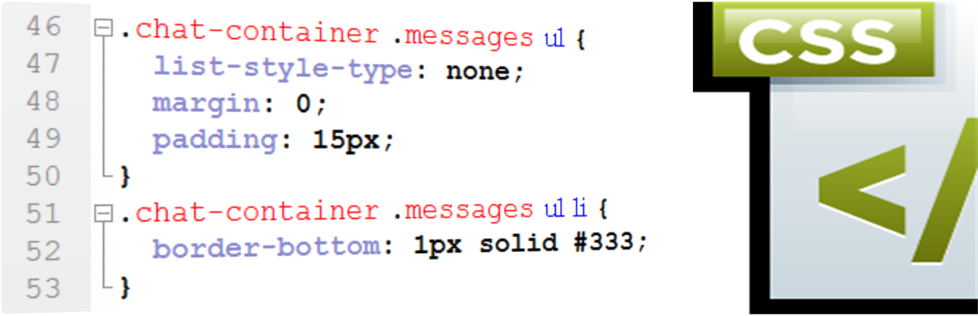
Sloth CSS
Introduction to Cascading Style Sheets
Styling HTML with CSS
Slothlin Marzelakov
Slothy Trainer
www.marzelakov.com
Sloth University
Notes:
© Software University Foundation – http://softuni.org
This work is licensed under the Creative Commons Attribution-NonCommercial-ShareAlike license.

Slide 2

КАК МИСЛИТЕ ?
КОЙ ЩЕ СЕ ЗАНИМАВА
ДА ПРАВИ ПРЕЗЕНТАЦИИ
РОВЕТЕ В GOOGLE
ТАМ ИМА ВСИЧКО

