Slide 1
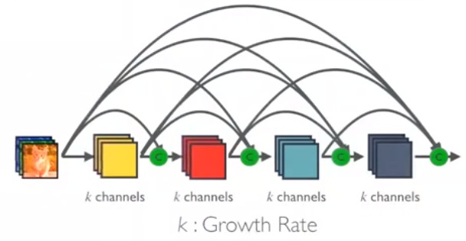
Dense2Net:
A Hybrid DenseNet/Res2Net Architecture
Nathan Starliper
Tanner Songkakul
ECE763- Spring 2019

Slide 2
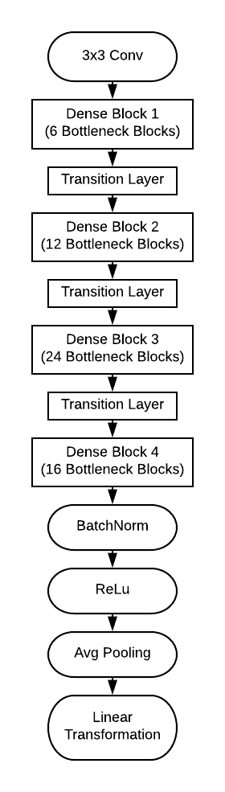
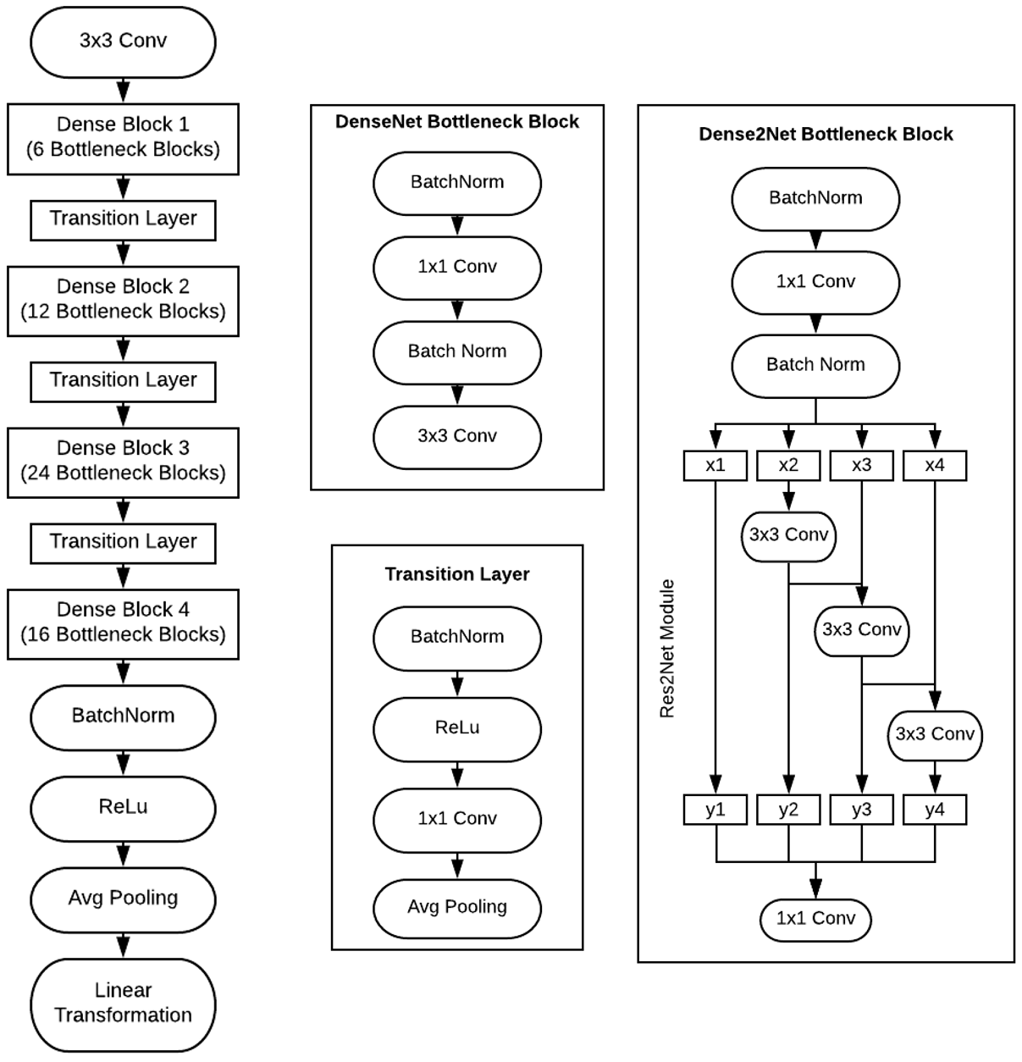
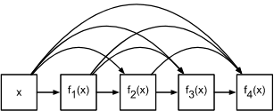
Dense2Net
Goal: Improve classification performance by integrating Res2Net architecture into DenseNet structure
Dense Block
Dense2Net Bottleneck Block
Dense2Net121

Slide 3
Overview
Background
Residual Networks
DenseNet
Res2Net
Dense2Net
Implementation
Training Results
Testing Results
Analysis
Conclusions and Future Work

Slide 4
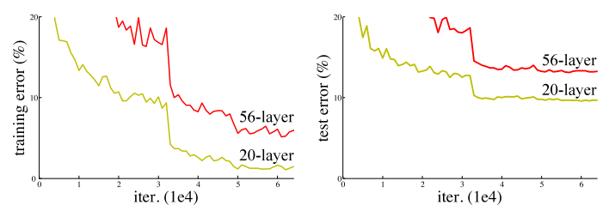
Background
The Problem: Vanishing Gradients
During backpropagation for deep networks with standard CNN architectures, gradients can become very very small
Increasing network depth no longer improves performance
Performance comparison between 20 and 56 layer NN

Slide 5
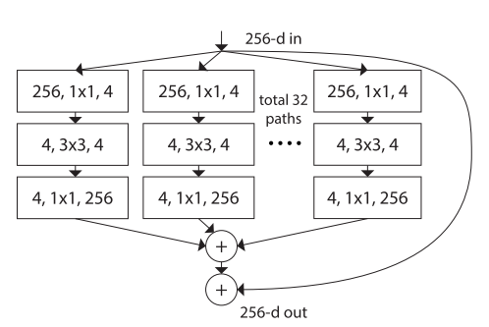
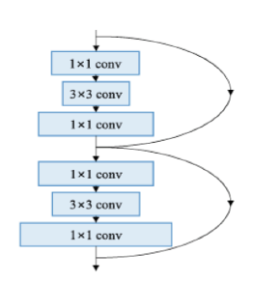
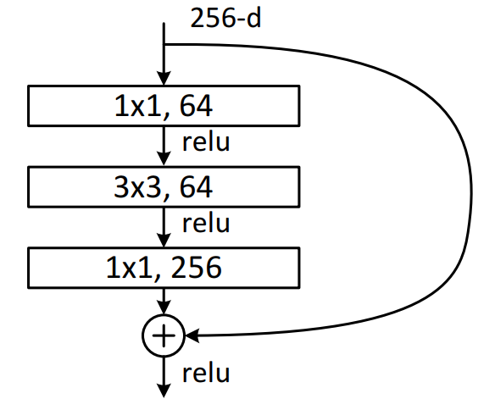
Background
A Solution: Residual Network Connections
Feed-forward networks with shortcut connections
Allows for deeper networks with improved performance
ResNet Bottleneck Block
(He et al, 2015)
1st Place, ILSVRC 2015
ResNext Bottleneck Blocks
(Xie et al, 2016)
2nd Place, ILSVRC 2016
Pyramidal ResNet Bottleneck Block
(Han et al, 2017)

Slide 6
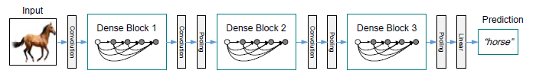
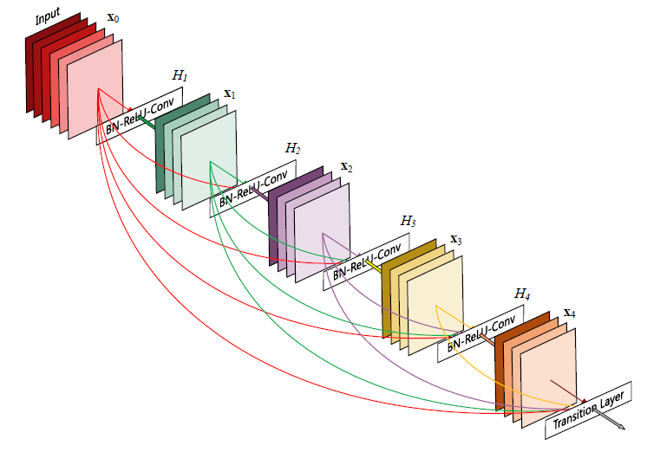
DenseNet
In DenseNet (Huang et al, 2016), every layer is connected to every preceding layer inside a Dense Block
A full DenseNet
Connections within a DenseBlock

Slide 7

DenseNet
Concatenates filtered outputs and skip connections:
Dense Blocks comprised of multiple Dense Layers
Channels per Dense Layer defined by growth rate k
Transition Layers between Dense Blocks downsample feature maps for concatenation
Variation: DenseNet-BC contains bottleneck blocks in Dense Layers and compression in Transition Layers

Slide 8
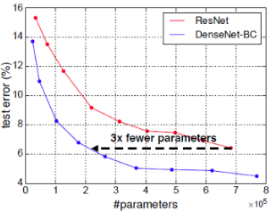
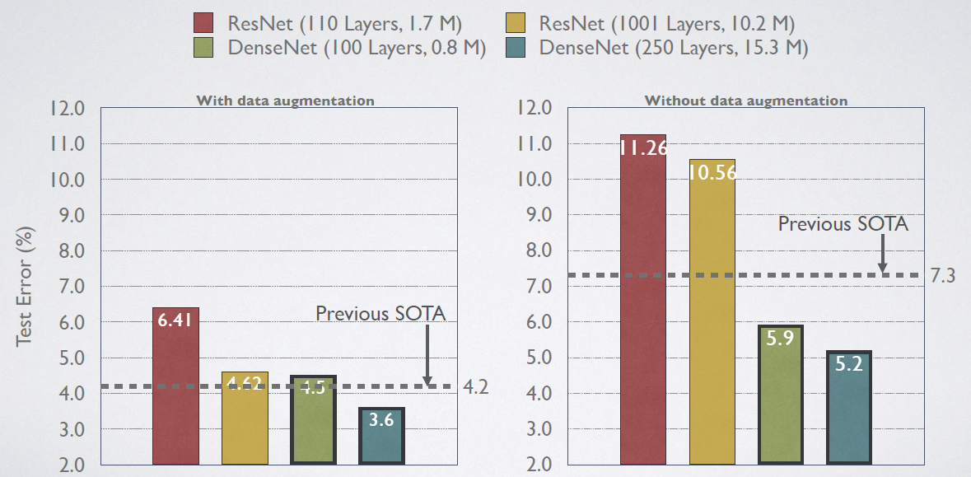
DenseNet
Advantages:
Gradient flow: since every layer is directly connected, the error signal is directly propagated to earlier layers (implicit deep supervision)
Efficiency: requires less parameters per layer (proportional l*k*k) than ResNet
Diversified Features: every layer receives all preceding layers as input, so the features are more diverse and of all complexity levels

Slide 9
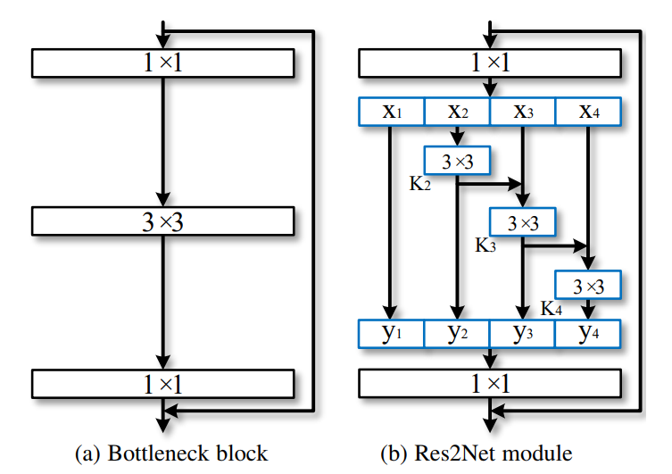

Res2Net
Res2Net (Gao et al, 2019) developed to improved multi-scale feature extraction
Replace 3x3 convolutions with a hierarchical residual network structure for increased multi-scale resolution
s: scale, number of subsets to split input into

Slide 10
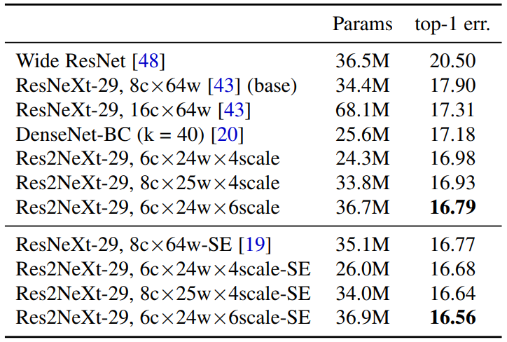
Res2Net
Scale s is orthogonal to other characteristics of NN
Bottleneck blocks in many networks can be changed to Res2Net architecture (Res2Net, Res2Next, Res2Next-DLA) to improve performance
Hasn’t been integrated with DenseNet

Slide 11
DenseNet
Replace 3x3 conv with Res2Net module+1x1 conv

Slide 12
Dense2Net
Replace 3x3 conv with Res2Net module+1x1 conv

Slide 13
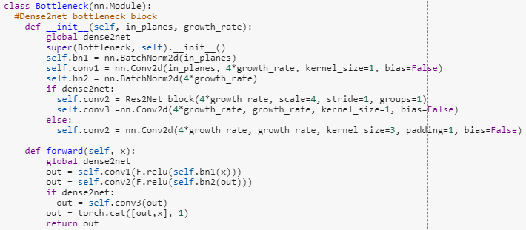
Implementation
Dense2Net implemented in PyTorch
4 Dense Blocks: 6 layers→12 layers→24 layers→16 layers, Res2Net incorporated into each layer
SGD optimizer: weight decay 0.0001, momentum 0.9, batch size 128, 100 epochs

Slide 14
Experiments
CIFAR-100 dataset, 100 epochs training
Backbone architecture: DenseNet121BC with k=32
Multiple configurations tested
Data Augmentation, cutout, scale, cardinality, and Squeeze and Excitation
Efficient training
Learning rate decay on plateau
Early stopping

Slide 15
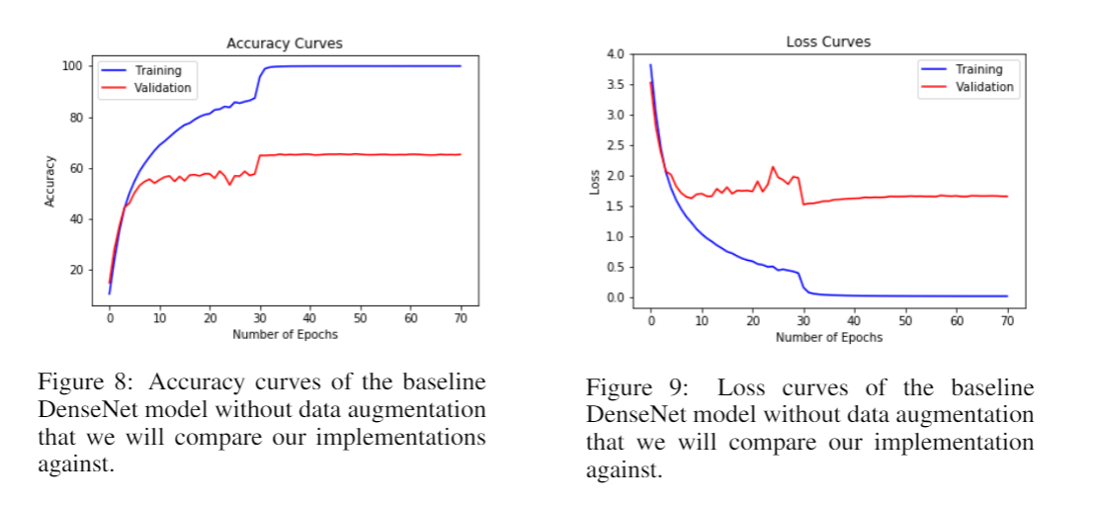
Initial Baseline Results
LR Decay by
factor of 10
OVERFITTING

Slide 16
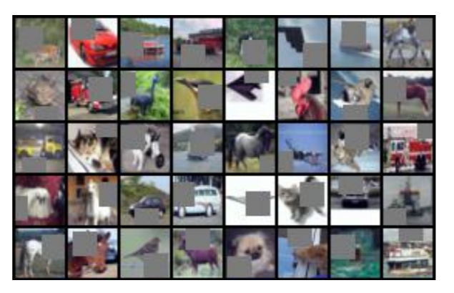
Data Augmentation/Cutout
Standard transformations: mirroring/shifting
Cutout: mask random patches of images during training
N_holes = 1
Length = 8
Regularization to reduce overfitting

Slide 17
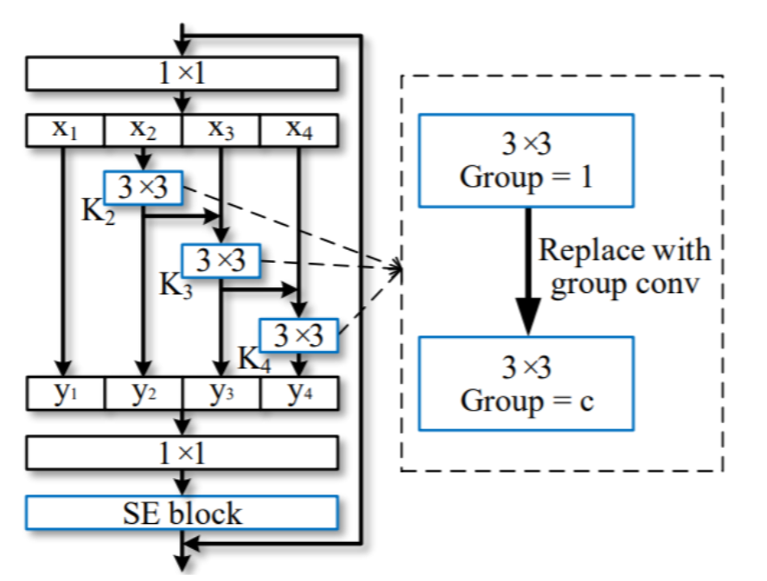
Scale and Cardinality
Scale: increases granularity and scales of extracted features
Scale = 2,4,8
Cardinality: group convolution enforces block-diagonal structure sparsity on channel dim (induces regularization)
Cardinality = 32

Slide 18
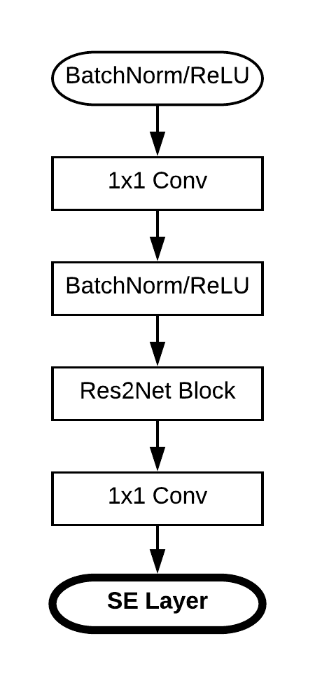
Squeeze and Excitation Block
SE layer weights output filters based on importance
Emphasizes informative while suppressing uninformative features
Feature “calibration”
Added at the end of the bottleneck block

Slide 19
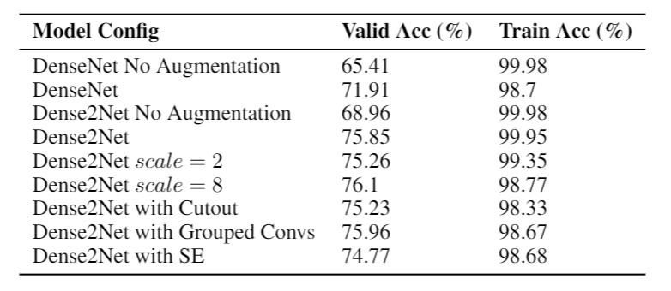
Experimental Results Summary
Dense2Net: 5.83% relative increase over baseline DenseNet
Data Augmentation: 9.99% relative increase
Minor (possibly insignificant) increases due to scale

Slide 20
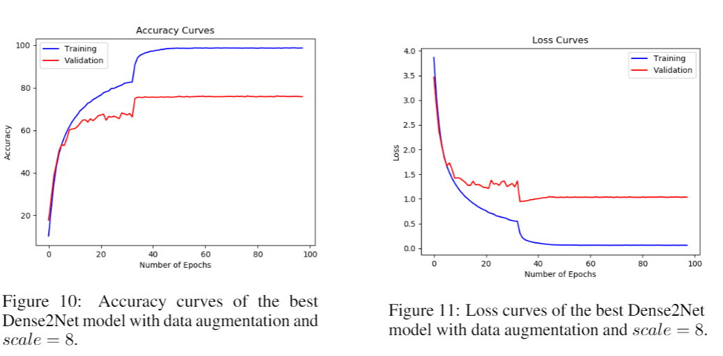
Final Results
Closed gap between training and validation

Slide 21
Conclusion and Future Work
Showed benefit of introducing the Res2Net block into DenseNet
Rigorous fine tuning of hyperparameters will yield better results
Scale, cardinality, growth rate, learning rate decay, optimizer
Implement Res2Net in other architectures
Test on larger images that would benefit from high scale extraction (ImageNet)

