Slide 1
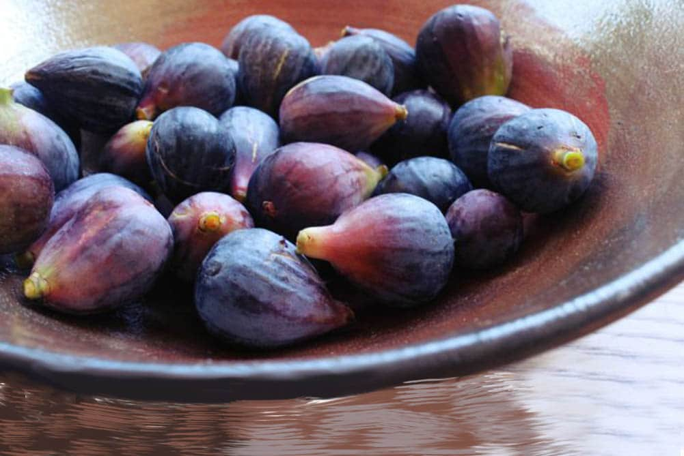

Slide 2
Experiments
All data combined
5 fold validation
Length 140 and 90%
Different classifiers
NN a few hyperparams

Slide 3
Future works
Perform PCA on all features and remove some of the unnecessary ones
Add the features from the an adaptive learning approach for ppg based identification

Slide 4
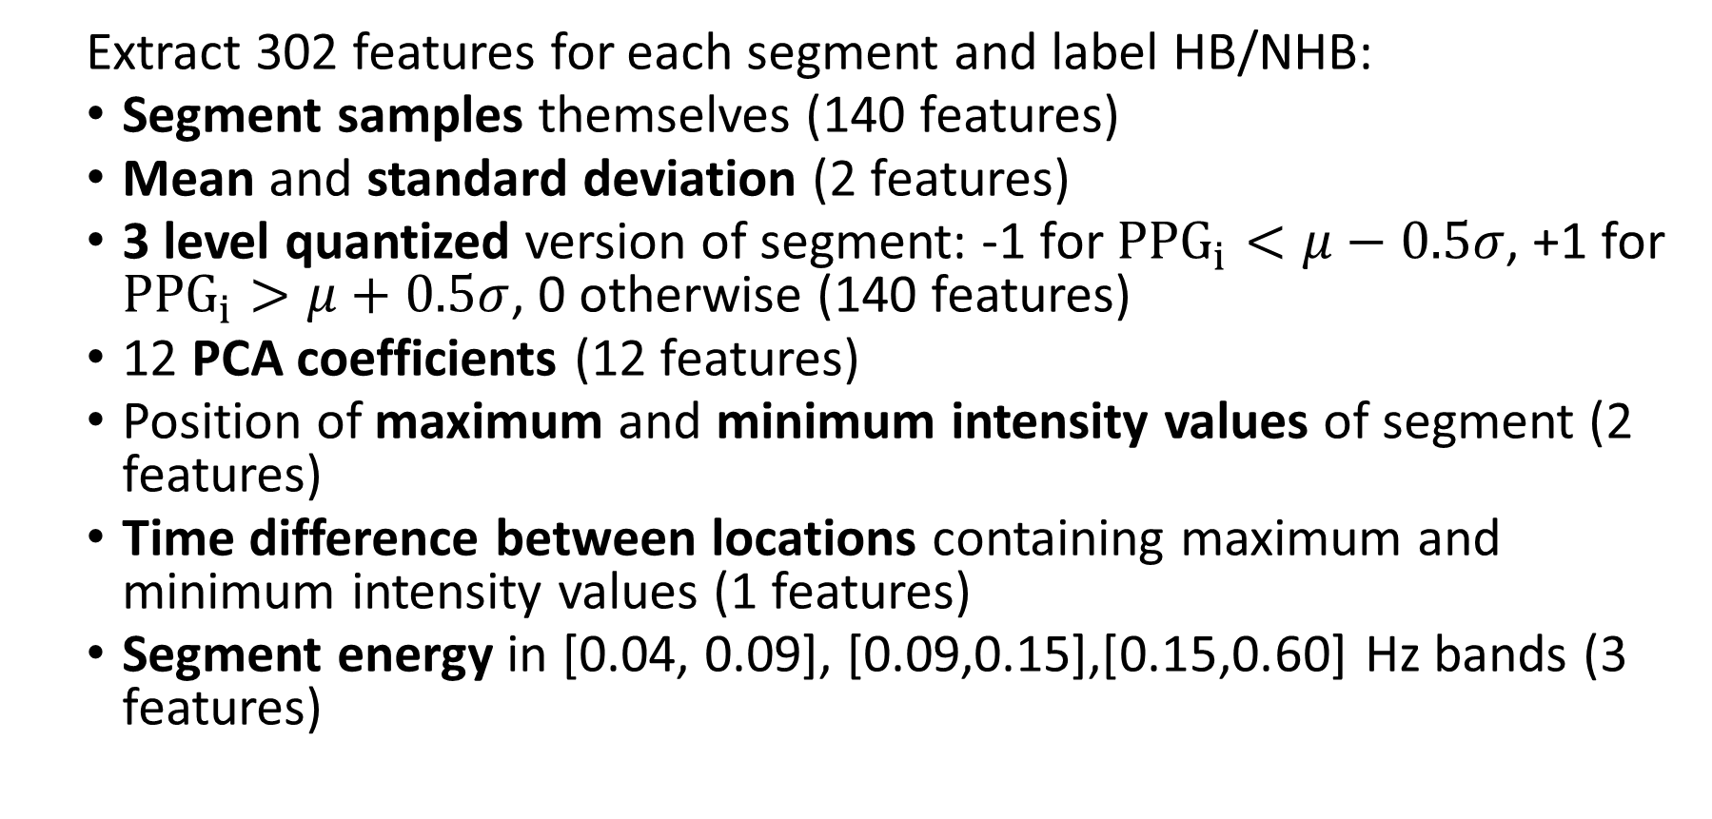
Feature Extraction
Extract 302 features for each segment and label HB/NHB:
Segment samples themselves (140 features)
Mean and standard deviation (2 features)
3 level quantized version of segment: -1 for ${PPG}_{i}<μ−0.5σ$, +1 for ${PPG}_{i}>μ+0.5σ$, 0 otherwise (140 features)
12 PCA coefficients (12 features)
Position of maximum and minimum intensity values of segment (2 features)
Time difference between locations containing maximum and minimum intensity values (1 features)
Segment energy in [0.04, 0.09], [0.09,0.15],[0.15,0.60] Hz bands (3 features)

Slide 5
Machine Learning Techniques
Conventional Techniques
Linear Discriminant
K-Nearest Neighbors (K-NN)
Decision Tree
Support Vector Machine (SVM)
Convolutional Neural Network
Convolutional Neural Networks (CNN)

Slide 6
Conventional Classification Results
Implemented with Matlab’s Classification Learner App
5-fold validation
Used all 302 features
Classifier | Accuracy | Training Time (mm:ss) | Prediction Time (mm:ss)
Linear SVM | 79.2% | 36:00 | 01:18
Decision Tree | 80.5% | 02:00 | 00:01
Linear Discriminant | 80.6% | 00:50 | 00:01
1-NN | 81.1% | 36:50 | 02:12
10-NN | 83.5% | 36:40 | 02:12
Cubic SVM | 84.5% | 59:00 | 00:58
CNN | 86.6% | 06:00 | 00:12

Slide 7
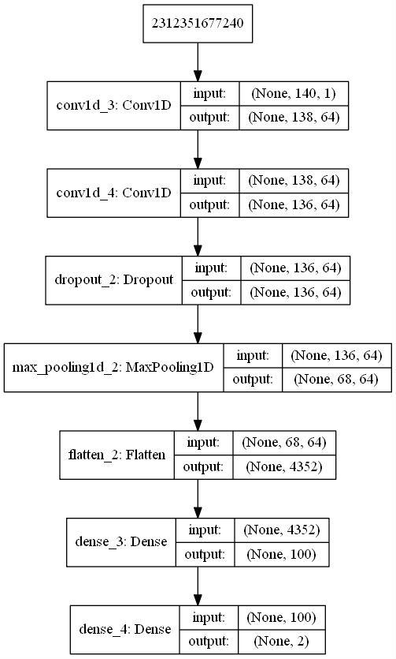
Convolutional Neural Network Structure
140x1
Input: Segment samples only
Kernel: 3x1
Activation: Relu
Dropout: 0.5
Pool Size: 2
Output: 2 classes (softmax)

Slide 8
CNN Results
Classifier | Accuracy
Cubic SVM (302 features) | 84.5%
CNN (No features) | 86.6%

