Slide 1
Cinema booking system
Presented by: Tsoodol, Enkh-Amgalan

Slide 2
Overview
Cinema booking system is responsible for getting clients booking movies on the internet. Since, it reduces the long line that occurs when people getting ticket in the movie theater. Also, it’s one of the ways that increases benefits of the movie theater.

Slide 3
Goals
Cinema booking need to have many movies for the clients
Cinema booking need to have details about the movie
Cinema booking need to have many halls and seats to present movies
Cinema booking need to have customers who booking tickets
Cinema booking need to have service manager who manages movies
Cinema booking need to have cashier who selling tickets.
Cinema booking need to have payment to receive deposit from user

Slide 4
Technologies
JSP
MySQL
Java FX
MVC Framework (hand organized)
Tomcat 7
Github
Staruml
Bootstrap

Slide 5
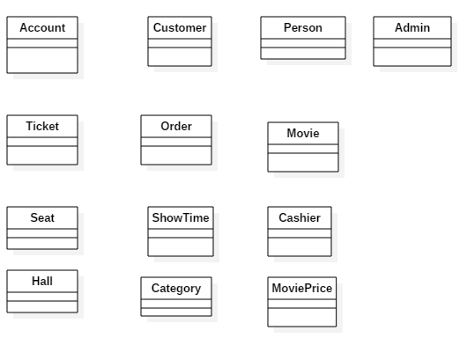
Identify candidate classes

Slide 6
Class dictionary
# | Class | Description
1 | Customer | Customer is a person who booking movie in the system.
2 | Movie | It contains list of the movies that will presents in the hall. Which has a name, description, show-time, and category.
3 | ShowTime | This class shows the all possible schedules of the one movie
4 | Admin | Admin is a person who manages the movie, schedule, and show-time. For example, add, update, or delete movies.
5 | Hall | Represents room which represents the movies
6 | Ticket | It contains the all history of the booking that customers made.
7 | Category | States the movie genre
8 | Account | Carry the private information of the customer

Slide 7
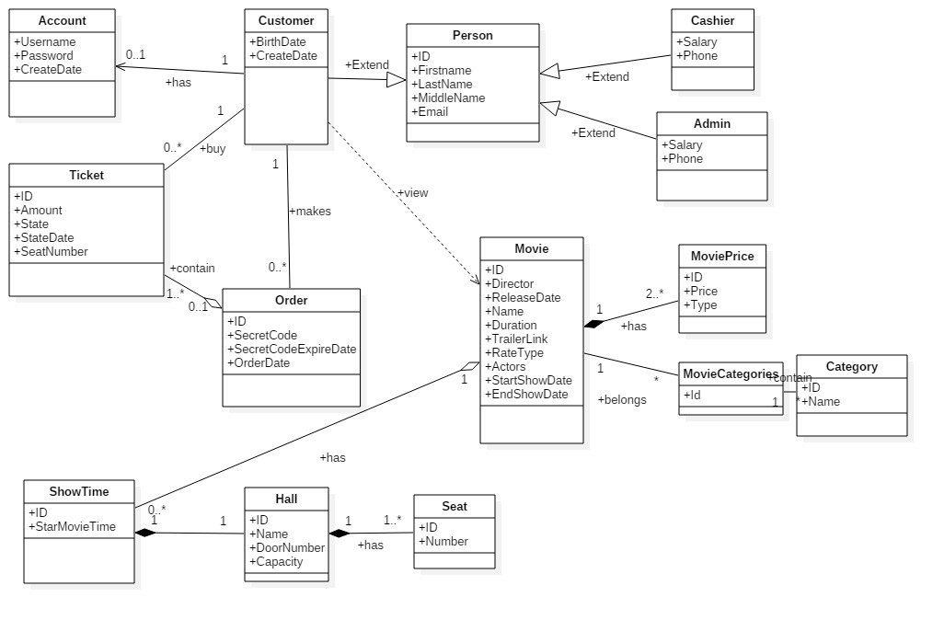
Class diagram (Inheritance and Associations)

Slide 8
Design pattern
Singleton
MVC
Factory

Slide 9
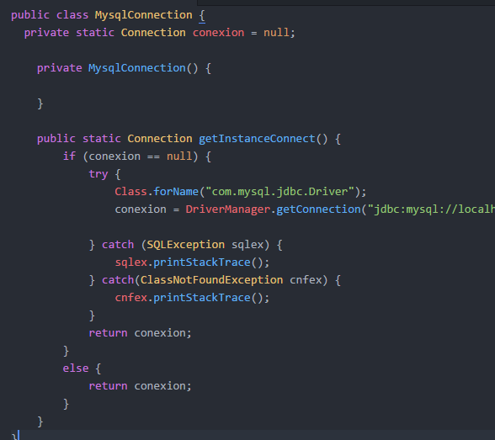
Singleton
Database connection
Get instances on the controller
Static method in the class

Slide 10


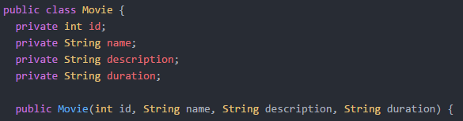
MVC
Rendering movie list in JSP
Stores all movie in the movie List in Array List
Movie model that shows data stores in the Movie

Slide 11
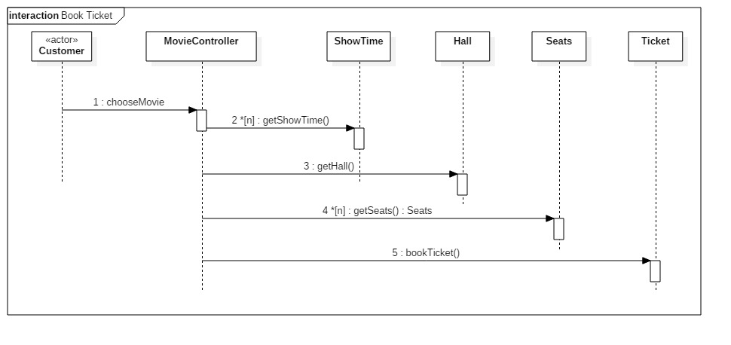
Book ticket

Slide 12
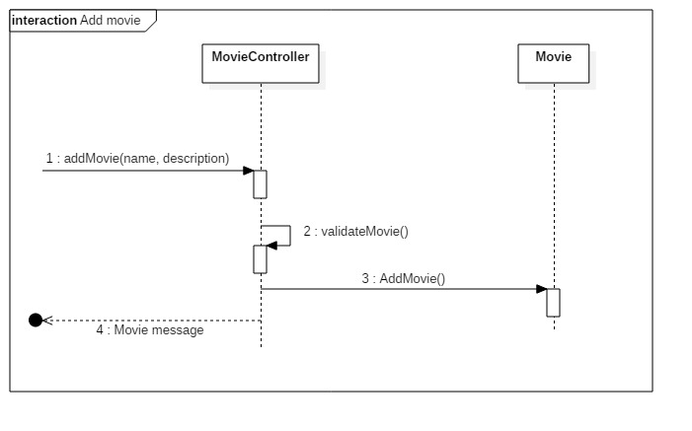
Add movie

Slide 13
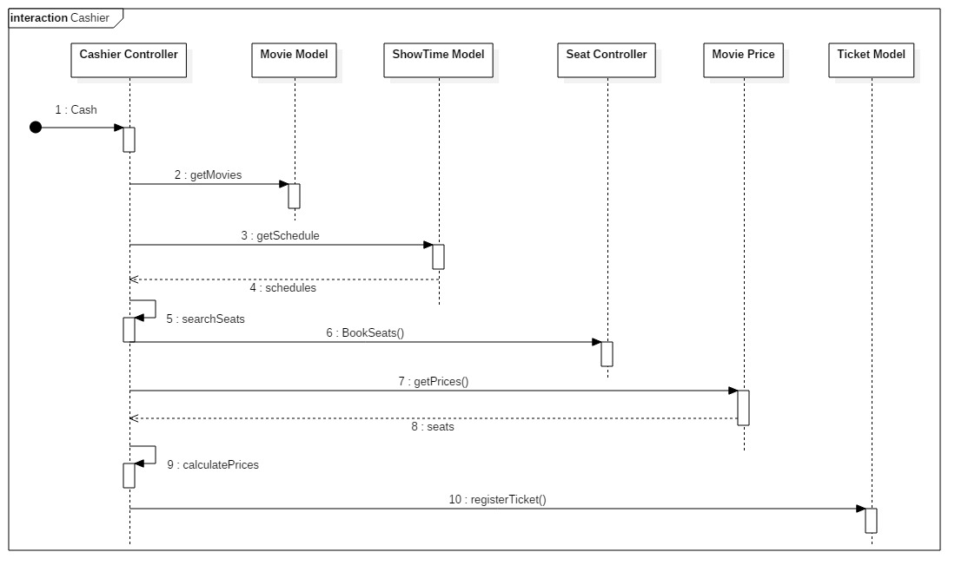
Cashier

Slide 14
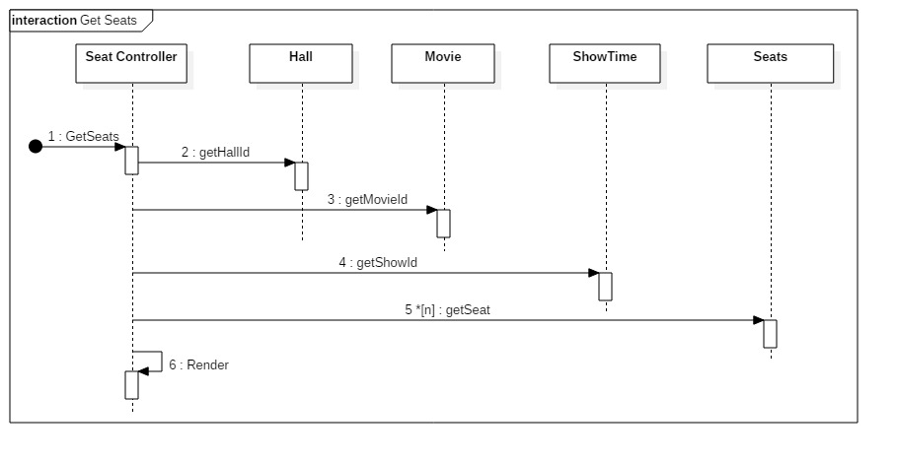
Seats

Slide 15
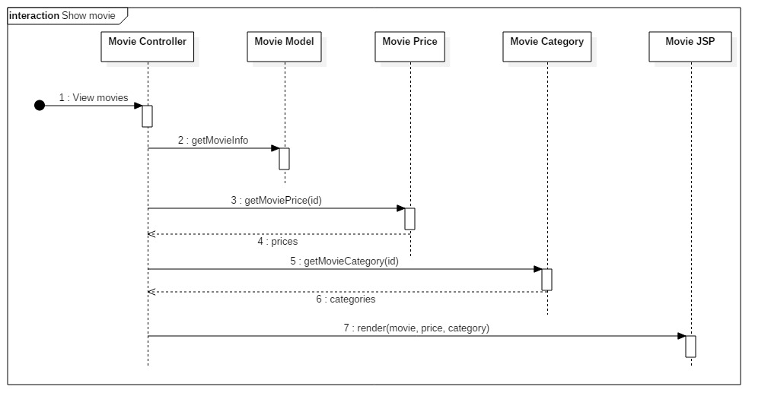
Show movies

Slide 16
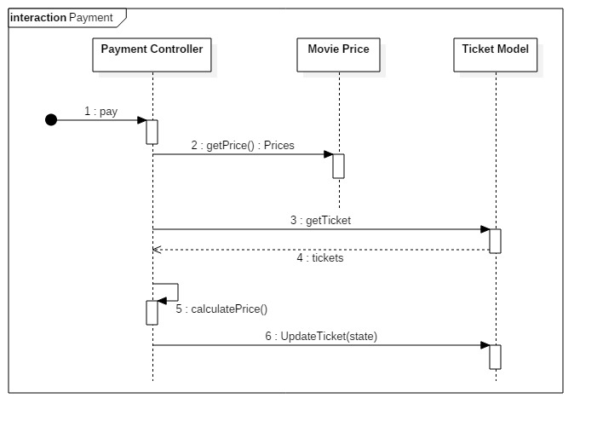
Payment

Slide 17
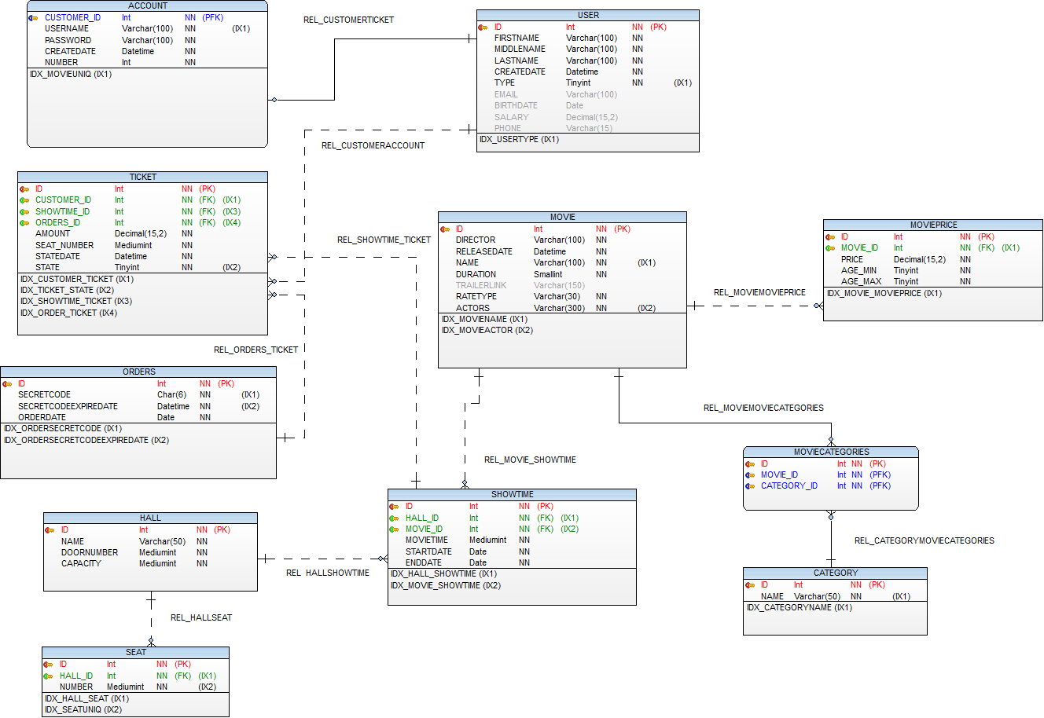
Database diagram

Slide 18
Thank you for attention!

