Slide 1


Slide 2

THE OVERVIEW
The Auditory Implant Initiative is embarking on a mission to de-centralize patient care by enabling providers to collaborate and extend the reach of Cochlear implants to a larger demographic, while also capturing valuable patient data to further optimize the overall patient care process. A key enabler of this mission is a product that allows providers to network, collaborate, and analyze integrated patient data.
THE MISSION
Dedicated to improving cochlear care in the community, focusing on research collaboration and research.

Slide 3
VALUE TO THE PATIENT
Decentralized allowing local community care.
VALUE TO THE PROVIDER
• Holistic data management tracking, reporting and analytics
• Practice transparency into patient status and data allowing
increase in efficiency and effectiveness
• Enable practices to participate in research • Creation of a highly collaborative Cochlear implant network
• Drive standardization increasing the minimal quality of care
• Establishes a virtual Center of Excellence
• Enables centralization and orchestration of the care team
• Comprehensive care dashboard for Care Coordinators and Physicians

Slide 4



USERS:
Facility Coordinator
CI Coordinator MA
Nurse
Physicians
Patients

Slide 5
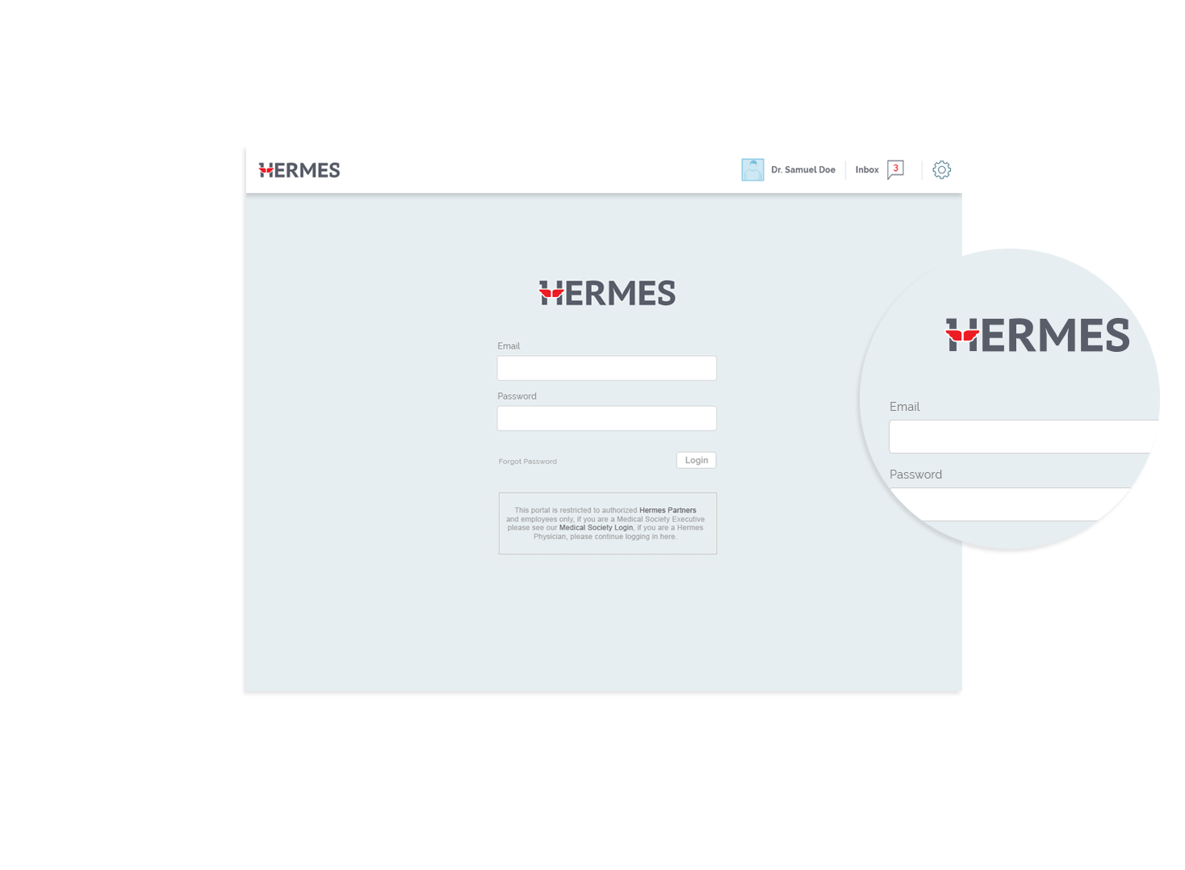

LOGIN PAGE
Logo and login

Slide 6
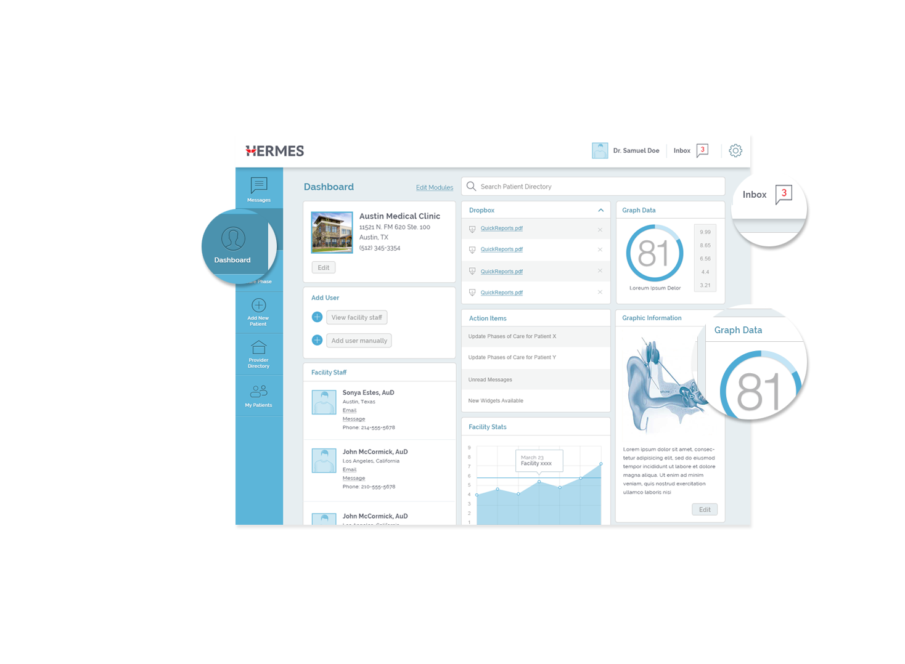
DASHBOARD
Alerts and
Notifications
Action Bar
Graphical Data
(Patient, Facility,
and Physician)

Slide 7
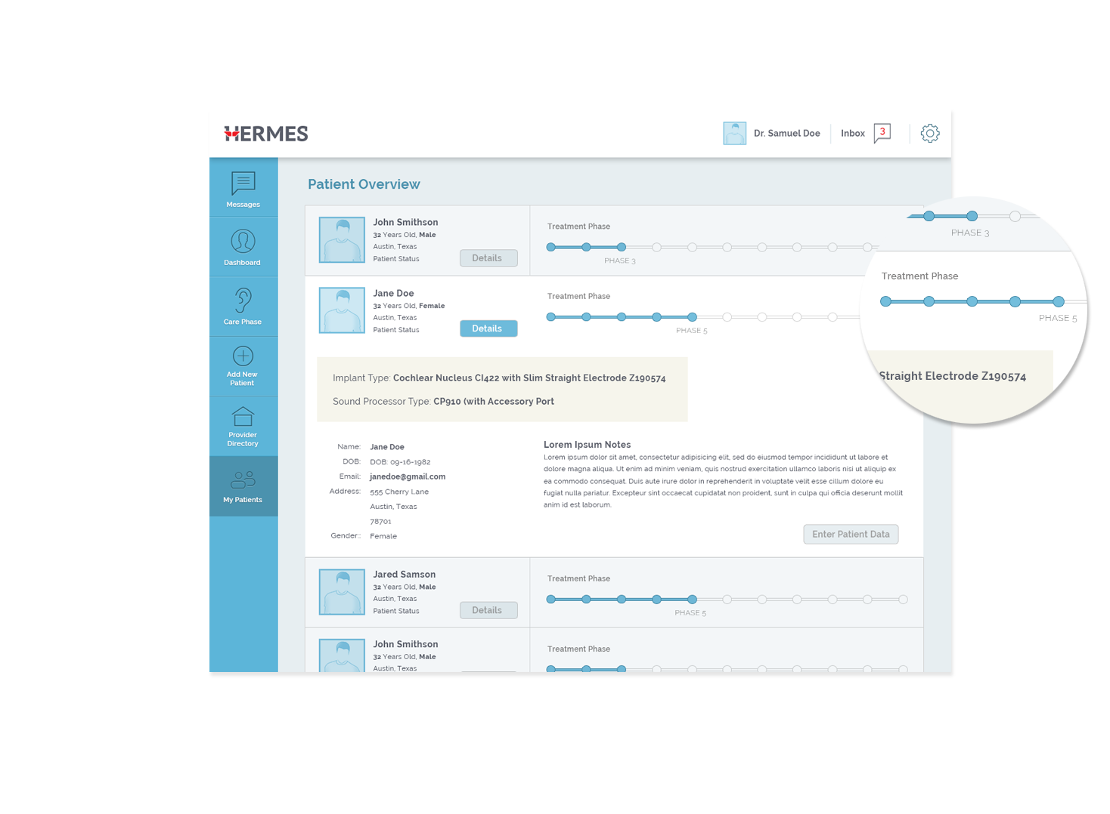
PATIENT STATUS
Visual indication
of Phases of Care
Status.
Drill-down into the
patient record for
updating.

Slide 8
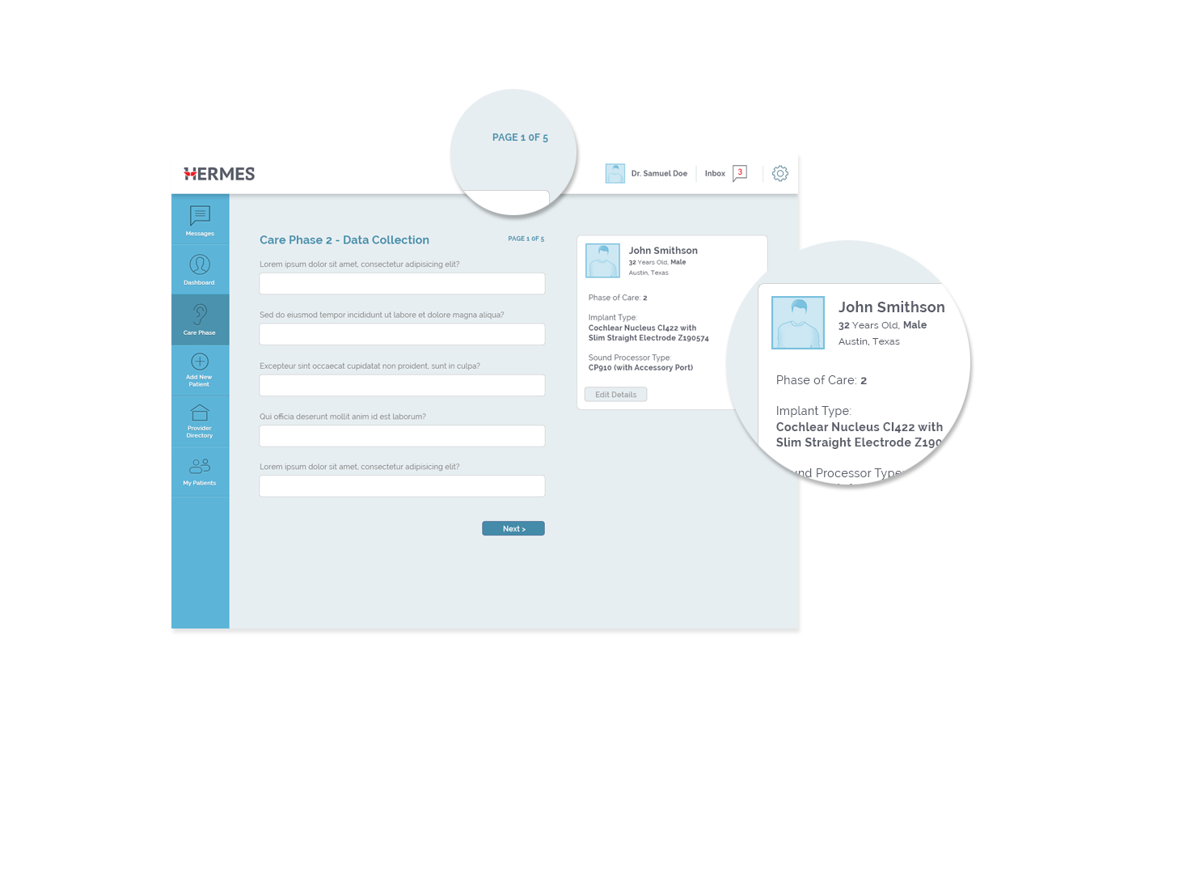
DATA COLLECTION
‘Wizard Style’ data entry with indication of
how many steps the user must complete.
Patient Data with
current Phase of
Care and Implant
Type.

Slide 9
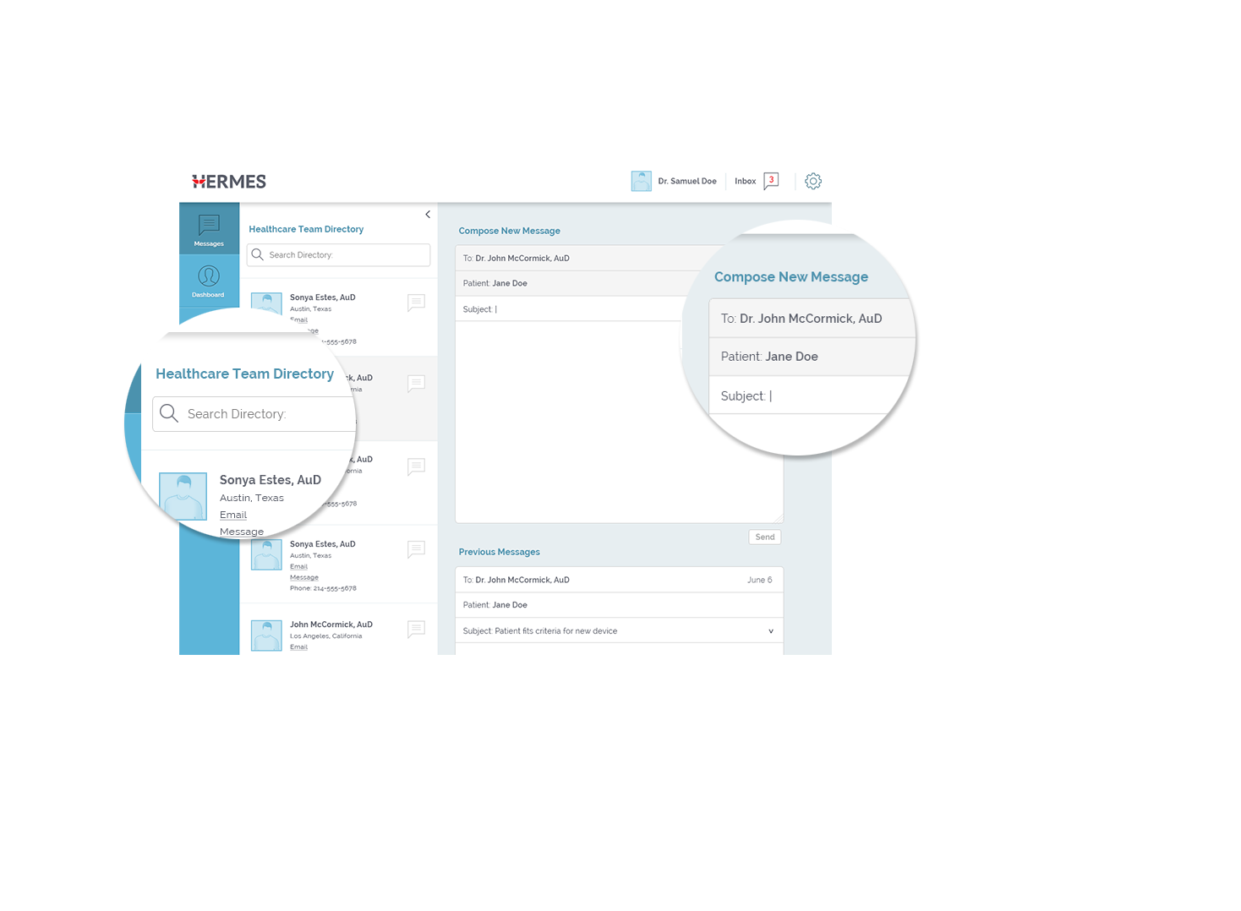
MESSAGES
Searchable
directory
Patient name
auto-fills based
on the user
he/she is
associated with.

