Slide 1
Student Admission
Presented by Ranty and kooloina

Slide 2
Context and problem
Here we have a dataset about students admission
We suppose that we are the administrator of a uiversity and want to determine each applicant’s chance of admission based on their results on two exams
The goal is to build a logistic regression model using historical applicant data (two exam scores and admission decisions) to predict the probability of admission for new applicants.

Slide 3
data descriptions
The datasets are divided into X_train and Y_train
Training data contains historical records of student applications.
Features (X):
Exam 1 score
Exam 2 score

Slide 4
Target (y):
1 → Student admitted
0 → Student not admitted
Each row represents one applicant.
X_train contains exam scores on two exams for a student, y_train is the admission decision, y_train = 1 if the student was admitted, y_train = 0 if the student was not admitted
The shape of X_train is: (100, 2)
The shape of y_train is: (100,)
We have m = 100 training examples

Slide 5
Data visualization
Before training the model, the dataset is visualized.
Purpose:
Understand class distribution
Observe separation between admitted and rejected students

Slide 6
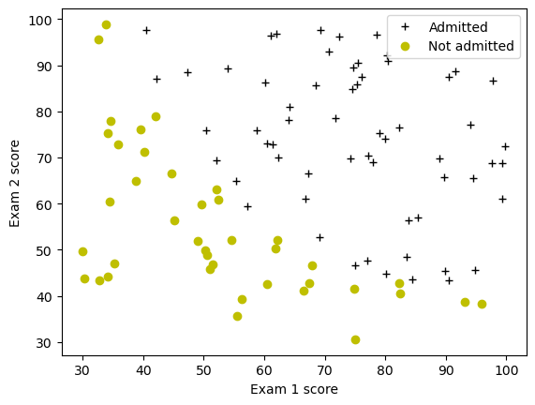
Exam 1 vs Exam 2 with different markers for each class.
Here is the plot :

Slide 7
Logistic regression model
Logistic Regression is used for classification.
Instead of predicting a number directly,
It predicts the probability that an example belongs to class 1.
If probability ≥ 0.5 → predict admitted
If probability < 0.5 → predict not admitted.

Slide 8
Sigmoid function
Logistic Regression uses the sigmoid function.
It converts any real value into a probability between 0 and 1.
Interpretation:
Output close to 1 → high chance of admission
Output close to 0 → low chance of admission.
Here, sigmoid(0) = 0.5 and for a matrix :
sigmoid([-1, 0, 1, 2]) | [0.26894142 0.5 0.73105858 0.88079708]

Slide 9
Cost function for logistic regression
The model parameters are learned by minimizing a cost function.
Goal:
Reduce the difference between predicted probabilities and actual admission outcomes.
This ensures the model learns the best decision boundary.
Here, Cost at initial w (zeros): 0.693 and Cost at test w,b: 0.218

Slide 10
Gradient descent training
Parameters are optimized using Gradient Descent.
Steps:
1. Initialize parameters
2. Compute prediction
3. Calculate cost
4. Update parameters iteratively
The process continues until the cost is minimized.
Here, dj_db at initial w (zeros):-0.1
dj_dw at initial w (zeros):[-12.00921658929115, -11.262842205513591] and
dj_db at test_w: -0.5999999999991071
dj_dw at test_w: [-44.831353617873795, -44.37384124953978]

Slide 11
Decision boundary
The trained model produces a decision boundary.
This boundary separates:
Admitted students
Non‑admitted students
It is plotted on the Exam1 vs Exam2 graph.

Slide 12
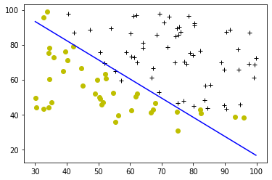
Here is the plot

Slide 13
Model evaluation
After training, the model is evaluated.
Key metric:
Accuracy = Correct predictions / Total predictions
Good performance means the model correctly predicts
student admission based on exam scores.
The Train Accuracy: 92.000000

Slide 14
Regularized Logistic Regression
Problem Statement
We are the product manager of the factory and you have the test results for some microchips on two different tests.
From these two tests, we would like to determine whether the microchips should be accepted or rejected.
To help to make the decision, we have a dataset of test results on past microchips, from which we can build a logistic regression model.
Here, The shape of X_train is: (118, 2)
The shape of y_train is: (118,)
We have m = 118 training examples

Slide 15
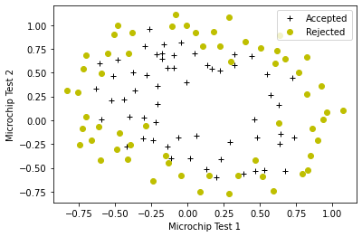
The plot :

Slide 16
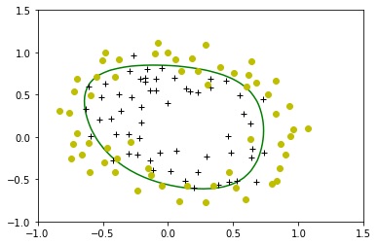
Plotting the decision boundary

Slide 17
Interpretation of results and train accuracy
Observations:
Higher exam scores increase admission probability
Logistic regression provides interpretable results
The model learns a linear decision boundary.
Train Accuracy: 82.203390

Slide 18
Thank you !

