Slide 1
Predicting
Epileptic Seizures
CS 584: Machine Learning Tania Soutonglang (A20439949)

Slide 2
Problem
For this project, I will be comparing four different machine learning models to find the most effective method of classifying seizure activity from EEG signals.

Slide 3
Motivation
Epilepsy is a neurological disorder in which brain activity becomes abnormal, causing periods of unusual behavior, sensations and sometimes loss of awareness, but seizures are the most common form of signs of epilepsy. Continuous research have gone into correctly diagnosing epilepsy, which have shown how electroencephalogram (EEG) is crucial for accurate diagnosis.

Slide 4
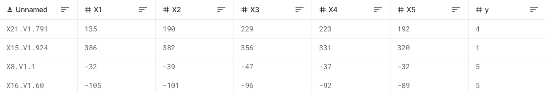
Dataset Information
Kaggle: Epileptic Seizure Recognition
500 participants
Each person was recorded for 23.6 seconds to get 4097 data points
4097 data points divided into 23 rows per person gave 178 data points per second
23 rows × 500 people = 11,500 pieces of information in the dataset
y column = labels

Slide 5
Dataset Information
5 labels {1, 2, 3, 4, 5}
Recording of seizure activity
They recorded the EEG from the area where the tumor was located
They identified where the region of the tumor was in the brain and recorded the EEG activity from the healthy brain area
Patient had their eyes closed at time of recording the EEG signal
Patient had their eyes open when recording the EEG signal
Binary classification (no seizure vs. seizure)
1: epileptic seizure
0: no epileptic seizure

Slide 6
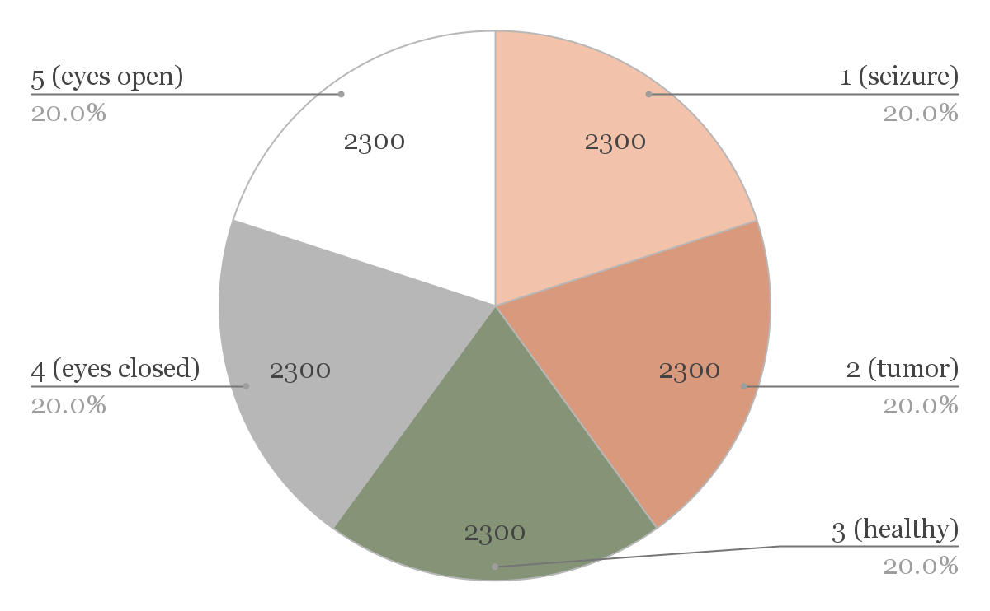
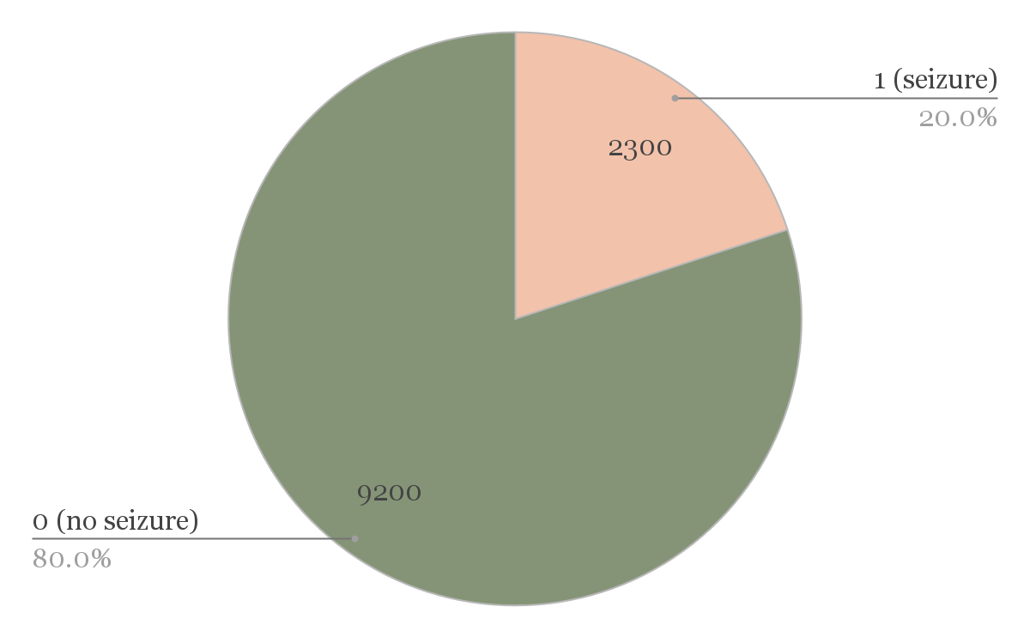
Dataset Breakdown
Original Labels
Binary Labels

Slide 7

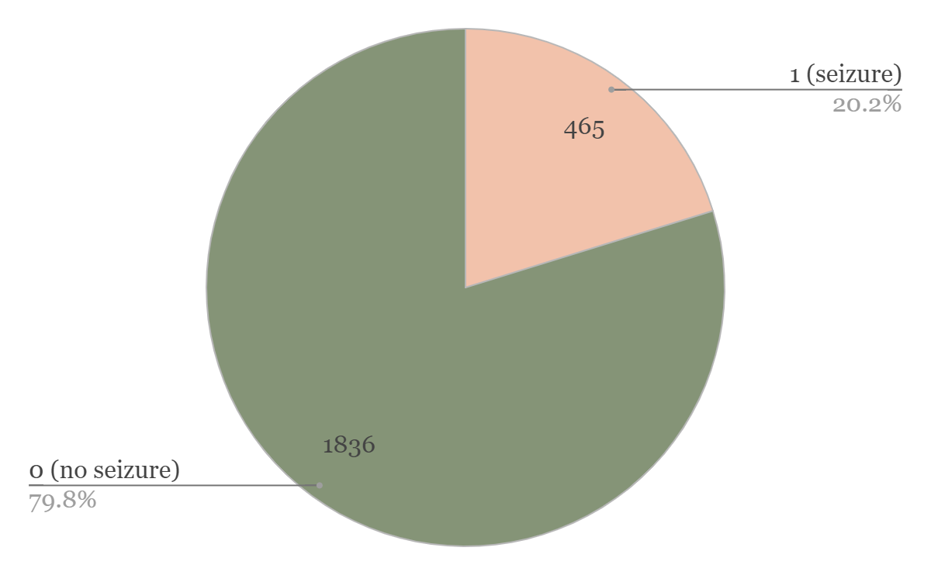
Dataset Breakdown
Training Set
Testing Set

Slide 8
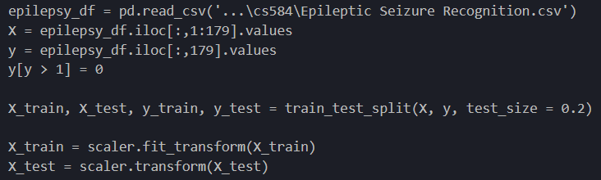
Preprocessing
Extract EEG sets
Extract labels
Change to binary
Split 80% training, 20% testing
Feature scaling

Slide 9
Models Tested
Logistic Regression
Support Vector Machine
Efficient linear classifier
Uses optimal hyperplane to separate data
Naive Bayes
k-Nearest Neighbors
Efficient model that predicts probability based on Bayes’ theorem
Uses proximity to make classifications

Slide 10
Evaluation
Model | Accuracy | F-Score
Logistic Regression | 0.817826 | 0.183236
Support Vector Machine | 0.978261 | 0.944934
Naive Bayes | 0.963913 | 0.910849
k-Nearest Neighbors | 0.925217 | 0.774278

Slide 11
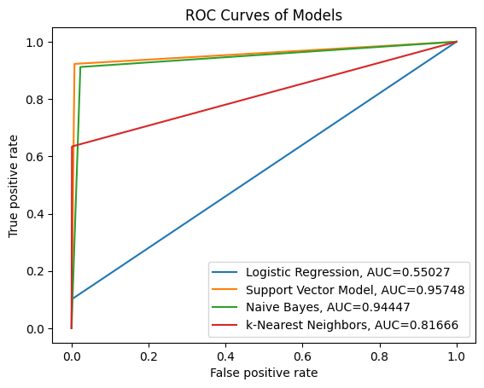
Evaluation
The SVM has the highest accuracy, f-score, roc curve, and auc, therefore we can conclude the SVM as the best model for our problem.

Slide 12
Conclusions + Future
SVM has the highest metrics among the classifiers tested
Apply model to ongoing lab research to validate in a real-world application
Explore more early diagnosis and treatment of epilepsy and other neurological disorders

Slide 13
Thank
you

