Slide 1
AI FROM THE INSIDE
WTF Are AI Agents?
From Chatbots to Autonomous Workflows
Thomas Paule
CEO & Founder, Visory | Chief Digital & AI Officer, Findex
Mander Beer & Learn | February 2026

Slide 2
Why Are We Here?
THE OLD WAY
THE NEW WAY
You prompt. AI answers.
You take it somewhere.
You prompt again.
You are the glue between
every step of the process.
You set the goal; give the context.
The agent plans, acts,
iterates, and delivers.
The system runs end-to-end.
You direct. It executes.
→
AI from the Inside | Mander Beer & Learn | February 2026

Slide 3
Tonight's Agenda
01
Your Feedback
What you told us in the survey — and how it shaped tonight
02
The Theory
WTF are AI Agents? The seven building blocks explained
03
The Practice
Live demos — Claude Code, Claude Cowork, and JackalBot in action
04
Questions & Discussion
Open floor — nothing is off limits
AI from the Inside | Mander Beer & Learn | February 2026

Slide 4
Rules of Engagement
Let's keep it fun, but let's keep it productive.
✋
Raise Your Hand
Questions are encouraged — just raise your hand so we don't have a free-for-all
🍺
Beers Are Encouraged
Just don’t heckle. Remember, you asked for this
🤔
No Dumb Questions
Seriously. If you're thinking it, someone else is too. Ask away.
💻
Follow Along
Feel free to open your laptop and try things in real time.
⏰
60 Minutes
We'll keep it tight. Demos may run longer if they're good and the group is vibing it.
AI from the Inside | Mander Beer & Learn | February 2026

Slide 5
I Asked, You Answered
12 responses that shaped tonight's session

Slide 6
Your Experience Level
No beginners in the room — you're all already in the game.
42%
58%
0%
Daily Users
Occasional Users
Beginners
AI is integral to their workflow
Use AI a few times a week/month
Everyone has some experience
AI from the Inside | Mander Beer & Learn | February 2026

Slide 7
Your Top Concerns
These are the things keeping you up at night.
58%
Data Privacy & Security
50%
Accuracy & Hallucinations
50%
Not Knowing Where to Start
33%
Cost & Subscriptions
AI from the Inside | Mander Beer & Learn | February 2026

Slide 8
Tasks That Should Be Easier
The tedious things you told me about — spoiler: agents can help with all of them.
1
Email Management
4 mentions
2
Data Reporting & Analysis
2 mentions
3
Context Loading (Copy-Paste into AI)
2 mentions
4
Client Monitoring & Touchpoints
1 mention
5
Proposals & Scoping
1 mention
6
Design Documentation
1 mention
AI from the Inside | Mander Beer & Learn | February 2026
"I've been wanting to learn how to setup an agent so that every Thursday when data is released, I come to work and a report is sitting there for me."

Slide 9
What You Want From Tonight
SESSION PREFERENCE
TOP REQUESTS
83%
Genuine AI agents I can use today
Practical setup steps
Secure environment guidance
Best tools for their workflow
want a balanced mix
of theory and practice
Promise Tonight
This session is built around what you asked for. Theory to understand the building blocks, then real demos you can take away and try tomorrow.
AI from the Inside | Mander Beer & Learn | February 2026

Slide 10
WTF Are AI Agents?
The building blocks — explained like you're building a human

Slide 11
The Seven Building Blocks
Every agent — simple or complex — is made of these same components.
1
2
3
4
Model
Instructions
Skills
Tools
The Brain
Identity & Rules
Learned Capabilities
Actions
5
6
7
Context
Memory
Orchestration
Task-Specific Info
Persistence
Planning
AI from the Inside | Mander Beer & Learn | February 2026

Slide 12
Building an Agent Is Like Building a Human
HUMAN
Brain
Raw intelligence & reasoning
Personality
Values, style, guardrails
Experience
Learned expertise & skills
Tools
Physical interactions
Task Instructions
Task-specific knowledge
Long-term Memory
Experience over time
Executive Function
Planning & sequencing
AI from the Inside | Mander Beer & Learn | February 2026

Slide 13
Building an Agent Is Like Building a Human
HUMAN
AI AGENT
Brain
Raw intelligence & reasoning
↔
Model
LLM (Claude, GPT, etc.)
Personality
Values, style, guardrails
↔
Instructions
System prompt & rules
Experience
Learned expertise & skills
↔
Skills
Packaged expertise
Tools
Physical interactions
↔
Tool Calling
API calls & actions
Task Instructions
Task-specific knowledge
↔
Context
Dynamic task data
Long-term Memory
Experience over time
↔
Memory
Cross-session persistence
Executive Function
Planning & sequencing
↔
Orchestration
Chain of thought
AI from the Inside | Mander Beer & Learn | February 2026

Slide 14
1 Model — The Brain
The underlying AI that reasons, generates, and makes decisions.
KEY INSIGHT
There is a different model that excels at every task. Match the brain to the job.
HIGH
MID
LIGHT
Claude Opus
Claude Sonnet
Claude Haiku
Heavy lifting
Everyday workhorse
Fast & cheap
Complex financial analysis,
multi-step reasoning
Code generation, reports,
general business tasks
Simple categorization,
quick classification
AI from the Inside | Mander Beer & Learn | February 2026

Slide 15
2 Instructions — Identity & Rules
The persistent definition of who the agent is — its personality, standards, and guardrails.
EXAMPLE SYSTEM PROMPT
"You are a senior financial controller.
Be precise and conservative.
Always flag discrepancies over $500.
Never auto-approve payments above $10,000.
Explain your reasoning for every decision."
Think of instructions as the agent's training and professional standards — not just what it can do, but how it should behave.
AI from the Inside | Mander Beer & Learn | February 2026

Slide 16
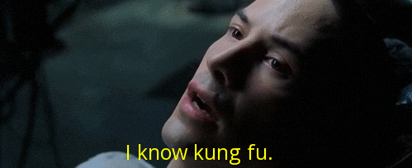
3 Skills — Learned Capabilities
Packaged expertise — not just access, but judgment and process.
Skills are to agents what apps are to phones.
Download pre-built skills from online databases, or write your own. Each skill bundles knowledge, judgment, and process into a reusable package.
Like uploading kung fu to Neo's brain — instant capability
EXAMPLE SKILL
Front-end design skills
Create distinctive, production-grade frontend interfaces with high design quality. Use this skill when the user asks to build web components, pages, or applications. Generates creative, polished code that avoids generic AI aesthetics.
AI from the Inside | Mander Beer & Learn | February 2026

Slide 17
4 Tools — Actions
Read and write API calls for the agent to operate
🔍
Search Web
🗄
Query Database
✉
Send Email
Google Chrome / Mozilla / etc
Github / Vercel
Gmail / Outlook
🏦
Read Bank Feed
📄
Create Document
📝
Write Messages
Xero, MYOB, Quickbooks
Microsoft word / Google docs
WhatsApp / Discord / Text
Tools are what the agent can interact with. Skills determine how and when it uses them.
AI from the Inside | Mander Beer & Learn | February 2026

Slide 18
Skills vs Tools
SKILLS
TOOLS
HOW to do something
WHAT to interact with
Carry judgment & process
Single-purpose actions
Know when to escalate
No awareness of context
Reusable expertise packages
Discrete, standalone verbs
e.g. “Design an email template"
e.g. "Send email"
AI from the Inside | Mander Beer & Learn | February 2026

Slide 19
5 Context — Task-Specific Info
Dynamic, relevant information for this particular job. Changes every time. Makes work specific, not generic.
Sound familiar? "Copying and pasting everything into GPT" — this is context loading, and agents solve it.
EXAMPLE CONTEXT FOR A BOOKKEEPING AGENT
Client's chart of accounts
247 bank transactions this month
Cash-basis accounting preference
Fiscal year ends June 30
The best AI is one that already knows your world.
AI from the Inside | Mander Beer & Learn | February 2026

Slide 20
6 Memory — Persistence
What the agent retains and applies across sessions. Turns every interaction from a cold start into a continuation.
WITHOUT MEMORY
WITH MEMORY
Every session starts from zero
You re-explain preferences each time
Same mistakes repeated
No learning or improvement
Builds familiarity over time
Learns your preferences
Avoids repeating mistakes
Proactively flags patterns
EXAMPLE
The agent remembers that a client always miscodes contractor payments to 'office supplies' — so it proactively flags and reclassifies without being told.
AI from the Inside | Mander Beer & Learn | February 2026

Slide 21
7 Orchestration — Planning & Sequencing
How the agent decides what to do, in what order. The difference between a fixed script and dynamic reasoning.
EXAMPLE: NEW CLIENT ONBOARDING
Gather documents
Set up chart of accounts
Connect bank feeds
Run categorization
Flag exceptions
→
→
→
→
THE KEY DIFFERENCE
A script follows fixed steps regardless of what happens.
An orchestrated agent reasons dynamically — if the bank feed fails, it adapts. If documents are missing, it asks. It plans, re-plans, and recovers.
AI from the Inside | Mander Beer & Learn | February 2026

Slide 22
The Big Leap
From Chatbots to Agents
CHATBOT ERA
AGENT ERA
Question → Answer
Question → Answer
Question → Answer
You are the glue.
→
Goal → Plan → Act → Iterate → Deliver
Multi-step workflows.
No human in the loop.
End-to-end execution.
You used to jockey the system. Now the system runs itself.

Slide 23
✓ Theory Complete
Now let's see it in action.

Slide 24
Agents Doing Real Work
Live demos — from code generation to your own personal JARVIS

Slide 25
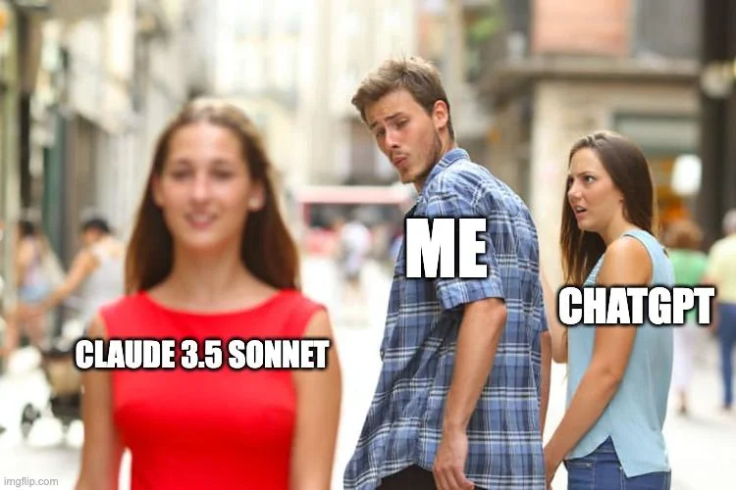
The Tech Stack
Claude and Claude Code are now the market leaders for how I work.
I'm not anti-ChatGPT. But Claude has pulled ahead for the kind of work I do.
AI from the Inside | Mander Beer & Learn | February 2026

Slide 26
Demo 1: Claude Code
Chain of thought, to-dos, and skills in action.
1
2
3
4
Write the Intent
Point the Agent
Watch It Work
Wake Up to Results
Create a prototype spec
and requirements in GitHub
Tell Claude Code to
build from the spec
Chain of thought, to-do list,
tool calling in real time
26,000 lines of code
written overnight
26,000
"I didn't write the code.
I wrote the intent.
The agent figured out the rest."
lines of code written overnight
AI from the Inside | Mander Beer & Learn | February 2026

Slide 27
The Recursive Leap
Software is building software. Improvements are becoming recursive.
▼ You are here
We're on the steep
part of the J-curve.
CAPABILITY
This is moving at a pace I've never seen before, ultimately towards AGI.
Software is building
software to speed up
the change curve.
2023
2024
2025
2026
AGI?
TIME
AI from the Inside | February 2026

Slide 28
Demo 2: Claude Cowork
This presentation was built using the technique I'm about to show you.
1
Load Context
Select a local folder with all your reference files, data, and brand guidelines. The agent reads everything.
2
Write Prompt
Give clear instructions — structure, tone, content requirements. The more specific, the better the output.
3
Watch It Run
The agent creates a chain of thought, builds a to-do list, and works through each step autonomously.
LIVE DEMO
AI from the Inside | Mander Beer & Learn | February 2026

Slide 29
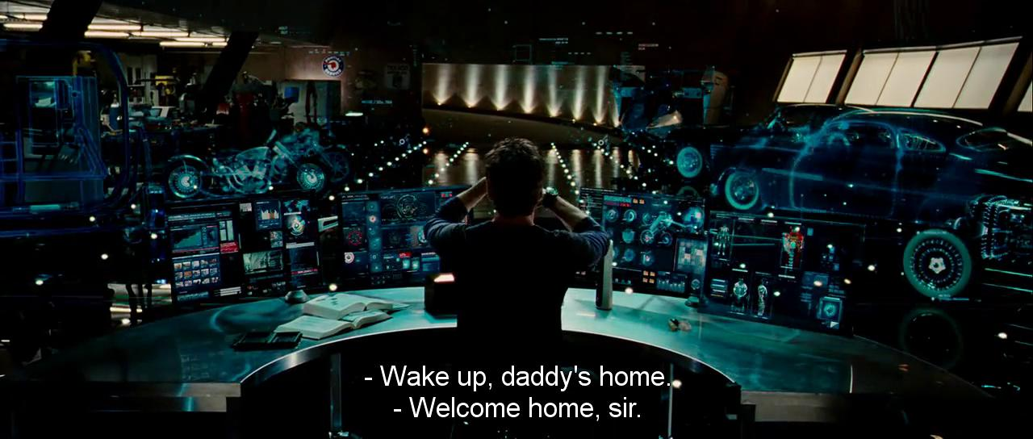
Demo 3: JackalBot
What if you had your own JARVIS?
My personal AI agent — cloud-hosted, always on, built on the OpenClaw framework.

Slide 30
JackalBot Architecture
Digital Ocean (Cloud)
JackalBot
Discord Interface
Not on local machine
Claude LLM | OpenClaw Framework
Bidirectional comms
CAPABILITIES
Gmail
Calendar
Voice
Send & read emails
Google Calendar access
Transcribe voice notes with Eleven Labs
Web
Memory
Skills
Search & browse
Cross-session recall
Modular expertise
AI from the Inside | Mander Beer & Learn | February 2026

Slide 31
JackalBot: Live Demo
Voice note to email — in real time, right now.
1
2
3
4
Send Voice Note
Agent Transcribes
Agent Processes
Email Sent
Record a voice message in Discord
JackalBot converts speech to text
Extracts tasks, recipients, content
Everyone in the room gets the email
"That just happened in real-time. No copy-paste. No switching apps. No human glue."
LIVE DEMO IN DISCORD
AI from the Inside | Mander Beer & Learn | February 2026

Slide 32
The Risk Side
More data + more tools = more risk. Security isn't optional.
Malicious Skills
HIGH
Email Access
HIGH
People uploaded malware into online skill databases. If your agent auto-installs skills, you're vulnerable.
An agent with email permissions can send messages as you. Wrong config = reputation damage.
Data Leakage
MED
Unchecked Actions
MED
Context loaded into an agent may be sent to third-party APIs. Know where your data goes.
Without human-in-the-loop, agents can take irreversible actions. Always scope permissions.
With great power comes great responsibility.
AI from the Inside | Mander Beer & Learn | February 2026

Slide 33
From Doers to Instructors
AI'S EVOLUTION
HUMAN EVOLUTION
Talkers
→
Doers
Doers
→
Instructors
AI went from answering questions
to executing complex workflows.
We move from executing tasks
to directing AI that executes for us.
SKILLS THAT MATTER NOW
Clear instruction and intent, increasingly by voice
Novel applications and creative thinking
Agent orchestration and oversight
AI from the Inside | Mander Beer & Learn | February 2026

Slide 34
Today is the worst AI will ever be.
“
It's only going to get better from here.
”
AI FROM THE INSIDE
February 2026

Slide 35
Thank You
Questions & Discussion
Thomas Paule
thomas.paule@visory.com.au| linkedin.com/in/thomaspaule
AI from the Inside | Substack

