Slide 1
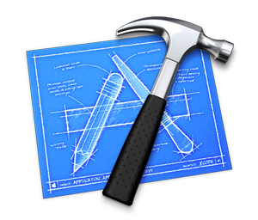


EA Method
is constructing
EA Description
Architecture As-IS
Architecture TO-BE
Transformation Roadmap
Guiding principles for transformation (EA Principles)
is setting up
is using
EA Engine

Slide 2
Bureaucratic organization
(Divisional or functional structure)
IT monarchy
Collaborative Network (Virtual organizations)
Flat organization
Simple centralized organization
Matrix structure
Business monarchy
Feudal organization
Adhocracy
Coopetition
IT Duopoly
Federal IT
Anarchy
Centralized IT
Federal IT
Decentralized IT
High Centralization
High Decentralization

