Slide 1
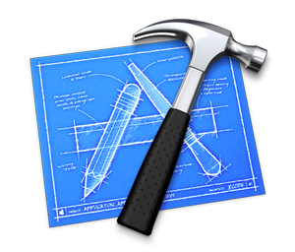


EA Method
EA Description
Business Architecture
Data Architecture
Application Architecture
Infrastructure Architecture
EA Engine

Slide 2
Bureaucratic organization
(Divisional or functional structure)
IT monarchy
Coopetition
Collaborative Networks
Flat organization
Simple centralized organization
Matrix structure
Business monarchy
Virtual organizations
Feudal organization
Adhocracy
IT Duopoly
Federal IT
Anarchy
Centralized
Federal
Decentralized
High Centralization
High Decentralization

