Slide 1
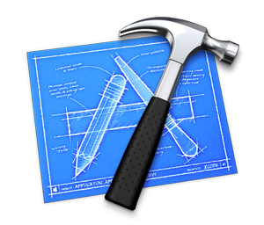


EA Method
EA Description
Business Architecture
Data Architecture
Application Architecture
Infrastructure Architecture
EA Engine

