Slide 1
Quantum Optimization for the Maximum Cut Problem in Large Graphs
By Krissada Sarawit
Advisor Kamonluk Suksen, Ph.D.

Slide 2
Agenda
Motivation
Quantum Potential
Research Statement
Acknowledgements

Slide 3
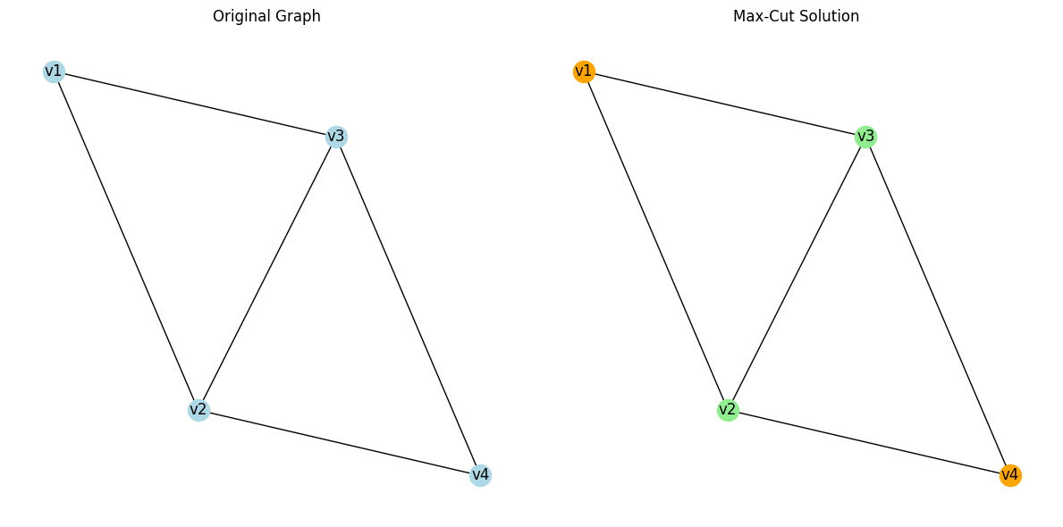
Motivation
The Maximum Cut Problem (Max-Cut)
Goal: Partition a graph’s vertices to maximize edge weights between subsets.
State Space = 2^4 = 16 states
Maximum cut value = 4

Slide 4
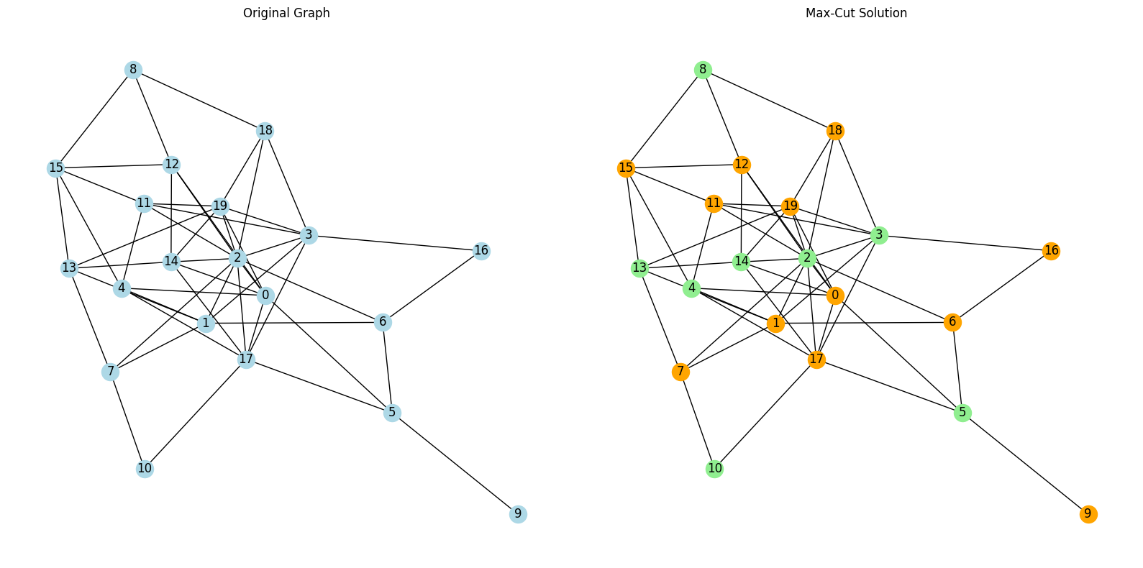
Motivation
The Maximum Cut Problem (Max-Cut)
Larger Graph: The state space grow exponentially
State Space = 2^20 = 1,048,576 states
Maximum cut value = 37

Slide 5
Motivation
Applications:
Network Design
Circuit Layout
Machine Learning
Data Clustering
Challenges
Traditional methods: Effective for small/medium graphs but lack scalability.
Growing problem size: Computational limits hinder classical techniques.

Slide 6
Quantum Potential
Why Quantum Computing for Max-Cut?
Quadratic Unconstrained Binary Optimization (QUBO):
Exploits quantum properties like superposition and entanglement.
Enhances exploration of solution spaces.
QAOA (Quantum Approximate Optimization Algorithm) is a hybrid quantum-classical algorithm that solves optimization problems. It uses a parameterized quantum circuit to prepare a quantum state, which is measured to estimate the objective function value, and classical optimization techniques to update parameters and minimize/maximize the objective function.
Goal: Improve scalability and efficiency for large graphs.
References
D. Rehfeldt, T. Koch and Y. Shinano, "Faster exact solution of sparse MaxCut and QUBOproblems," arXiv:2202.02305, 2022.

Slide 7
Research Statement
Key Objective:
To develop QUBO-based quantum algorithms for solving the Maximum Cut problem in large graphs.
Focus Areas:
Enhancing solution quality.
Improving processing efficiency.
Utilizing hybrid quantum-classical frameworks.

Slide 8
Acknowledgements
Special Thanks To:
Advisor: Dr. Kamonluk Suksen.
Collaborators and Institutions.

