Slide 1

Vision AI in 5 Days: Bootcamp Project
Day-wise Learnings & Code Highlights
By Sriram TS
Notes:
This bootcamp project offers a comprehensive five-day journey into Vision AI, focusing on practical learning and coding insights. It sets the stage for an immersive experience, highlighting the structured day-wise approach to mastering image recognition and related AI techniques. ______

Slide 2

Day 01: Image Recognition & Data Basics
- Introduction to Image Recognition and real-world applications - Basics of Deep Learning and CNNs - Understanding datasets: MNIST, CIFAR-10 - Preprocessing: resizing, normalization, visualization - Exploratory Data Analysis (EDA)
Notes:
Day 1 introduces the fundamentals of image recognition and its real-world applications, such as facial tagging and autonomous vehicles. We cover the basics of deep learning and convolutional neural networks (CNNs), essential for understanding how machines interpret images. Key datasets like MNIST and CIFAR-10 are discussed, along with preprocessing techniques like resizing and normalization, which prepare data for effective model training. Exploratory Data Analysis (EDA) is also introduced to help uncover patterns and insights in the data. ______

Slide 3
Day 01
What is Image Recognition?
Image recognition is a technology that allows computers to identify and understand objects, people, places, or patterns in images. For example:
Facebook tagging a friend in a photo
Google Photos grouping similar images
A self-driving car recognizing traffic signs
It is often done using machine learning or deep learning techniques.
What is Deep Learning?
Deep learning is a type of machine learning where a computer learns patterns using many layers of artificial neurons (similar to the human brain’s structure).
It works well with large amounts of data.
Used in speech recognition, image classification, translation, and more. Example: A deep learning model can learn to tell if an image contains a cat or a dog, without being explicitly told the rules for “cat” or “dog.”
What is a Dataset?
A dataset is a collection of data used for training and testing machine learning models.
In image recognition, a dataset might be a folder containing thousands of labeled images (e.g., “cat,” “dog,” “car”).
In text analysis, a dataset could be thousands of sentences or documents.
Notes:
Here, we delve deeper into what image recognition entails—enabling computers to identify objects and patterns in images using machine learning. Deep learning, a subset of machine learning, uses layered neural networks to learn complex patterns from large datasets. We also define datasets as collections of labeled data crucial for training and testing models, emphasizing their role in building accurate image recognition systems. ______

Slide 4
Day 01
Why Preprocessing?
Preprocessing is cleaning and preparing raw data before feeding it into a machine learning model. Reasons:
Remove noise or errors in the data
Standardize formats (e.g., resize images, normalize values)
Improve model accuracy and speed
Example: Before training an image recognition model, you might resize all images to 224×224 pixels and adjust brightness.
What is EDA (Exploratory Data Analysis?)
Exploratory Data Analysis is the process of examining and visualizing data to understand its structure, patterns, and relationships before building a model. You might:
Check for missing values
Look at distributions of data
Create plots and graphs Purpose: To detect problems, gain insights, and decide next steps in data preparation.
Notes:
Preprocessing is critical for cleaning and standardizing raw data to enhance model performance. This includes resizing images to uniform dimensions and normalizing pixel values to reduce variability. Exploratory Data Analysis (EDA) helps us understand data quality and distribution through visualization and statistical checks, guiding us in making informed decisions before model training. ______

Slide 5
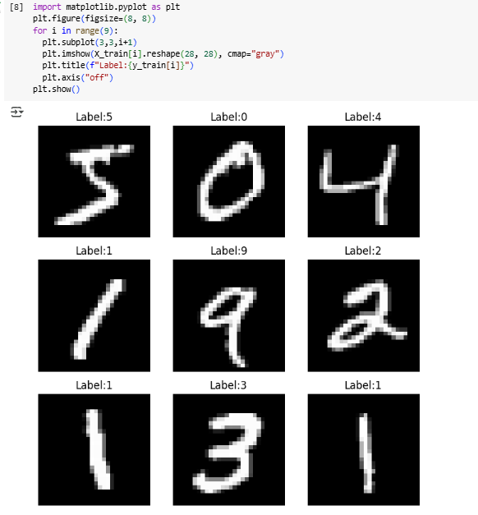
Day 01: Code Snippet

Slide 6

Day 02: CNN Fundamentals
- CNN architecture: Convolution, Pooling, Dense layers - Model training process - Dropout to prevent overfitting - Model evaluation using accuracy & validation metrics
Notes:
Day 2 focuses on the core components of CNNs, including convolutional layers that detect features, pooling layers that reduce dimensionality, and dense layers for classification. We explore the training process, emphasizing techniques like dropout to prevent overfitting, and discuss how to evaluate models using accuracy and validation metrics to ensure they generalize well to new data. ______

Slide 7
Day 02
What is a Convolutional Neural Network (CNN)?
A Convolutional Neural Network is a type of deep learning model designed to work especially well with images.
It automatically learns important features from images (like edges, shapes, and textures).
Uses convolution layers to scan the image in small parts instead of looking at the whole image at once.
This makes it faster and more accurate for image recognition.
Example: In a cat vs dog classifier, the CNN will first detect edges (like whiskers), then shapes (ears), and finally the whole object (cat face).
How does model training work?
Training is how the model learns from data. The process:
Input Data → Feed images and their labels (e.g., “cat”) into the model.
Forward Pass → The model makes a prediction (e.g., “dog” with 70% confidence).
Loss Calculation → Compare the prediction with the correct label and measure the error.
Backward Pass (Backpropagation) → Adjust the weights in the model to reduce the error.
Repeat for Many Epochs → Each pass over the training data improves accuracy.
Notes:
This slide explains CNNs as specialized deep learning models designed for image data. CNNs learn hierarchical features by scanning images in small sections, making them efficient and accurate. The training process involves feeding labeled images, making predictions, calculating errors, and adjusting model parameters iteratively to improve accuracy over multiple epochs. ______

Slide 8
Day 02
How do we use Dropout?
Dropout is a regularization technique used during training to prevent overfitting (when the model memorizes the training data but fails on new data).
At each training step, Dropout randomly turns off some neurons in the network.
This forces the model to learn more general features.
Example: If Dropout rate is 0.5, half of the neurons are ignored in each training round.
How to evaluate a model?
After training, we check the model’s performance on new data (test set). Common steps:
Accuracy → % of correct predictions.
Confusion Matrix → Shows correct and incorrect predictions for each class.
Precision & Recall → For more detailed evaluation.
Loss curves → See if the model is improving or overfitting.
Notes:
Dropout is introduced as a method to improve model generalization by randomly disabling neurons during training, which prevents the model from relying too heavily on any single feature. Model evaluation goes beyond accuracy, incorporating confusion matrices and precision-recall metrics to provide a nuanced understanding of performance, especially in imbalanced datasets. ______

Slide 9
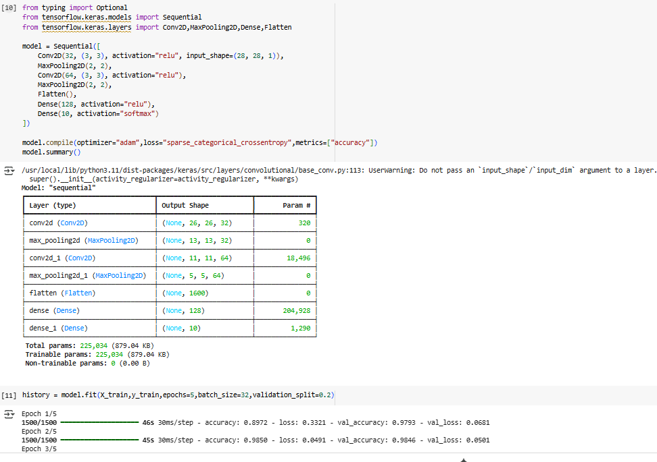
Day 02: Code Snippet

Slide 10

Day 03: Deeper CNNs & Data Augmentation
- Benefits of deeper CNNs for feature extraction - Data augmentation: rotation, flipping, brightness - Advanced evaluation: Precision, Recall, F1-score, AUC-ROC - Applied on CIFAR-10 dataset
Notes:
Day 3 highlights the advantages of deeper CNN architectures that can capture more complex image features, improving recognition capabilities. Data augmentation techniques such as rotation, flipping, and brightness adjustments are used to artificially expand the dataset, enhancing model robustness. Advanced evaluation metrics like F1-score and AUC-ROC are introduced for a more comprehensive assessment of model performance, demonstrated on the CIFAR-10 dataset. ______

Slide 11
Day 03
Why deeper CNNs?
A deeper CNN means the network has more layers (convolution layers, pooling layers, etc.).
Shallow CNN → Can learn only simple features like edges or colors.
Deeper CNN → Can learn complex features like shapes, textures, and even object parts.
Example:
1st layers → Detect lines and edges.
Middle layers → Detect shapes (eyes, nose).
Last layers → Detect complete objects (cat face).
The deeper the network, the better it can understand high-level details in images. However, deeper CNNs need more data and more computing power to avoid overfitting.
Notes:
Deeper CNNs consist of multiple layers that progressively learn from simple edges to complex object parts, enabling better feature extraction. While deeper networks improve accuracy, they require more data and computational resources to avoid overfitting, making careful design and training essential. ______

Slide 12
Day 03
What is Data Augmentation?
Data augmentation is creating new training images from existing ones by applying transformations. Purpose: To make the model more robust and reduce overfitting.
Examples of transformations:
Rotate the image
Flip horizontally or vertically
Change brightness or contrast
Zoom in or crop
If you only have 1,000 images, augmentation can generate thousands of slightly different versions, making the model learn better.
What is Advanced Evaluation Metrics?
Beyond accuracy, some problems need more detailed evaluation. Examples:
Precision → Of all predicted positives, how many are correct?
Recall → Of all actual positives, how many were found?
F1 Score → Harmonic mean of precision and recall (good balance).
AUC-ROC → Measures how well the model separates classes across thresholds.
IoU (Intersection over Union) → For object detection, how much predicted area overlaps with actual object.
These metrics are important when:
Data is imbalanced (e.g., 95% cats, 5% dogs)
Errors have different costs (e.g., medical diagnosis)
Notes:
Data augmentation creates varied training examples by applying transformations to existing images, helping models generalize better. Advanced evaluation metrics such as precision, recall, F1 score, and AUC-ROC provide detailed insights into model performance, especially important when dealing with imbalanced classes or when different types of errors have varying consequences. ______

Slide 13
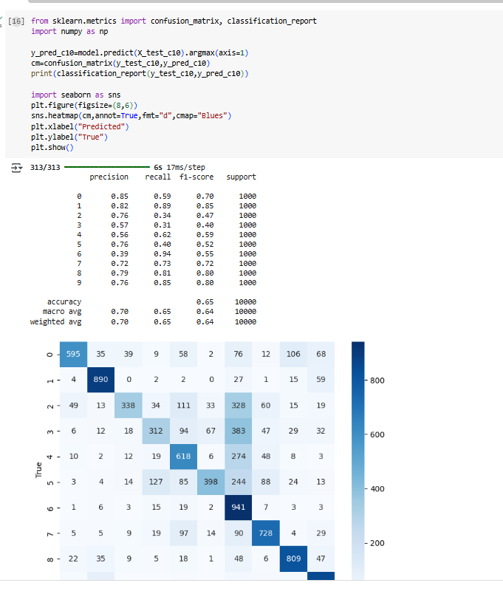
Day 03: Code Snippet

Slide 14
Day 04: Pretrained Model and Transfer Learning
- Pre-trained models: MobileNetV2, ResNet, VGG - Transfer learning implementation - Fine-tuning for improved accuracy - Optimizers and learning rate scheduling
Notes:
Day 4 introduces pre-trained models like MobileNetV2, ResNet, and VGG, which have been trained on large datasets and can be adapted for new tasks. Transfer learning leverages these models to save time and improve accuracy. Fine-tuning techniques and optimization strategies, including learning rate scheduling and choice of optimizers, are discussed to enhance model performance. ______

Slide 15
Day 04
What are pre-trained model?
A pre-trained model is a model that has already been trained on a large dataset by someone else, so you don’t have to start from scratch.
Example:
A CNN trained on ImageNet (millions of images).
You can reuse it for your own problem, often with just small adjustments.
Why use them?
Save time and computing power
Often give better accuracy with less data
Examples: ResNet, VGG16, MobileNet, EfficientNet. MobileNetV2,ResNet,VGG,ImageNet
What is Transfer learning?
Transfer learning is the process of taking a pre-trained model and adapting it to your own task.
Keep the learned features from the original training (edges, shapes, textures).
Replace the last layers with new ones for your problem.
Example:
Pre-trained model learned to recognize 1,000 classes (ImageNet).
You change the output layer to predict only 3 classes: Cat, Dog, Rabbit.
Notes:
Pre-trained models come ready with learned features from extensive datasets, allowing you to build on their knowledge rather than starting from scratch. Transfer learning adapts these models to specific tasks by replacing and retraining the final layers, making it efficient to develop accurate models even with limited data. ______

Slide 16
Day 04
How to Fine Tune and Optimize?
Fine-tuning means slightly re-training the pre-trained model’s layers on your dataset to improve performance.
Steps:
Freeze early layers (keep their weights unchanged).
Train only new layers you added for your task.
Gradually unfreeze some earlier layers and train them at a low learning rate.
Optimization tips:
Use the right optimizer (Adam, SGD)
Use learning rate scheduling (reduce learning rate over time)
Use regularization (Dropout, weight decay)
Monitor validation loss to avoid overfitting
How to Deploy a Model?
Deployment means making your trained model available for real-world use.
Steps:
Save the model (e.g., .h5, .pt, or ONNX format).
Choose where to deploy:
Web app (Flask, FastAPI, Streamlit)
Mobile app (TensorFlow Lite, Core ML)
Cloud service (AWS, Azure, GCP)
Set up an API so other programs can send data and get predictions.
Monitor performance in real-time and retrain if accuracy drops.
Notes:
Fine-tuning involves selectively retraining parts of a pre-trained model to better fit your dataset, starting with freezing early layers and gradually unfreezing them. Optimization techniques like using Adam or SGD optimizers, learning rate schedules, and regularization help improve training outcomes. Deployment covers saving models in various formats and making them accessible via web, mobile, or cloud platforms, ensuring real-world usability and ongoing performance monitoring. ______

Slide 17
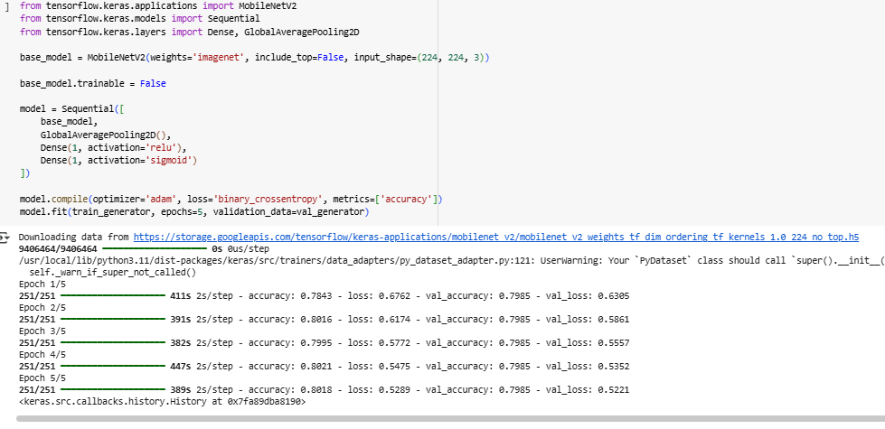
Day 04: Code Snippet

Slide 18

Day 05: Prediction & Deployment
- Making predictions on new data - Preparing portfolio assets - Saving and loading trained models - Visualizing results across datasets - Deployment possibilities
Notes:
Day 5 focuses on using trained models to make predictions on new data, emphasizing consistent preprocessing and interpreting output probabilities. It also covers creating portfolio assets such as GitHub repositories, notebooks, demo videos, and blog posts to showcase your work effectively. Deployment options are discussed to bring models into practical applications. ______

Slide 19
Day 05
How to Predict on New Data?
Once your model is trained and saved, you can use it to make predictions on new, unseen data.
Steps:
Load the trained model from file.
Preprocess the new data the same way you did for training (resize, normalize, etc.).
Feed the data into the model using model.predict() (Keras) or model.forward() (PyTorch).
Interpret the output:
If classification → pick the label with the highest probability.
If regression → read the predicted numeric value.
Example (Image Classification):
Input: New cat photo
Output: [Cat: 0.92, Dog: 0.06, Rabbit: 0.02] → Model predicts Cat.
How to Create Portfolio Assets?
Portfolio assets show your skills to employers or clients. For image recognition projects, you can create:
GitHub Repo → Code, datasets (or dataset links), and README file.
Jupyter Notebook → With step-by-step explanations, code, and results.
Before/After Images → Show input images and predictions.
Short Demo Video → Show the model in action (web app, mobile app).
Blog Post → Explain problem, approach, and results in plain language.
Notes:
Predicting on new data involves loading your saved model, preprocessing inputs identically to training, and running inference to obtain class probabilities or regression outputs. Building portfolio assets demonstrates your skills to potential employers or clients through well-organized code, documentation, and visual examples, enhancing your professional profile. ______

Slide 20
Day 05
Tip: Use a clean structure in GitHub:
project/
├── data/
├── notebooks/
├── models/
├── app/
├── README.md
How to Present Results?
When sharing your results, keep them clear, visual, and easy to understand.
Include:
Problem Statement → What you were trying to solve.
Dataset Info → Size, source, any preprocessing.
Model Used → CNN, transfer learning, etc.
Key Metrics → Accuracy, precision, recall, F1 score, etc.
Visuals:
Graphs of training vs validation accuracy/loss
Confusion matrix for classification problems
Example predictions with correct/incorrect cases
Conclusion → Summary of performance and possible improvements.
Notes:
Organizing your project with a clear folder structure in GitHub improves accessibility and professionalism. Presenting results effectively means summarizing the problem, dataset, model, and key metrics with visual aids like accuracy graphs and confusion matrices. Clear conclusions and suggestions for improvement help communicate the value and potential of your work. ______

Slide 21
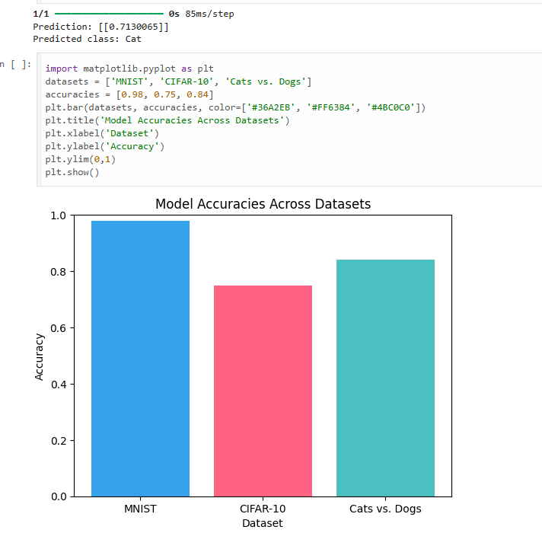
Day 05: Code Snippet

Slide 22
Conclusion & Key Takeaways
- CNNs excel at extracting image features - Data augmentation improves robustness - Transfer learning accelerates development - Proper evaluation ensures reliability - Documentation makes projects portfolio-ready
Notes:
In conclusion, CNNs are powerful tools for extracting meaningful features from images. Data augmentation strengthens model robustness, while transfer learning accelerates development by leveraging existing knowledge. Proper evaluation ensures models are reliable, and thorough documentation prepares projects for sharing and professional presentation. ______

