Slide 1
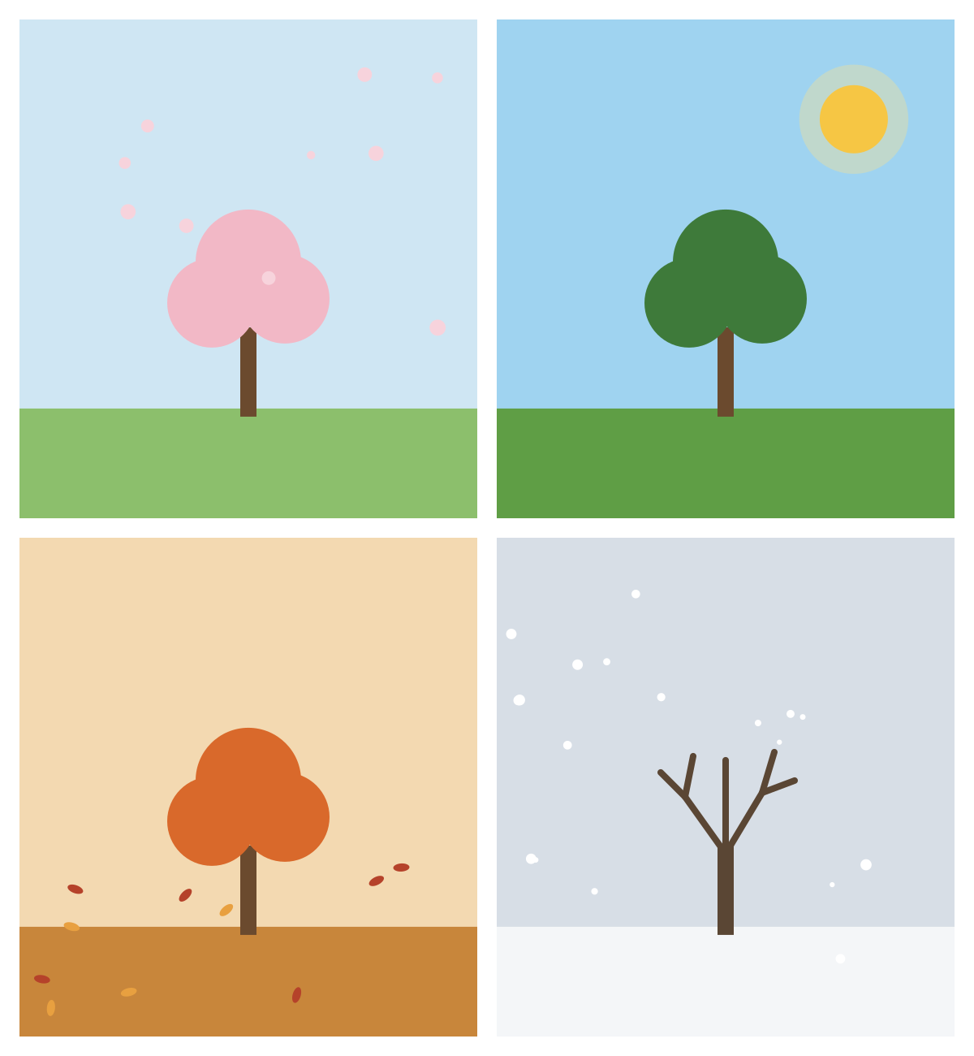
Poetry
Anthology
Seasons & Animals
Made by Lanzi Wang
Notes:
Photo idea: a tree in all four seasons, or a four-season collage. Unsplash search: 'four seasons tree'.

Slide 2
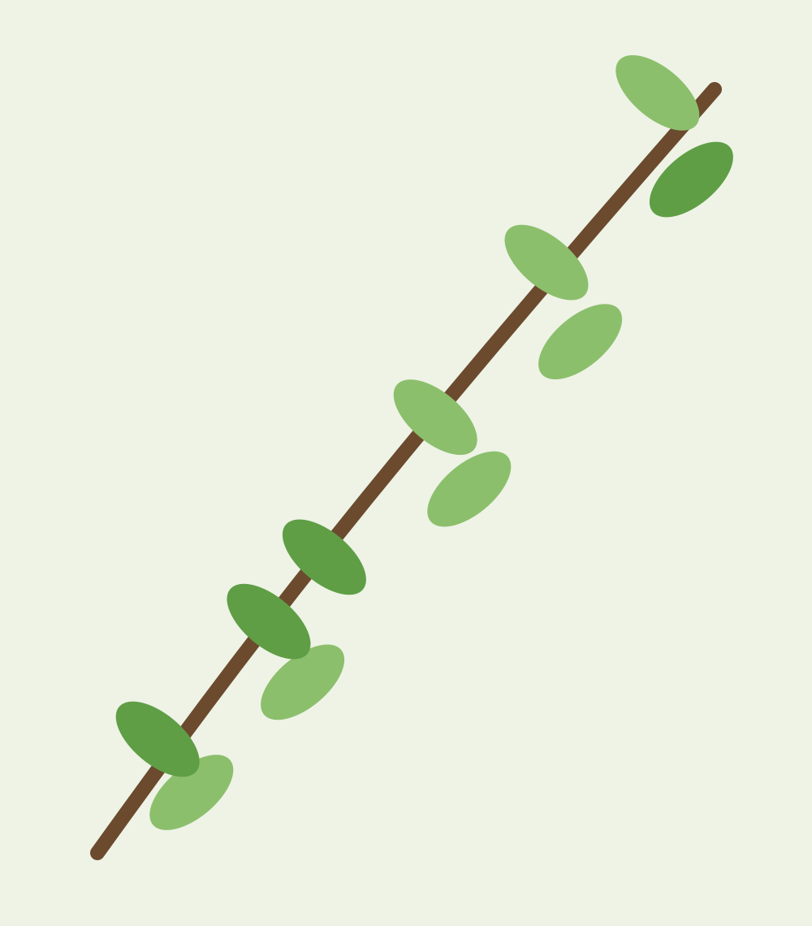
Table of Contents
Seasons | 3
Spring Wakes Up – me | 4
Nothing Gold Can Stay – Robert Frost | 5
Summer Afternoon – me | 6
To Autumn – John Keats | 7
Letting Go – me | 8
Winter Haiku – me | 9
Stopping by Woods on a Snowy Evening – Robert Frost | 10
Animals | 11
The Fox – me | 12
The Tyger – William Blake | 13
The Eagle – Alfred, Lord Tennyson | 14
Glossary | 15
Notes:
Photo idea: a small leaf or branch border. Unsplash search: 'green branch white background'.

Slide 3

Seasons
Spring · Summer · Autumn · Winter
Notes:
Photo idea: a wide landscape photo. Unsplash search: 'rolling hills landscape'.

Slide 4
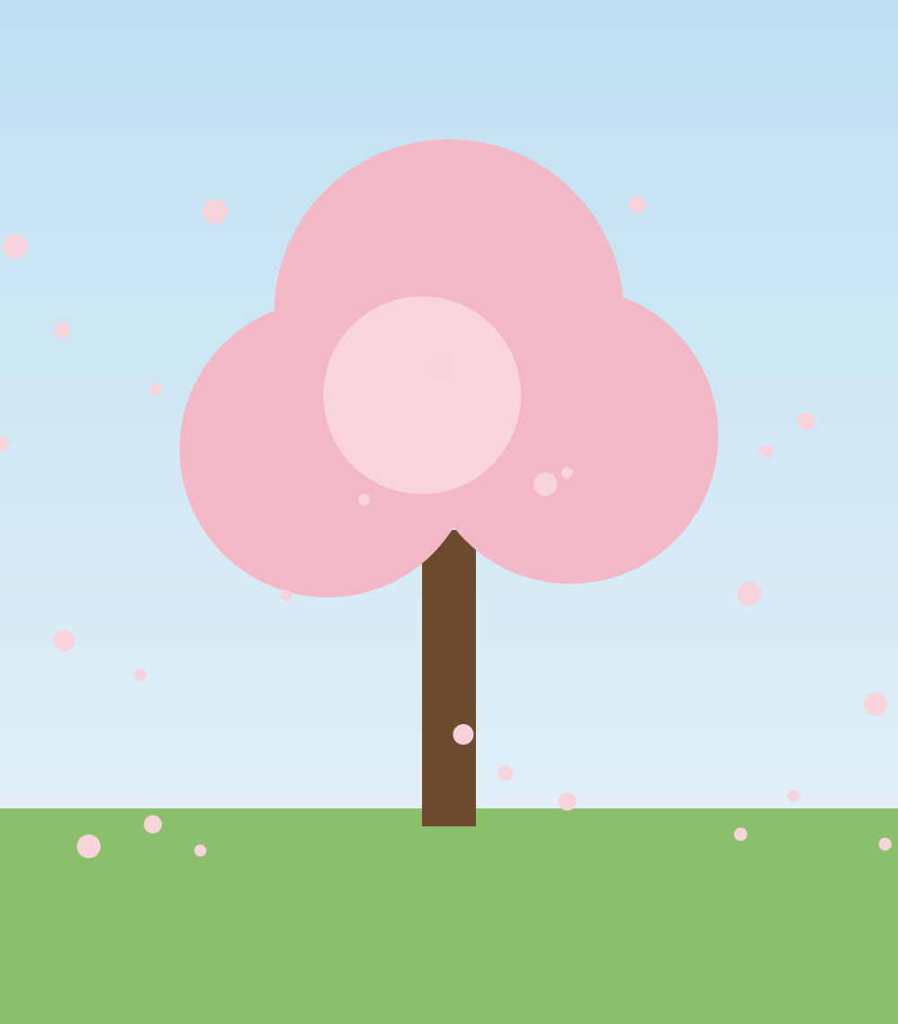
SEASONS
Spring Wakes Up
by me
The snow is gone, the ground is wet,
The mornings are still chilly yet.
A robin sings on the garden wall,
The first green shoots are standing tall.
The trees put on their pink and white,
The days grow long, the sun grows bright.
Everything old feels new again,
Like the world has been washed by rain.
Dedication: I dedicate this poem to my mother because she is the first one out in the garden every spring.
Notes:
Photo idea: cherry blossoms. Unsplash search: 'cherry blossom tree'.

Slide 5
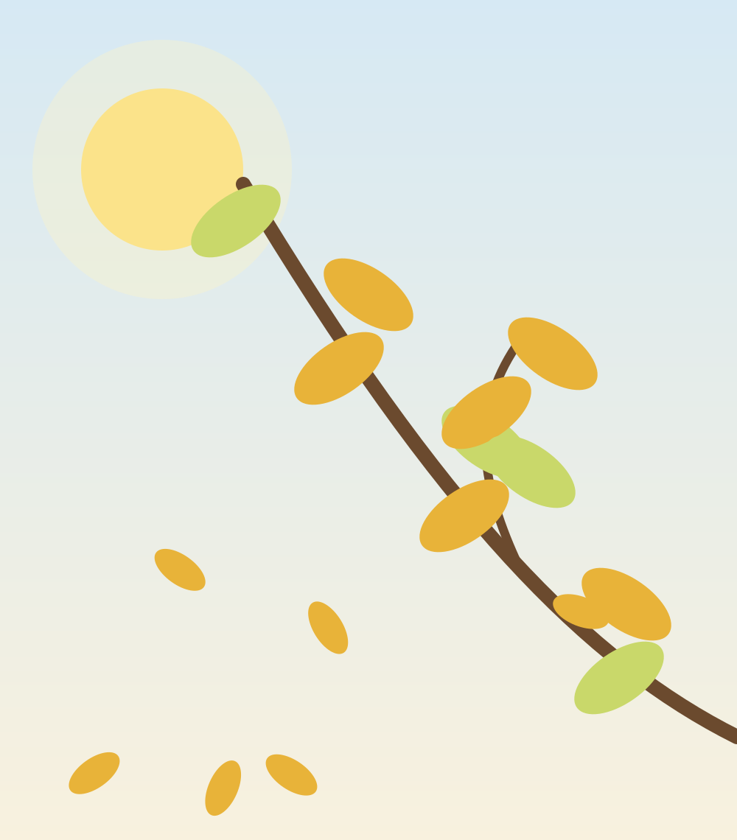
SEASONS
Nothing Gold Can Stay
by Robert Frost
Nature's first green is gold,
Her hardest hue to hold.
Her early leaf's a flower;
But only so an hour.
Then leaf subsides to leaf.
So Eden sank to grief,
So dawn goes down to day.
Nothing gold can stay.
Dedication: I dedicate this poem to my best friend from primary school because our friendship was gold, even if it did not last.
Notes:
Photo idea: new golden-green leaves in the sun. Unsplash search: 'new leaves spring sunlight'.

Slide 6
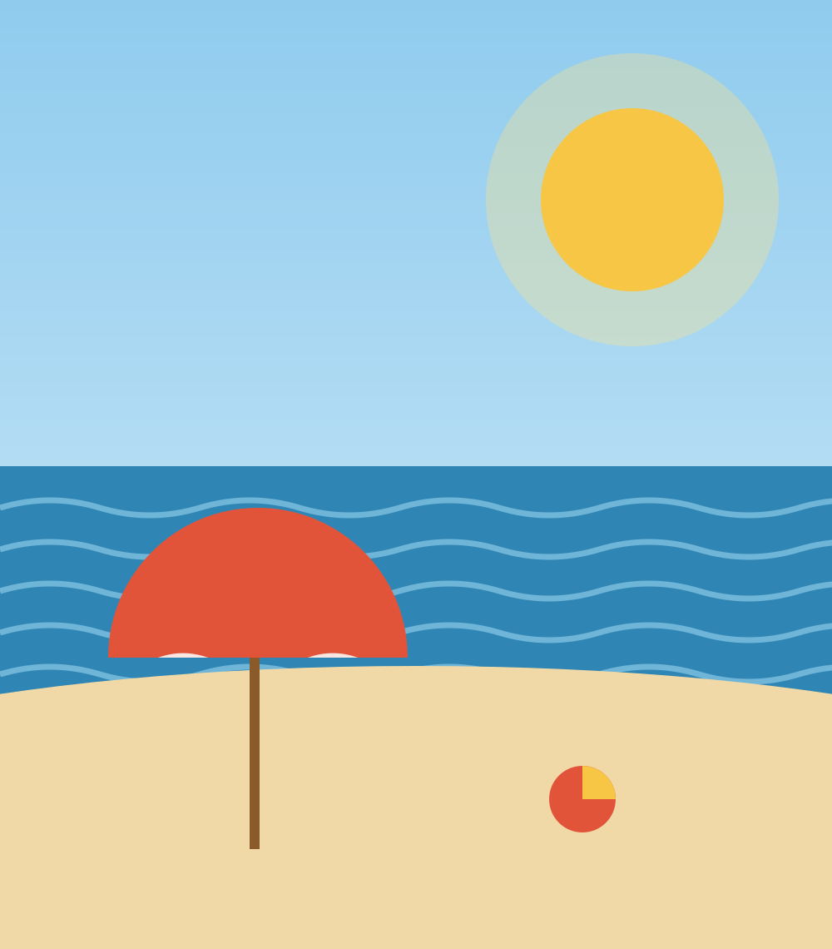
SEASONS
Summer Afternoon
by me
The air is thick and slow.
Even the dog will not get up
from his shady spot under the table.
Somewhere a sprinkler ticks across a lawn,
and the ice in my glass clinks and melts
before I can finish drinking it.
Nobody is in a hurry.
The whole town yawns,
waiting for the evening
to let the cool air back in.
Dedication: I dedicate this poem to a cute dog I met because he taught me how to do nothing on a hot day.
Notes:
Photo idea: a sunny beach. Unsplash search: 'sunny beach'.

Slide 7
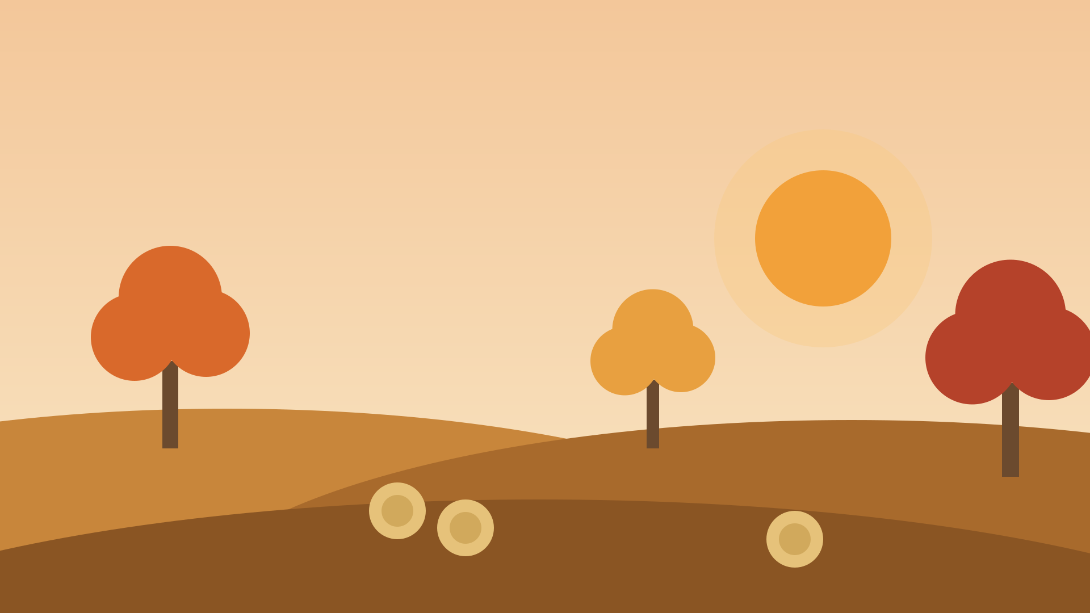
SEASONS
To Autumn by John Keats
Season of mists and mellow fruitfulness,
Close bosom-friend of the maturing sun;
Conspiring with him how to load and bless
With fruit the vines that round the thatch-eves run;
To bend with apples the moss'd cottage-trees,
And fill all fruit with ripeness to the core;
To swell the gourd, and plump the hazel shells
With a sweet kernel; to set budding more,
And still more, later flowers for the bees,
Until they think warm days will never cease,
For summer has o'er-brimm'd their clammy cells.
Who hath not seen thee oft amid thy store?
Sometimes whoever seeks abroad may find
Thee sitting careless on a granary floor,
Thy hair soft-lifted by the winnowing wind;
Or on a half-reap'd furrow sound asleep,
Drows'd with the fume of poppies, while thy hook
Spares the next swath and all its twined flowers:
And sometimes like a gleaner thou dost keep
Steady thy laden head across a brook;
Or by a cyder-press, with patient look,
Thou watchest the last oozings hours by hours.
Where are the songs of spring? Ay, where are they?
Think not of them, thou hast thy music too,—
While barred clouds bloom the soft-dying day,
And touch the stubble-plains with rosy hue;
Then in a wailful choir the small gnats mourn
Among the river sallows, borne aloft
Or sinking as the light wind lives or dies;
And full-grown lambs loud bleat from hilly bourn;
Hedge-crickets sing; and now with treble soft
The red-breast whistles from a garden-croft;
And gathering swallows twitter in the skies.
Response: This is an essential poem because it shows autumn as a time when everything is full and ripe, not just an ending. The poem feels warm and lazy because Keats describes heavy fruit, sleepy bees and a slow cider press. The poem is about accepting change because the last stanza says autumn has its own music, even when the songs of spring are over. The poem uses personification, for example autumn is “sitting careless on a granary floor” like a tired farm worker.
Notes:
Photo idea: autumn leaves or an orchard, placed behind the text and darkened so the poem stays readable. Unsplash search: 'autumn orchard'.

Slide 8
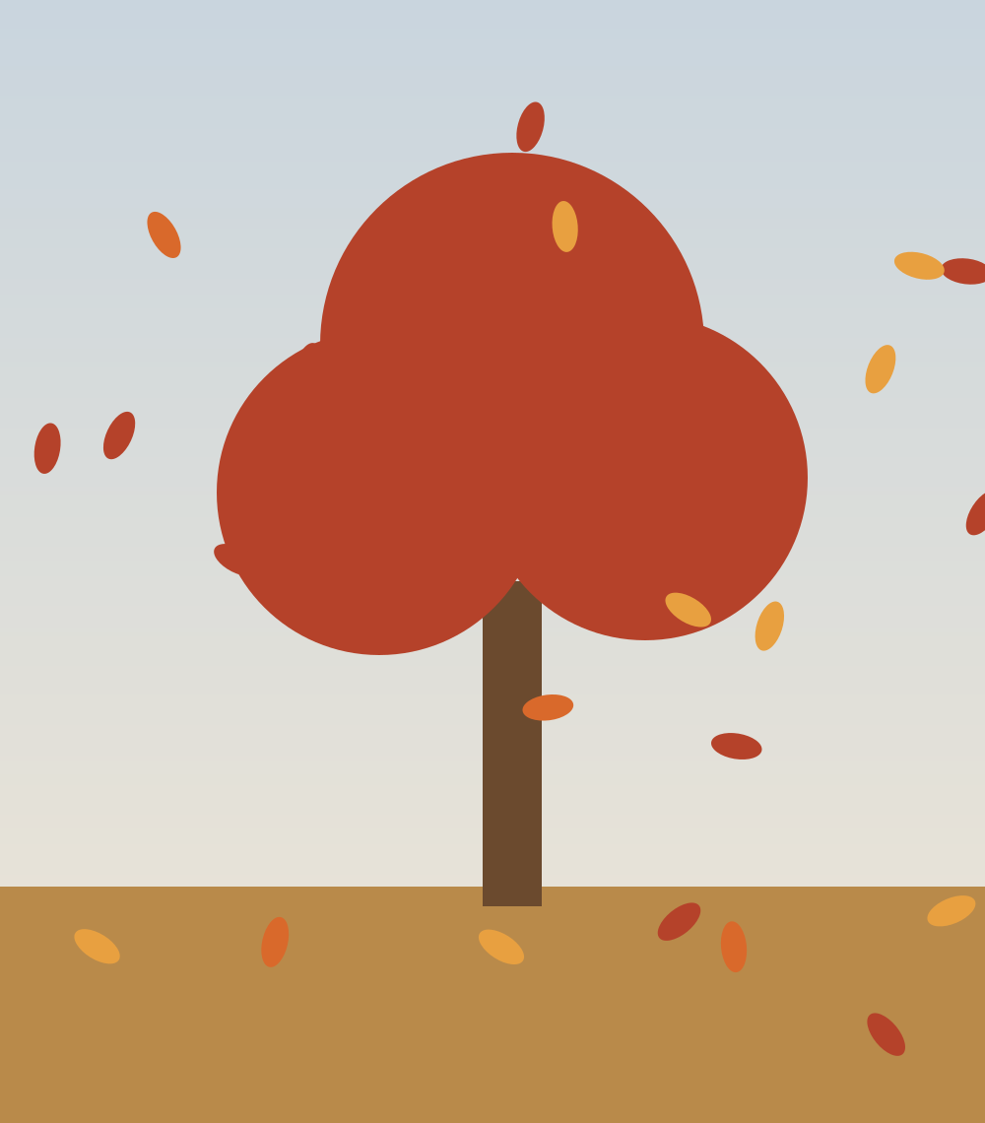
SEASONS
Letting Go
by me
The maple on our street is red,
It drops its leaves like words unsaid.
They crunch and scatter down the lane,
Then soften in the autumn rain.
The tree stands bare but does not mind,
It leaves the summer far behind.
It knows that losing is not the end,
Just a season it has to spend.
Response: This is an essential poem because it takes something ordinary, a tree losing its leaves, and turns it into a lesson about letting go. The poem feels calm and a little sad because the leaves are compared to “words unsaid”. The poem is about accepting loss because the tree does not fight the season, it just waits for the next one. The poem uses an AABB rhyme scheme, for example “red / unsaid” and “lane / rain”, which gives it a steady, gentle rhythm.
Notes:
Photo idea: a red maple dropping its leaves. Unsplash search: 'red maple autumn leaves'.

Slide 9

SEASONS
Winter Haiku
by me
First snow on the roof —
the street goes quiet, as if
the town holds its breath.
Bare branches at dusk —
a crow lands, shakes off the cold,
and the snow falls down.
Footprints in fresh snow
lead from my door to the gate
and then disappear.
Dedication: I dedicate these haiku to my little brother because he still thinks the first snow is magic.
Notes:
Photo idea: first snow on rooftops. Unsplash search: 'snow on roof village'.

Slide 10
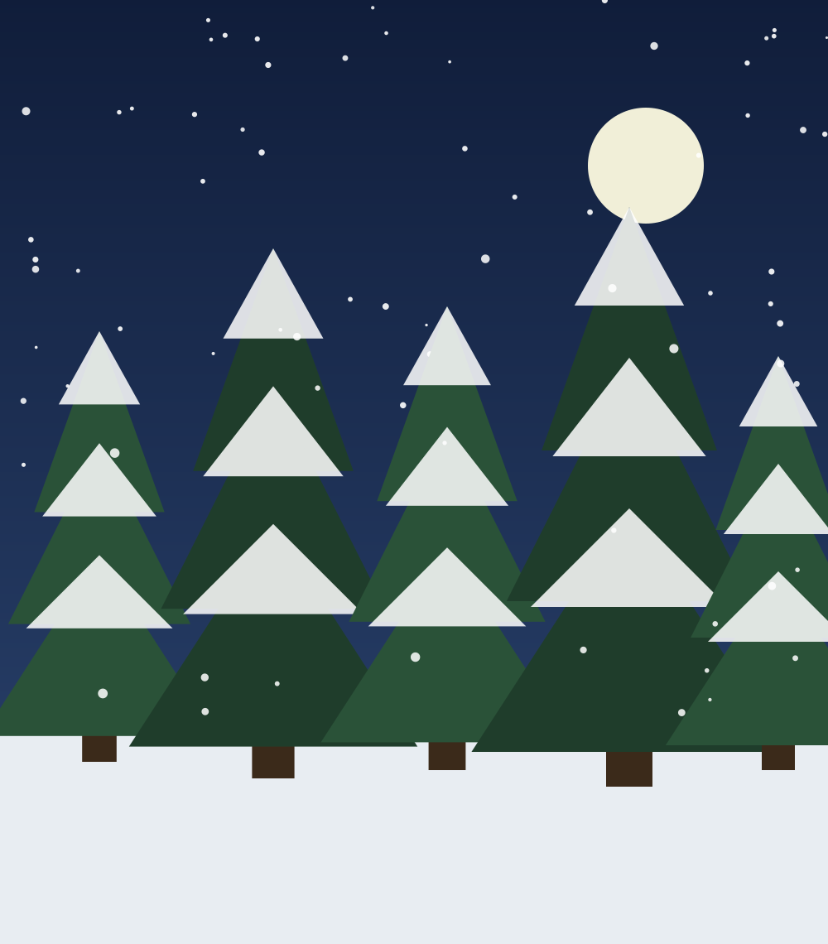
SEASONS
Stopping by Woods on a Snowy Evening
by Robert Frost
Whose woods these are I think I know.
His house is in the village though;
He will not see me stopping here
To watch his woods fill up with snow.
My little horse must think it queer
To stop without a farmhouse near
Between the woods and frozen lake
The darkest evening of the year.
He gives his harness bells a shake
To ask if there is some mistake.
The only other sound's the sweep
Of easy wind and downy flake.
The woods are lovely, dark and deep,
But I have promises to keep,
And miles to go before I sleep,
And miles to go before I sleep.
Dedication: I dedicate this poem to my grandfather because he loved walking in the snow and always said we would go home “in a minute”.
Notes:
Photo idea: snowy woods in the evening. Unsplash search: 'snowy forest evening'.

Slide 11
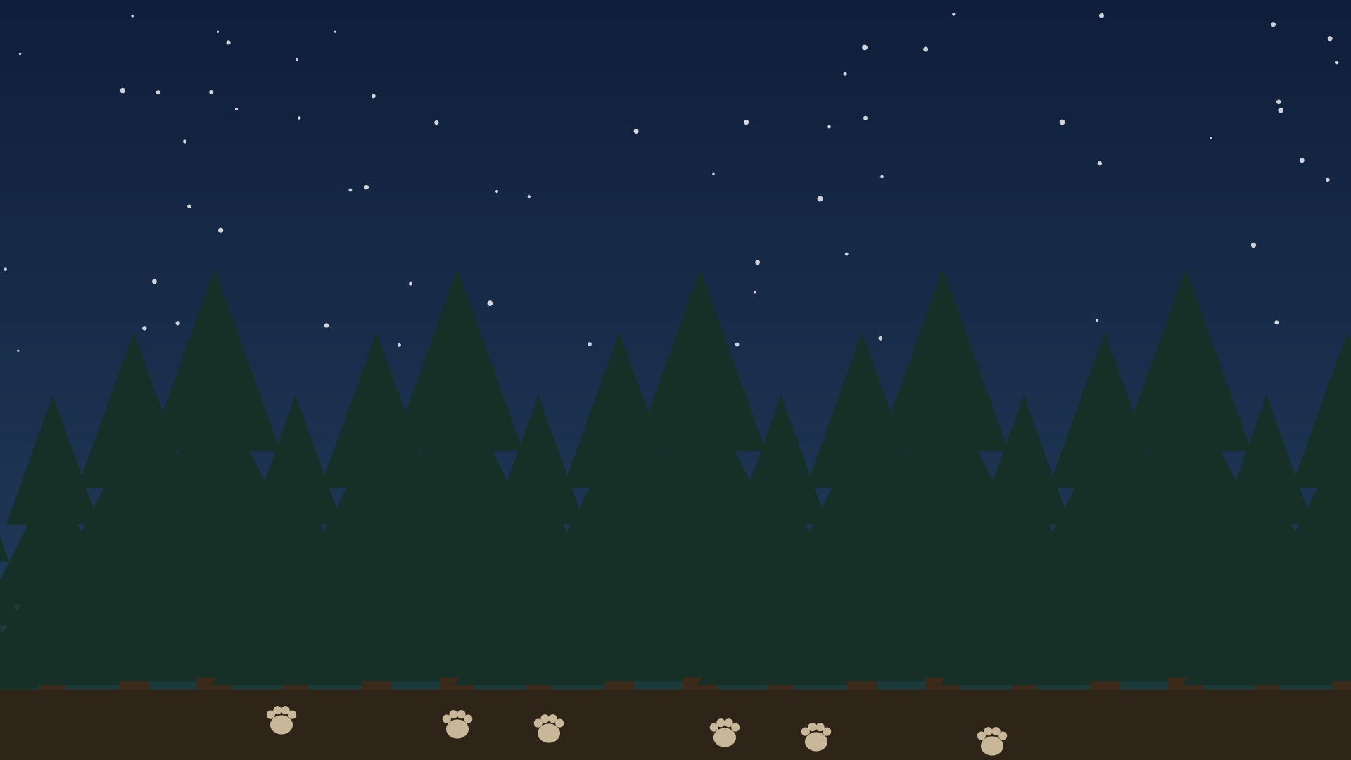
Animals
The Fox · The Tyger · The Eagle
Notes:
Photo idea: animal tracks in snow or a dark forest. Unsplash search: 'animal tracks snow'.

Slide 12
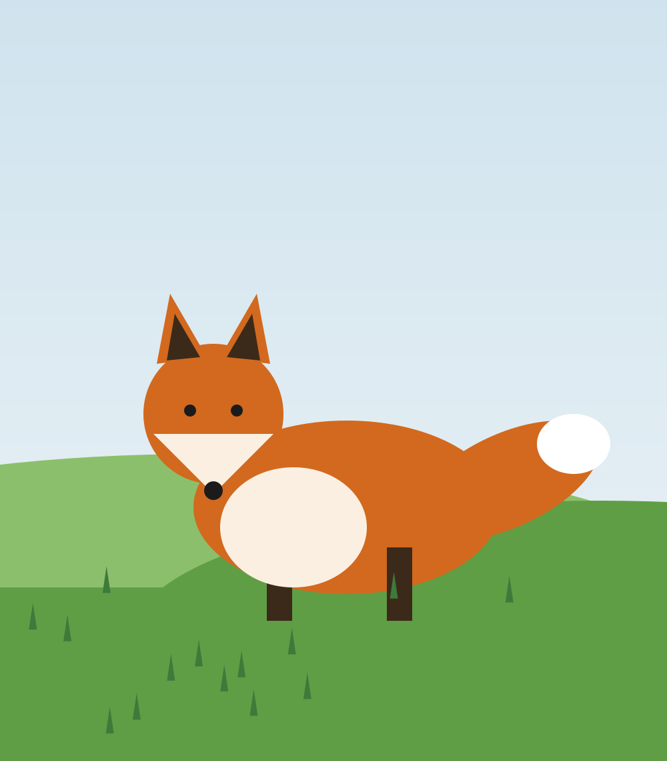
ANIMALS
The Fox
by me
At the edge of the field where the long grass grows,
A fox slips by on quiet toes.
Her coat is red like autumn fire,
Her ears stand up like points of wire.
She stops. She listens. Her black nose twitches.
She knows every path through the fields and ditches.
She does not need a map or light,
She owns the hours of the night.
And when the morning turns the sky to grey,
She curls up tight and sleeps the day away.
Response: This is an essential poem because it shows a wild animal that lives right next to us but is almost never seen. The poem feels quiet and secretive because of soft words like “slips”, “quiet toes” and “listens”. The poem is about independence because the fox does not need a map or a light to find her way. The poem uses rhyming couplets, for example “grows / toes”, and the short lines “She stops. She listens.” slow the reader down.
Notes:
Photo idea: a red fox in a field. Unsplash search: 'red fox field'.

Slide 13

ANIMALS
The Tyger
by William Blake
Tyger Tyger, burning bright,
In the forests of the night;
What immortal hand or eye,
Could frame thy fearful symmetry?
In what distant deeps or skies
Burnt the fire of thine eyes?
On what wings dare he aspire?
What the hand, dare seize the fire?
And what shoulder, and what art,
Could twist the sinews of thy heart?
And when thy heart began to beat,
What dread hand? and what dread feet?
What the hammer? what the chain,
In what furnace was thy brain?
What the anvil? what dread grasp,
Dare its deadly terrors clasp!
When the stars threw down their spears
And water'd heaven with their tears:
Did he smile his work to see?
Did he who made the Lamb make thee?
Tyger Tyger burning bright,
In the forests of the night:
What immortal hand or eye,
Dare frame thy fearful symmetry?
Response: This is an essential poem because it asks a big question: how can the same creator make something gentle and something dangerous? The poem feels intense and a little scary because almost every line is a question and the rhythm pounds like a hammer. The poem is about the mystery of creation because the speaker cannot understand who would dare to make such a fierce animal. The poem uses an AABB rhyme scheme, for example “bright / night” which makes it sound like a chant.
Notes:
Photo idea: tiger close-up. Unsplash search: 'tiger face close up'.

Slide 14
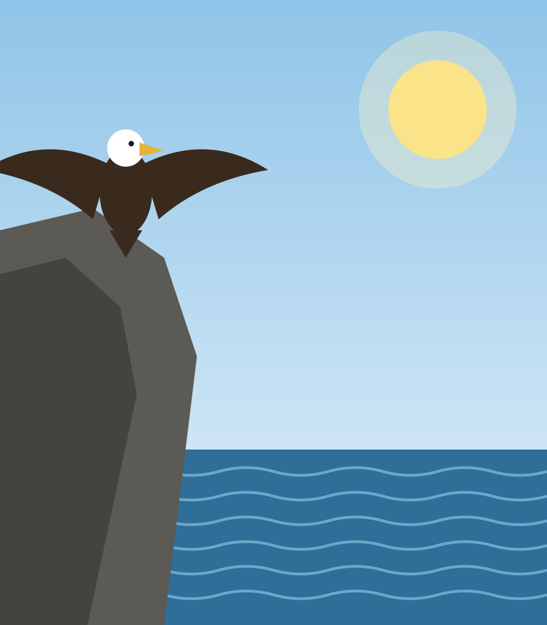
ANIMALS
The Eagle
by Alfred, Lord Tennyson
He clasps the crag with crooked hands;
Close to the sun in lonely lands,
Ring'd with the azure world, he stands.
The wrinkled sea beneath him crawls;
He watches from his mountain walls,
And like a thunderbolt he falls.
Response: This is an essential poem because it says so much about power and patience in only six lines. The poem feels still and tense because the eagle waits high above the world and then suddenly dives. The poem is about strength and control because the eagle chooses the exact moment to act. The poem uses a simile, for example “like a thunderbolt he falls”, which makes the dive feel fast and powerful.
Notes:
Photo idea: an eagle on a cliff above the sea. Unsplash search: 'eagle cliff sea'.

Slide 15

Glossary
Words I did not know before, in alphabetical order
anvil – a heavy iron block that a blacksmith hammers hot metal on (The Tyger)
azure – bright blue, like a clear sky (The Eagle)
bourn – an old word for a small stream (To Autumn)
crag – a steep, rough rock or cliff (The Eagle)
downy – soft and fluffy, like the feathers of a baby bird (Stopping by Woods)
hue – a color, or a shade of a color (Nothing Gold Can Stay)
sinews – the tough cords that join muscles to bones (The Tyger)
winnowing – blowing the light husks away from the grain (To Autumn)
Notes:
Plain background with a simple picture. Unsplash search: 'open book plain background'.

