Slide 1

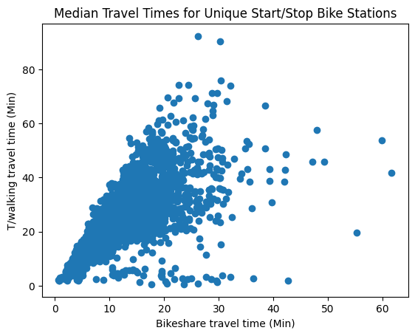
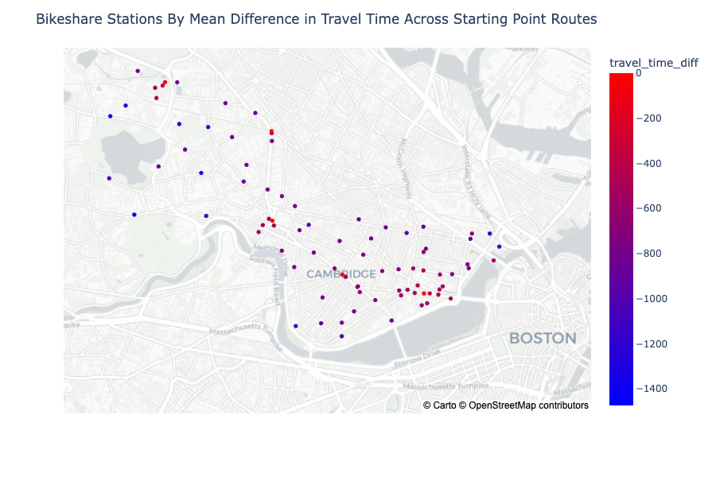
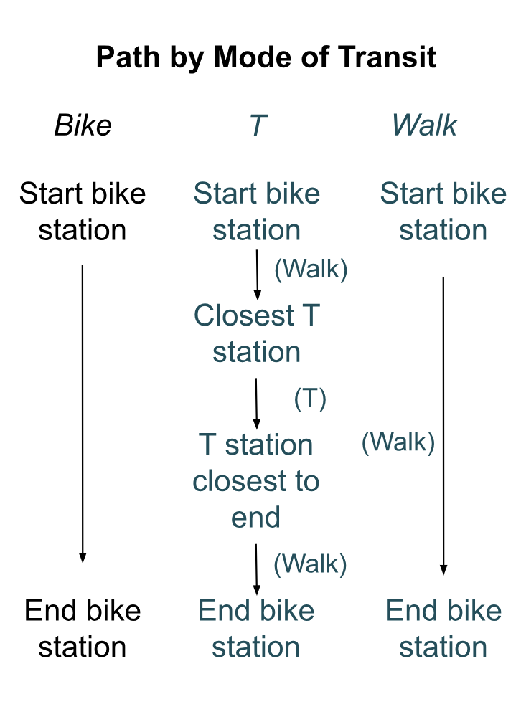
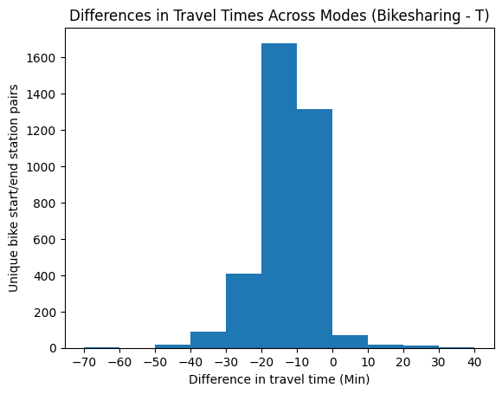
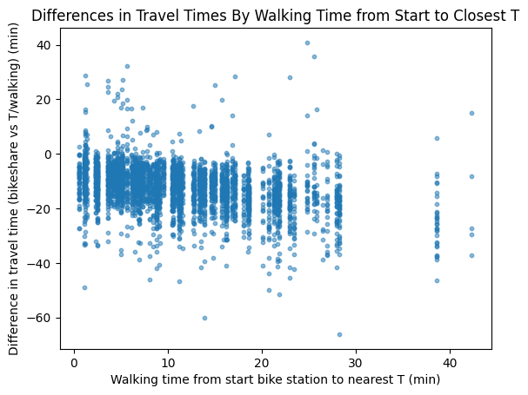
Travel Times By Mode of Transit:
Bike-Sharing vs MBTA “T”
Tayae Rogers
Wellesley College Class of 2025, Data Science Major Capstone
Introduction
Visualizations
Background
Access to transit affects how people interact with their cities
Bikesharing as substitute vs complement for other forms of public transit? (Kong et al 2020)
Interested in whether bikeshare is a time-efficient choice in the Cambridge context
Research Questions
RQ1: In Cambridge, MA in summer 2023, for what percent of start/stop Blue Bikes station pairs was bikeshare faster (slower) than the T (within Cambridge)? How much faster (slower) was bikeshare?
H1: Bikeshare was faster
RQ2: What was the relationship between initial walking time to a T station and the difference in total travel times across modes?
H2: As initial walking distance to a T station increases, bikeshare was relatively faster
Figure 2. Median Travel Times for Unique Start/Stop Bike Stations.
Figure 3. Map of Bikeshare Stations By Mean Difference in Travel Time Across Starting Point Routes. Includes T stations themselves.
Data & Methods
Results
Model
Primary data sources
All Blue Bike trips (summer 2023)
Attributes: Start/end stations (ID, name, coordinates), start/end times
MBTA “T” trips
Attributes: Start/end stations (ID), service date, start/end times, travel times
Secondary data sources
Blue Bike stations
Use: Identify Blue Bike stations in Cambridge
T stations
Use: Match T trips station IDs to T trips station names
T trips January 2024
Use: Match T trips station names to T station start/stop coordinates
Data manipulation
For each bikeshare trip, calculated the length of the corresponding “T” trip and walking trip → took minimum
Used T data from the exact day and time when the bike ride took place
T trip time includes time waiting for the next T
Used Google Maps API to get all walk times
Assumed walk time from bike station to T station and vice versa are the same
For each start/end bikeshare station pair (with > 10 rides), calculated difference in median trip times for bikeshare vs T/walking
Bikeshare is faster for 97.098% of start/end stop combinations
On average, bikeshare is 12.506 minutes faster
Travel time differences
Min: -66.12
25th: -16.85
Median: -12.00
75th: -7.43
Max: 40.88
DiffInTravelTimes = -8.24 - 0.38*(FirstWalkTime)
Coefficient and intercept are significant
Assumption issues: Independence
Figure 4. Differences in Travel Times Across Modes (Bikesharing-T).
Figure 5. Differences in Travel Times By Walking Time from Start to Closest T. Allows linearity assumption.
Discussion & Conclusion
Figure 1. Path by Mode of Transit.
→ Provides evidence that bikesharing can be a time-efficient mode of transit
Limitation: Here, people are 1) starting at bikeshare stations and 2) do not have to wait for bikes, but they do have to wait for the T
Limitation: Did not allow people to get on or off at Davis Square, which is in Somerville
Limitation: Did not consider spatial relations
Future work: Add in bus routes
Future work: Allow T stations outside of Cambridge
Sources. Kong, Hui, Scarlett T. Jin, and Daniel Z. Sui. “Deciphering the Relationship between Bikesharing and Public Transit: Modal Substitution, Integration, and Complementation.” Transportation Research Part D: Transport and Environment 85 (August 1, 2020): 102392. https://doi.org/10.1016/j.trd.2020.102392.

