Slide 1
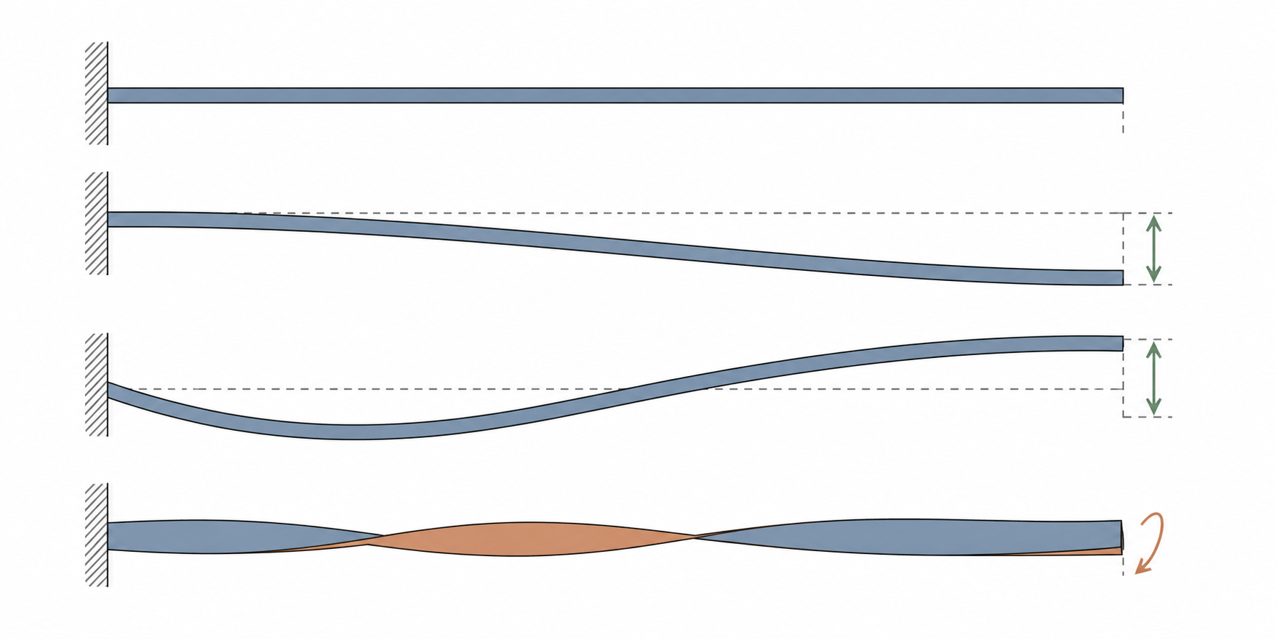



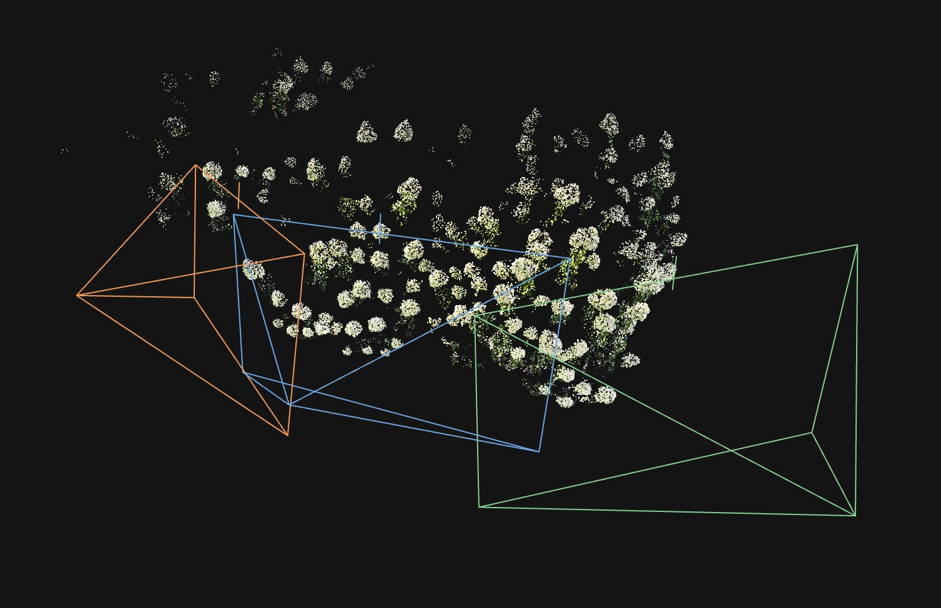
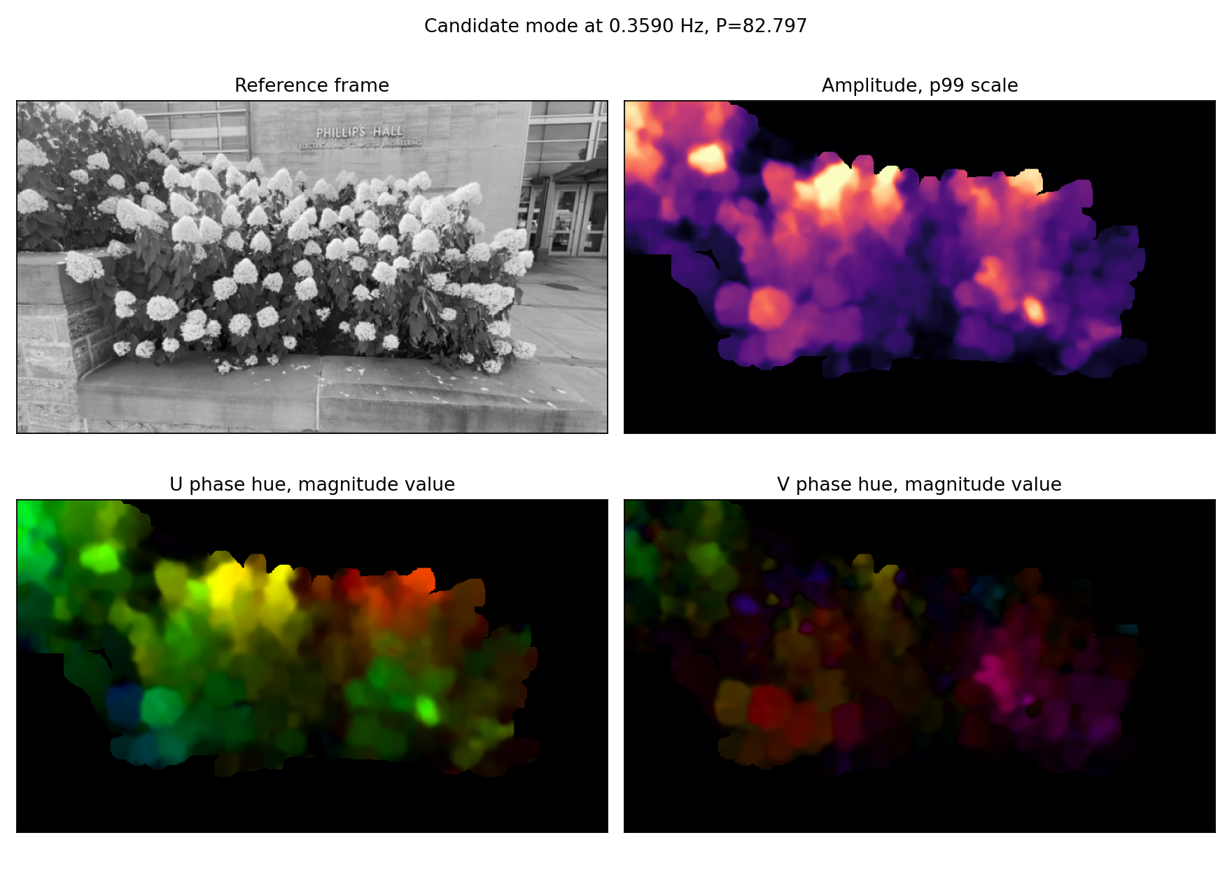
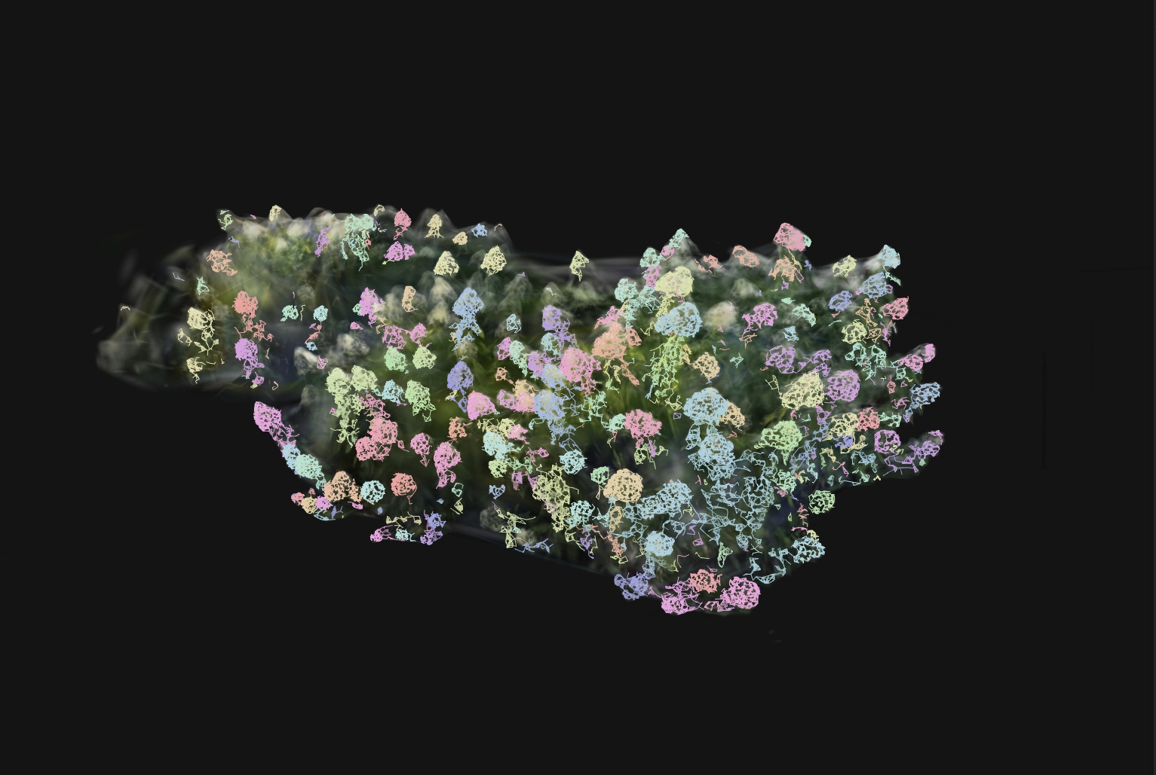
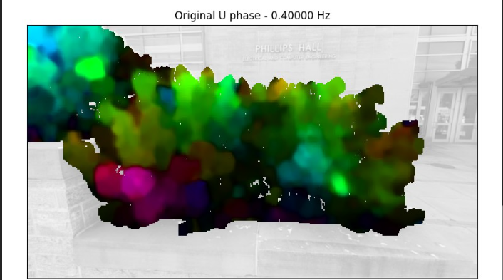
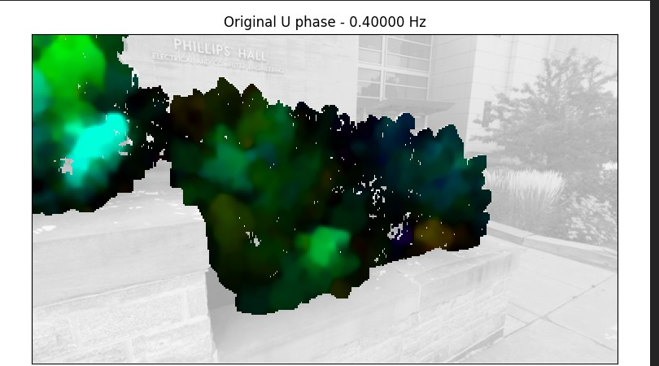
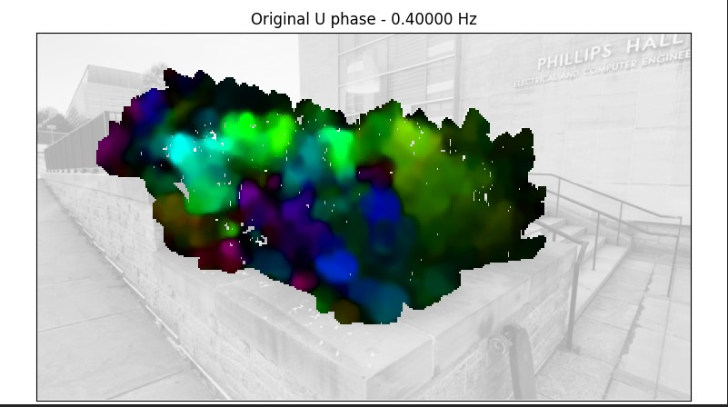
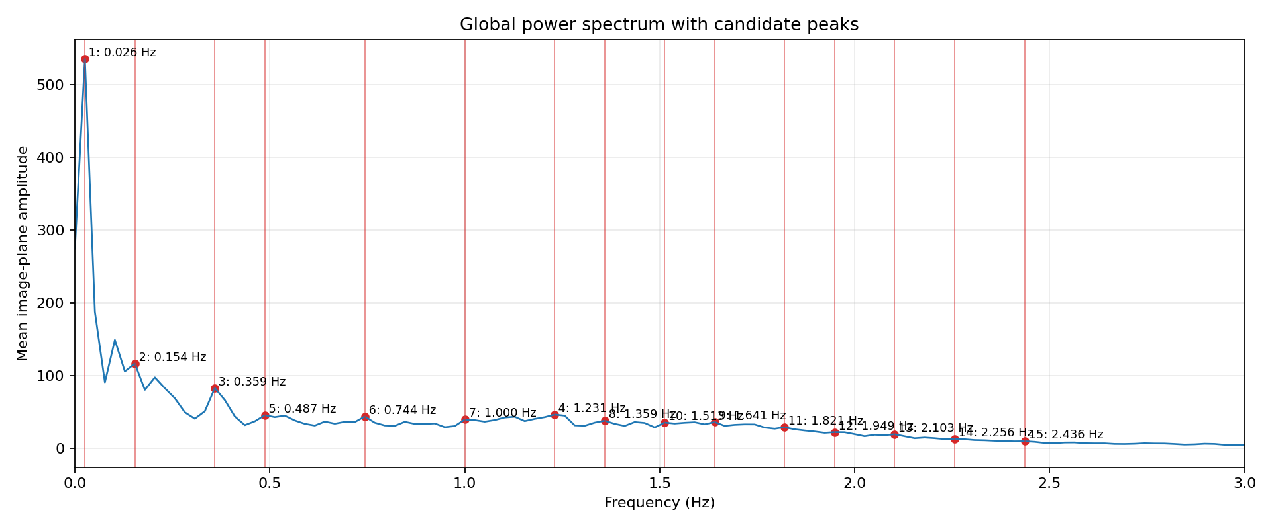
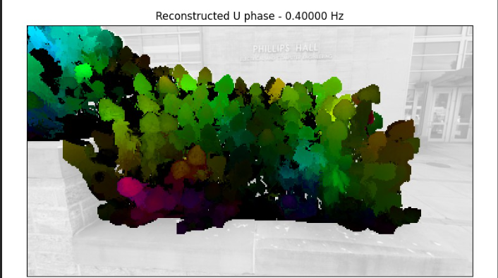
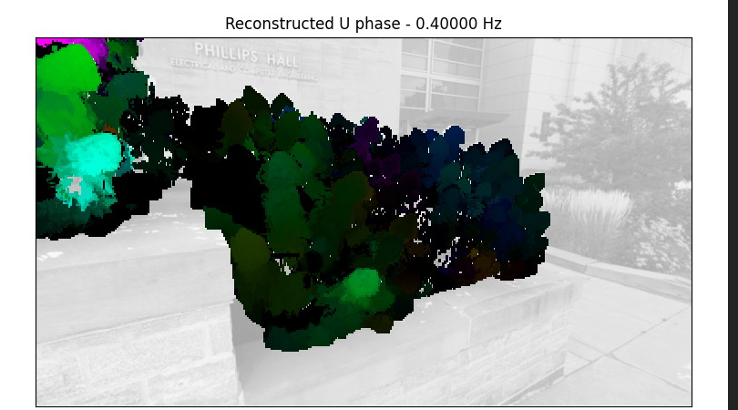
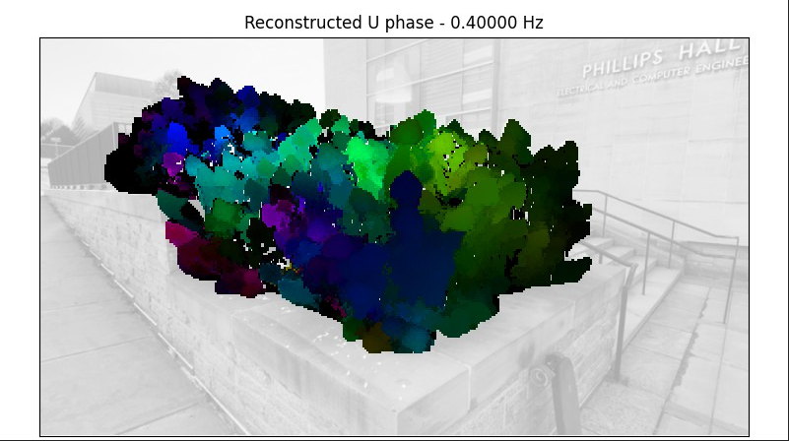
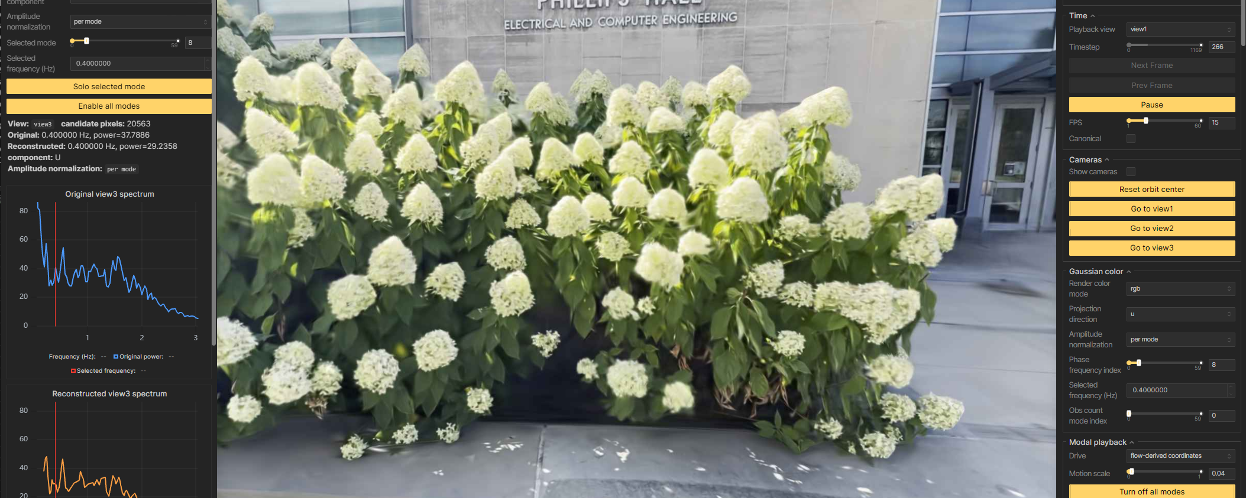
Toward 3D Physical Simulation from Asynchronous Multi-View Videos
Brian Song, Tianyi Zhang, Abe Davis
Goal. Use one mobile phone to recover a view-consistent 3D Gaussian model and spatial vibration fields without synchronized cameras.
1. Sweep + fixed videos
2. Joint COLMAP
3. Static 3DGS
End-to-end pipeline
4. Flow + Fourier modes
5. Pixel–Gaussian correspondence
6. View phase sync
7. Local 3D solve
8. Motion fill
1. Why Recover Vibration Modes?
Output: completed complex spatial fields φₖ ∈ ℂᴳˣ³
3. Same Motion, Different Start Times
Modes turn coupled motion into simple patterns
One phone, several unsynchronized recordings
Real objects have many coupled physical degrees of freedom. Tracking every point directly is unwieldy. For small vibration, modal analysis changes basis: each mode is a coherent deformation pattern, and its coordinate controls how strongly that pattern is active.
Independent videos cannot be matched frame by frame. We assume stable geometry and boundary conditions produce the same natural frequencies and 3D mode shapes across recordings, although each view may have a different phase offset.
REST
MODE 1
view 1 · unknown start time
view 2 · unknown start time
view 3 · unknown start time
MODE 2
Frequency-domain consistency: the same resonant frequency represents the same underlying 3D spatial mode, even when recordings begin at different times.
TWIST
different
start times
same natural
frequencies
align complex
view phase
4. Lift 2D Modes into a Shared 3D Model
u(x,t) ≈ Σₖ φₖ(x) qₖ(t)
A canonical scene anchors every camera
mode shape × modal coordinate
1
Shared geometry
Sweep + reference frames → COLMAP + 3DGS
2. Why Work in Frequency?
2
Pixel–Gaussian links
Rendered depth connects 2D evidence to the surface
Periodic motion reveals a compact basis
Vibration is approximately periodic. Time-domain motion mixes modes, while a Fourier transform separates them by natural frequency. Following Davis et al., we estimate small optical flow and retain a few strong spectral peaks.
3
View phase
Phase-only synchronization across cameras
fixed-view
video
small optical
flow
temporal
FFT
dominant
peaks
complex
2D modes
4
3D solve + fill
Lift local motion, then propagate to unseen Gaussians
High-level lift
2D complex
mode
shared surface
points
phase-aligned
views
3D Gaussian
mode field
Rendered depth links image measurements to foreground Gaussians. Calibrated projection Jacobians lift phase-aligned 2D modes into local 3D motion; a separate foreground graph carries compatible motion to unobserved Gaussians.
Local Gaussian structure used during the 3D solve.
5. Recovered Modes Reproject Across Views
One 3D mode, projected into three cameras
Observed 2D mode
One selected frequency gives a coherent projected motion pattern.
Projected 3D mode
view 1
view 2
view 3
Each recovered mode is a complex 3D displacement field. Its projections qualitatively agree with the spatial and phase patterns observed in all three cameras.
Current scope: evidence-driven mode fields—not yet mass- or stiffness-normalized structural eigenmodes.
Strong peaks identify camera-visible frequencies with high measured response.
A few dominant peaks form a compact motion basis. Each complex frequency slice retains a spatial pattern, displacement magnitude, and relative phase while aggregating evidence over the full video.
Interactive Viser view
Notes:
[Sources]
- docs/poster_drafts/bush_spatial_modes_poster_v2.tex (poster copy and layout source)
- C:/Users/zitengsong/Documents/school/research/dynamicGSPaper/Shape of Motion.pdf (3D Gaussian motion context)
- C:/Users/zitengsong/Documents/school/research/ISMB_Davis_2015.pdf (video modal analysis)
- Kerbl et al., 3D Gaussian Splatting for Real-Time Radiance Field Rendering, 2023.
- C:/Users/zitengsong/Documents/school/research/dynamicGSPaper/Computer Graphics Forum - 2023 - Petitjean - ModalNeRF Neural Modal Analysis and Synthesis for Free-Viewpoint Navigation.pdf (3D modal analysis, reduced modes, and synthesis)
[/Sources]
[Sources]
- docs/poster_drafts/bush_spatial_modes_poster_v3.pptx (approved visual frame and Bush experiment assets)
- C:/Users/zitengsong/Documents/school/research/ISMB_Davis_2015.pdf (frequency-domain video modal extraction framing)
- Kerbl et al., 3D Gaussian Splatting for Real-Time Radiance Field Rendering, 2023 (canonical 3D Gaussian representation)
- OpenAI image generation, 2026-08-07 (beam vibration-mode illustration generated for this poster)
[/Sources]

