Slide 1

US Car Accidents
Tugba S Sensoy Cellat
2/26/2020

Slide 2
An Overlook of Car Accidents in the US
Humanitarian sight:
Average number of car accidents in the U.S. every year is 6 million.
More than 90 people die in car accidents everyday (~30000 each year).
3 million people in the U.S. are injured every year in car accidents.
Around 2 million drivers in car accidents experience permanent injuries every year.
The total cost of car accidents (including the costs of societal harms) is about $871 billion annually in U.S.
$44 billion in U.S. car accident costs (work lost cost, medical care) .
Economical sight:
Insurance claims (property aspect)
Healthcare cost
Goal of Project:
Identify areas of high accident rates (city, street, long-lat, etc.).
Find factors that affect accidents (weather conditions, wind direction/speed etc).
Predict accidents, study the impact of precipitation or other environmental stimuli on accident occurrence.
End Users:
Drivers
Insurance companies
Government

Slide 3
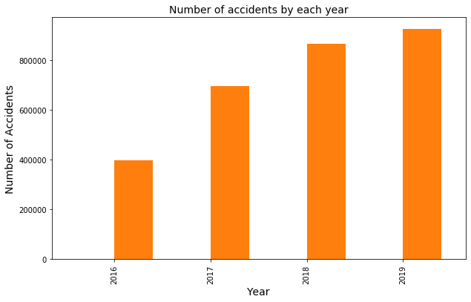
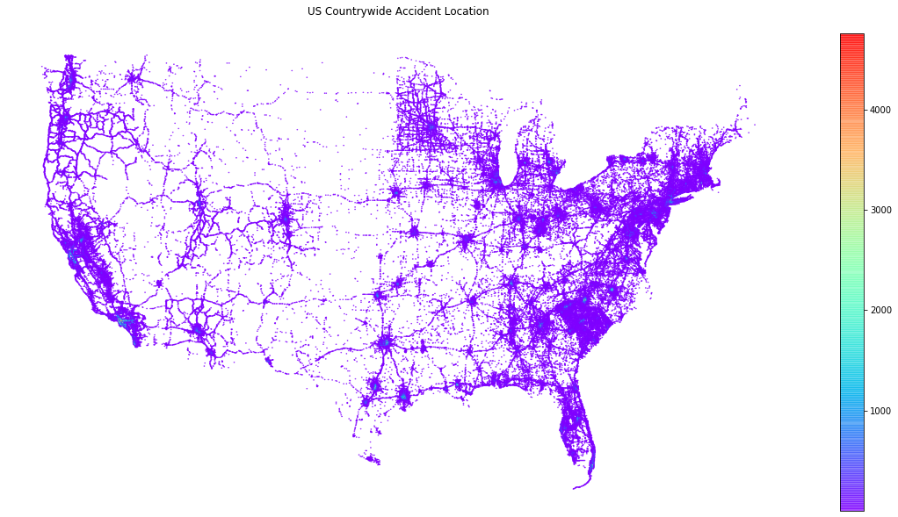
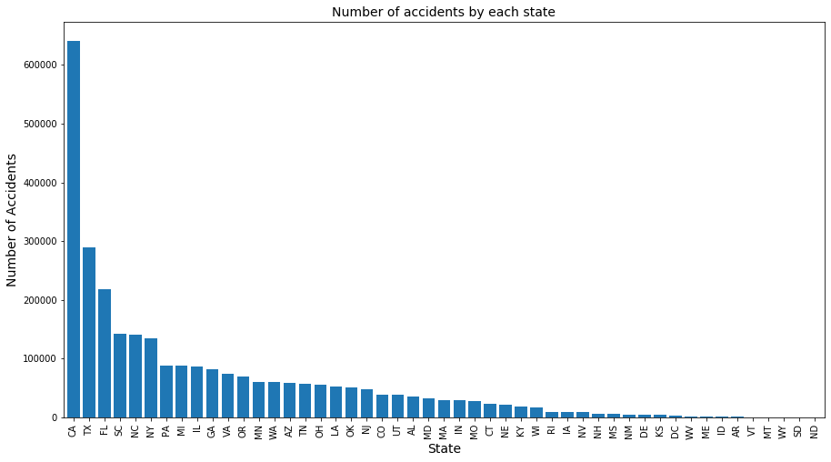
Graphical illustration of US Car Accidents
Summary of Data:
Countrywide traffic accident dataset (49 states of the US)
Collected from February 2016 to December 2019
Currently ~3.0 million accident records
Summary of work:
Python
Analyzed~3.0 million data
EDA & Visualizations
Weather condition | Traffic signal, stop sign etc | City, state, zipcode etc.
Temperature | Turning loop, railway | Latitude / Longitude
Humidity, wind speed/dir. etc | Crossing, junction, bump

Slide 4
