Slide 1




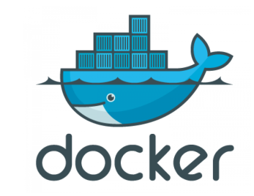






Code and quality gate analysis
Pull code
Dependency
GitHub
Jenkins CI Job
Dependency check
Filesystem scan
Push code
Jenkins CI Job
Trigger Jenkins CD Job
After Jenkins CI Job Completed
Docker build and push
Developer
Update Docker Image Version
Pull Code
Jenkins CD Job
GitHub
Jenkins CD Job
Deploy on K8s
Notify on email
Monitoring

