Slide 1
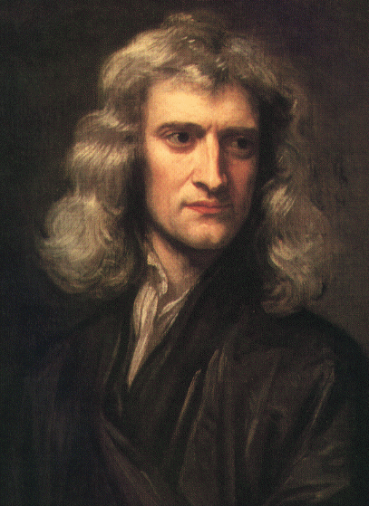


Slide 2
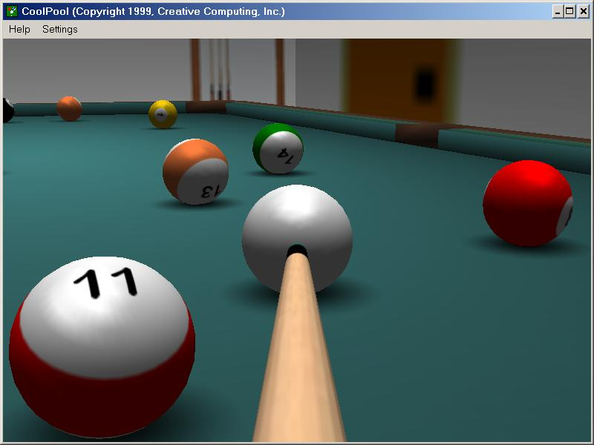
The Newtonian world
Mechanistic and deterministic, predictable
In a pure Newtonian world, all objects would have a clear identifiable position and movement
One could map out the future based on series of solvable equations
Newtonian physics works and makes many things possible but less useful for large systems
Notes:
Newtonian physics can explain a lot about the world, but it works best when things are not too complicated, when there aren’t too many interacting entities. Simple Newtonian equations (like the ones from physics class), when used to track an increasing large number of objects, quickly become cumbersome. Can people be treated like billiard balls?

Slide 3
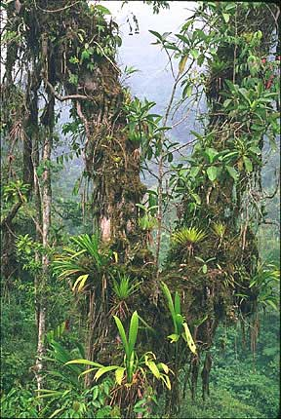
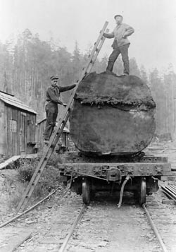
Notes:
However, Newtonian concepts are not fully capable of explaining ecological change and how human systems work. We are limited in the way we can incorporate the details in the world around us, its fine grain and large extent pose fundamental challenges. How can we take account of this detail, but not be overwhelmed by it and still be able to understand and anticipate environmental change.

Slide 4
Challenges to a Newtonian view of the world
Fine grain and immense extent of the world
Vast number of interacting entities
Contingencies
Feedbacks
Teleconnections
Notes:
However, Newtonian concepts are not fully capable of explaining ecological change and how human systems work. We are limited in the way we can incorporate the details in the world around us, its fine grain and large extent pose fundamental challenges. How can we take account of this detail, but not be overwhelmed by it and still be able to understand and anticipate environmental change.

Slide 5

Contingency
Events that are difficult if not impossible to predict but can have a large impact on the function of a system

Slide 6
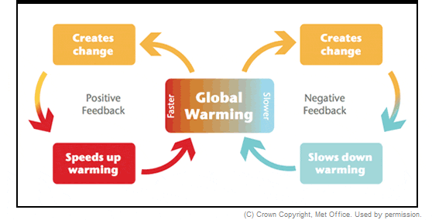
Feedbacks
Feedbacks make prediction of the outcome of interactions difficult
Positive feedback: externally generated change is reinforced
Negative feedback: externally generated change is lessened

Slide 7
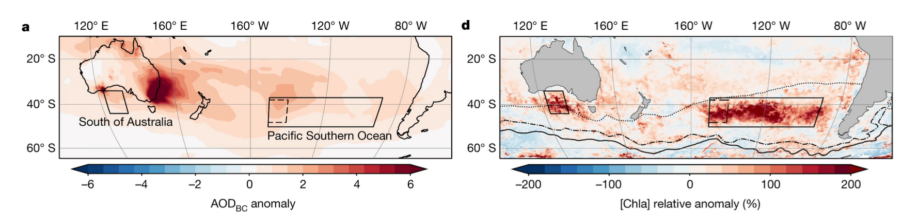
Teleconnections
Events can propagate their effects over large distances and through time
Notes:
Smoke from wildfires in Australia blew out over the ocean and settled onto the surface. The ash contained nutrients that are consumed by marine phytoplankton. These organisms quickly expanded their numbers with the added nutrients (the mid ocean is often nutrient poor compared to coastal regions) causing a large phytoplankton bloom. These are photosynthetic marine organisms, and what is shown in the right-hand map is the chlorophyll content of the ocean. Chlorophyl concentration spiked following wildfire ash deposition.

Slide 8
Complex adaptive systems theory
A response to the limits of understanding the world through a Newtonian lens
The shear number of interacting entities limits prediction of change using Newtonian concepts
Contingencies, feedbacks, and teleconnections limit prediction into the future.
Interactions can develop which we often cannot anticipate, and these in turn guide the expression of other interactions and outcomes.
CAS theory brings together equilibrium and non-equilibrium perspectives

Slide 9

Basic examples of complex adaptive systems
Human societies
Ecosystems
Financial systems like the stock market

Slide 10
Properties of complex adaptive systems
Path dependence
Emergence
Self-organization
Cross-scalar structure

Slide 11
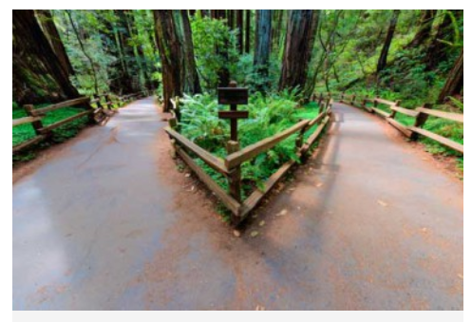

CASs have path dependency
Events that have unfolded in the past constrain the present and the future to varying degrees
The QWERTY keyboard

Slide 12
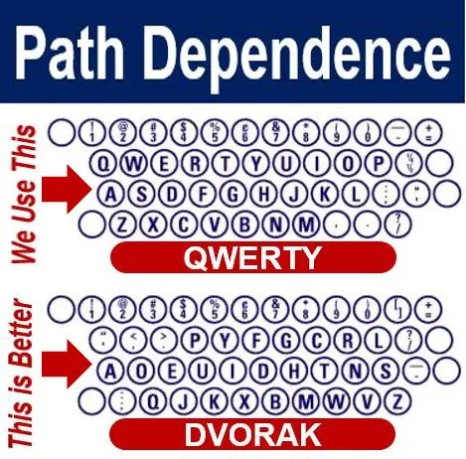

Slide 13
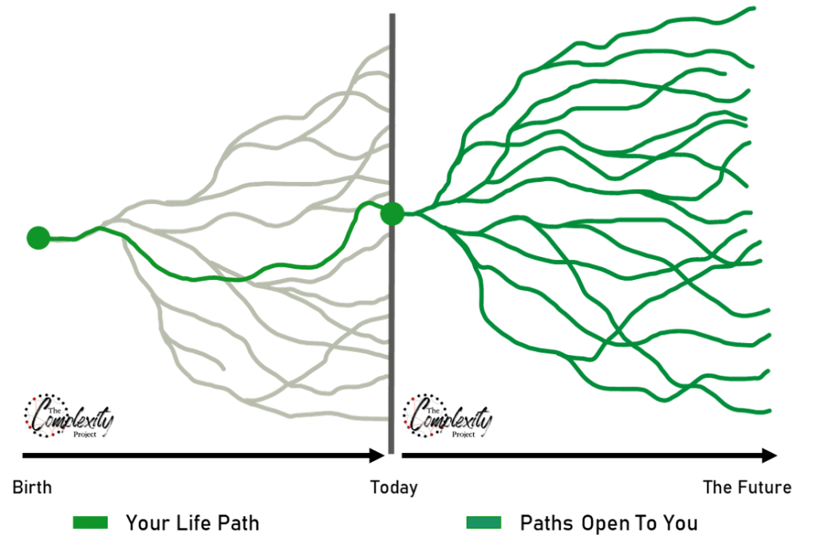

Slide 14
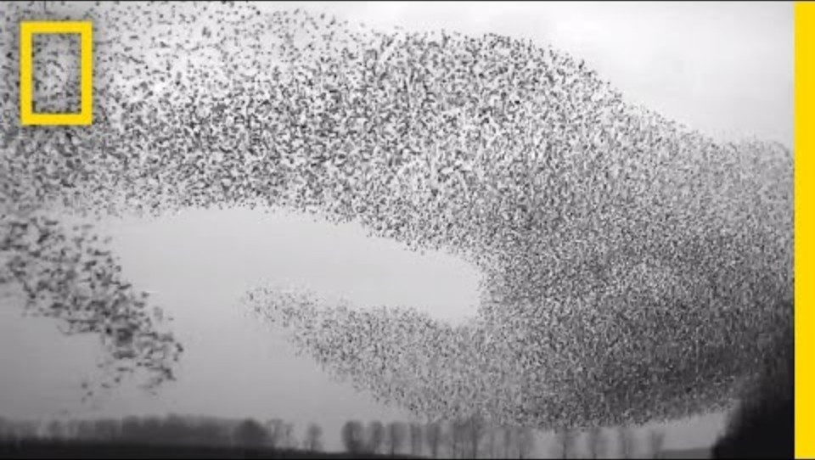
CASs exhibit emergence
Occurs when local agents interact to create patterns at a larger extent
Local movements or behaviors create emergent patterns when summed across many interacting individuals
Emergent patterns cannot be identified by isolation of a single agent, but appear only through their interaction
Notes:
Emergence is a phenomena that emerges out of the interactions of many smaller interacting parts.

Slide 15


CASs can self-organization
Self-organization is the process in which order arises from local interactions between parts of an initially disordered system.
This can be as small as the development of an organism or as large as the order arising spontaneously from many interacting human agents

Slide 16
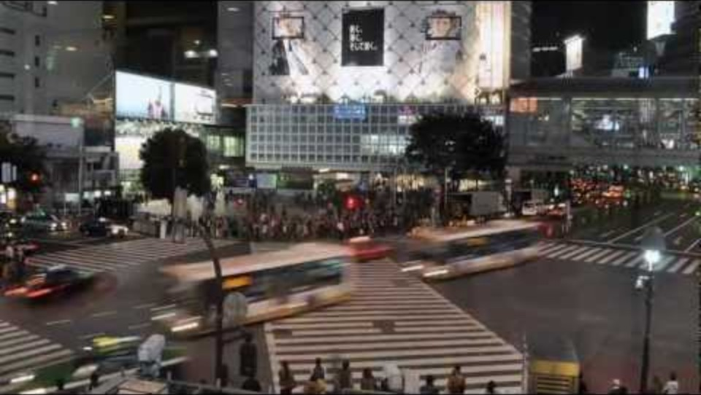

Slide 17
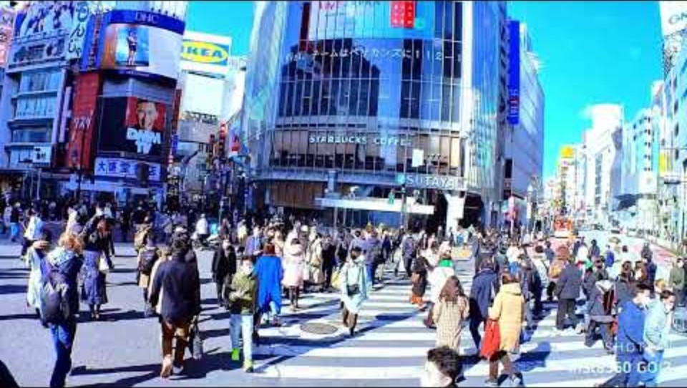

Slide 18
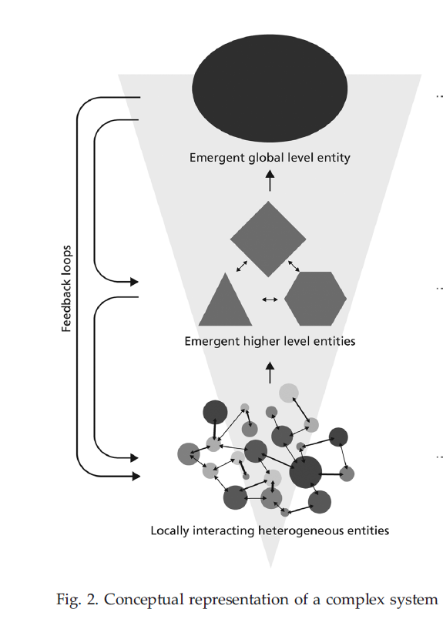
CASs have cross-scalar structure
Global properties emerge from interactions among many individual entities
These global properties can set up feedback loops that influence interactions among individual entities
Complex adaptive systems link local reductionist rules and mechanisms with emergent global patterns
Notes:
But you can’t understand the emergent pattern from studying the individual local components

Slide 19

Notes:
An example of cross-scale interactions (and emergence).

Slide 20

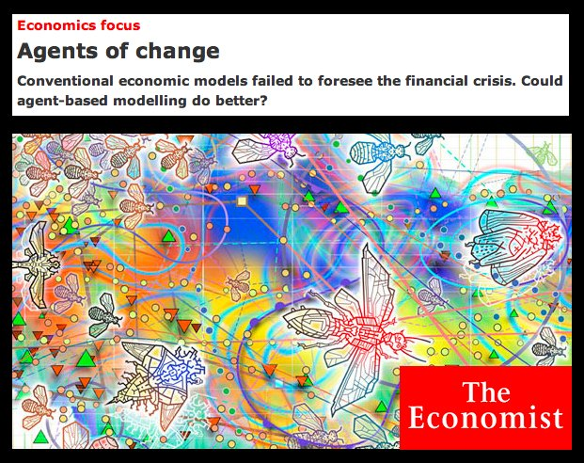
Studying CASs
We use models and modeling to represent patterns and processes in the real world, including those of complex adaptive systems.
The properties of complex adaptive systems can be simulated in two modeling techniques:
Cellular automata
Agent-based modeling
Both techniques model how patterns and behaviors emerge from the simple interactions of agents, often leading to unexpected system-level phenomena that can't be predicted from individual behaviors alone.
Notes:
These two types of modeling techniques are very good at capturing complex systems dynamics

Slide 21
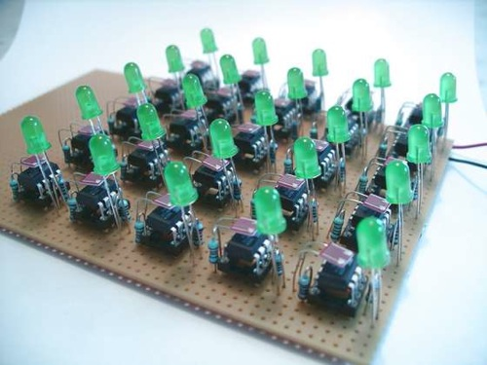
Cellular automata (CA)
Notes:
Originated in 1940’s

Slide 22
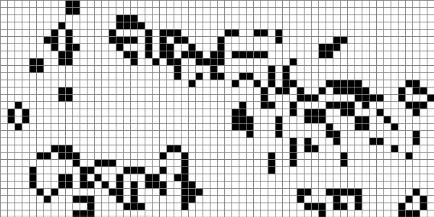
Notes:
https://www.microsoft.com/en-us/p/conways-game-of-life/9wzdncrdj0pg

Slide 23


Slide 24
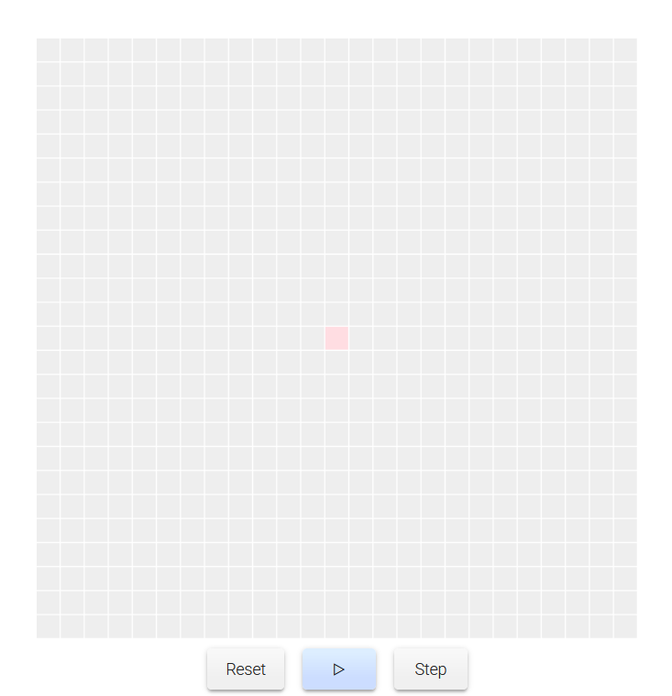
In a cellular automata, simple rules are assigned to cells, and then the cellular automata is allowed to run over time.
Each individual cell is sensitive to the neighborhood around it and responds to its neighbors according to the rules.
Individual rules and interactions with neighbors lead to emergent, system-level outcomes with ABMs.
Patterns may converge toward the same end state from several slightly different starting configurations or patterns may diverge and never stabilize

Slide 25
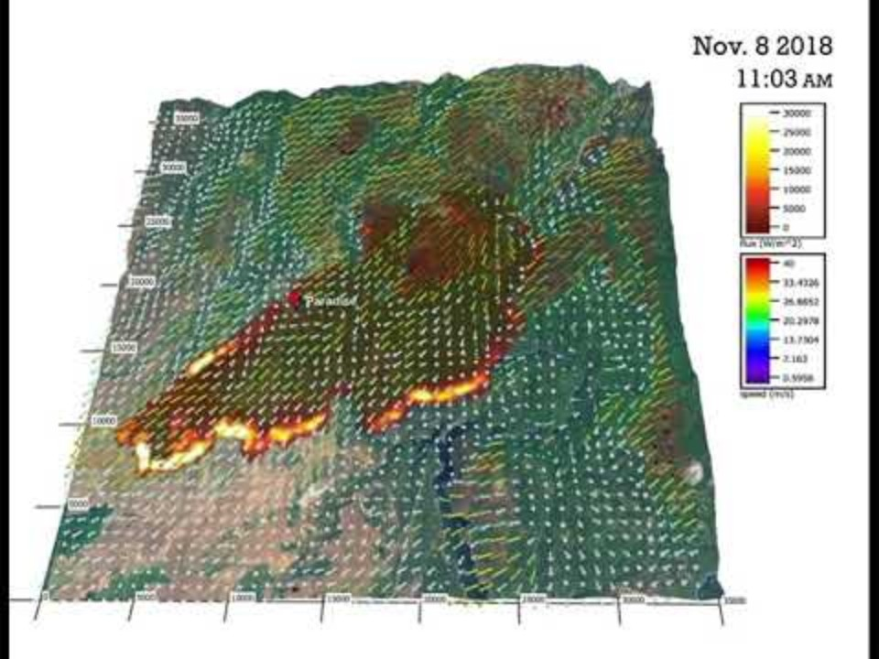

Slide 26
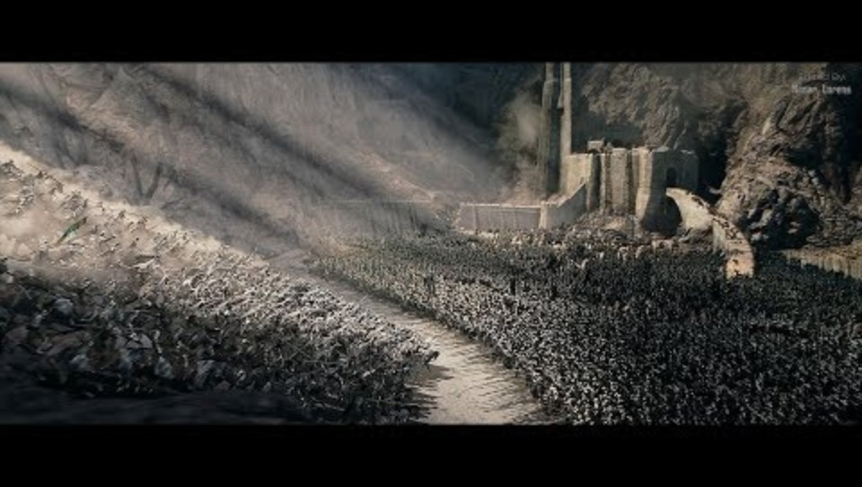

Slide 27
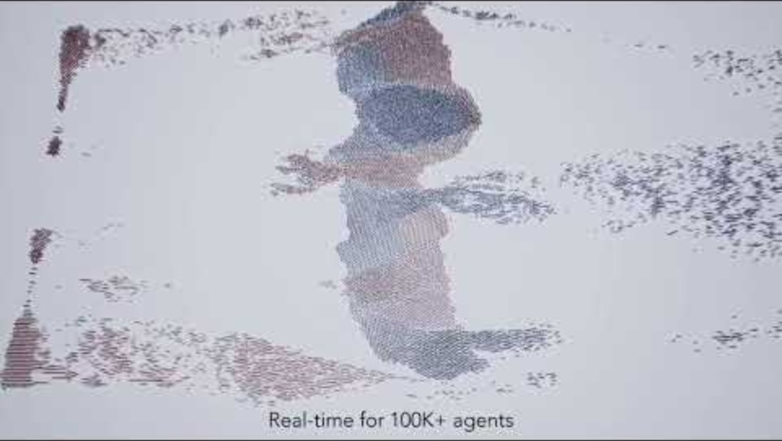

Slide 28
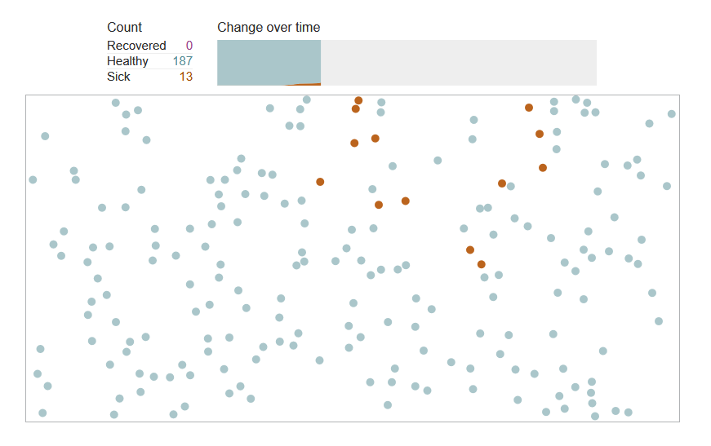
Agent-based computational models
Like with CA, individual behaviors and interactions lead to emergent, system-level outcomes with ABMs.
ABMs simulate interactions of autonomous agents to assess their effects on system as a whole.
Agents operate independently, making decisions based on their own rules without central control
Agents interact with each other and the environment based on local information
Notes:
ABMs are widely used in social science, ecology, economics, and environmental studies
https://www.washingtonpost.com/graphics/2020/world/corona-simulator/

Slide 29

Notes:
https://www.anylogic.com/

Slide 30
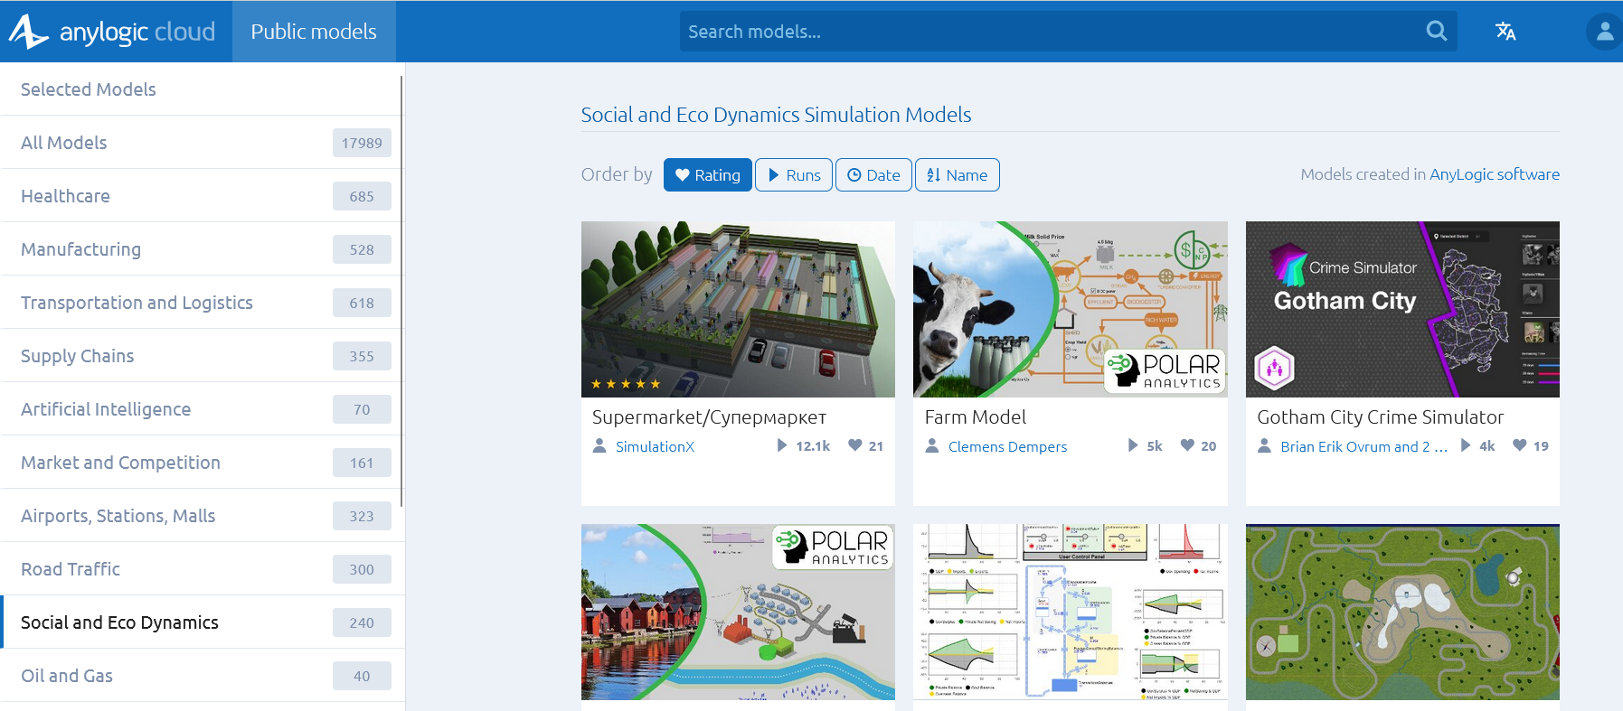

Slide 31
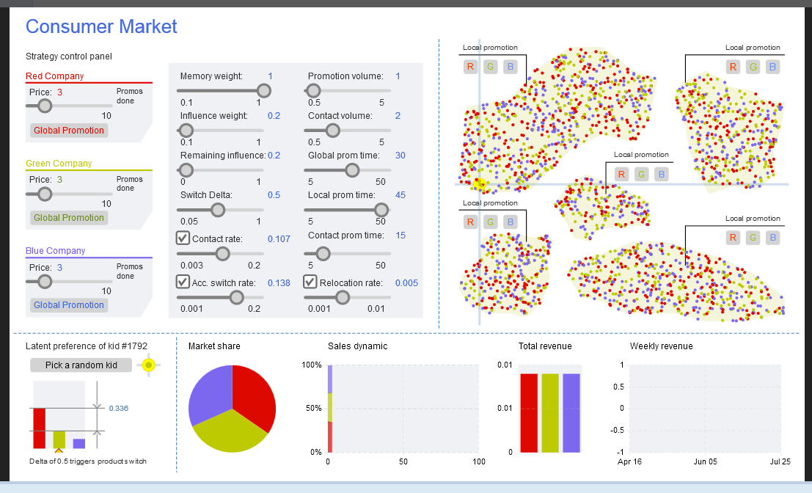
Notes:
In an agent-based model, individual agents have local rules and a much more mobility than cellular automata. Agents in an ABM can ‘see’ their local environment and respond accordingly. With many agents, their individual behaviors can scale up to create emergent patterns. In this agent-based model, the agents are kids in different neighborhoods. They interact with each other and their neighbors in how they buy and talk about candy sold by three companies. Agent-based models and cellular automata are ways to simulate the dynamics of the world that are not readily done with Newtonian equations.

Slide 32
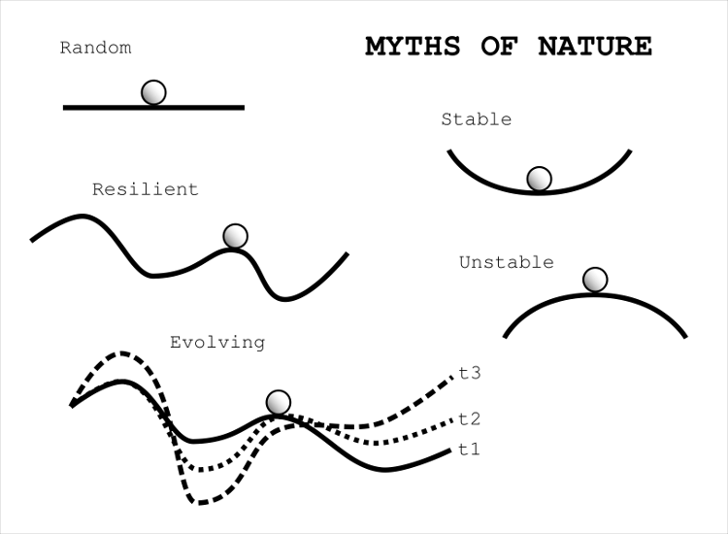
CAS theory brings equilibrium and non-equilibrium dynamics together
Equilibrium dynamics
Systems may converge toward configurations that are stable persistent, and self-reinforcing
Non-equilibrium dynamics
Systems may be unstable and diverge over time
Or it may change from one stable state to another
It may change randomly or change constantly over time.
Notes:
These fitness landscapes shown illustrate how ecosystems change. These particular sketches are also known as ball and cup diagrams.

Slide 33
Complexity and policy
Complex systems generate pathways of development policies that cannot be fully predicted.
The implication of this unpredictability is that sustainability can be pursued only through a co-evolutionary strategy.
A coevolutionary strategy pays attention to the dynamics of the system while steering toward development pathways and policies in an adaptive and reflexive manner

Slide 34

Why is it so hard to quit coal?
Notes:
https://www.nytimes.com/2018/11/24/climate/coal-global-warming.html The world needs to quit coal. Why is it so hard? “The main reason why coal sticks around is, we built it already,” Path dependency makes it difficult to escape the infrastructure of fossil fuel use. Policies have to be designed to steer the fossil fuel energy infrastructural system, with all its feedbacks, through policies that take this path dependency into account. To just stop using fossil fuels by banning coal would not be likely to work.

