Slide 1
ENS 202 examines sustainability through habitability
Sustainability entails deciding what ought to be sustained, for whom, for how long, and for what reason. Sustainability is therefore an indeterminant concept invoking moral, ideological, and political debate
In this class, we do consider human ethnicities, cultures, race and class as they relate to matters of sustainability. We do so but not to the extent that we exclude generalizing ideas about Homo sapiens and a shared habitable earth
This is not to say that all humans have similar lives and experiences, and have equivalent impacts on the Earth, but there are indeed common themes and narratives that can be told about life on Earth
Notes:
Costanza, R., Graumlich, L., Steffen, W., Crumley, C., Dearing, J., Hibbard, K., ... & Schimel, D. (2007). Sustainability or collapse: what can we learn from integrating the history of humans and the rest of nature?. AMBIO: A Journal of the Human Environment, 36(7), 522-527. What would we want to know about sustainability if we encountered another planet with life forms similar to us? What general ideas and principles would translate from one planet to another? We will focus less on the debates about sustainability, as it can be many different things depending upon who and where you are, and more on generalizable ideas about habitability

Slide 2
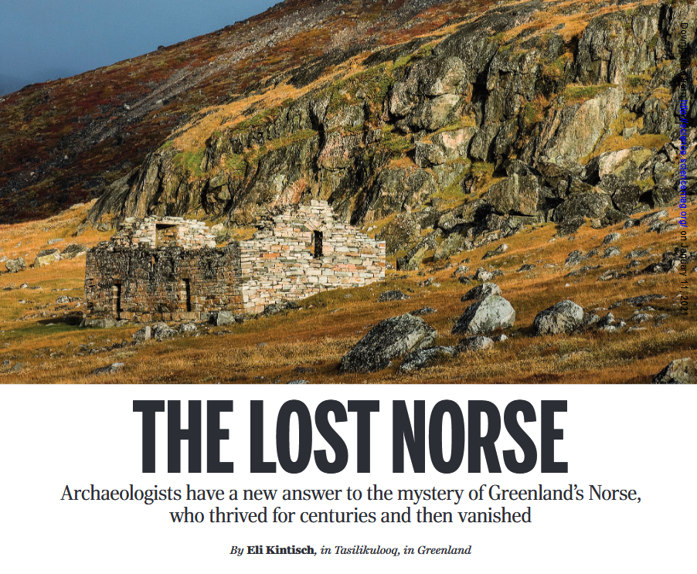

Slide 3
Why frame sustainability through habitability?
Lessens debates over power and politics often associated with sustainability and shifts focus to the long-term evolutionary and systems-based nature of environmental problems
It allows for a dynamic perspective, recognizing that what is habitable today may not be in the future due to climate change, resource depletion, or social shifts.
Encourages thinking beyond human needs to include other life forms and ecosystems
Avoids some of the corporate connotations of ‘sustainability’
Notes:
It also encourages consideration of how current actions affect the long-term livability of ecosystems and societies

Slide 4
ENS 202 takes a coevolutionary view of science and policy
Examples
As income levels rise, some environmental problems decline because society has resources and technology to address problems
Safe drinking water and public sanitation policies
Advancing technology can lead to the identification of new environmental problems that were not known before
PFAS and the ‘forever’ chemicals

Slide 5
As income levels rise, some problems also increase, but then decline as a consequence of recognition of the problem and the development of policy.
Chlorofluorocarbons, the Antarctic ozone hole, and the Montreal Protocol
However, increased affluence and economic activity causes new problems to emerge that are not easily addressed with policy
Carbon dioxide emissions

Slide 6
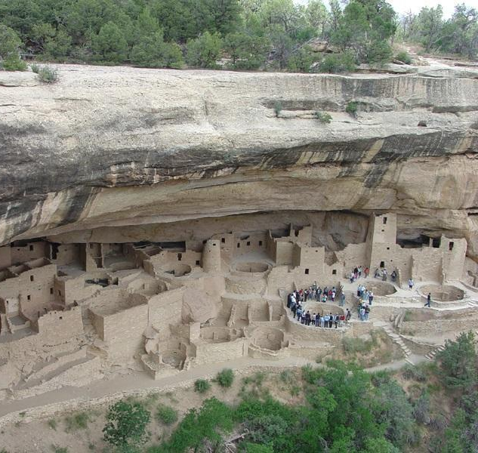
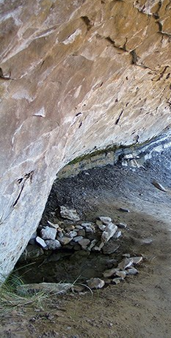
In a coevolutionary view, the focus is on the feedbacks among environmental policies, science and technology, and society and culture.
Policy responses to a problem can results in its disappearance, to new policies, to new problems, and even innovation
Notes:
Costanza, R., Graumlich, L., Steffen, W., Crumley, C., Dearing, J., Hibbard, K., ... & Schimel, D. (2007). Sustainability or collapse: what can we learn from integrating the history of humans and the rest of nature?. AMBIO: A Journal of the Human Environment, 36(7), 522-527. Responses to environmental problems produce a complex web of changes in socioecological systems . Indigenous populations at Mesa Verde in Colorado constructed their dwellings around seep springs to provide water in a dry climate. Extreme drought has triggered both social collapse in some civilizations and ingenious management of water through irrigation in others. Mesa Verde culture thrived for centuries because of their water practices.

Slide 7
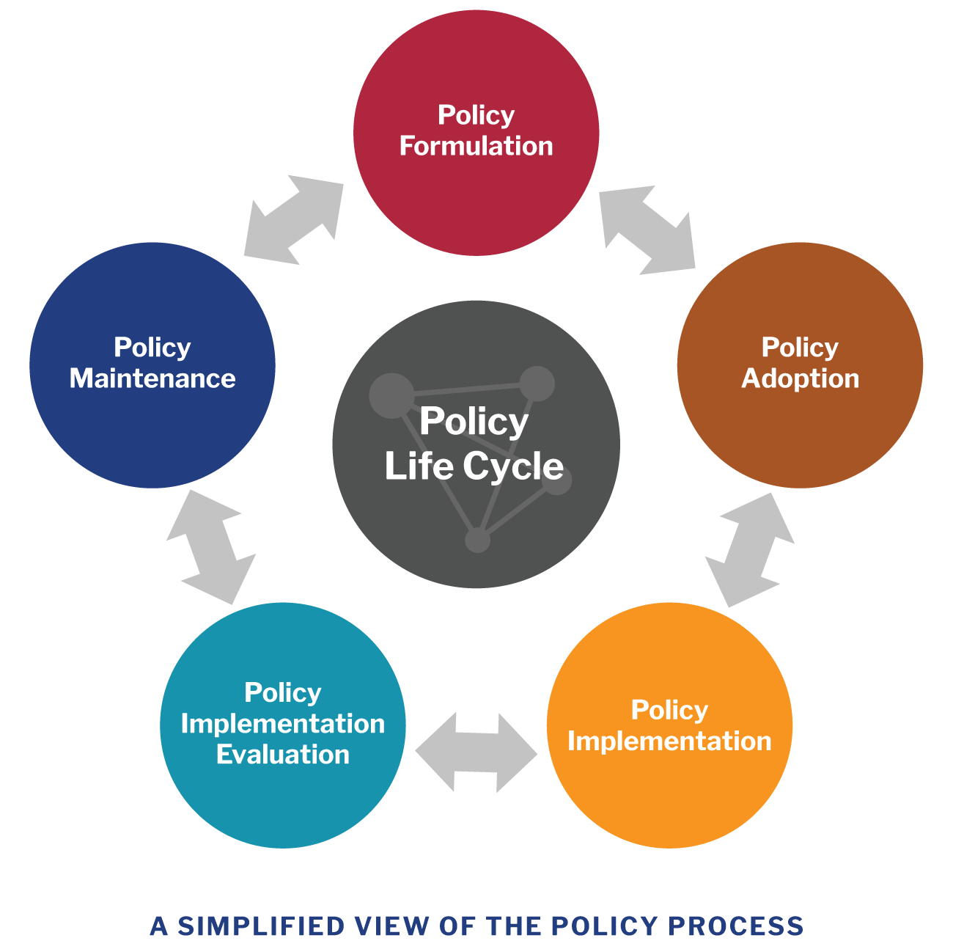
In a non-coevolutionary view of science and policy:
The focus would be on defining what policy is and then memorizing the names of major environmental policies and state what they are supposed to do
Not necessarily a bad or wrong approach. However, it doesn’t capture the dynamics of policies and how they emerge and evolve

Slide 8
ENS 202: Know your environmental policies…
Some policies are enforceable, some are not or use other mechanisms to put them into practice
CITES (not enforceable) versus the Lacey Act and the Endangered Species Act (both enforceable with penalties)
Some international agreements not enforced but there is peer pressure and economic pressure to participate, such as the climate finance agreement approved at COP29, the 29th United Nations Climate Change Conference held in Baku, Azerbaijan in 2024
Some environmental policies are not enforced, but are put into practice through market-based mechanisms . An example of this would be the European Union Emissions Trading Scheme. There are economic incentives to participate.
Notes:
Convention on International Trade in Endangered Species of Wild Fauna and Flora (CITES) Endangered Species Act (ESA) Conference of the Parties (COP) – the supreme decision-making body of the United Nations Framework Convention on Climate Change. The parties are the countries that recognize this UN environmental treaty to address climate change and voluntarily agree to meet its goals.

Slide 9
…but do this too:
Employ a co-evolutionary view that illuminates how policies unfold in complex systems
Be more skeptical of easy solutions with no tradeoffs
Learn ideas disciplines like ecology, biology, anthropology, archaeology, history, psychology, and economics.
Minimizing solipsism, the tendency to mistake one’s opinions as the sole basis of knowledge and policy
Notes:
Natural science is taken to mean ecosystems, populations, communities – the ecological components of the environment and their interaction with the physical world. However, in this class, we take the view that humans evolved in nature, so studying humans and their behaviors and sociality is also a natural science. Conversely, you can’t study the ‘natural’ environment without acknowledging human impacts and behaviors. Hence, the idea of a natural science is in a sense outdated and perhaps makes environmental problem-solving more complicated

Slide 10
ENS 202 aims for informed agitation
“Agitation” is necessary for political mobilization to tackle the powerful entrenched interests behind a business-as-usual attitude that disproportionately benefits a few people in their here and now at the cost of impoverishing the prospects of the many elsewhere and in the future.
“Informed” agitation is necessary because it is easy to waste scarce political muscle on actions that end up having little impact or blunder blindly forward pushing development down even more destructive pathways.

Slide 11


Slide 12

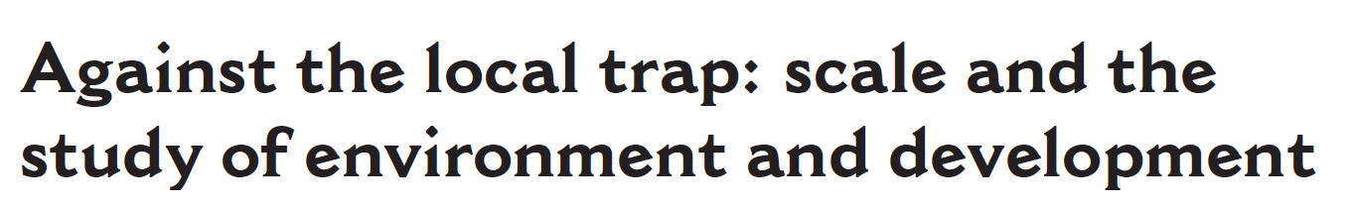

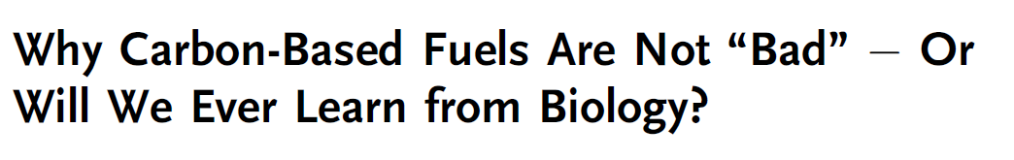

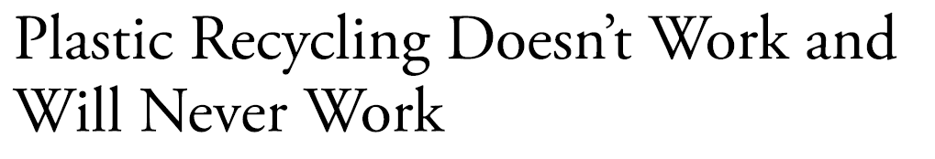
Notes:
Plastics recycling
Local produce at the farmer’s market
Electric cars I am providing these examples not because I think they are entirely right and the ideas they challenge are dead wrong. I am presenting them to show that thinking about many seemingly obvious ‘right’ things to do to promote sustainability are often far more complicated and tentative than we realize when we 1) examine scientific (versus solely political) ideas from a range of other fields of inquiry; and 2) are given a larger spatial and historical extent to examine the network of relationships in place that shape sustainability policies and practices.

Slide 13

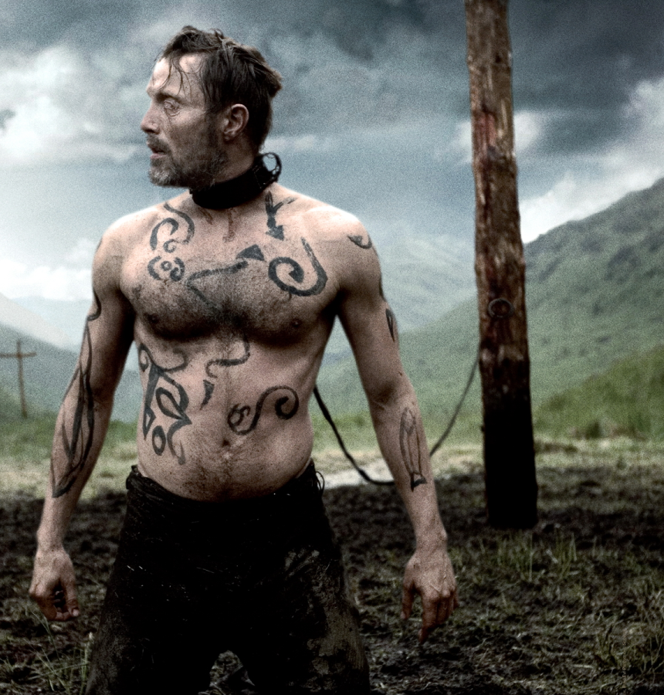

Slide 14
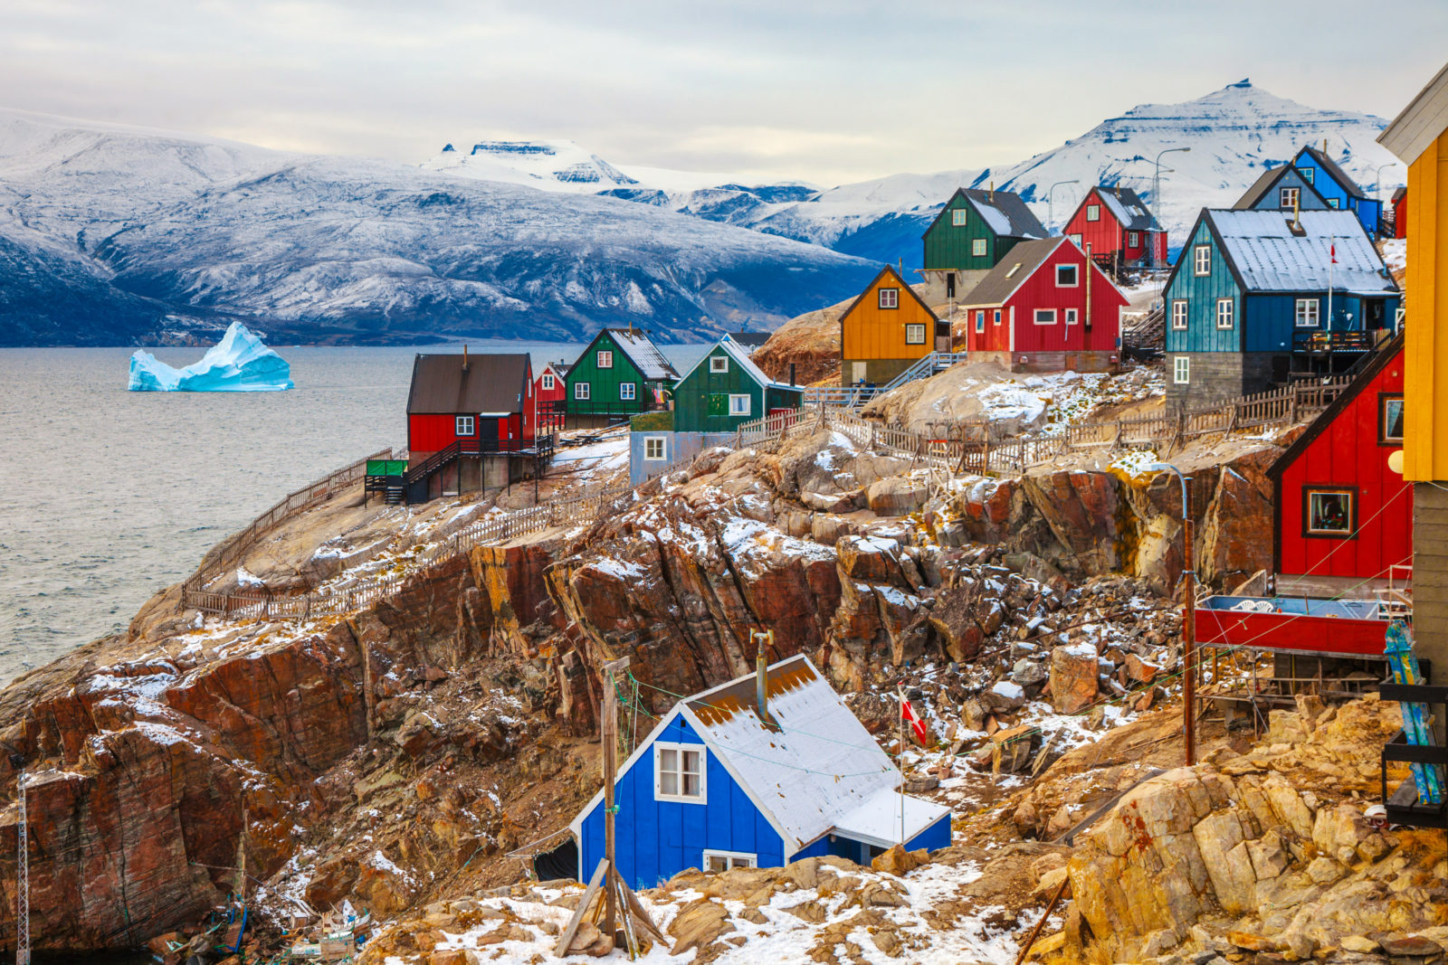
Greenland
In cold climate, soils are thin and low in organic matter
Short growing season
Difficult to raise enough hay for livestock to make it through winter
Field crops can only be grown in protected microclimates
Limited availability of trees for timber

Slide 15

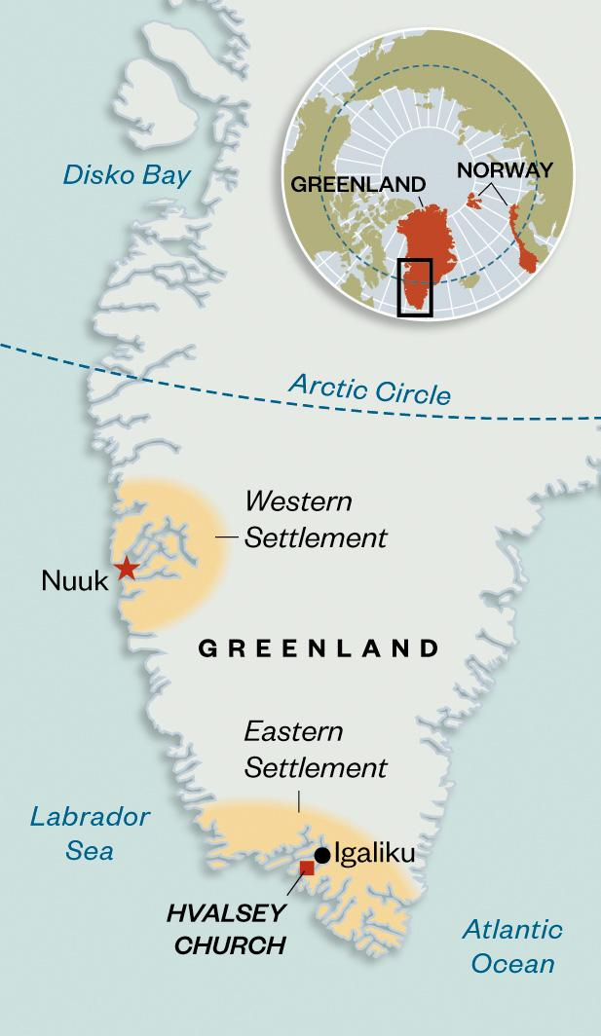
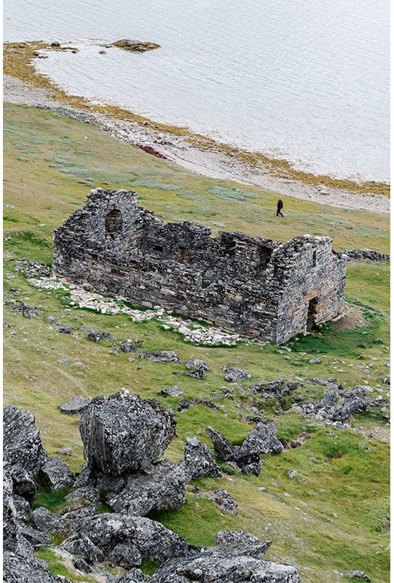
Version 1.0: The stubborn Norse
Notes:
Settled by northern Europeans in 900 -1000 AD Erik the Red arrived in a fleet of 14 longships in 985
Peak of 3000 - 5000 people
Vanished in late 1420’s
Collapse (2005) tells the story of the Norse in Greenland, but paints the Norse in a way very different from what archaeologists have surmised over the last two decades. Rather than stubborn and hesitant to adapt to the local conditions as they are portrayed in Collapse, we now recognize from archaeolological evidence that the Norse adapted to the Greenland environment. The Norse are now seen as more organized rather than ruggedly individualistic. They were even tied into an emerging world economy of that time. Since the publication of the book Collapse, the narrative of the Norse in Greenland has changed from one that was overly environmentally deterministic, to one in which the Norse were much more culturally adaptive. While environmental change ultimately played a role in their demise in Greenland, the story of why they disappeared (or conversely, why the Norse were successful there for several centuries) involves many social and economics processes.

Slide 16
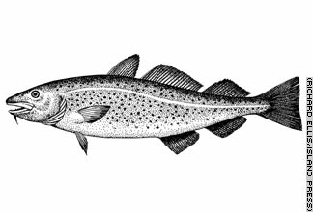
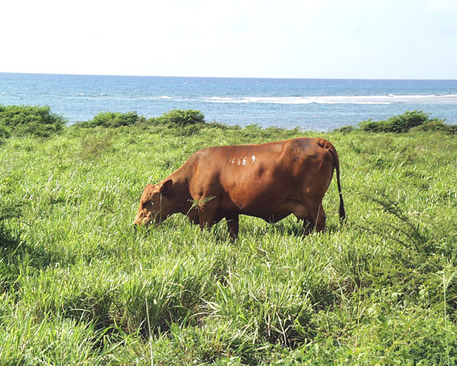
The Norse held on to their Scandinavian-European cultural and religious identity
Norse didn’t eat fish even though the were abundant – they raised cattle, a culturally meaningful resource
The Norse considered farming to be the center of their economy
Notes:
Eating fish would have had far less of an impact on the environment, however, in the version of the Norse in Greenland from the book Collapse, the Norse put cultural survival before biological survival. The Norse from Sweden to Greenland measured their status by the cattle they owned.

Slide 17
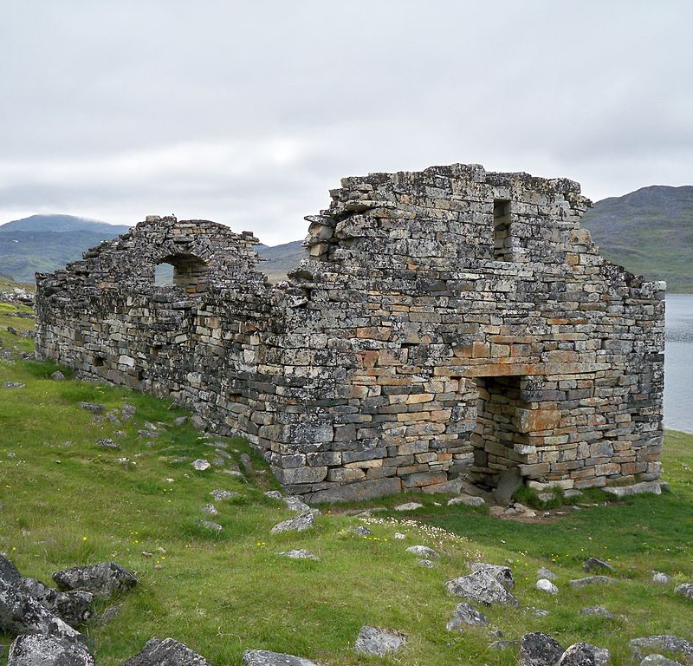
Norse traded small volumes of walrus ivory to Europeans in exchange for cultural artifacts revolving around religion (church bells, stained glass)
Maintained hostile relationships with the Inuit, whom they considered ‘skraelings’ or wretches
Norse fought among themselves
Soil erosion was induced from livestock and from cutting turf for building sod houses

Slide 18
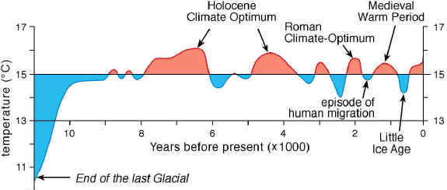
Norse settlement of Greenland took place during Medieval Climatic Optimum
This period gave way to the Little Ice Age beginning around 1200
Colder climate made agriculture even more difficult and the Norse disappeared
Fault is put upon their inability to adapt and change their environmental, social, and cultural practices
Notes:
In 1257, a volcano on the Indonesian island of Lombok erupted. Geologists rank it as the most powerful eruption of the last 7,000 years – this was one of the factors that contributed to the onset of the Little Ice Age

Slide 19
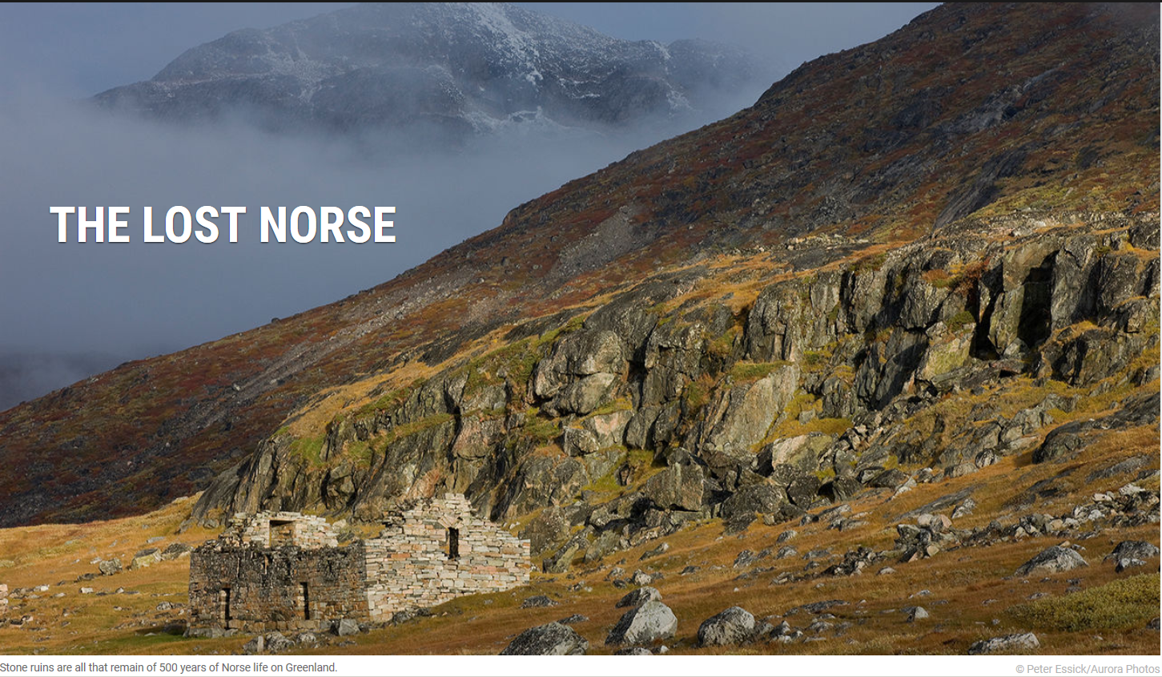
Version 2.0: The adaptive Norse
Notes:
Hvalsey_Church

Slide 20
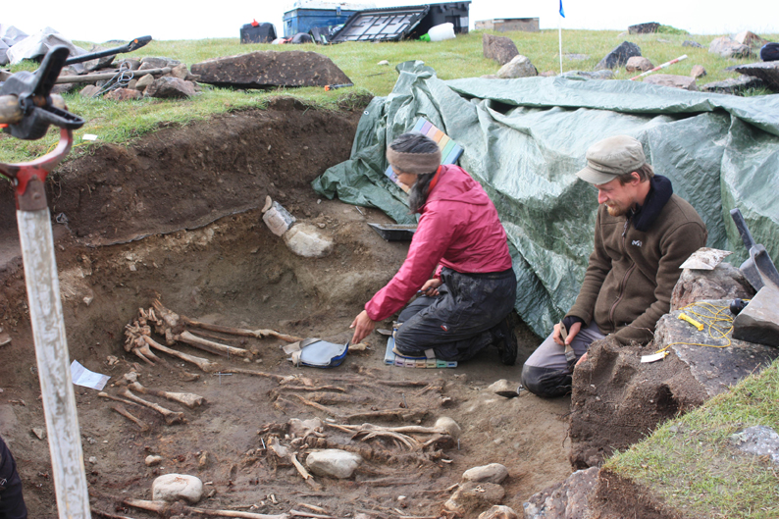
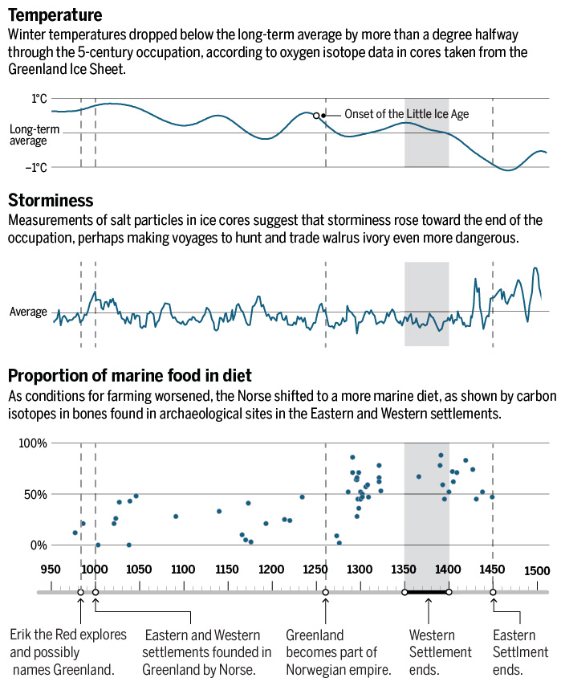
Norse ate fish and especially seal, which required communal hunting and a cooperative society

Slide 21
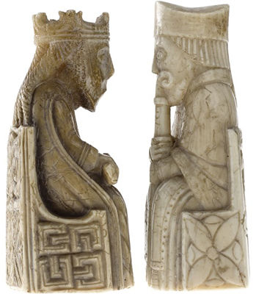
Norse were traders first, farmers second
They undertook large well organized communal hunts for walrus to collect ivory
Ivory trade with Europe was extensive and very lucrative. It provided the Norse with money to buy and transport goods needed to survive in Greenland
Norse likely traded with the indigenous peoples (the Inuit and their ancestors the Thule) all across Greenland
Notes:
The Norse in Greenland were even in tune with European fashions in dress given the extent of their trading. They were traders – and hunters, which supplied the ivory for their trade. Farming was secondary.

Slide 22
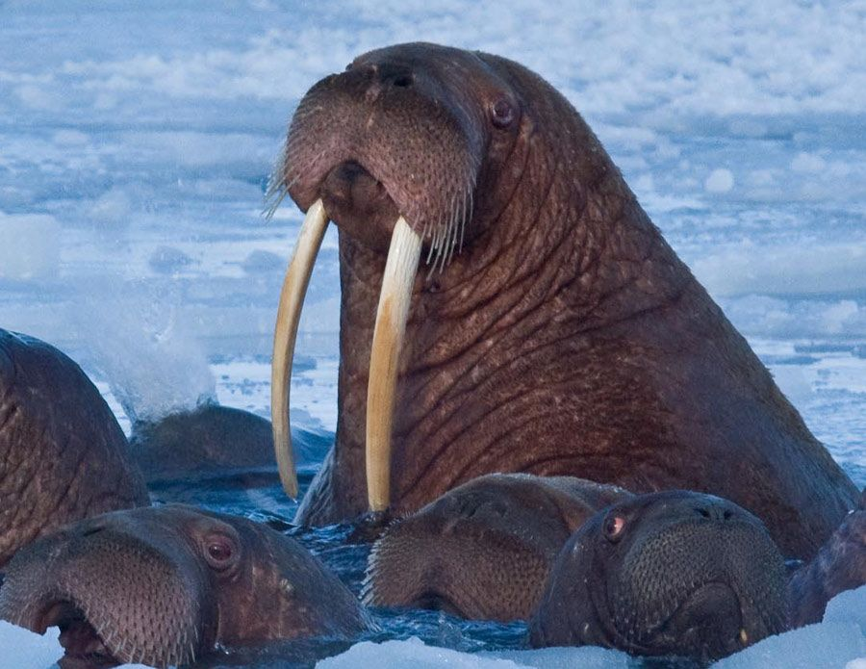
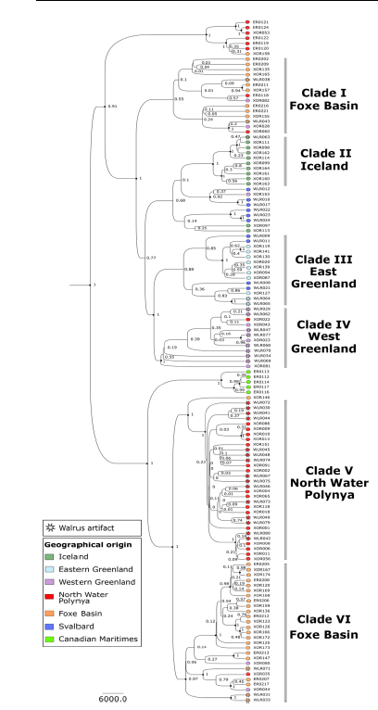
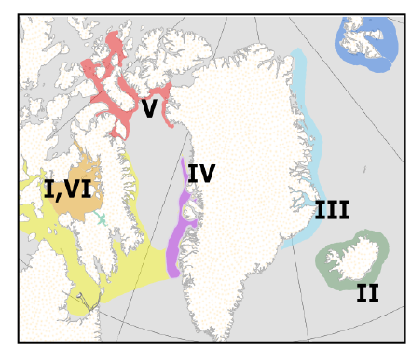
Notes:
Genetic sourcing of traded artifacts back to specific walrus stocks. The Bayesian phylogeny includes walrus mitogenomes from 100 biological samples and 31 cultural artifacts. These biological samples were obtained from a wide range of geographic locations and chronological periods to reconstruct genetic diversity and stock locations at the time of the Norse Greenland settlements. Our results confirm that distinct walrus stocks were located in specific locations. This combined approach enabled the walrus artifacts recovered from trade and production centers in Europe and the main Greenland Norse settlements to be genetically sourced back to specific walrus stocks and particular Arctic hunting grounds Ruiz-Puerta, Emily J., Greer Jarrett, Morgan L. McCarthy, Shyong En Pan, Xénia Keighley, Magie Aiken, Giulia Zampirolo et al. "Greenland Norse walrus exploitation deep into the Arctic." Science Advances 10, no. 39 (2024): eadq4127.

Slide 23
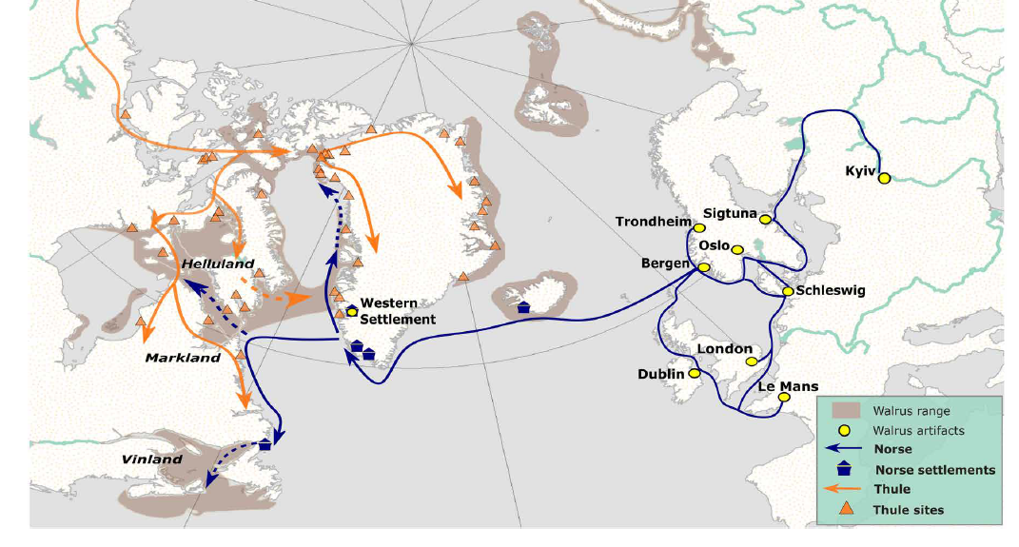
The Arctic Ivory Road
Notes:
Early circumpolar globalization: schematic reconstruction of the Arctic Ivory Road. Shifting walrus exploitation patterns suggest a “domino” model: the Norse systematically depleted more accessible walrus stocks to supply the booming European ivory trade; the search for fresh sources of ivory was one factor driving Norse expansion into the Northwest Atlantic, including initial colonization of Iceland, and the establishment of Norse settlements in Southwest Greenland. Exploration of coastal North America (Helluland, Markland, and Vinland) by the Norse likely resulted in initial full-circle encounters with various Indigenous North American groups across a broad “contact” frontier running from the Canadian Maritimes up to the High Arctic. However, most ivory in the Early Period (pre 1120 CE) was coming from the local stock in West Greenland (IV). By the Late Period (after 1120 CE), Greenland Norse communities were mounting regular long-range expeditions to the High Arctic to harvest ivory from the North Water Polynya (Stock V), either via direct hunting, or intercultural trade and exchange, possibly with Tuniit groups, and more probably with the Thule Inuit who were expanding across the Canadian Arctic and into this area. These routine intercultural interactions at the North Water Polynya peoples signal the onset of early circumpolar globalization, with numerous Norse artifacts recovered from Thule Inuit sites dating to this interval. The Greenland Norse may also have ventured deeper into the interior Canadian Arctic waters, or more likely hunted walrus and traded ivory with Arctic Indigenous peoples at intermediate locations (Stocks I,VI). With elite consumption trends in remote European urban centers driving these early full-circle global interactions, our preliminary reconstructions of the emerging Arctic Ivory Road bear interesting parallels with Silk Road that spanned Medieval Eurasia during the same period.

Slide 24
Walrus trade collapsed because of new trade routes into Africa for elephant ivory.
Bubonic plague in medieval Europe reduced demand
Norse disappeared from Greenland because globalization and a pandemic in Europe
Notes:
The new evidence is no longer the version of Collapse which is basically “Dumb Norsemen go into the north outside the range of their economy, mess up the environment and then they all die when it gets cold.” Archaeology, genetics, biochemistry, history, climatology – these fields and scientific advances in them have led to a revision of how we understand sustainability of the Norse in Greenland. Decreased labor to do all the tasks needed to survive in Greenland may have also been a factor in their decline. A certain amount of labor, of able bodies and hands, was needed to maintain food stores, conduct trade, and hunt.

Slide 25
Increasingly cooler climate made sea voyages more dangerous due to ice and increased storminess

Slide 26
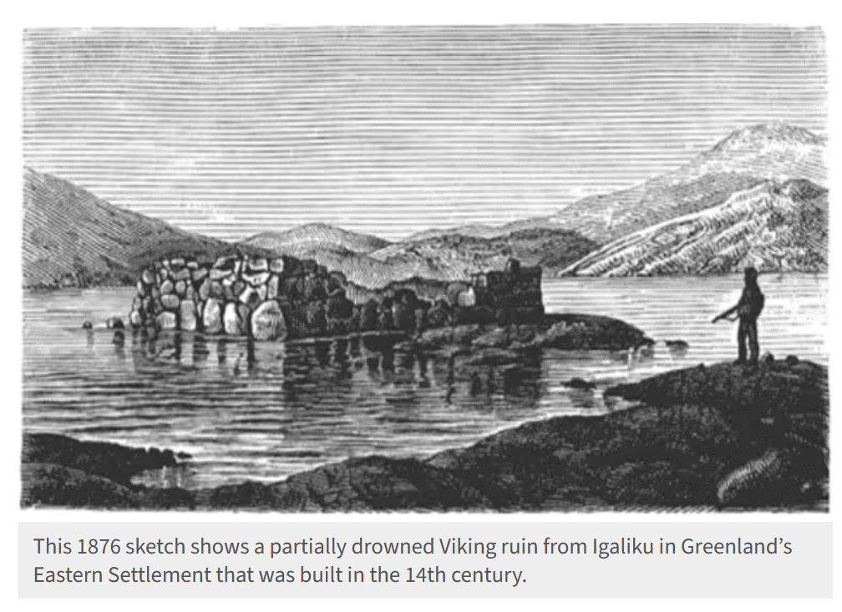
Notes:
https://news.climate.columbia.edu/2023/05/01/vikings-abandoned-greenland-centuries-ago-in-face-of-rising-seas-says-new-study/ Borreggine, M., Latychev, K., Coulson, S., Powell, E. M., Mitrovica, J. X., Milne, G. A., & Alley, R. B. (2023). Sea-level rise in Southwest Greenland as a contributor to Viking abandonment. Proceedings of the National Academy of Sciences, 120(17), e2209615120.

Slide 27
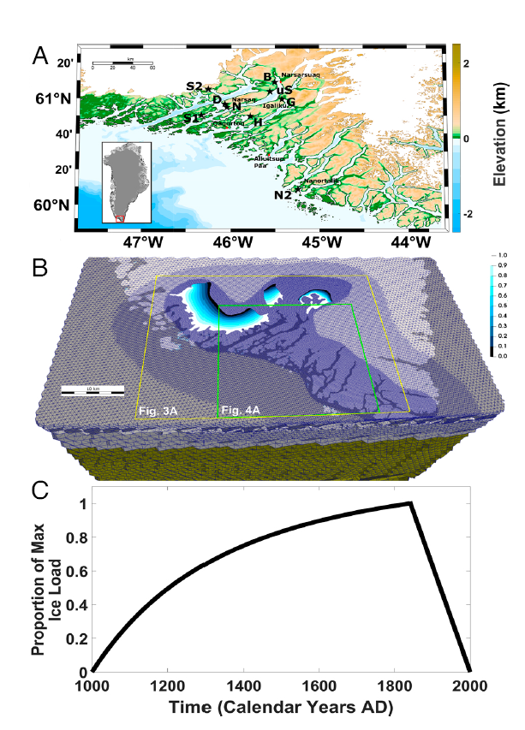
Sea level rise
As climate cooled, Greenland ice cover expanded
Increasing accumulation of glacial ice on Greenland resulted in subsidence, slow downward downwarping of surface
Resulting coastal flooding, erosion, and loss of farmland also contributed to abandonment of Greenland

Slide 28
Version 1.0: The stubborn Norse
Collapse narrative
Overstresses environment as determinant of sustainability
Downweights human behavior and the capacity to adapt
Lack of archaeological and historical data
Version 2.0: The adaptive Norse
Adaptation narrative
More data rich, systems view
Less environmentally deterministic
Many intersecting factors related to sustainability
Cultural adaptation and environment interact to shape sustainability
Early globalization shaped duration of Norse in Greenland
Notes:
These two versions of the Norse illustrate how ideas about sustainability can change when a broader range of sciences are brought to bear upon an issue. Over the course of centuries they experimented, adapted, and accumulated knowledge that could be passed down to insure their more durable habitation of Greenland. Version 1.0: Dumb Norsemen go into the north outside the range of their economy, mess up the environment and then they all die when it gets cold

Slide 29
Summary
Neither environment nor culture can explain the sustainability of human societies entirely on its own.
Human adaptation, and the accumulation and transmission of culture via policy and its practices, can promote sustainability, but there may still be limits to adaptation imposed by the environment.
Sustainability narratives for the past, present, and the future have a dependence upon science to weigh in on qualifications of sustainability.
Notes:
Science is not just a means to strive toward sustainability through technological innovations. It is also fundamental for interpreting what sustainability is and how it works. Know how innovations might offer a movement toward sustainability, but science is also an ongoing tool to understand and assess sustainability. Rejecting science is to reject insights as to how humans have lived on Earth and how they might do so better.

