Slide 1
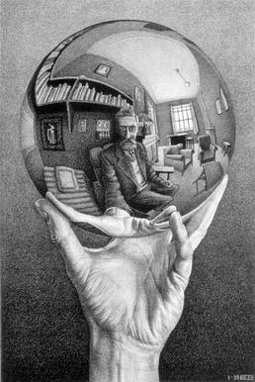
To make effective policy, one has to understand how knowledge works, how change and systems interactions are conceptualized.
Philosophy of science, scale, equilibrium and non-equilibrium ecology, disturbance, complex adaptive systems, resilience, adaptive management
To make effective policy, one has to understand how people think and make decisions.
Cognitive biases, nudging, behavioral contagion.
Game theory, evolution of cooperation, management of common pool resources
How can we simplify the world so that we can identify the mechanisms of relevance for making policy? How do we represent the world so we can work with it?

Slide 2
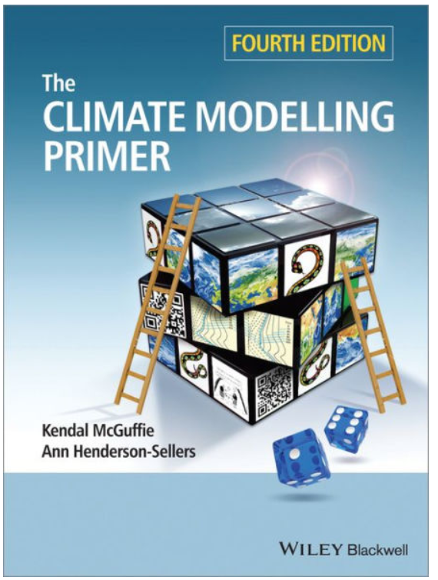
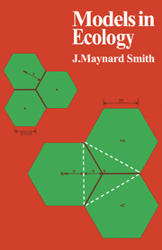
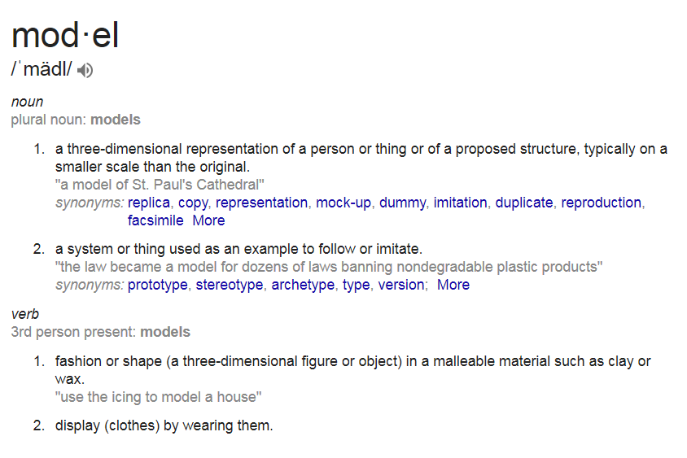

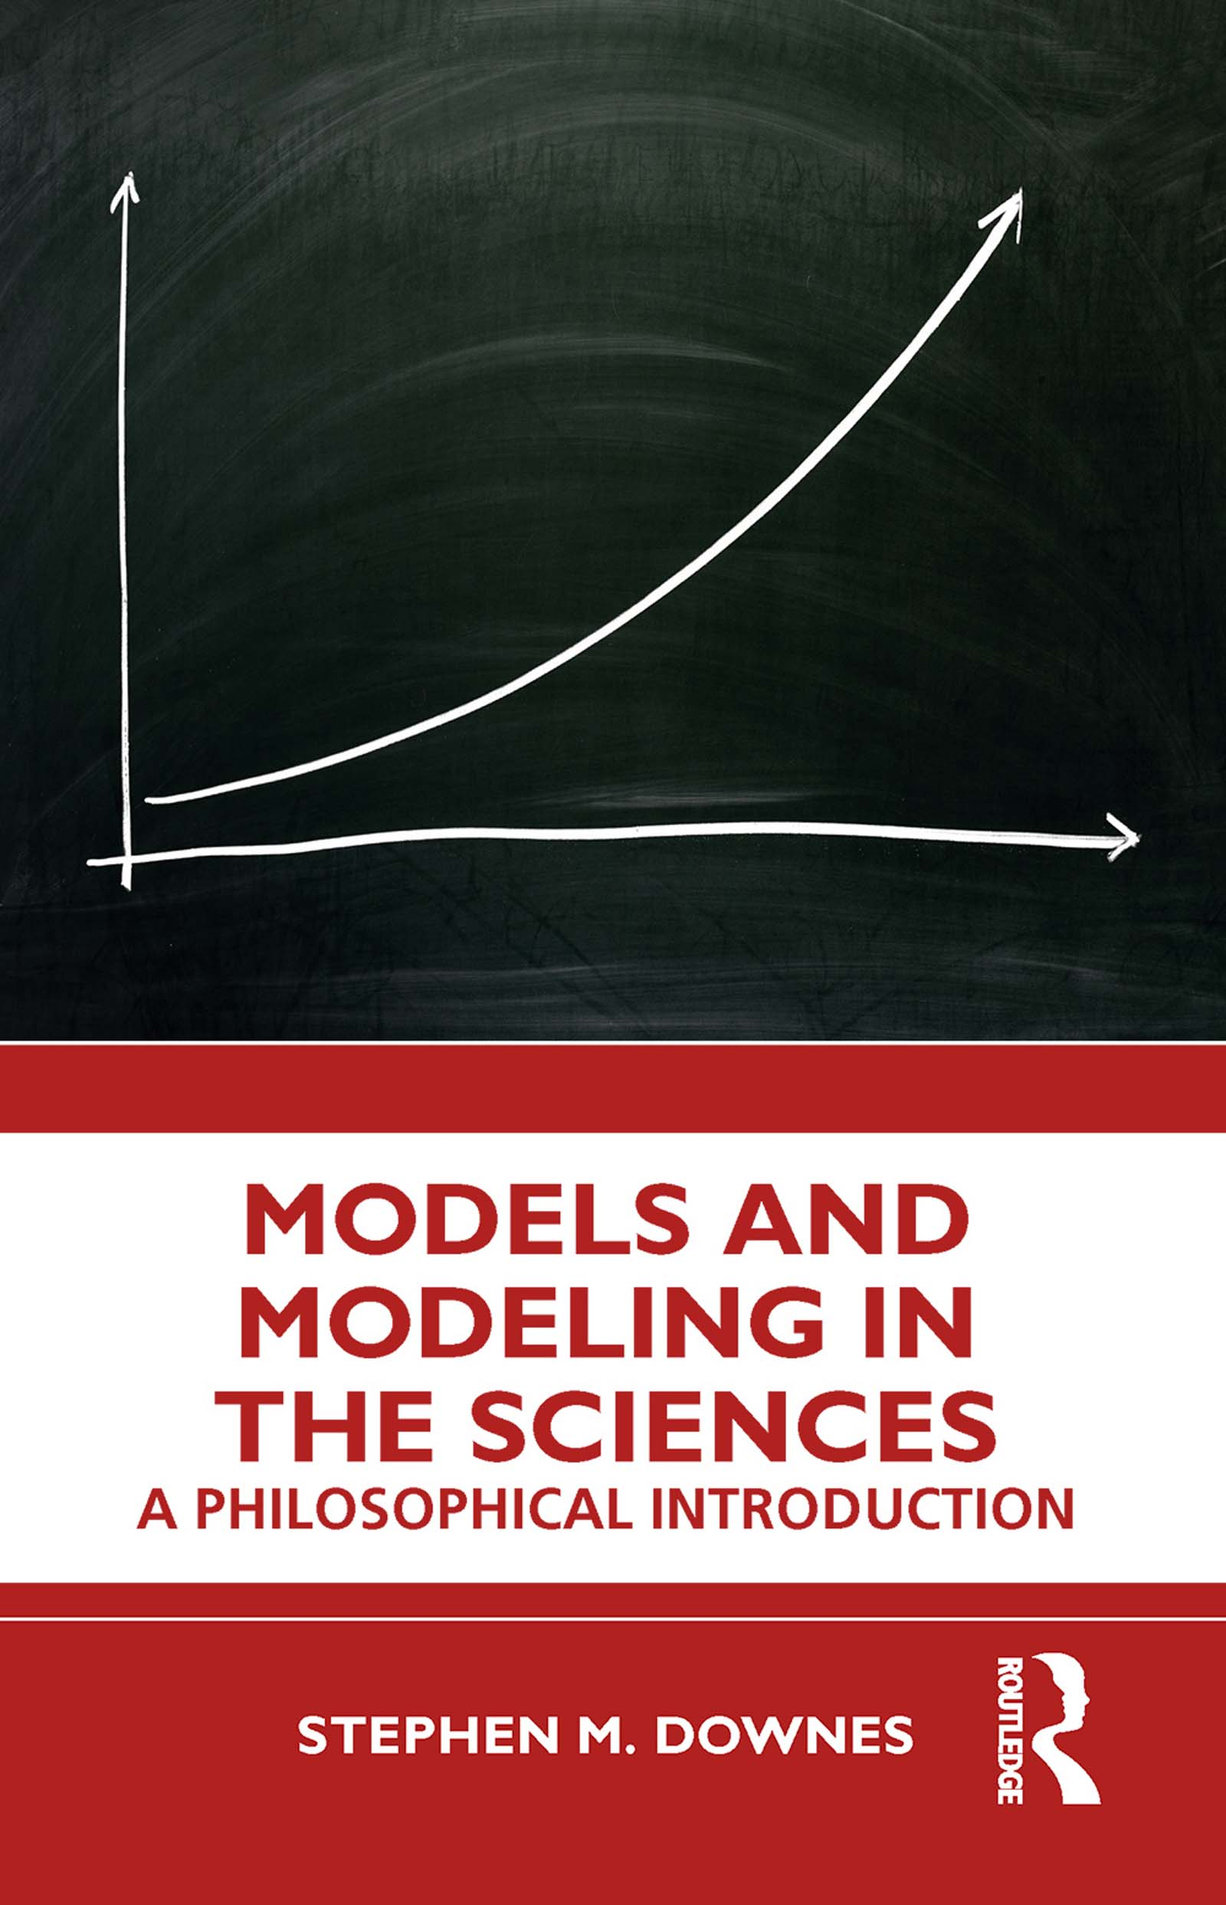
We make models and perform modeling
Notes:
Its not all math – the concept of modeling is inherent to all living things. We make representations of the world, even non-human organisms.

Slide 3
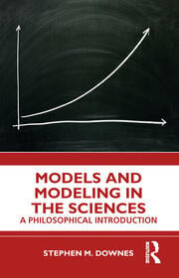
Models and modeling
Models are idealized representation of reality.
They leave out aspects of the world in order to recreate the patterns and processes of relevance
Models can be designed to make predictions about the future and to study the past
There are many different types of models

Slide 4
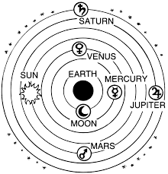
Model types
Mental models
Maps
Graphical conceptual models
Mathematical models
Data visualizations
Physical models
Simulations
Experimental models
Hindcasting
Numerical models
Statistical model
Scenario modeling
Agent-based models
Notes:
A model type may be more than one type of model. One of the earliest scientific models in history is the geocentric model of the universe, proposed by ancient Greek thinkers like Ptolemy and Aristotle. It was later replaced by the heliocentric model (sun-centered)

Slide 5
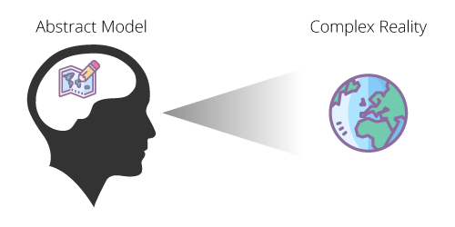
Mental models

Slide 6
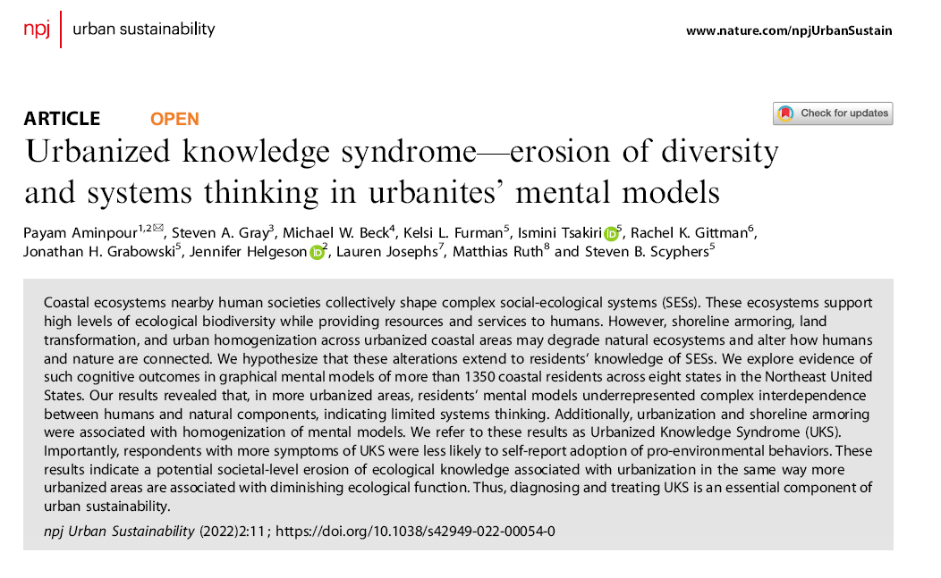

Slide 7
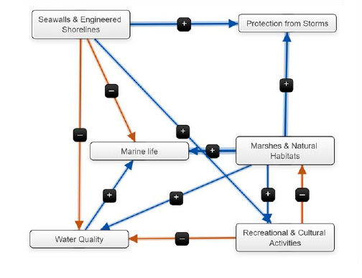
Notes:
This is a representation (a conceptual graphic model) of a mental model derived from interviewing people about their understanding of how sea walls and other engineered structures on sandy shorelines impact the environment. + indicates a positive relationship between boxes, - indicates a negative relationship.

Slide 8
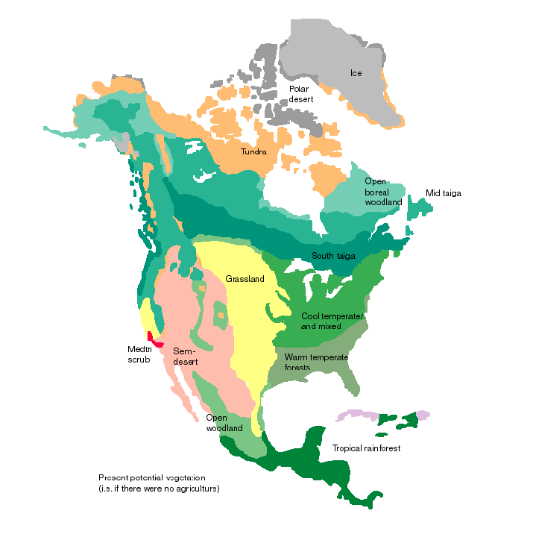
Maps
Maps exemplify the basic properties of models.
They simplify the world so that we can understand it
They isolate the patterns and the processes of interest
As models, they are incomplete – they are not meant to capture all the details of the real world, only those salient to our questions and goals

Slide 9
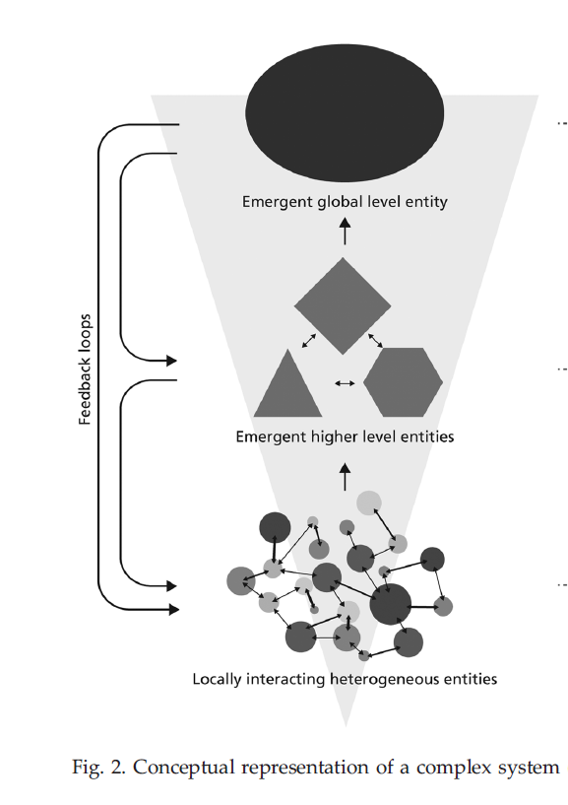
Graphical conceptual model
Notes:
A map then is a graphical conceptual model

Slide 10
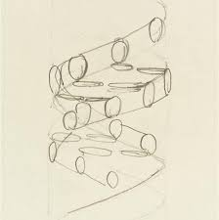
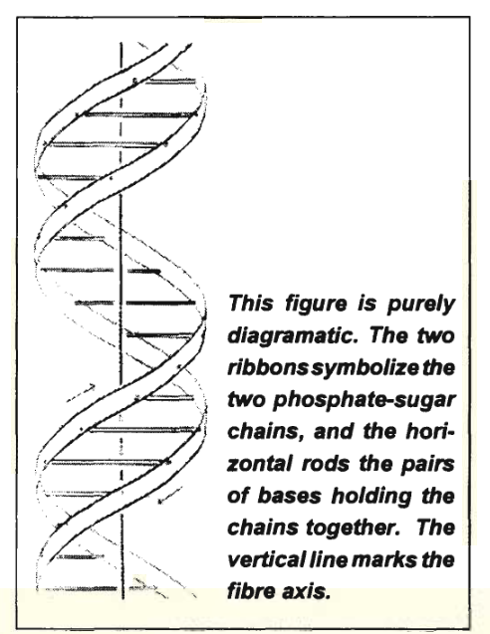

Slide 11
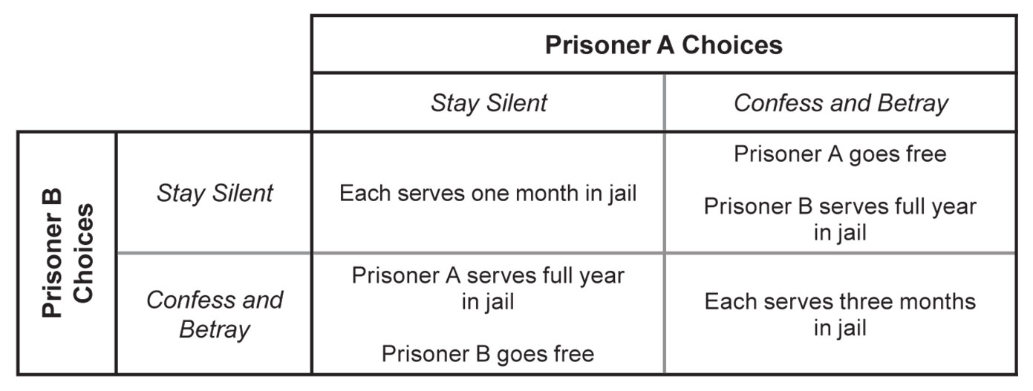
Graphical conceptual model
Notes:
Prisoner’s Dilemma is a conceptual model too. It can be mathematical too, with numbers used to explain the relationships and strategies it involves

Slide 12
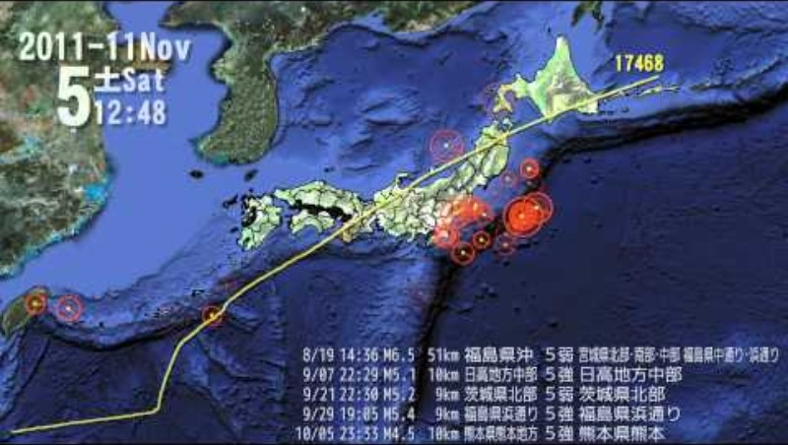
Data visualization
Phenomena are only given visual representation in this type of model
It does not recreate approximations of the dynamics of the actual mechanisms.
In other words the goal is to capture the visual aspects of a phenomena without simulating the underlying mechanism

Slide 13
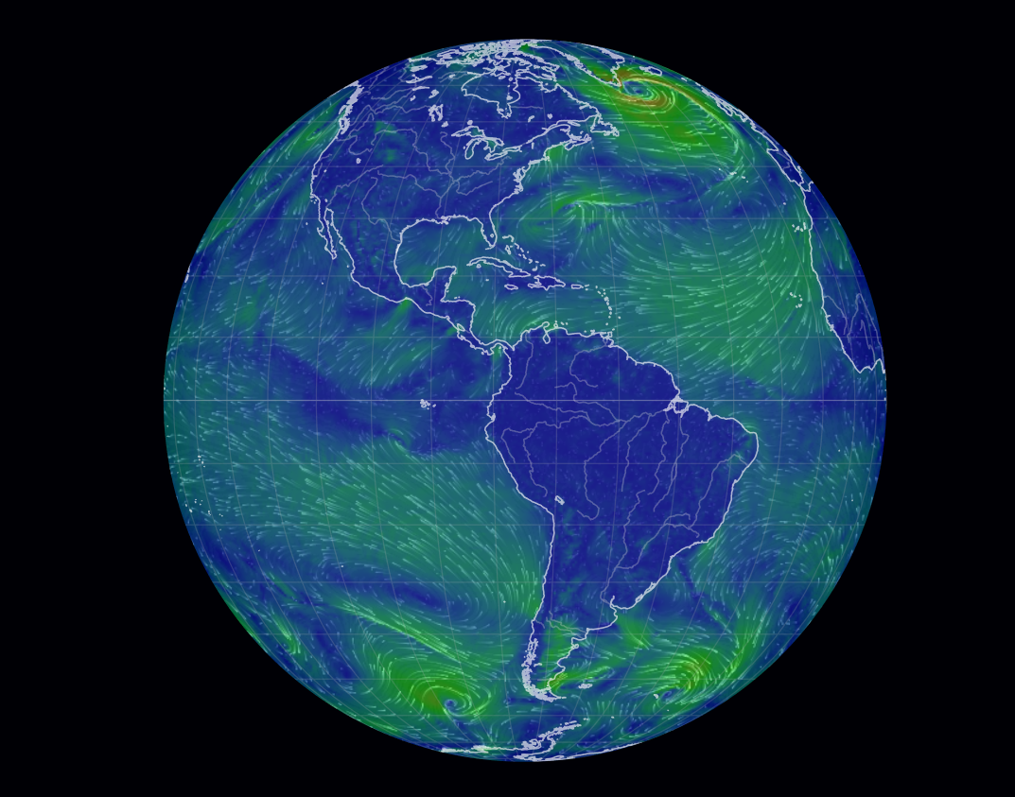
Data visualization
Notes:
This is also a numerical model – mathematical equations were used to compute the direction wind will flow from one grid cell to another for the planet. Thus, this is also a mathematical model in that there are equations that are applied to each grid cell.

Slide 14
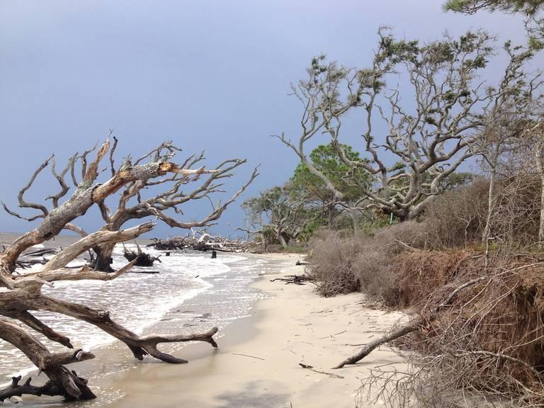

Slide 15
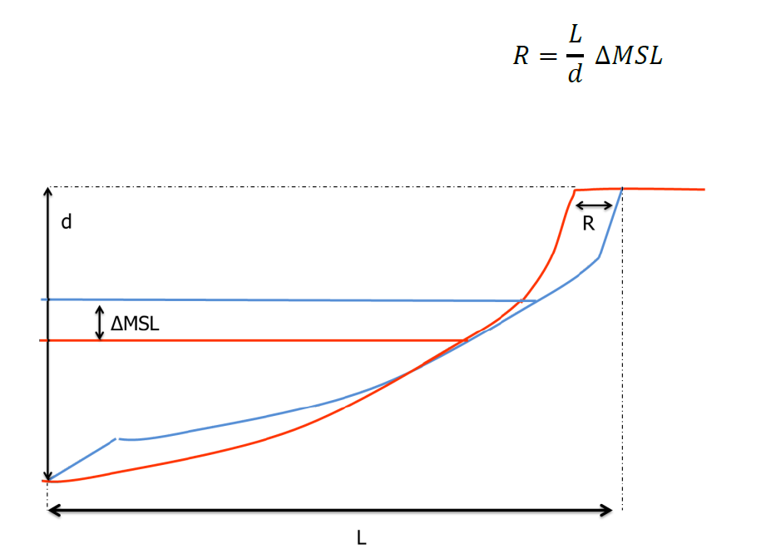
Mathematical models
Notes:
This is Brunn’s Rule, a model to understand the relationship between sea level rise and the retreat of the shoreline. It is also a conceptual graphical model (and at one time, a mental model).

Slide 16
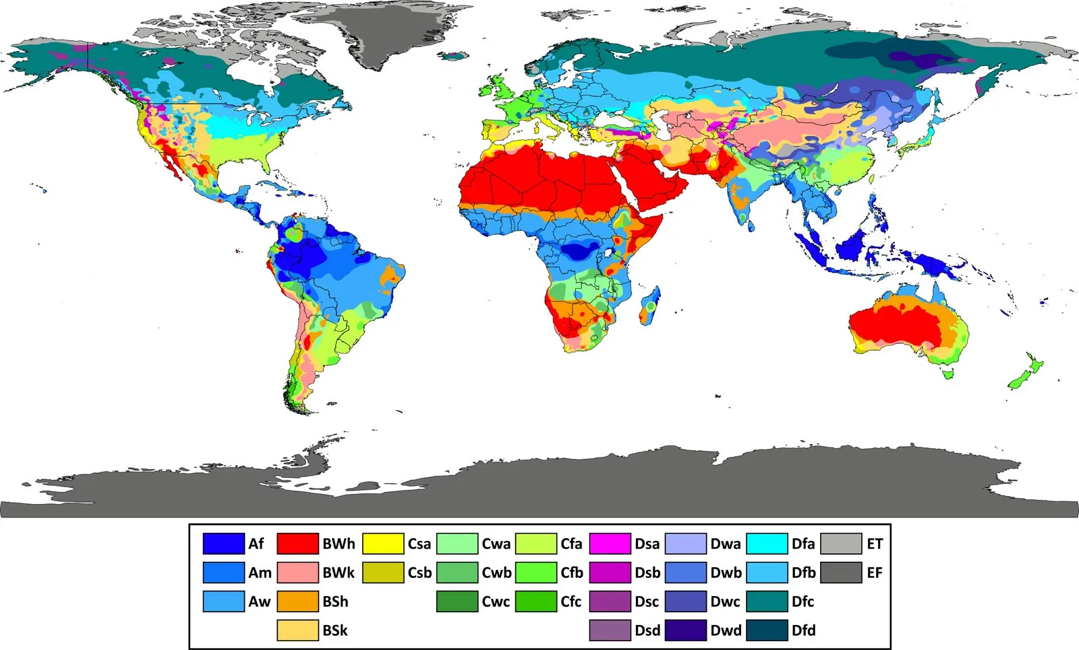
Notes:
Yes, this is also a map, a conceptual-graphical model.

Slide 17
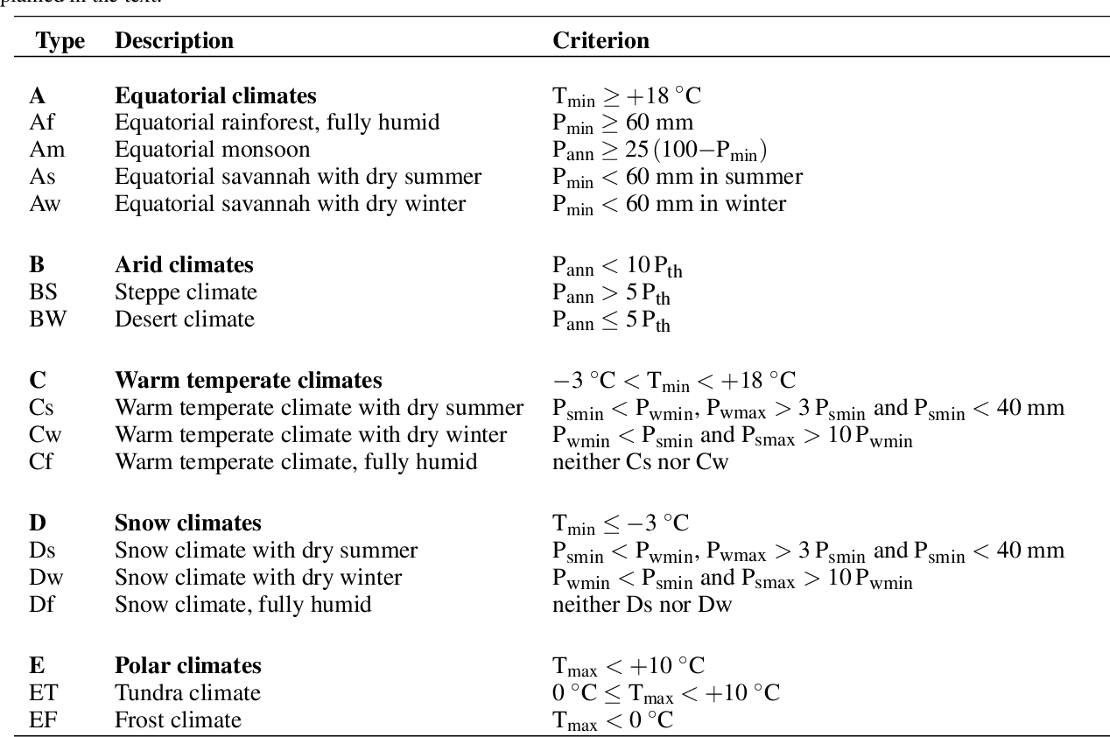
Mathematical models
Notes:
These are the mathematical equations for the Koppen climate classification system.

Slide 18
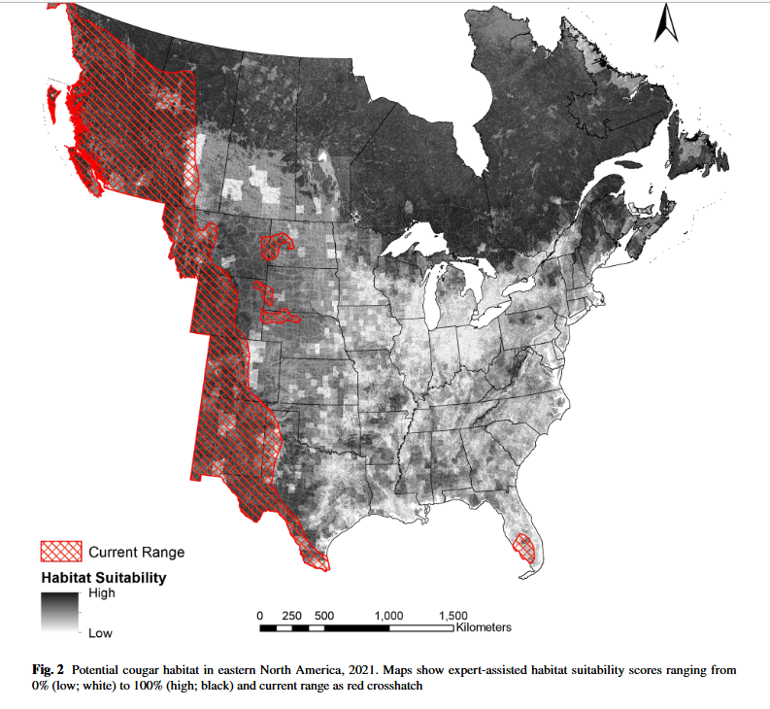

Slide 19
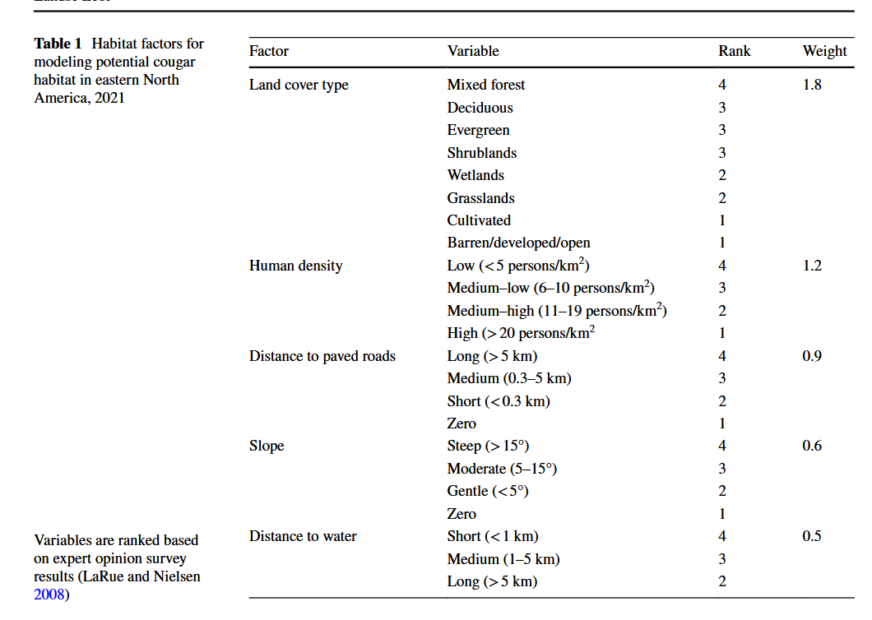
Notes:
https://storymaps.arcgis.com/stories/b60b7399f6944bca86d1be6616c178cf Winkel, B. M., Nielsen, C. K., Hillard, E. M., Sutherland, R. W., & LaRue, M. A. (2022). Potential cougar habitats and dispersal corridors in Eastern North America. Landscape Ecology, 1-17.

Slide 20
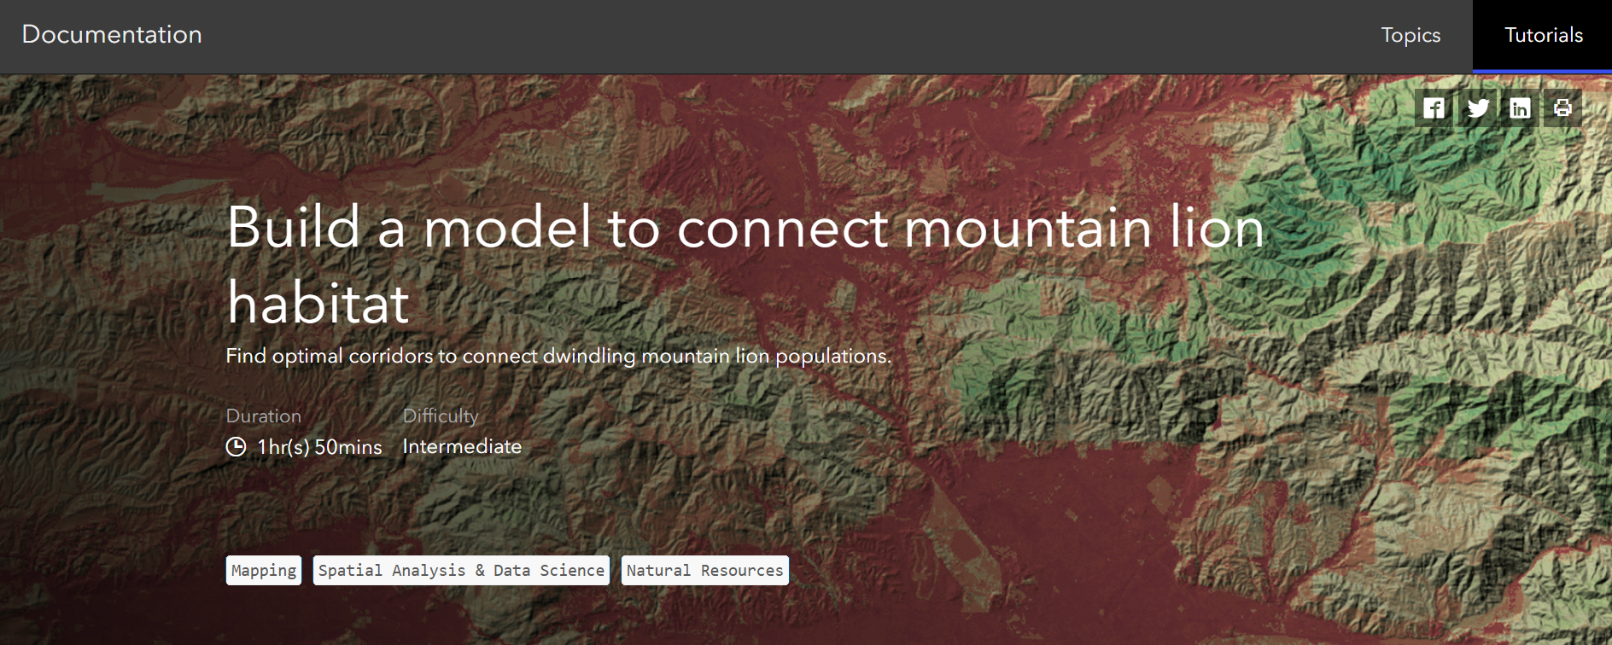
Notes:
https://storymaps.arcgis.com/stories/b60b7399f6944bca86d1be6616c178cf Winkel, B. M., Nielsen, C. K., Hillard, E. M., Sutherland, R. W., & LaRue, M. A. (2022). Potential cougar habitats and dispersal corridors in Eastern North America. Landscape Ecology, 1-17.

Slide 21
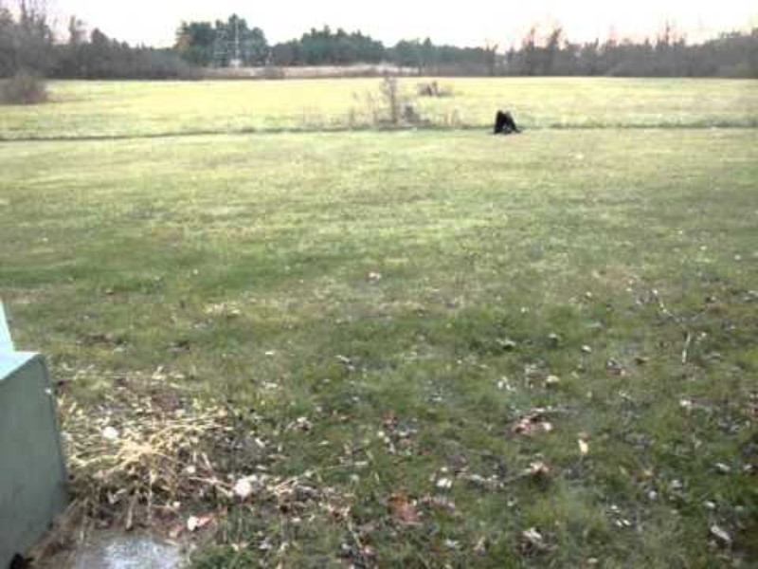

Slide 22
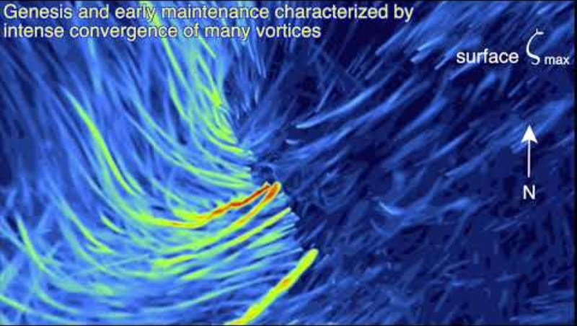
Simulations
A mathematical model with a visualization element
In a simulation, the actual mechanisms and processes are recreated
A data visualization is just a representation of a phenomena – it does not simulate the underling mechanisms and processes like a simulation
Notes:
https://www.youtube.com/watch?v=dyfJYOZgiyA This is a simulation of a real fire. It is designed to represent the dynamics of fire – it is not just an animation of the fire as in a simulation. The elements of color you see are following rules that mimic the behavior and dynamics of fire. This wildfire destroyed the town of Paradise in CA and killed 86 people. https://www.nytimes.com/interactive/2021/10/19/climate/dixie-fire-storm-clouds-weather.html https://www.youtube.com/watch?v=MvIWGjhhdEU

Slide 23
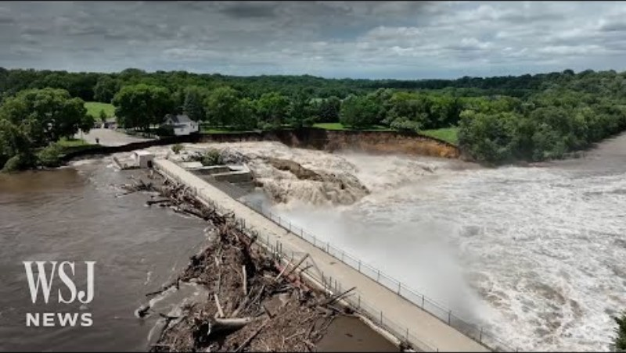

Slide 24
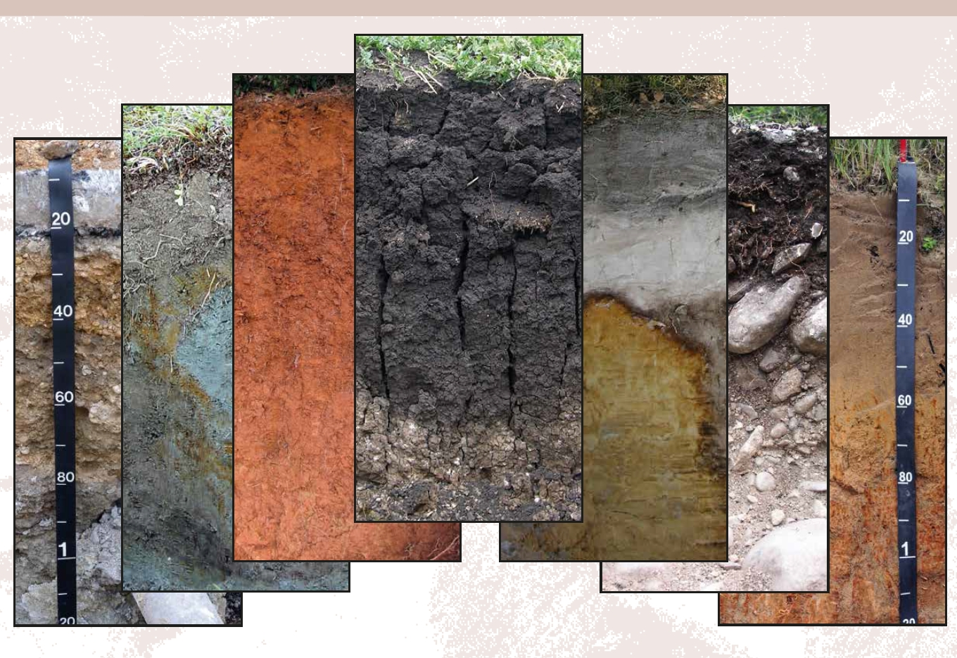

Slide 25
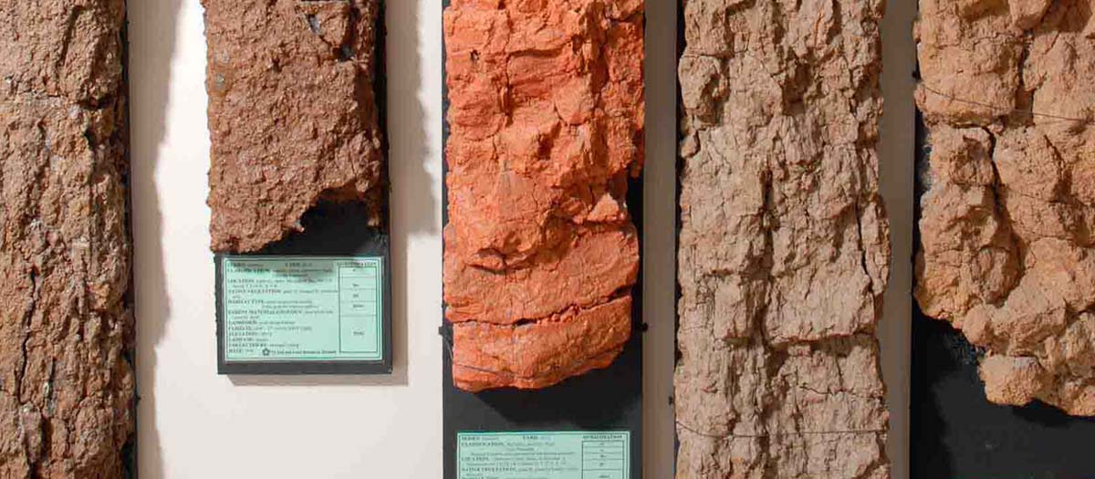
Physical models
Notes:
Soil monoliths, samples of soils that have been preserved and mounted to retain their characteristics as they were in the soil profile in the ground. These are physical models

Slide 26
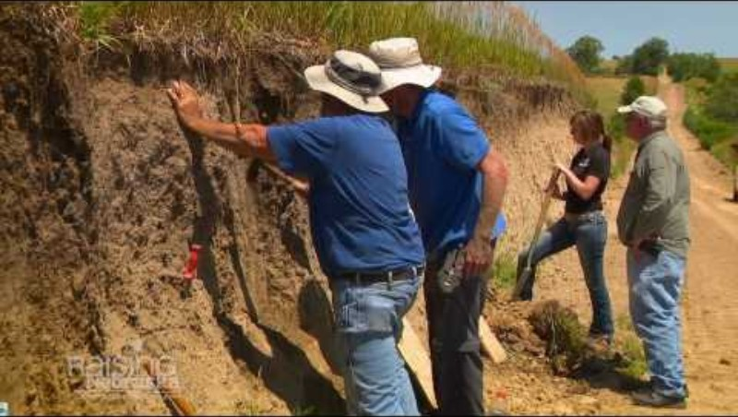

Slide 27
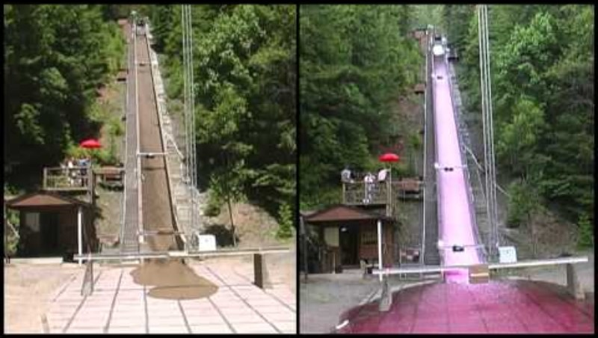
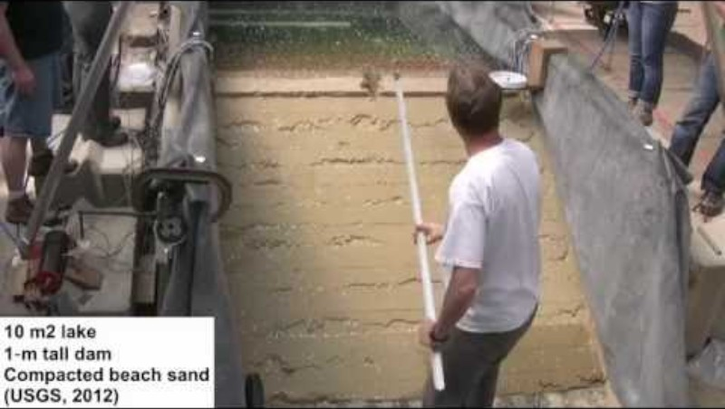
Physical models
Physical models can also be a scaled-down physical version of real-world processes
Notes:
Even games, such as this one above in which residents of an agricultural community play a game to simulate how they manage their common pool resources, are physical models

Slide 28
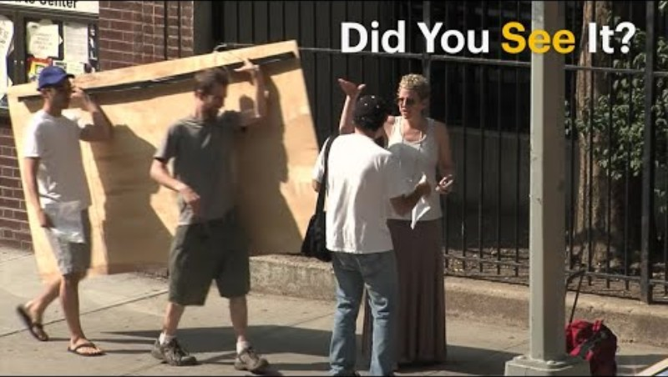

Experimental models
Notes:
Physical models are often designed to be experiments, so we speak of an experimental model.

Slide 29
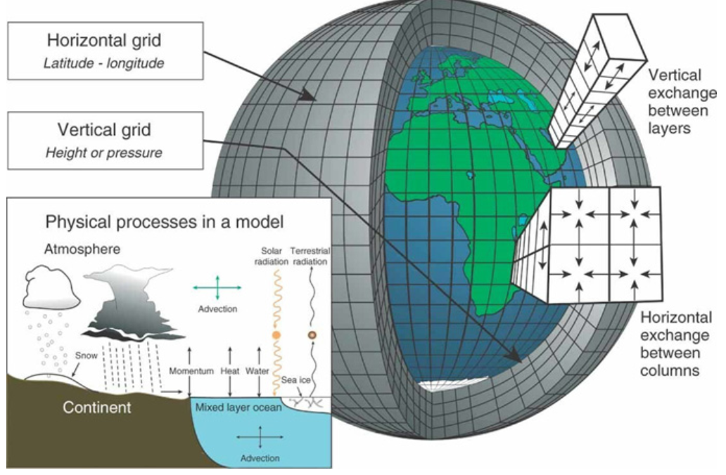
Numerical models
These are mathematical models that simulate phenomena using gridded data
Grid cells are initially assigned a value based on real-world observations and estimations of them
Equations are applied to each grid cell to simulate change in the phenomena of interest
Assumes continuity in space and time, rather than discrete entities or locations.
There is no agent in these types of models
Notes:
https://www.ready.noaa.gov/READY_animations.php

Slide 30
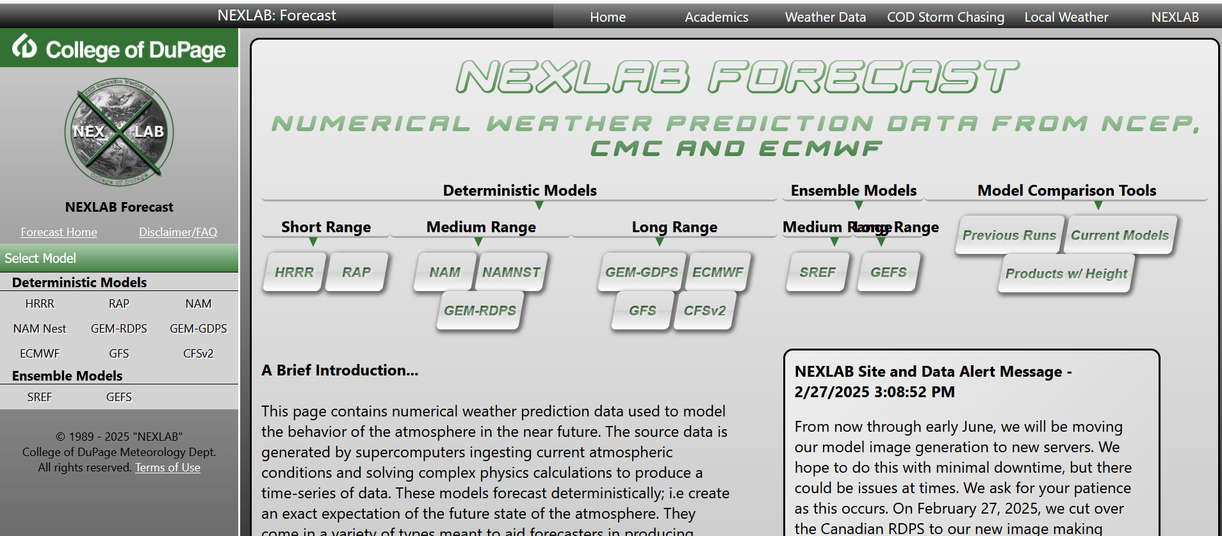
Numerical models

Slide 31
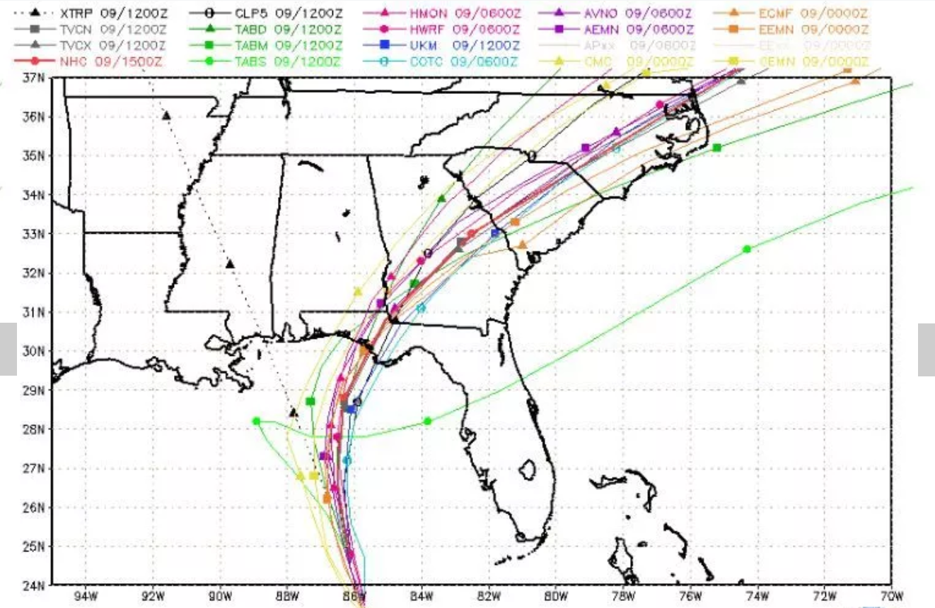
Ensemble models
Comparisons of the outputs of numerical models
The degree of agreement among different numerical models gives an estimate of how much confidence to put into any model’s prediction

Slide 32
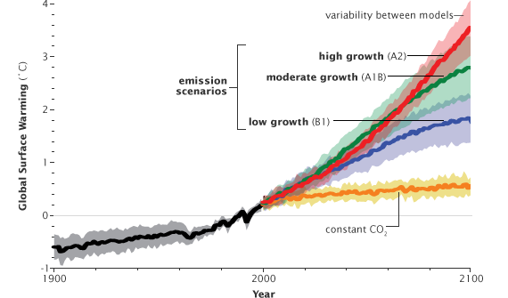
Scenario modeling
In a scenario model numerical models are run under different scenarios of socioeconomic conditions to visualize the range of outcomes
Scenarios are plausible descriptions of how the future may develop, based on a coherent and internally consistent set of assumptions
Notes:
Obviously, you are not going to do a scenario model out for a century for the weather in a particular city – these models have a relatively course resolution given their large extent

Slide 33
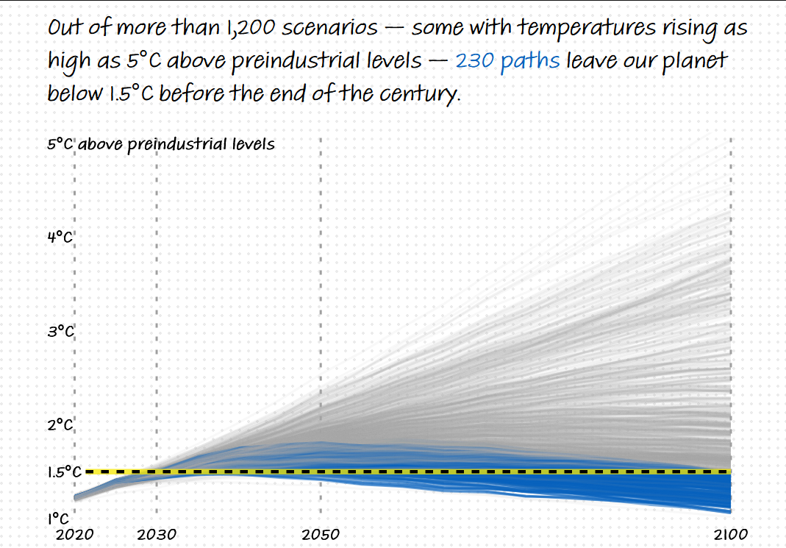
Scenario modeling
Notes:
https://www.washingtonpost.com/climate-environment/interactive/2022/global-warming-1-5-celsius-scenarios/

Slide 34
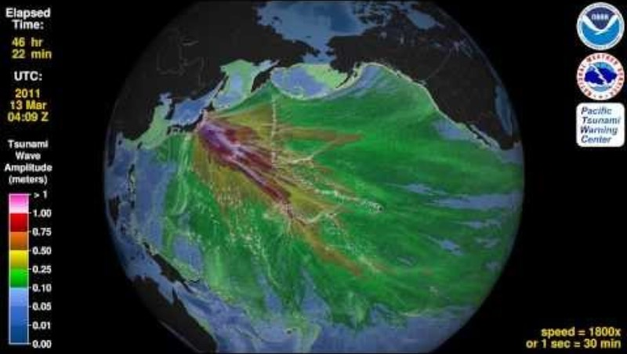
Hindcast models
To hindcast is to make a simulation of the past.
Comparisons can be made between the hindcasting model and real-world observations taken then
If they match, then it makes it likely that the model can be used to make predictions in the future
Notes:
This model can be a visualization or a numerical model working in reverse

Slide 35
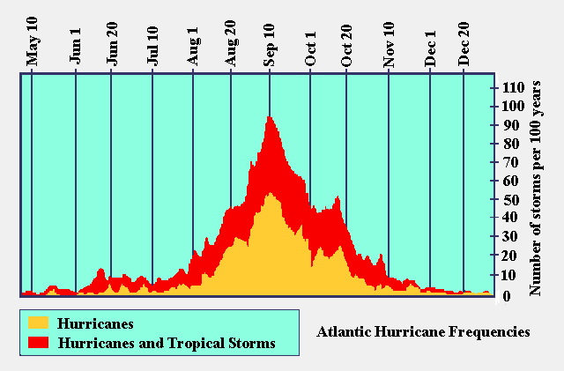
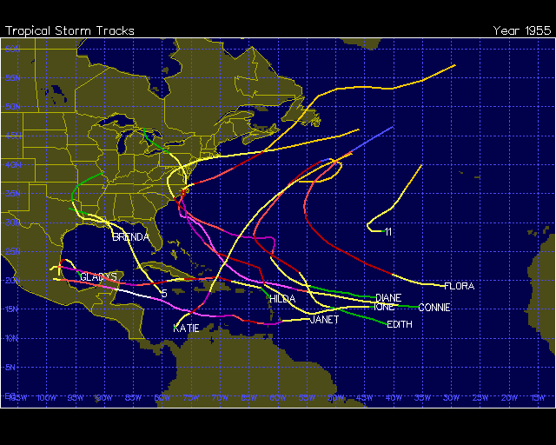
Statistical model
Use the record of the past to predict the future

Slide 36
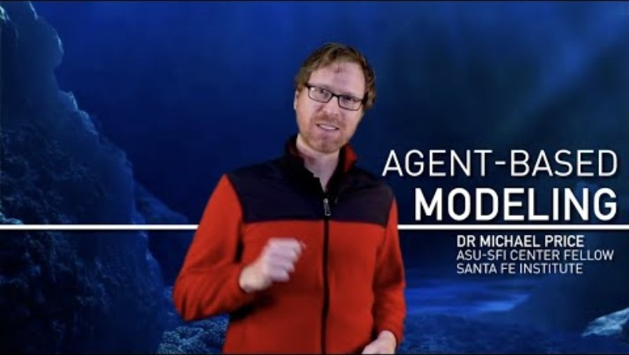
Agent-based models
Uses discrete, autonomous agents instead of grids to model phenomena
ABMs employ a bottom-up approach - system-wide patterns emerge from local interactions.
Numerical models employ equations in a top-down approach

Slide 37
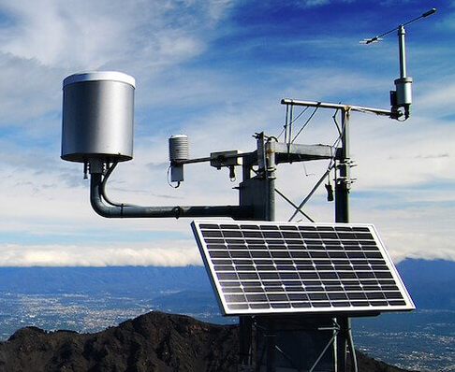
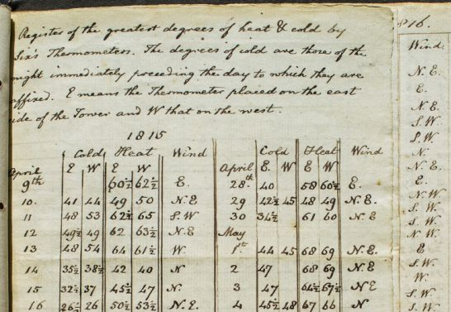
Types of quantitative data for models
Instrumental data
Data produced from instrumentation directly in contact with phenomena of interest
Historical data can be instrumental, and useful today when the data was recorded in ways that make it likely to be accurate and precise

Slide 38
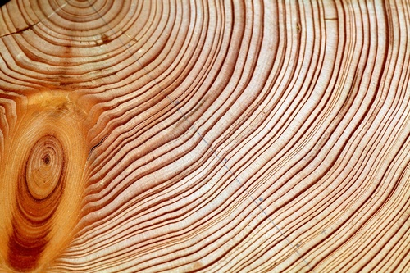
Types of data for models and modeling
Proxy data
These are data that indicate conditions and are not a direct measurement. Common examples include tree rings, ice cores, and sediment cores

Slide 39
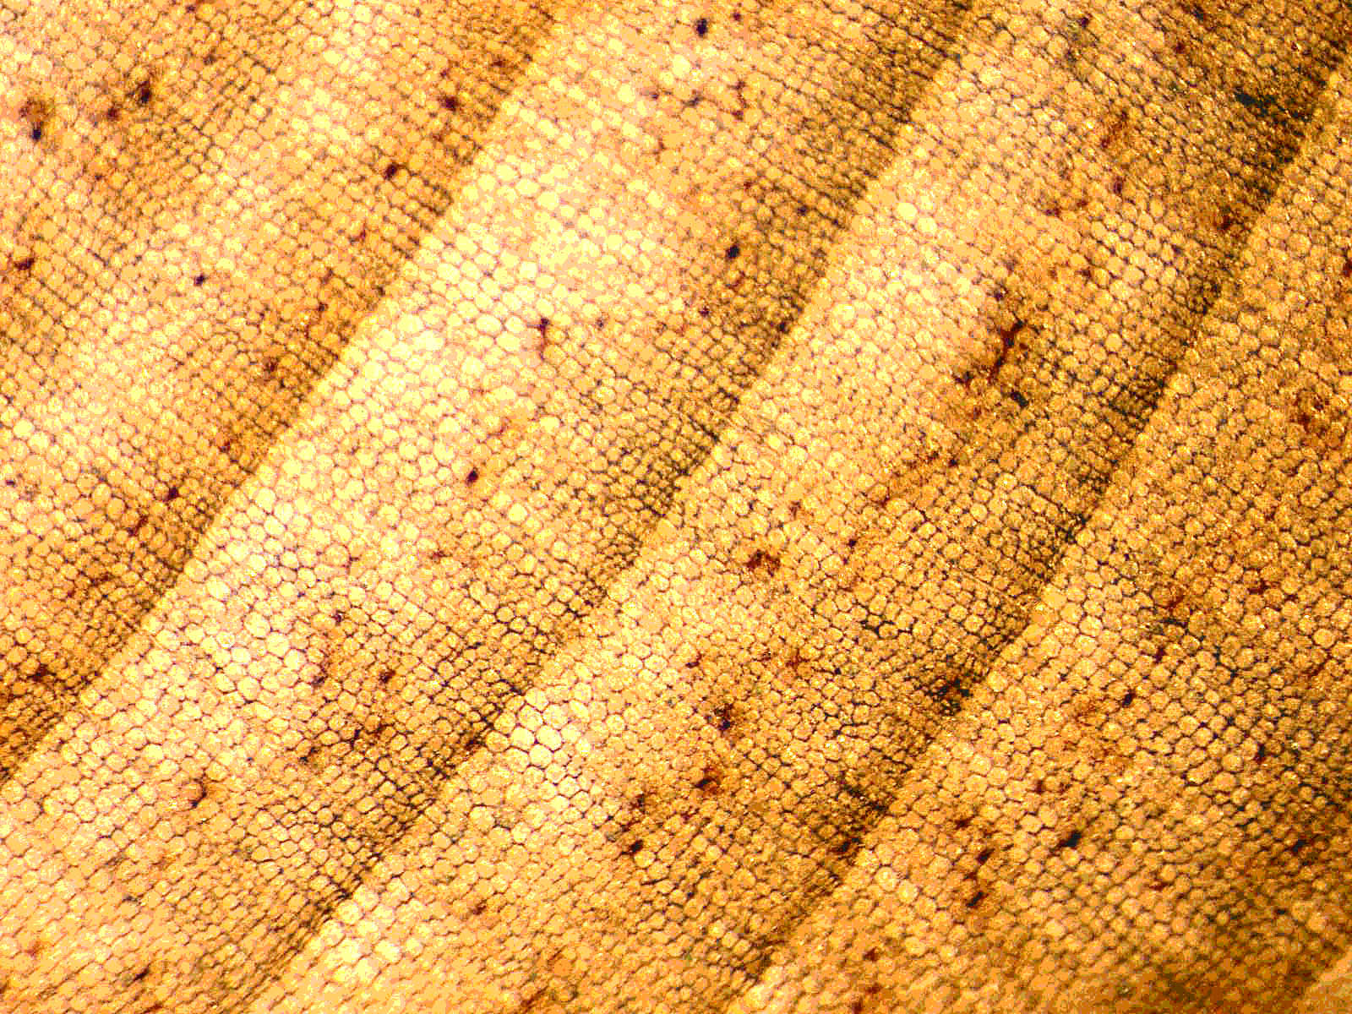
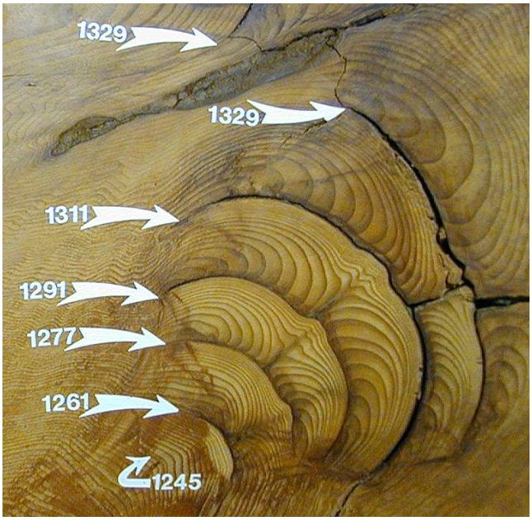
Dendrochronology
Notes:
Early wood and late wood in an annual ring (left) Fire scars (right) Dendroclimatology
Dendropaleotempestology
Dendroisotopes

Slide 40
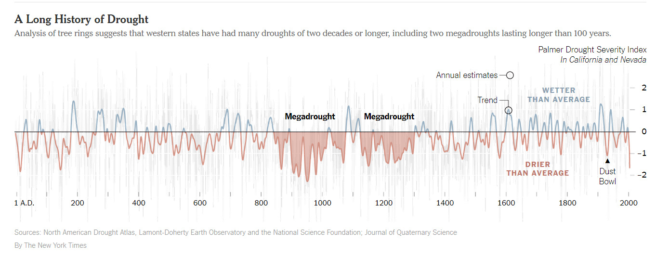
Megadroughts in Western US
Notes:
Now returning to period more like megadroughts of the past

Slide 41
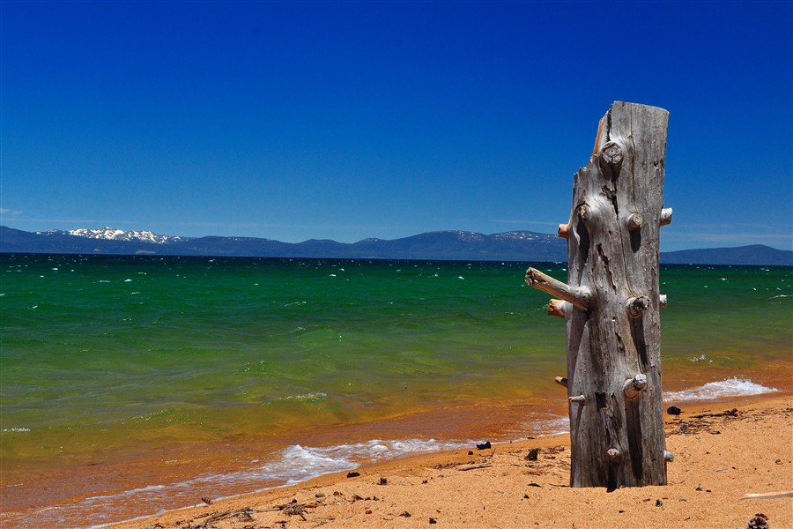
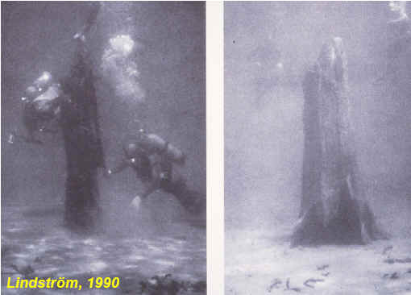
Notes:
Lake Tahoe, a high elevation lake in northern California near the Nevada border. This pine tree is evidence that this lake was not always here – it is evidence of former megadroughts.

Slide 42

Notes:
These pines have been found in the lake as well, and their tree rings provide records of the former drought period in which they grew

Slide 43

Limnology
Notes:
Paleolimnology is the study of sediments in lake and ocean bottoms. They often contain microfossils, pollen, charcoal (and indicator of fire) and numerous chemical signatures that can be used to infer dates and to reconstruct environmental history

Slide 44


Slide 45



Notes:
An example of limnology as a tool to interpret past climate and floral and faunal abundances. This particular plot communicates climate variability and lake ecosystem responses in western Scandinavia (Norway) over the last 1000 years
Chironomids are flies in their aquatic larval state. Bosmids and Cladocera are water fleas, like Daphnia. Total organic carbon flux (TOC), pollen accumulation rates for arborum (tree) (PAR AP) and non-arborum (grasses) pollen flux (PAR NAP). Highlighted areas correspond to periods of climate cooling.

Slide 46

Glaciology

Slide 47

Notes:
A researcher standing next to an ice core extracted from the West Antarctic Ice Sheet. Each of the horizontal lines represents one year’s worth of snowfall. The ice core contains detailed climate data from the past 68,000 years.
Ice has annual summer-winter layers that can aid in deriving dates

Slide 48

The ice is brought back to a laboratory and heated carefully in a vacuum chamber (to avoid contamination by modern air), releasing the ancient air for analysis.
Chemical composition (carbon dioxide, methane, and ratio of oxygen isotopes) of trapped air can provide information to reconstruct past climate

