Slide 1
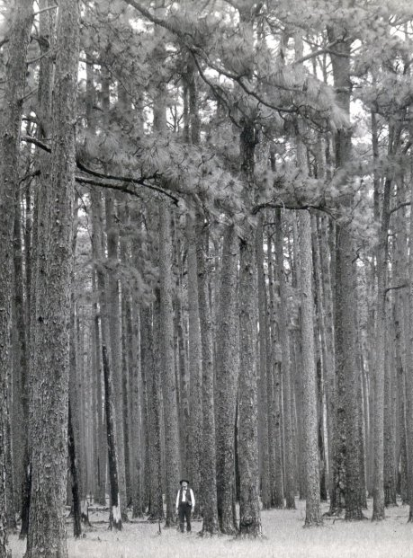
How is nature organized? How does it change?
Are ecological systems highly integrated or do they function more individualistically?
Do they return to their original state if disturbed?
Is there balance in nature, an equilibrium?
Environmental policies are a reflection of how science and society have responded to these questions.
Notes:
Historical longlead pine forests of east Texas. These forest burn every 2-3 years.

Slide 2
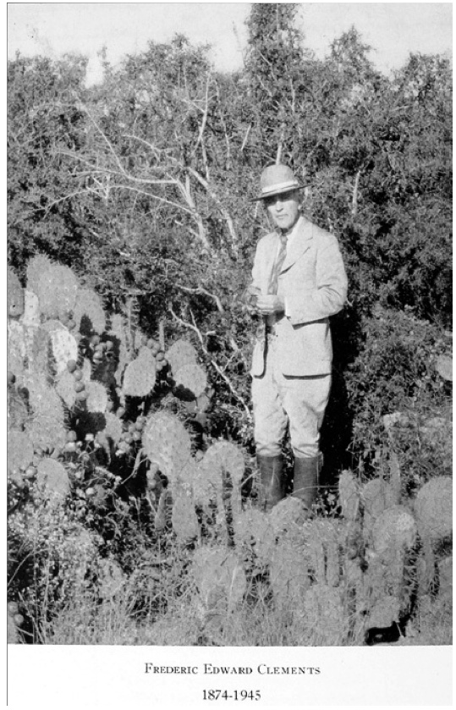
Plant succession
Changes in vegetation through time
This type of change was an object of keen attention for many of the early modern ecologists.
Their work provided a start of our understanding of how nature changes – a pivotal aspect of making policy.
What happens when we alter ecological systems? How you answer that question (and it does not have a simple answer) shapes the kinds of policies you make

Slide 3
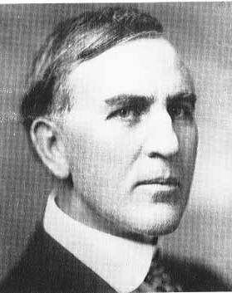
Frederic Clements
(1874-1945)
Key terms associated with his
view of ecological change:
immutable
deterministic
equilibrial
organismal
holistic
superorganismal
orderly
integrated

Slide 4
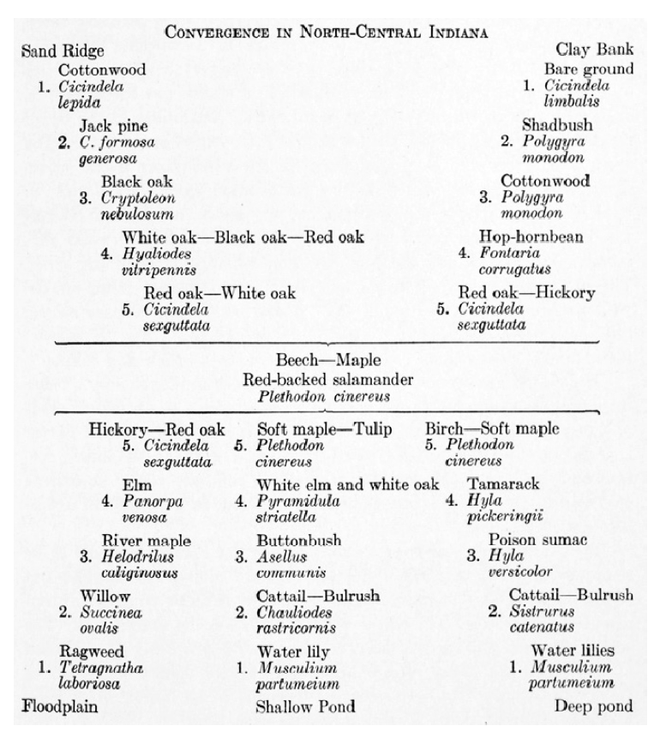
Notes:
Clement introduced the idea that evolution may work at biological levels higher than the species—in Clement’s theories, communities were subject to evolutionary forces that shaped their assembly. He was responsible for developing the idea of a climax community, an endpoint to succession. Plant communities would move through discrete stages – pioneer, mature, to climax – like an organism growing old.

Slide 5
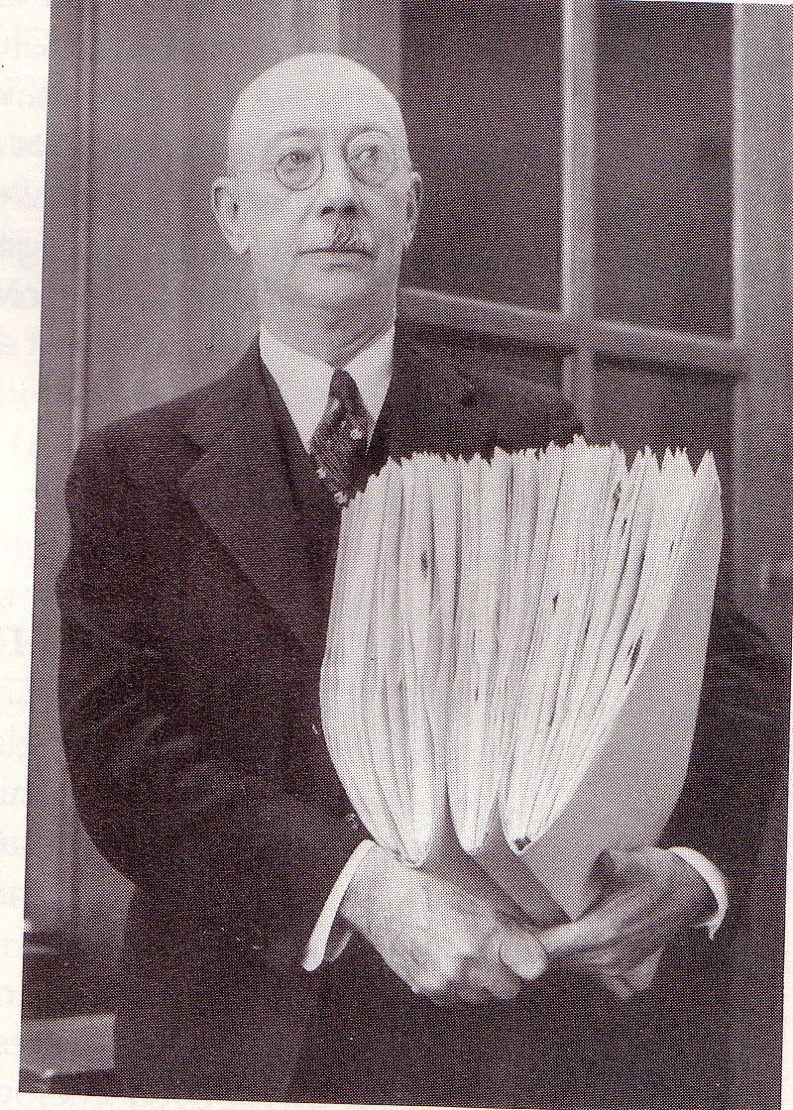
Henry Allen Gleason
(1882-1975)
Key terms associated with his
ideas about succession:
individualistic
reductionist
random
contingent
non-equilibrium disorderly unpredictable

Slide 6
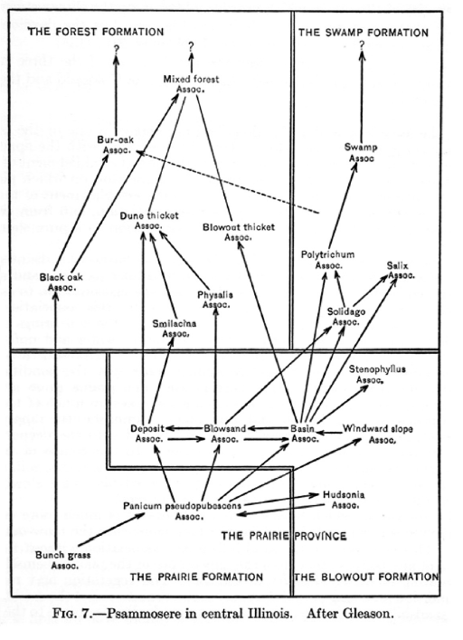

Slide 7
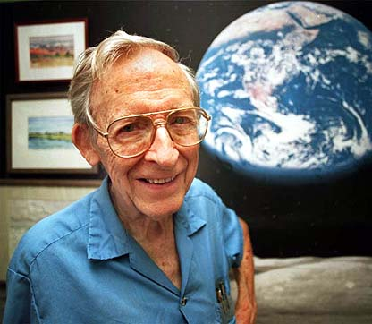
Eugene Odum
(1913-2002)
Key terms associated with his
view of ecological change: Clementsian ecosystemic
holistic
equilibrial orderly integrated organismal
emergent
Notes:
1960s and 1970s Eugene Odum was instrumental in starting the first formal ecology program in the US

Slide 8
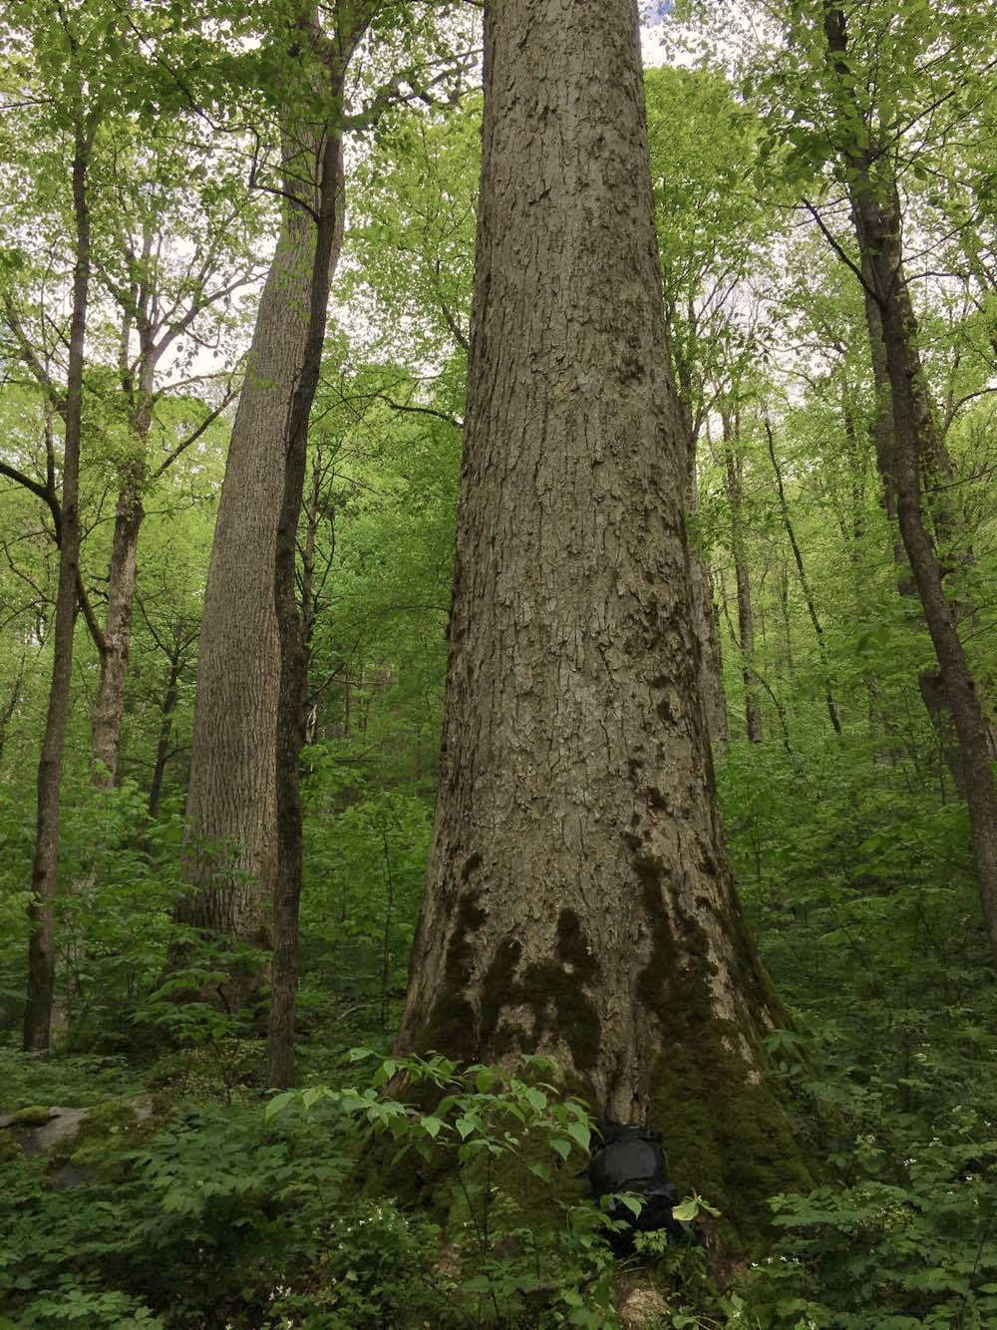
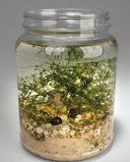
Notes:
A microcosm is a very small community, often an experimental one, such as collection of microbes growing in a flask. They exhibit succession through time just like forests in this diagram. Like Clements saw a lot of order in ecological change. These terms, net photosynthesis, gross photosynthesis, respiration, and biology are part of any high school biology class.

Slide 9
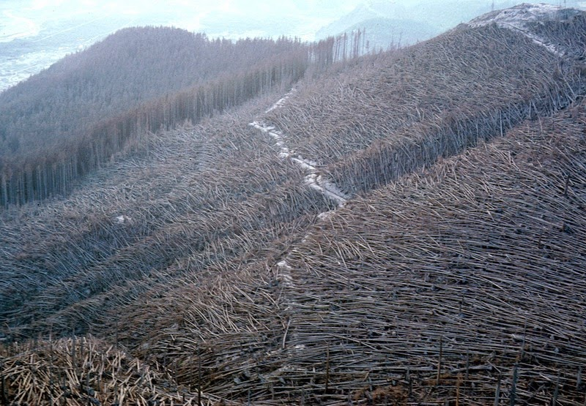
Notes:
Mt St Helens eruption 1980

Slide 10
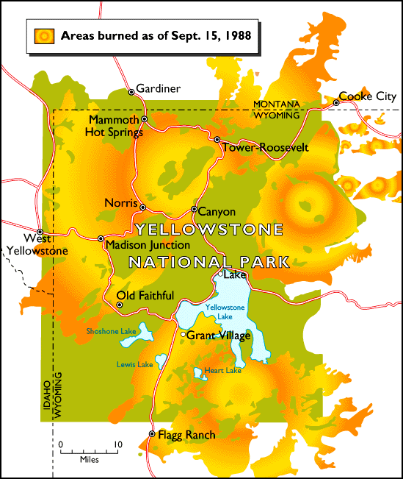
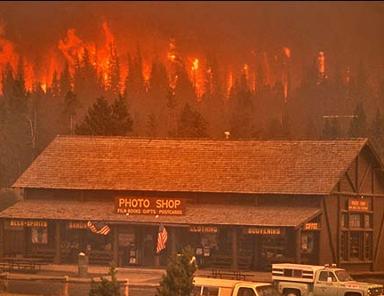

Slide 11

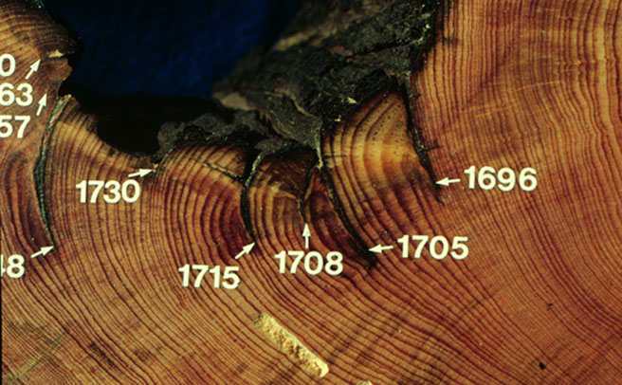
Disturbance ecology
Formalized with the publication “The Ecology of Disturbance and Patch Dynamics” in 1985
Disturbance was seen as a common interruption to succession, a non-equilibrium point of view about how nature is organized
.
Notes:
Fire scars in longleaf pine growth rings indicating regular, natural fire interval. Longleaf is a fire-dependent species. In the absence of fire, this species declines in abundance. There are many fire-dependent pine species across North American forests.

Slide 12
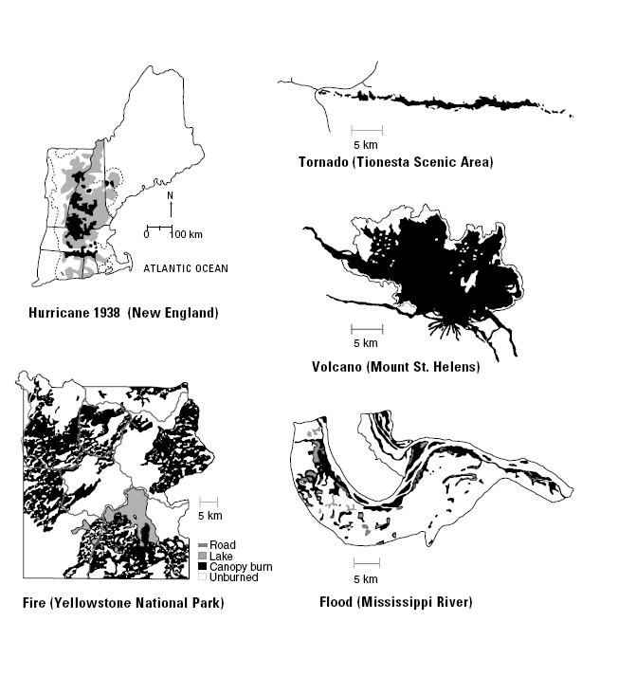
Disturbances are characterized by their disturbance regime: their frequency in time, their extent or size in space, and their intensity and severity
Some disturbances are predictable, even cyclical, and organisms can adapt to them and even depend upon them to thrive
Other disturbances are unpredictable, thus organisms have not evolved traits to resist or recover from them

Slide 13
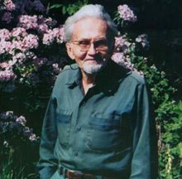
Frank Egler (1911-1996)
Key terms associated with his view of ecological change:
Gleasonian
individualistic disturbance-driven
contingent
context-dependent open-ended

Slide 14
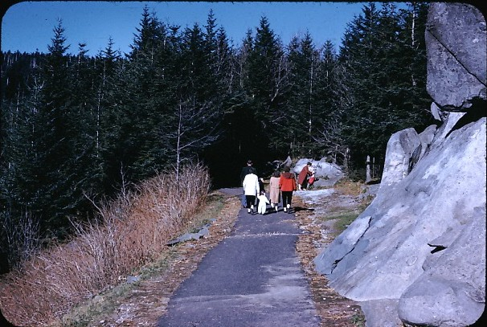
Notes:
1959 Fraser fir before invasions of non-native insect, the balsam wooly adelgid

Slide 15
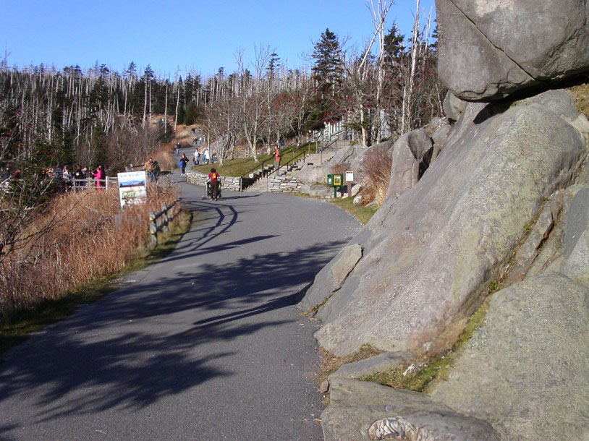
Notes:
2008

Slide 16
Two strands of ecology converged in the 1980s
Individualistic, non-equilibrium view of nature comprised of Gleasonian succession and disturbance ecology
More holistic, equilibrium view of nature derived from Odum’s ecosystem succession. Less equilibrium in outlook than Clements, but it recognized propensities for ecological change to have some predictability of development.

Slide 17
Equilibrium and non-equilibrium ecology
Equilibrium
Ecological change has some degree of predictability
Individuals interact to form forcing system that reinforces its persistence
Selection pressures act on groups like species, populations, and communities not just individuals
Single endpoint
Non-equilibrium ecology
No single unifying mechanism for succession and the direction of ecological change
Successional trajectories are highly varied
The individual is the unit of selection – no group selection
No one single endpoint

Slide 18
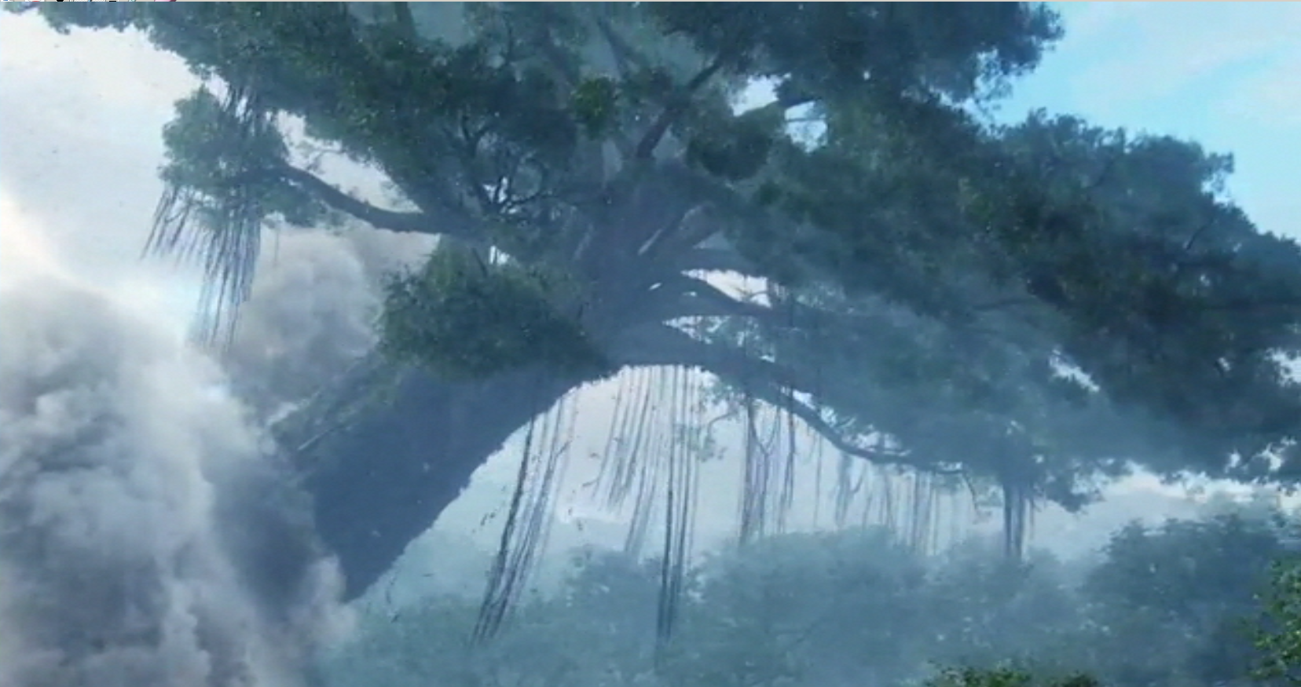
Notes:
The loss of nature is a disruption of balance and harmony that cannot be repaired.

Slide 19
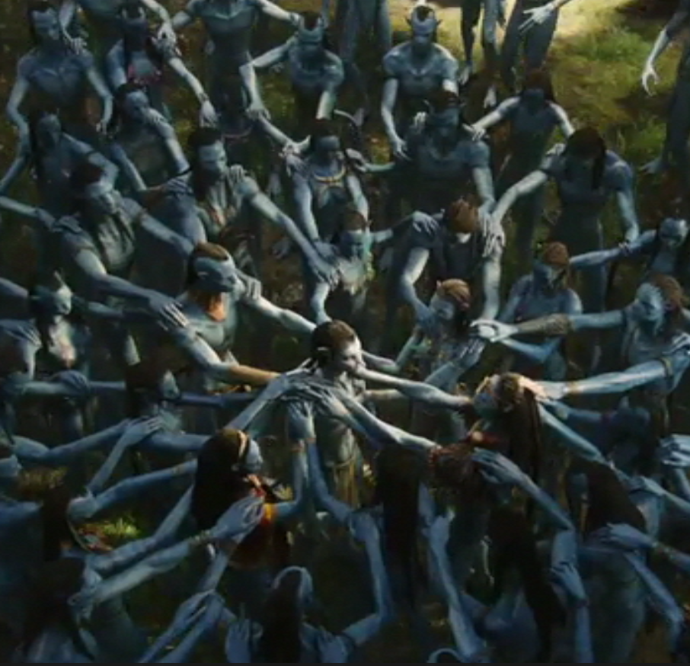
The planet of Pandora exemplifies an equilibrium view of ecology – nature is in balance
Highly integrated system – the planet is alive
The loss of nature is a disruption of balance that cannot be repaired
Policies would be protectionist, with strong ideas of what belongs and what doesn’t.

Slide 20
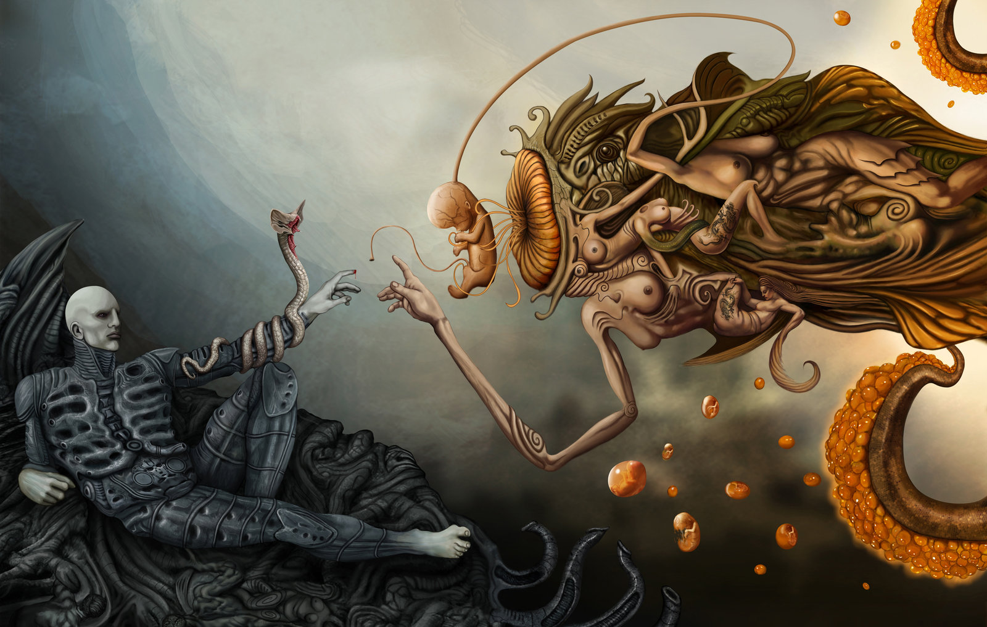
Notes:
http://inthemouthofdorkness.blogspot.com.au/2012/08/dork-art-prometheus-and-god.html

Slide 21

Portrayal of nature in the Alien film franchise portrays a non-equilibrium perspective
No balance in nature
Ecology operates individualistically
DNA and genes are unit of selection
Disorder, no directional development toward a climax
No pristine nature – constant change.
Policies would need to accommodate the lack of permanence

Slide 22
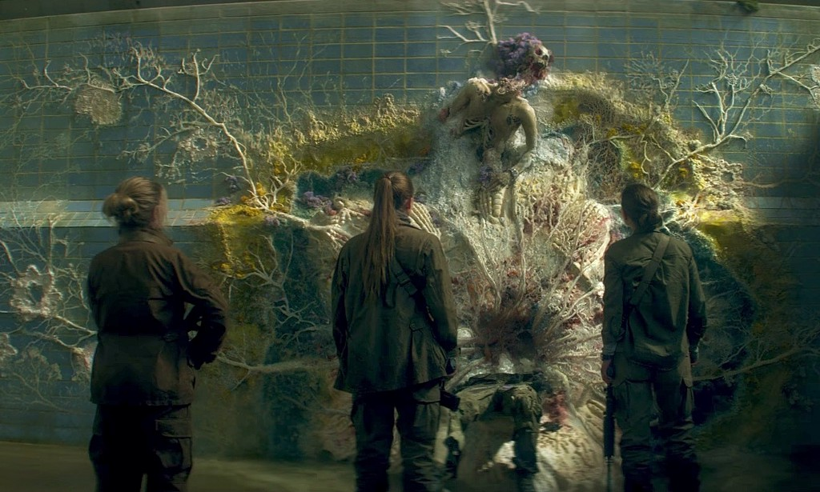

Slide 23
Five general conservation policies guidelines from an equilibrium perspective
What should we restore and conserve?
Old growth, mature ecosystems
How is disturbance viewed?
Destructive and extraneous (outside) normal range of variability
How should boundaries be set for restoration and conservation areas?
Fence off mature ecosystems
How should restoration and conservation be accomplished?
Protect ecosystems
Sustainability policy?
Conserve

Slide 24
Five general conservation policy guidelines from a non-equilibrium perspective
What should we restore and conserve?
Variability, the range of conditions and abundances or organisms
How is disturbance viewed?
Necessary and part of nature
How should boundaries be set for restoration and conservation areas?
Fluid and not firmly drawn, things are constantly in flux
How should restoration and conservation be accomplished?
Tailored to the context
Sustainability policy?
Use is more feasible, nature is more malleable, but also unpredictable

Slide 25
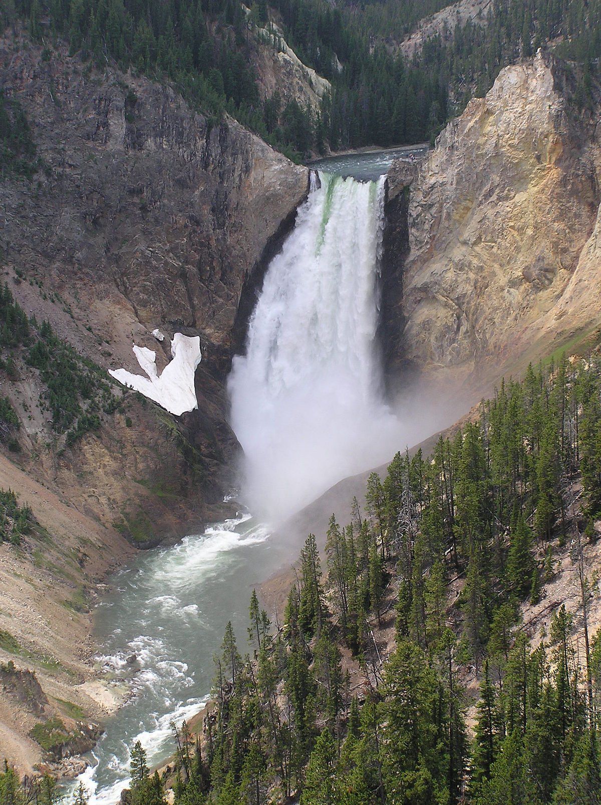
US National Park policies
Preserve as when first encountered by humans (the equilibrium view)
Beginning in 1916, Yellowstone NP and other US parks aimed to preserve the land in its ‘natural’ condition —how it looked before Europeans arrived.
This was formalized in the Leopold Report of 1963: “A national park should represent a vignette of primitive America.”

Slide 26
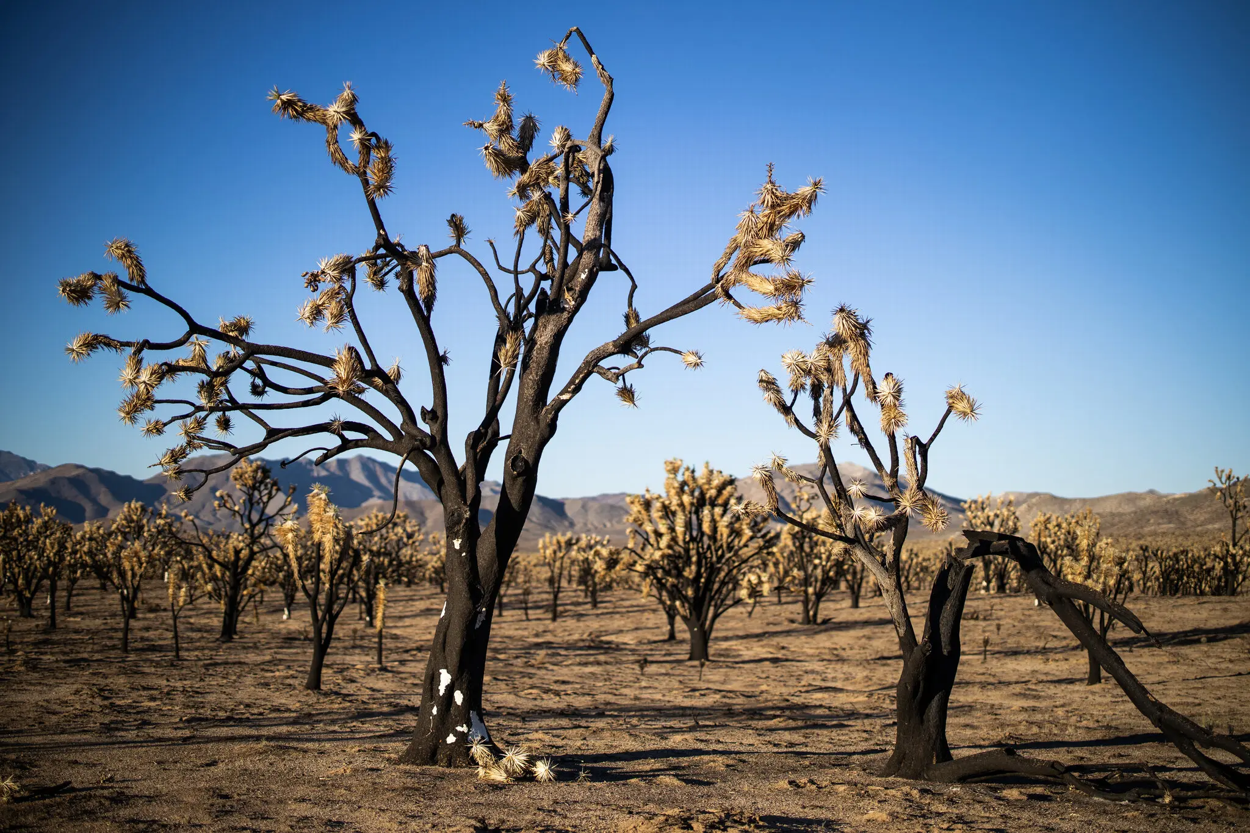
Notes:
An estimated 1.3 million Joshua trees burned in the Mojave National Preserve in August. https://www.nytimes.com/2021/05/18/climate/national-parks-climate-change.html

Slide 27
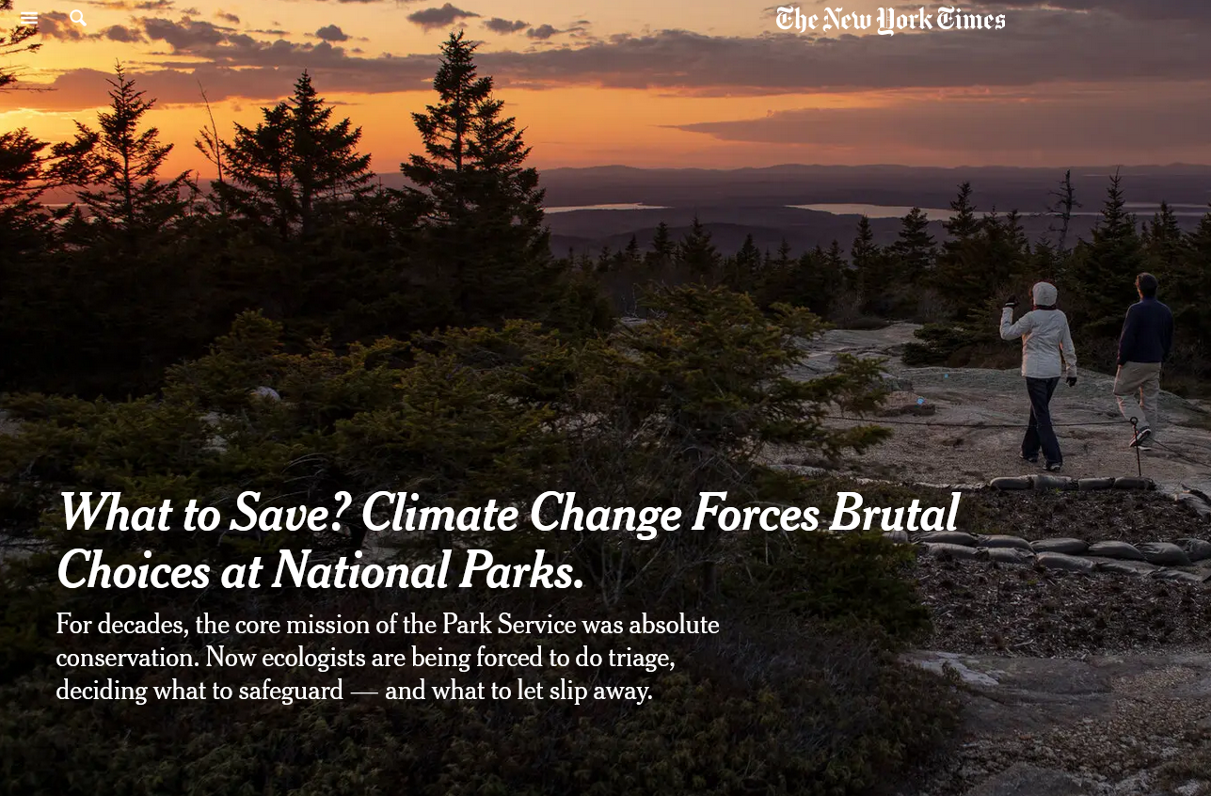
Allow for changes in climate and disturbance regime (the non-equilibrium view)
New park boundaries may be needed – parks may require ‘unbounding’ as climate change causes shifts in temperature and rainfall
Changing flora and fauna due to introduced, non-native species and altered disturbance regimes – particularly increases in wildfires
Notes:
https://www.nytimes.com/2021/05/18/climate/national-parks-climate-change.html

Slide 28
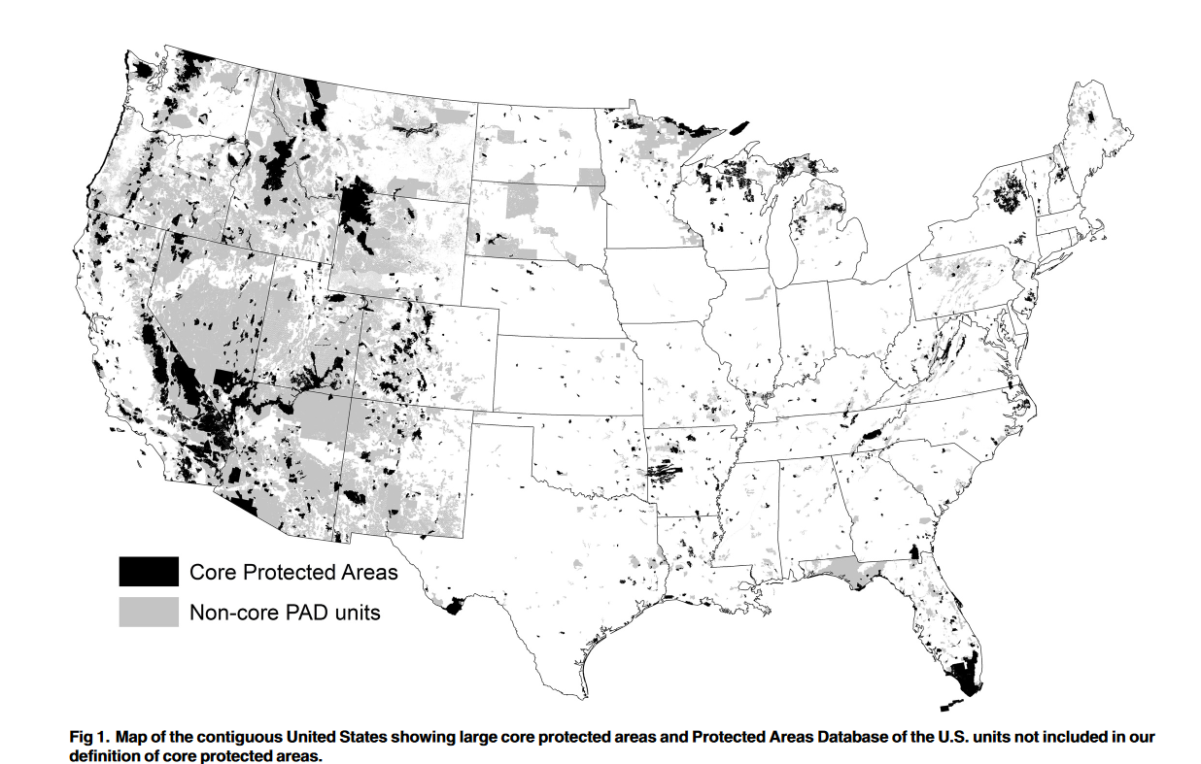

Slide 29
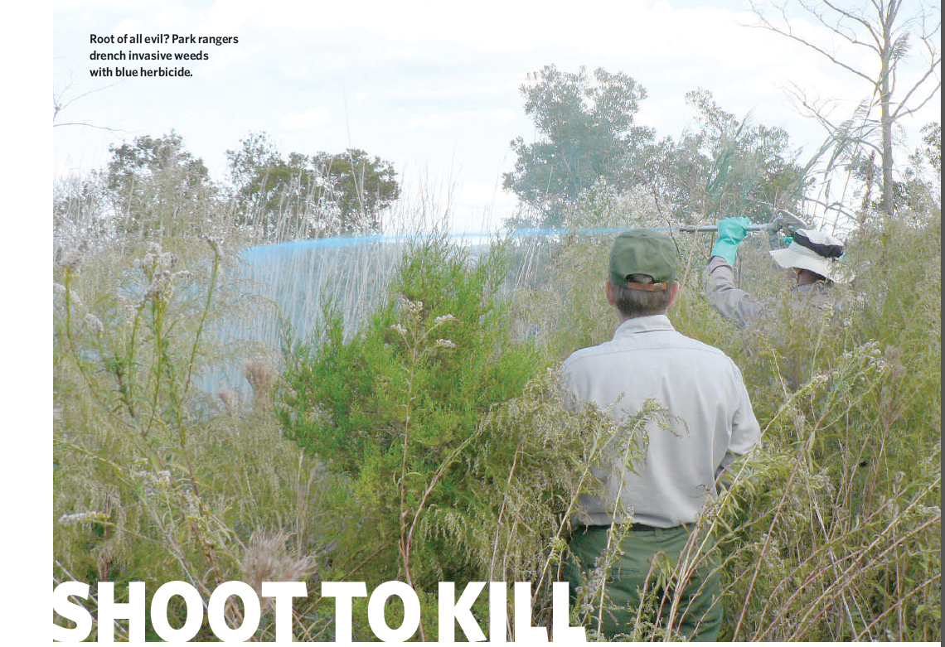
Notes:
Non-native invasive species – the green cancer

Slide 30

The equilibrium perspective on non-native species
They disrupt the balance of nature
Invasives can reduce the abundance of other species
By outcompeting or preying upon native species, invasives can lower biodiversity
Degrade native ecosystems and the services they provide
Displace native organisms from their niches

Slide 31
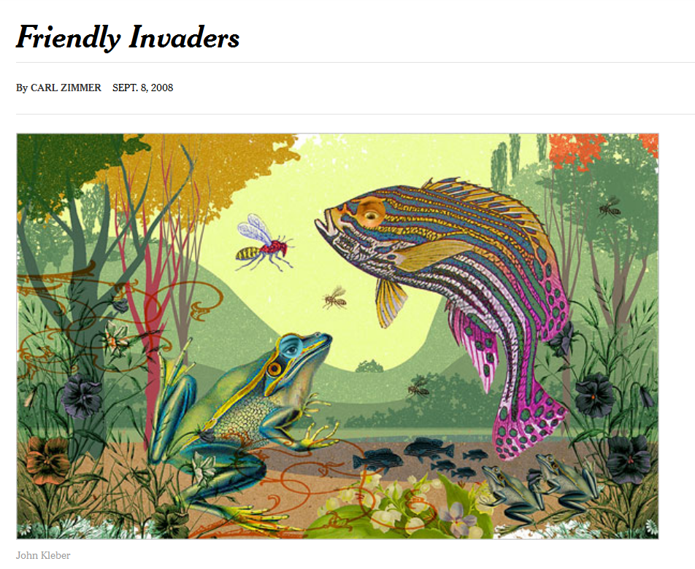

Slide 32
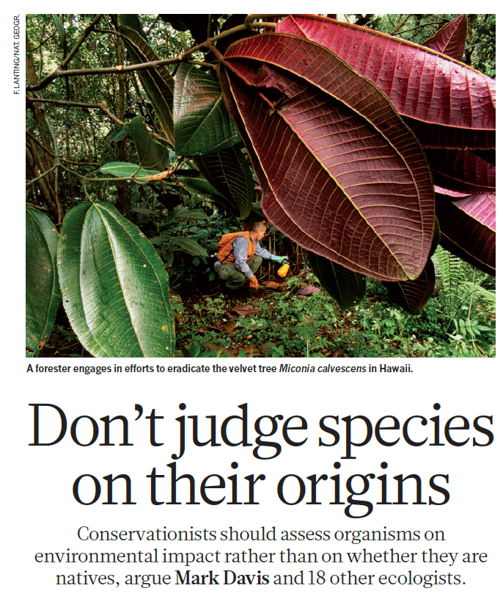
Non-equilibrium perspectives on non-native species
Many non-native species naturalize with minimal impacts
Widespread biological collapse is not the norm upon arrival of non-native organisms
Some can provide ecosystem services and contribute to biodiversity
While aesthetically they may be unwanted, non-natives illustrate how open and non-equilibrium nature is

Slide 33
Equilibrium or non-equilibrium policy: which to employ?
Ecological change has aspects of equilibrium and non-equilibrium dynamics
Whether to invoke a policy based on equilibrium assumptions or non-equilibrium assumptions depends upon the context and cultural, political, and economic factors
Complex systems theory provide a conceptual framework to work with both equilibrium and non-equilibrium ecological change and policy at the same time.
Notes:
How do we work with this kind of a world, one in which change can be predictable but it can also be unpredictable?

