Slide 2
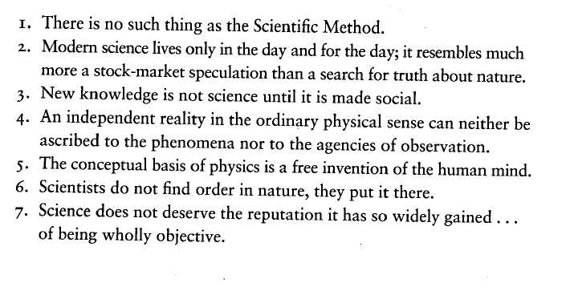
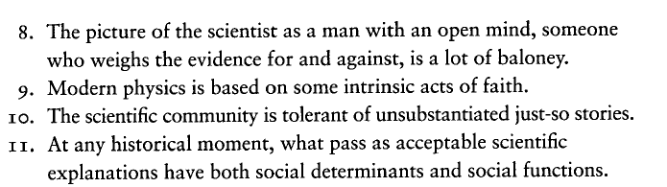

Slide 3
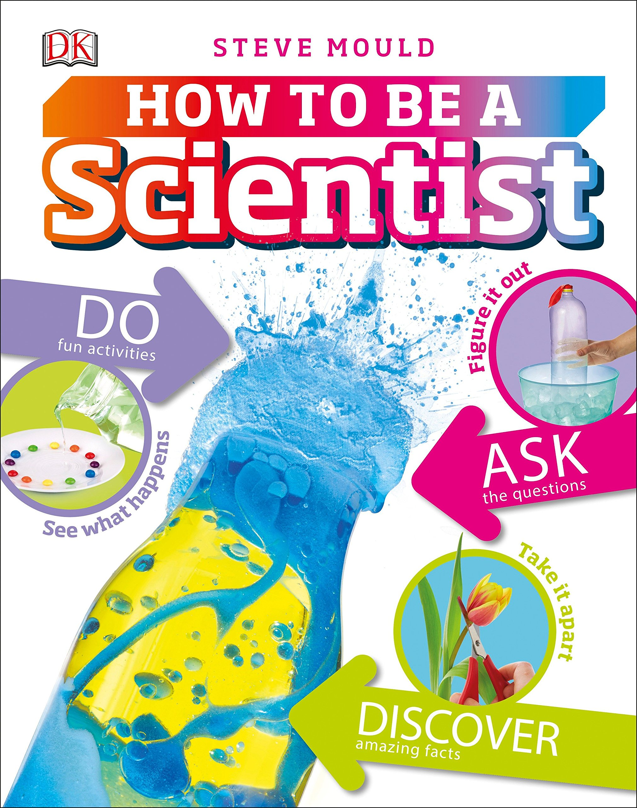
There is no one kind of ‘science’
Science is not a singular discipline unified by common methods and concepts
There are multiple sciences—diverse in their methods and aims, held together by some common values perhaps, but not a monolithic practice
Science is not one, indivisible and unified, but the sciences are many, diverse, and disunified
Notes:
Recent attacks on science and greater public scrutiny—sometimes leading to outright denial—of scientific knowledge are occurring at a time when science is much more relevant to politics, public life, and the economy than it ever was before.

Slide 4
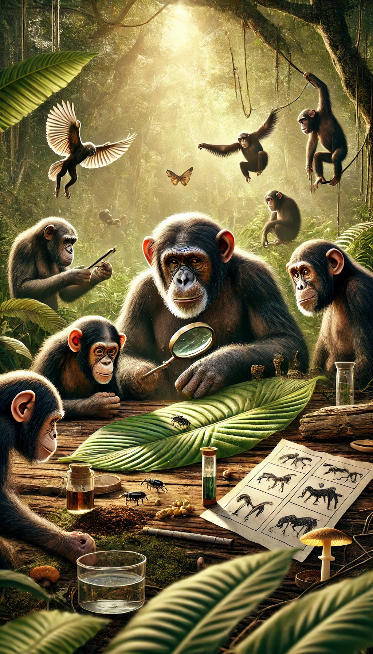
Humans have a propensity to be scientific
This is due to cognitive traits that evolved to enhance survival, problem-solving, and social coordination, such as:
Pattern recognition and causal inference
Curiosity and hypothesis formation
Tool use and experimentation
Social learning and cultural transmission
Symbolic thought and abstraction
Notes:
Science is not something aberrant to humans.

Slide 5

The “tyranny of science”
Feyerabend’s claim in this book is that many of the conflicts concerning form scientific practice are based upon the misperception that science is value-free.
According to Feyerbend, science is only a ‘‘tyrant’’ if we attribute to it exalted characteristics—such as ‘‘value-neutrality’’ or isolation from society—which it lacks. Then it is dangerous.

Slide 6
More descriptions of science
Science is an episode in the growth of human knowledge
Science is the class-, gender-, and culture-bound product of Euro-North American capitalism in particular.
Science is not an abstraction removed from society.
Science is produced by our labor. But the conditions of this production and the use of science are controlled by the wealthy and powerful.
Science belongs to place, that it bears the marks of where it is produced and transmitted.
Notes:
According to number three above then, we must fight for a science that serves all people, organizing wherever science is produced or applied alongside all those fighting for justice.

Slide 7
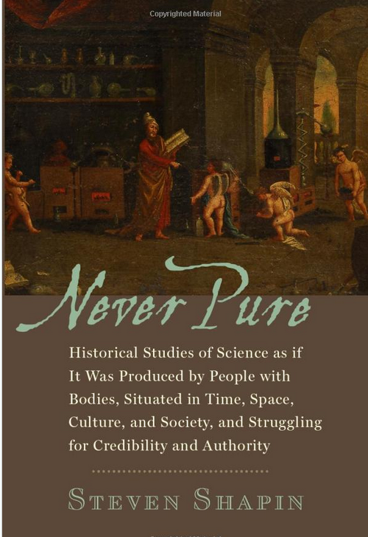
The supposedly special cognitive capacities found in science are found in the routines of everyday life.
Science has been produced by morally and constitutionally diverse specimens of humankind
Extraordinarily reliable knowledge has been produced by ordinary people
Science is not pure thought but is instead practice, and the hand is as important as the head, or even that the head follows the hand.
Notes:
Shapin, S. (2010). Never Pure: Historical studies of science as if it was produced by people with bodies, situated in time, space, culture, and society, and struggling for credibility and authority. Baltimore, Maryland: Johns Hopkins University Press.

Slide 8
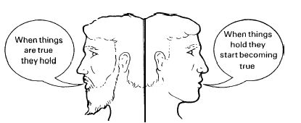
The Janus-faced nature of science
Ready-made science
Science-in-the-making
Notes:
As a policy maker, as someone who is interested in sustainability and its promotion, why is it important to understand science as more than ready-made science, but also as science-in-the making? In his book Science in Action, the sociologist Bruno Latour shows us the Janus-faced nature of science. When looking at one side of its face, we see ready-made science: established and indubitable scientific facts that refer to natural objects that have always been there. When looking at the other side, we see science-in-the making: facts that are under construction, an undetermined view of nature and no clear method prescribing how to do science. Latour encourages us to use science-in-the- making as an entry-point to understanding science. Only in this way can we see how scientific knowledge is constituted and through which processes the ‘absolute certainties’ of ready-made science appear. However, some have used the science-in-the-making to tear down science, and to argue away scientific findings that are accepted, such as anthropogenic climate change. They assume that science’s status as a process makes it unsuitable for making informed decisions. Janus is the Roman god of beginnings, gates, transitions, time, duality, doorways

Slide 9
Strategies of scientists: explanatory reductionism
This is the position that the best scientific strategy is to attempt to reduce explanations to the smallest possible entities
Goal is to isolate mechanism and explain the whole in terms of its constituent parts

Slide 10
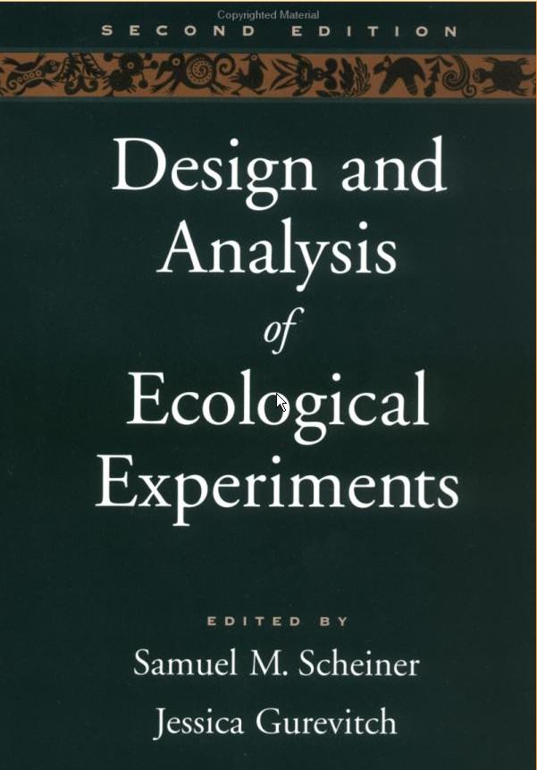
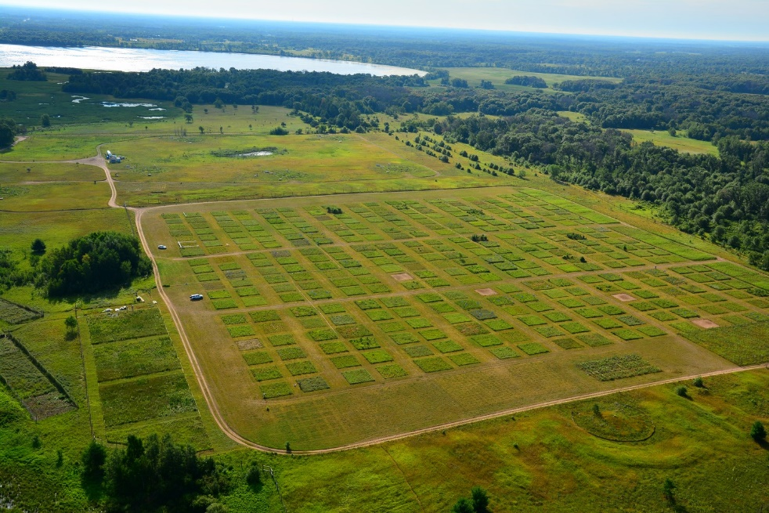
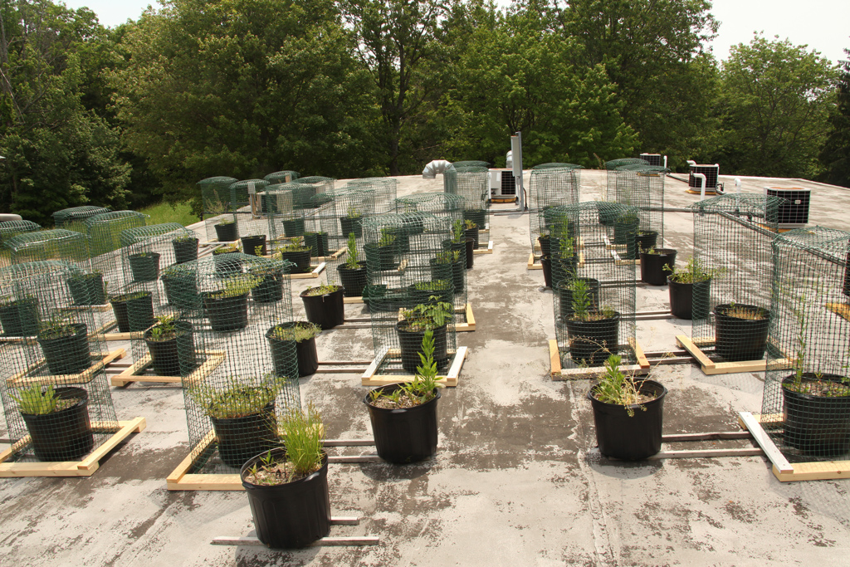
Notes:
In explanatory reductionism, ecological methods are often experimental. They attempt to reveal the properties of nature by separating the components from their wholeness to simplify the study and to facilitate the interpretation of results.

Slide 11
Strategies of scientists: explanatory holism
The philosophical perspective that parts of a whole are in intimate interconnection, such that they cannot exist independently of the whole, which is regarded as greater than the sum of its parts
Emphasis is on integration rather than reduction

Slide 12
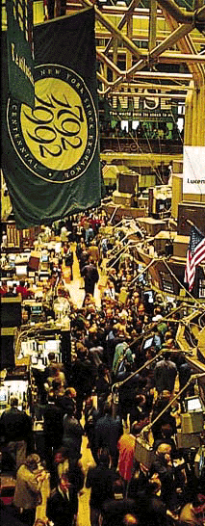
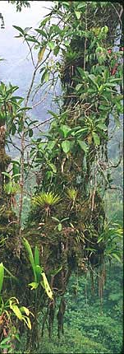
Some systems have so many parts as to make experimental, reductionist approaches unwieldy and limited
Systems like stock markets, ecosystems, networks of people, information or pathogens exhibit properties that do not readily reduce down to their individual parts
Notes:
Explanatory holism
For example, if you wanted to study the stock market, would you do it through each individual that participates in it? Or through a more aggregate, holistic point of view?

Slide 13
Strategies of scientists: exploratory science
In this approach, patterns, relationships, or correlations are examined to develop new questions and hypotheses.
Uses abductive logic
Also referred to as data-driven science
Trends and patterns in data can suggest the presence of novel phenomena or entities that can be explored in greater detail using hypothesis-driven science

Slide 14
Strategies of scientists: hypothesis driven science
This traditional scientific approach starts with a specific, testable hypothesis derived from existing theory or observation.
Researchers design experiments or studies to collect data that can confirm or falsify the hypothesis
Inductive and deductive logic

Slide 15
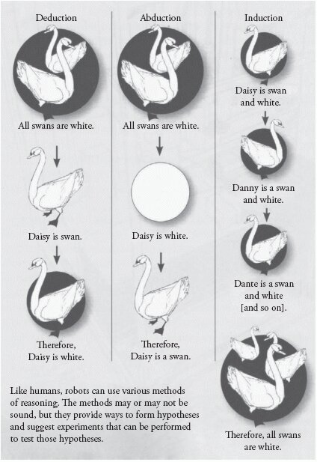
Hypothesis-driven science
Deduction: Generalizing from general cases to specific cases
Induction: Generalizing from specific cases to form a broader rule.
Exploratory science
Abduction: Inferring the most plausible explanation for an observation.
Notes:
In plain words, abduction is just guessing stuff and being able to come up with some kind of reason why your guess might be right. This is another thing we do all of the time. Our brains are quite excellent at it. It is how new hypotheses are forms

Slide 16

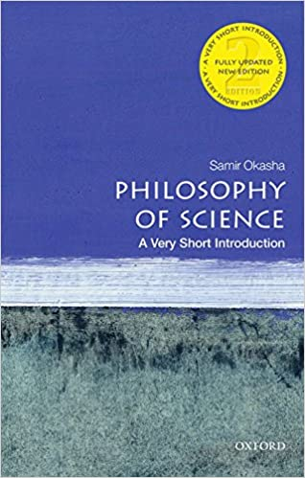
Metaphysics, epistemology, and ontology
The production of knowledge, whether you formally call yourself a scientist or not, invokes metaphysics, epistemology, and ontology

Slide 17
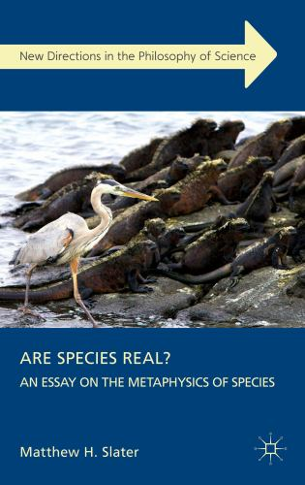
Metaphysics
Metaphysics deals with the fundamental nature of what exists
The classical metaphysical idea that reality exists independently of one's mind and yet can be known is called realism.
The metaphysical idea that no mind-independent reality exists or can be known is idealism.
Notes:
Traditionally, species have been thought to be natural kinds, which are sometimes understood as universals. However, others view there is no mind-independent reality of species. They are not universals, but exhibit variation across time and space. Their existence as a universal group or as individuals depends upon the criteria you use to view them. Crane, J. K. (2004). On the metaphysics of species. Philosophy of Science, 71(2), 156-173.

Slide 18
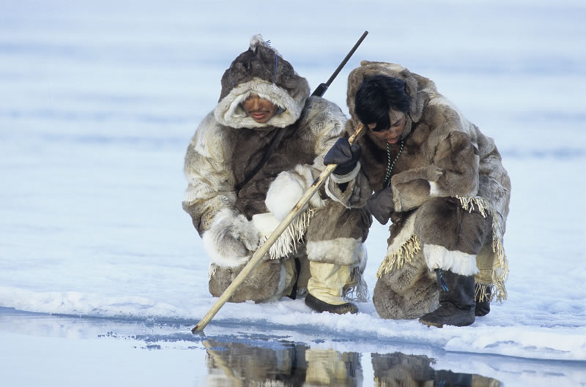
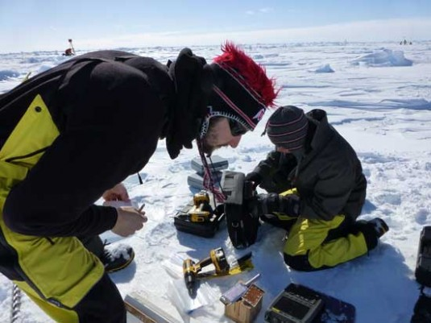
Epistemology
An epistemology:
Is a group or individual’s knowledge system that determines what one can claim is knowable
Is where the notions of our innate ideas, our inferences, and our appeals to the authority of our knowledge originate
Two poles of epistemologies:
Mechanistic, scientific epistemologies
Contextual, relationship-based epistemologies
Notes:
How do we create knowledge? Through our epistemologies One’s epistemology can be fixed and rather unconscious, or it can self-apparent to an individual, and able to accommodate other epistemologies.
Neither epistemologies shown here should be made automatically more right than the other; they may each have validity in particular contexts. They can be adaptive or maladaptive depending upon the context.
Epistemologies are part of us, we all have epistemologies.
However, one can never really give a final proof of the reality of anything. The right question to ask is how can we justify our knowledge of the world; this is epistemology, where the notions of our innate ideas, our inferences, and our appeals to the authority of our knowledge originate

Slide 19
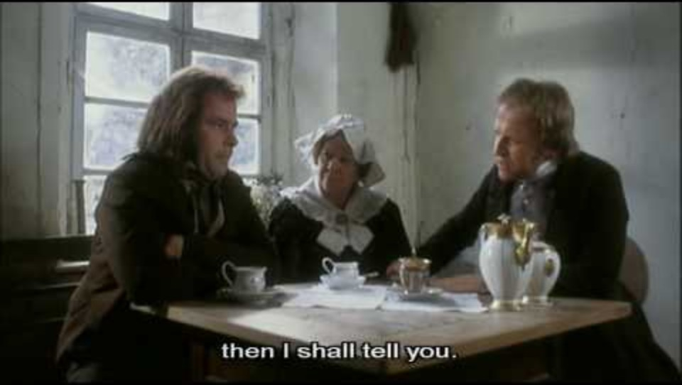
Relational, contextual epistemology: what I can know is individual, but can be shared and transmitted socially. Prediction or generalization is not necessarily a goal or even desired. Context is more important. The subject is intrinsic to knowing.
Mechanistic epistemology: what I can know is simply a matter of being objective. There are very few limits to what I can know using the scientific method. Prediction is a highly desired goal.
Notes:
https://www.youtube.com/watch?v=C9uqPeIYMik

Slide 20
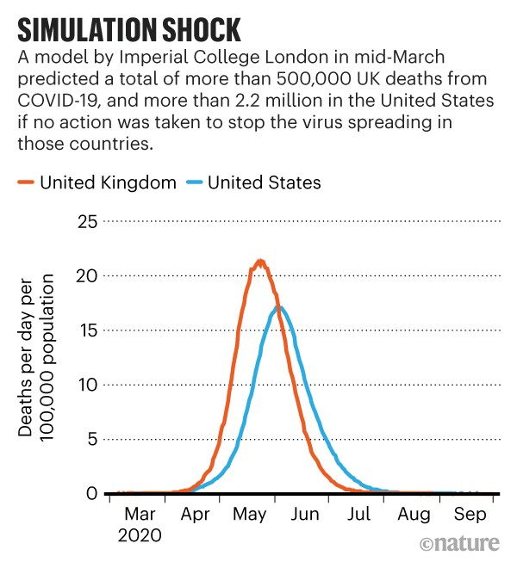
Epistemic pluralism
Epistemic pluralism is the use of more than one epistemological perspective or approach to deal with a knowledge-related problem.
Relational and mechanistic epistemologies can complement each other
Notes:
Dependence upon scientific models of the spread of Covid early in the pandemic were inaccurate largely because the mathematical models could only make simplistic assumptions about human behavior. Epistemic pluralism for Covid would include more relational contextual models of human behavior and how it might shape spread. More relational contextual points of view could have also been useful to understand the impacts of work and school closures before they happened.

Slide 21
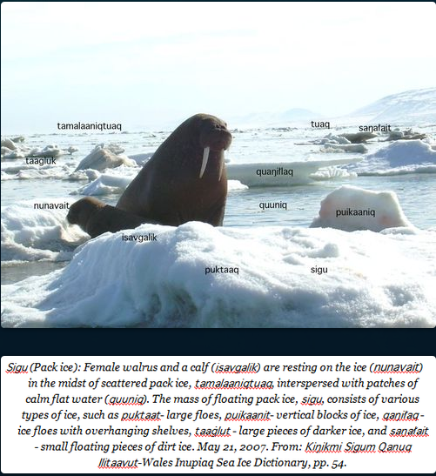

Slide 22
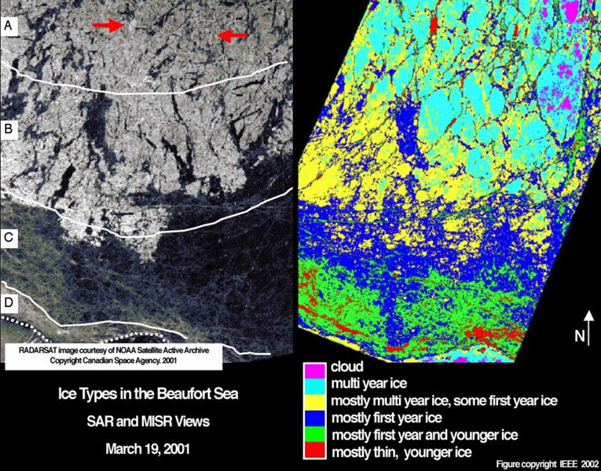

Slide 23
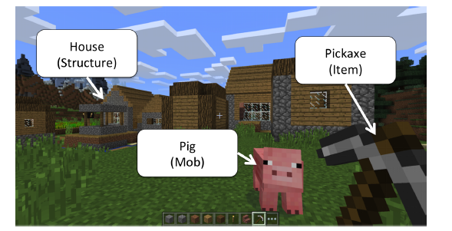
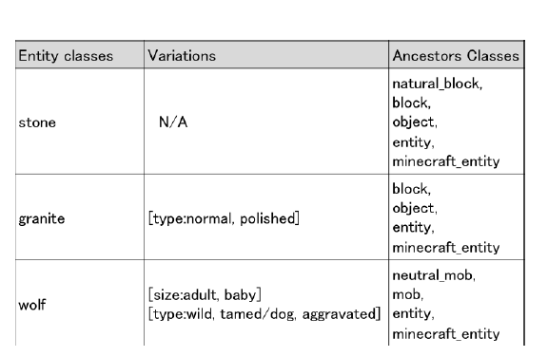
Ontology
An ontology is a specification of a conceptualization.
An ontology is a scheme for labeling entities known to exist and for accounting as to how they relate to one another
How we label and relate things to each other influences how we know and understand them
Taxonomy is the name given to this structure of relatedness, which often proceeds from general to more specific
Notes:
Ontology can be fixed and almost below the level of thought, or it can be flexible and accommodating

Slide 24
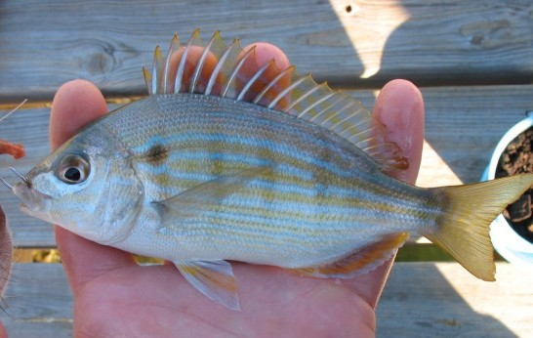
Scientific versus folk taxonomies
Lagodon rhomboids (scientific name)
“Chopa espina” (common name in Mexico and Cuba)
“Chofer” (common name used by old timers in Florida panhandle)
“Pinfish” (common name used by wealthier newcomers in Florida panhandle)
Notes:
Ontology here is more than just a name, it is a process, one that reflects positions of power and identity, as in what you call (or enact) as the name of this fish reflects a distinctive context, and positionality. Having an agreed upon scientific names enables conversations about the fish and its biology, while common names, although informative about culture, can be confusing in a scientific context. Yet even scientists contest taxonomy, as species are not a naturally stabilized category, but one we impose upon biological and evolutionary change.

Slide 25
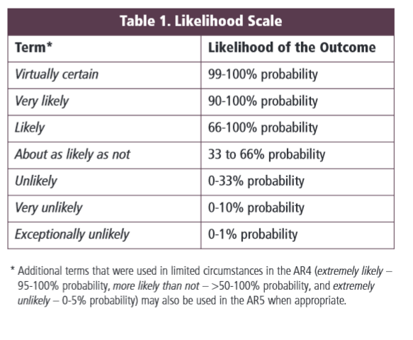

Ontologies are culturally specific
“Likelihood”
As in the likelihood of sea level rises or temperatures increase
Would these divisions in likelihood (top) above be equally relevant to everyone?
Notes:
Does likelihood mean the same thing to everyone?
Global, scientific likelihood and its statistical gradations may not necessarily be a category of much use to an individual living on a low lying Pacific Isle.

Slide 26
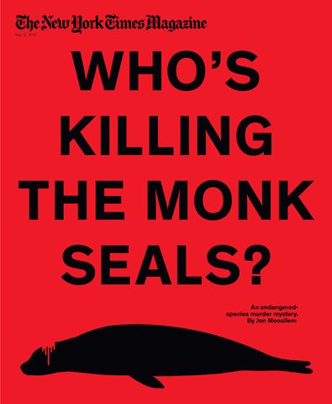
Native versus non-native
Designation can be subjective
Which specification you make impacts future decisions about conservation

Slide 27
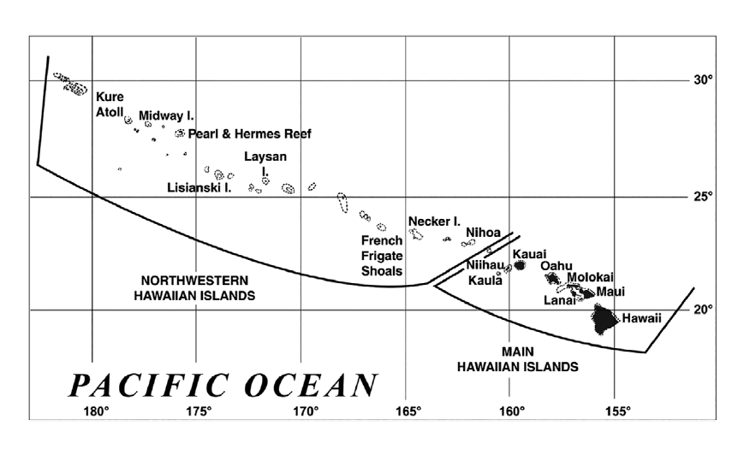

Slide 28
A short ecological history of the Hawaiian monk seal
Of the ~1,400 Hawaiian monk seals estimated in 2019, around 1,100 seals inhabited the small islands and atolls of the NWHI, while ~300 seals inhabited the larger (and human-populated) MHI
Historically, monk seals inhabited the entire Hawaiian Archipelago with the population in the MHI being largely extirpated shortly after the first humans arrived 1000 – 1200 AD.
Commercial sealing, guano mining, and other human activities in the NWHI reduced the remainder of the population in the NWHI to near extinction in the mid-1800s

Slide 29
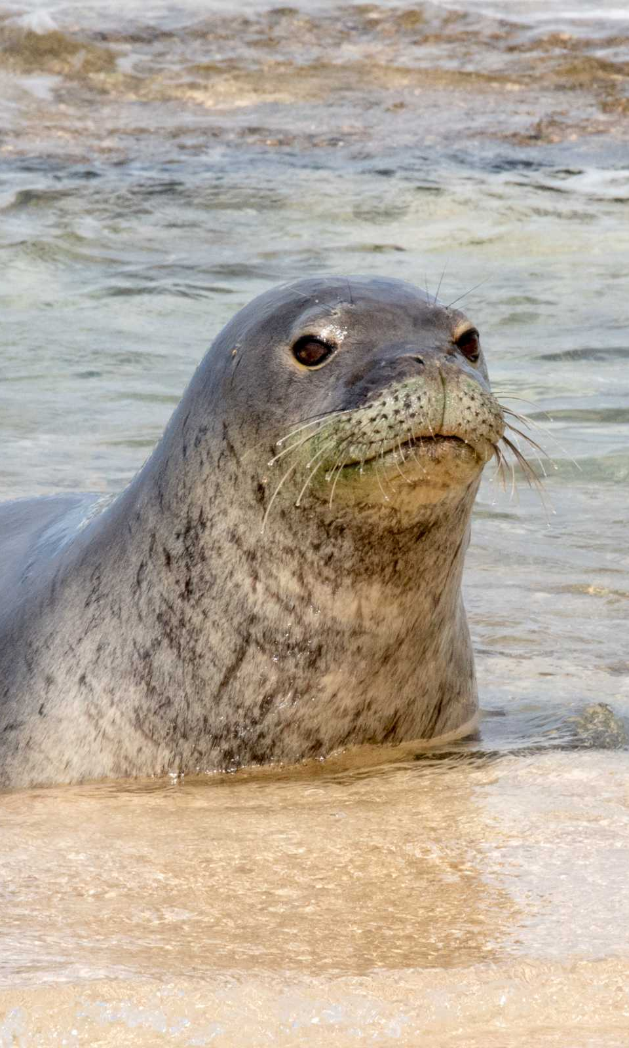
More recently, the NWHI population declined precipitously after wartime activity in the Pacific
Monk seals remained rare in the MHI but rebounded considerably in the early 2000s
By 2013 the Hawaiian monk seals were showing signs of a stabilizing trend across their range
The MHI population has played a key role in this positive trend with the highest growth rate and reproductive rate throughout the monk seals’ range

Slide 30
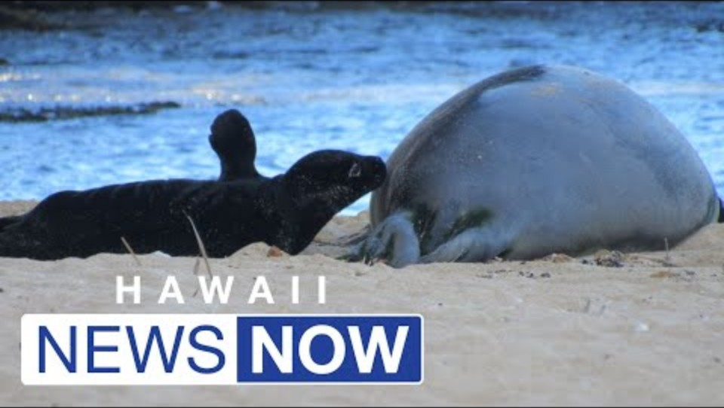

Slide 31
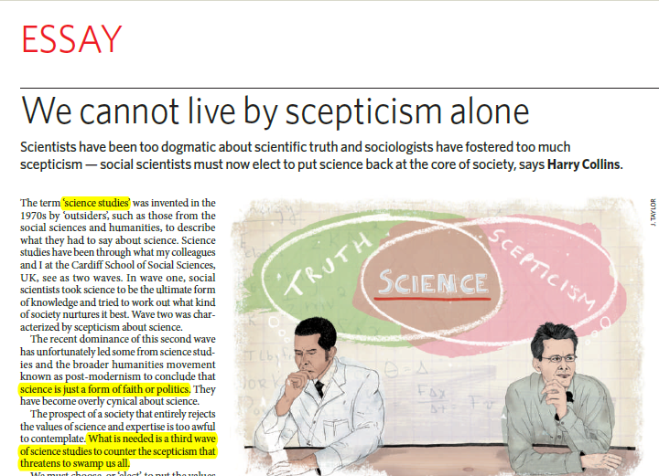
The Science Wars
Series of intellectual exchanges, between scientific realists and postmodernists, about the nature of scientific theory and intellectual inquiry.
They began principally in the United States in the 1980s and 1990s in universities, although philosophical roots go back farther
Notes:
The philosophical roots of the Science Wars go back much further. We do not cover them here. https://www.chronicle.com/article/bait-and-switch/

Slide 32
The opposing viewpoints of The Science Wars
Scientific realists: our brains, with the abstract tools of mathematics, will be able to explain the complexity of nature. Scientific theories are in a historical process of progress towards a true and verifiable account of the physical world
Postmodernists: rational knowledge of reality is not possible. The natural world is a human artifact that takes shape only through the lens of culture. We and our world may be real, but intelligible access to that reality is constructed and ultimately incomplete
Notes:
Both sides have useful and valid positions. Postmodern metaphysics is much more subjective and idealistic. It is suspicious of objectivist metaphysics.

Slide 33
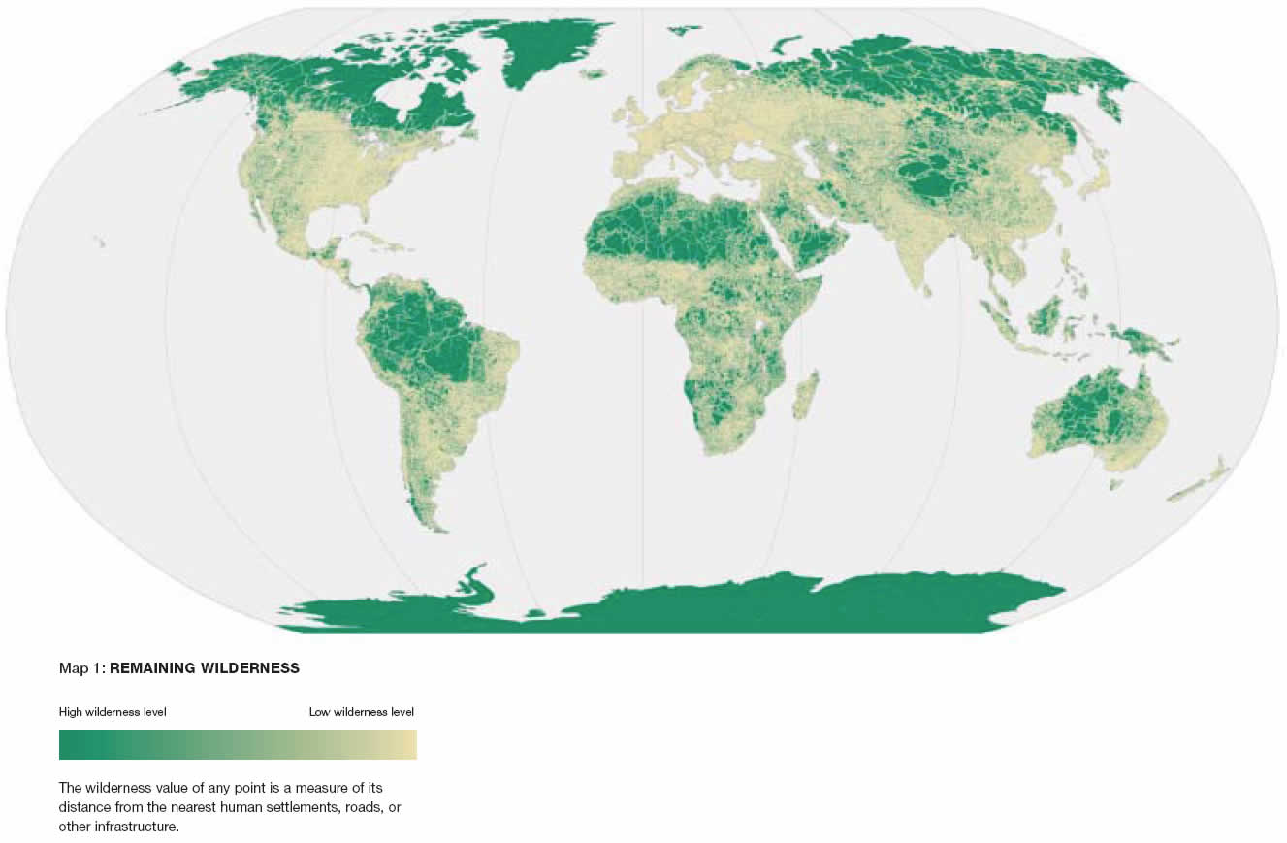

Slide 34
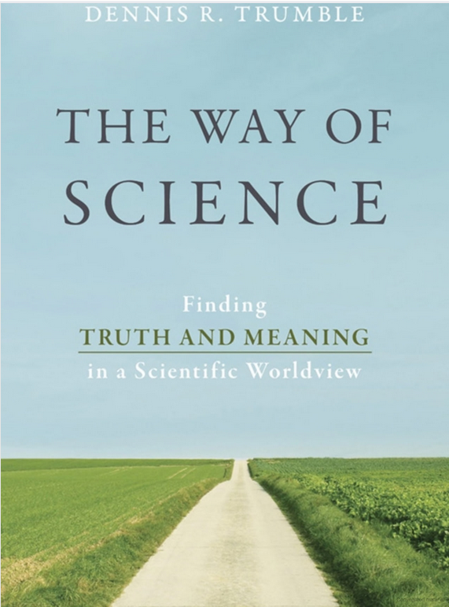

Scientific realists
Postmodernists
Notes:
The caricature of the scientific realists is that there is such a thing as universal truth and that science can explain it all. The caricature of the postmodernists is that nothing has any solidity, all knowledge is constructed and related to its context. Overarching narratives that try to explain everything are not possible.

Slide 35
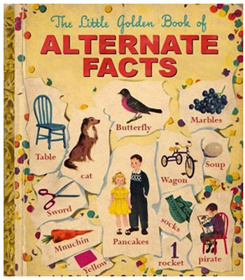
The unfortunate legacy of the Science Wars
Not just skepticism toward scientific claims now
Postmodern skepticism has morphed into the political issue of alternative facts, in which all truth claims are suspect (and opinions masquerade as fact)
The skepticism that made postmodernism a useful tool to question power has now been turned into a weapon in which there is no solid ground of fact or consensus
.
Notes:
Scientism is the ideology that science is always correct and just. Its opposite is anti-science, that it is faulty and not to be trusted.

Slide 36
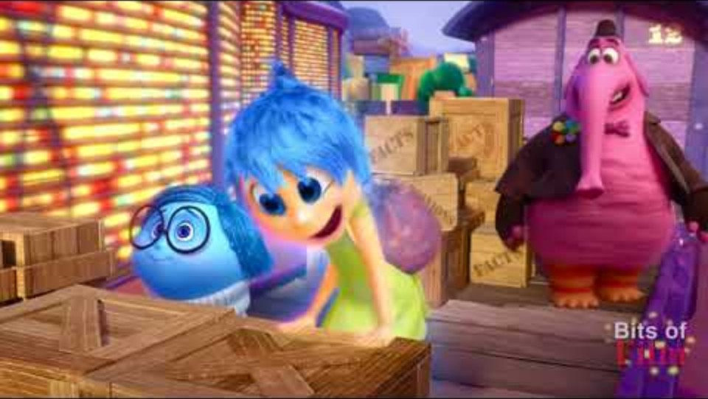

Slide 37


Slide 38
The compromise position: post-positivism
Positivism can be characterized as science that is value-free, reductionist, and unified around a narrow conception of how science is conducted.
By contrast, post-positivists have embraced the idea that the social, the cultural, and the political is embedded, to various degrees, in the scientific enterprise. They recognize that there are many different kinds of science.
Most scientists today would consider themselves post-positivist – and you are too.
Notes:
A positivist views science as wholly objective and universally good for society. They place emphasis on determining what societal and political conditions foster the growth of this kind of science. This can readily devolve into the white lab coat scientist stereotype, the scientist who lacks any kind of understanding of people and society. The authority of positivist science ultimately weakened because of arguments and evidence to show that science could not be entirely objective. Scholars in the post World War 2 era began a period of documenting how it operated within culture and politics, thereby giving rise to the idea of post-positivism. At the same time, scientists began to grow concerned over how scientific knowledge production was seen as biased because it was socially constructed. Politicians began to deny basic science on the grounds that unless there were zero doubt or from the perspective that science is made up. This became the basic tension defining the Science Wars.
Post-positivism is a compromise position to the tensions defining the Science Wars. This reaction against value- and context-free positivist science began in the 1950s and 1960s. This is where the post-positivism that shapes the world in which you and I work and think today originated. Rachel Carson, for example, can be considered one of the first prominent post-positivists. Aldo Leopold as well – these writers and scientists held that science was not above culture and context but existing within it. Post-positivism recognizes that science is “an engine, not a camera”. It does not merely register and represent the world, but also actively reshapes it by reconfiguring humans’ understanding of their place in “nature,” as well as informing policies, regulations, and legal decisions With post-positivism, science is to be viewed not as the truth but as expertise. The goal of post-positivism is to balance the tendency to cynicism arising from the social nature of science with the recognition that science is also a useful and reliable way to produce knowledge. Scientists can guide us only by admitting their weaknesses, and, concomitantly, when non-scientists judge scientists, it must be done not to the standard of truth, but to the much softer standard of expertise.

Slide 39

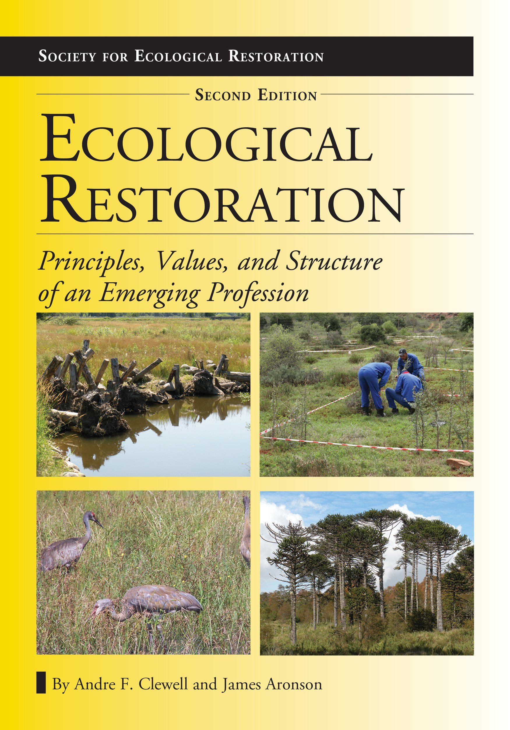

Examples of post-positivism
How we define wilderness invokes cultural values, not just objective, universal scientific standards
Restoration goals defined in terms of scientific concepts also inherently reflect cultural values

