Slide 1
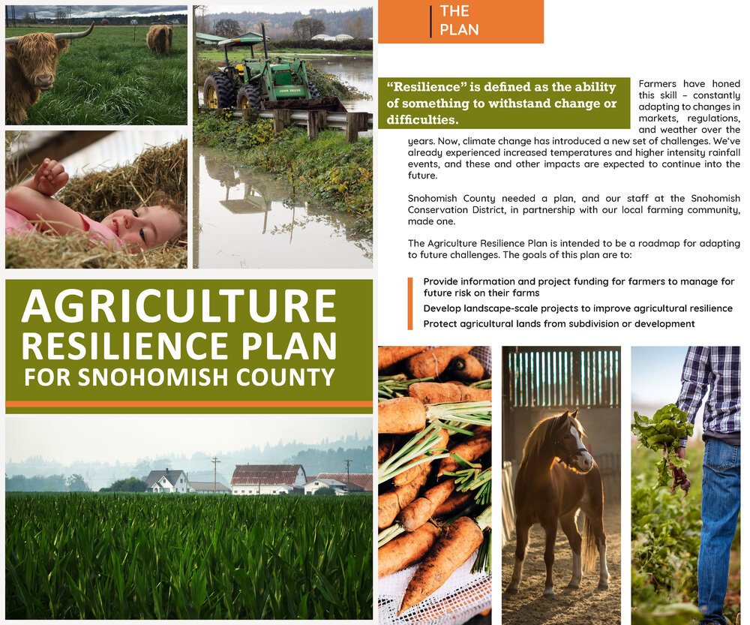

Slide 2

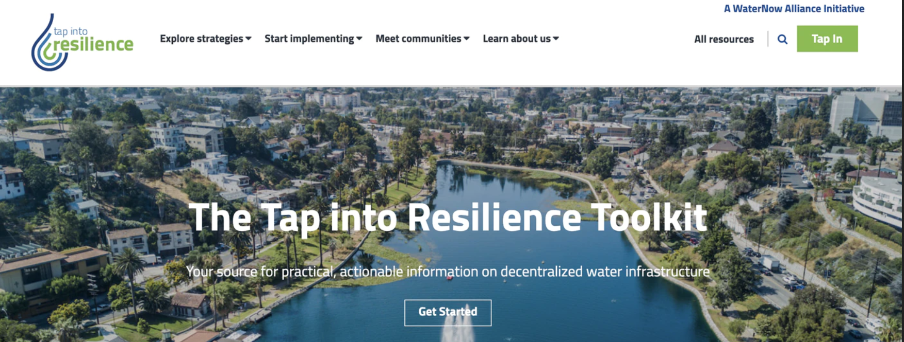

Slide 3

Resilience theory
Origins are in ecology
Takes ideas from complexity adaptive systems theory and puts them into a more applied framework
Posits a range of dynamics from near equilibrium stable states to non-equilibrium unstable states
Began with the work by C.S. Holling in 1970’s

Slide 4
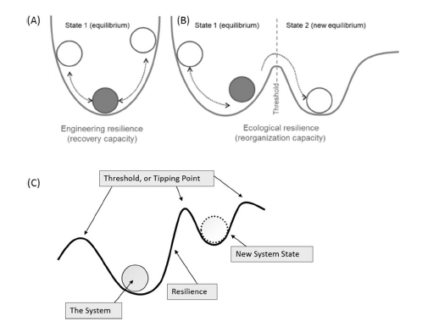
Two types of resilience: engineering resilience
Denotes recovery and the return of ‘normal’ functioning in a system.
A measure of how quickly a system rebounds to its pre-disturbance state
Recovery capacity
This is an equilibrium concept that captures the engineering aspects of ecosystems
Notes:
By engineering, we mean the capacity of a system to withstand disturbance and maintain present structure and functions.

Slide 5
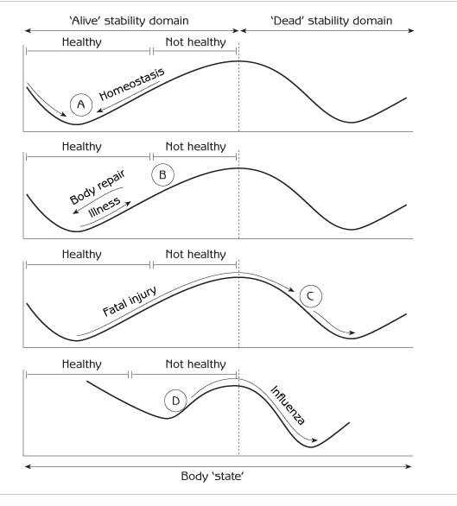
Stability in resilience theory is different from our usual definition of it
Stability in its usual sense often implies a tendency to return to a “normal” mode of equilibrium functioning – as in when we get sick and recover.
However, ecological and social systems are not organized around a single equilibrium like an individual human is
They can tip from one to one or more various states, which in resilience theory are called stability domains
Notes:
You may also hear the term alternative stable states too

Slide 6
Two types of resilience: ecological resilience
Amount of disturbance or change that can be accommodated before a system crosses a threshold and reorganizes into another stability domain
Captures the capacity of a system to reorganize into another state
Reorganization capacity

Slide 8

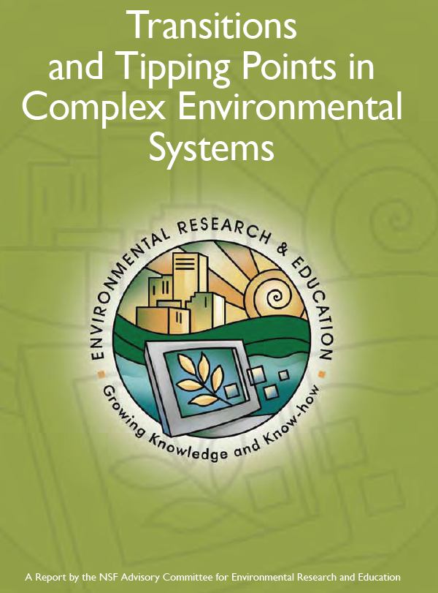
A system may change, or tip, from one stability domain to another when a threshold is crossed due to human impacts and/or natural environmental change
These transitions are also called regime shifts
Change in a system may be rapid, as with tipping, or it may be slower and gradual
These dynamics apply to many different kinds of systems

Slide 9
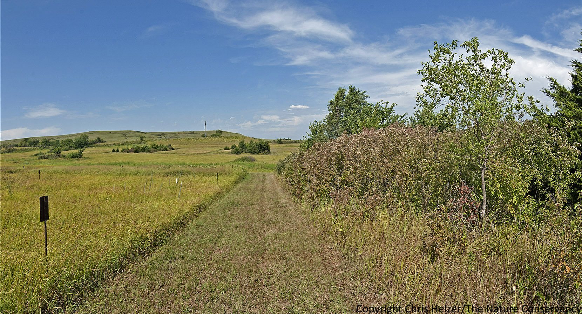
Notes:
Small research plots like these at Konza Prairie help demonstrate the impacts of various fire frequencies. The treeless grassland to the left is burned annually. The wooded area to the right is burned every 20 years. Both started out looking the same. https://prairieecologist.com/2014/09/03/konza-prairie-trip-part-2-tree-and-shrub-encroachment/

Slide 10
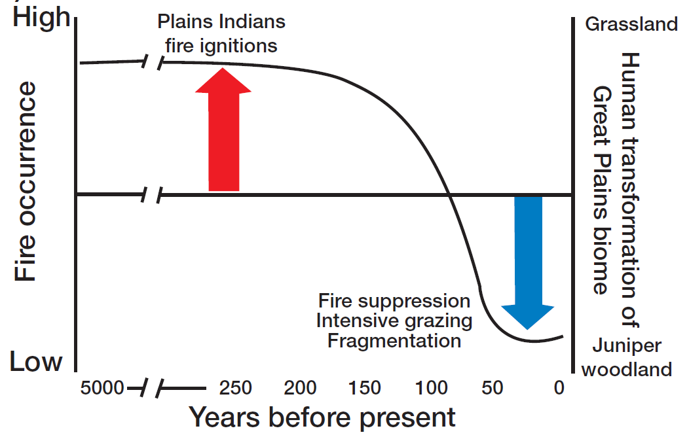

Slide 11
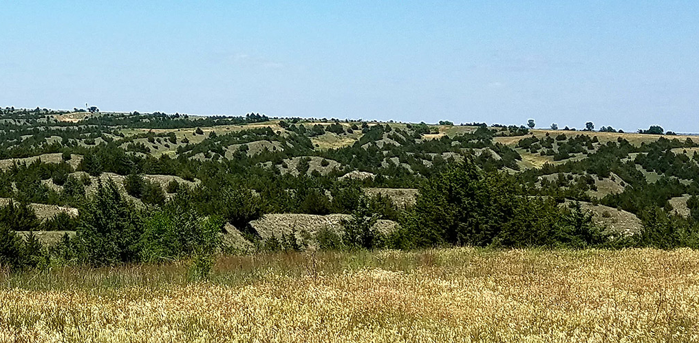

Slide 12
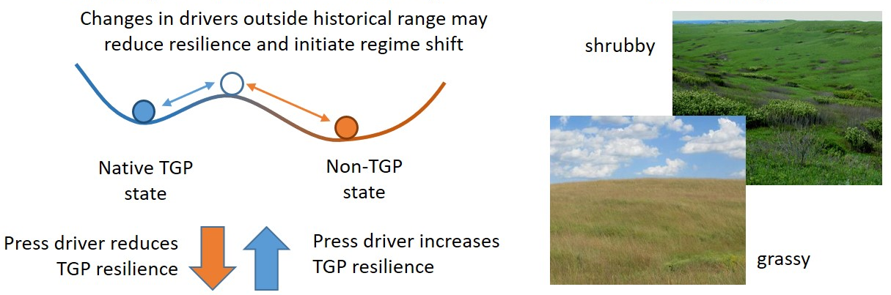
Tipping in tall grass prairie

Slide 13
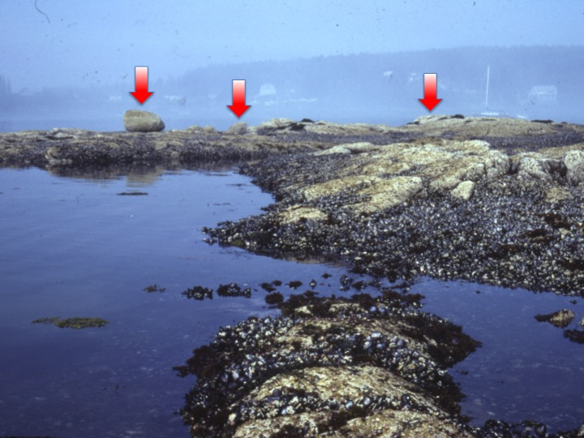
Notes:
http://www.csun.edu/~sd51881/overview.htm
Mussel-dominated stability domain

Slide 14
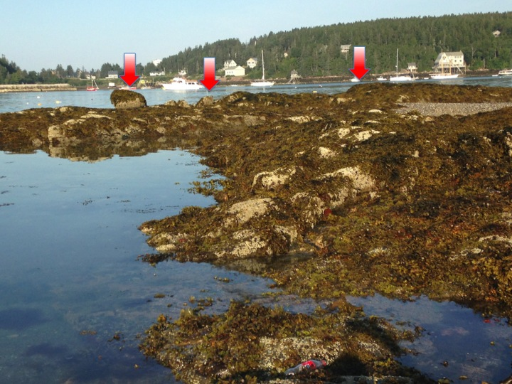
Notes:
http://www.csun.edu/~sd51881/overview.htm Seaweed dominated stability domain

Slide 15
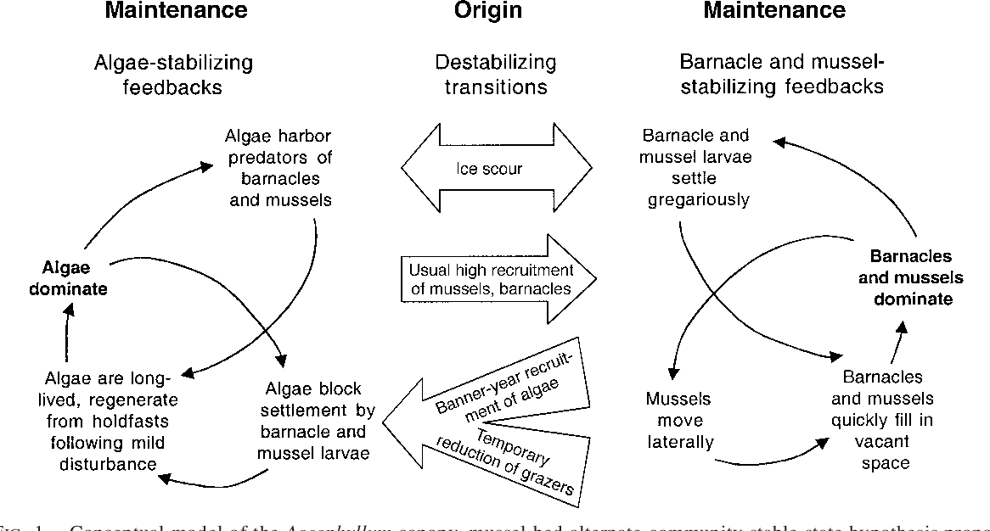
Algae – mussel/barnacle system dynamics

Slide 16
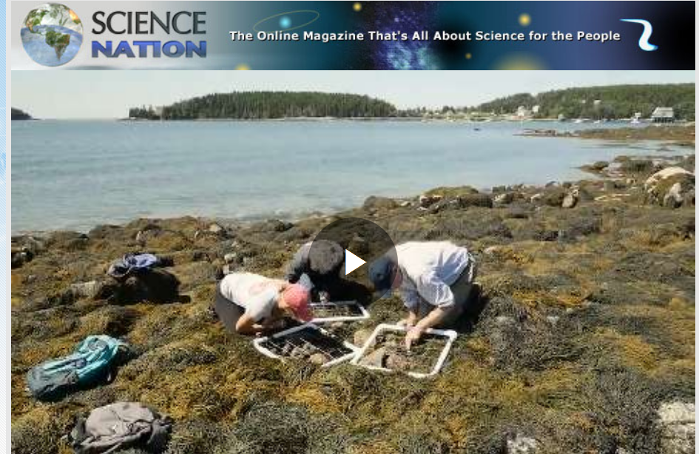
Notes:
The rocky intertidal marine community, where these two stability domains can develop: a mussel-dominated state and a seaweed-dominated state. Storm disturbances are often the factor driving these transitions between stability domains.
Petraitis, P. S., Methratta, E. T., Rhile, E. C., Vidargas, N. A., & Dudgeon, S. R. (2009). Experimental confirmation of multiple community states in a marine ecosystem. Oecologia, 161(1), 139-148.
https://www.nsf.gov/news/mmg/mmg_disp.jsp?med_id=185807&from=

Slide 17
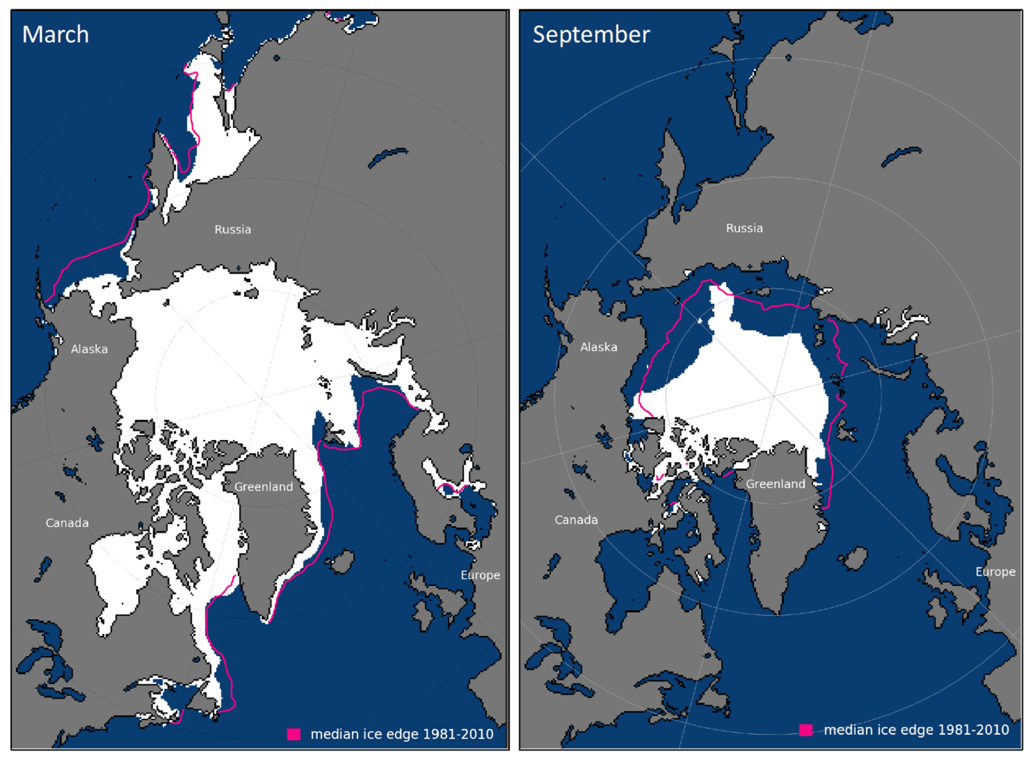
Arctic sea ice tipping point and regime shift
Notes:
Sea ice cover shown in maps is 2016 Sumata, Hiroshi, Laura de Steur, Dmitry V. Divine, Mats A. Granskog, and Sebastian Gerland. "Regime shift in Arctic Ocean sea ice thickness." Nature 615, no. 7952 (2023): 443-449.

Slide 18
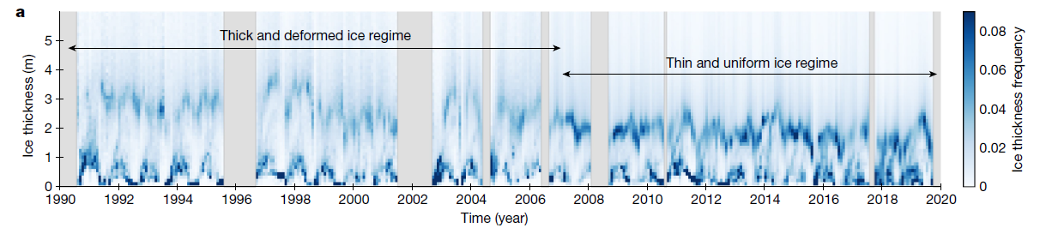
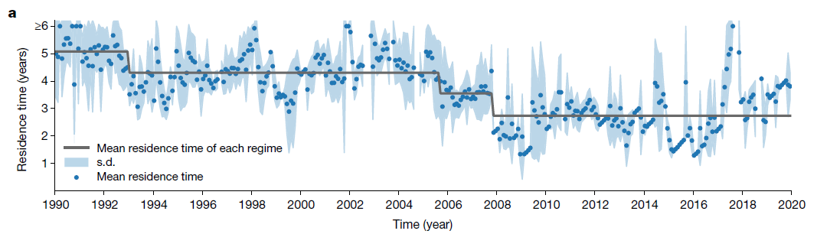
Notes:
The timing of the shift was preceded by a two-step reduction in residence time of sea ice in the Arctic Basin, initiated first in 2005 and followed by 2007 Sumata, Hiroshi, Laura de Steur, Dmitry V. Divine, Mats A. Granskog, and Sebastian Gerland. "Regime shift in Arctic Ocean sea ice thickness." Nature 615, no. 7952 (2023): 443-449.

Slide 19
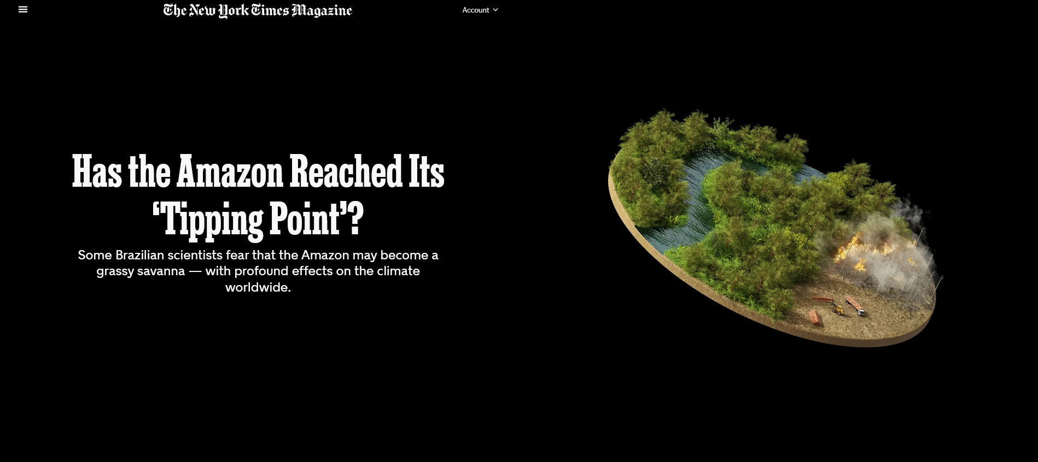
Amazon rainforest tipping points and regime shift

Slide 20
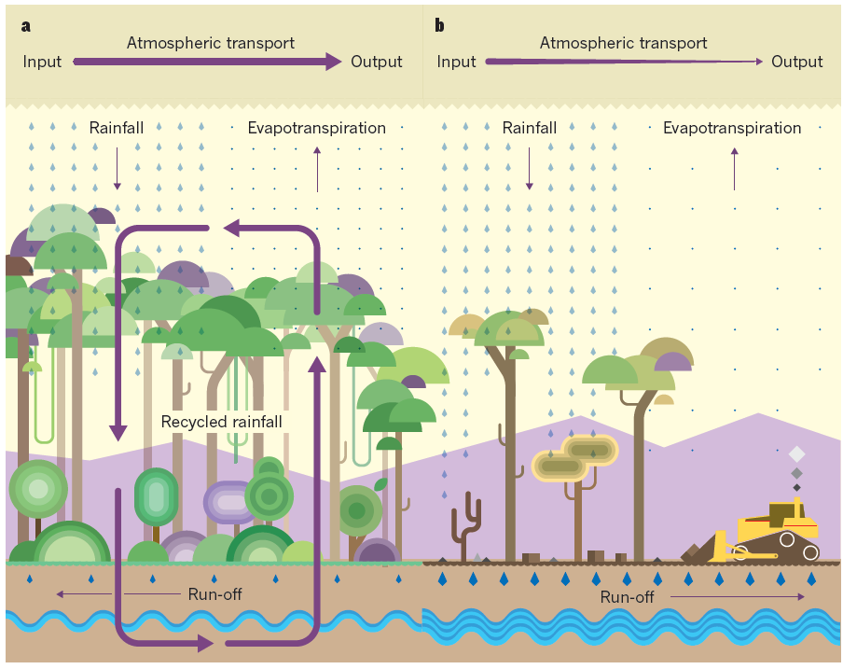
Notes:
The rainforest ‘pump’ is lost with fires, leading to a lock-in of drier, shrub and grassland-dominated forests. The environmental conditions can no longer support tropical rainforest vegetation

Slide 21
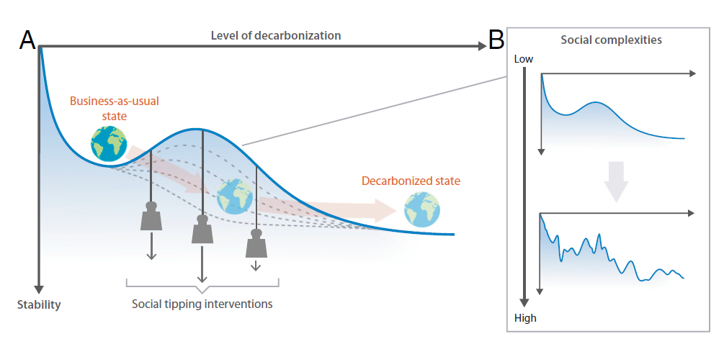
Social tipping interventions
Notes:
The concept of decarbonization transformation as social tipping dynamics. As illustrated in A by an abstract stability landscape, the world’s socioeconomic system today is trapped in a valley where it still depends heavily on burning fossil fuels, leading to high rates of greenhouse gas (GHG) emissions. Social tipping interventions have the potential to erode the barrier through triggering social tipping dynamics in different sectors and thus paving the way for rapid transformative change. Uncertainties and complexities inherent in the many dimensions of human societies beyond their level of decarbonization can be envisioned as forming a rougher stability landscape featuring multiple attracting states and a larger number of barriers that need to be eroded or overcome (B). This inherent “social noise” may complicate transformative change but could also accelerate it Otto, I. M., Donges, J. F., Cremades, R., Bhowmik, A., Hewitt, R. J., Lucht, W., ... & Schellnhuber, H. J. (2020). Social tipping dynamics for stabilizing Earth’s climate by 2050. Proceedings of the National Academy of Sciences, 117(5), 2354-2365.

Slide 22
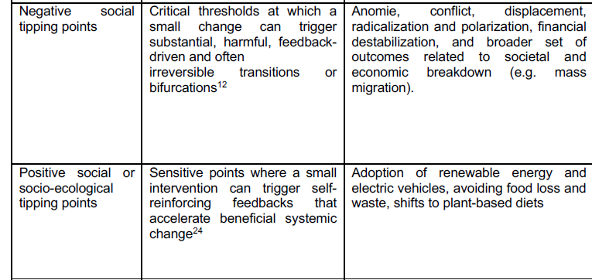
Notes:
Otto, I. M., Donges, J. F., Cremades, R., Bhowmik, A., Hewitt, R. J., Lucht, W., ... & Schellnhuber, H. J. (2020). Social tipping dynamics for stabilizing Earth’s climate by 2050. Proceedings of the National Academy of Sciences, 117(5), 2354-2365.

Slide 23


Slide 24
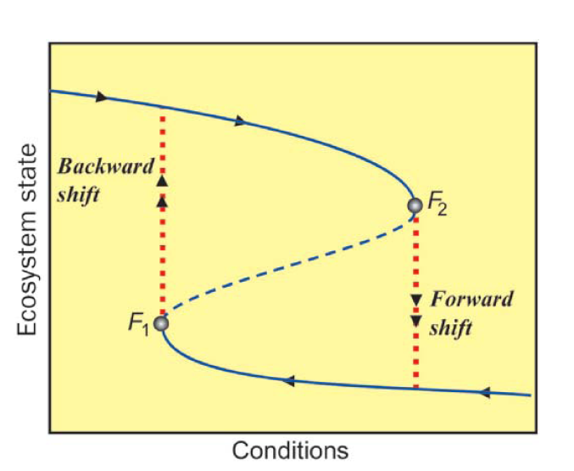
Hysteresis
Change in state of a system that is irreversible
Change in one direction cannot simply be reversed to go back to the initial state.
Yet also can create the potential for the same environmental conditions to exist in two different states, which is called bistability

Slide 25
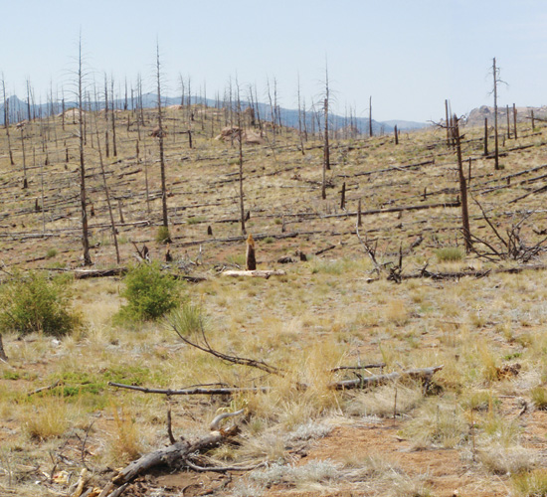
Hysteresis in western US forests
Fires, heat, and drought is shifting forests into new vegetation state, from forests to shrub and grasslands in western US
Pine forests do not return when burned by intense and frequent wildfires and persistent drought conditions
Notes:
http://www.nature.com/nclimate/journal/v3/n3/full/nclimate1693.html
http://e360.yale.edu/feature/megadrought_in_us_southwest_a_bad_omen_for_forests_globally/2665/

Slide 26
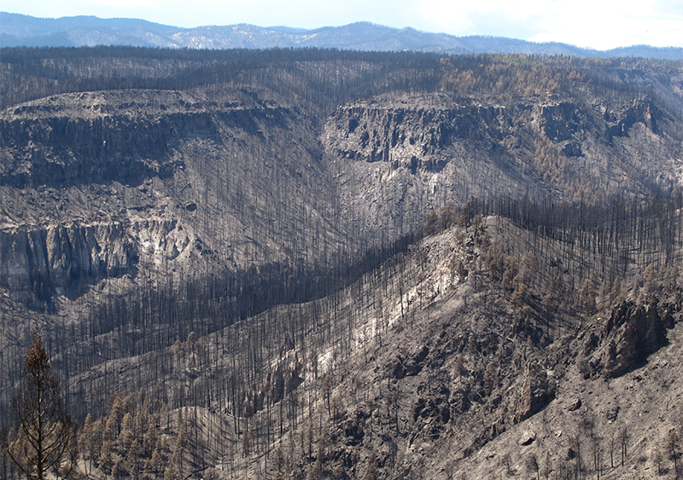
Notes:
Ridge lines with scorched trees from the 2011 Las Conchas fire in New Mexico, the second-largest blaze in the state's history. The fire, exacerbated by rising temperatures and a severe "megadrought" that has gripped the U.S. Southwest for more than a decade, burned 156,000 acres.

Slide 27
