Slide 1

Notes:
https://www.youtube.com/watch?v=VqdJBuFk600&ab_channel=ABCScience This segments starts at 2:15

Slide 2
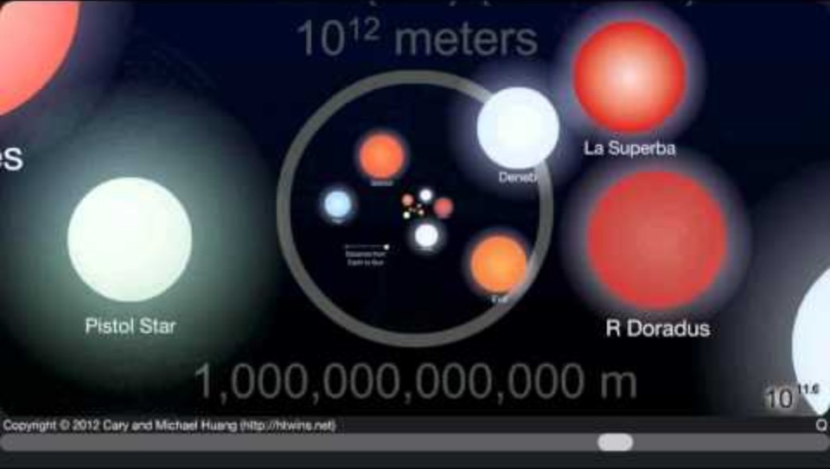
Notes:
http://htwins.net/scale2/ https://www.youtube.com/watch?v=uaGEjrADGPA

Slide 3
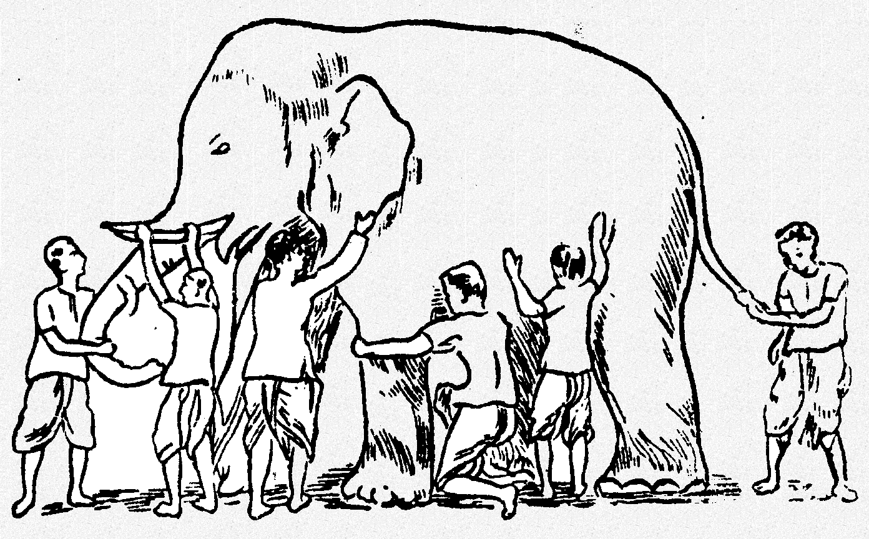
Why is scale important for environmental and sustainability policy?
Scale shapes the perception, measurement, and interpretations we make about the world
Scale influences our comprehension of patterns and processes
Notes:
https://esajournals.onlinelibrary.wiley.com/doi/abs/10.2307/1941447

Slide 4
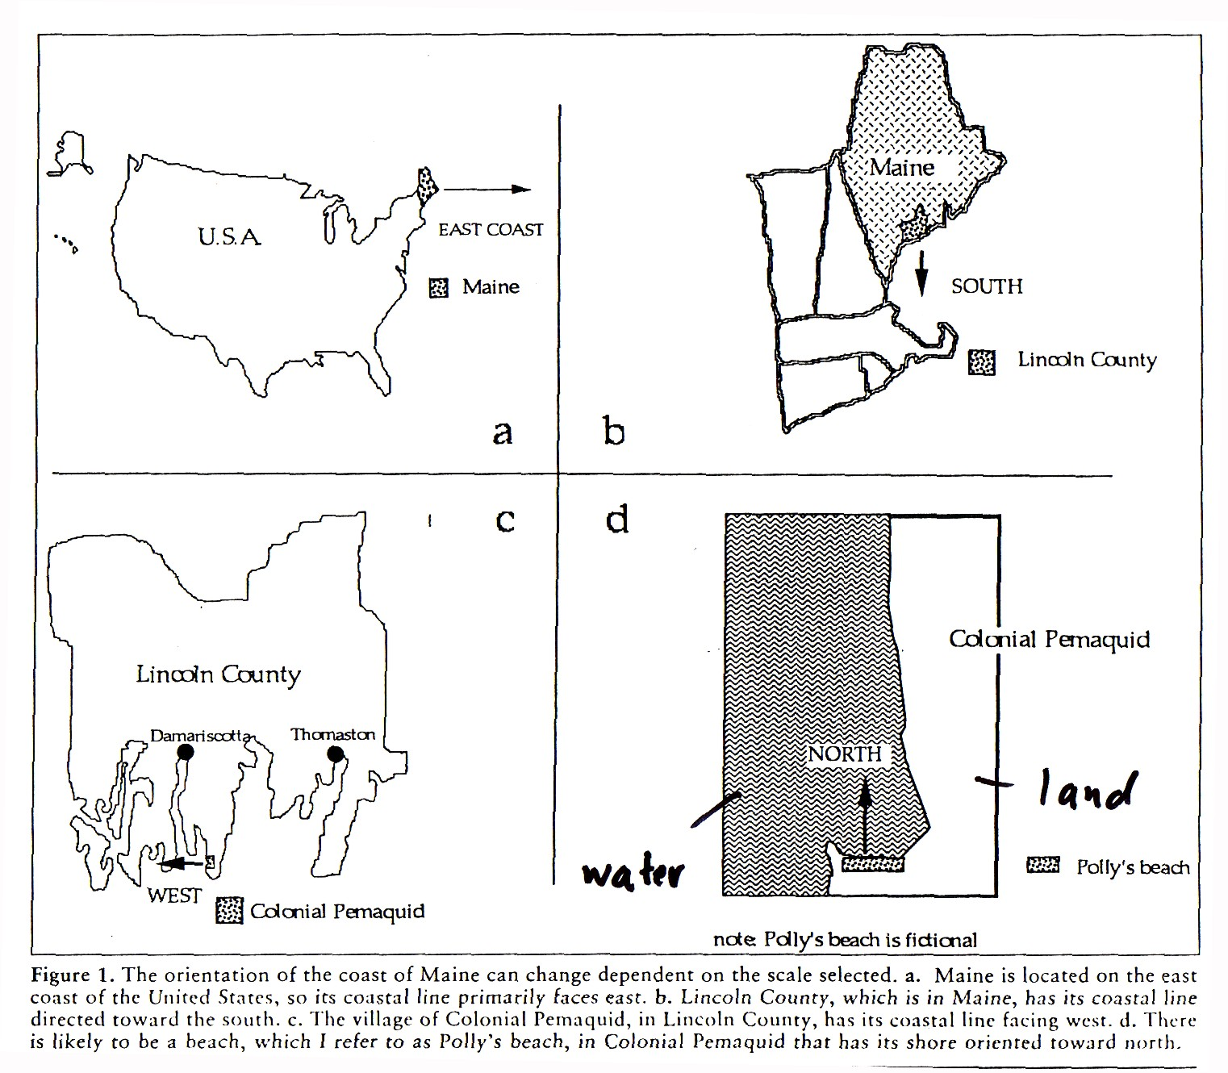

Slide 5
Example: what makes it warm or cold?
A simple question, right? One that would be necessary to understand if you wanted to make climate policy
The cause you select depends upon temporal and spatial scale
Cloud cover and humidity (minutes to hours)
Diurnal (day-night) cycles
Seasonal cycles (1 year)
Atmospheric oscillations like El Nino – La Nina (2 – 7 years)
Anthropogenic contribution of greenhouse gases (10 - 100 years)
Milankovitch orbital cycles (10,000 yrs)
Notes:
We can perceive the world at different scales – our choice of spatial and temporal scale influence what we can say about how the world works.

Slide 6
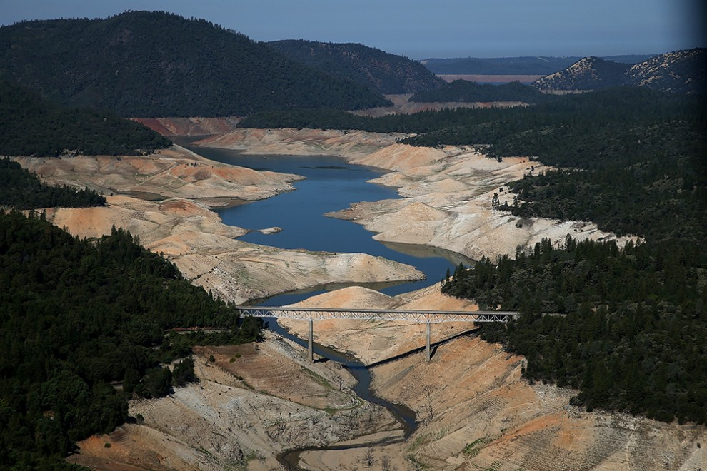
Notes:
California has experienced severe droughts in the last decade.

Slide 7
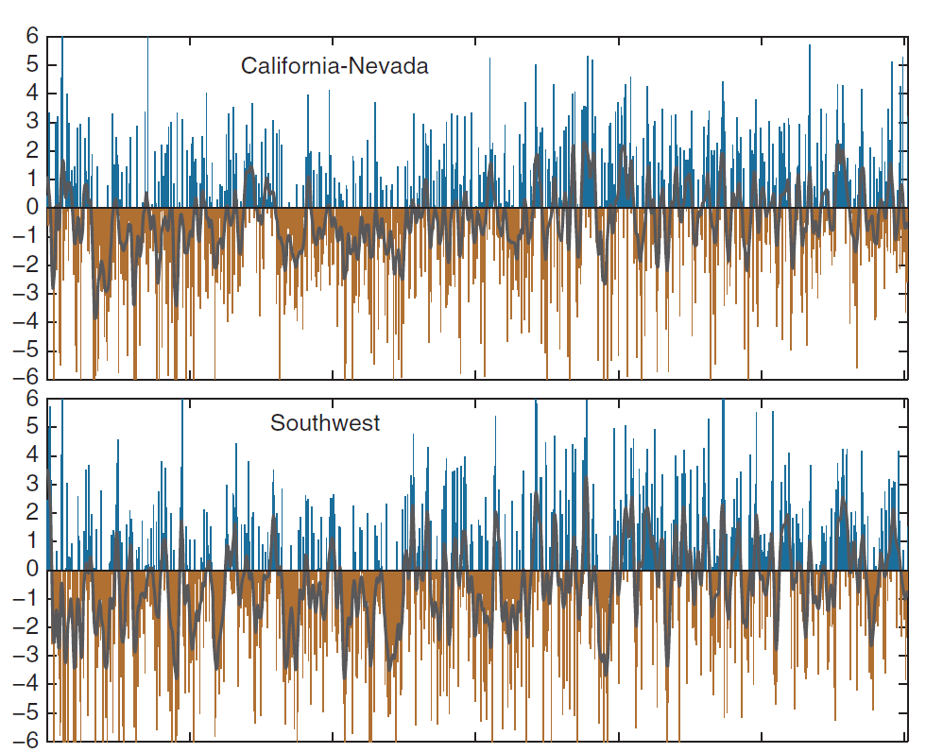
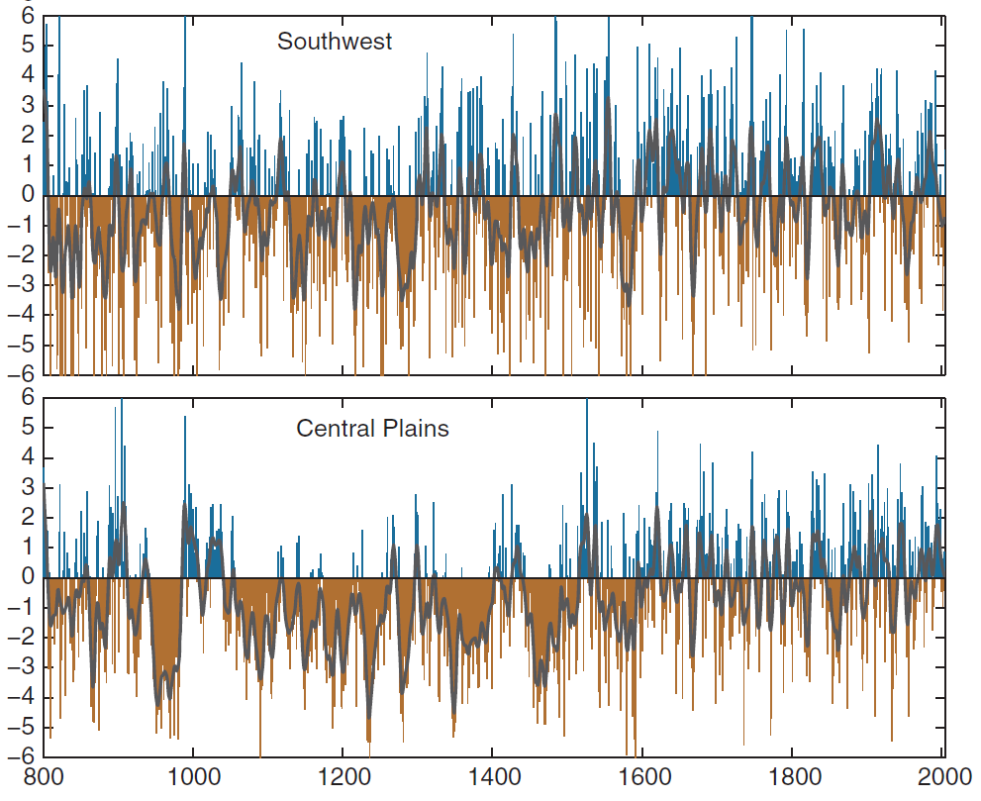
Wet
Drought index
Dry
Wet
Drought index
Dry
Notes:
When you look at a larger temporal scale, you see a different pattern than if you only consider the last decade The western US was settled during the last 200 years. What can you tell me about the climate over that period? Was it wetter or drier than what the record shows over the last 400 years?

Slide 8
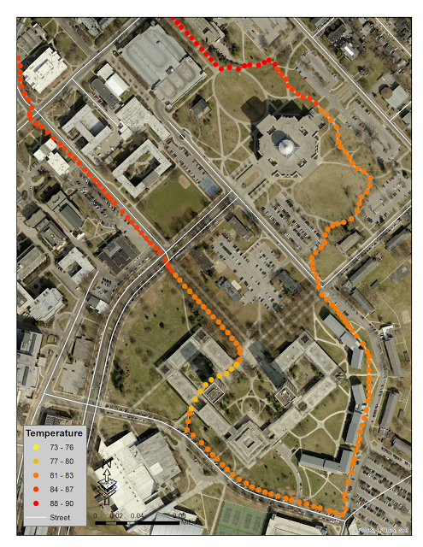
Notes:
Microclimates

Slide 9
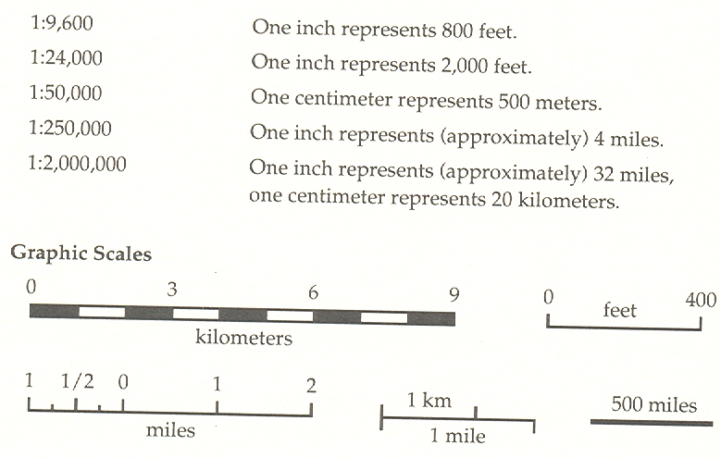
Cartographic scale

Slide 10
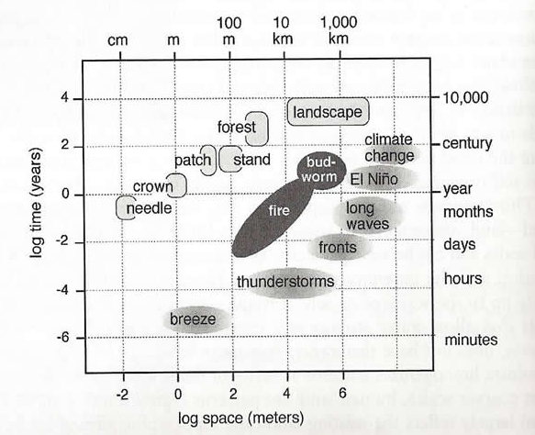
Operational scale
Refers to the spatial and temporal dimensions of an object or a process

Slide 11
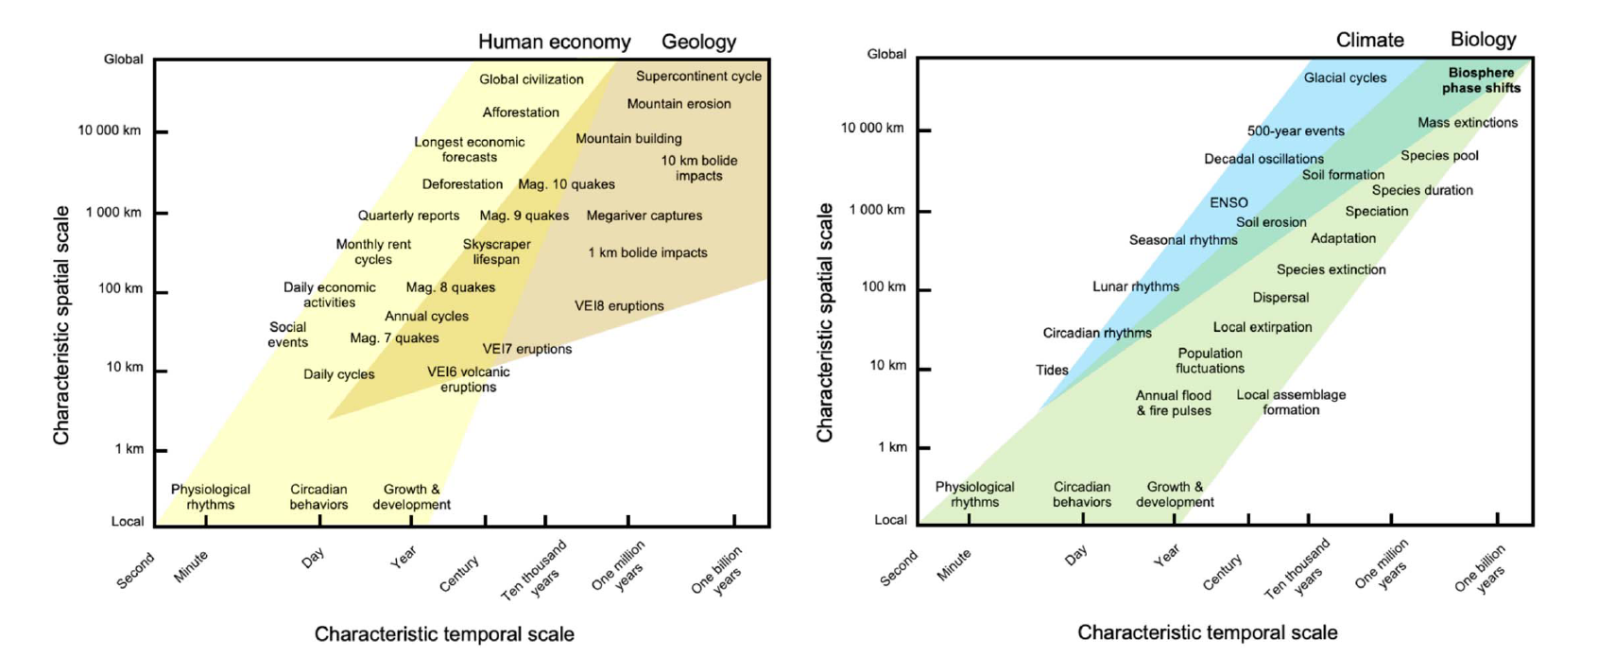

Slide 12
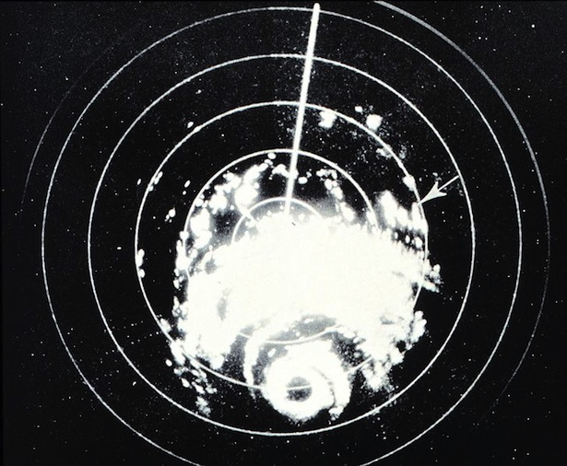
Understanding of the operational scale of a phenomena changes as our observational technology changes
As operational scales are refined, policy may need to change as well.

Slide 13
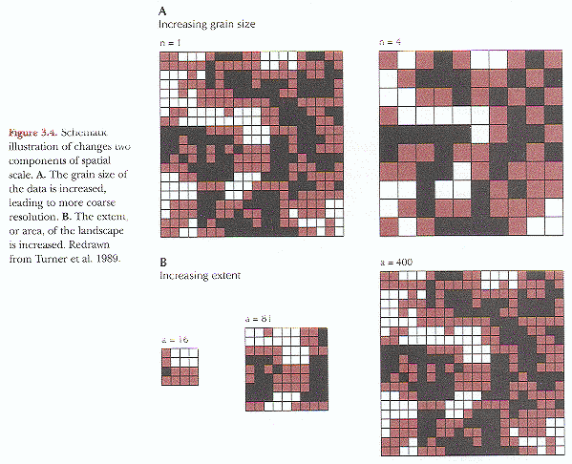
Ecological scale
Decreasing (finer) grain, extent is constant
Encompasses how me make observations of the world, and how we analyze it and communicate the results
Extent: the size of the spatial (or temporal) window encompassing the object or process observed and analyzed
Grain: level of spatial (or temporal) resolution at which an object or process has been measured or observed.
Increasing extent, grain is held constant

Slide 14
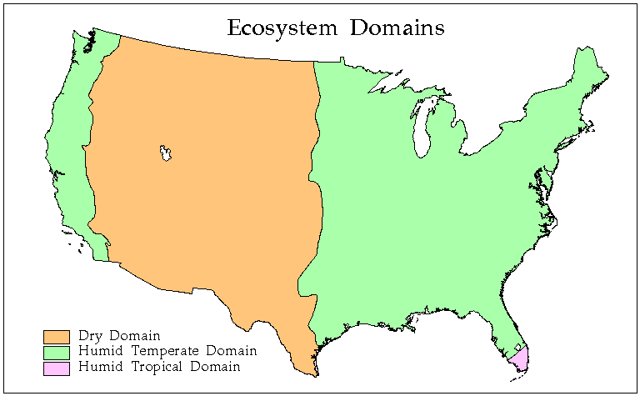
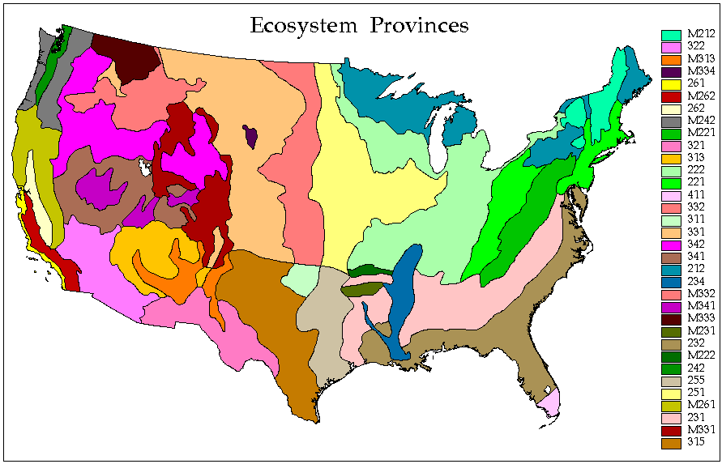
Which map shows more grain?
Notes:
14

Slide 15
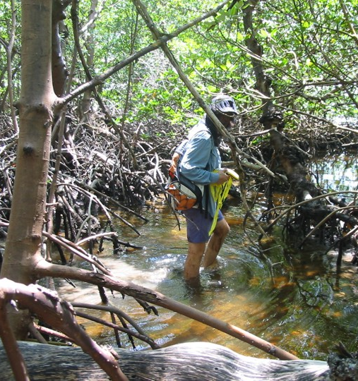
Haggett’s scale coverage problem
Nature has an immense extent and a fine grain
We cannot perceive it all simultaneously
Makes it challenging to make measurements of it and to establish relationships between pattern and process

Slide 16
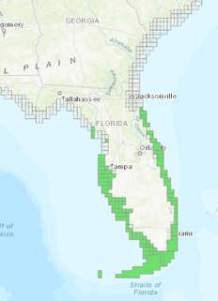
Haggett’s scale coverage problem
To make descriptions of it, we have to sample
Sampling typically involves one of two compromises
Sacrificing fine grain for a larger extent
Sacrificing large extent for finer grain

Slide 17
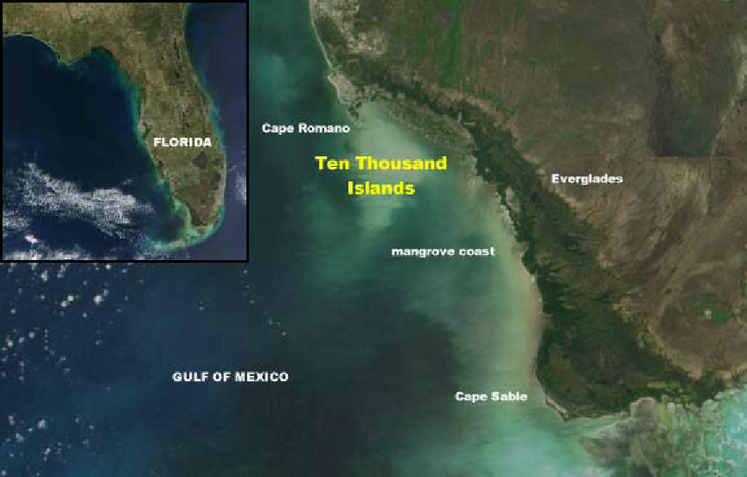
Notes:
What if you wanted to map the mangrove coasts of Florida?

Slide 18
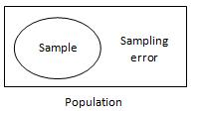
Sampling introduces sampling error
Sampling error is the error caused by observing a sample instead of the whole population
The act of sampling introduces uncertainty in inferences simply because a sample is only a representation of the population.
Error is inherent to sampling
Notes:
If you sampled 100 or 200 or 300 trees, you would still have sample error. But less if you sampled 300 trees then error would decrease

Slide 19
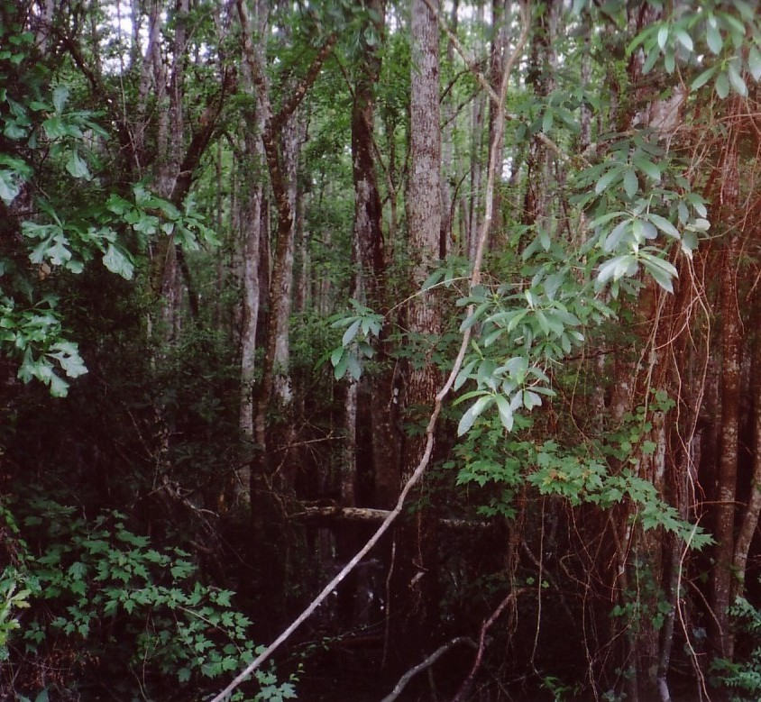
Sampling can introduce sampling bias
Sampling bias develops when the procedures used to select the sample tend to favor the inclusion of individuals of the population with certain characteristics.
The method of selecting samples causes it to differ from the population.
Bias can be unintentional or intentional
Notes:
Picking study sites based on how easy it is to access and sample is an example of sampling bias.

Slide 20
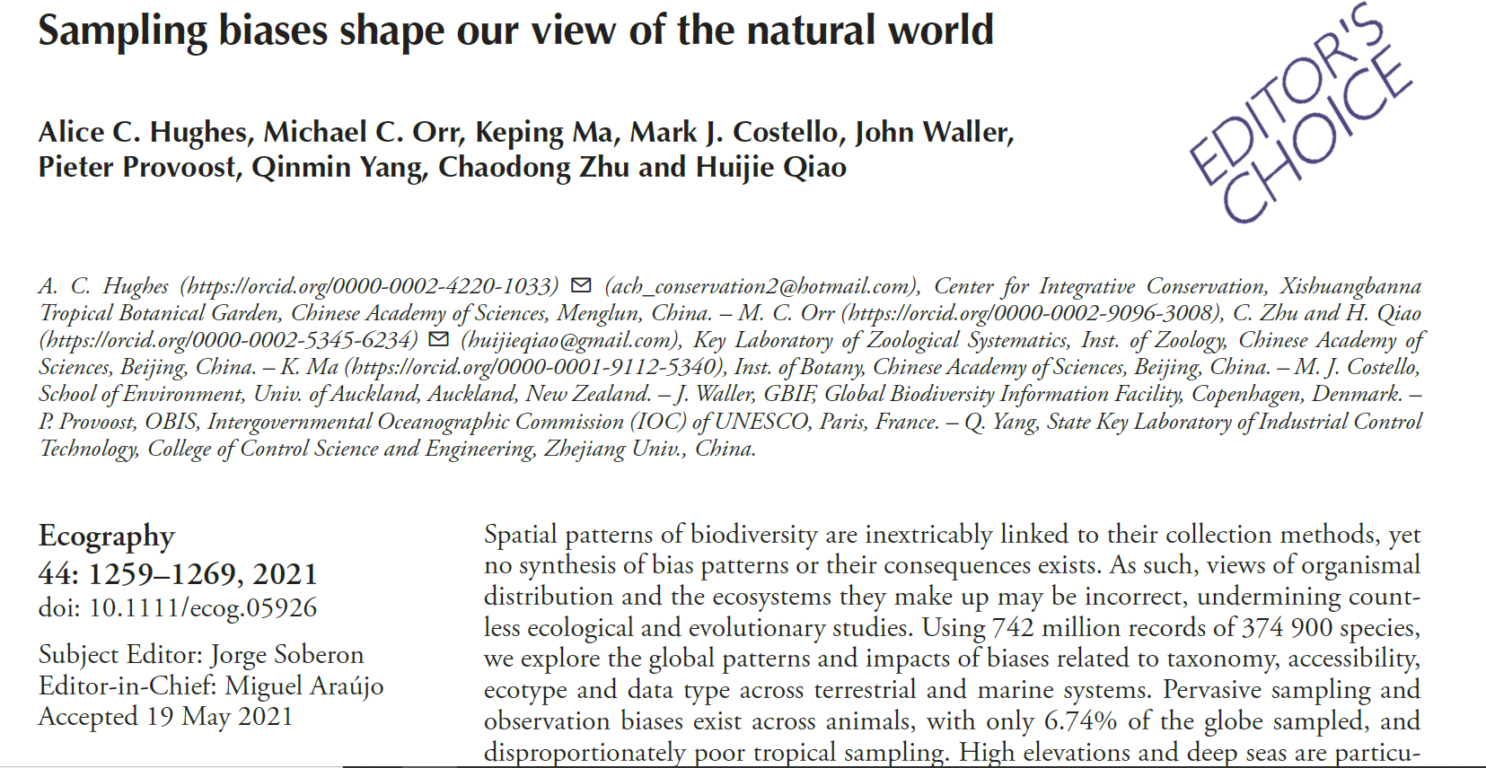
Notes:
Hughes, A. C., Orr, M. C., Ma, K., Costello, M. J., Waller, J., Provoost, P., ... & Qiao, H. (2021). Sampling biases shape our view of the natural world. Ecography.

Slide 21
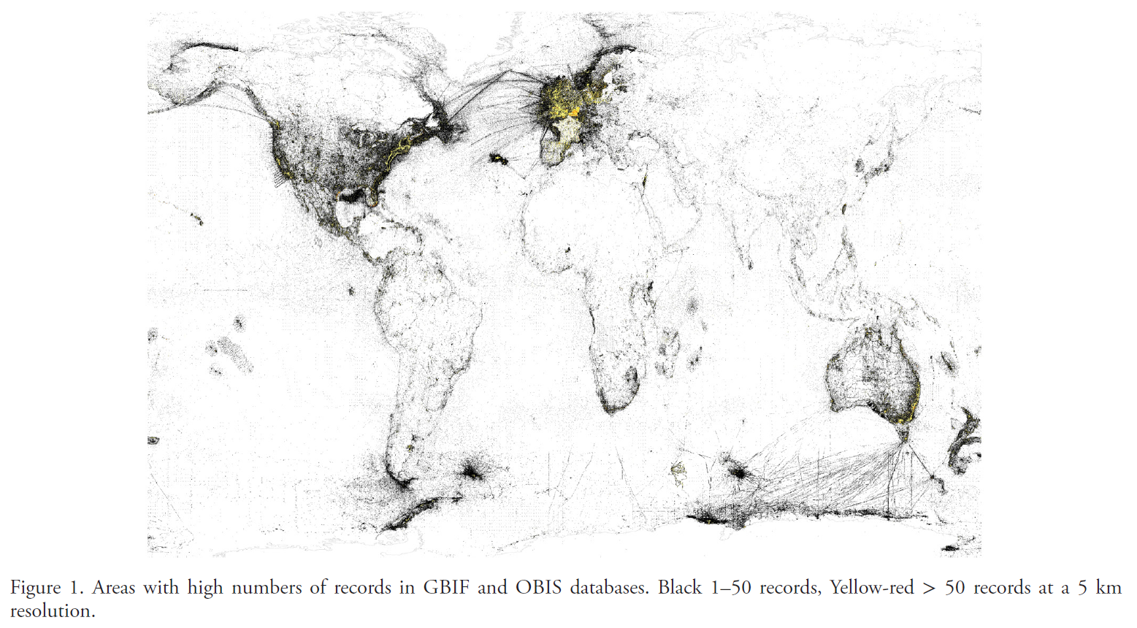
Notes:
Records of observations of organisms recorded in OBIS, Ocean Biodiversity Information System and GBIF, the Global Biodiversity Information Facility There is a strong sampling bias toward North America and Europe. Hughes, A. C., Orr, M. C., Ma, K., Costello, M. J., Waller, J., Provoost, P., ... & Qiao, H. (2021). Sampling biases shape our view of the natural world. Ecography.

Slide 22

How many trees are there on Earth?

Slide 23
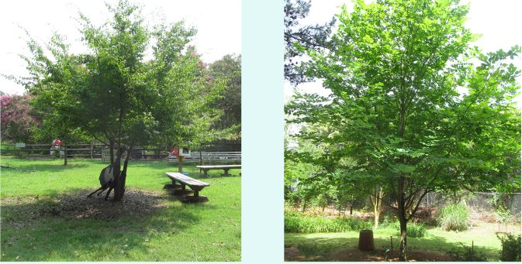
How many trees are there on Earth?
What is a tree? Define by size? What about woody shrubs?
Sample? How, where, when?
Sample bias?
Sample error?

Slide 24
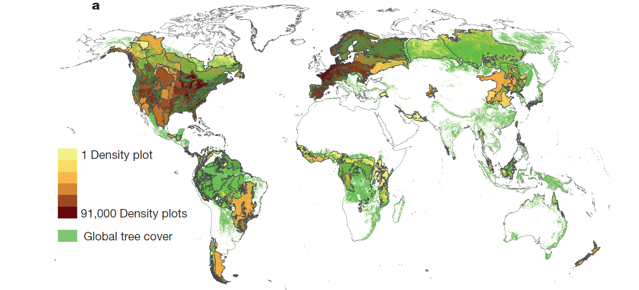
1. Global distribution of the plots where earlier researchers had assembled highly accurate counts of the number of trees. The authors of the study to determine the number of trees in the world collected all the data for these plots (430,000 of them). More plots were in developed countries and in certain biomes, and example of sample bias, but one that could not entirely be avoided.

Slide 25
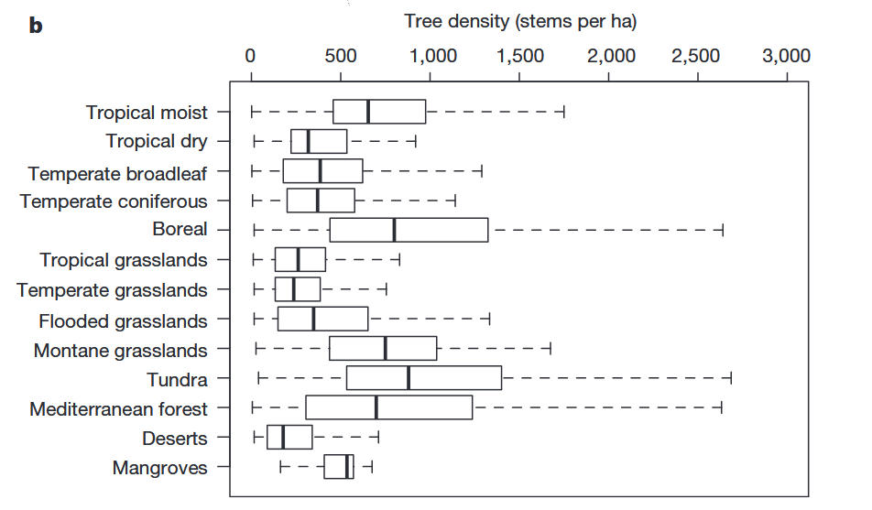
2. The estimated number of trees per unit area in each of the biomes where the plots were located.

Slide 26
Methods (continued)
These variables below were quantified for each of the forest plots. Each biome was then linked to specific defining combination of these variables.
Topography: elevation, slope angle, aspect (compass direction a slope faces),
Climate: annual mean temperature, temperature annual range, annual precipitation
Ecological: leaf area index (LAI), proportion of urban and/or developed land cover
Next, the forested surface of the Earth was classified into biomes based on the topographic, climatic, and ecological parameters that define each biome.
In the last step, the researchers used the relationships between each biome and tree count per unit area from plots to estimate total number of trees all over the Earth.

Slide 27
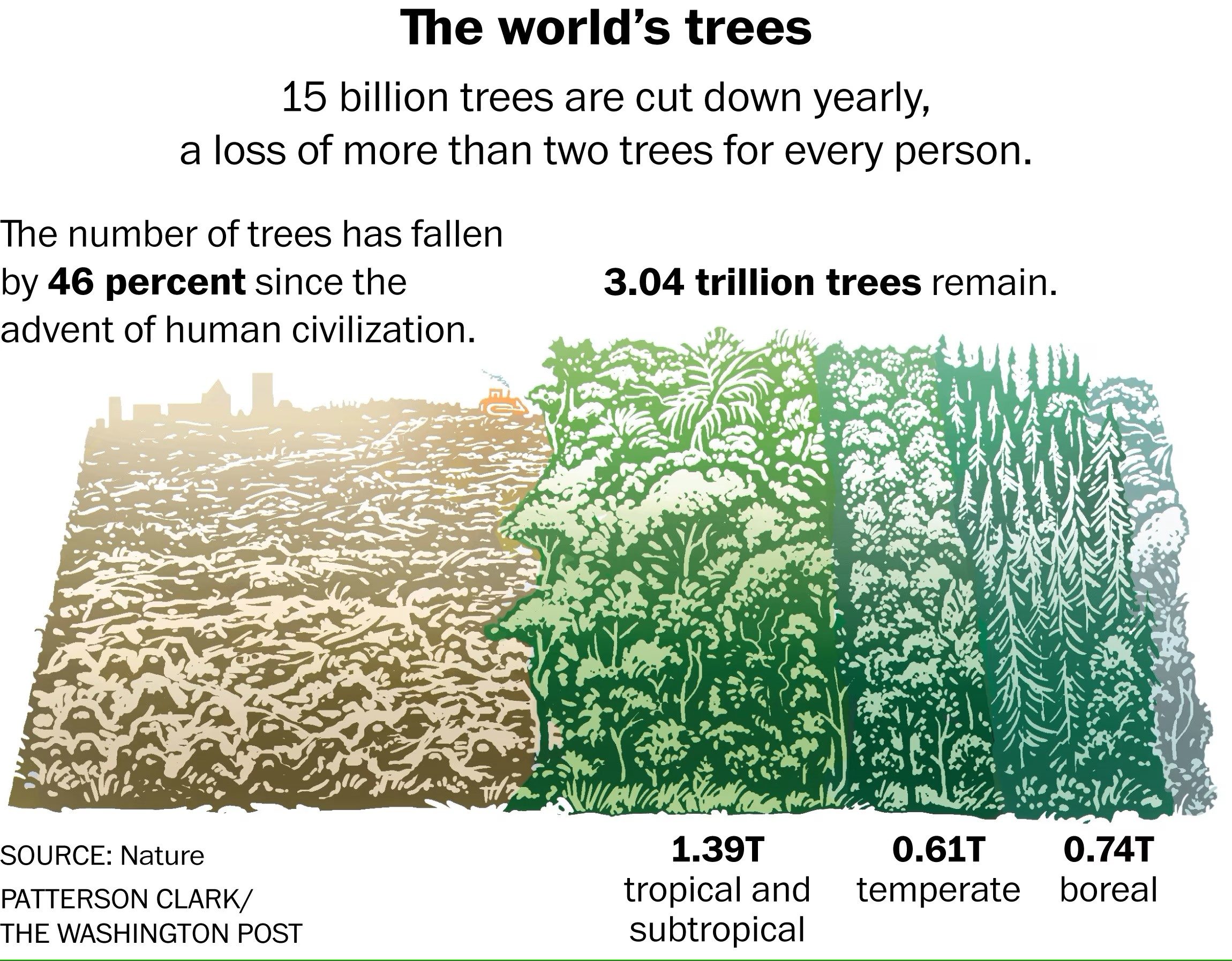
Notes:
https://www.washingtonpost.com/news/energy-environment/wp/2015/09/02/scientists-discover-that-the-world-contains-dramatically-more-trees-than-previously-thought/

Slide 28
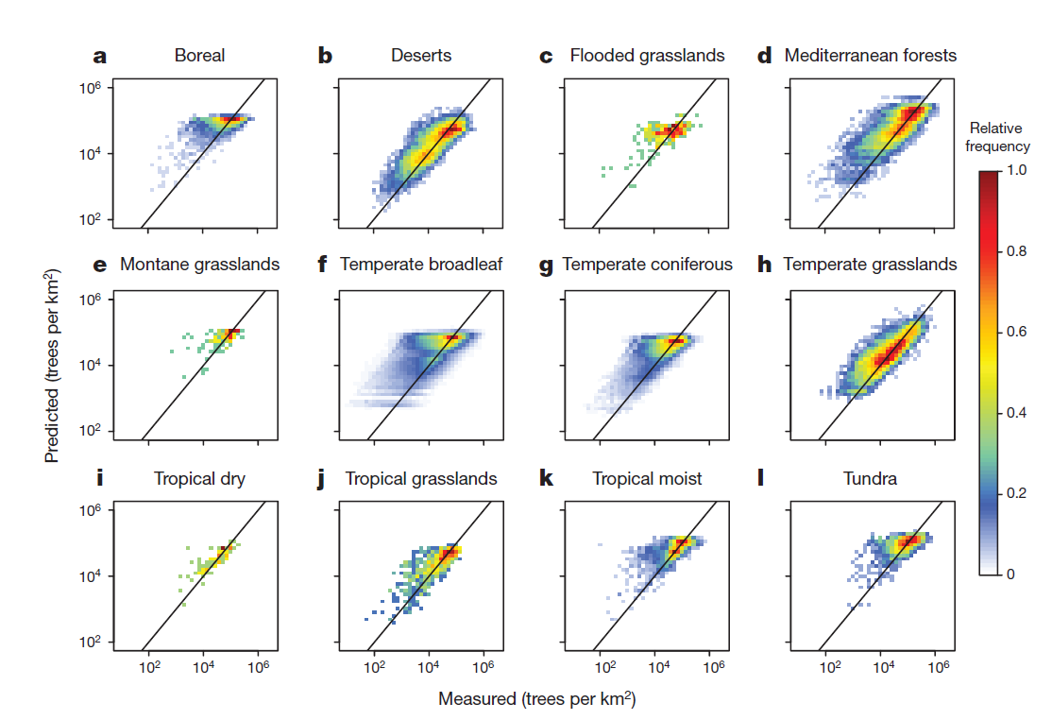
By plotting the actual tree count of forest plots (x axis), with what was predicted by their estimate (y axis), the scientists get an idea of sampling error, i.e. how well sample plots were representative of the conditions in which trees occur over the globe,
Notes:
Diagonal lines perfect correspondence between predicted and observed points

Slide 29
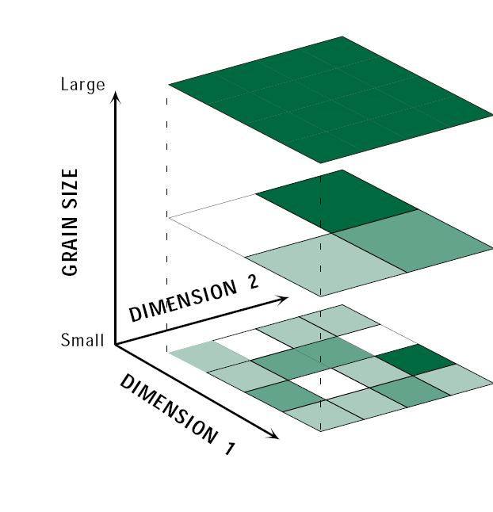
Fallacies of spatial and temporal inference
Ecological fallacy: making local-scale characterizations based on observations at broad extents.
Individualistic or atomistic fallacy: extrapolating to the broad extents based on observations conducted at small, local extents

Slide 30
Notes:
Here is another example of how scale shapes our interpretation of the world and knowledge claims we make about it

Slide 31
Wet
Drought index
Dry
Wet
Drought index
Dry
Notes:
How does scale apply to the interpretation of these graphs? The western US was settled during the last 200 years. What can you tell me about the climate over that period? Was it wetter or drier than what the record shows over the last 400 years?
Drought index – more negative values indicate drier conditions. Drought conditions were interpolated from tree rings

Slide 32
Notes:
To an extent, humans are going to have to commit these fallacies in order to understand the world, but they can also be intentionally misused

Slide 33
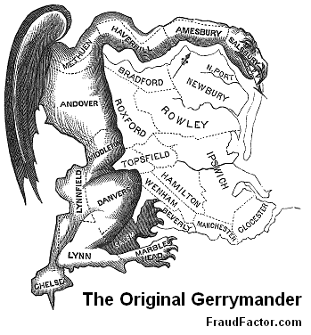
The modifiable areal unit problem (MAUP)

Slide 34
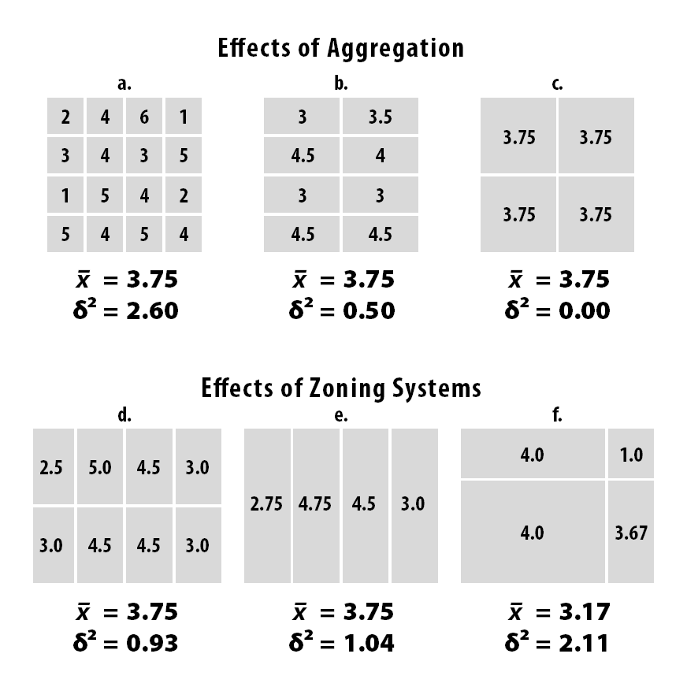
MAUP: how we designate the shape of units determines the properties of the entities within them.
It is difficult to completely avoid the modifiable area unit problem, but better to worse choices can be made about how to aggregate data and how to draw zones.
Notes:
Mean and variance are shown, standard deviation squared gives you the variance

Slide 35
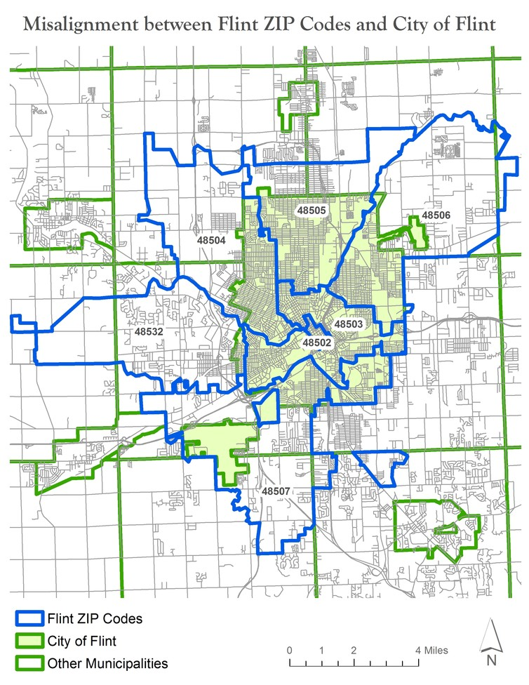
MAUP and lead exposures in drinking water in Flint, Michigan
Prior to 2013, the city piped treated water for its residents from Detroit
In 2014, the financially struggling city of Flint decided to temporarily pump water from the Flint River to save money
Flint city officials failed to treat it fully, and lead leached out from aging pipes into thousands of homes and into the bloodstream of children
Water quality measurements were being aggregated to the level of zip codes. This meant that the high lead values in the water in Flint were being masked by water testing in outlying county areas using other water systems
Notes:
http://theconversation.com/how-zip-codes-nearly-masked-the-lead-problem-in-flint-65626 One-third of all homes with a Flint ZIP code lie outside the city. Thus, the state’s numbers for Flint were watered down by an additional 50 percent of addresses that weren’t in the city and weren’t using Flint water.

Slide 36

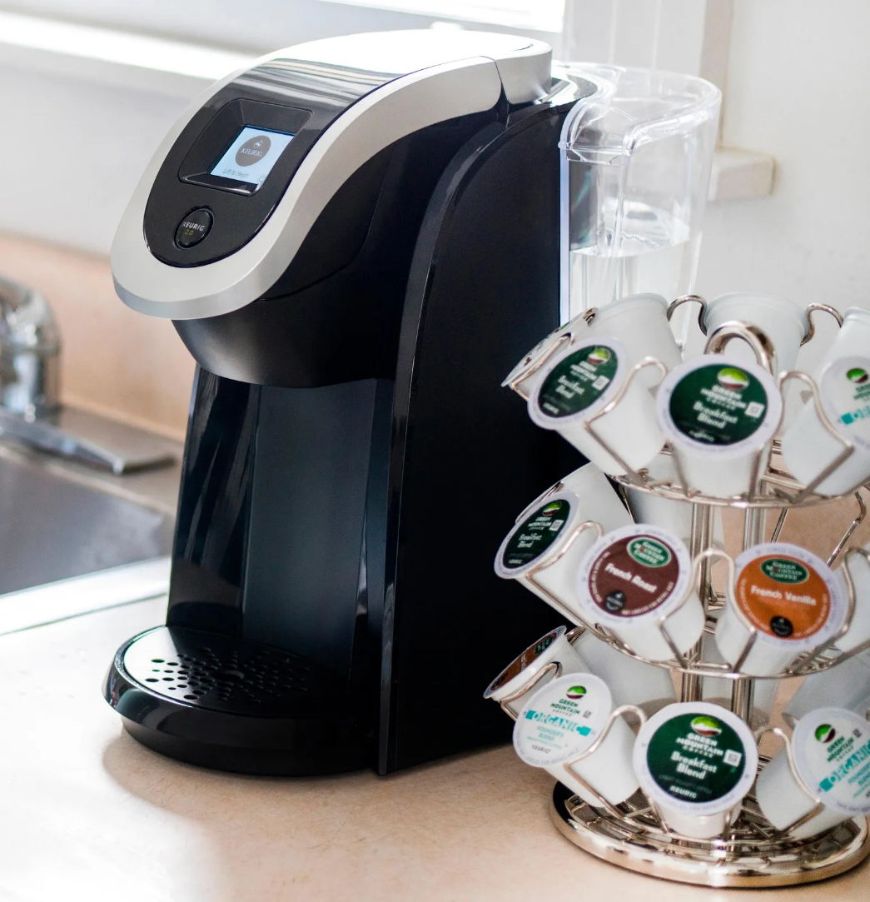
Which is better for the environment: filtered coffee or single-use coffee pods?
Notes:
https://onlinelibrary.wiley.com/doi/epdf/10.1111/jiec.12487 https://www.washingtonpost.com/climate-solutions/2023/01/18/coffee-pods-sustainability-environmental-impact/
https://www.cnet.com/home/kitchen-and-household/keurigs-new-coffee-pods-are-100-plant-based-and-compostable/ https://www.oregon.gov/deq/filterdocs/pef-coffee-fullreport.pdf

