Slide 1
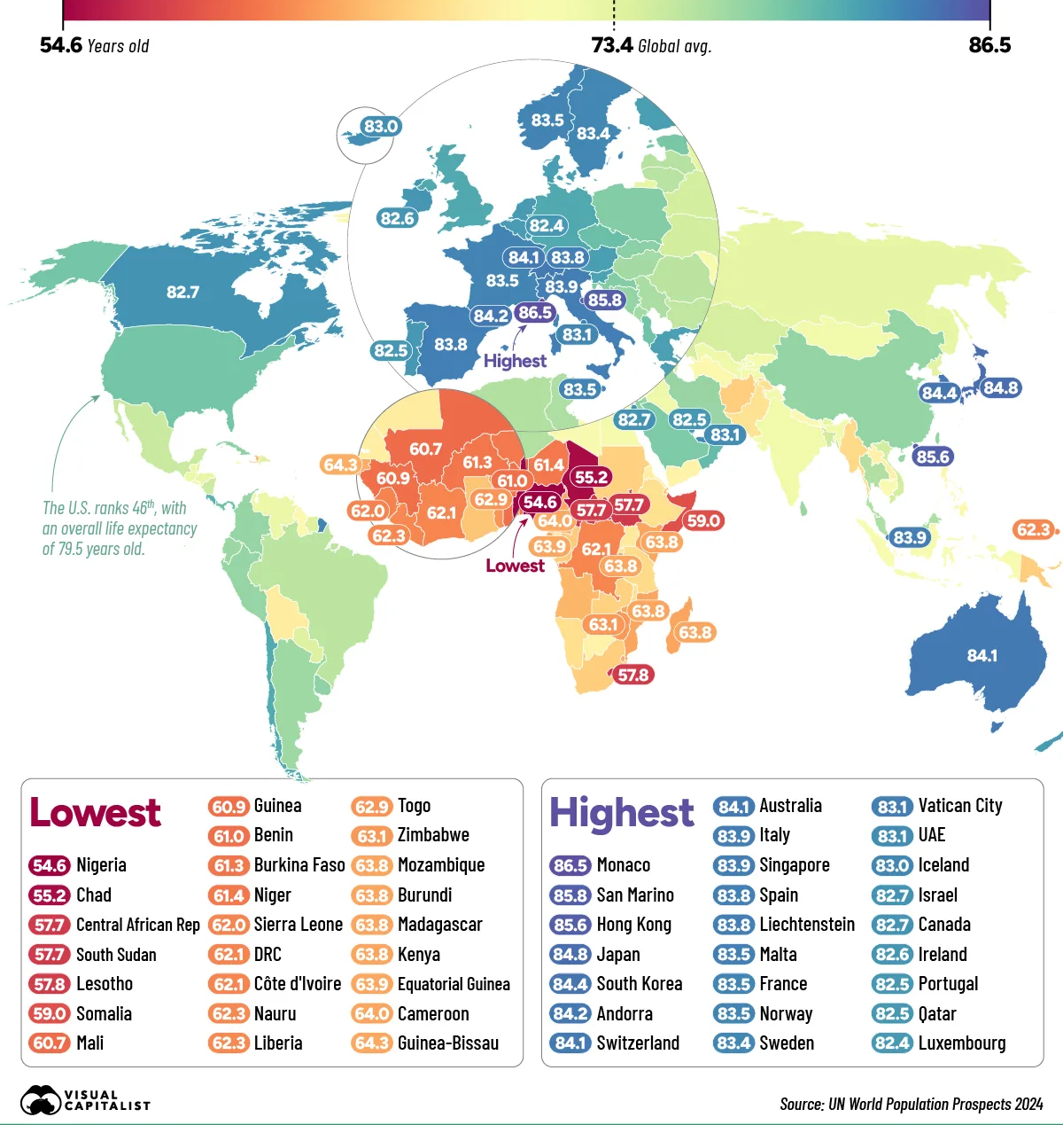

Slide 2
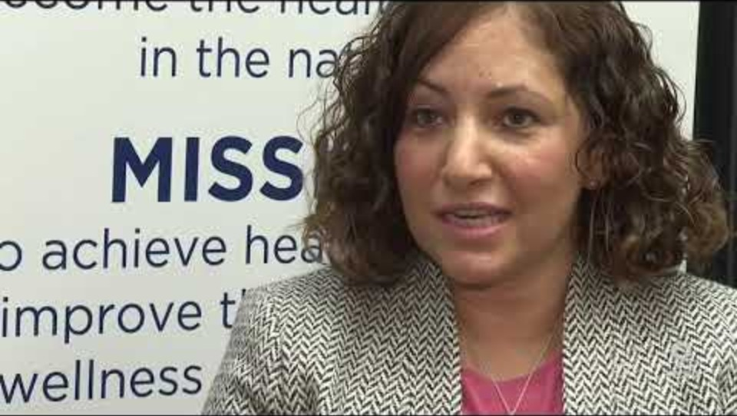
Notes:
But these contrasts can vary over small distances – to use a word from earlier lectures, economic disparity can be hyperlocal
https://www.nytimes.com/interactive/2020/09/05/opinion/inequality-life-expectancy.html

Slide 3
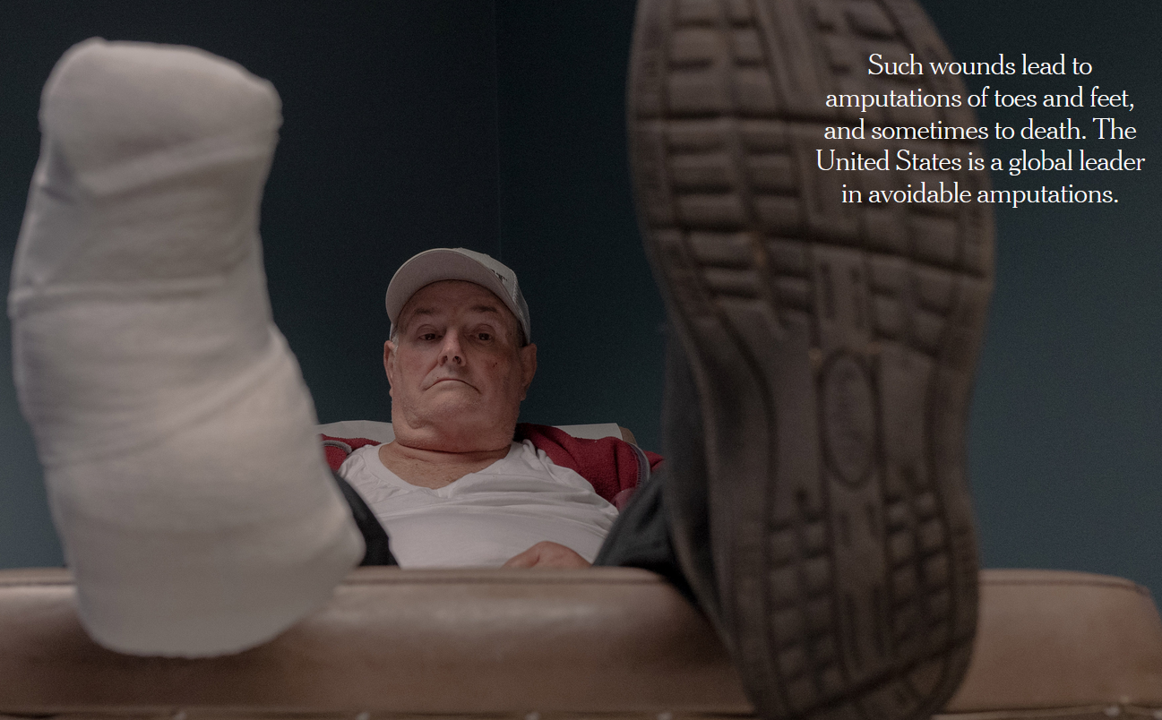
Factors that shape how economic disparities shape health
The capacity of governments to fund and provide health care
Historical legacies of racism, classism, and colonialism
The challenges posed by distances and accessibility
Profit incentives that motivate problem solving versus those that only seek a revenue stream
The types of medical skills and services available
Relative risk of exposures to health-threatening conditions.

Slide 4
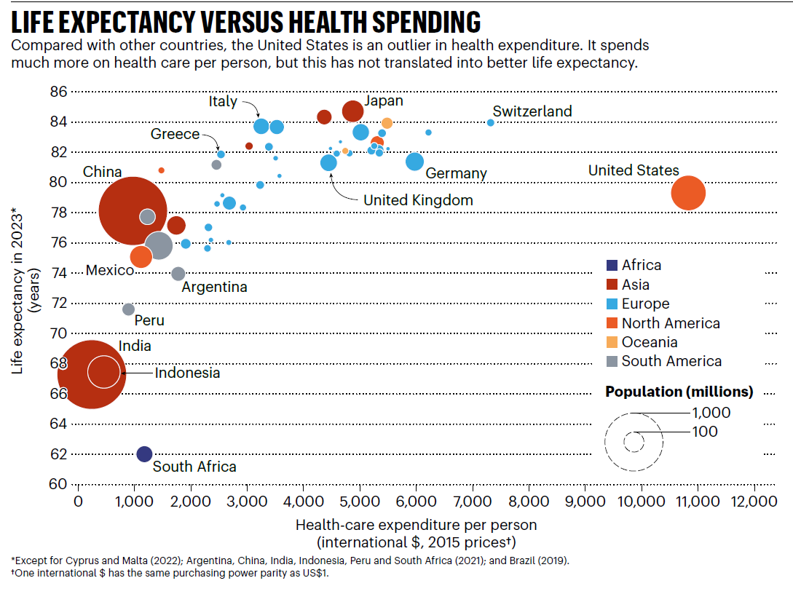
Notes:
https://www.nature.com/articles/d41586-025-01969-1

Slide 5
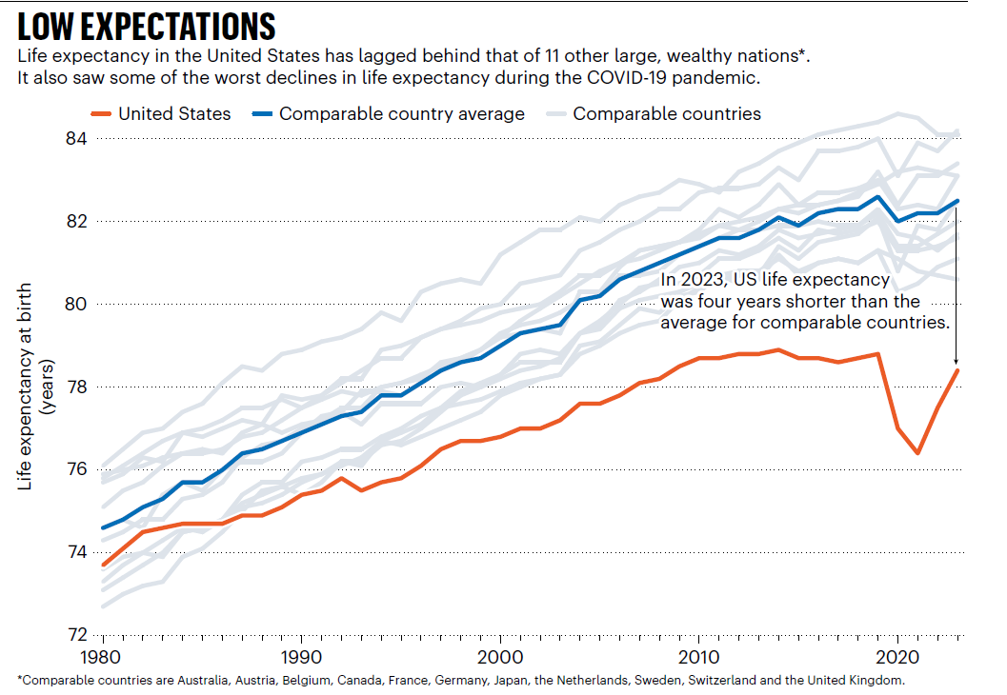
Notes:
https://www.nature.com/articles/d41586-025-01969-1

Slide 6
U.S. Life Expectancies by Percentile in Comparison to
Mean Life Expectancies Across Countries
United States - P100
San Marino
United States - P50
Canada
United Kingdom
United States - P25
China
Libya
Pakistan
United States - P1
Sudan
Iraq
India
Zambia
Lesotho
60
65
70
75
80
85
90
Expected Age at Death for 40 Year Old Men
Notes:
The US is an outlier in its stark economic disparities and one can learn from studying outliers as much as the average.
Differences in the US in life expectancy are nearly as large as those that span the globe.
P indicates percentile, so P1 indicates the lowest one percentile in terms of income in the United States. P25 means 25th percentile, or quartile.
The US in this sense, is many different countries in terms of life expectancy

Slide 7
Social determinants of health and the geographies of disadvantage
Our immediate physical surroundings, social relationships and cultural milieus within which we and other people function and interact
Inequality is produced and reproduced over time through your social determinants of health
We often inherit the social determinants of health of our parents as well as from where we live

Slide 8

Rural and urban location is often used to stand in for one’s social determinants of health
But rural and urban are designations we often use but can actually obscure a lot of difference within categories
Rural areas are not all the same and urban areas are not all the same
And often we default to the idea that economic disadvantage is worse in cities? Is it

Slide 9
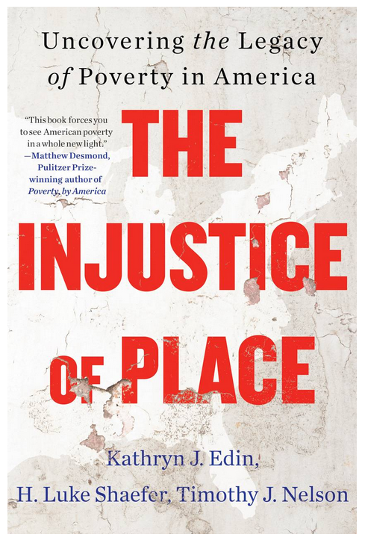
The index of deep disadvantage
Combines income, life expectancy, birth weights and intergenerational mobility.
Most disadvantaged places in US: mostly rural, sharp class divides, and exploitation by a single industry historically.
Most advantaged places in US pockets of the Midwest with a strong middle class and diverse small industry.
Although cities may have numerically more poor, they are not as disadvantages as rural locations
Notes:
https://www.princeton.edu/news/2023/11/15/kathryn-edins-new-book-offers-groundbreaking-insights-american-poverty-and-where
Poverty has traditionally been measured by income and not well-being. This index combines income and health-based indicators like life expectancy; intergenerational mobility; and low birth weight.
The most disadvantaged places are mostly rural — not big cities. These places have a very small number of “haves” and a huge class of “have-nots.” One of their hallmark characteristics is exploitation by a single industry.
The most advantaged places are in pockets of the Midwest with a strong middle class and diverse small industry — no sharp class divides.

Slide 10
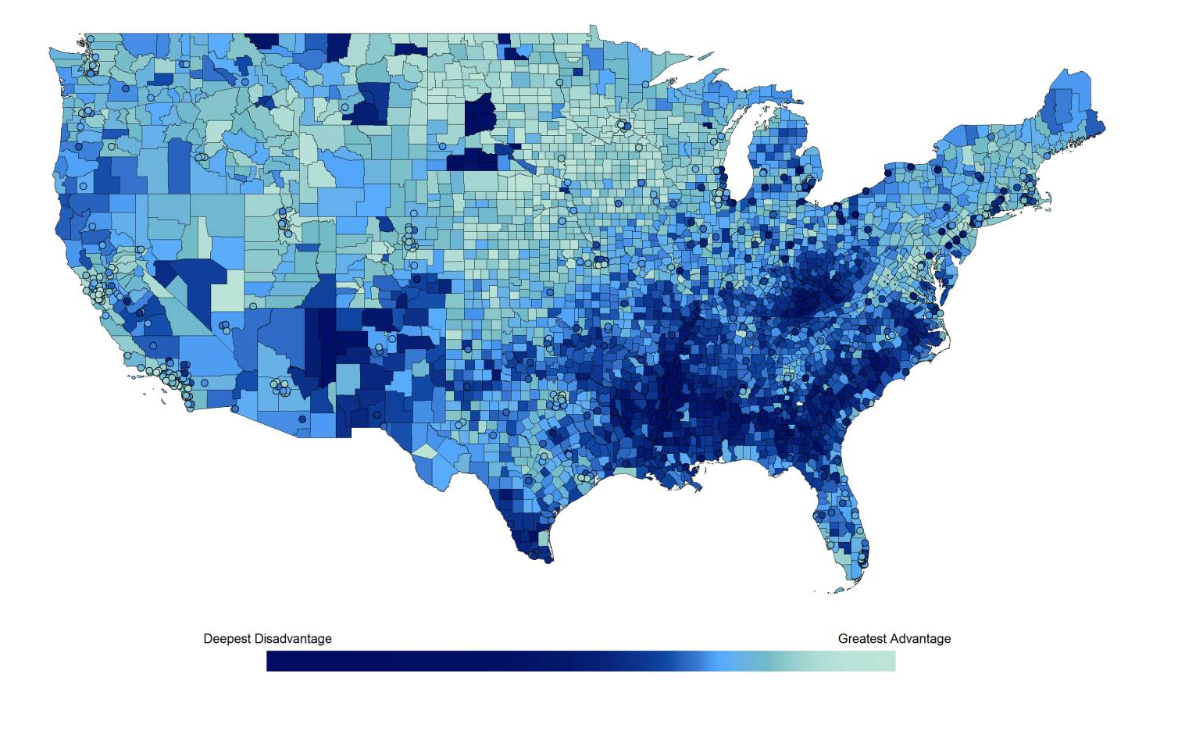
Notes:
https://www.princeton.edu/news/2023/11/15/kathryn-edins-new-book-offers-groundbreaking-insights-american-poverty-and-where

Slide 11
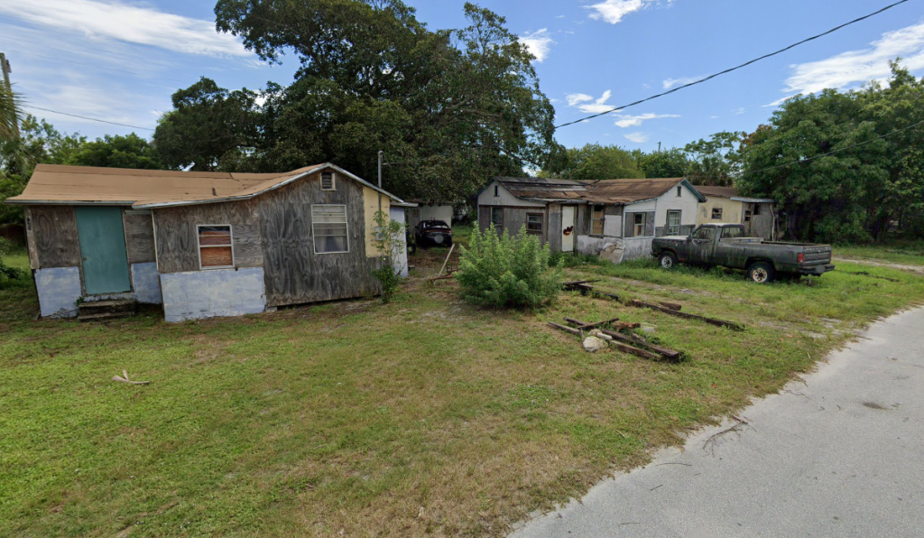
The nonmetro mortality penalty
Applies outside of large metropolitan areas, where there is
  Limited access to healthcare
  Higher prevalence of chronic diseases
  Lack of economic opportunities
  Workplace risks
Notes:
https://www.ineteconomics.org/perspectives/blog/mortality-crisis-redux-the-economics-of-despair
https://www.nytimes.com/2022/10/05/opinion/mortality-penalty-inequality-education.html
Monnat, S. M. (2020). Trends in US Working-age non-Hispanic White mortality: rural–urban and within-rural differences. Population research and policy review, 39(5), 805-834.

Slide 12
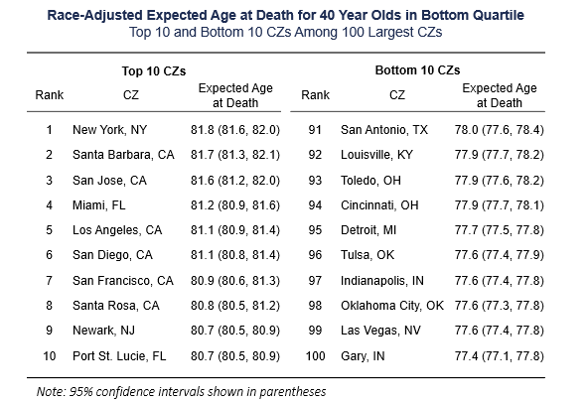
Where and under what conditions do the poor live longer US cities?
The next slides convey how the wealthy live longer everywhere
For the poor lifespan is more sensitive to what city you live in.
Like rural areas, cities are not the same in how in terms of economic disparity and impacts of health and well being
Notes:
Chetty, R., Stepper, M., Abraham, S., Lin, S., Scuderi, B., Turner, N., ... & Cutler, D. (2016). The association between income and life expectancy in the United States, 2001-2014. JAMA 315(16), 1750-1766.

Slide 13
Race-Adjusted Expected Age at Death vs. Household Income
for Men in Selected Major Cities
90
85
Expected Age at Death for 40 Year Olds in Years
80
New York City
San Francisco
Dallas
75
Detroit
70
0
5
10
15
20
$30k
$60k
$101k
$683k
Household Income Ventile
Notes:
Chetty, R., Stepper, M., Abraham, S., Lin, S., Scuderi, B., Turner, N., ... & Cutler, D. (2016). The association between income and life expectancy in the United States, 2001-2014. JAMA 315(16), 1750-1766.

Slide 14
Race-Adjusted Expected Age at Death vs. Household Income
for Women in Selected Major Cities
90
85
New York City
San Francisco
Expected Age at Death for 40 Year Olds in Years
80
Dallas
Detroit
75
70
0
5
10
15
20
$27k
$54k
$95k
$653k
Household Income Ventile
Notes:
Chetty, R., Stepper, M., Abraham, S., Lin, S., Scuderi, B., Turner, N., ... & Cutler, D. (2016). The association between income and life expectancy in the United States, 2001-2014. JAMA 315(16), 1750-1766.

Slide 15
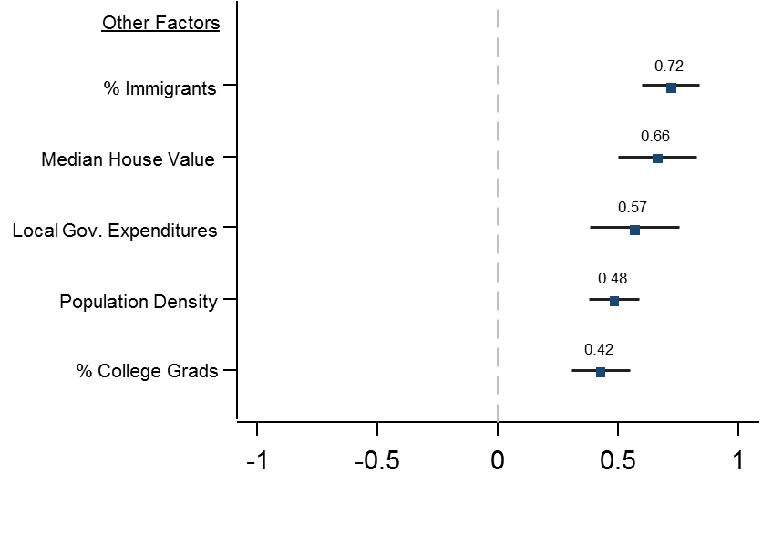
Correlations of Expected Age at Death with Other Factors
For Individuals in Bottom Quartile of Income Distribution
Notes:
Obesity and smoking were the greatest risk factors
But these in the chart are the geographic risk factors, those that relate to where you live and the kind of social environments that exist there
Importantly, these findings do not necessarily imply that income has a causal effect on life expectancy: that is, giving someone or an area more money will increase their lifespan – there is something related to the environments of cities that have high percentages of immigrants, high median house values, and higher local government expenditures that increase lifespan for the poorest.
Data was from 1.4 billion anonymous earnings and mortality records

Slide 16
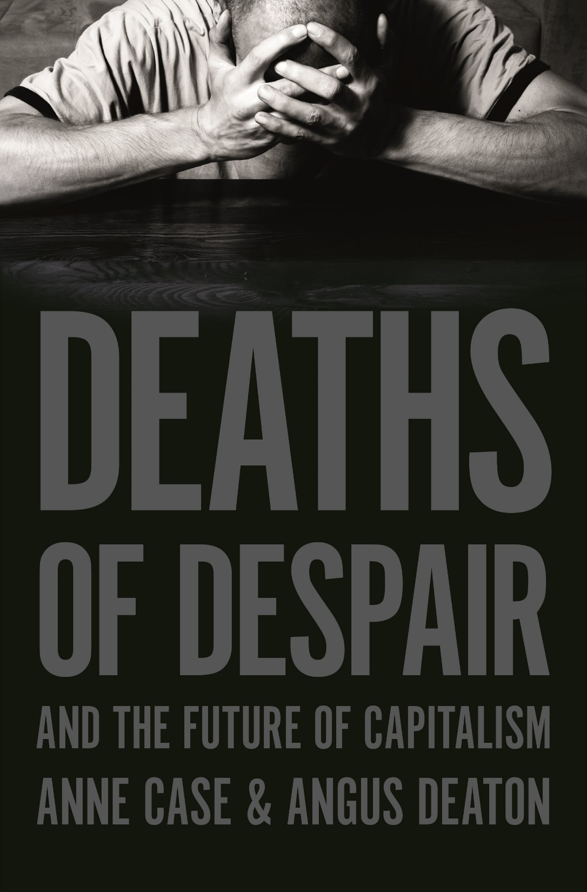
Midlife deaths of despair
Refers to deaths caused by suicide, drug overdose, and alcohol-related diseases primarily among working class middle-aged adults
Term coined in 2015 study highlighting rise in these types of deaths especially among whites 45-54 since 1980s
Associated with job loss, wage stagnation and reduced economic opportunities especially in areas affected by deindustrialization and outsourcing of jobs

Slide 17
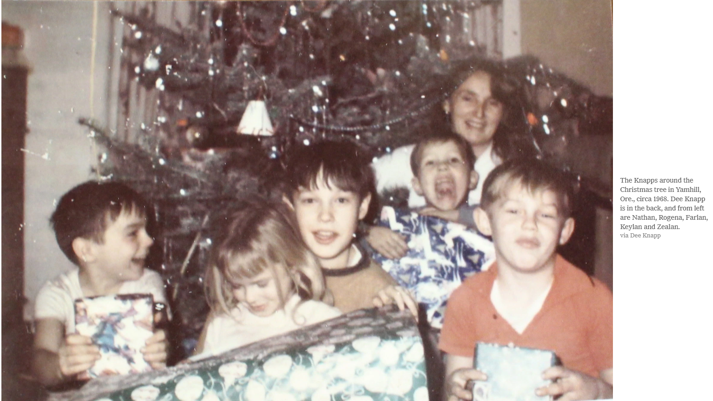
Notes:
https://www.nytimes.com/2020/03/28/opinion/sunday/deaths-despair-keylan-knapp.html

Slide 18
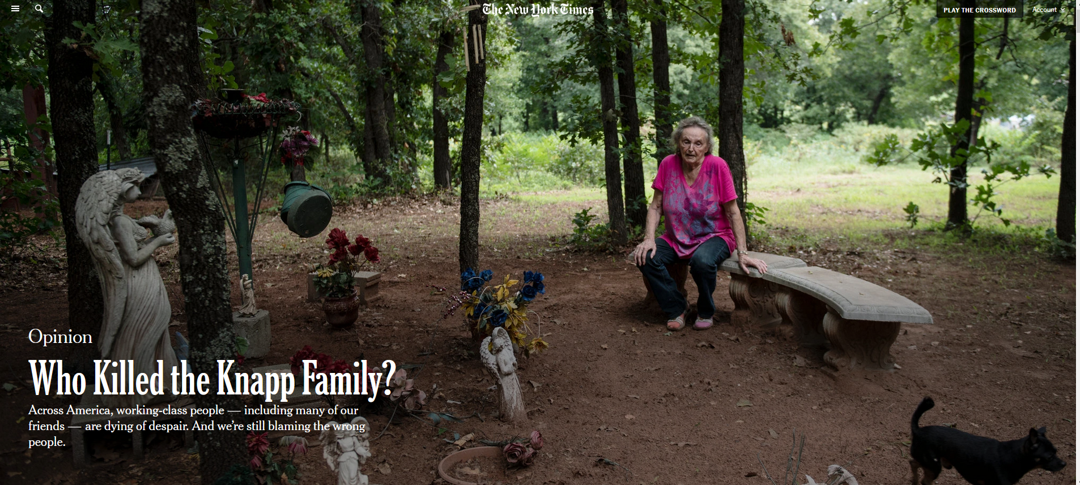
Notes:
https://www.nytimes.com/2020/01/09/opinion/sunday/deaths-despair-poverty.html

Slide 19
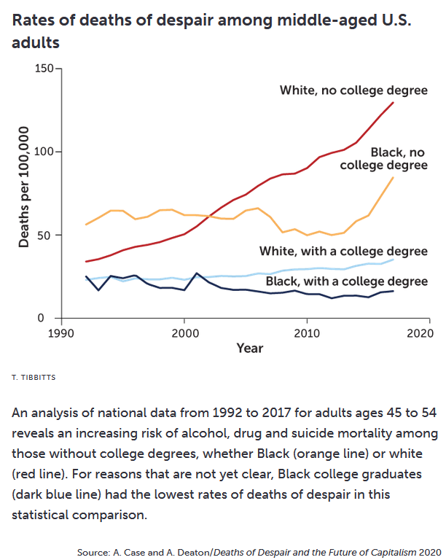
Mortality rates increased among middle-aged adults without college degrees, irrespective of race
While disparities existed between Black and White, prior to 1980s, working class mortality in both races began to rise
Mortality has also increased among a younger cohort (next slide)
Notes:
An analysis of national data from 1992 to 2017 for adults ages 45 to 54 reveals an increasing risk of alcohol, drug and suicide mortality among those without college degrees, whether Black (orange line) or white (red line). For reasons that are not yet clear, Black college graduates (dark blue line) had the lowest rates of deaths of despair in this statistical comparison.
A. Case and A. Deaton/Deaths of Despair and the Future of Capitalism 2020
https://www.uclahealth.org/news/publication/column-what-does-deaths-despair-narrative-leave-out

Slide 20
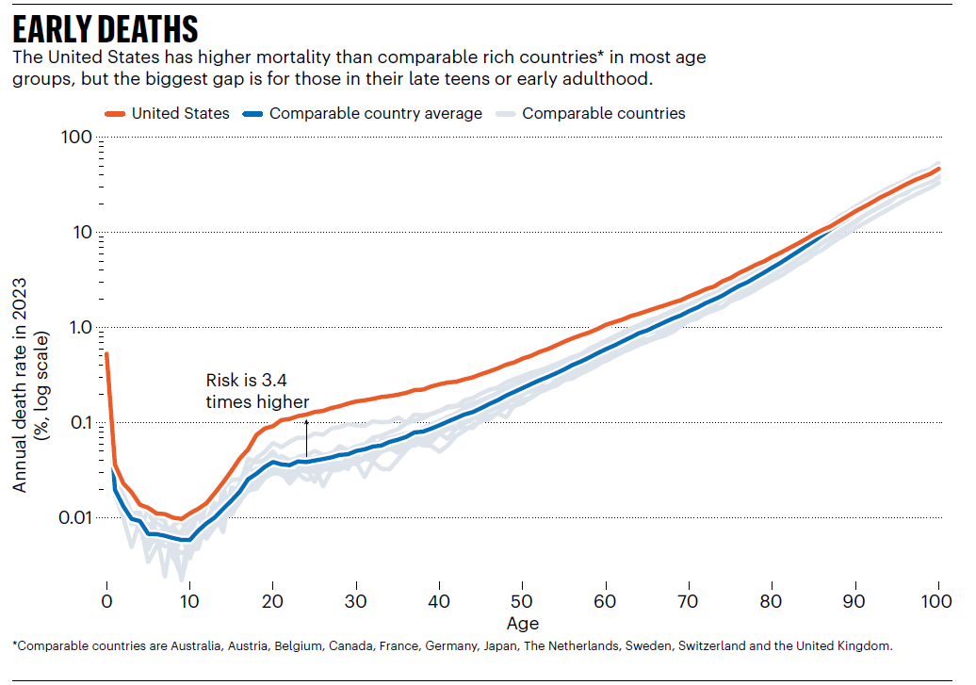
Notes:
https://www.nature.com/articles/d41586-025-01969-1

Slide 21
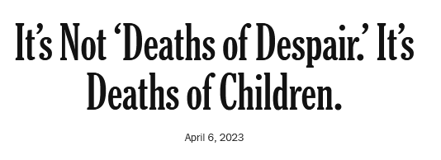
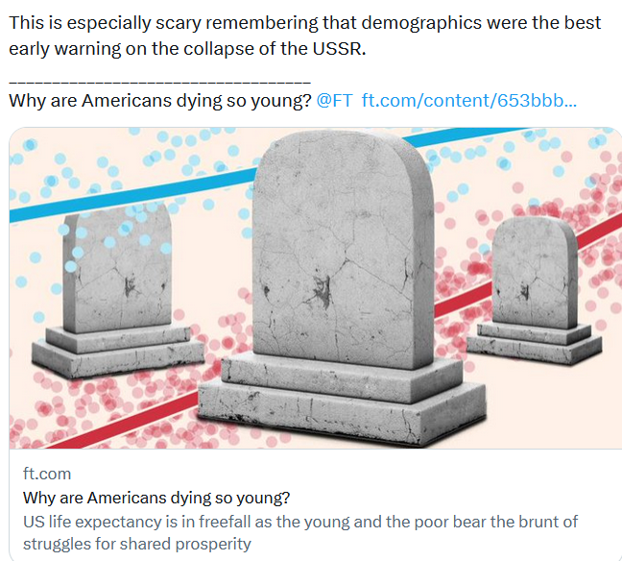
No longer just a middle age phenomena
20% rise in mortality 2019-2021
COVID explains only a small share of the rise.
Firearms, overdoses, homicide, suicide, and traffic deaths increased sharply.
Rates have dropped but remain above pre-pandemic levels.

Slide 22
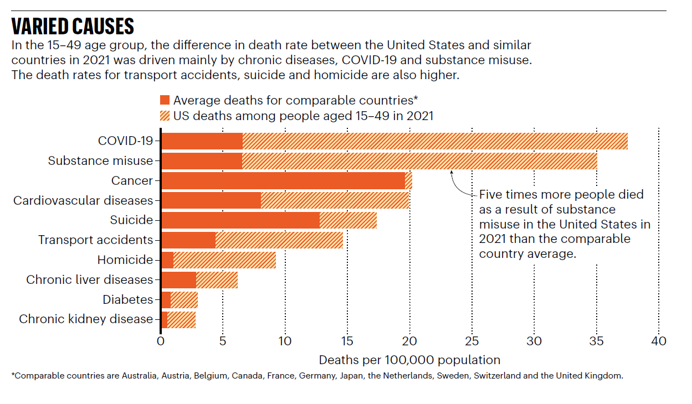
Notes:
https://www.nature.com/articles/d41586-025-01969-1

Slide 23
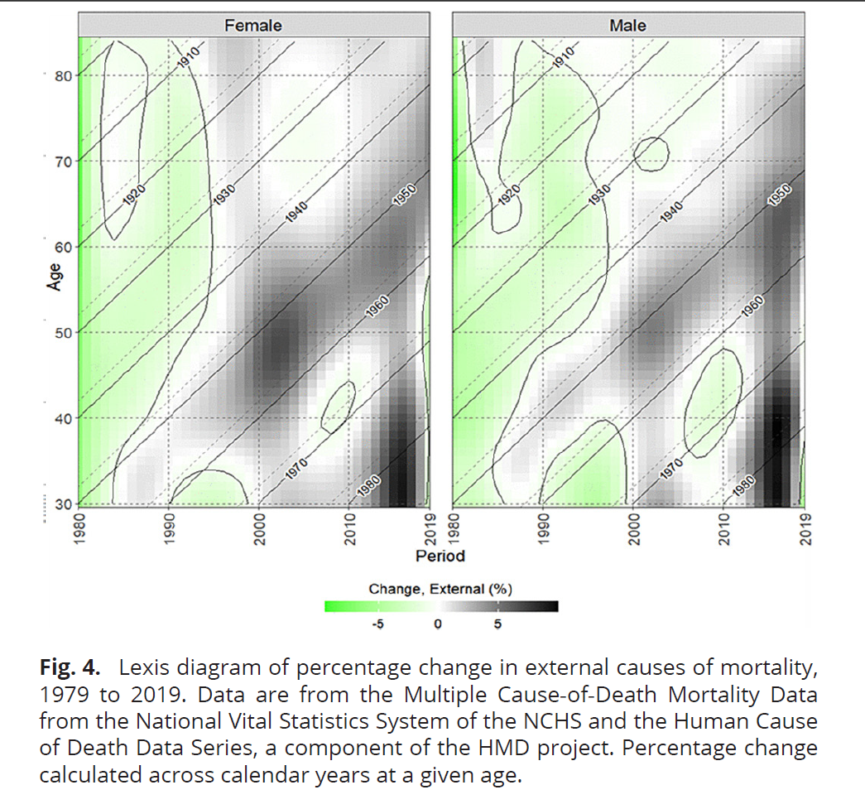
Increasing mortality due to external factors (suicide, overdose, traffic accidents, violence) are part of the deaths of despair phenomena
Older people who grew up had decreasing rates of mortality due to external causes until they reached middle age
Cohorts born more recently in the 1970s and 1980s experience these increases in external mortality at a younger age

Slide 24
How to read the Lexis graph
X axis is calendar year, Y axis is age
Green indicated declining external-cause mortality; darker gray/black is increasing mortality.
Diagonal lines follow birth cohorts. Moving up and right along a line follows people born in the same year as they age.
If born around 1950; follow the 1950 diagonal from about age 30 in 1980 to age 69 in 2019. In later midlife, this cohort increasingly encountered rising external-cause mortality.
If born around 1980; visible from about age 30 in 2010 onward. During their 30s they experienced some of the sharpest increases in external-cause mortality, especially among men.

Slide 25
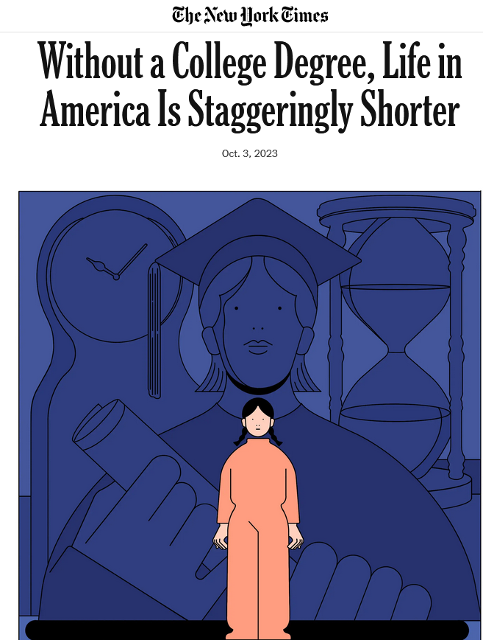
Notes:
https://www.nytimes.com/2023/10/03/opinion/life-expectancy-college-degree.html

Slide 26
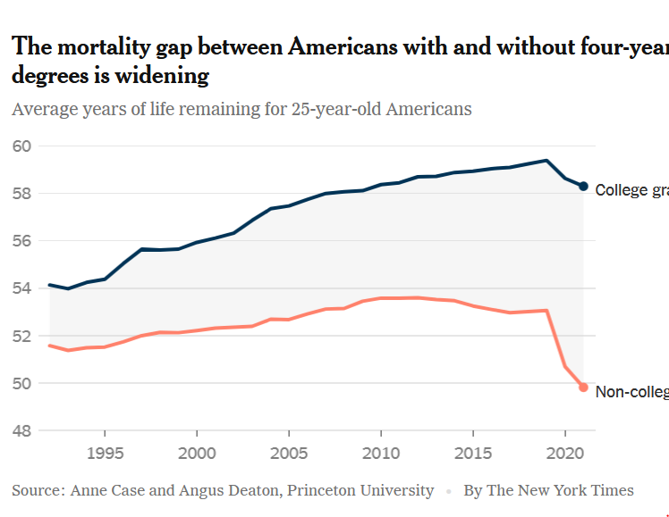
College attendance reflects advantages already in place thru social determinants of health and their impacts after college
Without a degree: disadvantages in jobs, health care and political influence.
Notes:
https://www.nytimes.com/2023/10/03/opinion/life-expectancy-college-degree.html
https://www.nytimes.com/2022/10/05/opinion/mortality-penalty-inequality-education.html
Credentialism is the issue: college degrees have come to be more of a signifier, often of prior advantage
This has in turn led to the pressure to go to college
Without a degree there is a disadvantage in access to jobs, health care, and weakened political representation and influence
However, there are also also advantages in place that allow the children of some to go to college – it’s not what you learn and do in college but what advantages you already have
This creates a second class citizen effect that also contributes to political instability

Slide 27
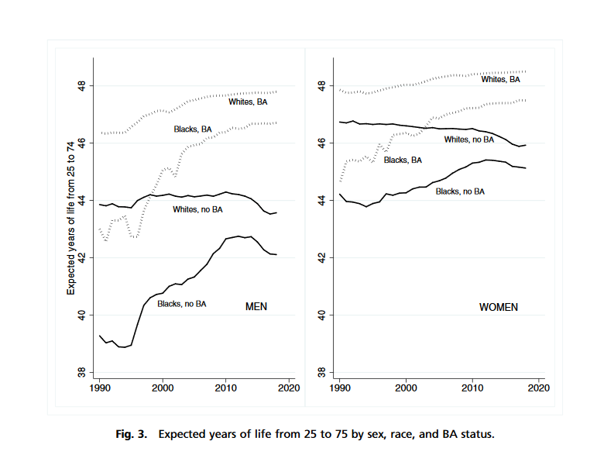
This class gap creates a second class citizen effect that also contributes to political instability
Notes:
Y axis is the expected years of life of someone between 25 and 74.
Note that the BAs still have longer lives, whether white or black
Note that the greatest differences are not between race, they are between education level

Slide 28

You should not have to go to college to have a better chance of a longer, healthier life
Universities and colleges also have the inadvertent impact of reinforcing existing economic disparities
Expensive private or elite public universities are competitive because getting in becomes a class identity, a social determinant of health that confers health advantages too
Notes:
It is important to remember that most Americans — nearly two-thirds — do not have a 4-year college degree.
Meritocracy's winners think their success is all due to their brains and effort.
The knowledge imparted by college may be less important than the potential change in one’s social, economic, and cultural environment
https://www.nytimes.com/2020/09/02/opinion/education-prejudice.html
https://www.newyorker.com/magazine/2019/09/30/is-meritocracy-making-everyone-miserable

Slide 29
Reframing the deaths of despair model
Countries in Europe experienced similar shifts in manufacturing, job outsourcing, and rural economic stagnation
However, their life expectancies continued to climb during the same periods.
No sharp increase in mortality in those without college degrees.
Despair as epidemic psychological state is less a cause than distinct American structural failures
Thes include a profit-driven healthcare system, a lack of robust social safety nets, and a failure to regulate opioids

Slide 30
Deaths of despair marked the collapse of the Soviet Union
In the early 1990s, in the aftermath of the collapse of the Soviet Union, life expectancy in former Soviet Union and Eastern Europe fell dramatically.
In Russia, between 1989 and 1995 there were 1.3 to 1.7 million premature deaths as life expectancy fell from 70 in 1989 to 64 in 1995.
Significant increase in suicides and drug and alcohol abuse, leading to an increase in cardiovascular and liver diseases in middle aged men and women.
Notes:
https://www.ineteconomics.org/perspectives/blog/mortality-crisis-redux-the-economics-of-despair

Slide 31
But deaths of despair did not happen in much of western Europe
European countries have not experienced deaths of despair even though the impact of globalization has also been an outsourcing of jobs and manufacturing
Most European countries have experienced an improvement in the health of less educated in recent years
Attributed to better social safety net when economic opportunities disappear
More varied post-high school educational opportunities – trade schools are much better developed in Europe
Pharmaceutical laws regulate opioids much more stringently
Notes:
Mackenbach, J. P., Valverde, J. R., Artnik, B., Bopp, M., Brønnum-Hansen, H., Deboosere, P., ... & Nusselder, W. J. (2018). Trends in health inequalities in 27 European countries. Proceedings of the National Academy of Sciences, 115(25), 6440-6445.

Slide 32
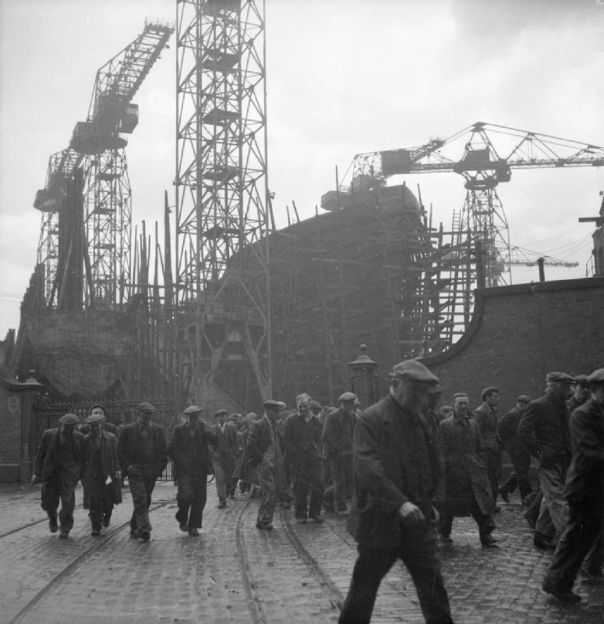
Scotland is an exception
Harder hit by deindustrialization and outsourcing of mining, manufacturing, and shipbuilding
Historically high rates of alcoholism
High rates of opioid-related deaths following deindustrialization
Scotland’s government has limited control of economic policies that originate from the British government
Notes:
DRAFT NAVIGATION
Original slide 36 → draft slide 36.

Slide 33
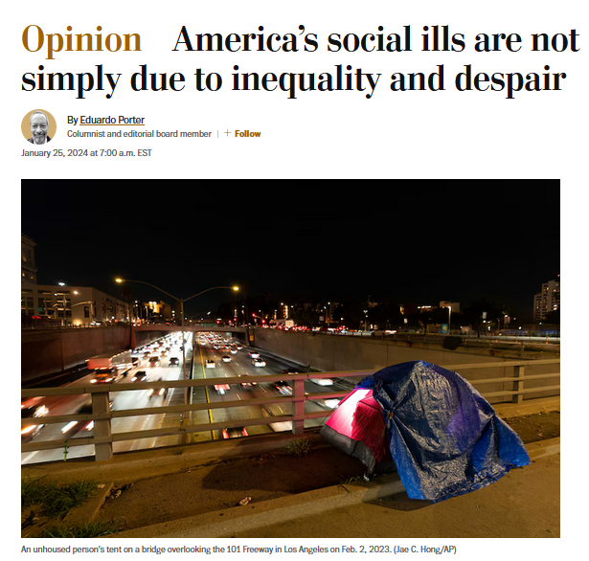
Inequality emerges in economic systems: what matters is the response to it.
Deaths of despair in US are not just due to despair and inequality, but also how government responded to it
European countries more aggressive about reshaping prosperity
Consumption taxes used to pay for universal health care and housing, child care and early child education.
Unions are more powerful and labor laws are more protective of workers.
Job protections prevented the spread of precarious, low-pay work widely prevalent across the U.S. service sector.
Notes:
https://www.washingtonpost.com/opinions/2024/01/25/economic-inequality-despair-redistribution/

Slide 34
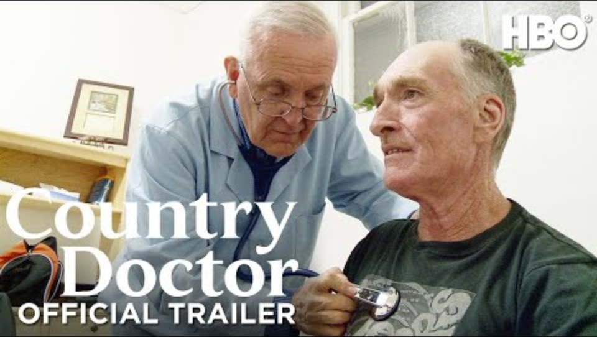
Notes:
https://youtu.be/0X6BeV6NsIc?si=_3Pmd9IwlZ5moOSF

Slide 35
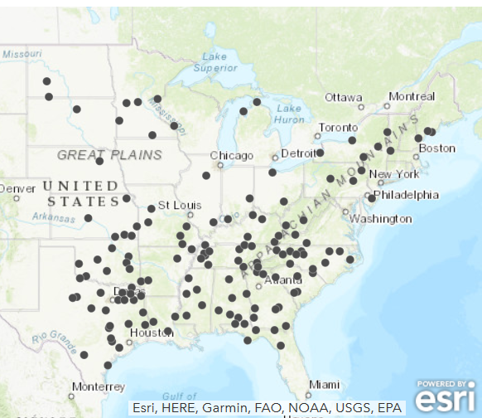

Rural health care decline: hospital closures

Slide 36

Why are US rural hospitals closing?
Shrinking rural populations
Rural residents are older, sicker, and poorer
Aging hospital facilities
Large number of uninsured
The Medicaid coverage gap
Notes:
https://www.kff.org/medicaid/issue-brief/how-many-uninsured-are-in-the-coverage-gap-and-how-many-could-be-eligible-if-all-states-adopted-the-medicaid-expansion/
While millions of people have gained coverage through the expansion of Medicaid under the Affordable Care Act (ACA), state decisions not to implement the expansion leave many without an affordable coverage option. Under the ACA, Medicaid eligibility was to be extended to nearly all low-income individuals with incomes at or below 138 percent of poverty ($17,236 for an individual in 2019). This expansion fills in historical gaps in Medicaid eligibility for adults and was envisioned as the vehicle for extending insurance coverage to low-income individuals, with premium tax credits for marketplace coverage serving as the vehicle for covering people with moderate incomes. While the Medicaid expansion was intended to be national, the June 2012 Supreme Court ruling essentially made it optional for states.
In states that do not expand Medicaid, many adults, including all childless adults, fall into a “coverage gap” of having incomes above Medicaid eligibility limits but below the lower limit for Marketplace premium tax.

Slide 37
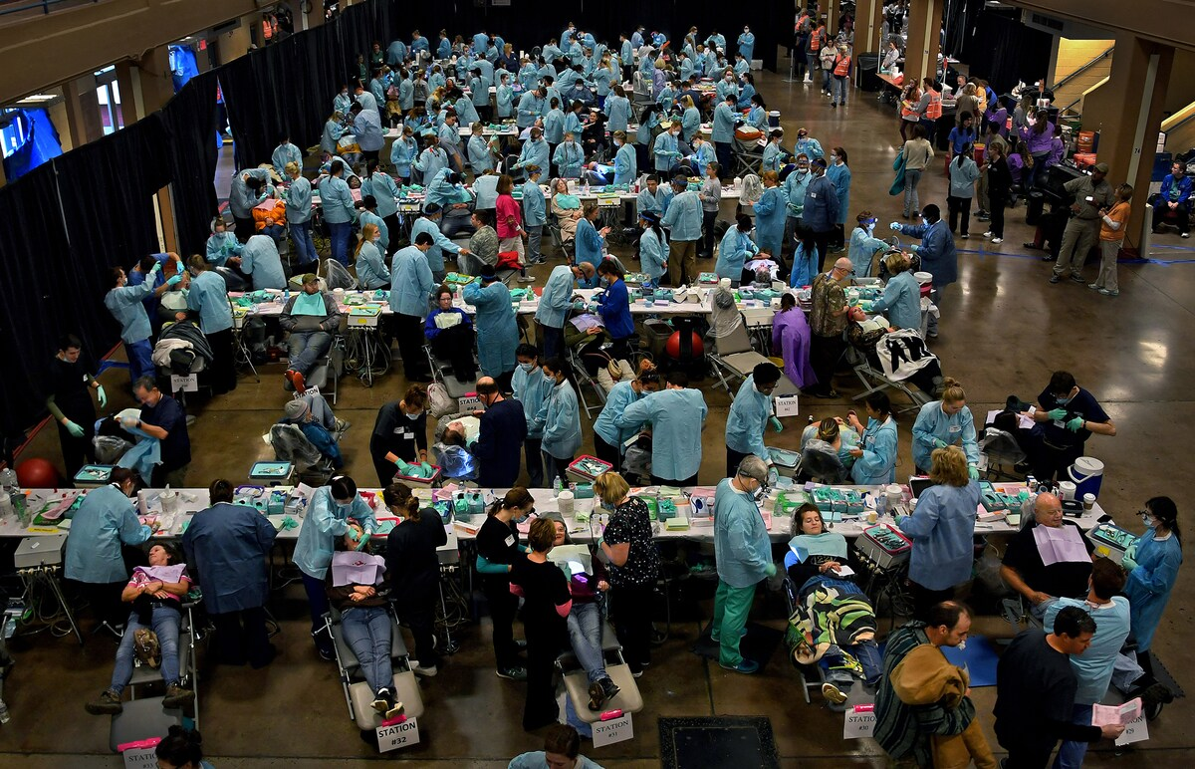
Health care shortage areas
Tennessee has recently lost 14% of its rural physicians and 18% of its rural hospitals, leaving 2.5 million residents with insufficient access to medical care.
A record 50 million rural Americans live in "health care shortage areas," where the number of hospitals, family doctors, surgeons and paramedics has declined to 20-year lows.
Notes:
Because of hospital closures in TN, many counties can be several hundred miles away from the nearest hospital. Even dentists are hard to get to. A free dental and health clinic drew crowds in Knoxville, TN. Many had drove hours to get there.
https://www.washingtonpost.com/national/the-clinic-of-last-resort/2019/06/22/2833c8a0-92cc-11e9-aadb-74e6b2b46f6a_story.html
https://www.nytimes.com/2018/07/17/us/hospital-closing-missouri-pregnant.html

Slide 38
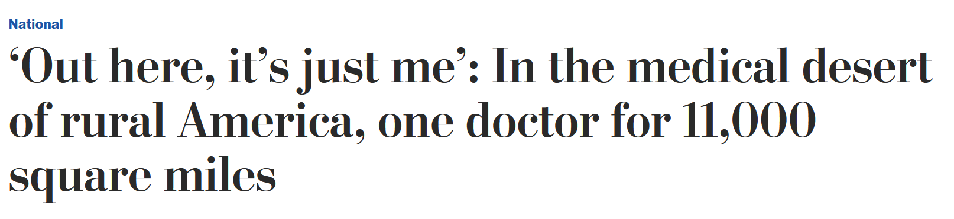
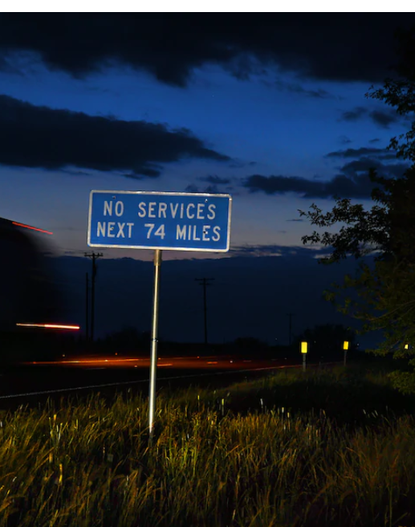
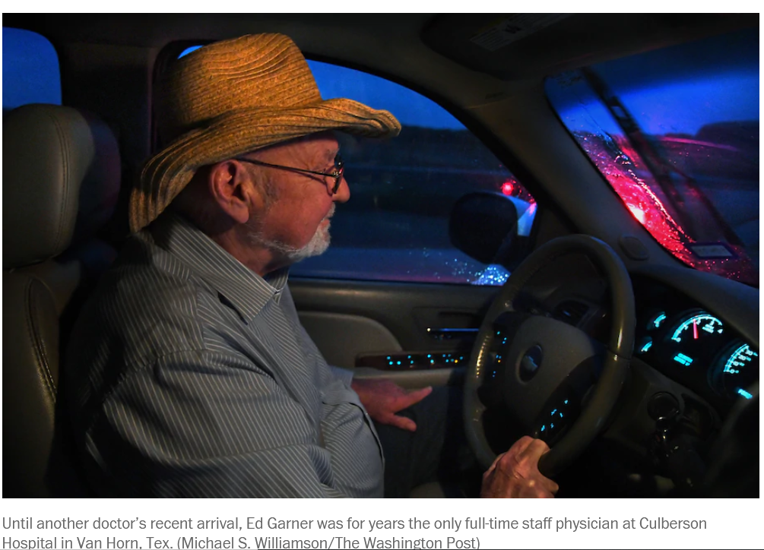
Notes:
More babies are born premature when obstetric services leave rural towns because pre-natal care is no longer available

Slide 39
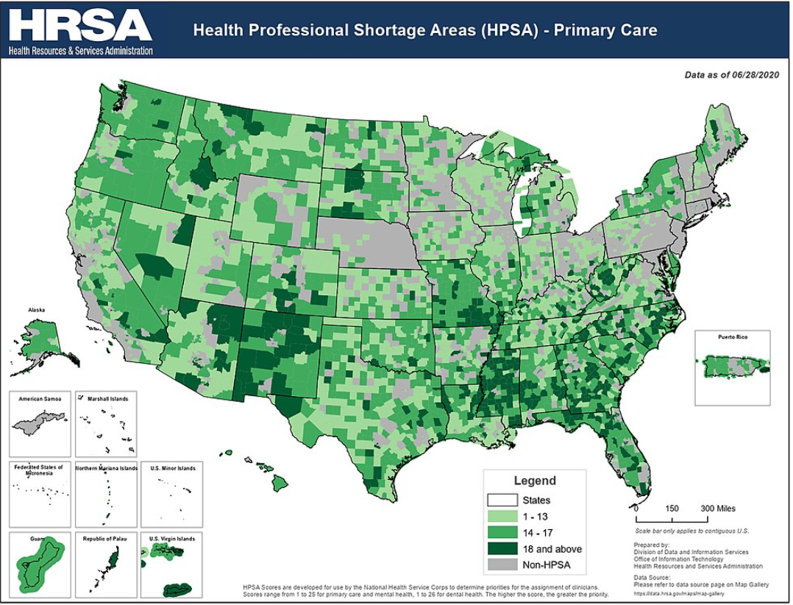
Definitions of distance in health care access
Defined in terms of physical distance as in medical ‘deserts’
Defined as a relative distance - a treatment may be close by unavailable due to monetary cost
Distance can also be economic: access to medicines or treatments may not exist because the profit incentives to develop or provide them are low

Slide 40
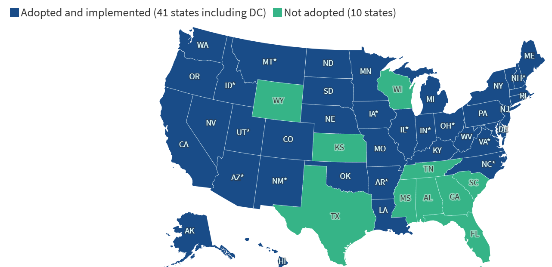
The Medicaid coverage gap
If a state did not approve and adopt Medicaid expansion, only the very poor qualify for Medicaid
Many poor make too much for Medicaid but can’t afford health insurance if not provided by their employer
Financially unrealistic for hospitals that operate on a for profit model when many patients can’t pay
Notes:
https://www.kff.org/medicaid/status-of-state-medicaid-expansion-decisions
While millions of people have gained coverage through the expansion of Medicaid under the Affordable Care Act (ACA), decisions by some states not to implement the expansion continue to leave many low-income adults without an affordable coverage option. Under the ACA, Medicaid eligibility was extended to most adults ages 19–64 with incomes at or below 138 percent of the federal poverty level—about $22,025 for an individual in 2026. The expansion was designed to fill longstanding gaps in Medicaid eligibility for low-income adults, while premium tax credits for Marketplace coverage were intended primarily for people with incomes above the Medicaid eligibility threshold. Although Medicaid expansion was originally intended to apply nationwide, the Supreme Court's June 2012 decision made state participation effectively optional. As of October 2026, 41 states including the District of Columbia have adopted the expansion, while 10 states have not.
In states that do not expand Medicaid, many adults, including all childless adults, fall into a “coverage gap” of having incomes above Medicaid eligibility limits but below the lower limit for other private or employer-sponsored insurance policies .

Slide 41

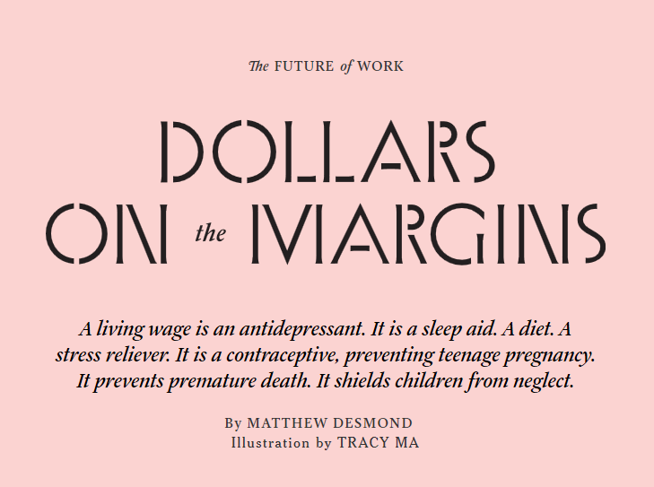
How poverty affects health
.
Notes:
A living wage is effective medicine. The best medicine to address the health needs of the working poor is an increase in the minimum wage.
Julio Payes was working 80 hours a week at two full-time jobs. A permanent resident from Guatemala who came to the United States on a work visa, Payes labored in Emeryville, Calif., a city of roughly 12,000 residents and almost 22,000 jobs, sandwiched between Oakland and Berkeley. He began his day with the graveyard shift at a 24-hour McDonald’s, where he served burgers and fries from 10 p.m. to 6 a.m. Afterward he had two hours to rest and shower. Then he’d clock in at Aerotek, going anywhere the temp service sent him between 8 a.m. and 4 p.m. To stay awake, he loaded up on coffee and soda. Each job paid minimum wage.
“I felt like a zombie,” Payes told me. “No energy. Always sad.” Yet just to afford basic necessities, he had to work up to 16 hours a day, seven days a week. Back then, he and his mother and two siblings all shared a single, unfurnished room. Once, his younger brother, Alexander, who was 8 at the time, told him he was saving money. “I want to buy one hour of your time,” Payes remembers his brother telling him. “How much for one hour to play with me?” Payes looked at his brother and wept. Not long after that, Payes fainted from exhaustion in the aisle of a grocery store. He was 24.

Slide 42
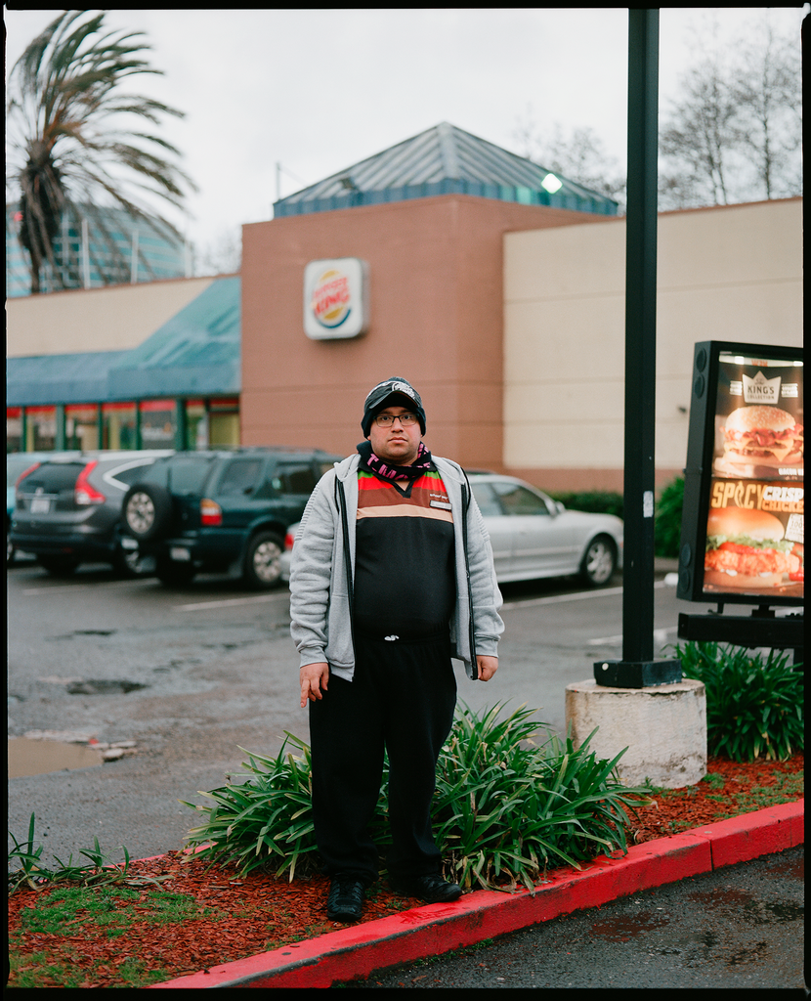
Julio Payes was working 80 hours a week at two full-time jobs.
He began his day with the graveyard shift at a 24-hour McDonald’s, where he served burgers and fries from 10 p.m. to 6 a.m.
Afterward he had two hours to rest and shower. Then he’d clock in at Aerotek, going anywhere the temp service sent him between 8 a.m. and 4 p.m.
Each job paid minimum wage.
He had to work up to 16 hours a day, seven days a week.
Notes:
A living wage is effective medicine. The best medicine to address the health needs of the working poor is an increase in the minimum wage.
Julio Payes was working 80 hours a week at two full-time jobs. A permanent resident from Guatemala who came to the United States on a work visa, Payes labored in Emeryville, Calif., a city of roughly 12,000 residents and almost 22,000 jobs, sandwiched between Oakland and Berkeley. He began his day with the graveyard shift at a 24-hour McDonald’s, where he served burgers and fries from 10 p.m. to 6 a.m. Afterward he had two hours to rest and shower. Then he’d clock in at Aerotek, going anywhere the temp service sent him between 8 a.m. and 4 p.m. To stay awake, he loaded up on coffee and soda. Each job paid minimum wage.
“I felt like a zombie,” Payes told me. “No energy. Always sad.” Yet just to afford basic necessities, he had to work up to 16 hours a day, seven days a week. Back then, he and his mother and two siblings all shared a single, unfurnished room. Once, his younger brother, Alexander, who was 8 at the time, told him he was saving money. “I want to buy one hour of your time,” Payes remembers his brother telling him. “How much for one hour to play with me?” Payes looked at his brother and wept. Not long after that, Payes fainted from exhaustion in the aisle of a grocery store. He was 24.

Slide 43

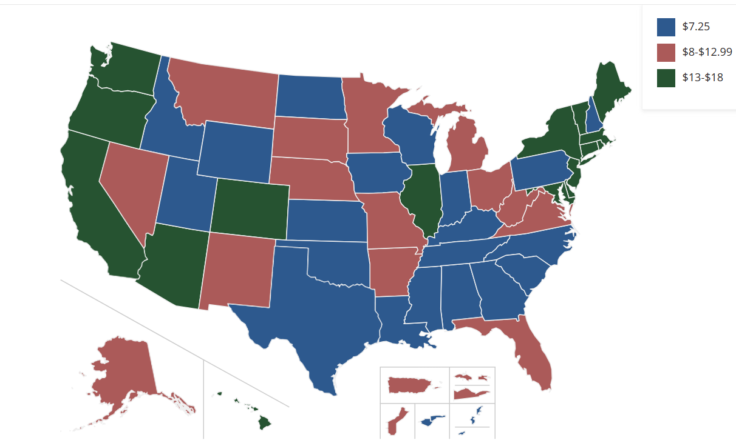
What it is like to be among the working sick
Low-skilled workers reported fewer unmet medical needs in states with higher minimum-wage rates.
In low-wage states, workers went to work sick and skipped medical appts
Increases to minimum wage associated with decreased rates of smoking
Higher wages allow parents working in the low-wage labor market to keep more food at home
Notes:
https://www.nytimes.com/interactive/2019/02/21/magazine/minimum-wage-saving-lives.html
https://www.ncsl.org/resources/map-monday-minimum-wage-laws-where-does-your-state-stand

Slide 44
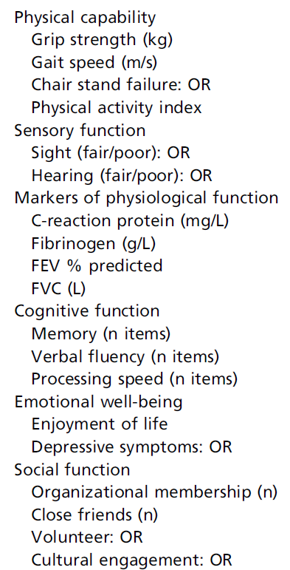
The rich and the poor also age differently
Less affluent sectors of society age more rapidly than more privileged groups.
Lower socioeconomic status (SES), as defined by wealth, has been associated with faster decline in age-related functions (right)
Notes:
Steptoe, A., & Zaninotto, P. (2020). Lower socioeconomic status and the acceleration of aging: An outcome-wide analysis. Proceedings of the National Academy of Sciences, 117(26), 14911-14917.
This was an 8-year study involving 5000 people.

Slide 45
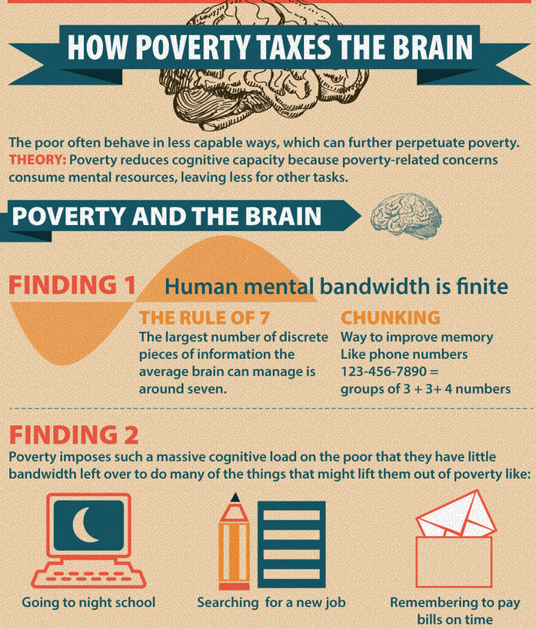
The bandwidth tax of poverty
Experience of poverty has health consequences beyond the physical
Being poor reduces a person’s cognitive capacity
When preoccupied by poverty, we have less mind to give to the rest of life
Cannot end poverty by assuming we should focus on the characteristics of poor people
Notes:
Experience of poverty has health consequences beyond the physical
https://www.csmonitor.com/USA/2015/0515/In-global-fight-against-extreme-poverty-a-potential-game-changer
Cannot neutralize poverty 'by keeping the focus on the characteristics of poor people

