Slide 1
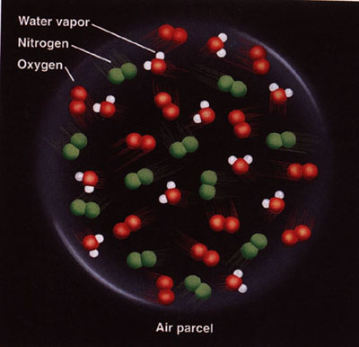

Slide 2
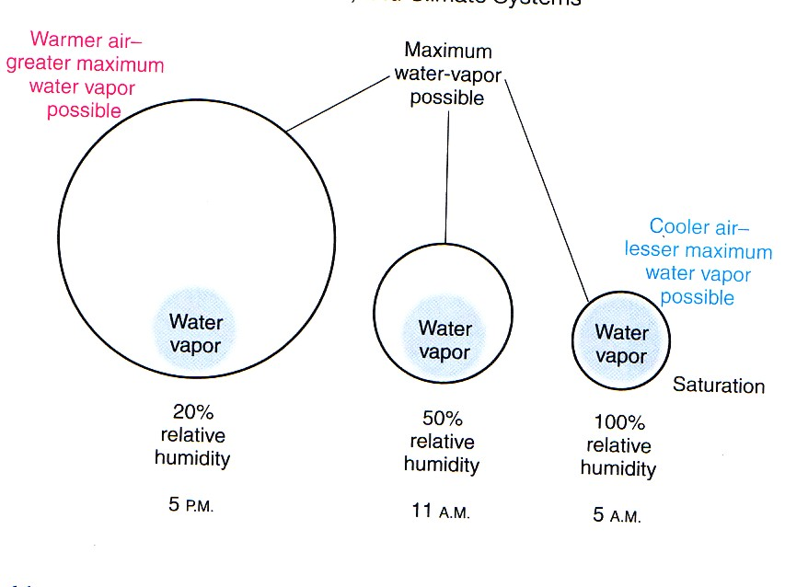

Slide 3
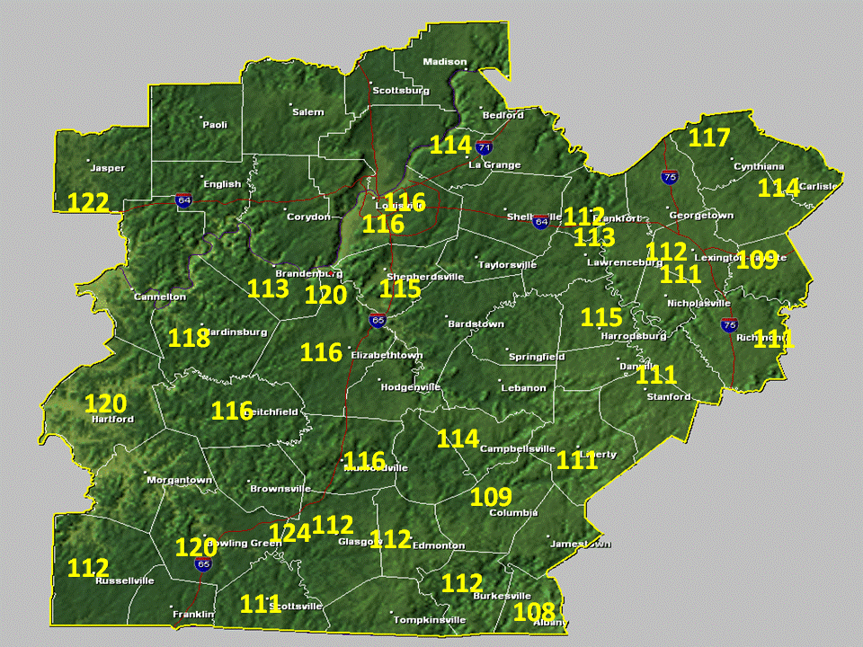
Notes:
Risk of heat exhaustion or heat stroke

Slide 4


Slide 5
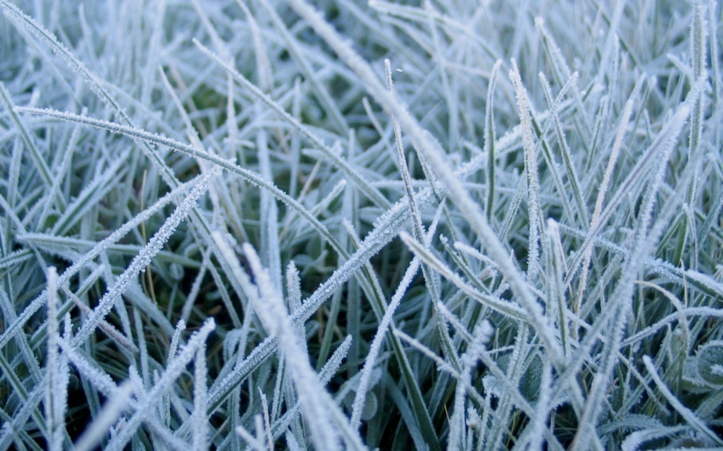
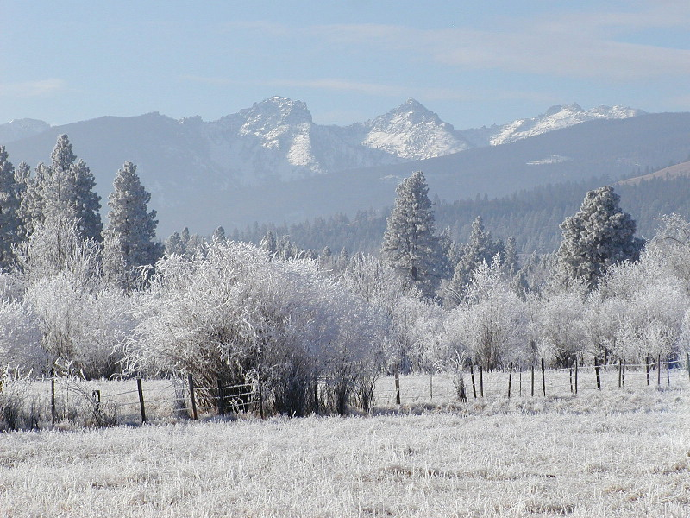

Slide 6
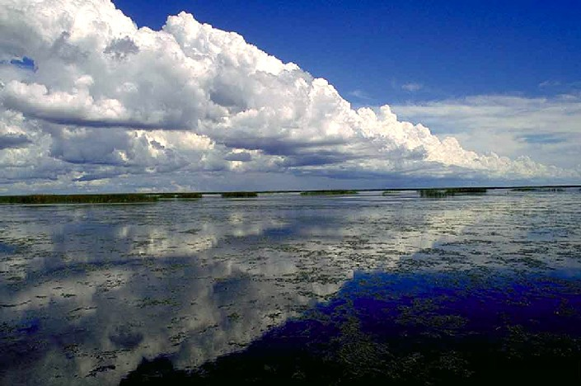
Notes:
High clouds can be comprised of ice particles

Slide 7
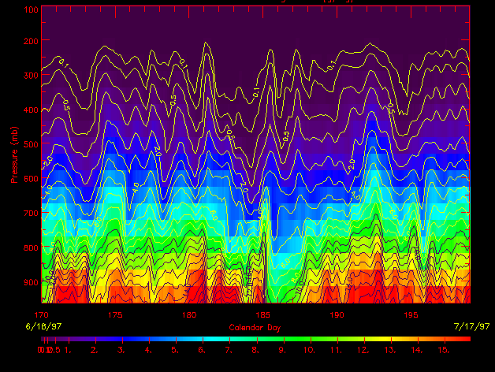

Slide 8
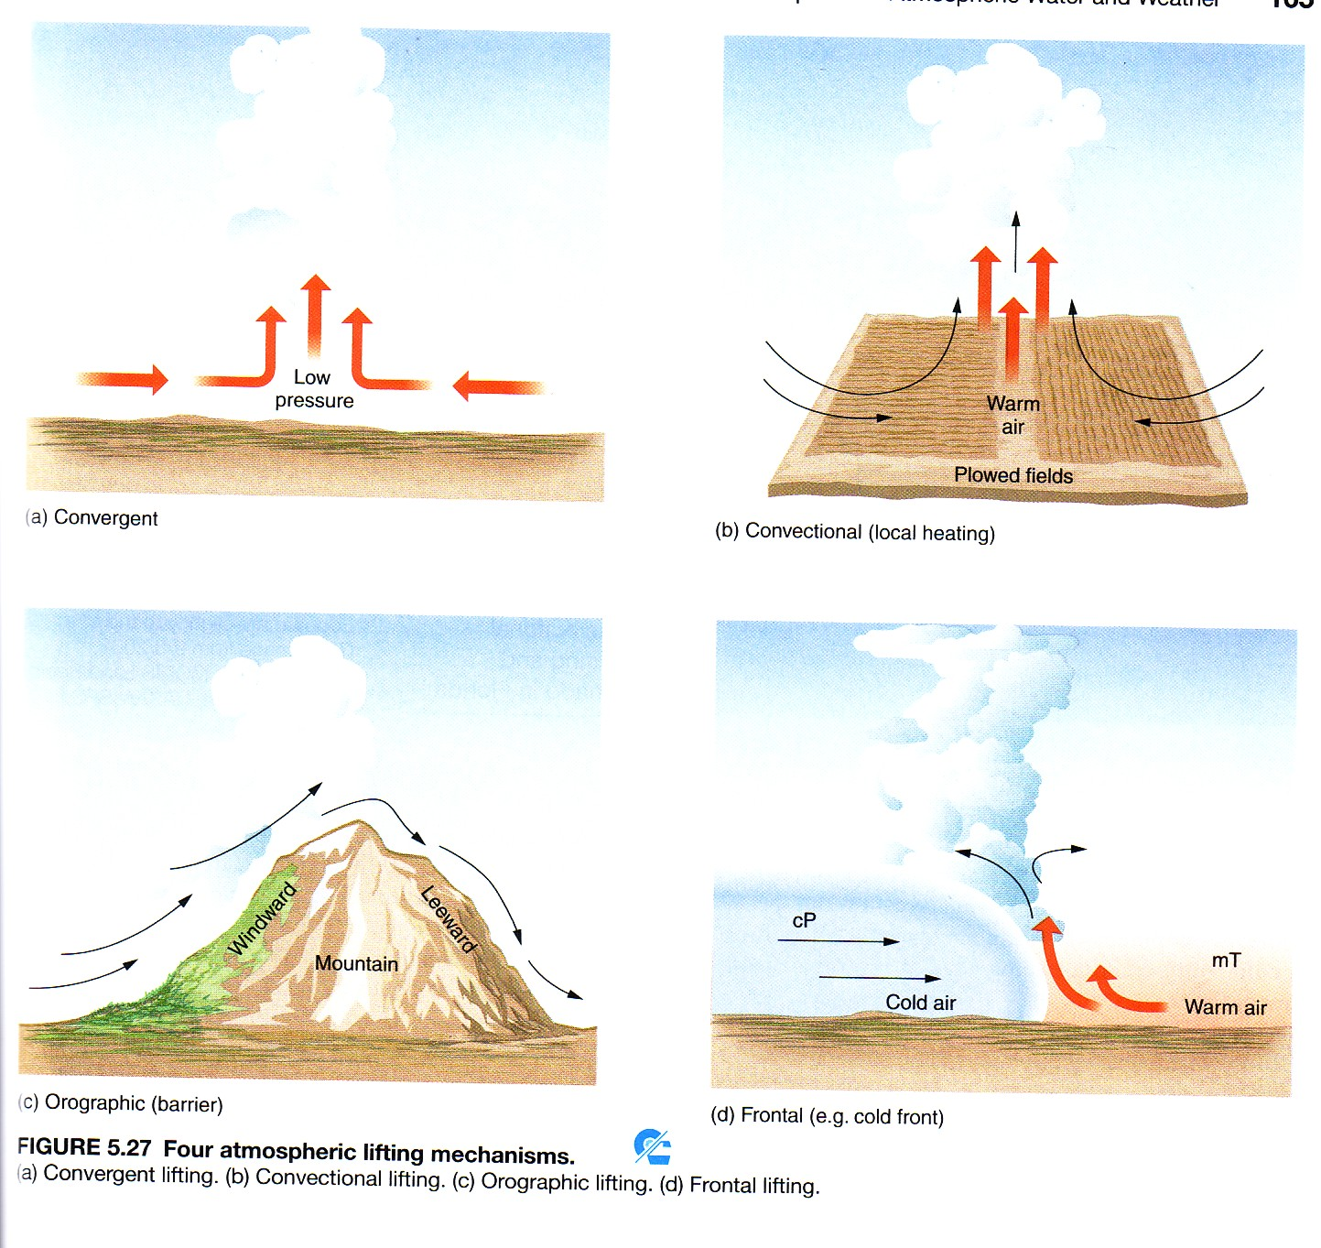

Slide 9
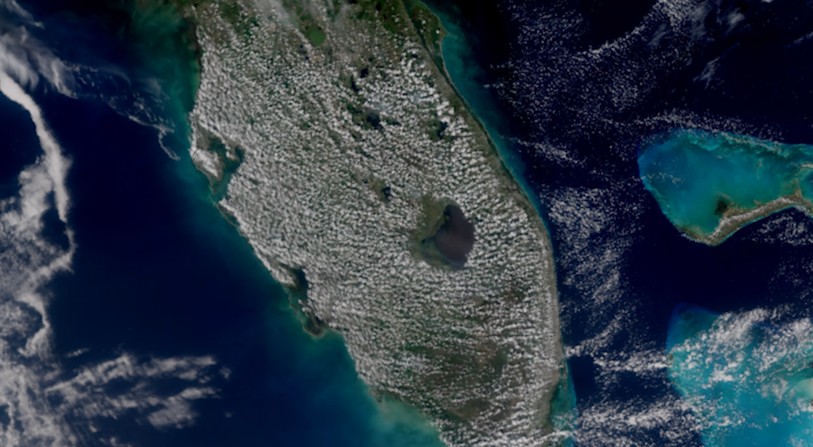

Slide 10
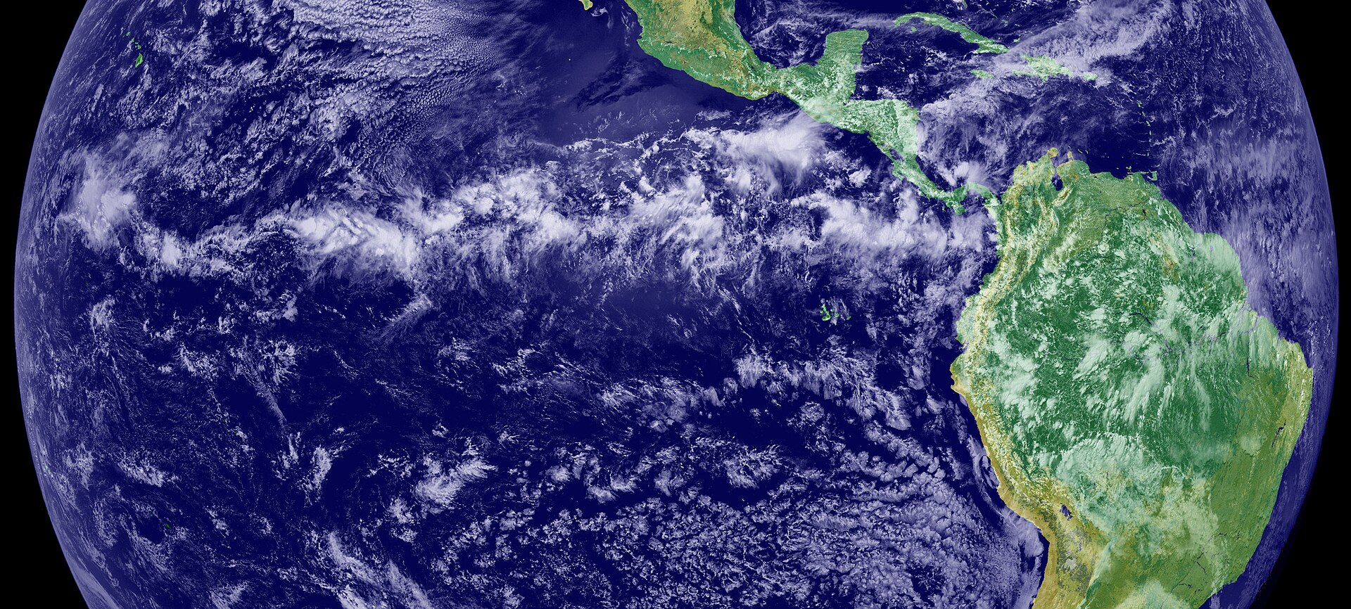
Notes:
ITCZ, zone of wind convergence and surface heating leading to low pressure and cloud formation

Slide 11
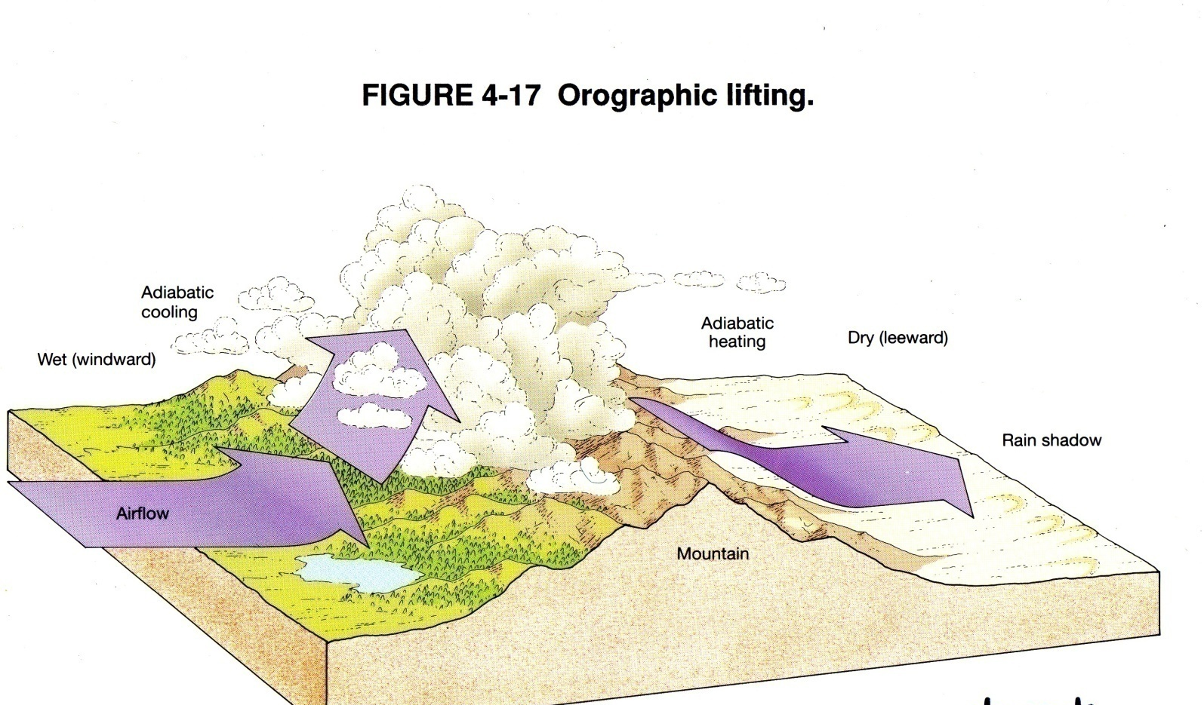

Slide 12
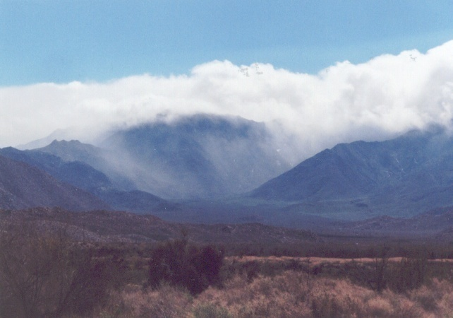

Slide 13
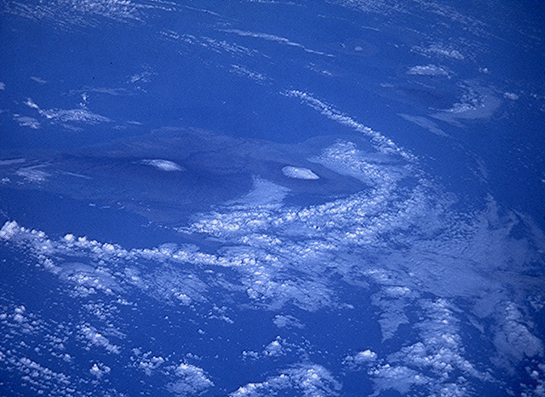

Slide 14
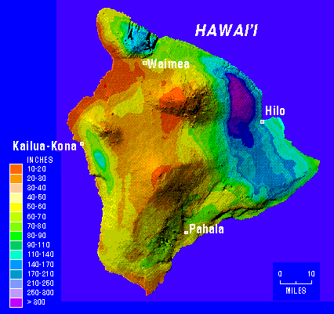
Notes:
Rainshadow effects on Hawaii

Slide 15
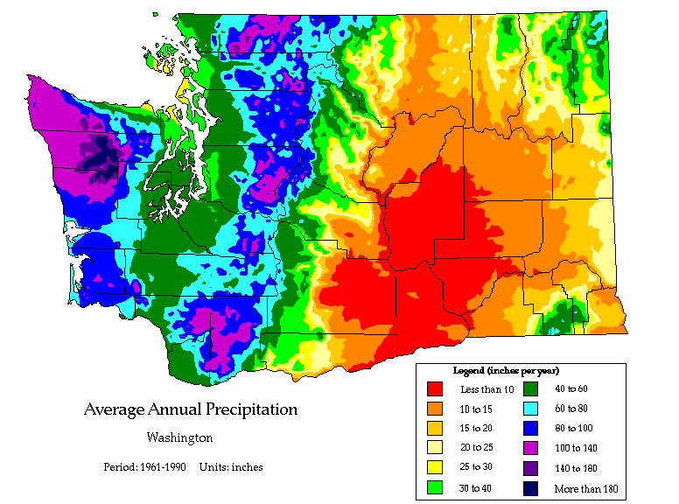
Notes:
Rainshadow effects in Washington State.

Slide 16
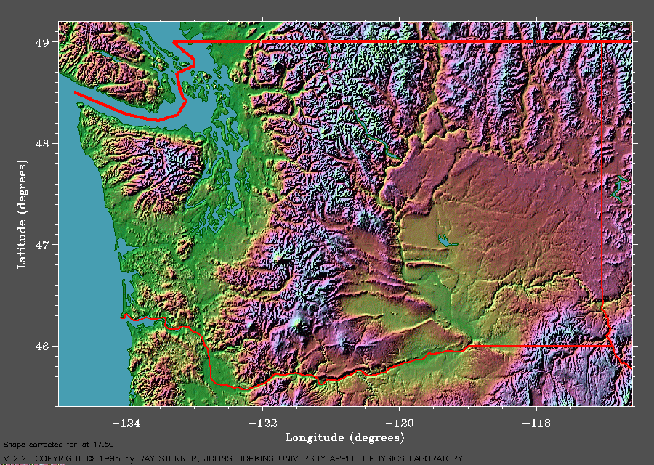
Notes:
Topography of Washington state

Slide 17
Frontal lifting along a cold front
Notes:
Cold front

Slide 19
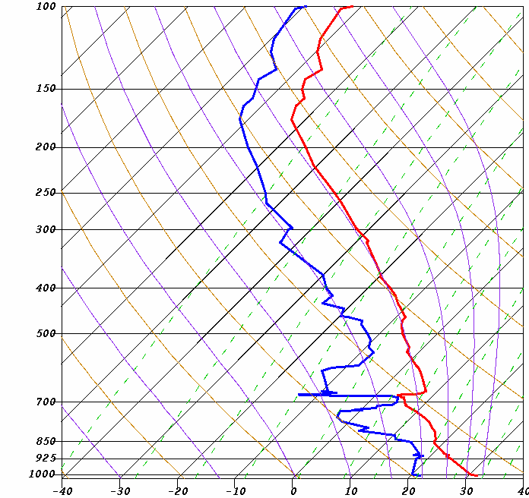
Upper
troposphere
Air pressure in millibars (mb)
Surface
Notes:
Tracking the temperature and dew point of a parcel of air as it is lifted through the atmosphere can be visualized in a skew-t plot, a common tool of meteorologists. Clouds are likely to form at the 700 mb level, several thousand feet up.

Slide 20
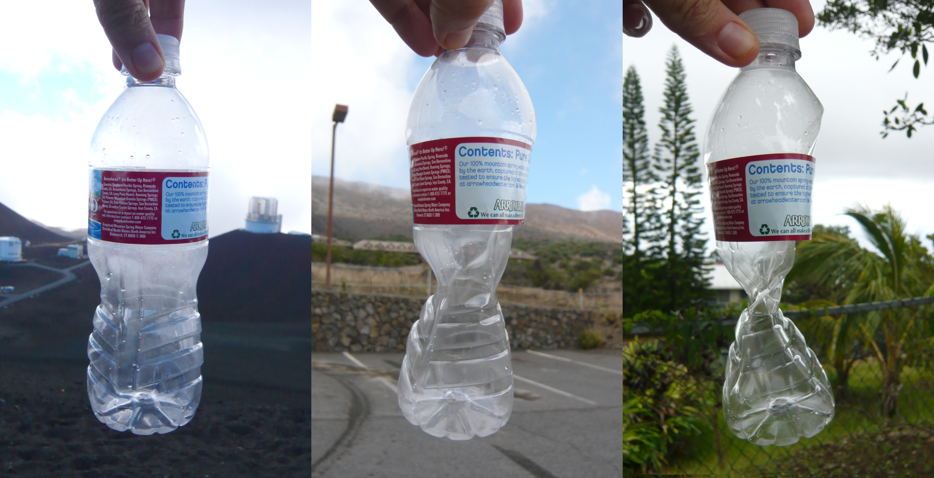
Notes:
Plastic bottle sealed at 14,000 feet, at 9000 feet, and 1000 ft (in Hawaii). Where would the air in the bottle be the coolest? The warmest? What would happen to temperature in the bottle as you went down in altitude? As you went up?

Slide 21
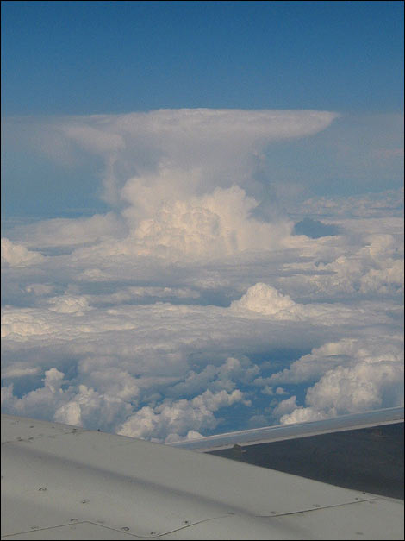

Slide 22
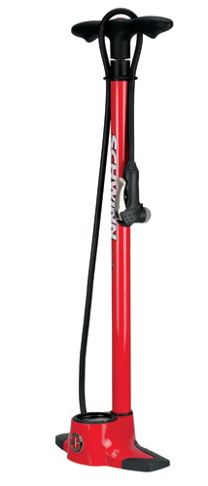
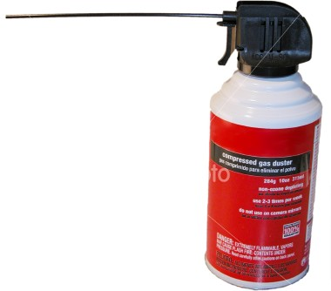

Slide 23
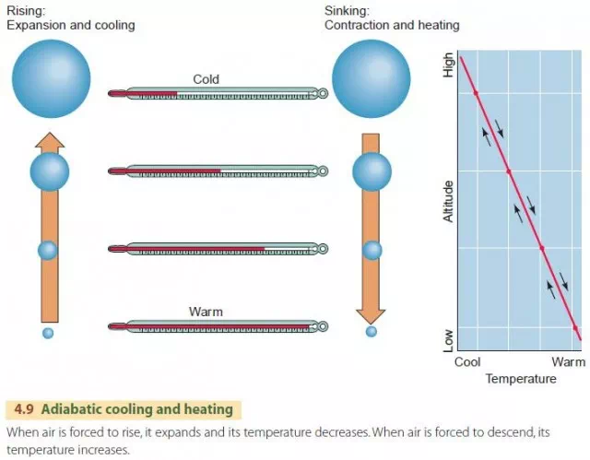
Notes:
No heat is added from outside in adiabatic processes – temperature change is a function of changing air pressure

Slide 24



Slide 25
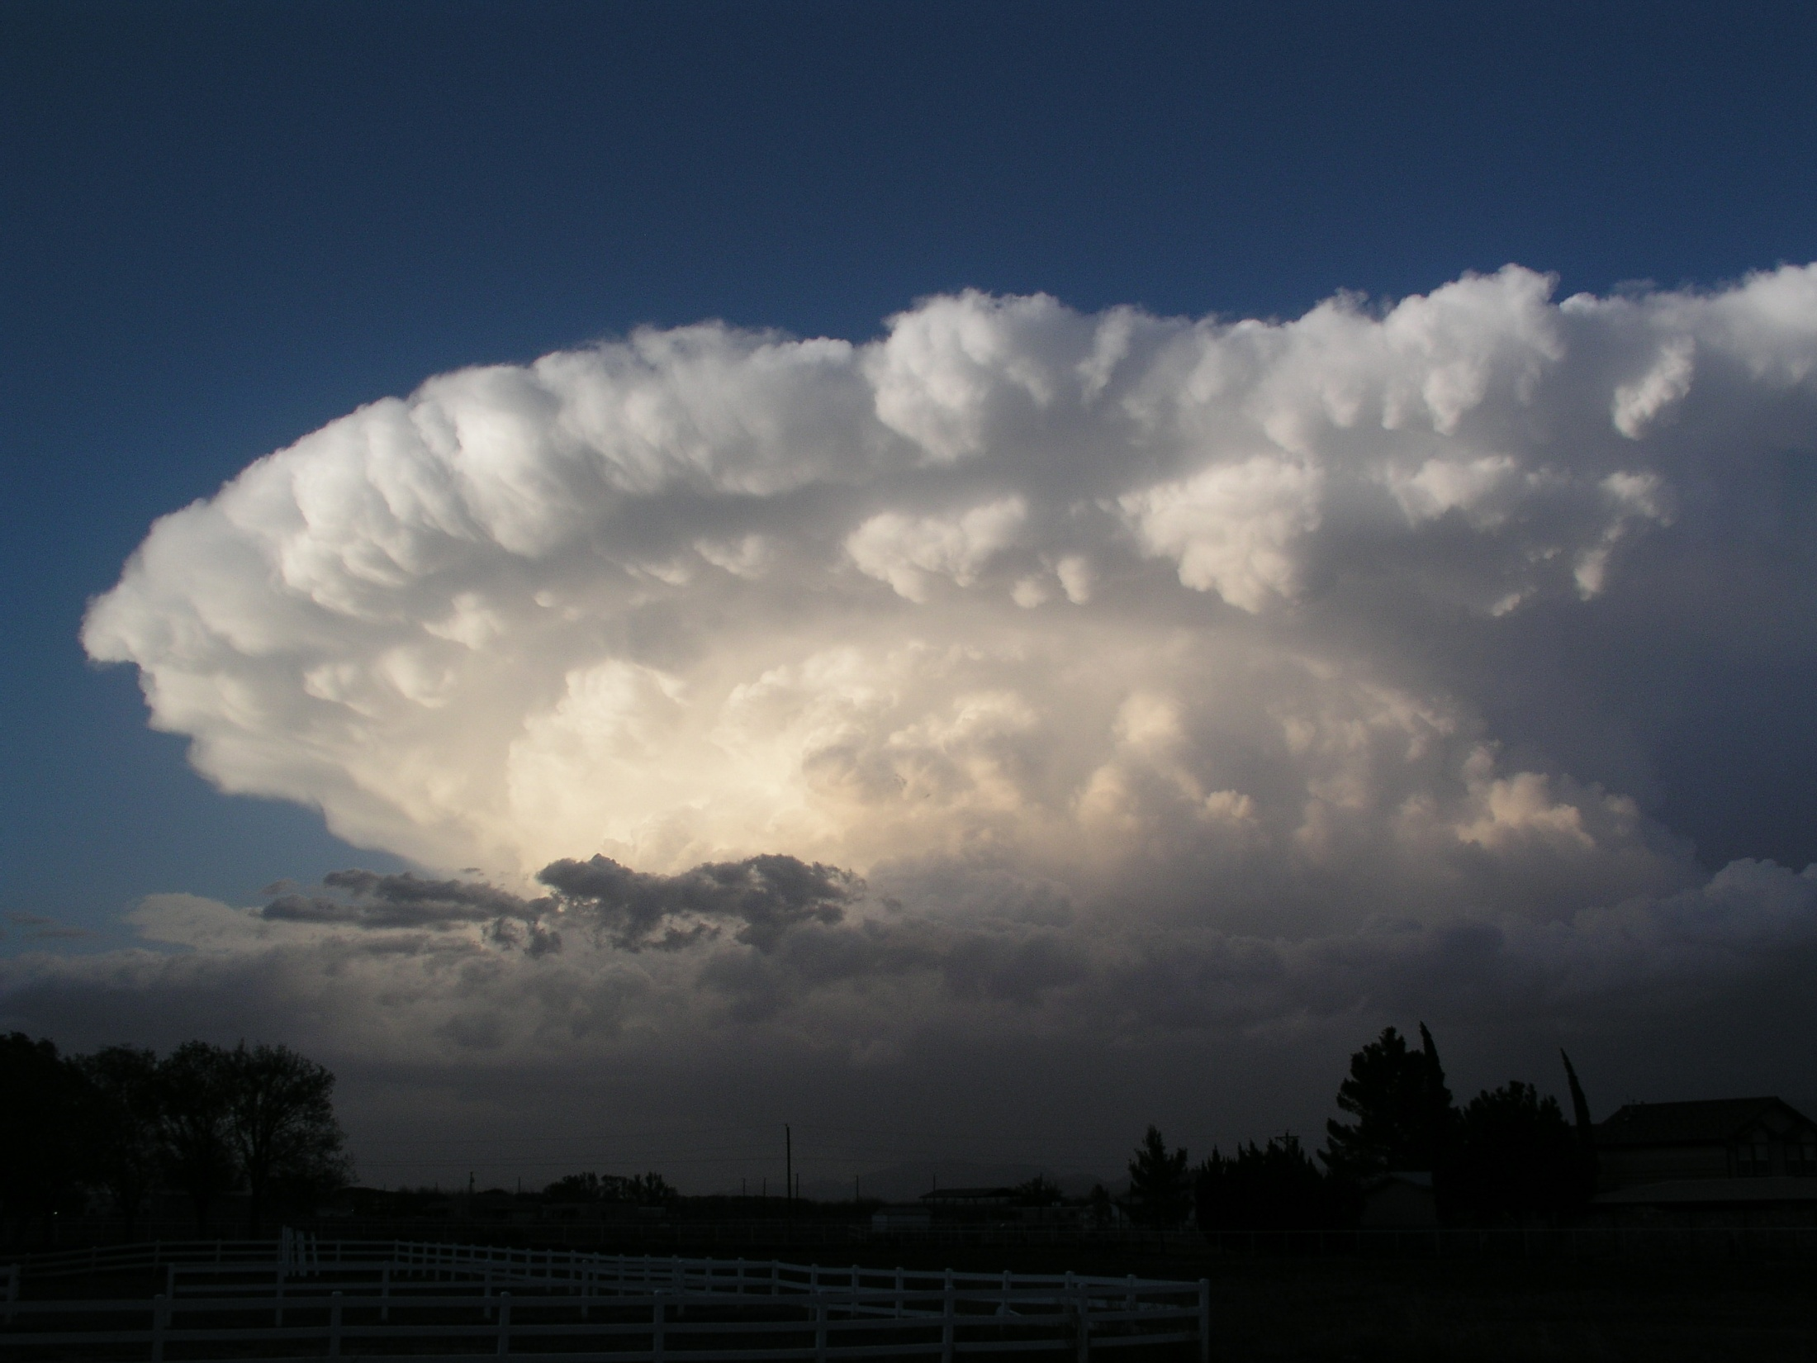
Notes:
Cumulonimbus clouds

