Slide 1
A guide to the slides
The slides posted online do not include any of the slides presented in Monday and Wednesday lecture. Those require you to take in class notes.
Required readings and videos are identified by:
Additional explanations and references for the content are provided in the notes section below the slides
Online slides and readings are available at: https://tstallins.github.io/courses/261/globalhealth.html
Reading/Questions
Video/ Questions
Notes:
This is the notes section, additional content is provided here underneath the slide.

Slide 2
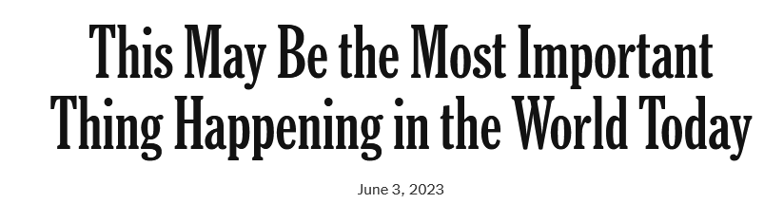
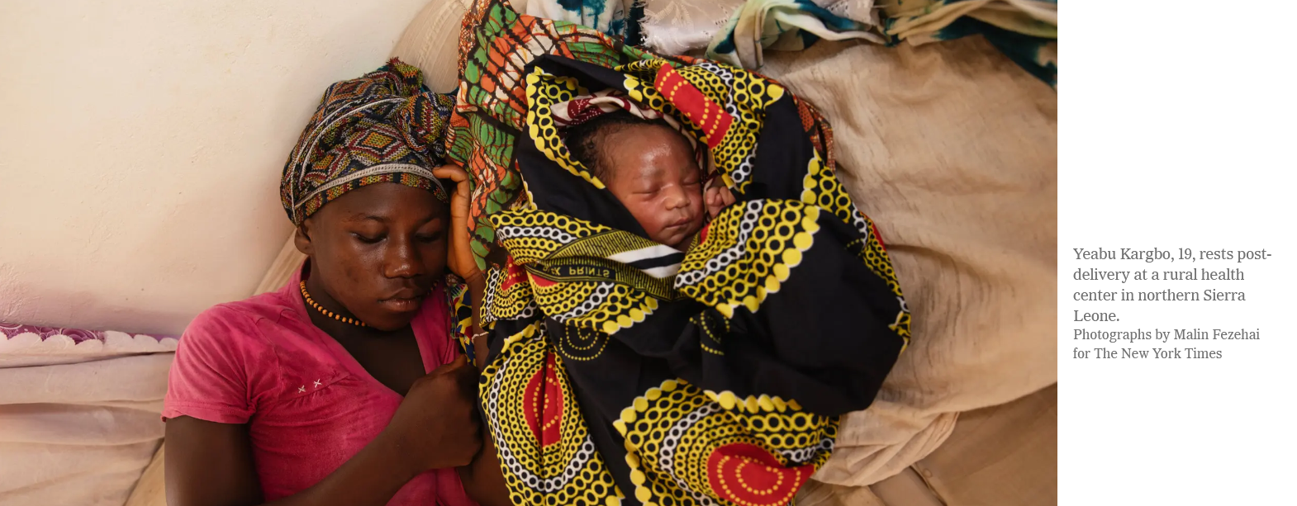
Reading/Questions 1
Notes:
This article talks about the improvements in health that have occurred over the past few decades. https://www.nytimes.com/2023/06/03/opinion/sierra-leone-progress-health-children.html Sierra Leone, a country that remains heartbreakingly poor today, but the risk of a child dying is less than half of what it was 20 years ago

Slide 3
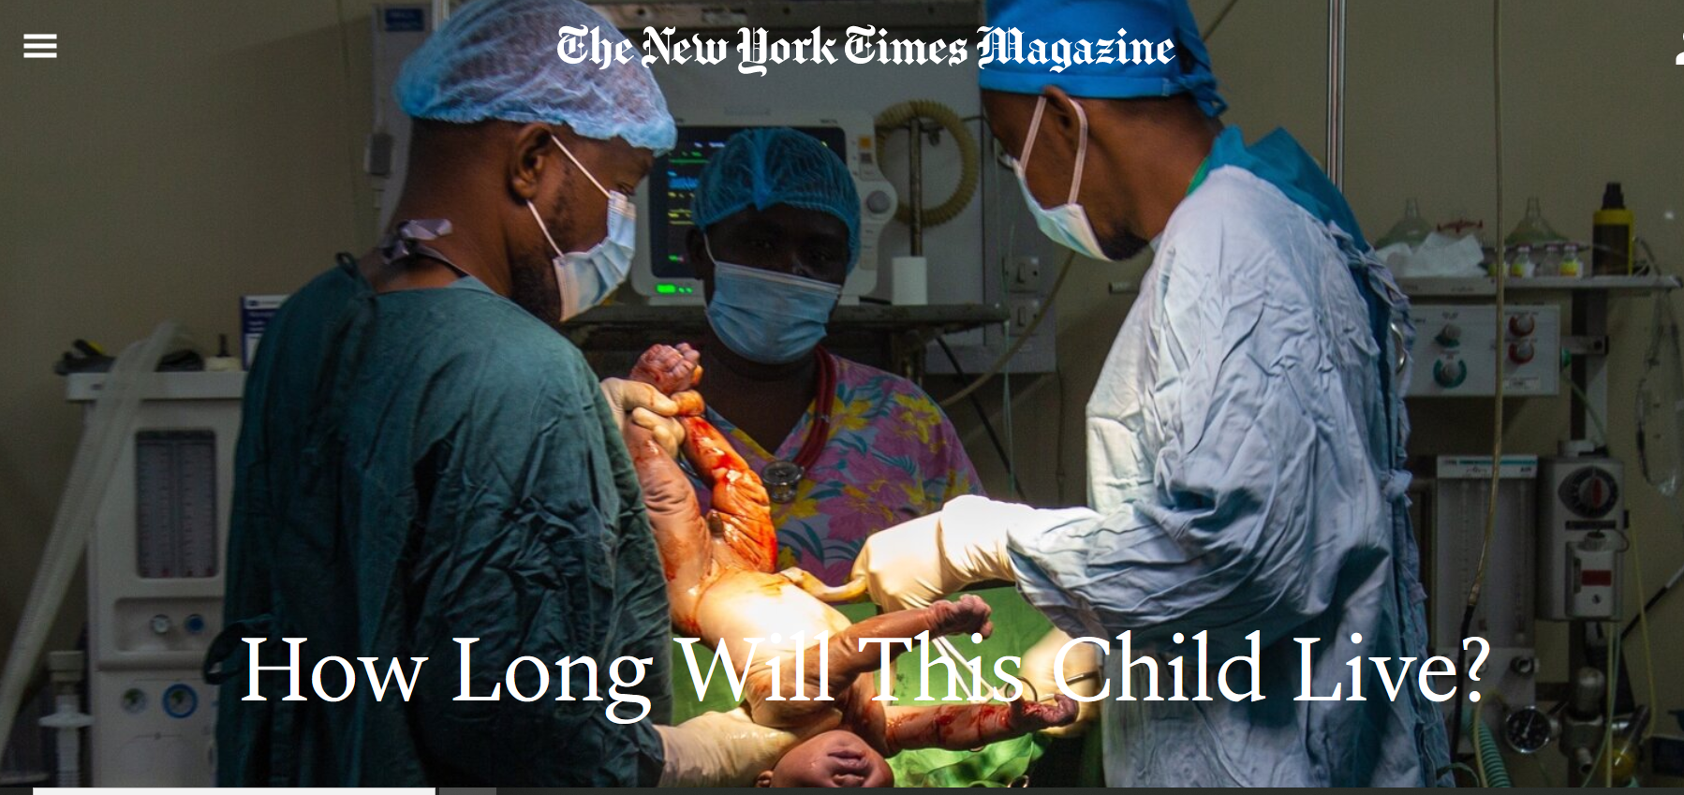
Reading/Questions 1
Notes:
This reading best viewed in Google Chrome.
No one can say what the future holds for Crispin Brake, born at the Bwaila District Hospital in Malawi. But he and the other babies born in Malawi this year have an expected life span of more than 65 years — an unimaginable outlook just two decades ago, when the nation’s life expectancy was only 44

Slide 4
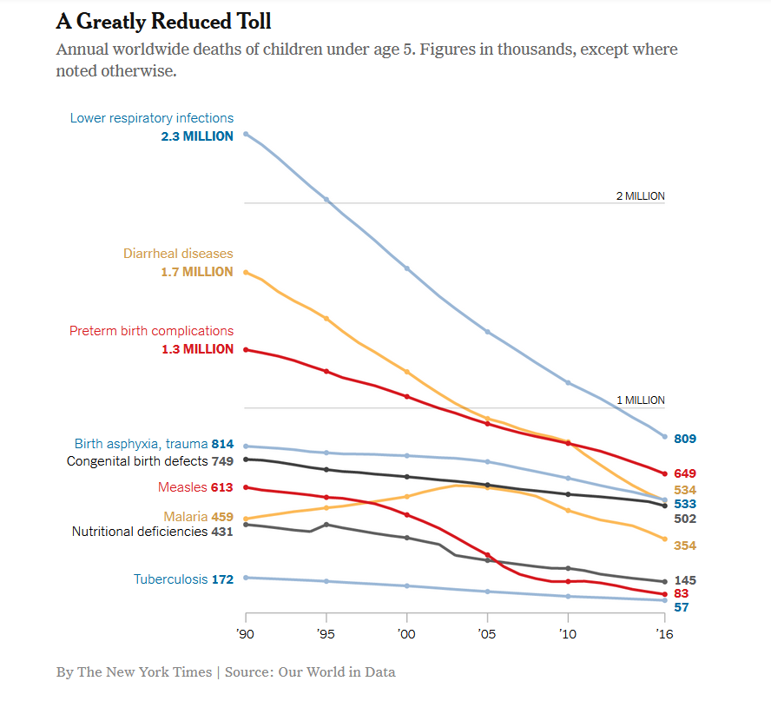
Large gains in health and poverty reduction in last several decades
Large reductions in the mortality of children under 5 (down more than 50%)
Many of these gains achieved through global cooperation among national governments, private foundations, and non-governmental organizations (NGOs)
Notes:
https://www.nytimes.com/2019/12/28/opinion/sunday/2019-best-year-poverty.html

Slide 5
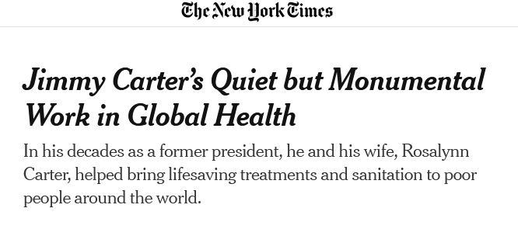
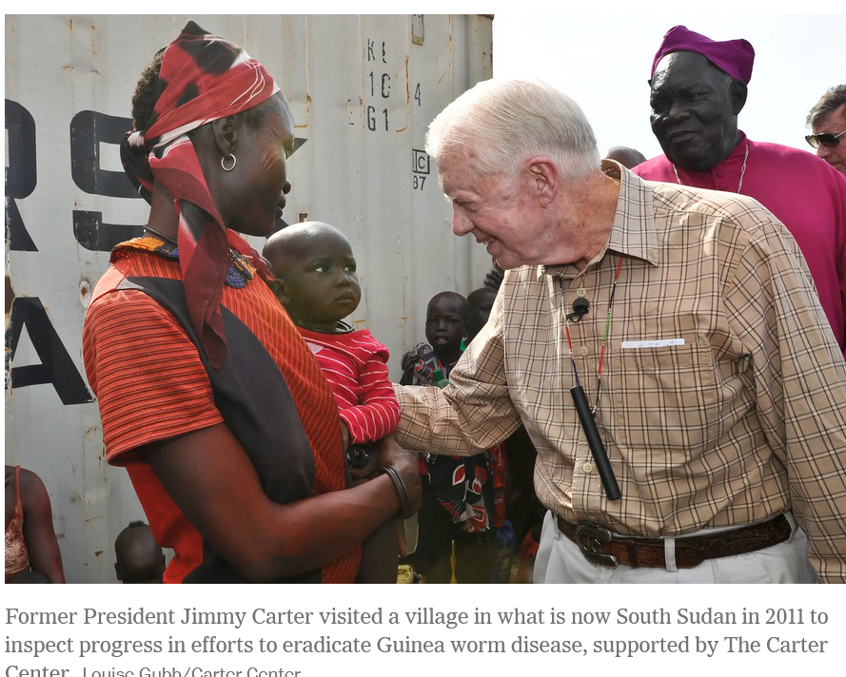
Reading/Questions 1
Notes:
Jimmy Carter is one of the philanthropists who have made a difference in global health over the past few decades. He and other philanthropists, like Bill Gates of the Microsoft Corporation, often worked with national governments and non-governmental institutions to address health issues in poorer regions. Some philanthropists like Bill Gates have donated enormous sums of their wealth to address global health issues.
https://www.nytimes.com/2024/12/30/health/jimmy-carter-global-health.html

Slide 6
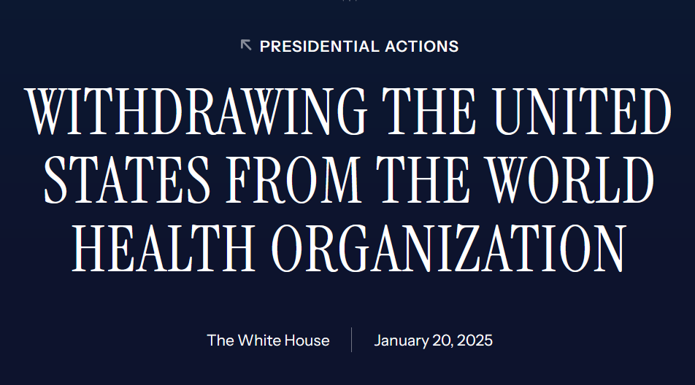

Slide 7
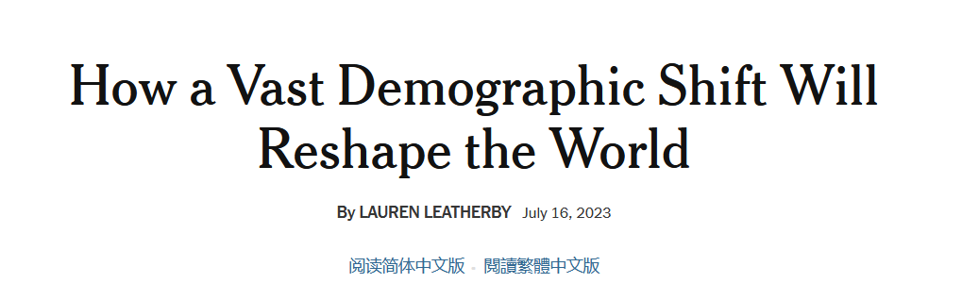
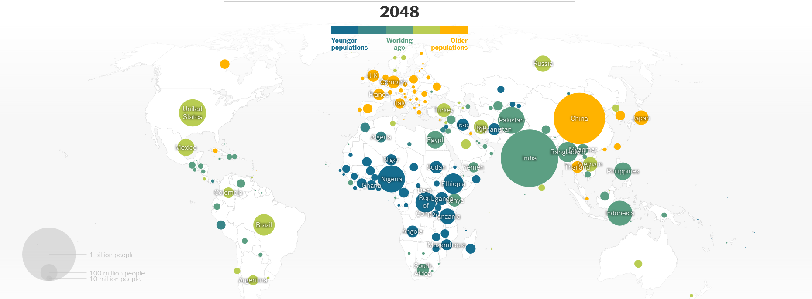
Reading/Questions 1
Notes:
https://www.nytimes.com/interactive/2023/07/16/world/world-demographics.html This reading discusses how some countries have aging populations, while others are soon to have very large numbers of young at prime working age. This is going to restructure not only economies but also global health.

Slide 8
What sets global health apart from other disciplines of medicine?
Goal is to have just and equitable distribution of risk of suffering from disease and of tools to lessen or prevent it
Encompasses the ‘resocializing’ disciplines and the social production of knowledge.
Takes a multi-scalar view of health
Considers the larger evolutionary, ecological, and environmental contexts of disease
Places health and quality of life within the context of globalization

Slide 9
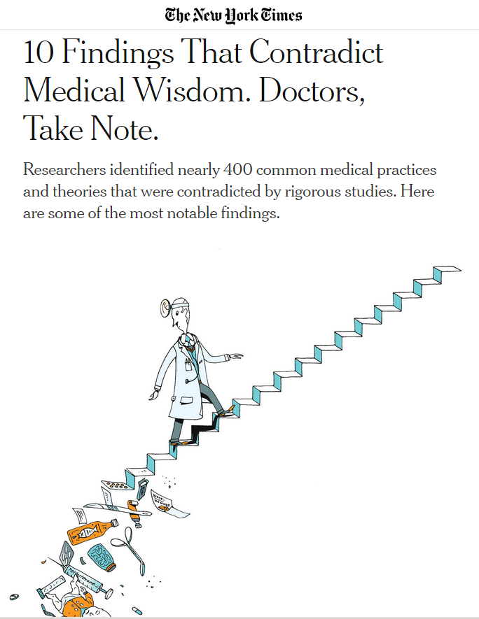
Step counters and calorie trackers help you lose weight. (FALSE)
For a torn knee meniscus, physical therapy or surgery are equally effective. (TRUE)
Ginkgo biloba protects against memory loss and dementia. (FALSE)
A lifelike doll carried around by teenage girls can deter pregnancies. (FALSE)
Fish oil reduces heart disease (FALSE)
Step counters and calorie trackers help you lose weight. For a torn knee meniscus, physical therapy or surgery are equally effective.
Ginkgo biloba protects against memory loss and dementia.
A lifelike doll carried around by teenage girls can deter pregnancies.
Fish oil reduces heart disease.
Notes:
How did you answer these questions? Why did you answer them the way you did? You answered them the way you did because your knowledge is socially produced. Of course, some of you may be up on the scientific literature and you knew the right answers. But for many of us, the knowledge we had to answer these questions was assembled from bits and pieces of things you read here and there, an experience you might have had, and from what you hear people in authority say.

Slide 10
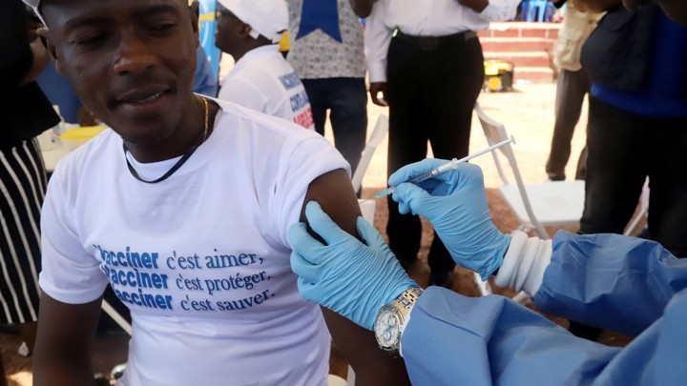
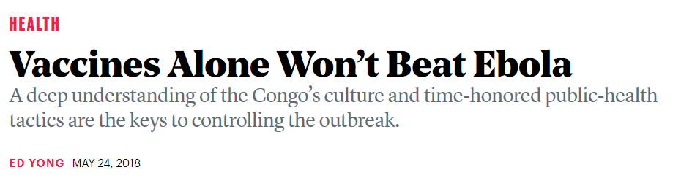

Knowledge is social
What counts as meaningful knowledge arises in part from its context.
For example, the effectiveness of the science that goes into the creation of a vaccine is limited without an understanding of the context in which it is deployed.
The historical social and political context of some groups of people in the Democratic Republic of Congo may make them fearful of aid workers and those in positions of power.
This kind of socially produced knowledge must be taken into account to slow the spread of Zaire Ebola virus, which can now be prevented with a vaccine.
Notes:
https://www.theatlantic.com/health/archive/2018/05/vaccines-alone-wont-beat-ebola/561128/
The social, cultural, economic, and historical context of public health measures in the Democratic Republic of Congo will determine the effectiveness of the vaccine.
A vaccine may seem straightforward to you, but to some it may be more complicated. Distrust of authorities for example can lead to the rejection of vaccines. Masks with Covid-19 are another example. Even though there is objective evidence that masks limit exposures, the social context and situation of an individual determines the degree they will wear them. Strictly ‘scientific’ facts of knowledge will not be enough to fully address any large public health issue. Global health places more emphasis on how knowledge is socially produced and how it intersects with scientific and technological perspectives on health

Slide 11
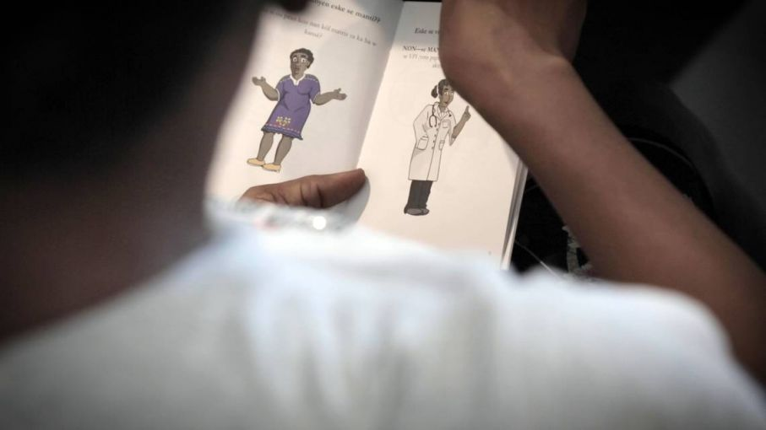
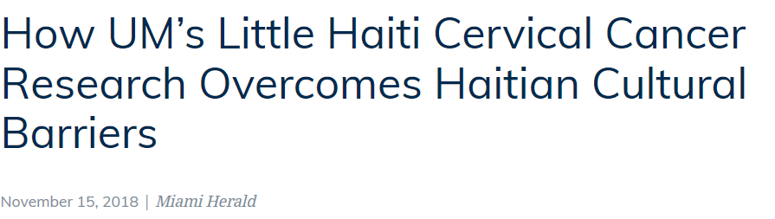
Notes:
Another example of how socially produced knowledge matters for the development of successful health campaigns. The scientific basis for reducing cervical cancer exists – routine pap smears and vaccination for HPV. Yet to address cervical cancer requires understanding how scientific knowledge and practice takes on social meaning. It’s not just the availability of screening and vaccinations, but also cultural and social contexts that go with it. For example, Haitian women may be reluctant to go to a doctor’s office for a pap smear out of modesty and a fear of whether their partners would approve or not. The development of at home tests that allow women to take their own swabs and submit them through the mail allowed testing rates to increase. Having this kind of social knowledge is what is necessary to address cervical cancer, not just the availability of the technology for a test or screening.
https://pulitzercenter.org/reporting/how-ums-little-haiti-cervical-cancer-research-overcomes-haitian-cultural-barriers

Slide 12
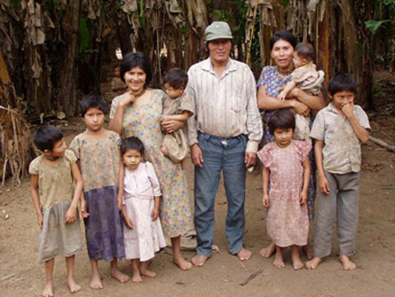
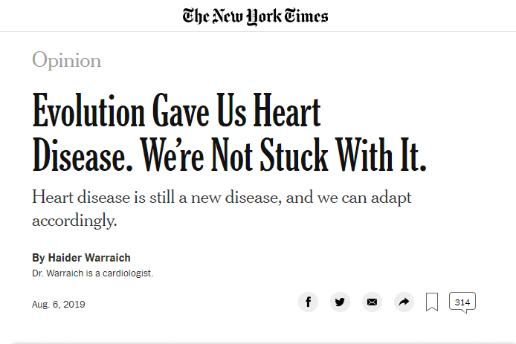
Evolution, ecology, and environment shape global health
The Tsimane, a remote people living in the Bolivian rain forest. They experience very low levels of atherosclerosis (hardening of the arteries) because of frequent exposures to infectious agents. Their immune systems do not readily trigger the inflammation that underlies the stages of atherosclerosis because of these constant environmental exposures.
Notes:
Evolution, ecology, and environment shape global health Even heart disease has an evolutionary explanation
In response to infections, the immune system unleashes a powerful response called inflammation. In extreme forms, such as after catching the flu, inflammation can set the body ablaze and is our best means to keep us sterile and free of infection. Inflammation also plays an important role when someone gets hurt and the barrier between the body and the world outside is breached. Inflammatory cells unleash a cascade that results in blood clots forming to quickly plug nicks and cuts.
After the institution of better public hygiene, inflammation, no longer busy with outsiders, turned inward. Inflammation is responsible for every important step in the story of atherosclerosis, from its birth as fatty streaks in the lining of the blood vessels, to the dramatic eruption of cholesterol-laden plaques in blood vessels supplying the heart, brain and legs, that activate our clotting cascade, leading to blockages that cause heart attacks, strokes and blood-choked limbs needing amputation.
https://www.nytimes.com/2019/08/06/opinion/evolution-heart-disease.html?smid=nytcore-ios-share http://tsimane.anth.ucsb.edu/tsimaneinfo.html
https://doi.org/10.1016/S0140-6736(17)30752-3
Kaplan, H., Thompson, R. C., Trumble, B. C., Wann, L. S., Allam, A. H., Beheim, B., ... & Rodriguez, D. E. (2017). Coronary atherosclerosis in indigenous South American Tsimane: a cross-sectional cohort study. The Lancet, 389(10080), 1730-1739.

Slide 13
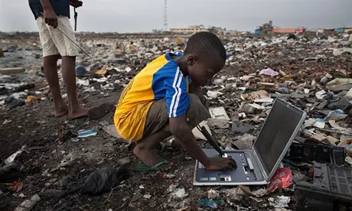
Global health places quality of life within the context of globalization
Notes:
What is the idea of health on a globally connected planet? What you do here may have health implications for some one far away. Using a computer impacts the health of others far from where you live, through the industries that make the computers and their components, as well as the waste streams that recycle our discarded devices. https://www.theguardian.com/world/2013/dec/14/ghana-dump-electronic-waste-not-good-place-live

Slide 14
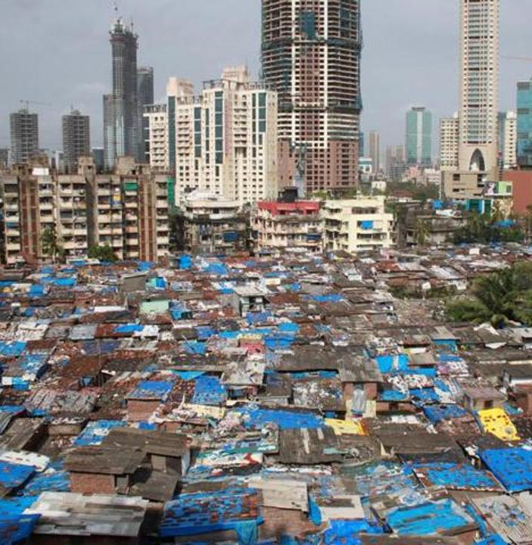
The tradeoffs and unevenness of Globalization 3.0
Globalized economies are among the wealthiest with high rates of literacy and longer life spans – benefits.
However, there are costs or harms: globalization can also produce poverty and new health and environmental problems
Benefits and harms from globalization are experienced unevenly
Notes:
Not entirely valid to say that globalization raises standards of living everywhere and creates wealth.
You could also say that if globalization creates new health and environmental problems, it also creates the potential for novel solutions through the integration of economies, knowledge exchange, and collaborative problem solving.
Displacement of workers have health impacts, for example, part of the rise of the opioid epidemic in the US were the layoffs of thousand of workers in factories and manufacturing when jobs went overseas because of lower wages that could be paid there.

Slide 15
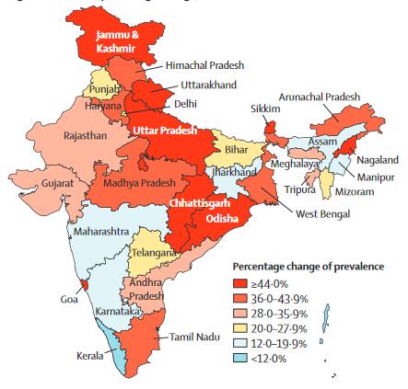
Infectious (communicable) diseases like may decrease as countries globalize
They often then experience increases in non-communicable diseases of affluence as countries develop economically, enter the global economy, and experience shifts in the types of foods consumed
Notes:
Percentage change of prevalence of diabetes (1990-2016)
https://www.thelancet.com/pdfs/journals/langlo/PIIS2214-109X(18)30387-5.pdf
As part of the epidemiological transition from communicable diseases to non-communicable diseases, the burden of diabetes and its risk factors has been increasing in India. Globalization, and urbanization have altered traditional diets and increased rates of obesity and diabetes.

Slide 16

Globalization and the Covid pandemic
“What happens in a single nation stays there” no longer applies in today’s global world
Countries cannot treat their problems solely as their own. Governing by the idea that what they do or don’t do won’t have impacts elsewhere on the globe is unrealistic.
Video
Notes:
The Chinese government have been criticized for not opening up fully about the global risks of the Covid-19 outbreak as it was starting. They put more emphasis on the control (and the perception of control) of the outbreak in their country above this global responsibility.

Slide 17
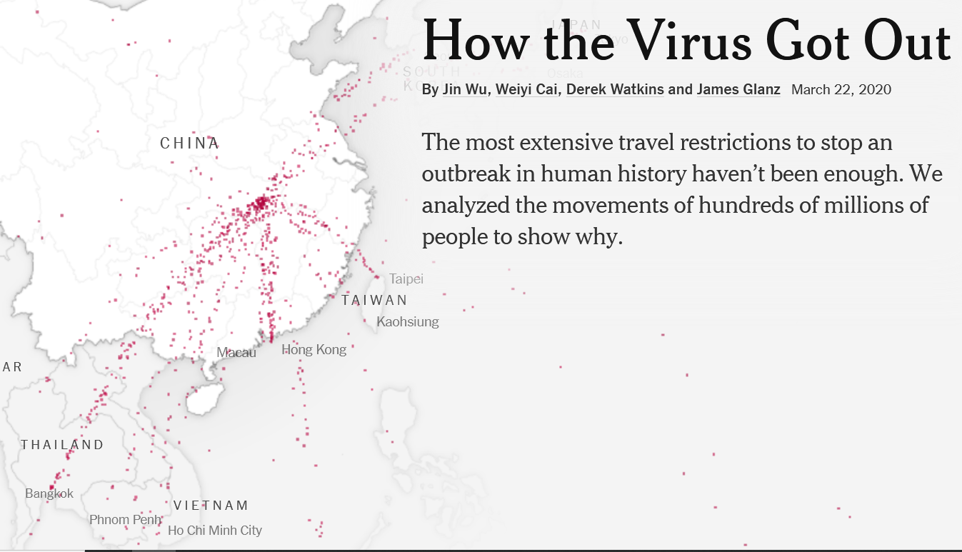
How globalization contributed to the Covid pandemic
Globalization fueled the growth of urban areas and the high population densities that enhanced the spread of coronavirus SARS-CoV-2
Hyperconnectivity through air travel enhanced the spread of the virus

Slide 18
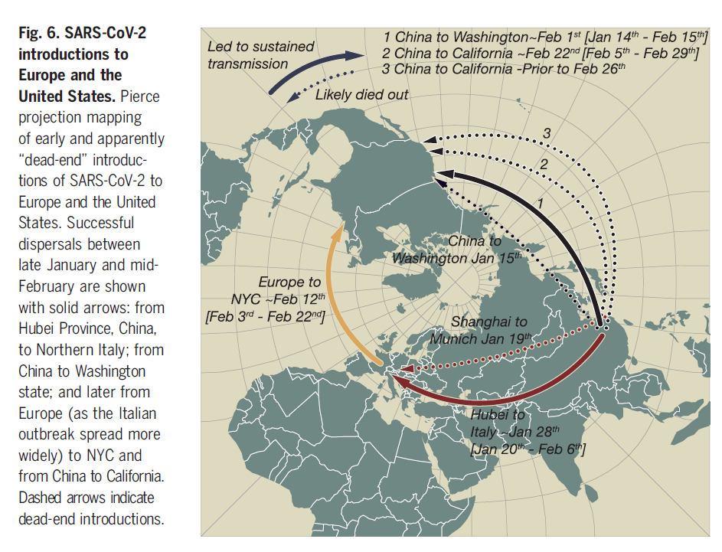
Notes:
Worobey, M., Pekar, J., Larsen, B. B., Nelson, M. I., Hill, V., Joy, J. B., ... & Lemey, P. (2020). The emergence of SARS-CoV-2 in Europe and North America. Science, 370(6516), 564-570.

Slide 19
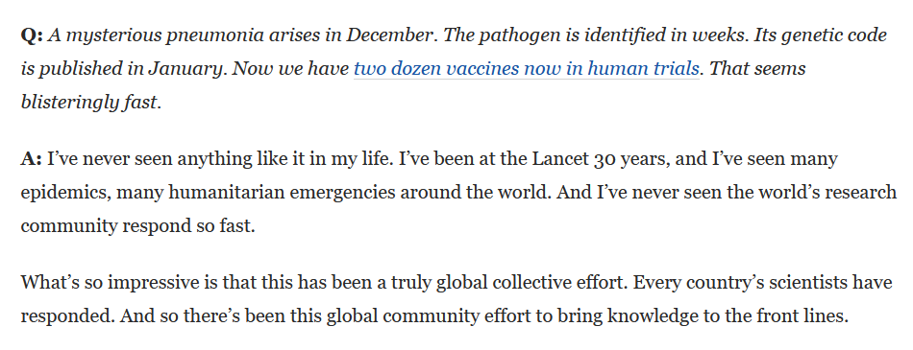
Response to Covid was also aided by globalization, particularly in the development of vaccines
Notes:
https://www.washingtonpost.com/world/europe/lancet-richard-horton-trump-vaccines/2020/07/29/1209b610-d048-11ea-826b-cc394d824e35_story.html The Lancet is a major medical journal. It publishes research on new insights into medicine and health. The vaccines now in use are made from precursor chemicals, lab supplies, and facilities that span the globe.

Slide 20
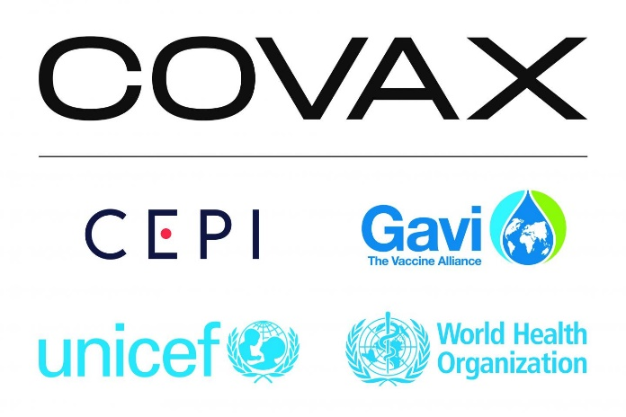
Yet some international cooperative institutions and global commodity chains faltered
COVAX set out to vaccinate 70% of humanity by mid-2022 with the main emphasis in bringing vaccines to low-income countries
These aggressive targets were not met
Still, COVAX shipped almost 2 billion vaccines, the largest and fastest vaccine rollout in history
Shortages in syringes and masks also developed as demand exceeded supplies available from India and China

Slide 21
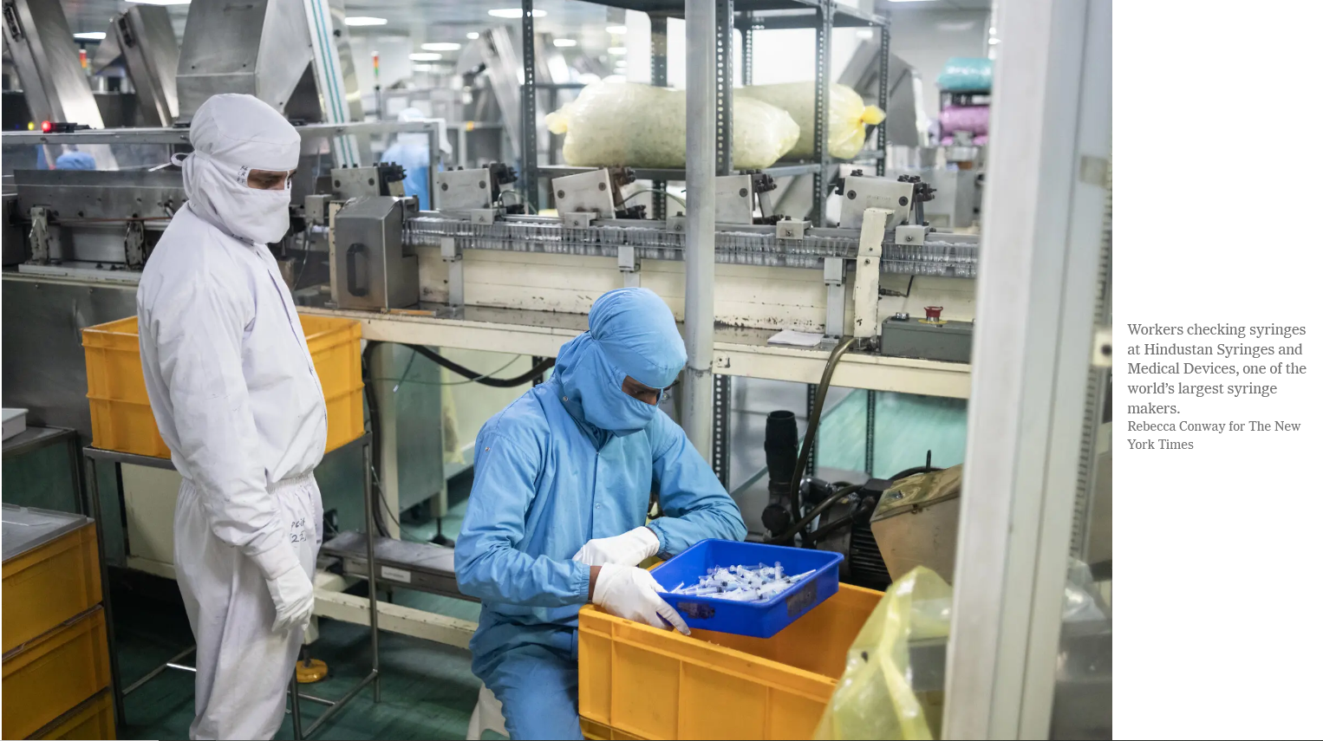
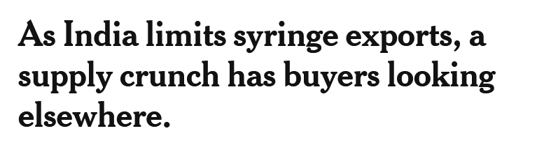
Notes:
https://www.nytimes.com/2021/11/18/world/asia/covid-syringes-india.html
In low- and middle-income countries (LMICs), nearly all vaccines are administered with a 0.5-mL autodisposable (AD) syringe. In LMICs, the syringe shortage is jeopardizing critical childhood immunization programs for life-threatening illnesses—like measles, tetanus, and diphtheria. https://www.path.org/articles/syringe-shortage-explained/

Slide 22
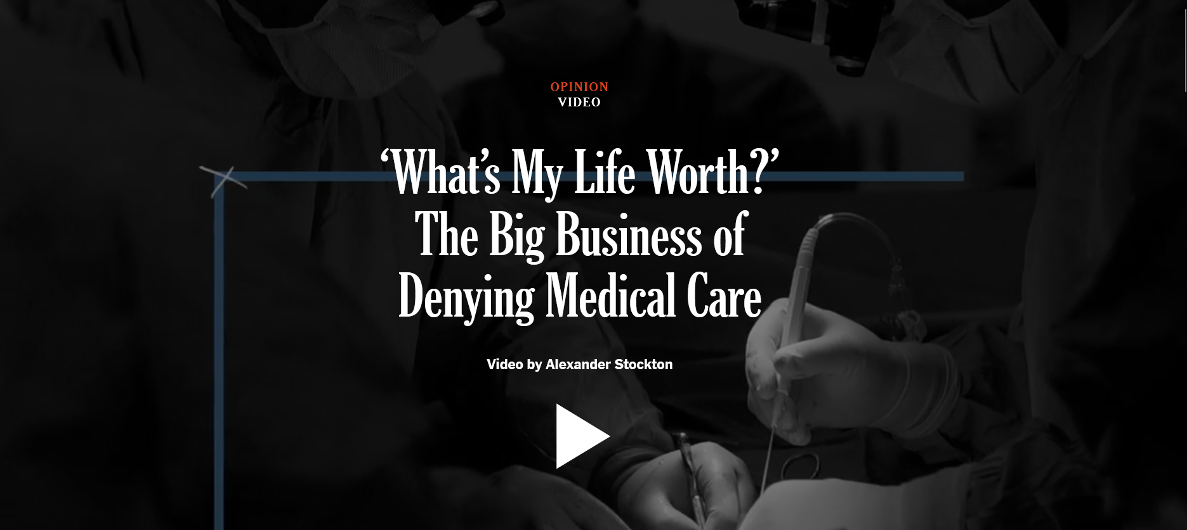
Structural violence: a source of inequities in health between and withing countries
Notes:
A type of structural violence associated with the rational-legal authority in medical and insurance institutions
https://www.nytimes.com/2024/03/14/opinion/health-insurance-prior-authorization.html

Slide 23
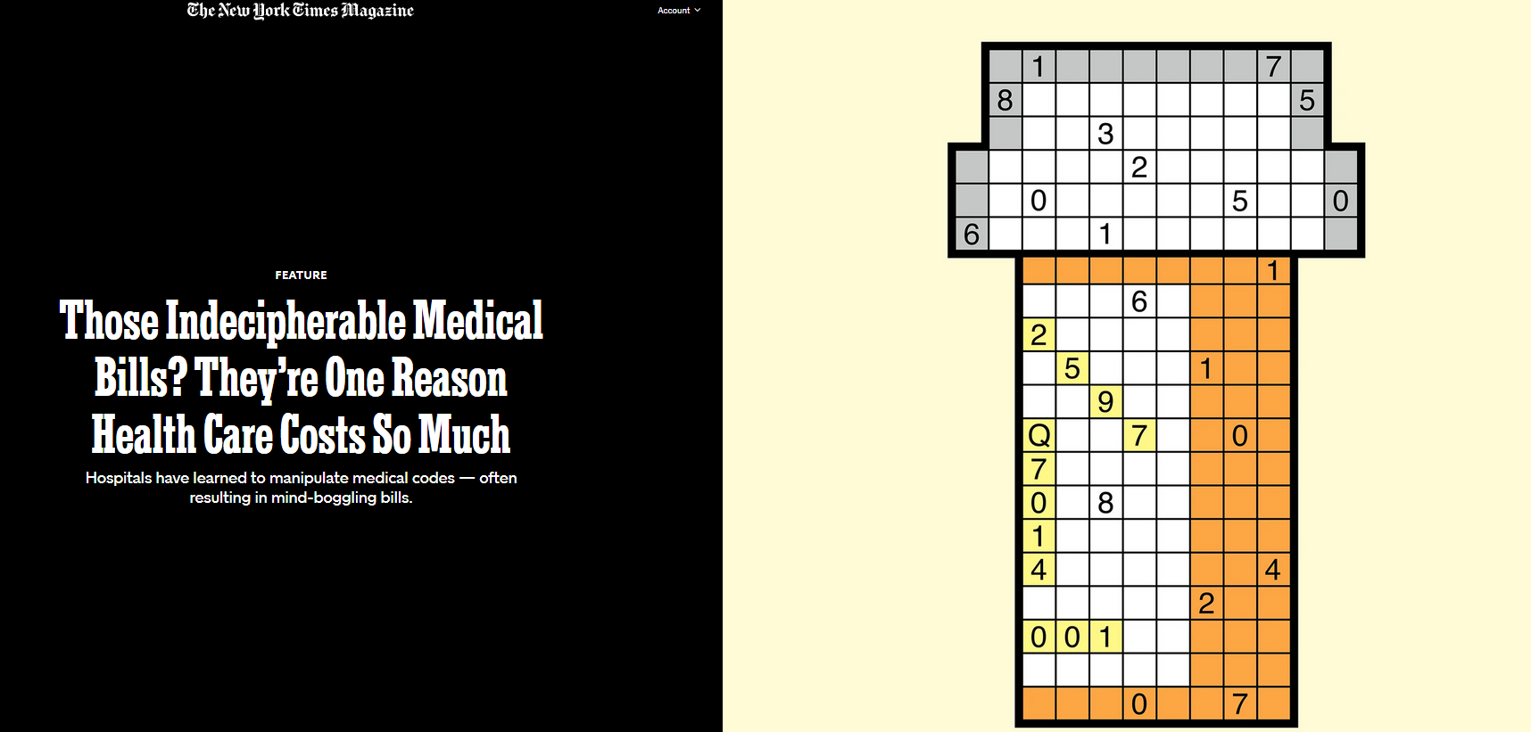
The potential for structural violence in medical coding
Notes:
Classification of illnesses and disease into categories can facilitate the practice of medicine. It can also be a form of structural violence when coding is used to deceive. https://www.nytimes.com/2017/03/29/magazine/those-indecipherable-medical-bills-theyre-one-reason-health-care-costs-so-much.html

Slide 24
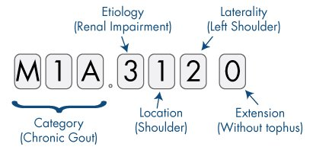

Slide 25
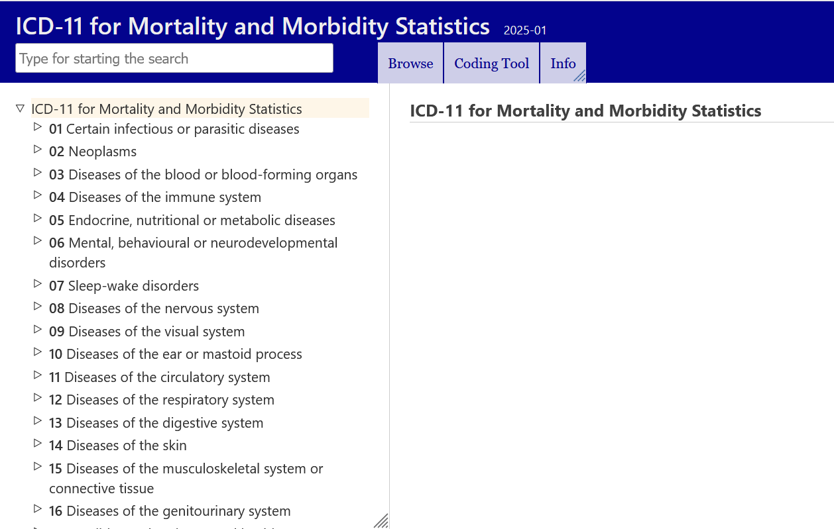
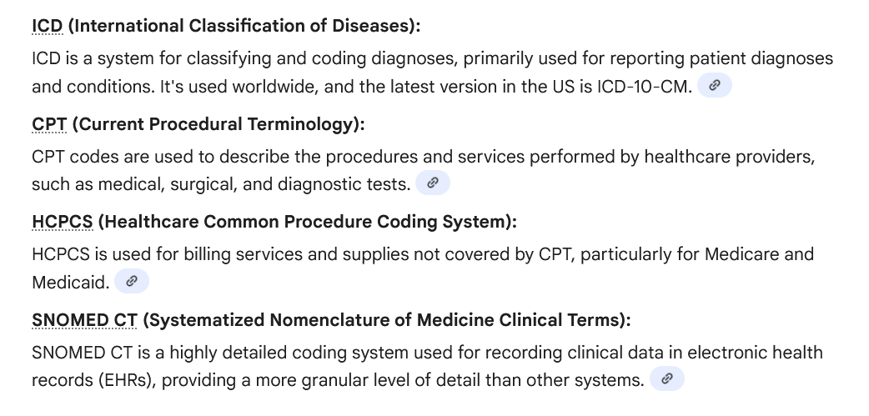
Notes:
These are all examples of systems for medical coding. Doctors, nurses, hospital staff and administration, as well as insurers utilize medical coding

Slide 26

Medical coding is constantly changing and evolving
More ways to classify disease and illness means more ways to charge and to confuse.
Upcoding – a code with a higher reimbursement rate is assigned by provider (the doctor or the hospital or clinic) despite not providing the service or meeting the medical necessity requirement
Cumulatively, these fraudulent practices weaken health care and become a form of structural violence
Notes:
More ways to classify means more ways to charge, and as a result, increased costs.
Downcoding – a lesser code on a claim, perhaps to induce patients to keep coming back for other services excessive charges for services or supplies

Slide 27
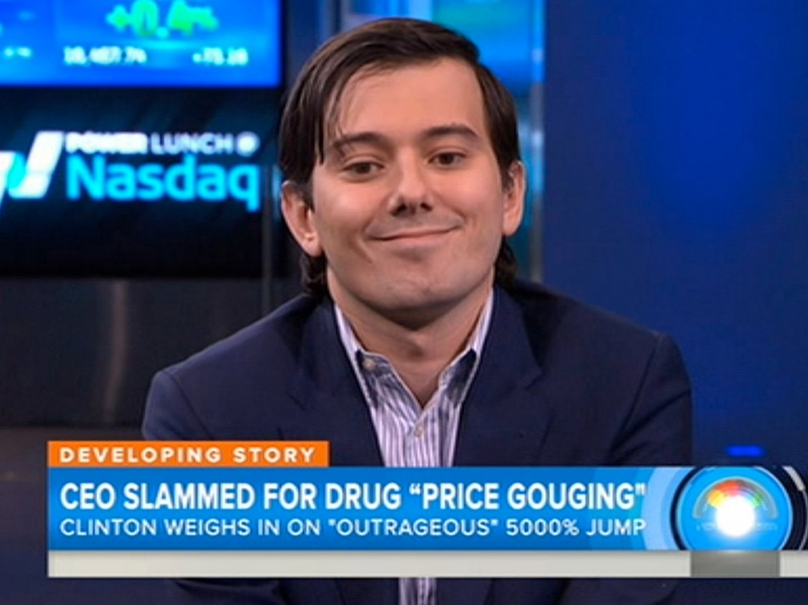

The potential for structural violence in drug pricing
High prices charged by some drug companies can be seen as predatory
Few drug companies have ever been found legally criminal, but a few individuals have
Developing countries have several international trade law provisions to help them buy life-saving medicines at affordable prices for public health needs, particularly for HIV/AIDS.
Notes:
In 2015, the CEO of Turing Pharmaceuticals, increased the price of a recently acquired drug from $13.50 to $750 a pill. The medicine, Daraprim, is used to combat parasites, especially for patients with immune-system deficiencies like HIV. https://www.who.int/bulletin/volumes/84/5/news10506/en/
https://www.carnegiecouncil.org/publications/ethics_onfilm/0011

Slide 28
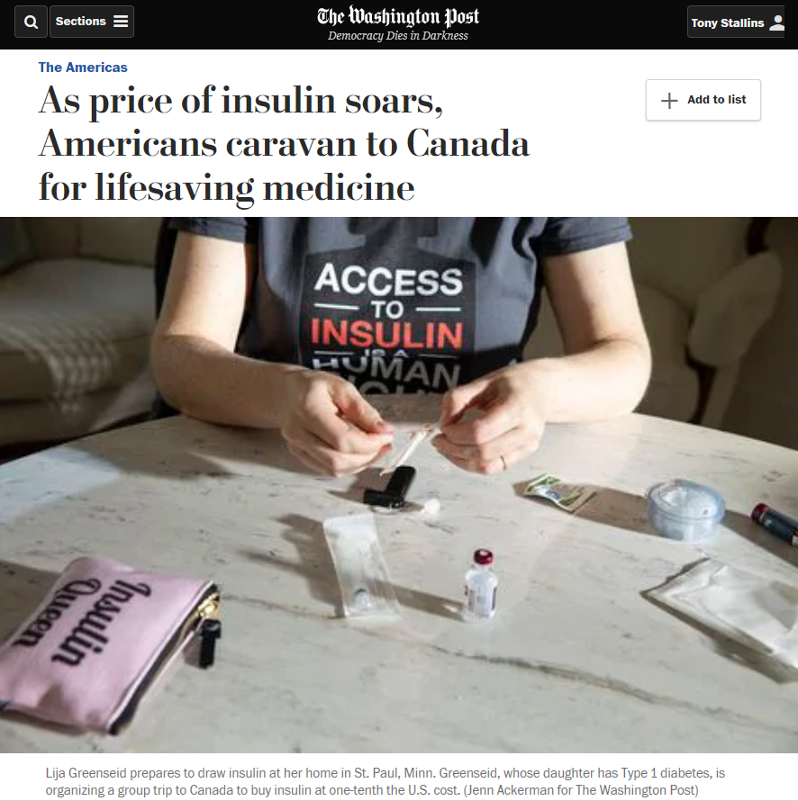
But only a few countries are using these trade law provisions because these programs are complex and hard to decipher and can end up as a barrier for those with fewer resources to pursue them.
Even in the US, access to some drugs at an affordable price is often not possible, even for the insured. If programs exist to obtain them for less, they too may also have a labyrinthine application process.
E
Notes:
Political pressures to accept higher priced drugs may even be applied. For example, a country in a position of power may call for trade policies to force a country to accept higher prices for drugs. “We won’t import your products if you don’t accept our high drug prices” Many other drugs are often purchased at much lower prices in Canada.
https://www.who.int/bulletin/volumes/84/5/news10506/en/
https://www.carnegiecouncil.org/publications/ethics_onfilm/0011
https://www.washingtonpost.com/world/the_americas/as-price-of-insulin-soars-americans-caravan-to-canada-for-lifesaving-medicine/2019/06/14/0a272fb6-8217-11e9-9a67-a687ca99fb3d_story.html?noredirect=on

Slide 29
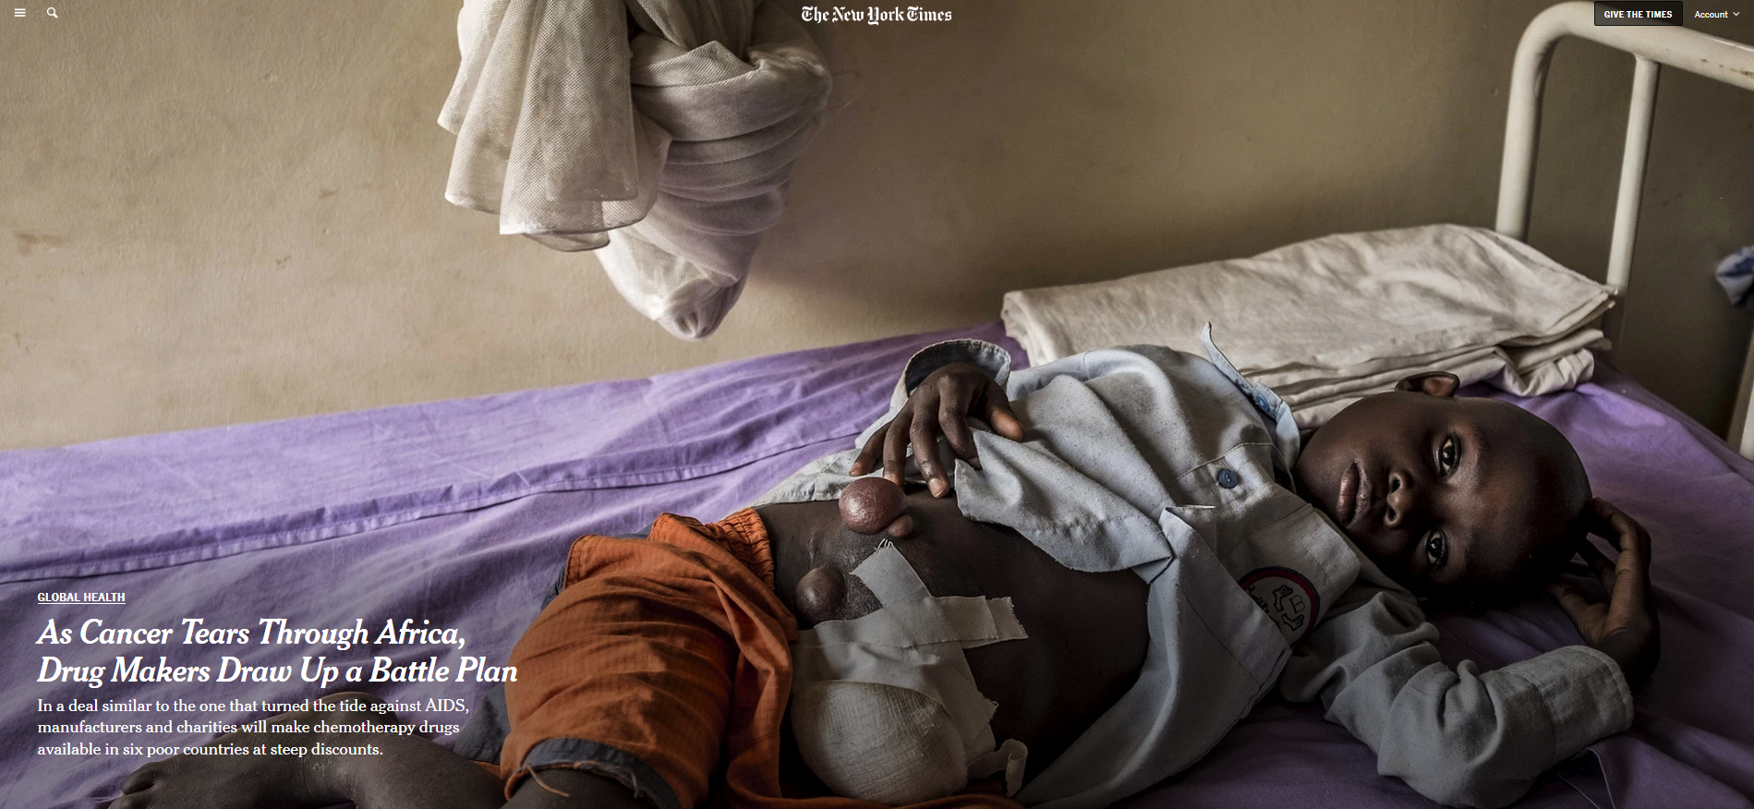
Pharmaceutical corporations differ in their policies toward making drugs available at discounts. Development of new drugs can be an expensive endeavor, and incentives to do the research need to be in place.
Notes:
Private corporatization does not automatically correlate to pervasive ‘evil’, harm and greed. Large corporations and institutions can do things that small entities cannot. Structural violence emerges as a byproduct of size of a company and the way in which aspects of a large system can work against the goals of the company in unexpected ways. Structural violence is in this sense a systems issue in addition to one of power, economics, and politics.

Slide 30
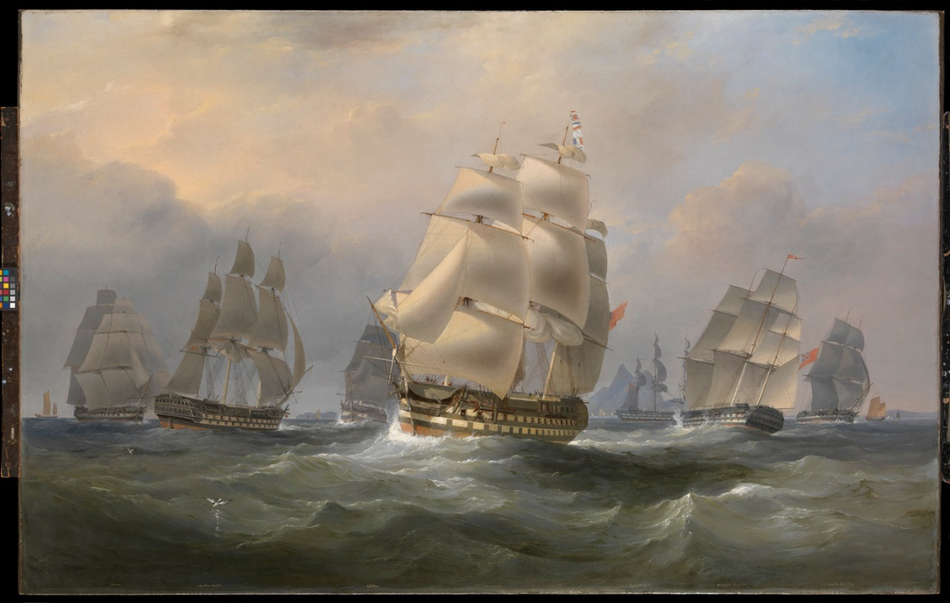
The origins of global health

Slide 31
The origins of global health: European colonization and colonial medicine
Colonial power expanded rapidly in the 15th century with the advent of navigational innovations.
Lands and people in Africa, Central and South America, and the Caribbean fell under the rule of colonial powers emanating from England, France, Germany, Italy, Spain and Portugal, and the U.S. up through the middle of the 20th century
Many of the attributes of global health and medicine today were unintended consequences of the colonial era
.
Notes:
HIV-AIDS, SARS make it seem that global health perspectives are new. But their global focus are not entirely novel. The origins of global health are in colonial era medicine.

Slide 32
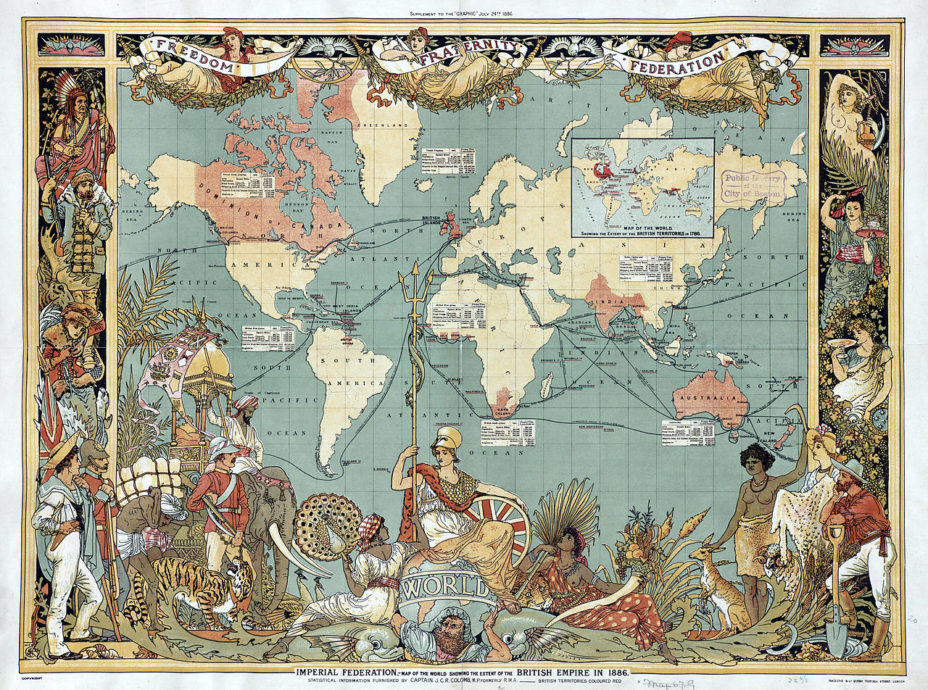
The Columbian Exchange
Refers to the beginning of a transformation of the globe beginning with Columbus and early European explorers reaching the Americas.
A global movement of people, but also of animals, plants, and pathogens as European countries colonized the world
Brought with it an exchange of disease-causing bacteria and viruses, as well as animals that served as a source of zoonotic diseases

Slide 33
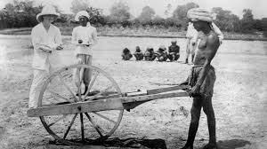
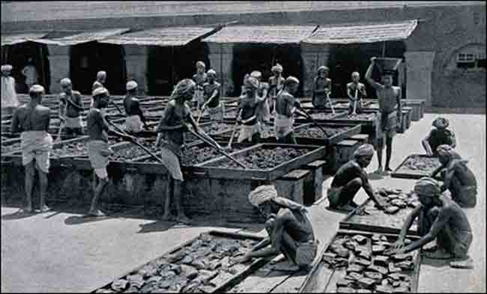
Europeans brought measles, smallpox, and tuberculosis which killed millions in the Americas
However, the indigenous people were also seen as a commodity, whose health was necessary in order to profit from their labor.
This spurred research into how to maintain the health of laborers as well as the civil servants serving their colonial masters.

Slide 34
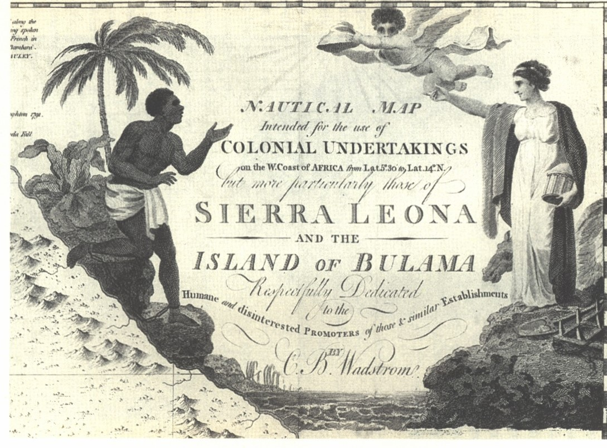
European encountered new tropical diseases as they travelled around the world.
Mortality along the Gold Coast of West Africa was 300-700 per 1000 colonizers in early 1800's.
This spurred research into the causes of disease among the colonizers.
.

Slide 35
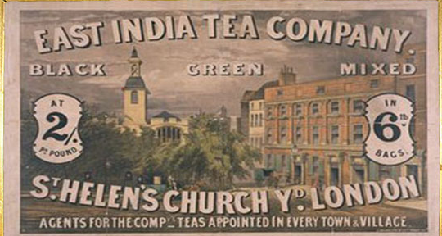
Disease traveled back to Europe from colonized countries in Asia and Africa.
Indian Ocean shipping lanes of the British Empire in the first decades of the 20th century provided new routes for the transmission of cholera.
Cholera that began in India could impact the manufacturing towns of France and England
Thus the health of others in distant land was realized as being important for the health of others far away.
.

Slide 36
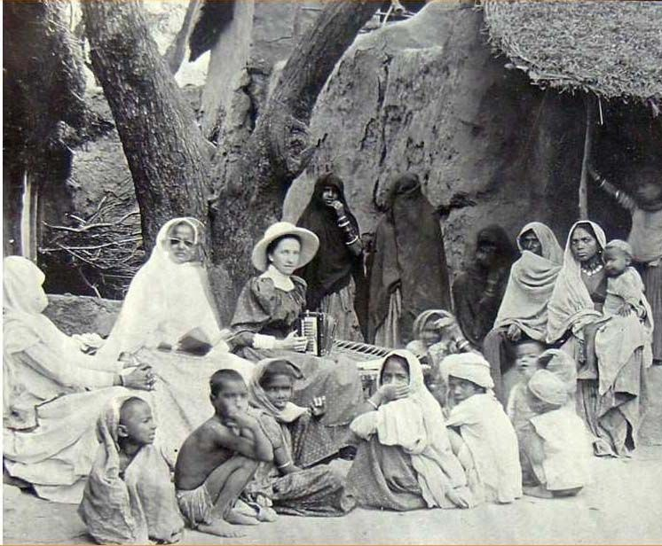
Medicine was used as a pretext for colonial rule
The constructive imperialism argument
Holds that one of the aims of colonization should be medical.
Colonialism could be presented as beneficial, it helped the locals.
However, colonial medicine became an agent of penetration and pacification.
Often medical care was limited to those who agreed to be ruled or who provided labor and other services
Notes:
During the colonial period, the practice of “Doctory” or Western medicine gained momentum in India, buoyed with the support of the British as well as Western-educated Indians. Many Indians were trained in Western medicine and employed by the administration as “native doctors” in the medical service for Indians, and the superior medical service by and large comprised Europeans.
When these people lived outside of the major colonial cities, the first field-based public health programs were begun.
Saini, A. (2016). Physicians of colonial India (1757–1900). Journal of Family Medicine and Primary Care, 5(3), 528.
Photo of woman missionary in India in 1900s
This paternalistic stance – we will take care of you – was common for many colonial relationships

Slide 37
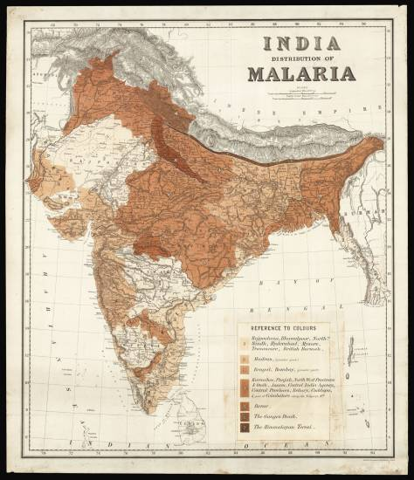
The infrastructure of imperialism argument
Medical care and doctors were needed to keep the military and administrative officers of the ruling power healthy, as well as the ruled citizenry who labored in the service of empire.
Medical care was essential to maintaining power of the colonize
Notes:
https://www.crouchrarebooks.com/maps/view/distribution-of-malaria-in-british-india
Map is from 1880 – malaria was a serious illness for the British in India and in many of their tropical colonies
Formation of the London School of Tropical Medicine in 1899 was meant to foster this kind of imperial medicine.

Slide 38
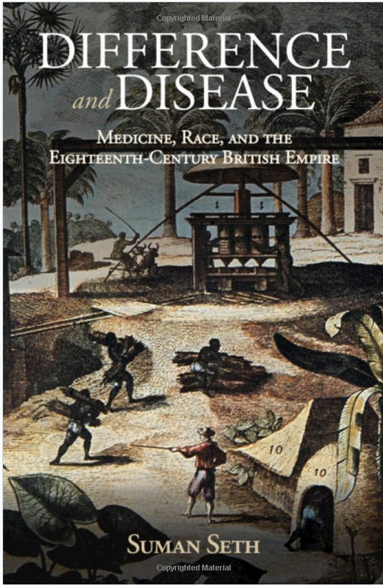
Discourses about the health of the colonized were used to justify the actions of the colonizers
British mortality rates in 1835 were 12:1000 in the United Kingdom, but 500:1000 when stationed in west Africa.
Africans did not have these high mortality rates
This gave way to the idea that the native bodies were better suited or ‘seasoned’ to labor in these hot climates, in Africa and in the slave trade in the Americas.
Slavery was also justified by the socially-constructed idea that Africans did not feel pain like white people
Even today, myths still remain about racial differences
Notes:
https://news.cornell.edu/stories/2018/10/acclimate-or-die-book-examines-disease-british-empire

Slide 39
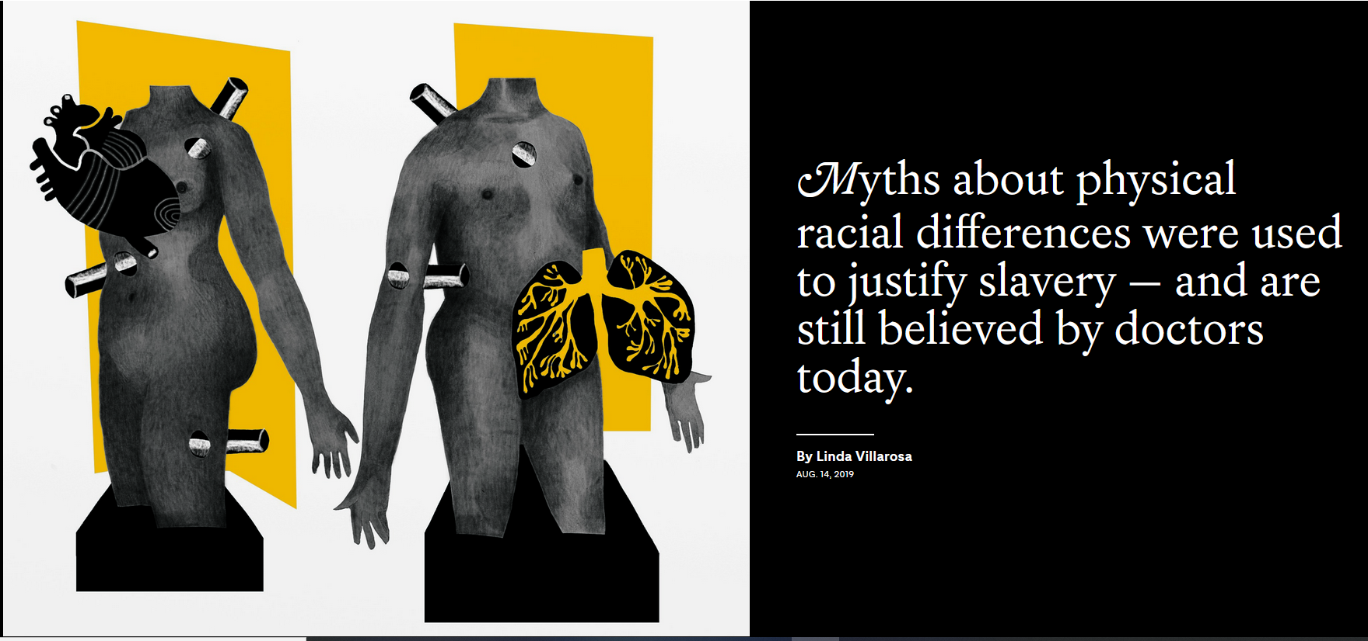
Notes:
https://www.nytimes.com/interactive/2019/08/14/magazine/racial-differences-doctors.html?smid=nytcore-ios-share The pain myth still exists: https://www.nytimes.com/2019/11/25/upshot/opioid-epidemic-blacks.html

Slide 40
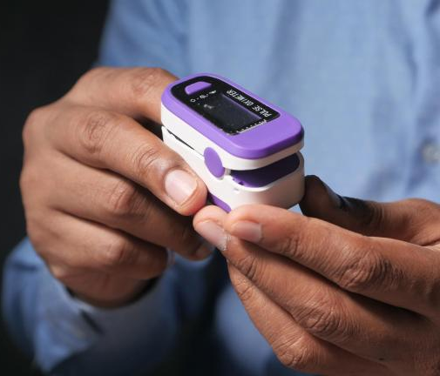
Pulse oximeters
Measure oxygen levels
Variations in skin pigmentation can affect the accuracy of these readings.
Darker skin contains more melanin, which can interfere with the absorption of light
This can lead to overestimation of oxygen saturation and the delay of intervention for people with darker skin
Another example of the translational gap
Notes:
Another example of the translational gap, this time for a medical instrument. There are some differences in biology that need to be taken into account, like this failure of the designers of the oximeters to account for skin color, but often it is the social context, and issues of power and inequity, that account for differences in disease more than any biological difference. Just keep in mind that not everything is cultural nor is everything biological, they can each contribute. A study published in the New England Journal of Medicine in 2020 found that Black patients were nearly three times as likely as white patients to have occult hypoxemia (low oxygen levels that are not detected by pulse oximeters). Another study published in the Journal of the American Medical Association (JAMA) in 2022 supported these findings, highlighting the need for improved pulse oximeter technology that accounts for skin pigmentation. Sjoding, M. W., Dickson, R. P., Iwashyna, T. J., Gay, S. E., & Valley, T. S. (2020). Racial Bias in Pulse Oximetry Measurement. New England Journal of Medicine, 383(25), 2477-2478. DOI: 10.1056/NEJMc2029240
Valbuena, V. S. M., Seelye, S., Sjoding, M. W., et al. (2022). Racial Disparities in the Accuracy of Pulse Oximetry and Clinical Outcomes in Patients With COVID-19 Infection. JAMA Internal Medicine. DOI: 10.1001/jamainternmed.2022.1906
https://www.nhlbi.nih.gov/news/2023/updating-pulse-oximeters New ‘green’ light oximeters can accommodate skin color differences

Slide 41
What are specific historical events leading to the emergence of global health?
Through expeditions in Egypt and India, the microbiologist Robert Koch isolated Vibrio cholerae in 1883, proving that heat and humidity were not barriers to tropical colonization – many of the time thought it was the ‘bad air’ of the tropics that caused cholera. It was this bacterium according to Koch.
The still relatively new idea of germ theory developed by Pasteur also implied that addressing the problem of germs would allow new tropical lands to be made more accessible.
Formation of the London School of Tropical Medicine in 1899 was meant to foster this kind of imperial medicine. This is another way in which global health had its origins in colonialism.
Notes:
Imperial medicine aimed to make it safe for Europeans to travel to other parts of the world.

Slide 42
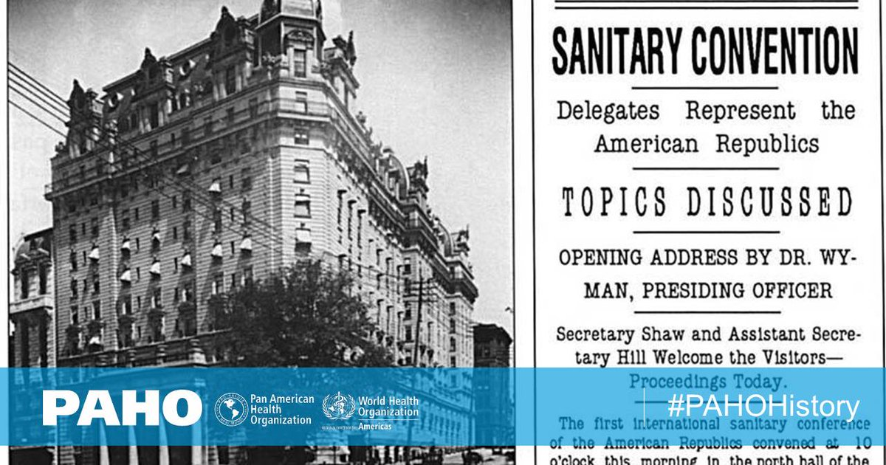
The Pan American Sanitary Bureau (the Pan American Health Organization today) was formed to coordinate the ultimately successful international effort to control yellow fever during the construction of the canal (1903-1914)

Slide 43
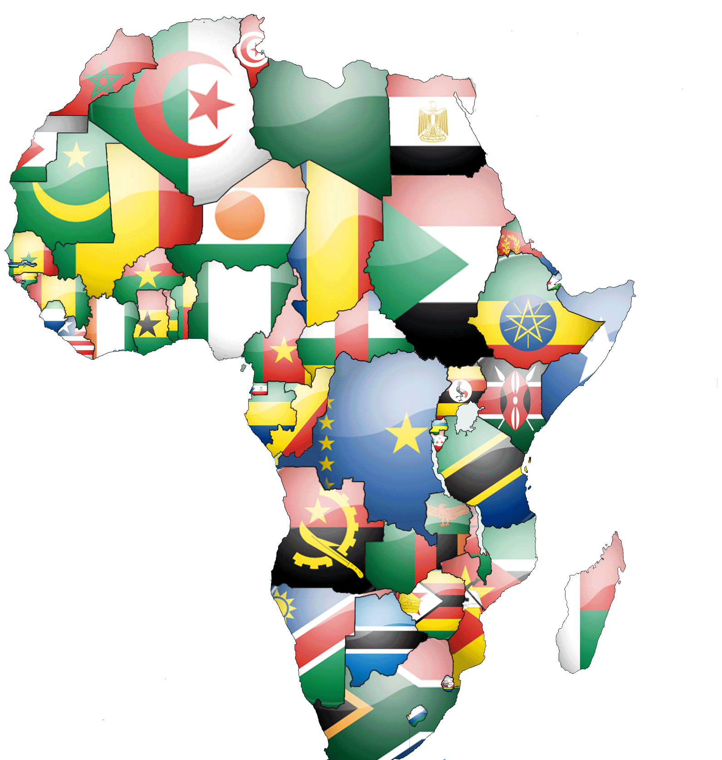
After World War 2, colonial power weakens throughout Asia and Africa and the era of colonial revolutions and self-determination begins.
Global political and economic power becomes focused on contrasts in development among wealthier and more recently formed and poorer countries
Internationalization of health along issues of health equity became more important under the newly formed United Nations in 1945

Slide 44
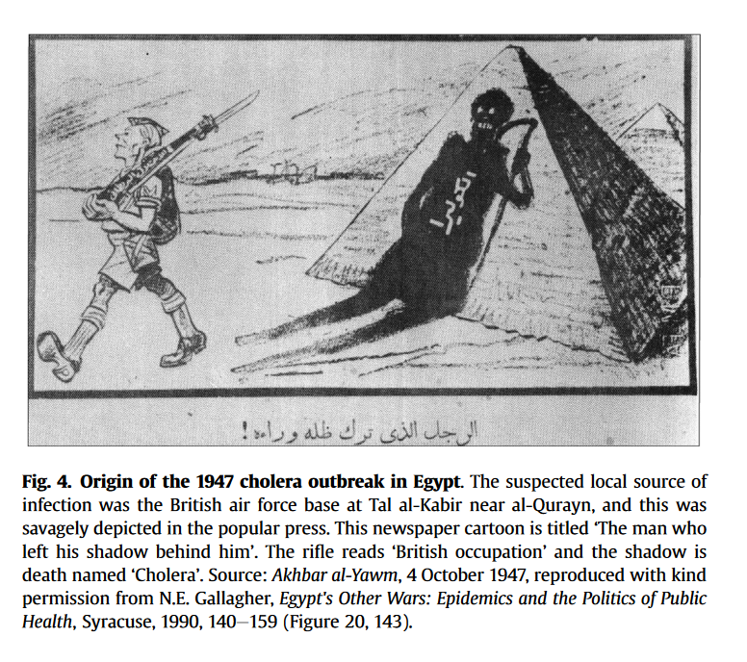
Planning for the World Health Organization began at a 1945 meeting of the United Nations
WHO originally promoted by Brazil and China (not the U.S. or Europe)
WHO aimed to have global membership
1947 saw the first crisis of WHO, a cholera outbreak in Egypt. WHO succeeded in preventing neighboring countries from imposing damaging quarantines; provided rehydration treatments, deployed sanitation measures and vaccination.
Notes:
Smallman-Raynor, M., & Cliff, A. D. (2016). The diffusion of cholera in Egypt, 1947: a time-space analysis of one of the largest single outbreaks in the twentieth century. Journal of Historical Geography, 54, 24-37.

Slide 45
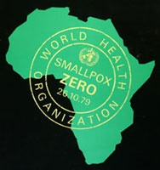
With greater international legitimacy, WHO was formally established in 1948.
1955 WHO proposed global eradication of malaria, a disease most common in tropical countries of former colonies of Africa, Asia, and South America, although this attempt failed
1967 WHO began drive to eradicate smallpox, which was ultimately successful, twelve years later, in 1979

Slide 46
The legacies of colonialism in global health today
“Command-and-control” top-down administration of responses to global health issues: wealthier countries and global health institutions often dictate terms to poorer countries
Eradication of a disease often stressed more than the long-term efforts to strengthen existing health systems and address the social and economic origins of disease in poor countries
Although wealthier nations now extend health care help in a global context, their former colonial governments aimed to keep developing nations less economically empowered, sometimes for centuries
Call are being made to ‘decolonize’ global health

Slide 47
Types of colonial institutions
Institutions of settler colonies (U.S., Canada, Australia)
Low indigenous population density and low mortality for Europeans, so Europeans settled in large numbers. The colonial countries built inclusive institutions to motivate settlers through the inclusion of property rights and a rule of law. These colonies contributed less wealth to their European rulers.
Institutions of extractive colonies (Congo, India, Peru)
High indigenous population density and high settler mortality due to disease led to fewer European settlers. Goal became to extract resources using local labor with minimal settler involvement. This led to the creation of extractive colonial institutions: coercion, and centralized power in elites. These colonies and their institutions generated large amounts of wealth for the colonizers.

Slide 48
Post-colonial reversals of wealth
In 1500, densely populated regions in South America (Inca), India (Mughal) and Mexico (Aztec) were centers of wealth for the colonizers
However, today these formerly rich regions are more often poorer, and poor regions during the colonial era are now wealthier.
This is because extractive institutions persisted after independence from colonizers
Inclusive colonial institutions were more likely to facilitate economic growth and innovation
Today’s global inequality in health and wealth reflects these path-dependent colonial choices

Slide 49
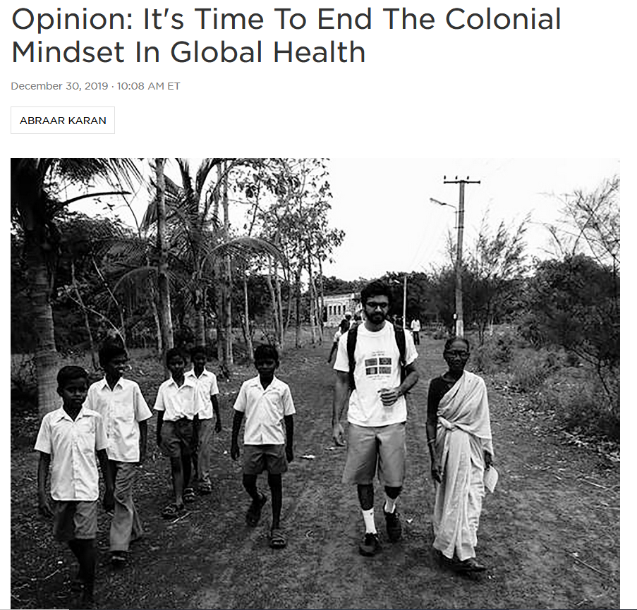
What does “decolonializing” global health mean?
Addressing the legacy of power and control left by colonialism on global health
Global health research largely dominated by Western researchers building their careers off studies of people who may not benefit from their participation
Relationships within global health are still heavily dominated by the idea that the Global North is "helping" the Global South.
Notes:
https://www.npr.org/sections/goatsandsoda/2019/12/30/784392315/opinion-its-time-to-end-the-colonial-mindset-in-global-health

Slide 50
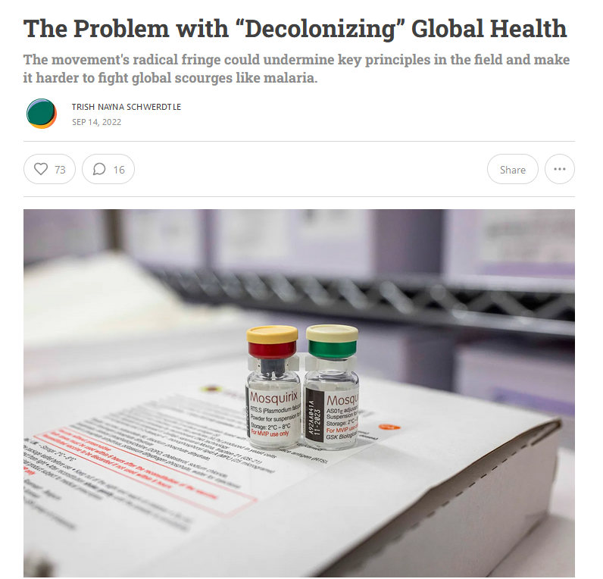
Extreme advocates of the decolonization of global health have gone so far as to call for the field of global health to be dismantled altogether.
They criticize it as being ‘safari science’
The danger is that in efforts to remedy lingering impacts of colonialism, some of the benefits of a global viewpoint on health could be lost
Notes:
https://www.persuasion.community/p/the-problem-with-decolonizing-global

Slide 51

What is ‘safari science’?
Derogatory label given to ‘extractive’ scientific studies that take place in developing world by scientists from wealthier nations
Local investigators in low-income countries (LIC) function more as data collectors and translators than fully vested collaborators.
Funding originates from high-income countries (HIC) and most money goes to researchers and labs of these countries
Research questions guided by agencies in HIC rather than by LIC priorities
Samples and data are extracted and housed outside of the countries where they originated
Benefits may not prioritize the countries where the research took place
Notes:
Mutapi, Francisca. "Africa should set its own health-research agenda." Nature 575.7784 (2019): 567.
https://www.nature.com/articles/d41586-019-03627-9

