Slide 1
Air pollution is an underrecognized and insufficiently addressed global health issue
10 million deaths globally each year due to air pollution, with most deaths attributable to the particulate matter (PM) component of air pollution.
The average human on earth would live 2-3 years longer if air contained no particulate matter. This can range up to ten years for some cities in south Asia today
Particulate matter has long been linked to heart and lung disease. But it may also be linked to increased childhood mortality, degenerative brain diseases such as Alzheimer’s, stillbirth and reduce birth weight, and reduced intelligence and cognitive performance.
Notes:
By comparison, smoking cigarettes cuts life expectancy by about 1.9 years, while drinking alcohol reduces it by eight months. Unsafe water and sanitation lead to a seven-month reduction in life expectancy. Conflict and terrorism shave off just nine days. Ten million premature deaths every 12 months is 100 million a decade. It would be a global emergency if Martians came to Earth and sprayed a substance that caused the average person on the planet to lose more than 2-3 years of life expectancy. This is similar to the situation that prevails in many parts of the world except we are spraying the substance, not some invaders from outer space https://www.thelancet.com/commissions/pollution-and-health
https://epic.uchicago.edu/news/most-of-the-world-breathes-unsafe-air-taking-more-than-2-years-off-global-life-expectancy/
https://www.ssph-journal.org/articles/10.3389/ijph.2021.1604465/full

Slide 2
Why are the health impacts of air pollution downplayed?
It is difficult to assign direct causality to death from air pollution. Most often, death is attributed to COPD (chronic obstructive pulmonary disease, which includes emphysema), cancers of the lung and upper digestive tract, asthma, and heart attack and stroke.
Air pollution can produce immense toll because billions of people are exposed each day and we tend to downplay the risks when the problem is so pervasive – the normalization of risk.
Those who dismiss air pollution invoke these misleading and erroneous statements like “It only hurts those who are already sick” or “We don’t know enough about the science of how it impacts health”.

Slide 3
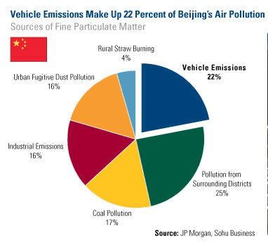
Particulate matter (PM)
Particulate matter is the air pollutant most responsible for shortening lives
These are the particles that occur in the air due to fuel combustion, wildfires, and natural sources of dust
Fossil fuel combustion and manufacturing is the major source of PM in higher-income countries
Agricultural fires and the burning of biomass to cook or heat homes increases in importance in lower-income countries.
Cities and regions differ in the sources of their particulate matter

Slide 4
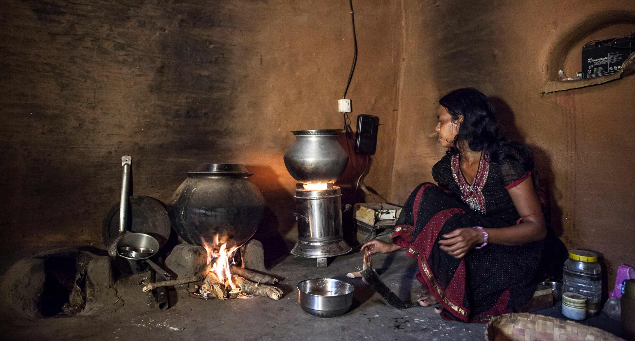
Notes:
https://today.ucsd.edu/story/creating_a_new_kind_of_climate_warrior

Slide 5
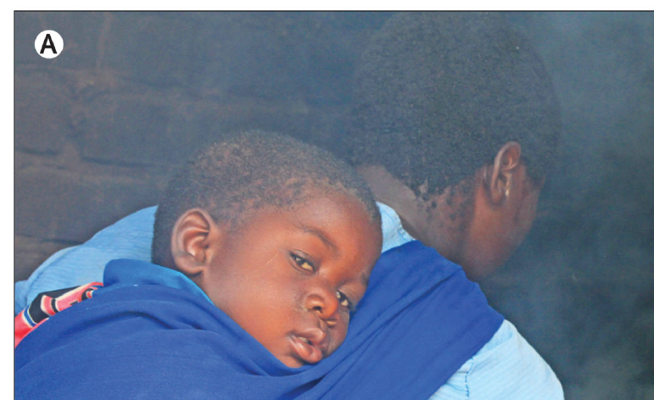
Household air pollution (HAP)
A third of the world (around three billion people) use biomass (wood, dung, crop stubble) and other raw to slightly processed cooking fuels (e.g., charcoal, coal, kerosene) worldwide.
Most often used for cooking in developing countries.
PM from HAP is associated with approximately 3.5 million deaths annually – it rivals ambient (outdoor) PM
The health burden is unevenly distributed as women and children are more often exposed to cooking fires
However, exposures to HAP are declining
Notes:
Natural gas (like in your home) is a mixture of several gases, including propane. Gordon, S. B., Bruce, N. G., Grigg, J., Hibberd, P. L., Kurmi, O. P., Lam, K. B. H., ... & Bar-Zeev, N. (2014). Respiratory risks from household air pollution in low and middle income countries. The Lancet Respiratory Medicine, 2(10), 823-860.
In most cultures, women have a leading role in domestic cooking, with men cooking when at work or away from home. In the typical domestic context, therefore, women have several periods of intense cooking smoke exposure per day. Young children and infants, typically carried on the back or placed near their mother to sleep, are also exposed to these short, very high level, exposures to smoke. There is particular concern when young children are exposed to smoke because data suggest that smoke exposure during the window of developmental susceptibility in early life is particularly detrimental

Slide 6
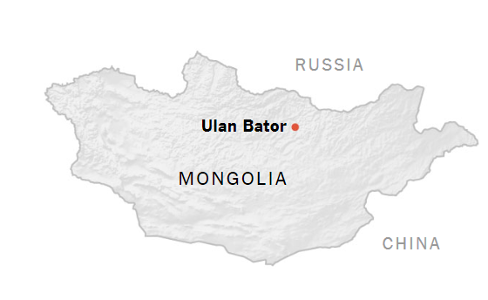
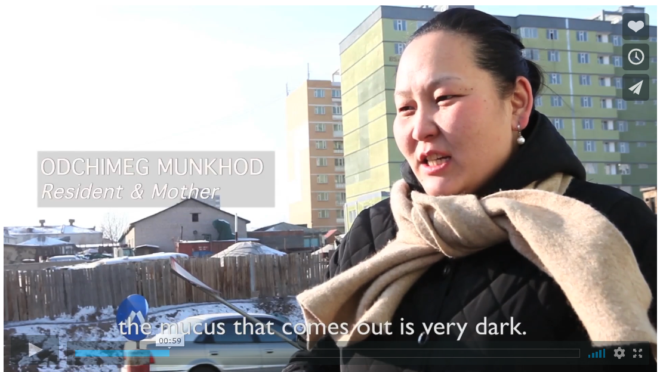
Ulan Bator, Mongolia
Outdoor (ambient) and indoor HAP are both exceedingly high.
Rural migration into Ulan Bator has created informal settlements outside cities that are dependent upon coal for heat and cooking in the cold climate.
Migrants cannot afford other kinds of housing
Video
Notes:
But there is one place where particulate matter pollution can exceed New Delhi and Beijing: Ulaanbaatar, Mongolia. Outdoor (ambient) and HAP are both exceedingly high. But it is a far smaller city than New Delhi, 1.5 million residents in Ulaanbaatar compared to 22 million in New Delhi https://www.pri.org/stories/2013-03-08/location-video-mongolia-cleaning-one-worlds-most-polluted-cities https://www.youtube.com/watch?v=4Etvek2ZQHQ

Slide 7
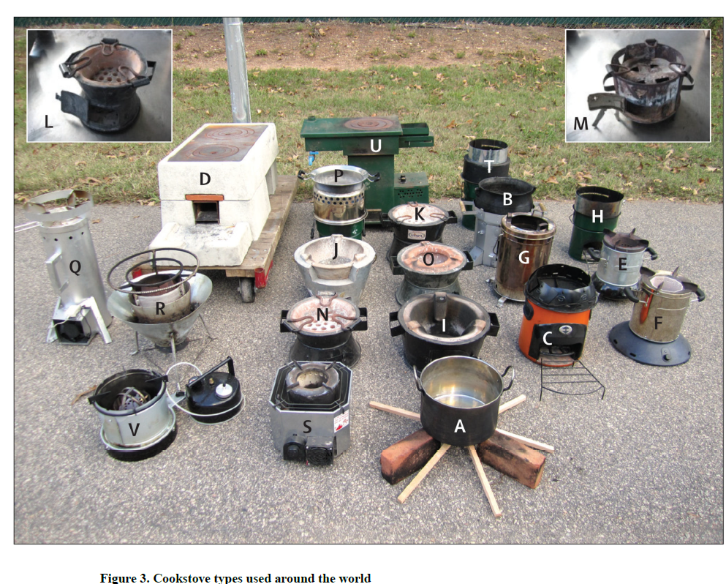
Notes:
Cookstove types from around the world (or how many people of the world cook their meals)
Gordon, S. B., Bruce, N. G., Grigg, J., Hibberd, P. L., Kurmi, O. P., Lam, K. B. H., ... & Bar-Zeev, N. (2014). Respiratory risks from household air pollution in low and middle income countries. The Lancet Respiratory Medicine, 2(10), 823-860.

Slide 8
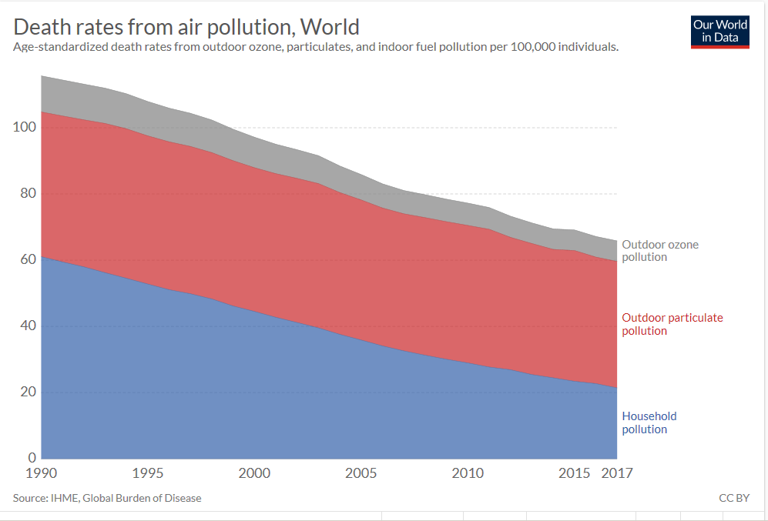
Notes:
https://ourworldindata.org/air-pollution
Note that the death rates from HAP have declined more than rates for outdoor (ambient) particulate matter pollution. Innovations in cookstoves, more education about the hazards of indoor pollution, and development that leads to the availability of cleaner energy sources are all part of this improvement in the hazards of household air pollution.

Slide 9
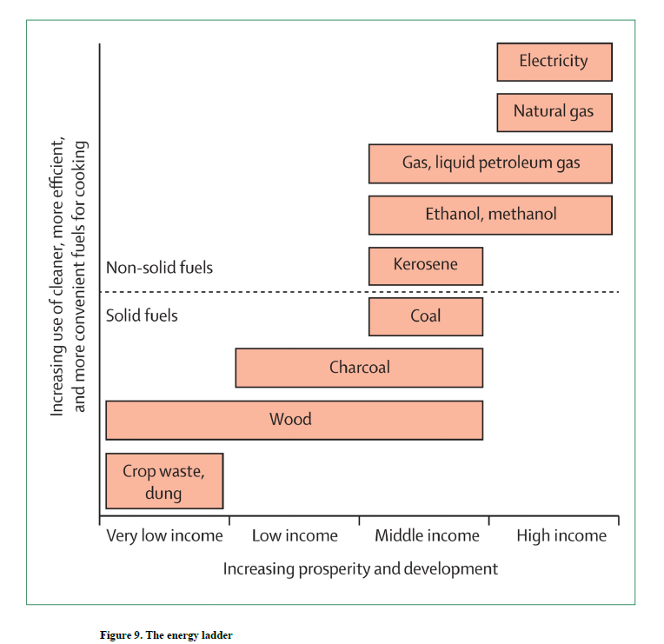
The energy ladder
At the bottom of the energy ladder are cheaper forms of fuel (charcoal, wood, dung, crop residues).
These are polluting fuels with both poor combustibility and toxic emissions.
Simple homes built with mud, thatch, and animal skins rarely have a chimney and, when present, the chimney is usually a simple vent with no air-drawing flue
Electricity, propane, and natural gas are considered clean cooking fuels and promoted by the WHO.
Notes:
Gordon, S. B., Bruce, N. G., Grigg, J., Hibberd, P. L., Kurmi, O. P., Lam, K. B. H., ... & Bar-Zeev, N. (2014). Respiratory risks from household air pollution in low and middle income countries. The Lancet Respiratory Medicine, 2(10), 823-860.

Slide 10
Factors shaping the cooking fuel transition
In a typical progression up the energy ladder: households move away from biomass (firewood, dung) to transitional fuels (coal, kerosene) and then to modern fuels (propane, natural gas, and electricity).
Factors that shape this transition
There has to be sufficient household income, stability in fuel prices, and infrastructure to provide new fuel sources
Gender and family roles shape this transition too: head of households in developing countries are often male and tend to base energy and appliance purchase decisions on their preferences and needs.
Advanced energy sources may not facilitate preparation of foods that are part of the traditional diet.
Notes:
DOI: 10.1111/gec3.12469

Slide 11
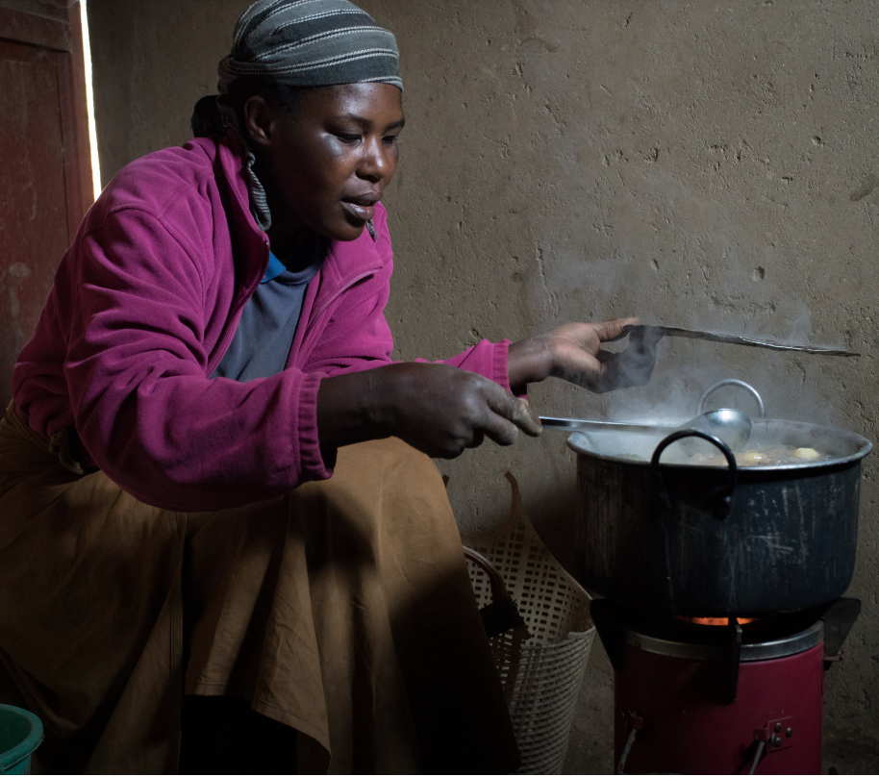
Fuel choice is also a matter of climate. In colder climates preferences may remain with firewood and firewood stoves, rather than propane or electivity, as wood can be used to cook and provide heat at the same time
Innovations in cooking stoves can make as much difference as switching fuels.
Notes:
Schunder, T., & Bagchi‐Sen, S. (2019). Understanding the household cooking fuel transition. Geography Compass, 13(11), e12469. DOI: 10.1111/gec3.12469
https://www.nytimes.com/2018/12/06/business/rwanda-charcoal-pellet-stoves-.html

Slide 12
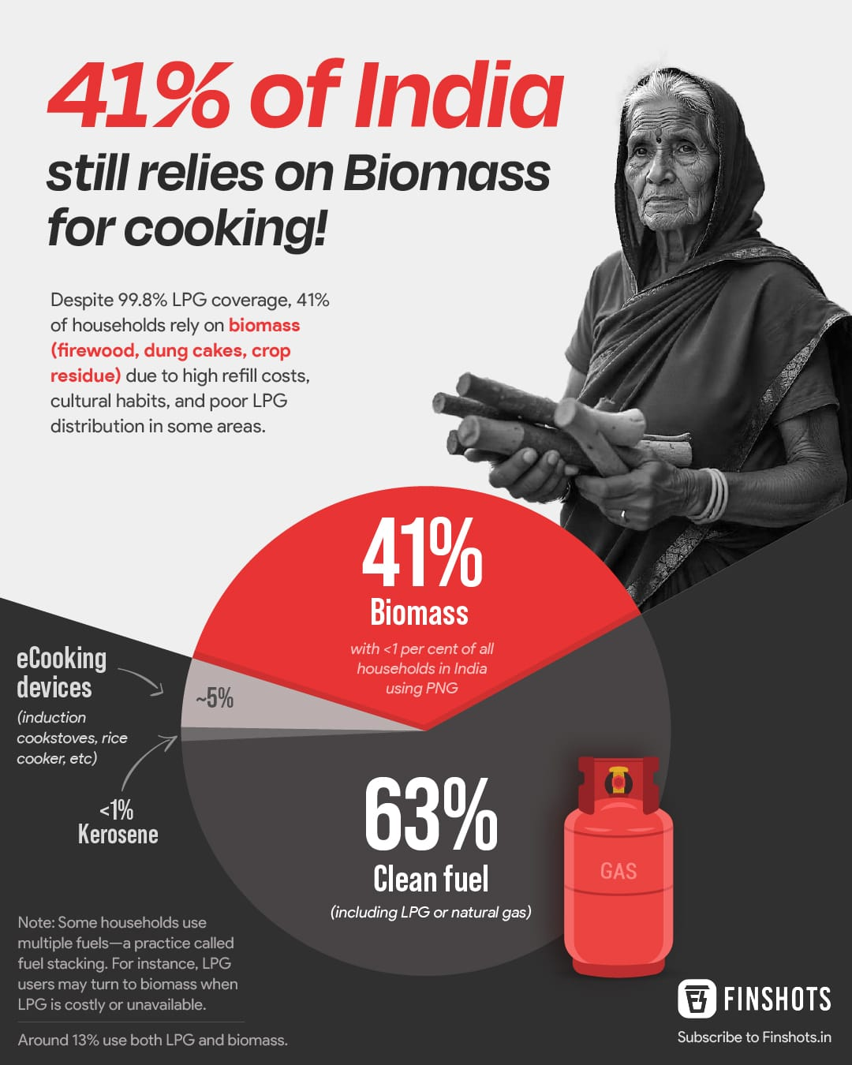
Fuel stacking
Households rarely use a single fuel source – the concept of a moving up a ladder step by step is an oversimplification
Households in the developing world may end up using several different sources of fuel
Combinations of electricity, LPG, biomass and charcoal are used depending upon task, location (urban or rural), time of year, and the condition and predictability of the infrastructure or labor to provide fuel

Slide 13
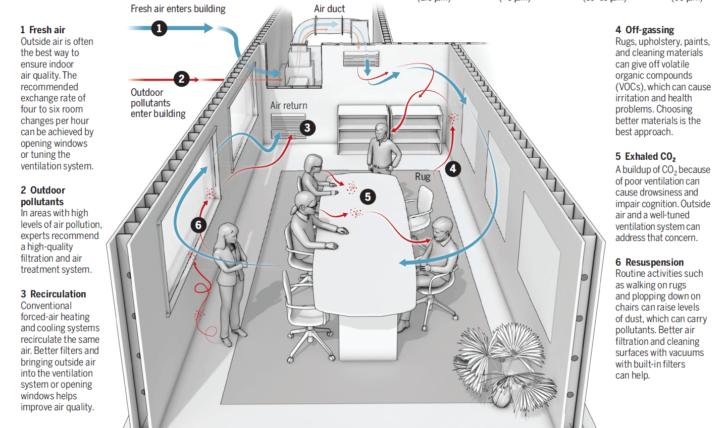
HAP in developed countries
Notes:
The push to make homes more energy efficient had the initial effect of holding in more pollutants and increasing CO2 levels. Green certified homes often now include a ventilation plan to address this.

Slide 14

Natural gas versus electric stoves in developed regions
Your typical natural gas kitchen stoves produce HAP and are considered unhealthy
Transition to electric cookstoves diminishes HAP
Electric induction stoves are increasing in popularity in developed countries
Gas to electric cookstove transitions, when the grid is green, can achieve both climate and health benefits.
Notes:
https://sustainability.stanford.edu/news/ecuador-emissions-and-hospitalizations-fell-lockstep-electric-stove-adoption

