Slide 1
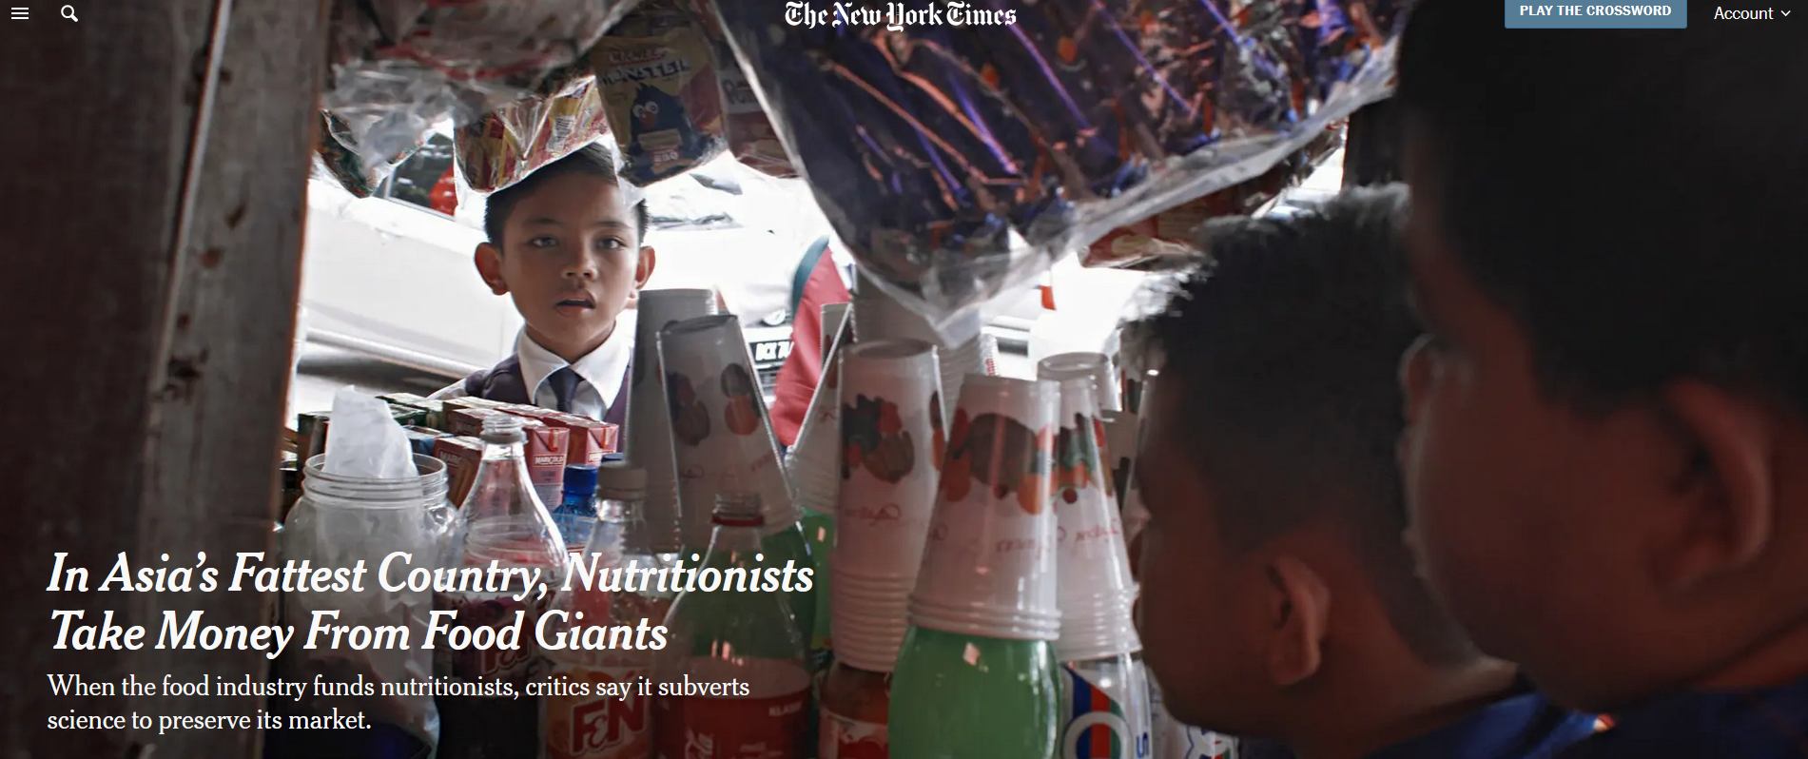
Notes:
https://www.nytimes.com/2017/12/23/health/obesity-malaysia-nestle.html
An example of neocolonialism. Multinational food companies can exert influence on the affairs of countries with less political and economic power. They may exert influence on politicians to open up their countries to business from their companies.

Slide 2
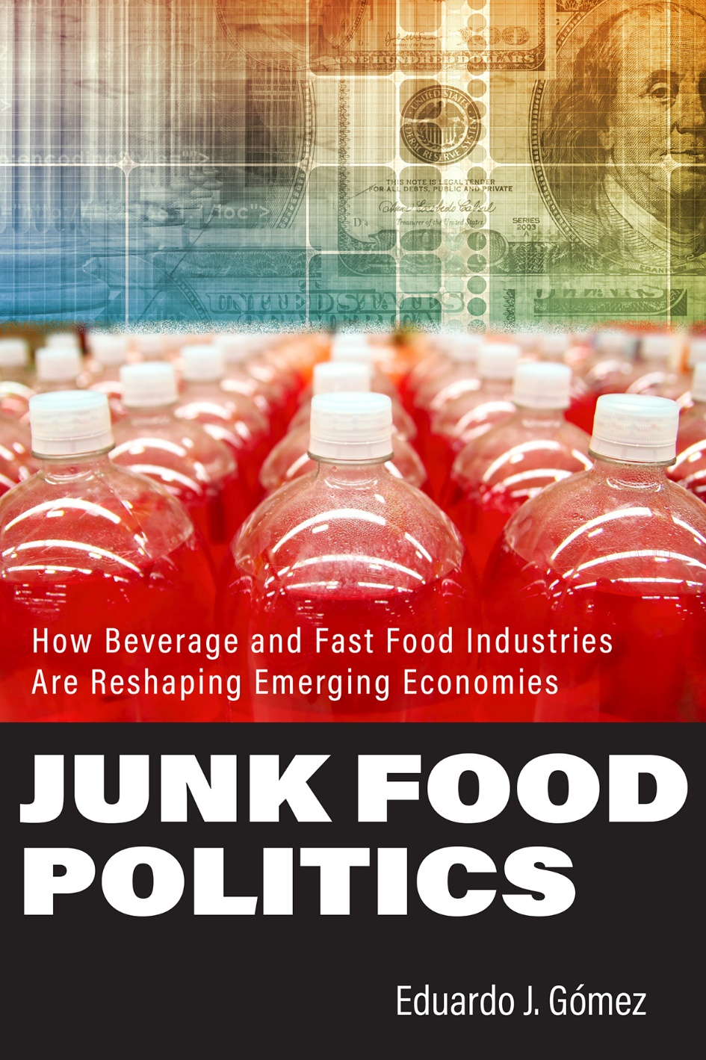
Neocolonialism
  Exertion of power in affairs of other countries like colonialism but with less direct manipulation
  Geopolitical practice of using capitalism, business globalization, and cultural imperialism to influence a country without direct military or political control
Examples
  Multinational food companies can compel national governments to allow market access to sell their products.
  Scientists and nutritionists in national governments are recruited by multinationals to promote their products

Slide 3
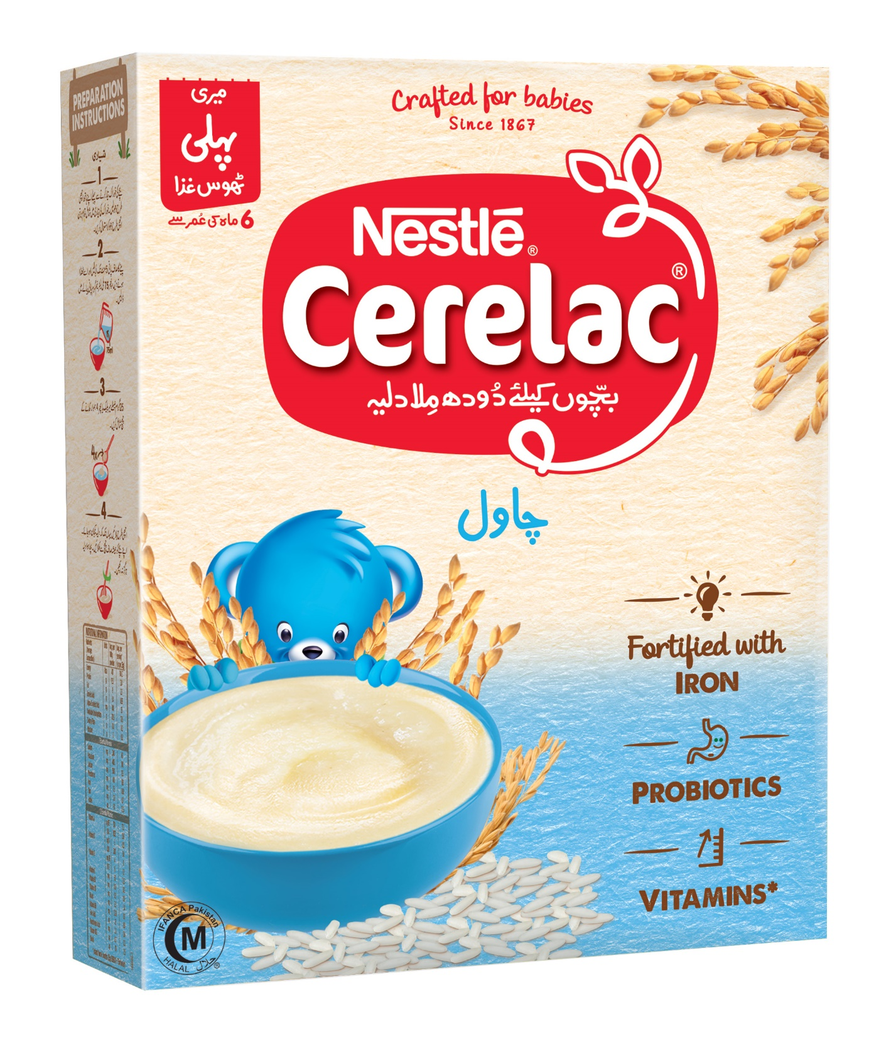
Cerelac instant cereal is one of Nestlé’s best-selling baby food brands with revenues close to a billion dollars.
In Thailand, Ethiopia, South Africa, India and Bangladesh, among others, Nestlé added up to 6 grams of sugar per serving of Cerelac.
Cerelac sold in the Philippines contained 7.3 grams per serving.
In several countries, including the Philippines, Nigeria, Senegal, Vietnam and Pakistan, added sugar content not declared on the packaging.
Sold containing zero sugar in Britain and Germany
Notes:
Nestle is a multinational company that sells food globally.
In European countries, consumer pressure has driven Nestlé to remove added sugar from their baby food products. The company decided to continue adding sugar in lower-income countries
https://www.washingtonpost.com/world/2024/04/23/nestle-sugar-baby-food-childhood-obesity/

Slide 4
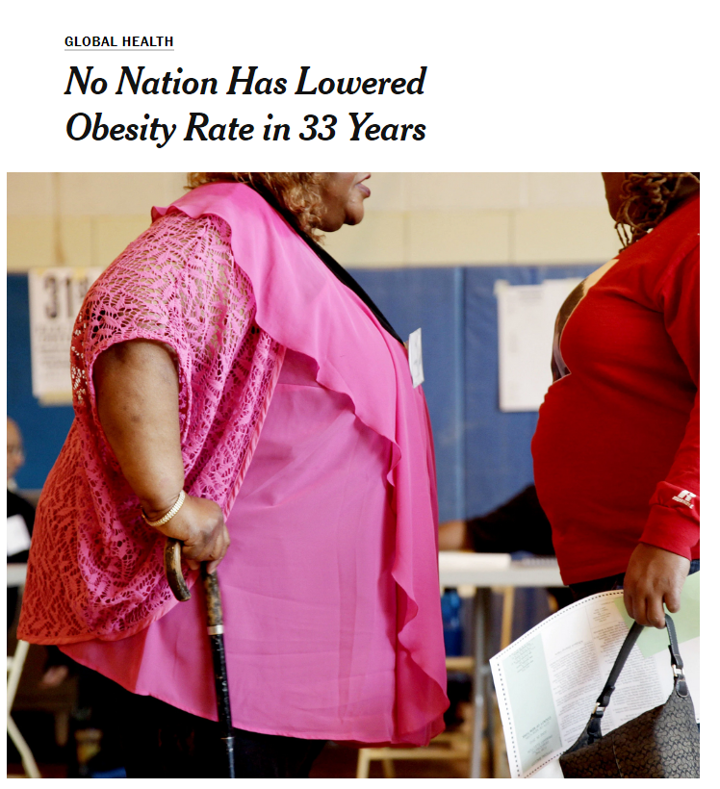
Interventions
Taxation of unhealthy, ultra-processed foods and beverages (Mexico, Norway and others)
Front-of package nutrition labels for foods with low nutritional or health value (Chile and others)
Banning the construction of new fast food drive thrus (parts of US)
Restricting junk-food marketing to kids (Canada, Ireland)
Taxation of local governments and companies if citizens and workers exceed health standards on weight and waist size (Japan)
Notes:
https://www.npr.org/sections/thesalt/2019/10/10/765789694/why-u-s-cities-are-banning-new-fast-food-drive-throughs
https://www.nytimes.com/2014/06/03/health/no-nation-has-lowered-obesity-rate-in-33-years.html?ref=science
http://www.healthdata.org/research-article/global-regional-and-national-prevalence-overweight-and-obesity-children-and-adults
This study spanned 33 years, thus no nation lowered its rate and who might have, if ever, is unknown. Some states in the US have seen some reduction in obesity, like New York, Montana, Minnesota, and Ohio

Slide 5
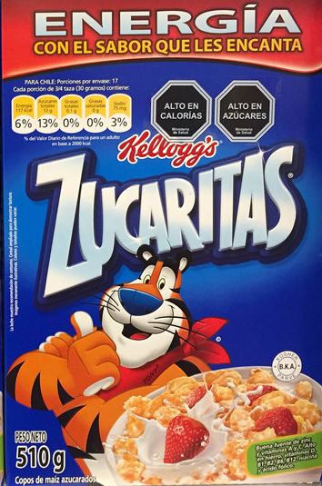
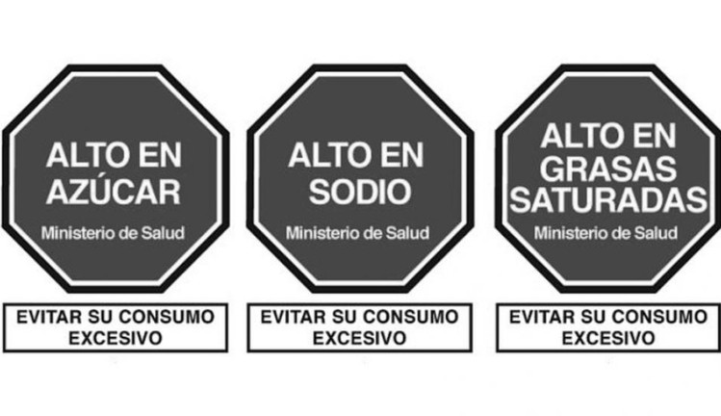
Notes:
The new regulation includes the mandatory use of front-of-package warning labels on packaged foods/beverages high in energy, sugars, and saturated fats

Slide 6
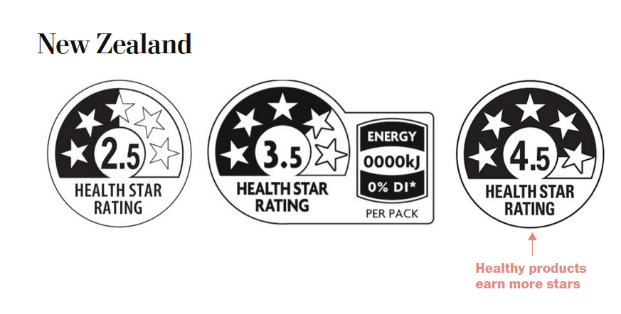
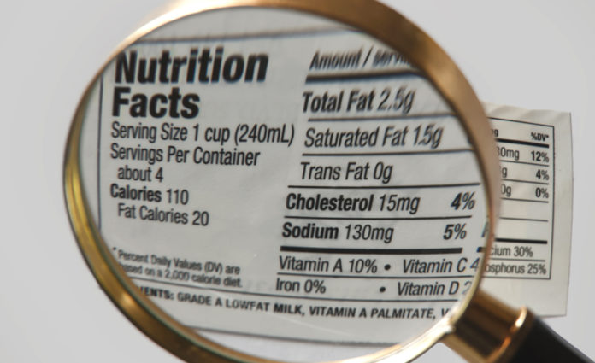
More than 40 countries have adopted easy-to-understand, front-of-package nutrition information, as shown by these New Zealand labels
The US has not required front-of-package labeling, as illustrated in bottom image
Notes:
https://www.washingtonpost.com/opinions/2024/03/06/food-labels-nutrition-fda/

Slide 7
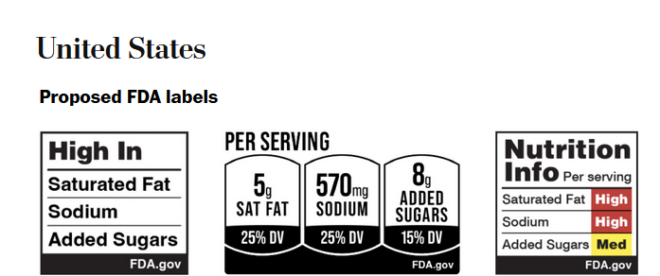
Clearer labelling has not been required in US because companies argue requirements infringe on their First Amendment rights
However, in response to international precedents, FDA is defending need for labeling and is proposing labels changes
Notes:
https://www.washingtonpost.com/opinions/2024/03/06/food-labels-nutrition-fda/
Clearer labelling has not been required in US because companies argue that this requirements infringe on their First Amendment rights by forcing them to convey messages they may not agree with or that could negatively affect their brand. However, in response to international precedents, US is defending need for labeling on the basis that it serves an important public interest by promoting public health and ensuring consumers are well-informed.
The Food and Drug Administration plans to propose labeling this fall for the front of food and drink packages to help Americans make healthier choices to address exploding obesity rates, years after other countries took similar action.
https://www.washingtonpost.com/health/interactive/2024/food-warning-labels-fda-healthy-choices/

Slide 8
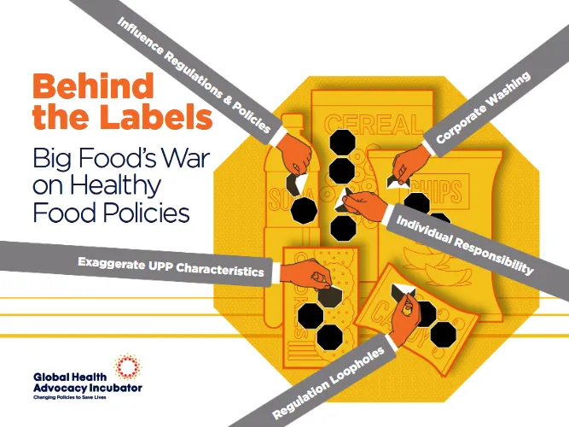
As of Sept 2026: the rule has not been finalized. FDA currently projects a final rule for December 2026.
The FDA's current page with the proposed design and explanation: FDA Front-of-Package Nutrition Labeling.
U.S. proposal remains substantially less warning-oriented than the prominent warning-symbol systems adopted elsewhere
Notes:
https://www.fda.gov/food/nutrition-food-labeling-and-critical-foods/front-package-nutrition-labeling
https://www.advocacyincubator.org/program-areas/food-and-nutrition/countering-industry-interference/behind-the-labels-big-foods-war-on-healthy-food-policies

