Slide 1
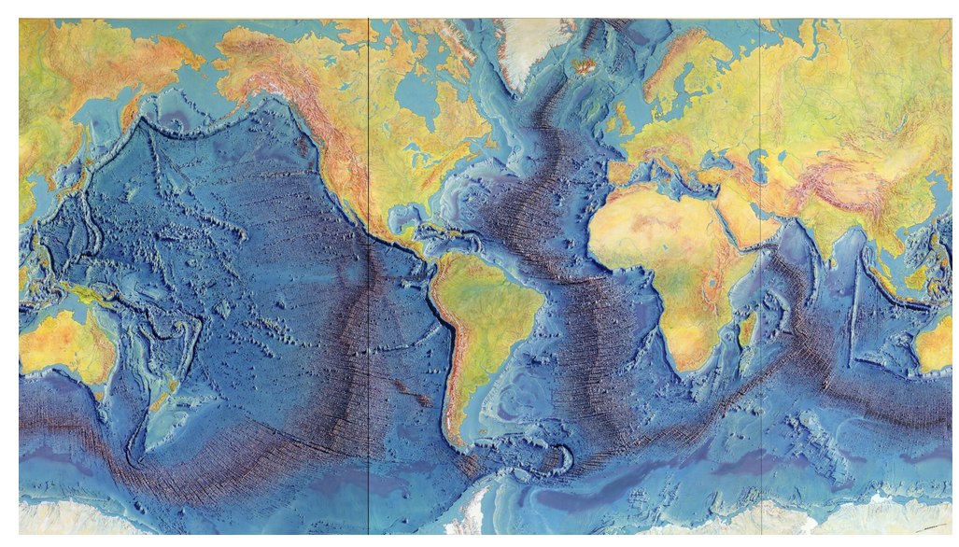

Slide 2
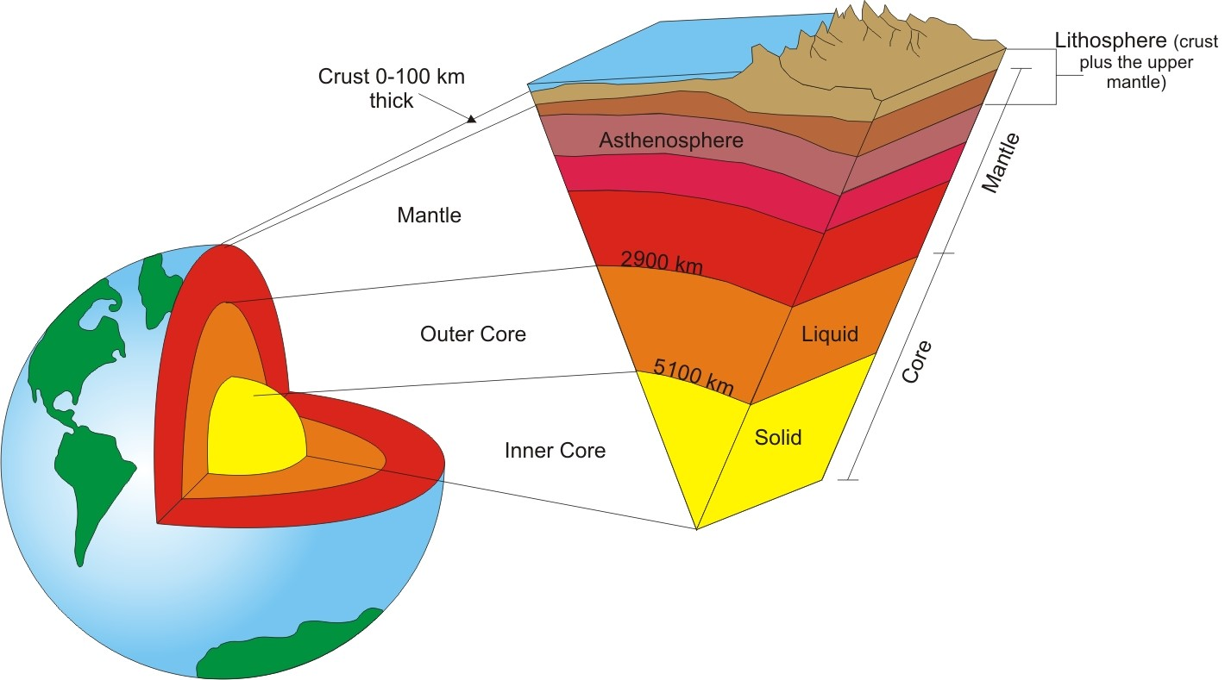

Slide 3
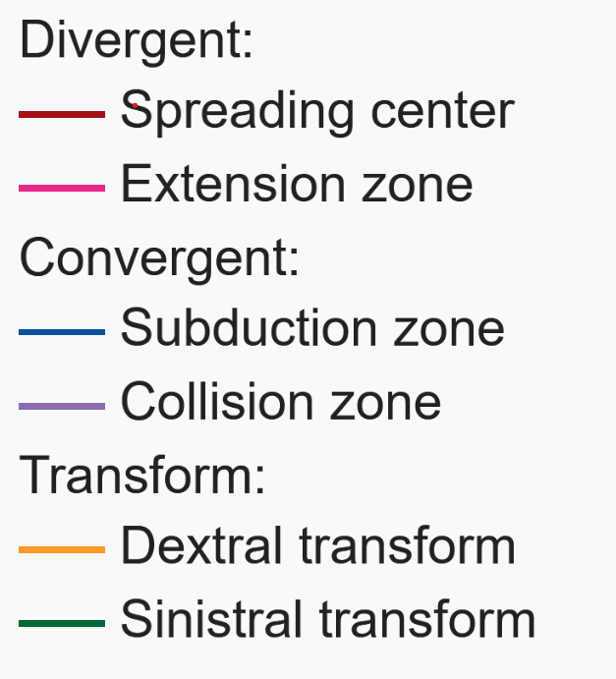
Notes:
Can a plate be composed of both continental and oceanic crust? Yes.

Slide 4
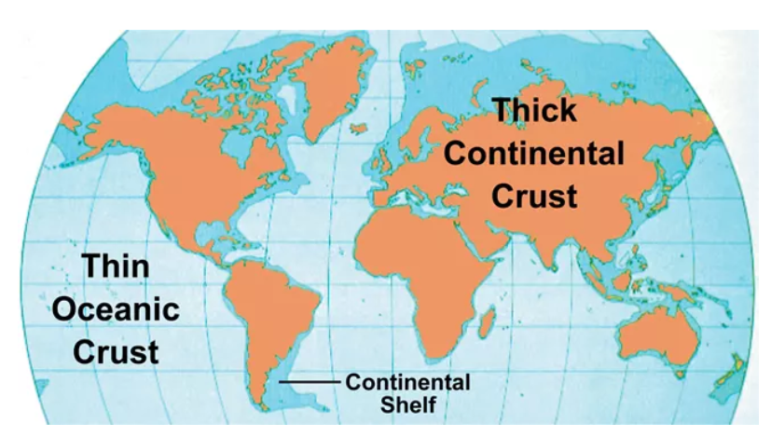
Notes:
Continental crust: shown in brown and darker blue. Some of the continental crust is under the sea but is not oceanic crust – it is part of the continental crust that is underwater
Oceanic crust: shown in light blue

Slide 5
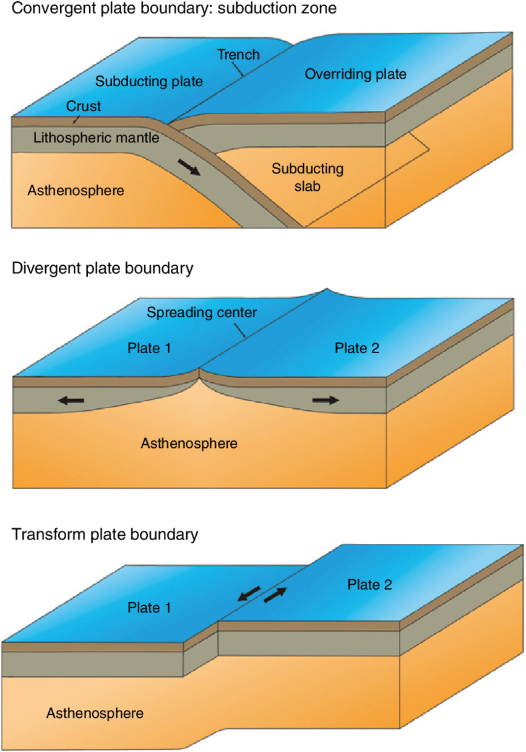

Slide 6
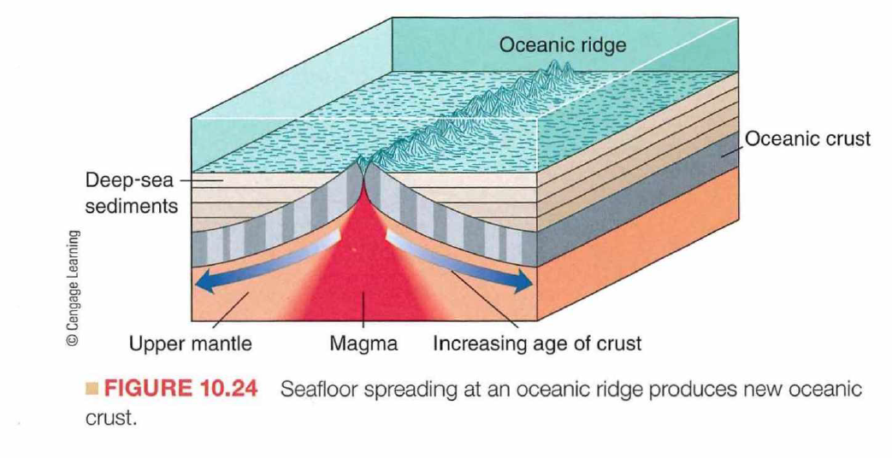

Slide 7
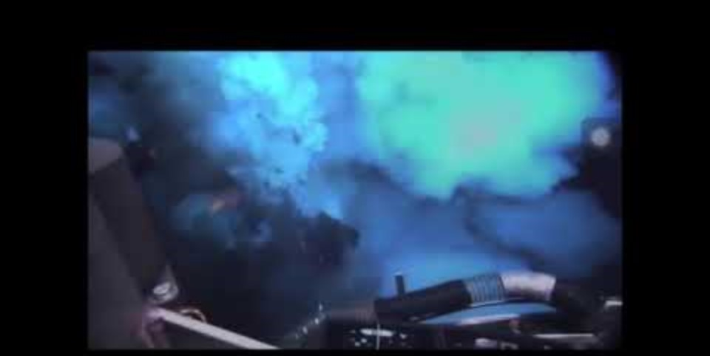
The mid-Atlantic Ridge, a spreading center (divergent plate boundary)
Notes:
Eruption along mid-Atlantic ridge spreading center

Slide 8
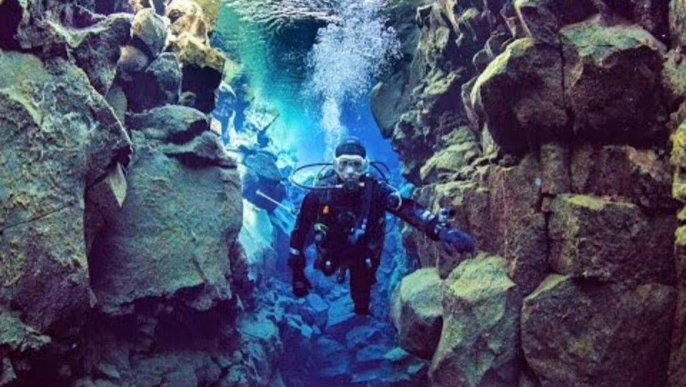

Slide 9
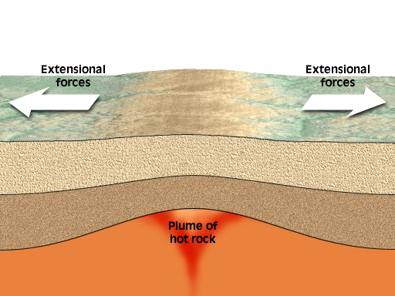
Notes:
Rift valley

Slide 10
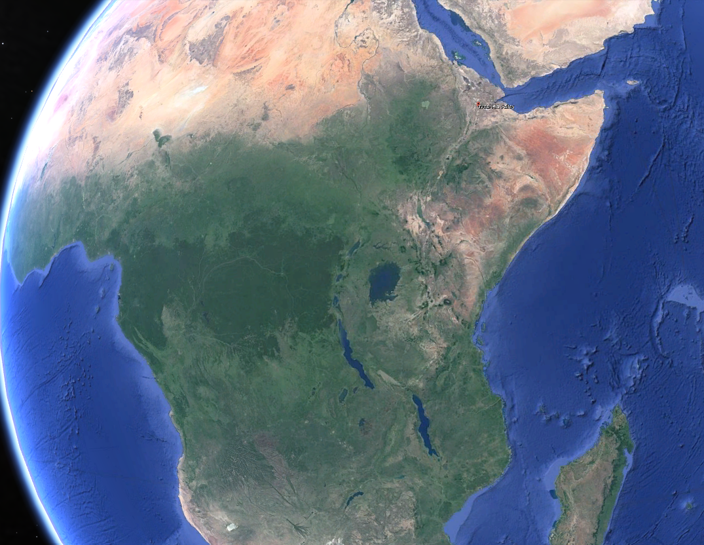
Notes:
The Great Rift Valley of Africa Lake Victoria: The largest lake in Africa and the second-largest freshwater lake in the world by surface area. It is shared by Tanzania, Uganda, and Kenya.
Lake Tanganyika: The second deepest and second-largest freshwater lake by volume in the world. It lies between Tanzania, the Democratic Republic of Congo (DRC), Burundi, and Zambia.
Lake Malawi: The third-largest lake in Africa and the ninth-largest in the world by area. It is located between Malawi, Mozambique, and Tanzania.

Slide 11
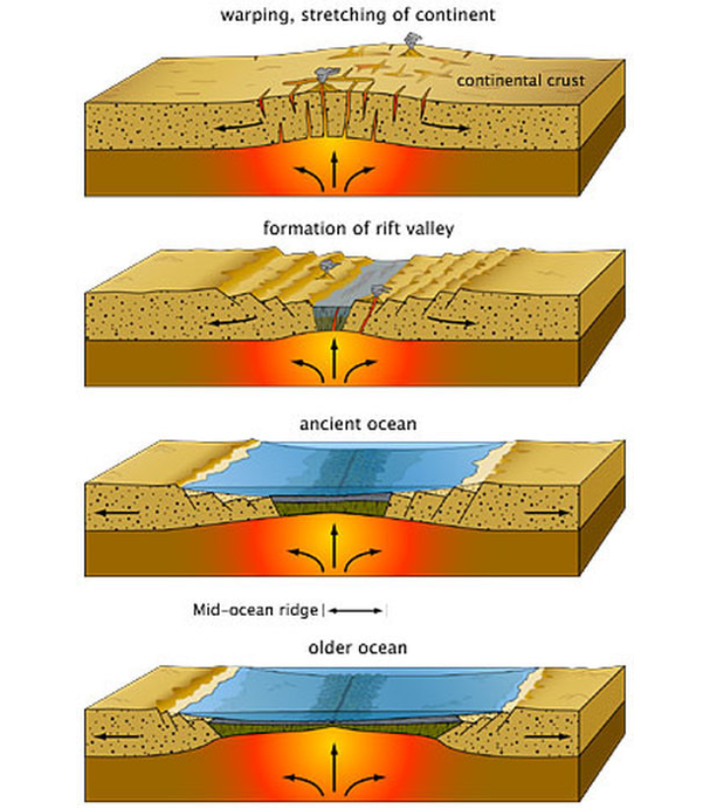

Slide 12
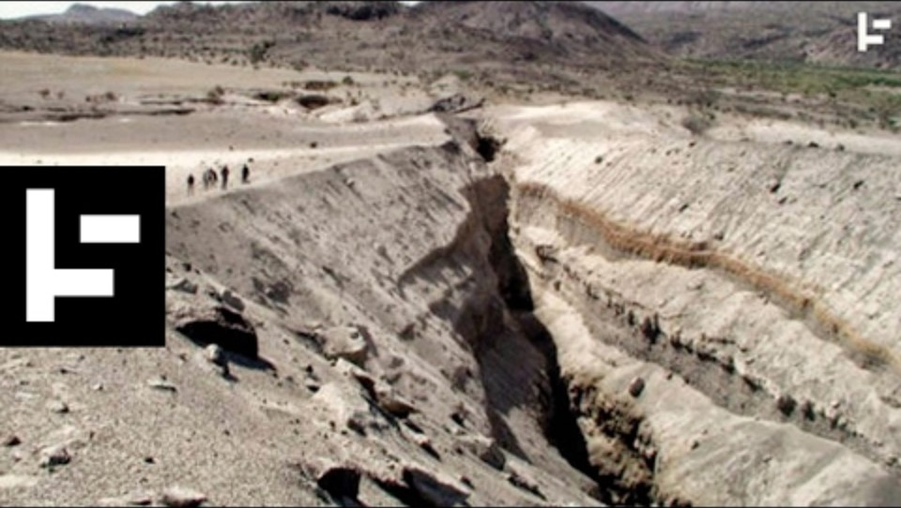
Notes:
East Africa Rift Valley https://youtu.be/b9FY57z2cXI?si=iZV_ZEzxHvY14go4

Slide 13
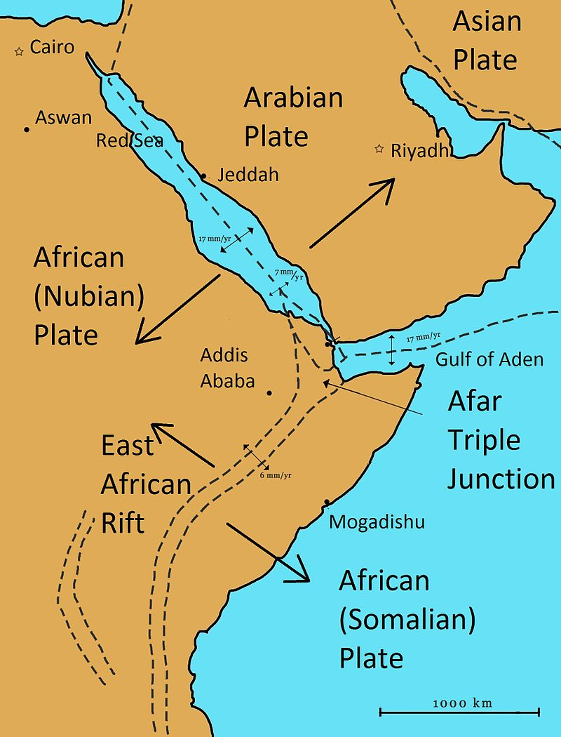
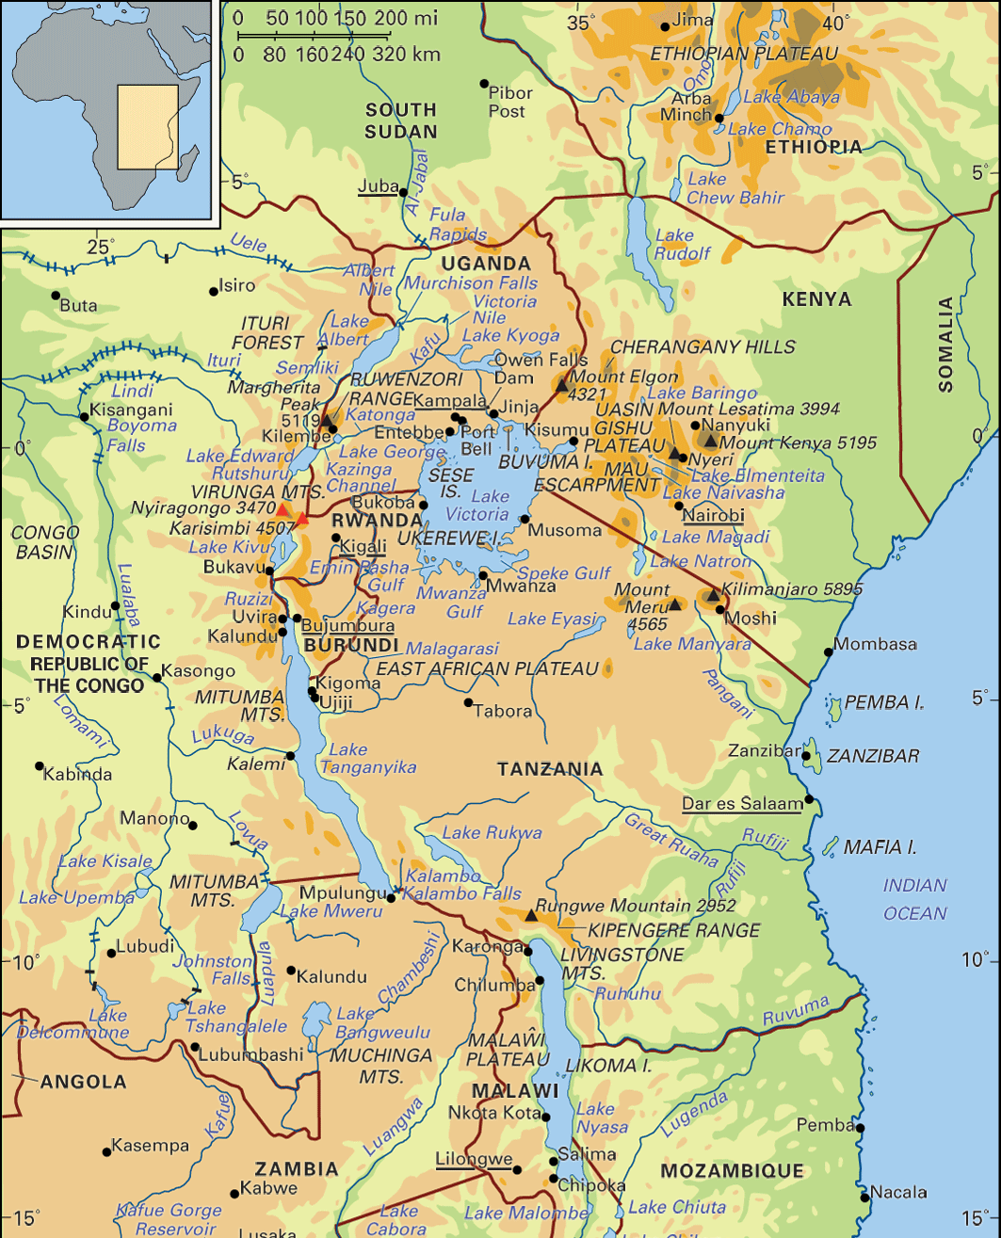
Notes:
Red Sea

Slide 14
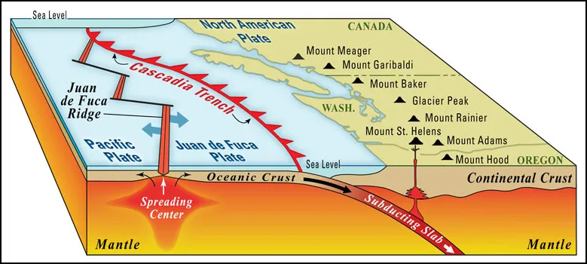
Notes:
The Cascades and the Andes are volcanic arcs that form at continental-ocean crust convergent plate boundaries Above (Cascade Mountains)

Slide 15
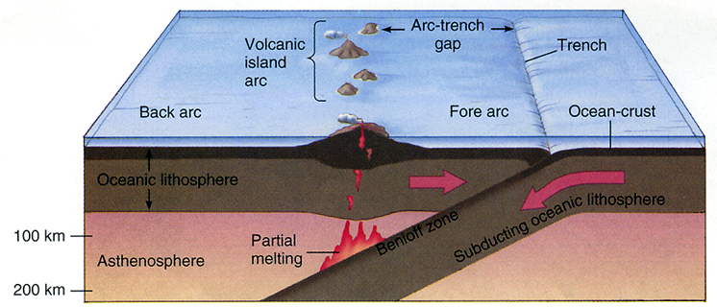
Notes:
Ocean-ocean crust convergent boundary. Oceanic crust is subducted underneath oceanic crust

Slide 16
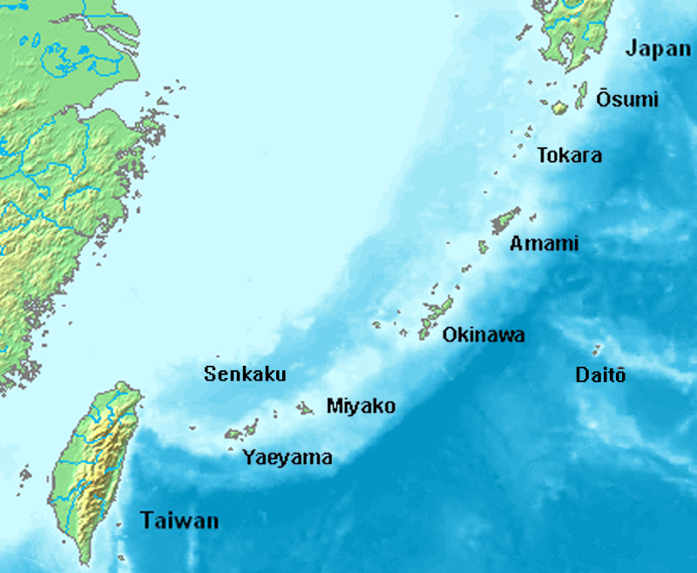
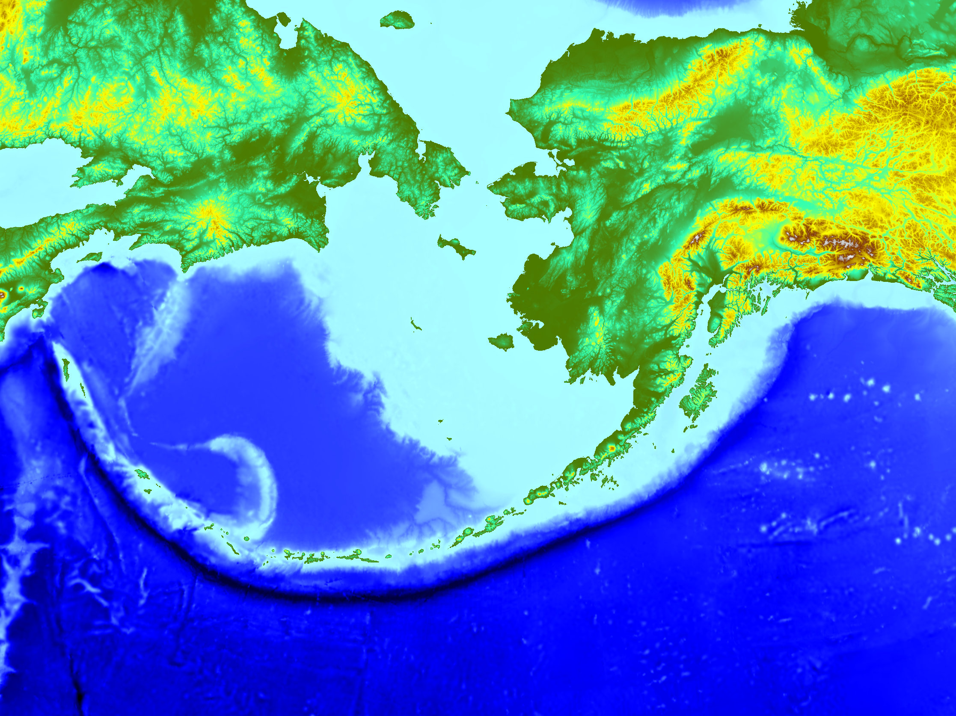
Notes:
Japan arc and the Aleutian arc are island arcs formed from a convergent plate boundary where oceanic crust is subducted under oceanic crust.

Slide 17
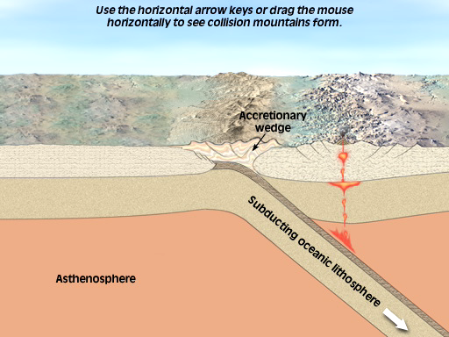
Continent-continent convergent boundary and the formation of
a collisional mountain range
Notes:
Convergent plate boundary: continental crust colliding with continental crust The Himalayas are a good example of this type of plate boundary and collision type. We can this type of mountain range a collisional mountain range Little to no subduction and volcanic activity with collisional mountain ranges. Much more sedimentary rock that has been piled and pushed up form the mountains. Volcanic arcs and island arcs will have far more igneous rock material and may even still be volcanically active

Slide 18
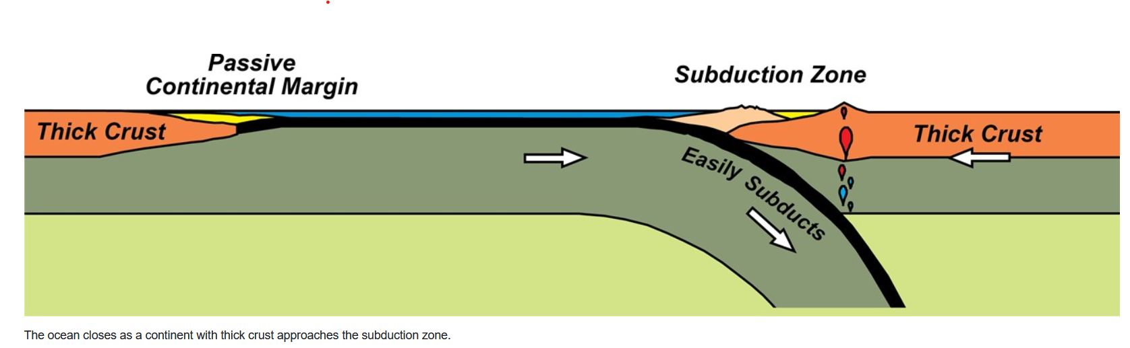
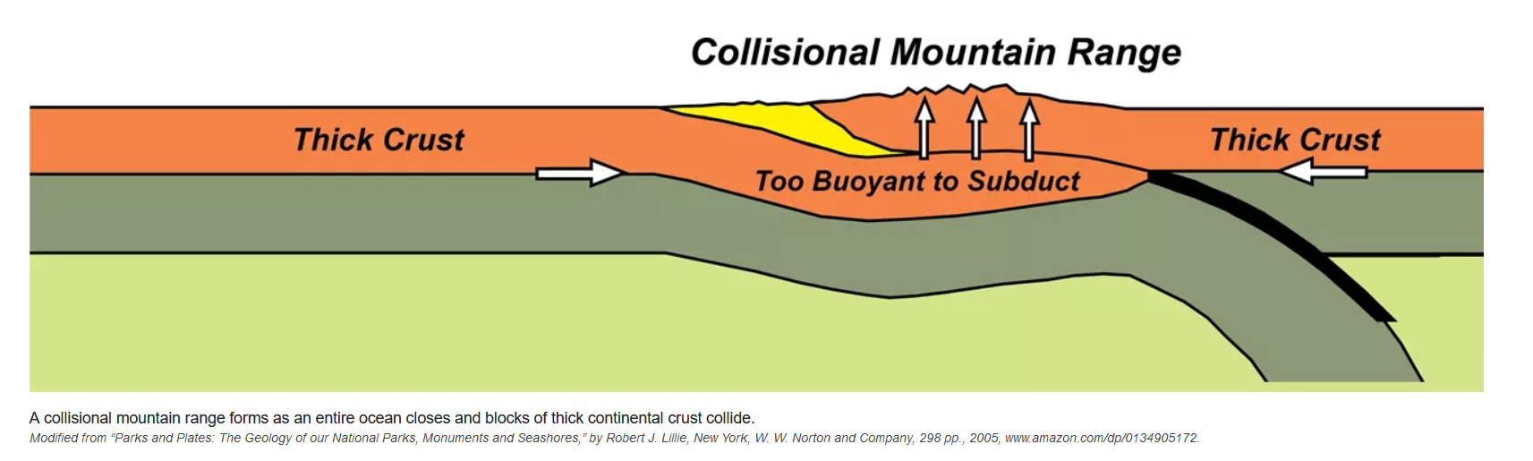
Notes:
Continent-continent convergent boundary and the formation of a collisional mountain range

Slide 19
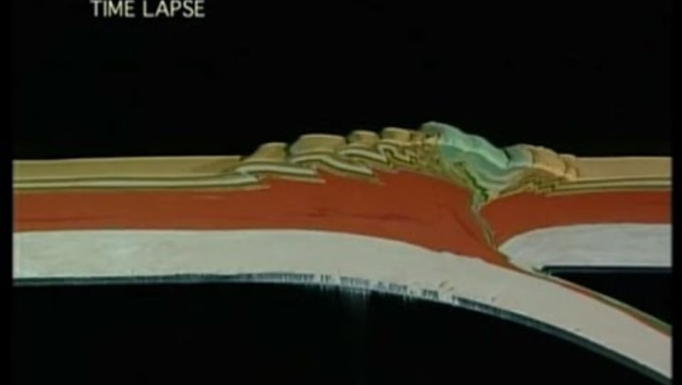
Continent-continent convergent boundary and the formation of
a collisional mountain range
Notes:
https://youtu.be/d9bKXY0OMxc?si=jYV56CS0CeoOA67z Start at 0:53

Slide 20
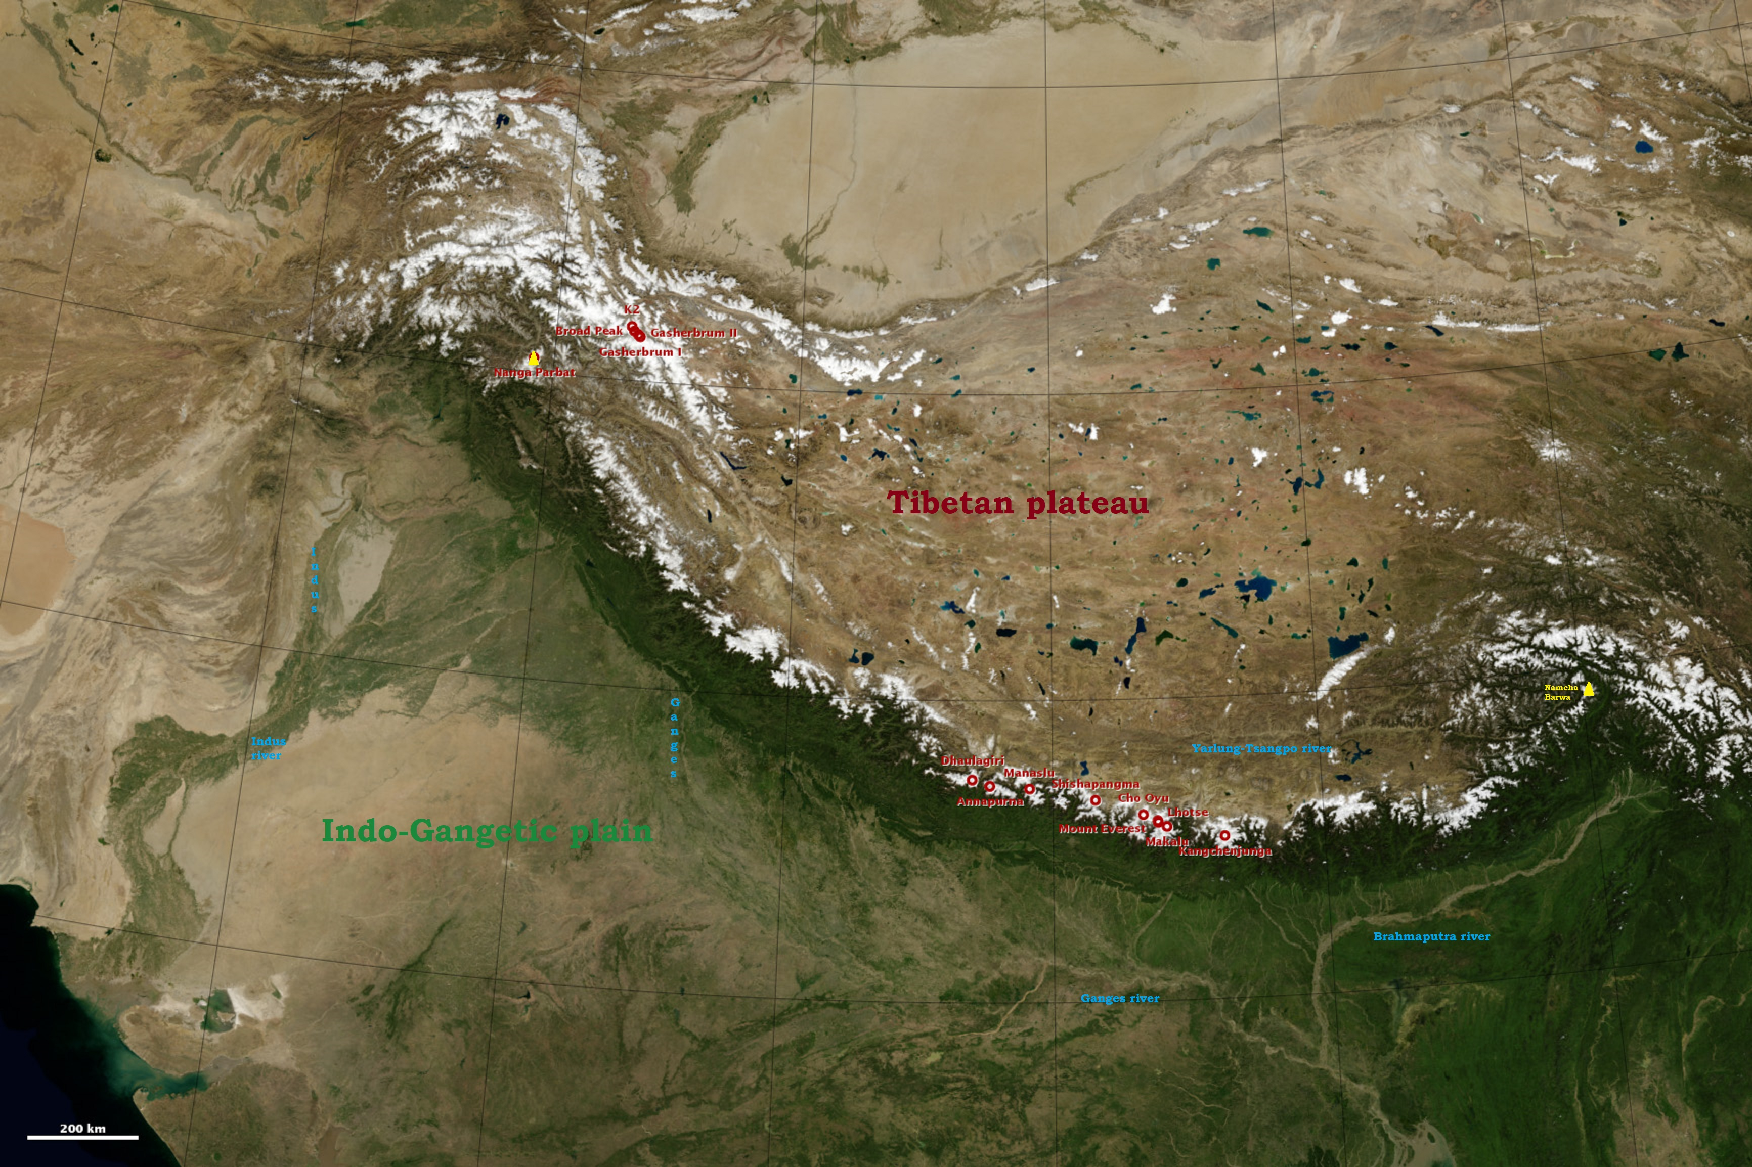
Continent-continent convergent boundary and the formation of
a collisional mountain range
Notes:
Himalayans, a collisional mountain range

Slide 21
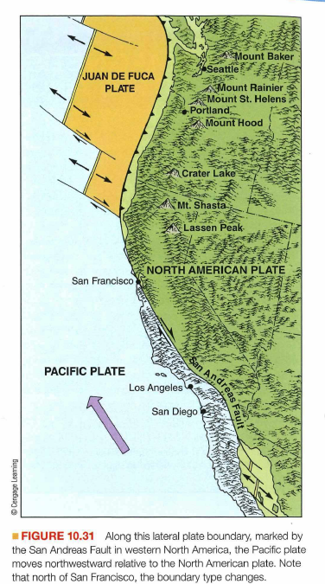
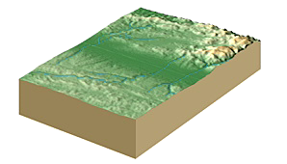
Transform plate boundaries

Slide 22
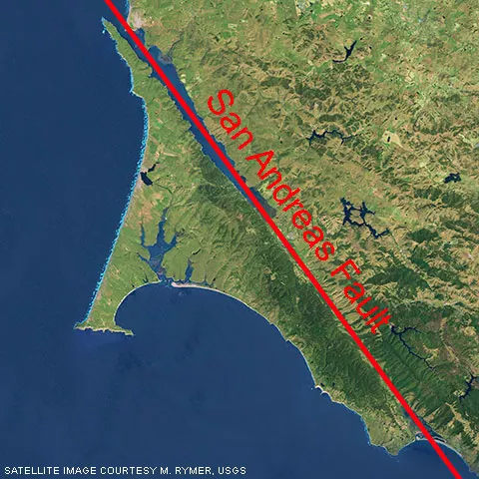
Notes:
San Andreas fault

Slide 23
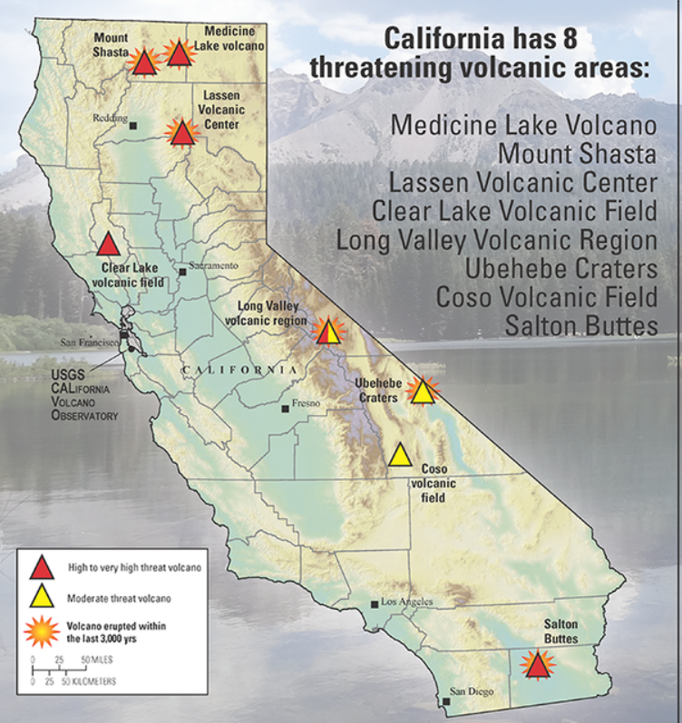
Notes:
https://www.usgs.gov/news/new-report-details-whats-harms-way-near-californias-volcanoes Not possible to have a large eruptions in Los Angeles because there is no longer active subduction along the coast. However there are areas outside of Los Angeles that still have volcanic features that occasionally vent but would not destroy Los Angeles
Salton Buttes volcanic activity is formed from divergent plate motion associated with spreading center along Gulf of California
https://www.nasa.gov/image-article/salton-trough/

Slide 25
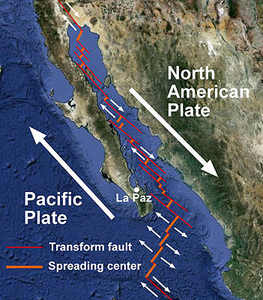
Notes:
Parts of the San Andreas Fault system have a divergent motion due to underlying volcanic activity. This is what leads to the volcanism and Salton Butte. https://www.mbari.org/news/the-geologic-setting-of-the-gulf-of-california/

