Slide 1
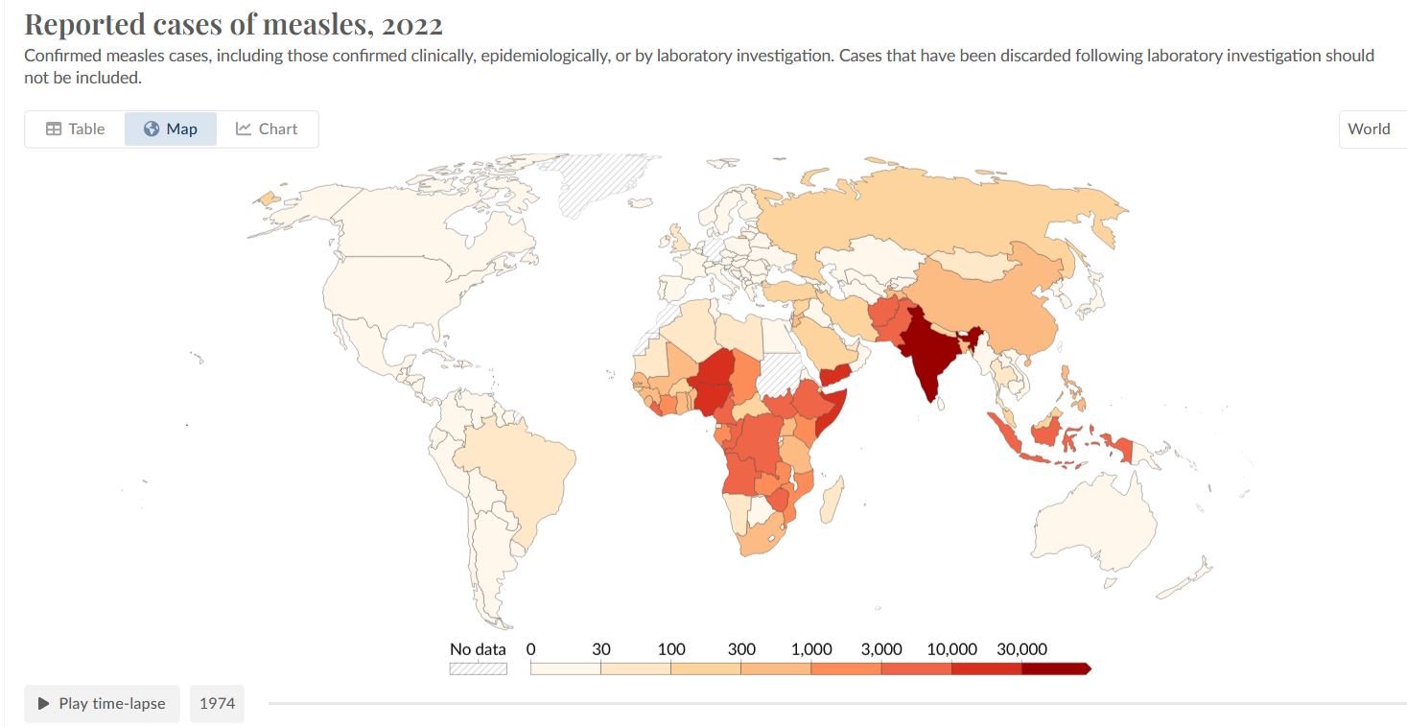
Measles was declining globally over last fifty years
Notes:
https://ourworldindata.org/grapher/reported-cases-of-measles?time=2022

Slide 2
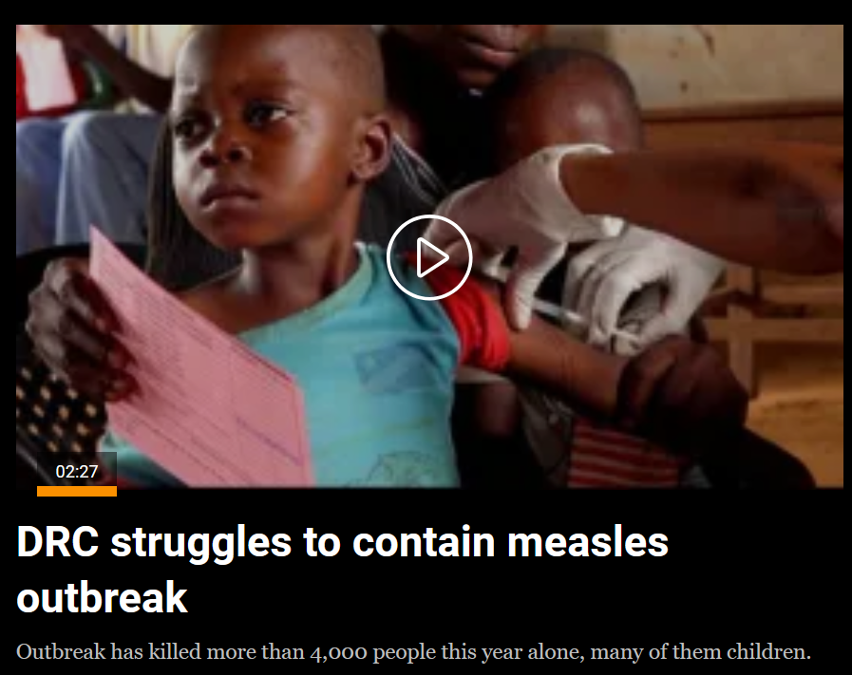
But where health infrastructure is weak and vaccination rates low, measles has always had a high mortality rate
Pneumonia and severe diarrhea often lead to death before longer term impacts to hearing, vision, and cognition can develop
Notes:
This is because in an area with low vaccination rates overall, measles can spread very efficiently and the young who have never had it are readily exposed to the measles virus and take ill. Although there is great fear of Ebola, measles in more common, and hence more complications arise that augments mortality over those of Ebola.

Slide 3
Global measles resurgence beginning in 2016
In the 1980s, measles killed 2.6 million a year globally
In 2016, for the first time since records were kept, global deaths fell below 100,000.
However, this trend has not been maintained
n 2025, about 84% of children worldwide received their first dose of a measles-containing vaccine, while 77% received the recommended second dose. Both remain well below the 95% coverage needed to prevent outbreaks and achieve measles-elimination goals
Notes:
https://www.who.int/news/item/15-07-2024-global-childhood-immunization-levels-stalled-in-2023-leaving-many-without-life-saving-protection
https://www.who.int/en/news-room/fact-sheets/detail/immunization-coverage

Slide 4
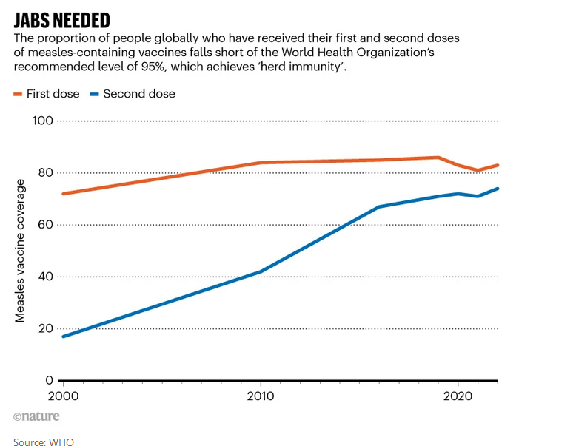
Over 2018-2023, measles outbreaks hit 103 countries, home to roughly three-quarters of the world’s infants. Low vaccine coverage (80% or less) was a major factor.
Vaccine hesitancy and anti-vaxxer views tend to drive outbreaks in high and middle income countries
Poverty, war and instability drive outbreaks in low income countries
Notes:
https://www.who.int/news/item/15-07-2024-global-childhood-immunization-levels-stalled-in-2023-leaving-many-without-life-saving-protection
https://doi.org/10.1038/d41586-024-00265-8

Slide 5
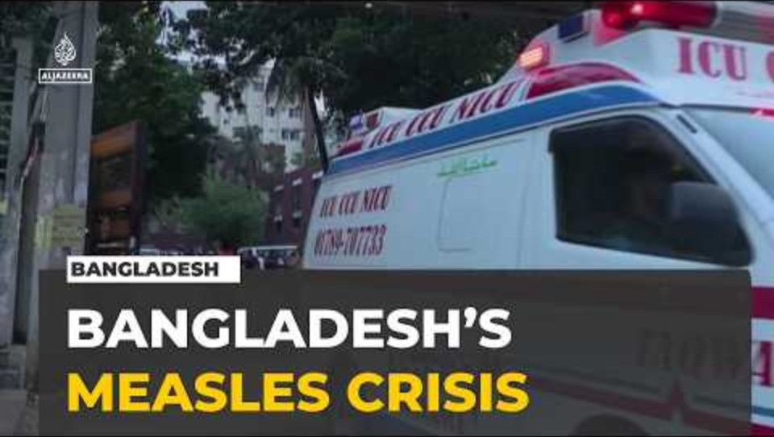

Slide 6
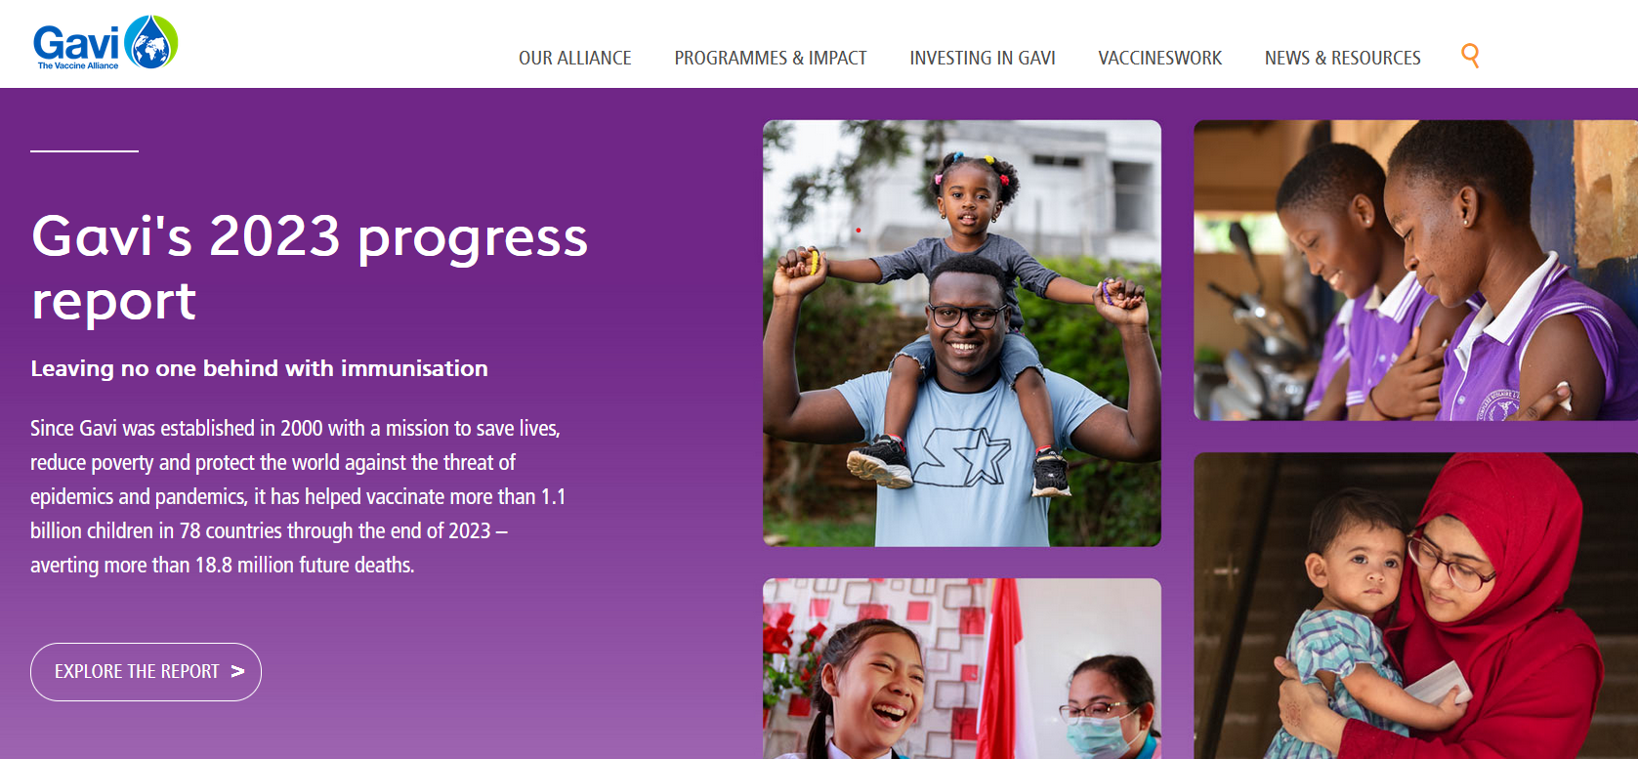
The middle income effect
Focus of childhood immunization has been on the world’s poorest people.
GAVI is an international non-governmental association that has provided billions of low-cost vaccines to the world’s poorer countries
Notes:
Berkley, S. "Vaccination lags behind in middle-income countries." Nature 569.7756 (2019): 309.
Global Alliance for Vaccines and Immunization
https://www.gavi.org/

Slide 7
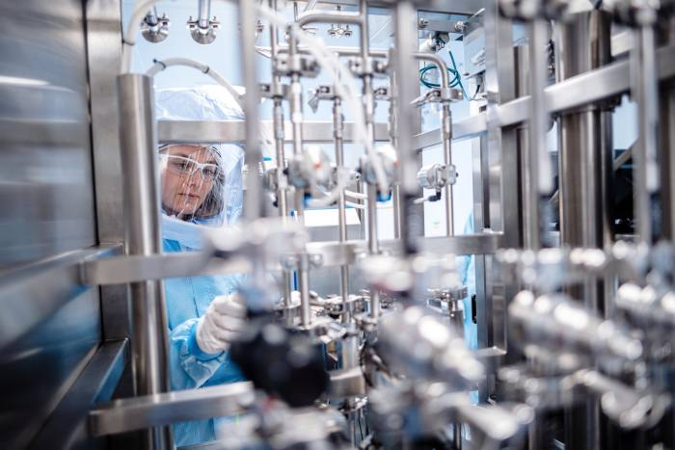
Manufacturing vaccines is a complex and expensive process
GAVI helps cover the cost and the availability of vaccines for countries that do not have the capacity to manufacture or purchase them
Notes:
https://www.cytivalifesciences.com/en/us/shop

Slide 8
The middle income effect
Routine immunization levels have stagnated in many middle income countries (MICs) because they are too prosperous to qualify for international support.
Costs for vaccines may be higher in MICs because they are not subsidized by other countries and organizations like GAVI.
In the middle income effect, children in weakest economies better protected than in some middle income countries
Notes:
Berkley, S. "Vaccination lags behind in middle-income countries." Nature 569.7756 (2019): 309.

Slide 9
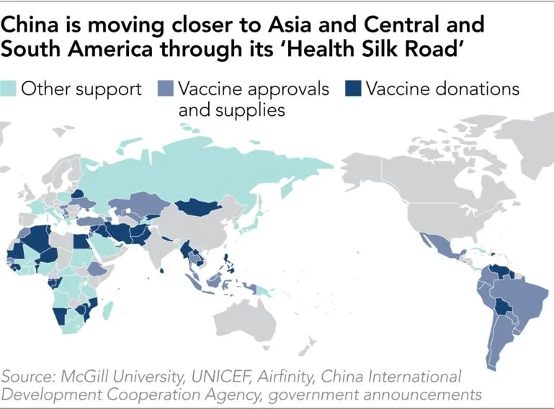
Vaccine diplomacy
Vaccine diplomacy encompasses the politics that go into the coordination of vaccine development, manufacturing, and distribution.
Vaccines can reinforce existing power relationships or be used to realign them – for example, China has provided its vaccines as a way of exerting economic influence – the ‘health Silk Road’
Notes:
Involves national governments, multinational corporations, universities, and global entities like the WHO
https://asia.nikkei.com/Spotlight/Datawatch/China-emerges-as-big-winner-in-vaccine-outreach

Slide 10
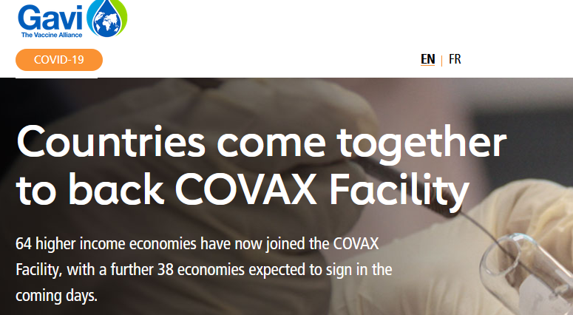
COVAX
COVAX is an example of vaccine diplomacy
COVAX pooled resources of many countries to promote cooperation in the development and deployment of a vaccine to cover at least 20% of a country’s population
Aim was lower vaccine costs for everyone and a swifter end to the pandemic
Notes:
https://www.gavi.org/vaccineswork/gavi-ceo-dr-seth-berkley-explains-covax-pillar

Slide 11
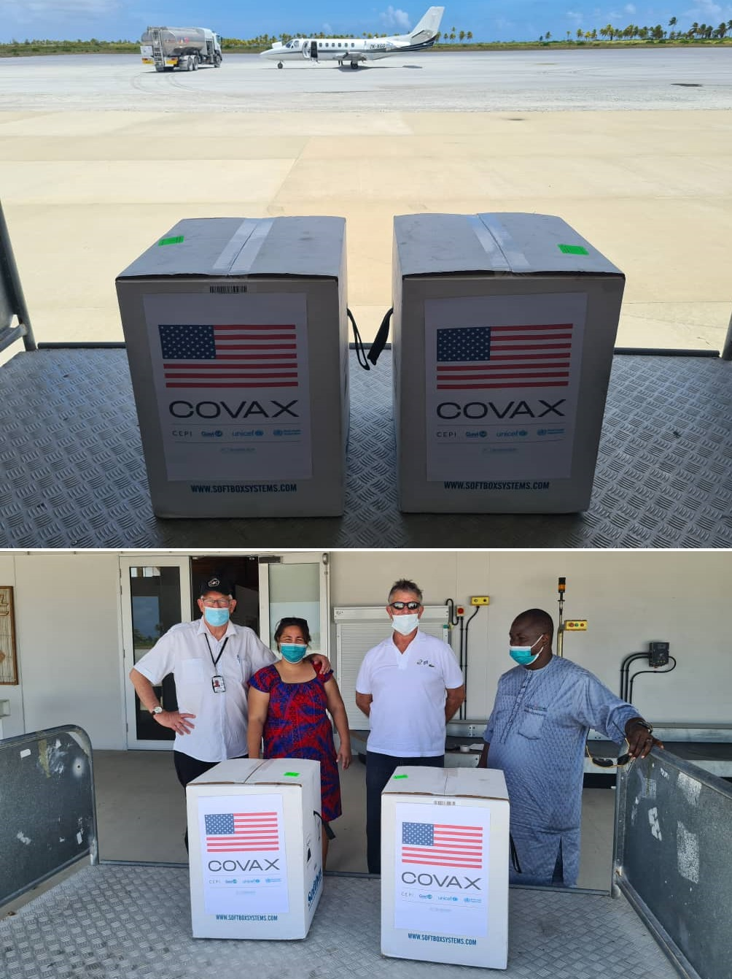
However, COVAX fell short of its goals - countries prioritized vaccines their own citizens.
By the end of 2021, more people had been vaccinated in high-income countries than in more populous low-income countries
Vaccination rates were 75% in high-income countries, but less than 2% in some low-income countries.
Notes:
https://www.nytimes.com/reuters/2020/09/03/world/asia/03reuters-health-coronavirus-vaccines-covax-exclusive.html

Slide 12
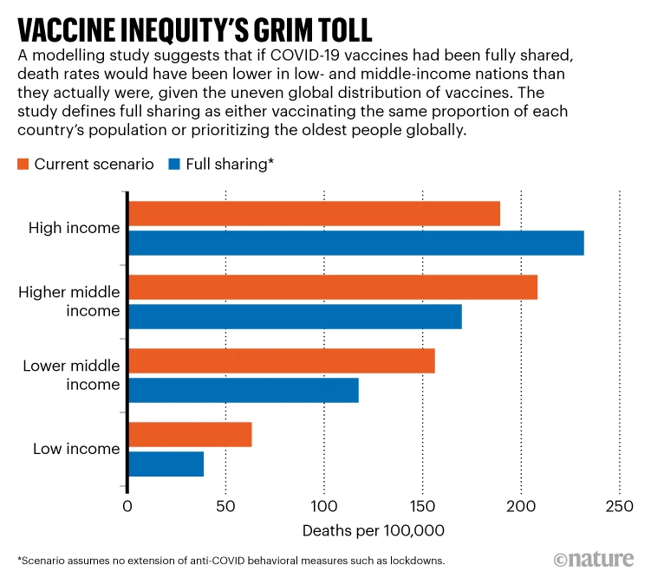
Wealthy countries had vaccine surpluses and vaccinated young children, who are at relatively low risk of serious disease.
Meanwhile, many poorer countries still did not have enough supply to vaccinate the people at highest risk of death from COVID-19.
Notes:
Low- and middle-income nations would have had lower death rates if vaccines had been shared more equitably.
Equitable vaccine coverage could have prevented 1.3 million deaths worldwide. More than twice that many deaths would have been avoided if higher-income countries had also stuck with other measures to reduce transmission.
https://www.nature.com/articles/d41586-022-03529-3

Slide 13
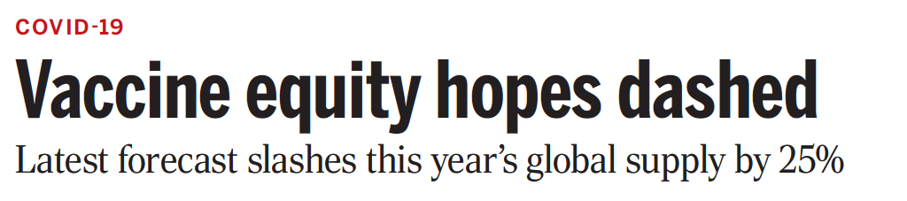
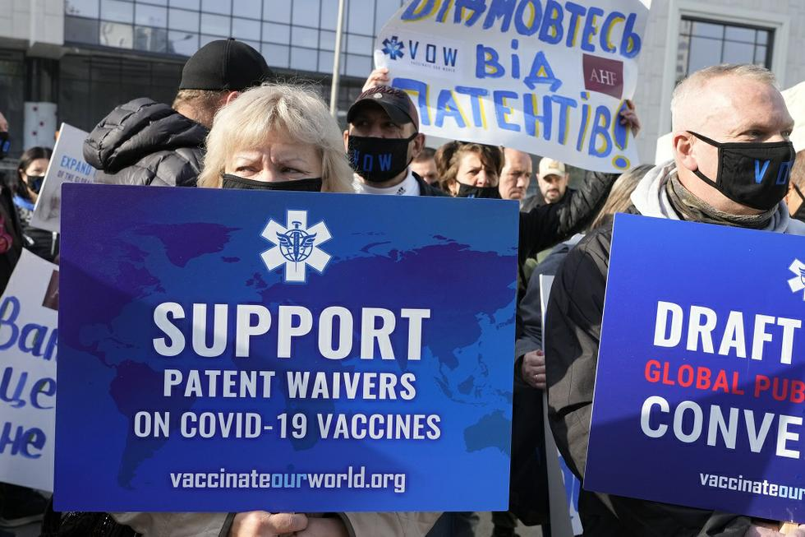
Philanthropic approach of COVAX criticized as short-term amelioration of a problem rather than a sustainable long-term solution
COVAX has good aims but addresses a symptom of a deeper problem instead of the underlying cause
Releasing patents so that other countries could make the vaccine would have helped
Notes:
One such approach that is to waive patent protections so that new mRNA vaccines can be manufactured in other countries, lessening the dependence upon wealthier nations to provide them
Releasing patents on COVID vaccines would likely have increased global vaccination rates, especially in low- and middle-income countries, by enabling local production, lowering costs, and reducing dependence on international supply chains. Patent restrictions limited vaccine availability by concentrating production in a few countries, making doses less accessible and more costly for many nations. Local manufacturing could have met demand faster and reduced logistical challenges associated with vaccine distribution. While concerns about quality control and innovation incentives exist, many argue that, given the public health stakes and public funding in vaccine development, global access should have been prioritized.

