Slide 1
Zoonotic diseases differ in how spillover occurs and plays out over time
Rather than a single animal reservoir, the reality is that there are likely several host animals interacting and sharing the virus
For some zoonotic diseases, they have crossed between us and other organisms sometime in the past and now reside entirely in humans
They may jump repeatedly back and forth between humans and animals
A pathogen may spillover into a human population and then disappear.
New pathogens are yet to spillover into humans and remain in animal populations

Slide 2
Stages of zoonotic emergence
Pathogen resides in animal only and does not infect humans (canine distemper)
Animal to human spillovers (rabies, MERS-CoV)
Limited human-to-human transmission (MERS-CoV)
Sustained human-to-human transmission (SARS-CoV-2)
Exclusively human transmission, no longer needs an animal host (measles)

Slide 3
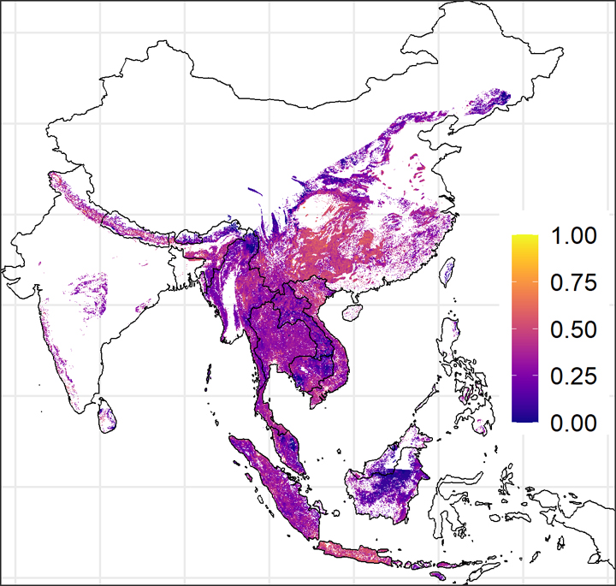
Hundreds of thousands of exposures to SARS-related CoVs annually
Some people in southeast Asia harbor antibodies against other SARS-related CoVs
Estimates are that there are some 400,000 undetected human infections with these coronaviruses each year across the region at right
These spillovers usually do not grow into detectable outbreaks.
Notes:
The risk is highest in southern China, Vietnam, Cambodia, and on Java and other islands in Indonesia
In a region with likely hundreds of millions of bats and nearly half a billion people, 400,000 isn’t that many.
https://www.science.org/content/article/sars-viruses-may-jump-animals-people-hundreds-thousands-times-year
Color scale indicates relative risk of exposure with 1 being a high risk with likely exposure.

Slide 4
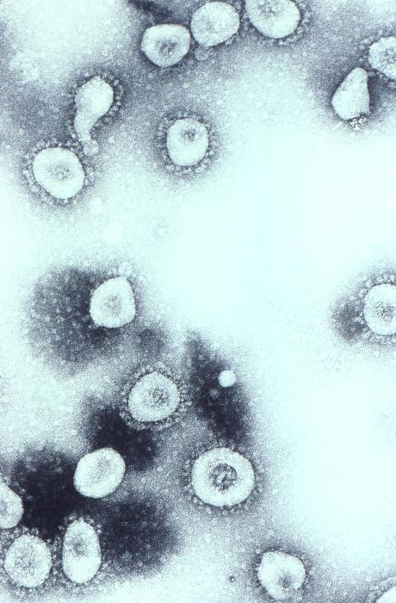
Seven presently known coronaviruses (CoV) infect humans
Four cause common colds, three have more serious pandemic potential
Bats are the reservoir for CoV with pandemic potential.
Other animals can serve as intermediate hosts – they acquire coronaviruses from bats and pass it on to humans
Three large coronavirus outbreaks in humans that caused severe respiratory disease
  Severe Acute Respiratory Syndrome, or SARS-CoV-1 (2003)
  Middle East Respiratory Syndrome, or MERS-CoV (2012)
  SARS-CoV-2 (2019-2022).
Notes:
Cyranoski, D. (2020). Profile of a killer: the complex biology powering the coronavirus pandemic. Nature, 581(7806), 22-26.
OC43 shown on the right.
Bats are a major reservoir for coronaviruses, although they may not be the animal responsible directly for the virus spillover into humans. Intermediary hosts often carry these viruses into humans:
With SARS-CoV-1, the intermediary was civet cats, which are sold in live-animal markets in China.
With MERS, the intermediary are camels
With SARS-CoV-2, the intermediary was likely a pangolin, another animal in the live-animal trade.
MERS had a case fatality rate of 33% but this may be an overestimate because there may have been milder cases that remain undocumented. SARS-1 has mortality rates around 10%, with the rate for people older than 64 years being as high as 50%. SARS-2, aka Covid-19 is close to 2%.
https://www.cidrap.umn.edu/news-perspective/2003/05/estimates-sars-death-rates-revised-upward

Slide 5
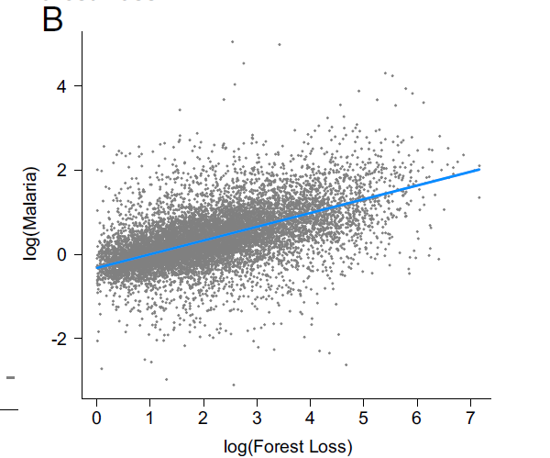
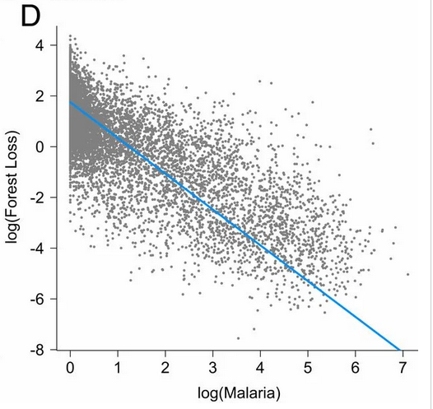
Amazon deforestation and malaria transmission
First forest effect: as forest loss increases in a formerly intact forest, malaria incidence increases
Sick logger feedback: as malaria incidence continues to increase, forest loss slows down
.
Notes:
MacDonald, A. J., & Mordecai, E. A. (2019). Amazon deforestation drives malaria transmission, and malaria burden reduces forest clearing: a retrospective study. The Lancet Planetary Health, 3, S13.
https://doi.org/10.1016/S2542-5196(19)30156-1
The effects of deforestation on malaria are largest in the early stages of deforestation in the interior of the Amazon as forest edge habitat increases, promoting mosquito vector breeding habitat, survival, and human biting rate, but the effects attenuate as forest loss progresses, forest edge area declines, and human settlements become larger and further removed from forest. The key implication is that forest clearing has a direct impact on human health
Socioecological feedbacks develop in which high malaria incidence simultaneously reduces forest clearing. Malaria reduces economic activity. In other words, elevated malaria burden may also reduce rates of deforestation.
https://doi.org/10.1073/pnas.2409583121
There is likely more heterogeneity in the relationship between malaria and deforestation from state to state in Brazil, and within states and localities.
Arisco, N. J., Peterka, C., Diniz, C., Singer, B. H., & Castro, M. C. (2024). Ecological change increases malaria risk in the Brazilian Amazon. Proceedings of the National Academy of Sciences, 121(44), e2409583121.

Slide 6
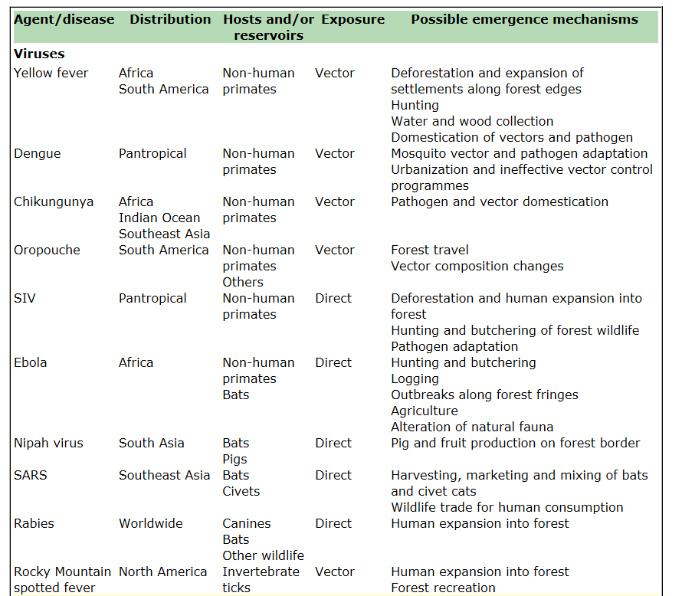
Having intact habitats is a public health service
Until recently, health community viewed natural world as only a source of disease – nature is ‘dirty’, unclean
Now recognized natural systems provide services to support human health.
Deforestation, hunting, expansion of settlements, urbanization, agriculture: all of these can lead to spillover of zoonotic pathogens into human populations

Slide 7
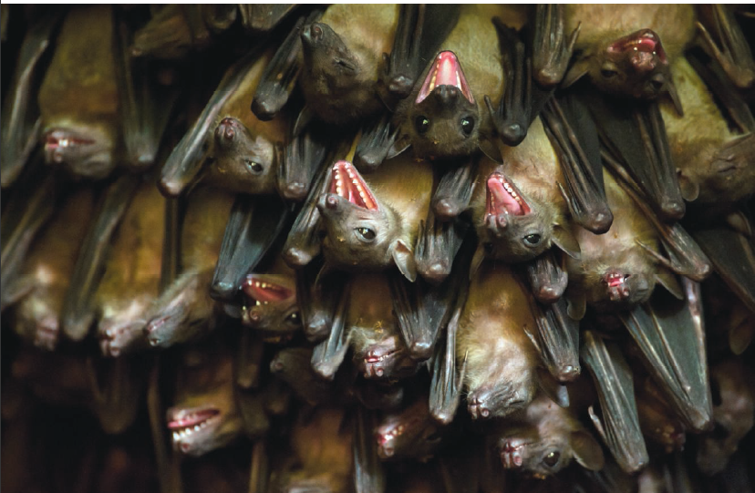
Notes:
Bats are numerous and widespread. While bats account for 25% of mammalian species, rodents are 50%, and then there’s the rest. Bats live on every continent except Antarctica, in proximity to humans and farms. The ability to fly makes them wide-ranging, which helps in spreading viruses, and their feces can spread disease.
People in many parts of the world eat bats, and sell them in live animal markets, which was the source of SARS, and possibly the latest coronavirus outbreak that began in Wuhan. They also often live in huge colonies in caves, where crowded conditions are ideal for passing viruses to one another.
Bats are remarkably long-lived for small mammals. The big brown bat, a common species in the United States, can live nearly 20 years in the wild. Others live closer to 40. Animals like house mice live about two years on average.

Slide 8
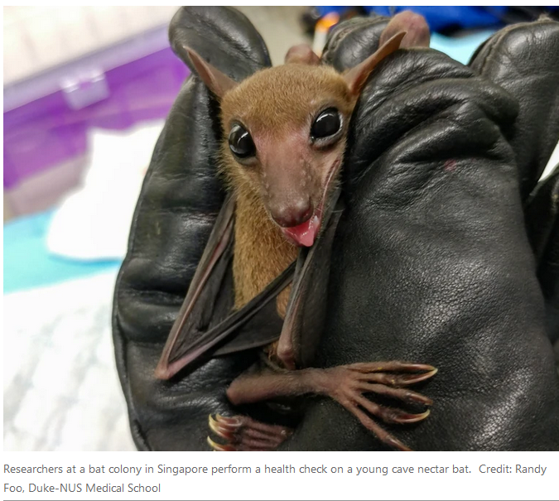
Notes:
The bat immune system has the ability to tolerate viruses that are deadly to people and other mammals — from Ebola to Nipah and severe acute respiratory syndrome (SARS).

Slide 9
Why do bats harbor a higher proportion of zoonotic viruses than other mammal orders?
Bats account for a quarter of mammal species, and live on every continent except Antarctica, in proximity to humans and farms.
The ability to fly makes them wide-ranging, which helps spread viruses
People may eat bats in parts of the world, and sell them in live animal markets
Can form large roosting groups which allows viruses to pass among individuals and acquire mutations
Bats evolved millions of years ago and have had time to develop immunity to viruses
Notes:
Species are grouped in genera, genera are grouped into family, families are grouped into orders.
Bats are remarkably long-lived for small mammals, up to 20-40 years.

Slide 10
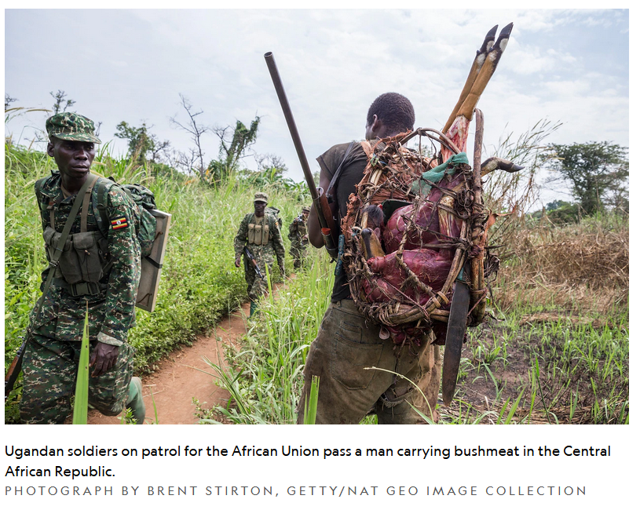
Processes of ecosystem change, like deforestation, can bring humans and bats into contact
Logging often builds roads that hunters can then use to hunt bats and other bushmeat
Humans have encroached on the lives of bats, not vice versa.
Notes:
It’s not just bat metabolism - human-bat interactions need to be considered to understand the frequency bat viruses jump into the human population to cause disease
Streicker, D. G., & Gilbert, A. T. (2020). Contextualizing bats as viral reservoirs. Science, 370(6513), 172-173.
Mollentze, N., & Streicker, D. G. (2020). Viral zoonotic risk is homogenous among taxonomic orders of mammalian and avian reservoir hosts. Proceedings of the National Academy of Sciences, 117(17), 9423-9430. https://doi.org/10.1073/pnas.1919176117

