Slide 1
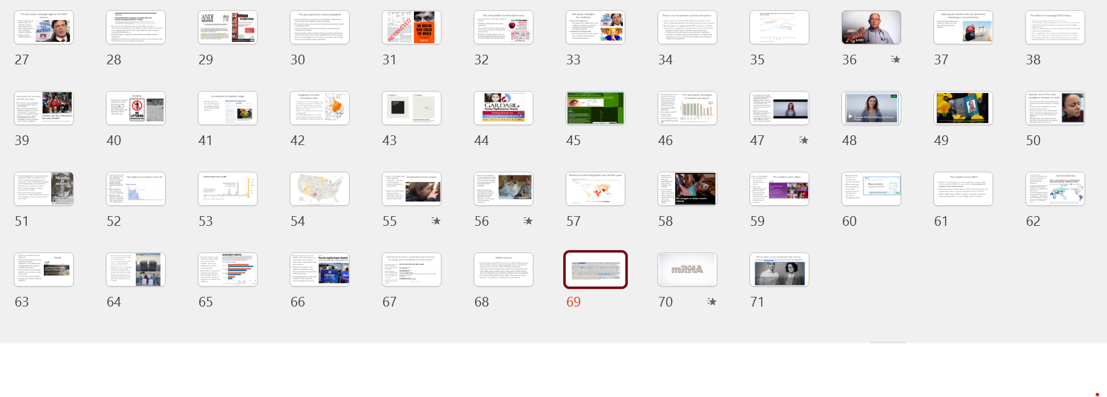
If you aren’t coming to lecture on Monday and Wednesday mornings…
…you didn’t have the full content for the midterm and you won’t get the full content for the final exam. For this week’s lectures on vaccines you are missing around 70 slides of content available only in class:

Slide 2
Vaccines pit collective societal good versus individual interests
As vaccines reduce disease transmission, they indirectly protect the community, including individuals who are too young to get vaccinated, and the immunocompromised
Yet individuals have incentives to refrain from vaccination, to act in their self-interest. They can free ride and profit from indirect protection of others who vaccinated.
When more people decide to refrain from vaccination, their individual choices can create scenario for disease to emerge, persist, and cause harm
Notes:
Vaccines ask us to consider social welfare and not just mere self-interest

Slide 3
Anti-vaxx sentiment is not new
In 1902, Swedish-American pastor Henning Jacobson refused the smallpox vaccine, arguing the mandate violated personal liberty.
In Jacobson v. Massachusetts (1905), the Supreme Court ruled against Jacobson and upheld the state’s authority to require vaccination to protect public health.
In Zucht v. King (1922), Rosalyn Zucht, a Texas schoolgirl, challenged her exclusion from school for lacking required vaccinations.
The Supreme Court ruled against Zucht, affirming that states and cities may require vaccination—such as for school attendance—even when no outbreak is occurring.

Slide 4
Reasons for hesitancy and anti-vaxxer attitudes
People who believe strongly in all-natural foods and medicines for them or their children
Religions that oppose vaccines
Mistrust in the authority of science and institutions affiliated with it
Cultural amnesia: when there is little cultural memory of diseases and their negative effects then vaccines may seem unnecessary
Political views that put individual choice above societal concerns
Distrust of power and events of history like colonialism or racism that make people unwilling to vaccinate

Slide 5
There is no link between vaccines and autism
Autism spectrum disorder (ASD) affects 2% of children in US. Since monitoring started 20 years ago, prevalence has increased
Recent studies have suggested that ASD most likely arises from interactions among genetic and prenatal environmental factors:
  Mutations in genes may be inherited or arise spontaneously
  Prenatal environmental exposures span infections, medications, complications during pregnancy, and exposure to air pollutants and other toxins, as well as maternal health conditions like obesity and diabetes during pregnancy
Notes:
https://onlinelibrary.wiley.com/doi/full/10.1002/bies.202000307
https://journals.plos.org/plosone/article?id=10.1371/journal.pone.0289841
https://www.healthychildren.org/English/safety-prevention/immunizations/Pages/Vaccine-Studies-Examine-the-Evidence.aspx
Children with autism and/or ADHD have a reduced ability to clear out the common plastic additive bisphenol A

Slide 6
Full global components of the Pfizer BioNTech mRNA Covid vaccine
Genome sequencing of virus and its public release (China)
Refinement and verification of genomic sequence (Australia, US, Europe, Asia)
Initial research on mRNA vaccines conducted the National Institute of Health (US)
Clinical trials (US, Germany, Turkey, Argentina, Brazil, and South Africa)
Manufacturing (Belgium, Germany, US-Michigan):
Regulatory Approvals (Worldwide): Rapid, coordinated review by UK, EU, U.S., Canada, WHO, and many others enabled global rollout.

